Slide 1
Pulmonary Capillary Hemangiomatosis

Slide 2
Pulmonary Capillary Hemangiomatosis
    a rare cause of pulmonary hypertension characterized by extensive proliferation of pulmonary capillaries within alveolar septae
    Extensive capillary proliferation ➔ hypertrophied & narrowed pul.vv ➔ PHTN
    First described by Wagenvoort et al in1978, fewer than 100 cases have been reported
    The clinical and radiographic features can be nonspecific, making histology the only reliable means of diagnosis

Slide 3
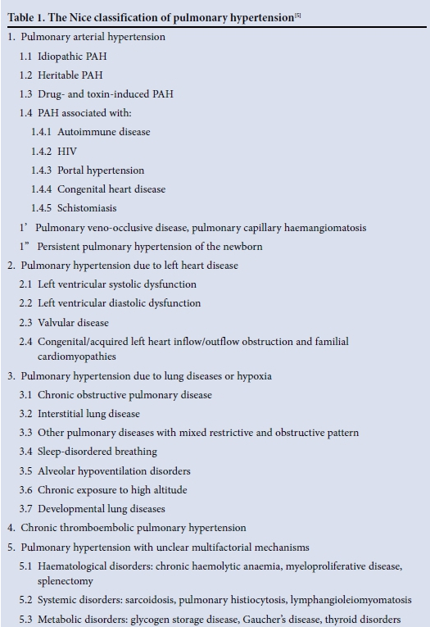
Pulmonary Capillary Hemangiomatosis
    Clinical presentation
    progressive dyspnea (m/c), cough, chest pain, fatigue, hemoptysis
    age : from infancy to 71 years
    PFT : normal FVC, FEV₁ w/ markedly reduced diffusion capacity
    right heart catheterization : pressure elevated → pulmonary hypertension
    alveolar lavage : increased hemosiderin-laden macrophages
    One of the rare cause of PHTN

Slide 4
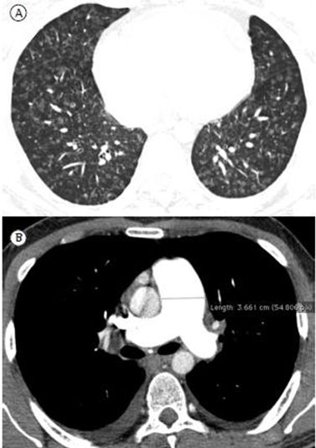
Pulmonary Capillary Hemangiomatosis
    Radiologic features
    - nonsepcific
    - include changes consistent with pulmonary hypertension
    (bilateral interstitial infiltrates, cardiomegaly, enlargement of the pulmonary artery)
    CT scan : hallmark - diffuse centrilobular ground-glass nodular opacity
    periphery is generally spared
    typically bilateral, involve all lobes
Notes:
A : HRCT - diffuse centrilobular ground-glass opacities
B : CT angiography - marked dilatation of the main pulmonary artery (diameter, 36 mm)

Slide 5
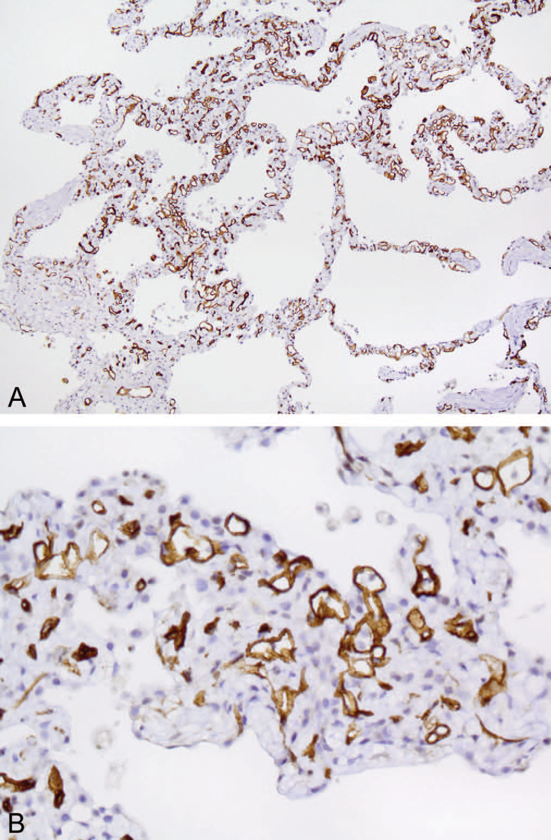
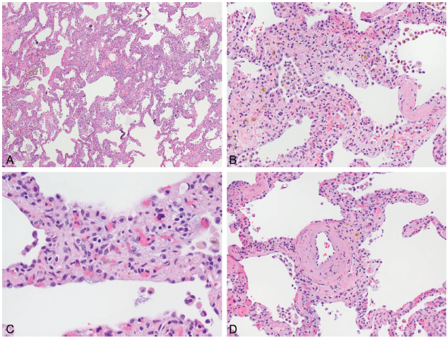
Pulmonary Capillary Hemangiomatosis
    Histopathologic features
CD34(+)
Arch Pathol Lab Med. 2015;139:274–7
Notes:
exuberant septal capillary proliferation
Septum 의 congestion
Septum의 more than 4 layers of capillary
Arteriole의 hypertrophy and luminal marrowing

Slide 6
Pulmonary Capillary Hemangiomatosis
    Differential diagnosis
    Clinically, PCH is difficult to distinguish from many other causes of pulmonary hypertension & impossible to distinguish from PVOD

Slide 7
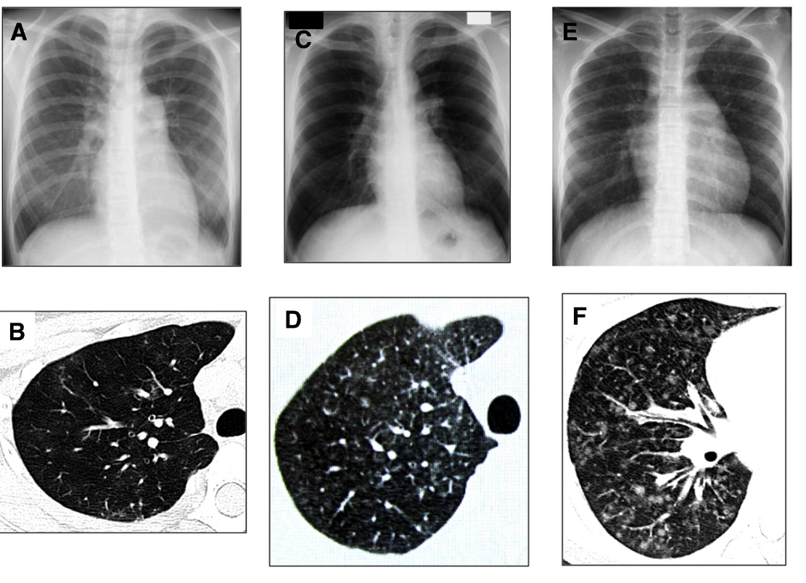
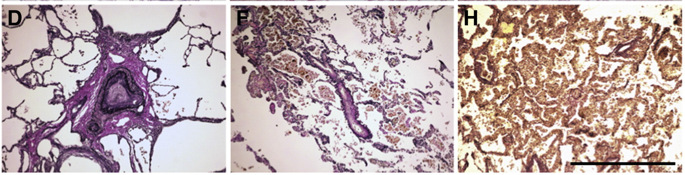
D/Dx
IPAH
PVOD
PCH
Cardiovascular Pathology 22 (2013) 287–293
Notes:
D. Intimal and medial hypertrophy
E. Stenosis of pul.arteriole w/o capillary proliferation or deficienct
F: capillary proliferation

Slide 8
Pulmonary Capillary Hemangiomatosis
    Treatment and Prognosis
    Pul.HTN treatment : ACEi, diuretics, corticosteroid, warfarin
    → relatively ineffective, poor prognosis
    Epoprostenol (prostacyclin) : ineffective
    Interferon α-2a : effective, a few cases
    Lung transplantation : only definitive treatment
    median survival : 3 yrs after onset of Sx.
Imatinib is Partially Effective for the Treatment of Pulmonary Capillary Hemangiomatosis
Intern Med 53: 603-607, 2014
: 43-year-old man presented with dyspnea on exertion, pulmonary hypertension (WHO-FC Ⅳ) in spite of treating with bosentan, sildenafil and intravenous epoprostenol.
After three months of treatment with imatinib (tyrosine kinase inhibitor), chest X-ray and echocardiography findings improved, and the WHO-FC class was III.

Slide 9
Pulmonary Capillary Hemangiomatosis
    Current case report
EIF2AK4 Mutations in Pulmonary Capillary Hemangiomatosis
CHEST 2014; 145(2):231–236
: use exome sequencing to identify a candidate gene for PCH in a family with two affected brothers
→ mutations in EIF2AK4 are likely to cause autosomal-recessive PCH in familial and some nonfamilial cases

Slide 10
재발하는 기흉으로 내원한 18세 남자

Slide 11
Patient information
Chief complaint
Dyspnea onset) 3 days ago
Present illness
2015년 12월 및 2016년 5월 spontaneous pneumothorax 로로 본원 TS 입원하여 tube thoracostomy시행 후 호전되어 퇴원하였던 자로 3일 전부터 숨차는 증상 있어 2016.8.4 응급실 내원함.

Slide 12
Past medical Hx.
DM/HTN/TB/Hepatitis(-/-/-/-)
OP Hx(+)
s/p septoplasty d/t nasal septal deviation
s/p orchiopexy, Rt. d/t undescended testis(2016.7.26.)
Medication Hx (-)
Personal Hx.
Alcohol (-)
Smoking(-): second-hand smoke exposure(+)
Occupation: 고등학생
Family Hx.
None
Notes:
과거력상
만성질환은 없으나
올해 7월해 비중격수술과 오른쪽 잠복고환 수술한 적 있으며,
학생으로 담배는 안피우지만 아버지가 집에서 담배를 피워 간접흡연에는 노출되어 있는 상태
가족력은 특이사항 없고, 유사 증상을 보이는 사람도 없었습니다.

Slide 13
Review of System
General fever(-), chills(-), fatigue(-), sweating(-) edema(-)
Skin rash(-), itching(-), pigmentation(-), jaundice(-)
H&N headache(-), neck pain(-), stiffness(-), sore throat(-)
Respiratory cough(+), sputum(-), rhinorrhea (-),
dyspnea(+): NYHA II , pleuritic pain(+): Rt.
Cardiac chest pain(-), palpitation(-), orthopnea(-), syncope(-)
GI A/N/V/D/C (-/-/-/-/-), abd. pain(-), distension(-)
GU dysuria(-), urgency(-), frequency(-), hematuria(-)
Musculoskeletal pain(-), edema(-), weakness(-), arthralgia(-)
Nerve system sensory loss(-), motor weakness(-), dizziness(-)

Slide 14
Physical examination
V/S 130/90 mmHg – 84/min – 24/min – 36.8°C – 98%
Bwt 45kg, Ht 164cm (BMI: 16.73 kg/m²)
General alert consciousness, acute-ill looking appearance
Chest symmetric, clear breath sound
decreased breath sound, Rt.
Heart regular heart beat without murmur
Abdomen flat & soft abdomen, normoactive bowel sound
abdominal Td/rTd(-/-)
Back & Ext. CVA tenderness (-/-) , back pain (-)
Pretibial pitting edema (-/-)
Notes:
심박동은 규칙적이었고 가슴청진상 심잡음은 들리지 않았으나 우폐야의 호흡음이 감소되어 있었다.

Slide 15
Initial lab finding
CBC/DC
6,920/mm² - 14.3 g/dl – 42.2% - 419,000/mm³ (Seg. 58.6%)
Chemistry
Prot/Alb | 7.6/4.6 g/dL | BUN/Cr | 10/0.7 md/dL
TB | 0.72 mg/dL | Na/K/Cl | 140/4.4/103 mmol/L
AST/ALT | 21/13 IU/L | Ca/P/Mg | 9.2/4.9/2.5 mg/dL
ALP/γGT | 51/15 IU/L | CRP | <0.3 mg/dL
CK | 11 U/L | LD | 427 U/L
CK-MB | 1.4 ng/dL | Tn-I | 0.00 ng/dL
U/A
Occult blood (-) Protein (-) Glucose (-)
RBC 0~1/HPF WBC 0~1/HPF
Notes:
검사 소견: 백혈구 6,920/mm3, (중성구: 58 %, 림프구 28%, 호산구 0.2% ) 혈색소 14.3
g/dL, 혈소판 287,000/mm3였으며, 일반 화학 검사에서는 Protein 7.6 g/dL, Albumin 4.6 g/dL, BUN/Cr 10/0.7 로 모두 정상범위였다. C반응단백 0.3 mg/dL 이하, 항핵항체, 항중성구 세포질 항체 모두 음성이었다. 동맥혈 가스분석에서 특이소견은 없었다.

Slide 16
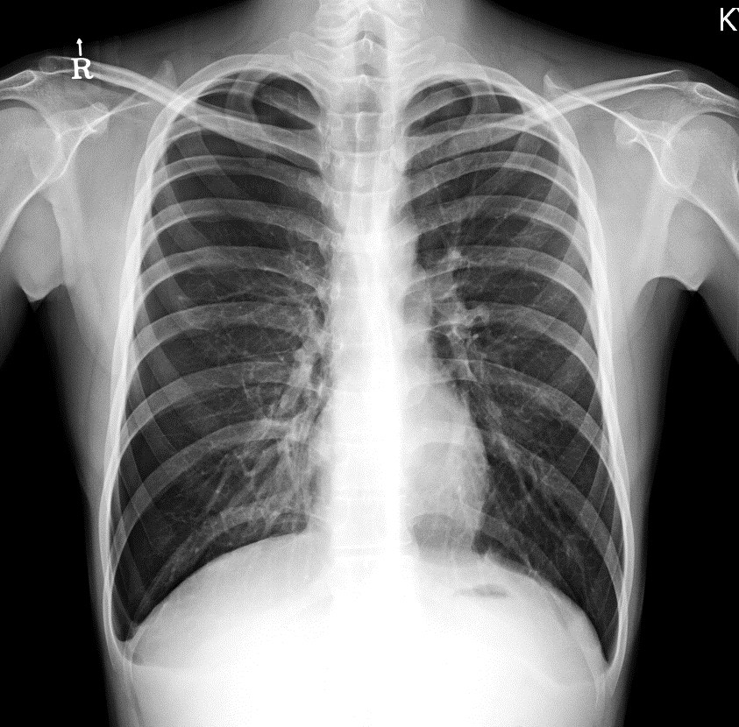
Chest X-ray (2016.8.4)
4.4cm
1.8cm
1.4cm
Rt.pneumothorax : 40%
Notes:
Subpleural reticulation and GGO in BLLFs.
suggestive of interstitial lung disease.

Slide 17
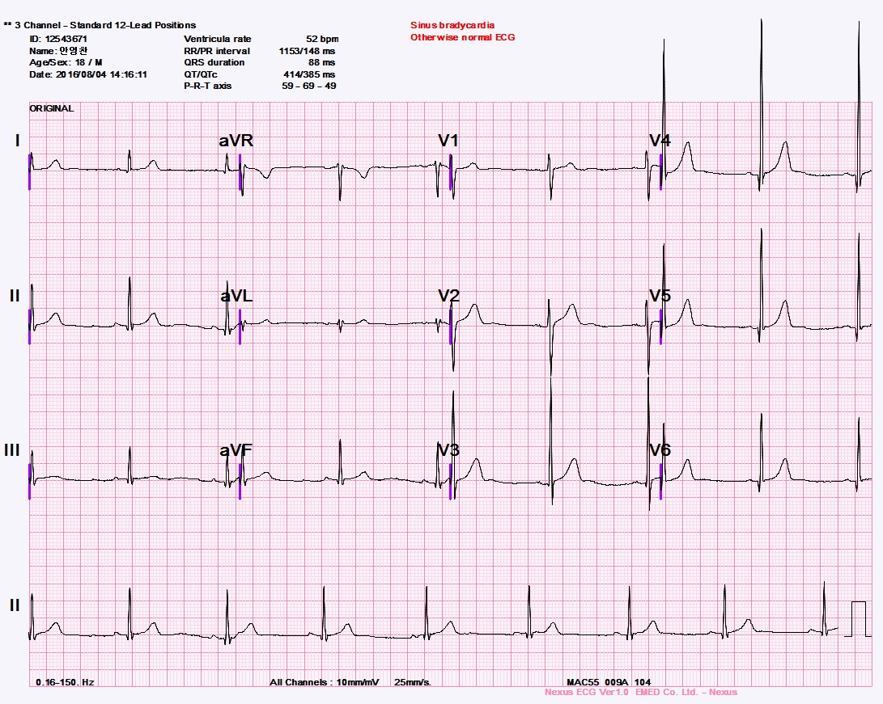
EKG (2016.8.4)
Notes:
HR 52
V1 V12QRS amplitude 낮다

Slide 18
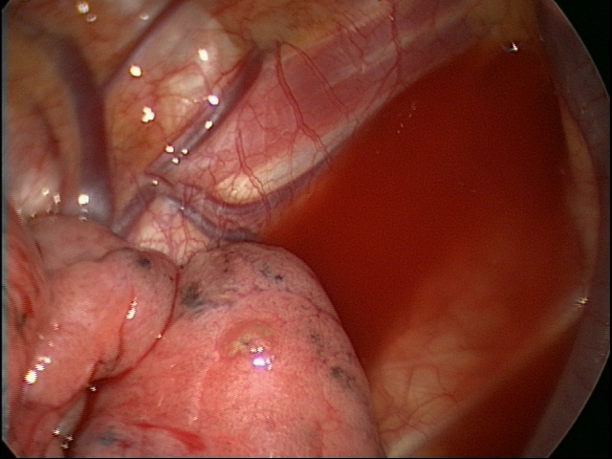
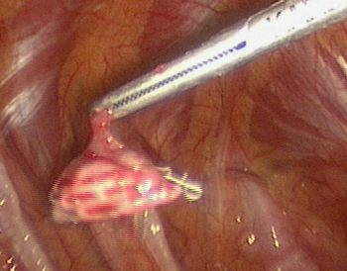
Clinical course
HD #1
8.4
HD #5
8.8
HD #6
8.9
HD #9
8.12
HD #13
8.16
Chest tube insertion
Bullectomy on RUL
Pneumo-peritoneum
Pleurodesis
with 50% DW
Pleurodesis
with 50% DW
Air leakage
18
Notes:
REFERRAL TO THORACIC SURGEONS
< In cases of persistent air leak or failure of the lung to reexpand,
an early (3e5 days) thoracic surgical opinion
should be sought. (C)

Slide 19
Radiologic findings

Slide 20
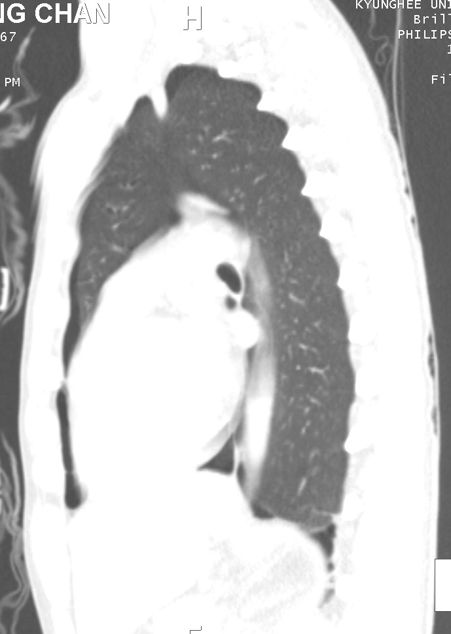
5/14 chest CT
Notes:
전과이유

Slide 21
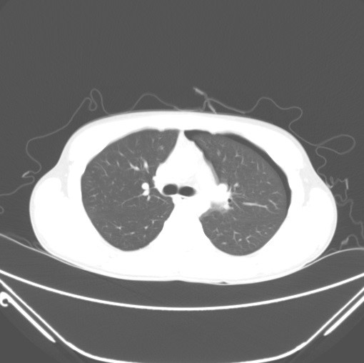
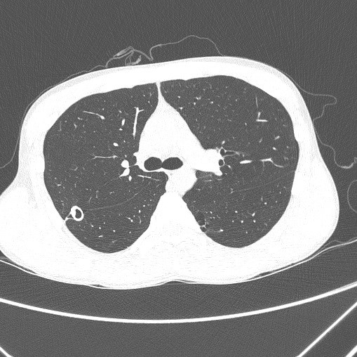
HRCT
5 .14
8 .17
5 .14

Slide 22
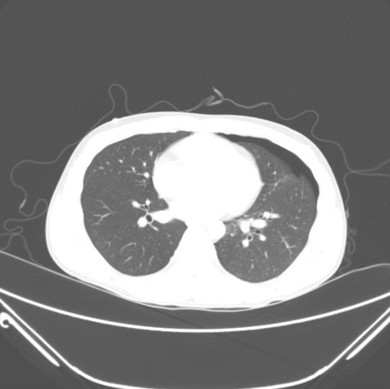
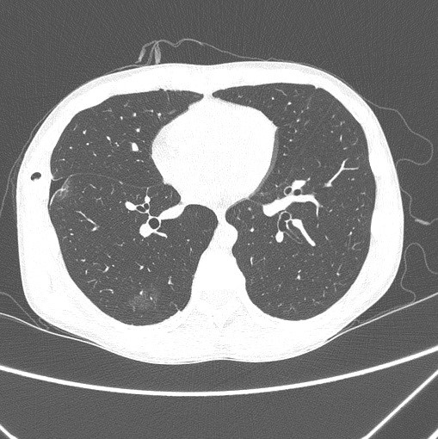
HRCT
5 .14
8 .17
5 .14

Slide 23
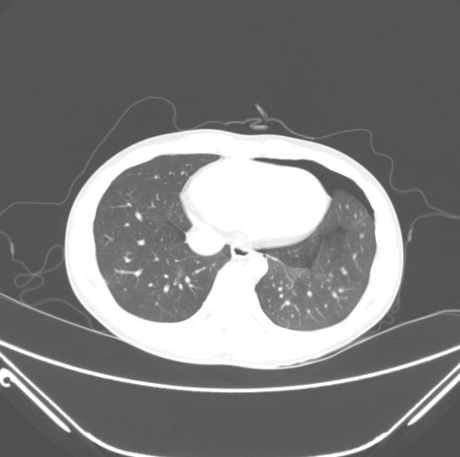
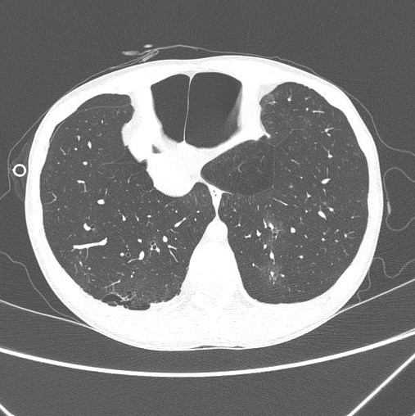
HRCT
5 .14
8 .17
5 .14

Slide 24
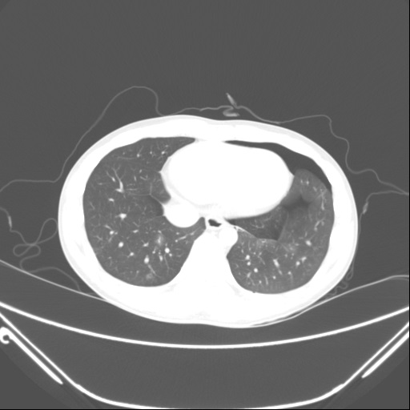
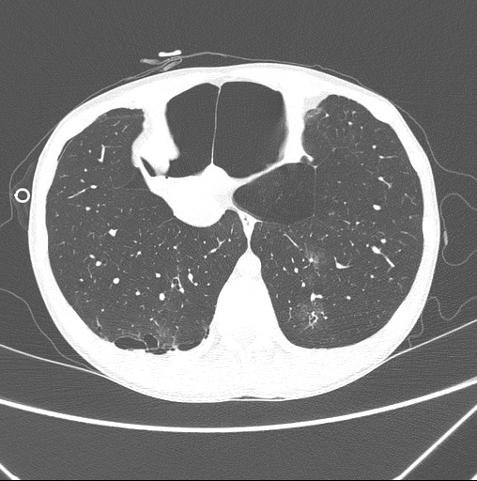
HRCT
5 .14
8 .17
5 .14

Slide 25
Re-assessment & Plan
#1. r/o diffuse cystic lung disease
such as PLCH
#2. r/o P. westermani infestation
#3. r/o eosinophilic pneumonia
Notes:
Broncho한 이유
젊은 남자, 반복적, CR소견
PW infestation 및 eosinophilic pneumonia은 왜 의심하였는지 (f/u CBC상 Eosinophil증가) 설명 꼭 합시다.
Bronchoscopy한 이유 (기관지내부를 관찰하기 위한 목적이 아니라 BAL 을 시행하기 위함!)
추정진단 1에 대해; PLCH의 진단시 BAL fluid에서 CD1a(+) cell이 5%이상이면 PLCH를 의심할수 있고
추정진단 2,3 에 대해 BAL fluid 상 Eosinophlia 또는 parasite egg등이 관찰되는지 확인하기 위함.

Slide 26
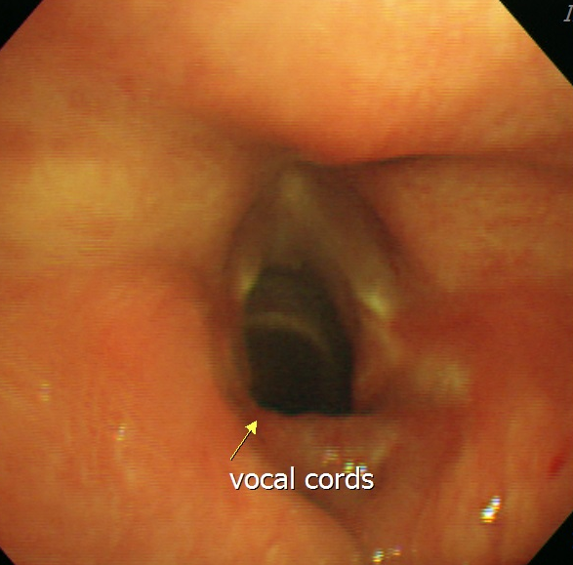
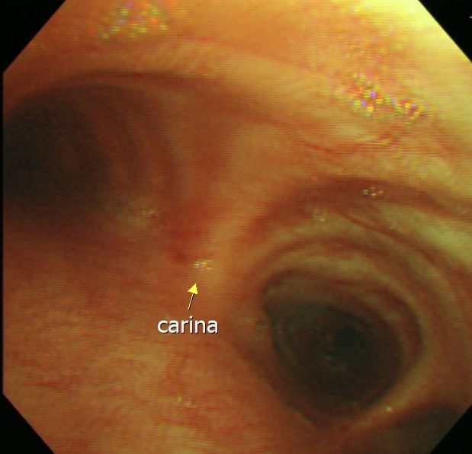
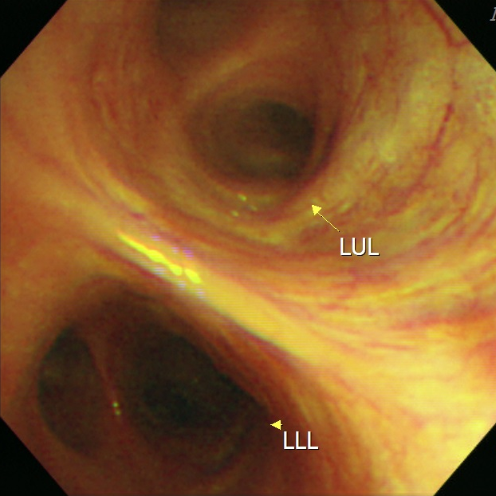
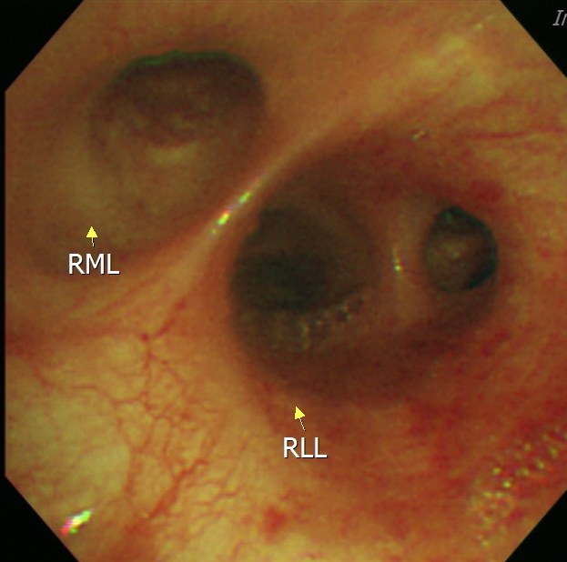
Bronchoscopy (2016.8.18)
Notes:
Broncho한 이유
젊은 남자, 반복적, CR소견

Slide 27
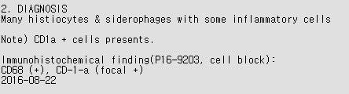
BAL fluid analysis
Cell count
RBC | 2800
WBC | 293
Neutrophil | 12
Lymphocyte | 9
Eosinophil | 1
Macrophage | 78
Cytology
Notes:
정상 BALF 조성
Macrophage >85%
Lympho 10-15(CD4+/CD8+ =0.9~2.5%)
Neutrophil <3% : airway imflammation 가능성
Eosino <1%
Epithelial <5%

Slide 28
Progress
BALF상 Eosinophil증가 소견은 없었고 neutrophil만 약간 증가한 소견 관찰 됨. 또한 parasite egg도 관찰되지 않음.
➔ 2, 3 진단의 가능성은 매우 낮아짐.
하지만 CD1a cell 이 focal (+)보여 PLCH의 가능성이 높은 상태였음.
➔ chest CT상 RLL 의 새롭게 발생한 cystic lesion 및 GGO에 대해 VATS Bx 시행함.

Slide 29
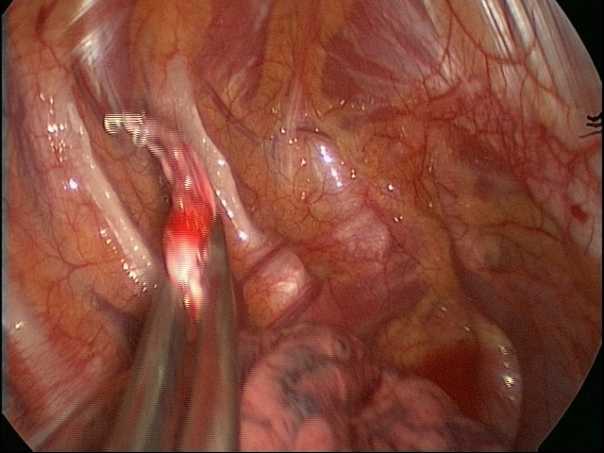

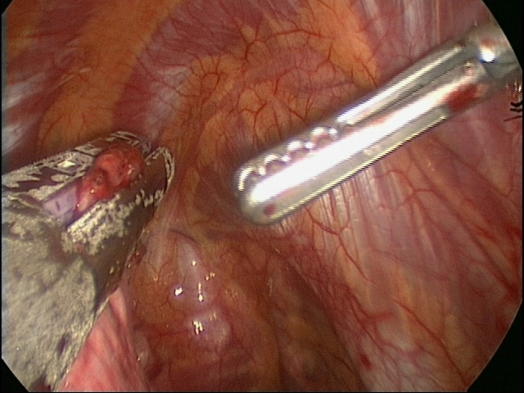
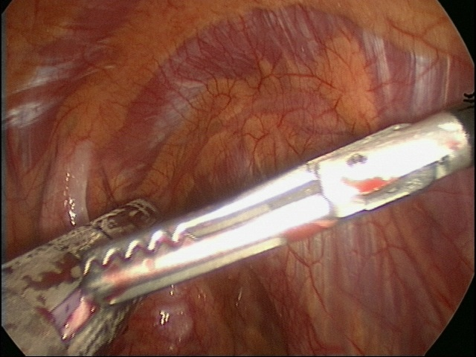
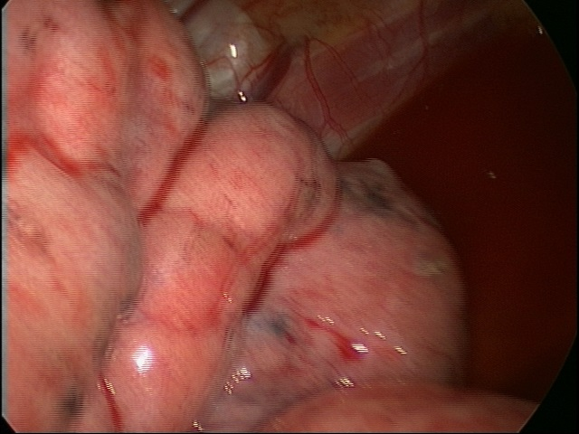
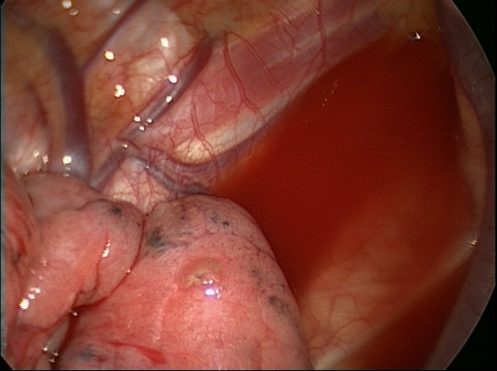
Wedge resection via VATS with bullectomy(8/8)

Slide 30
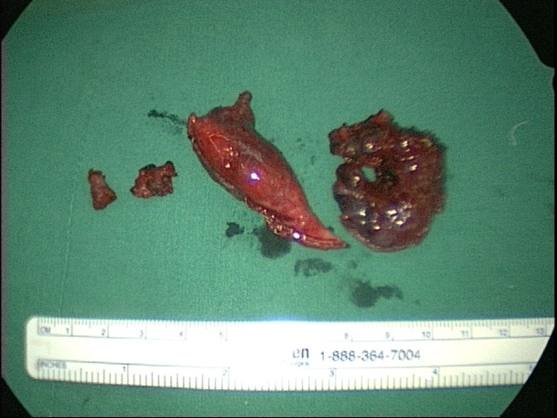
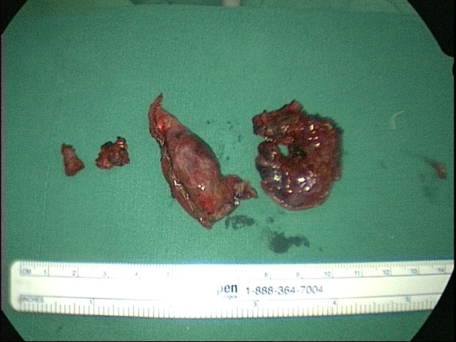
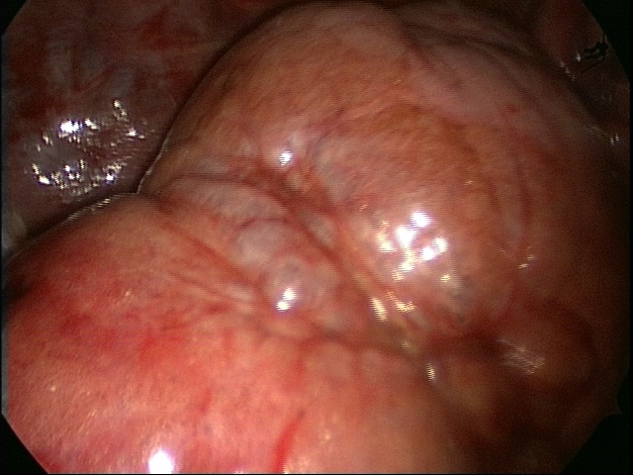
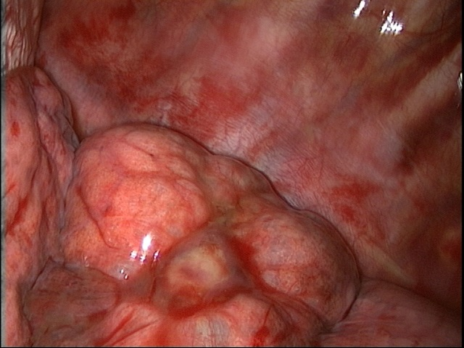
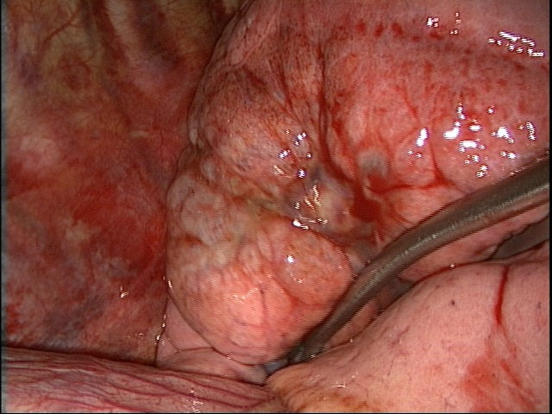
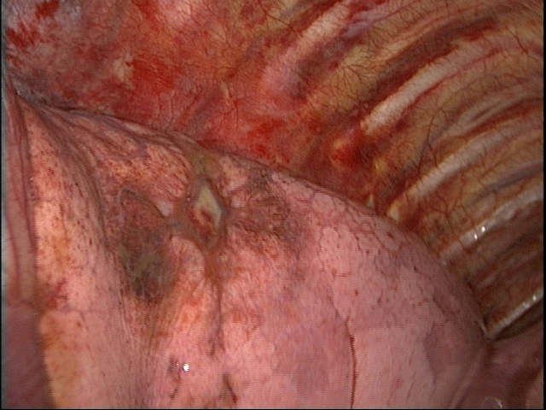
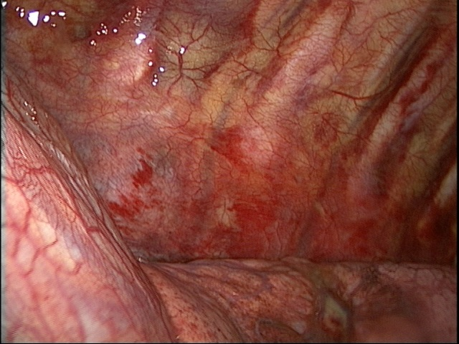
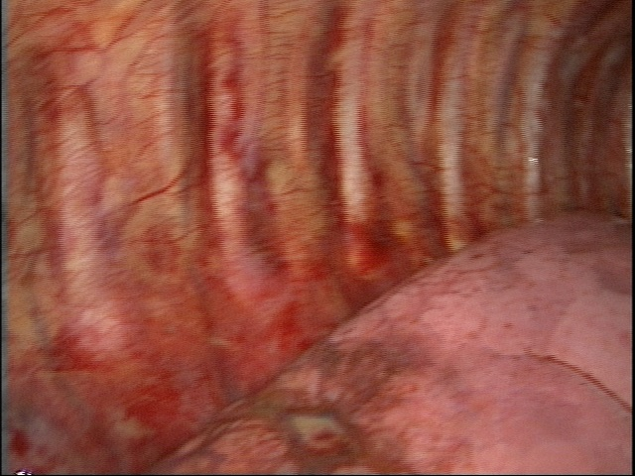
Wedge resection Bx. via VATS (2016.8.24)

Slide 31
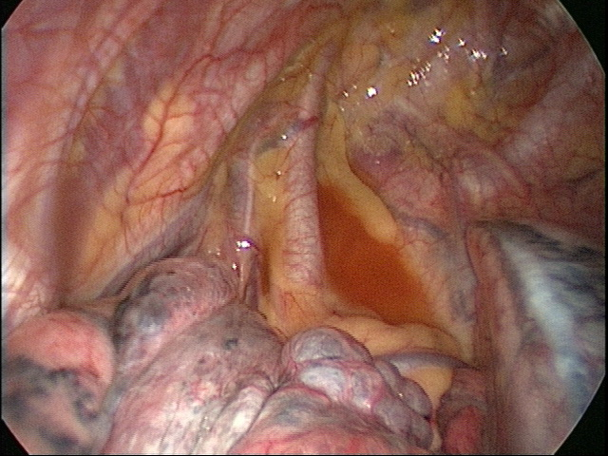

Slide 32
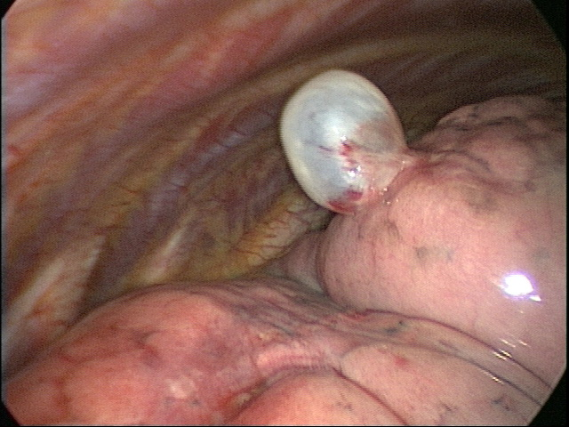

Slide 33
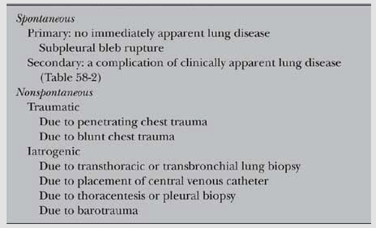
TABLE 58-1 Classification of Pneumothorax

Slide 34
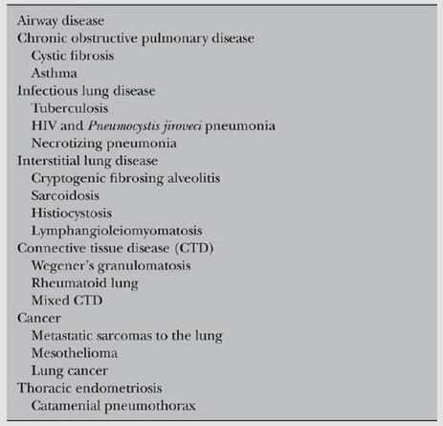
TABLE 58-2 Causes of Secondary Spontaneous Pneumothorax

Slide 35
Pathologic findings

Slide 36
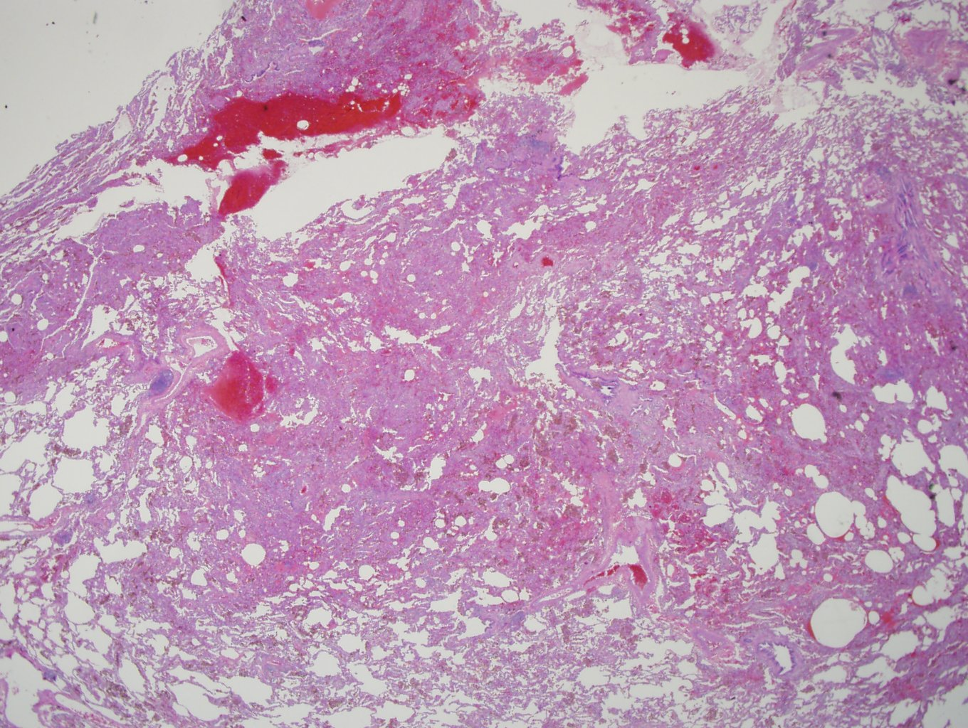
Pathologic findings
Extensive proliferation of pulmonary capillaries within alveolar septae
Hemorrhage and macrophage, x40

Slide 37
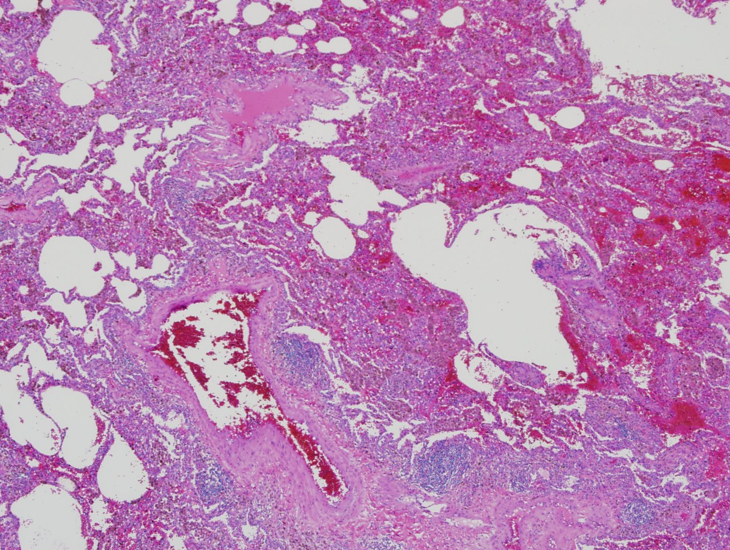
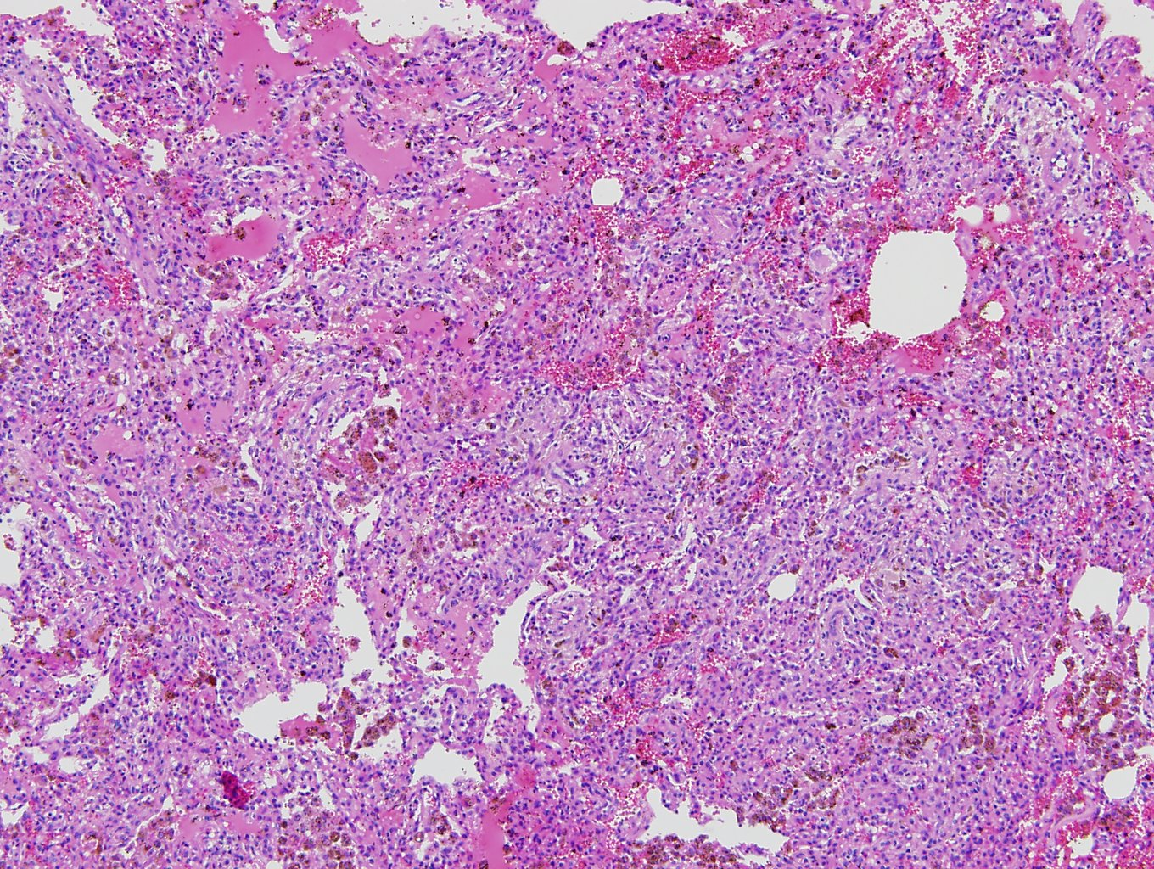
Pathologic findings
Macrophage x100

Slide 39
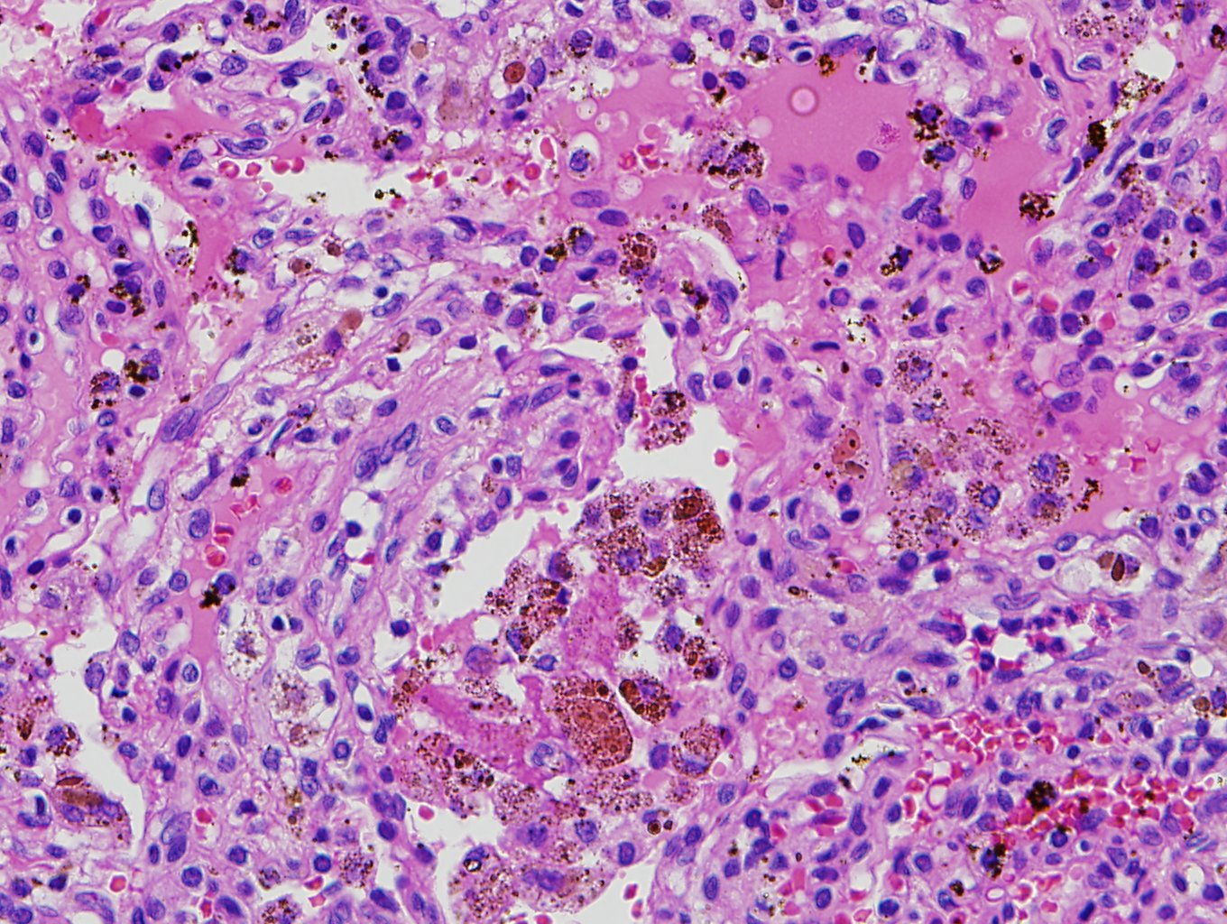
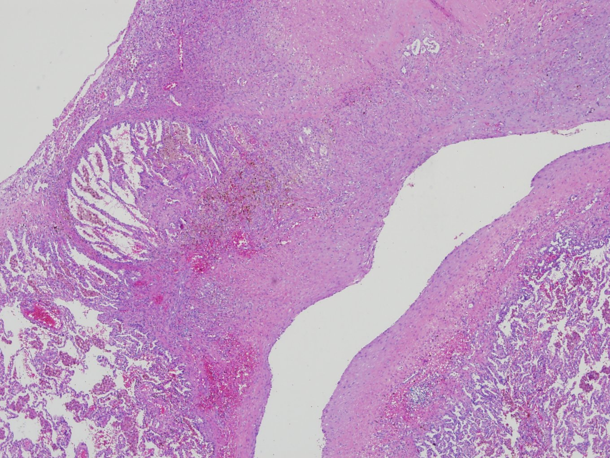
Pathologic findings
Subpleural bulla

Slide 40
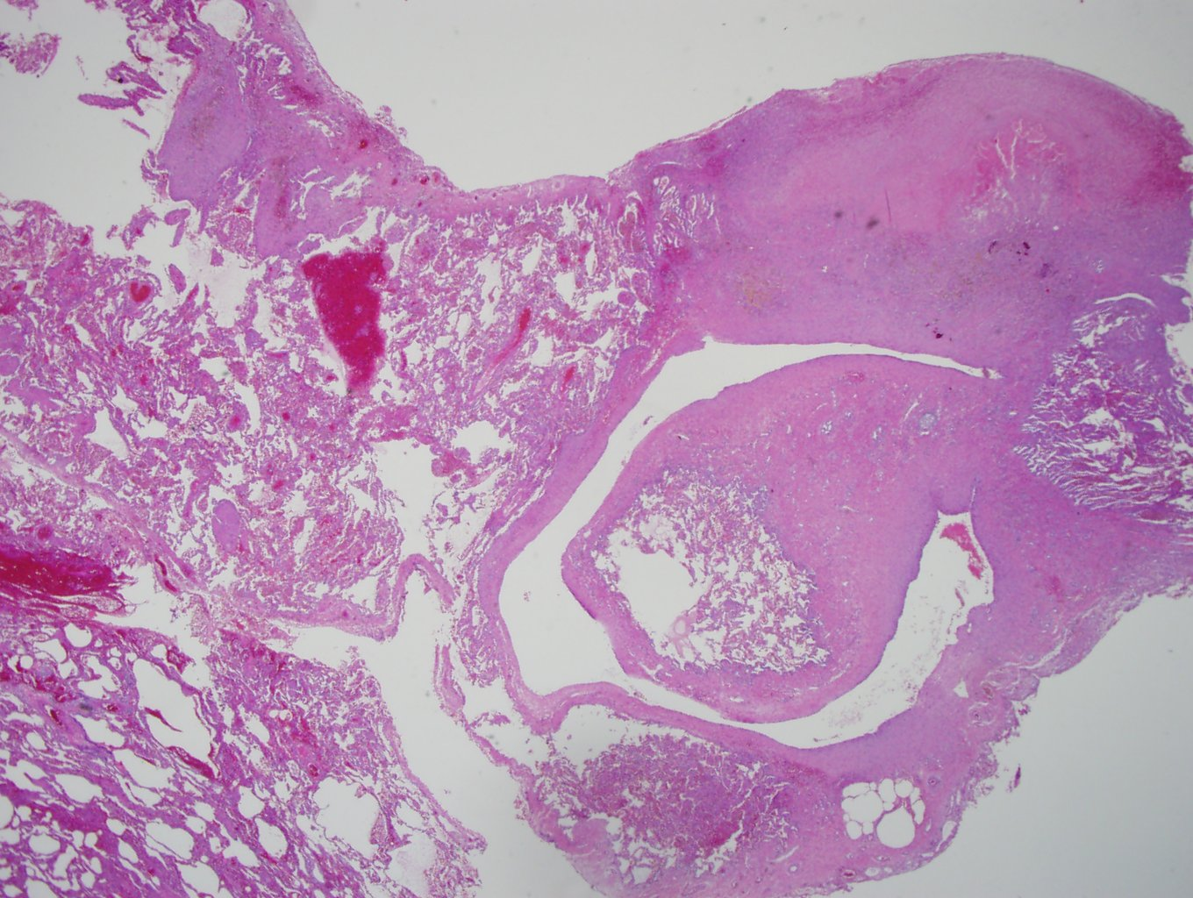
PVOD is the diffuse involvement of venules and septal veins in a vasculopathy characterised by intimal fibrosis resulting in luminal narrowing or obliteration

Slide 42
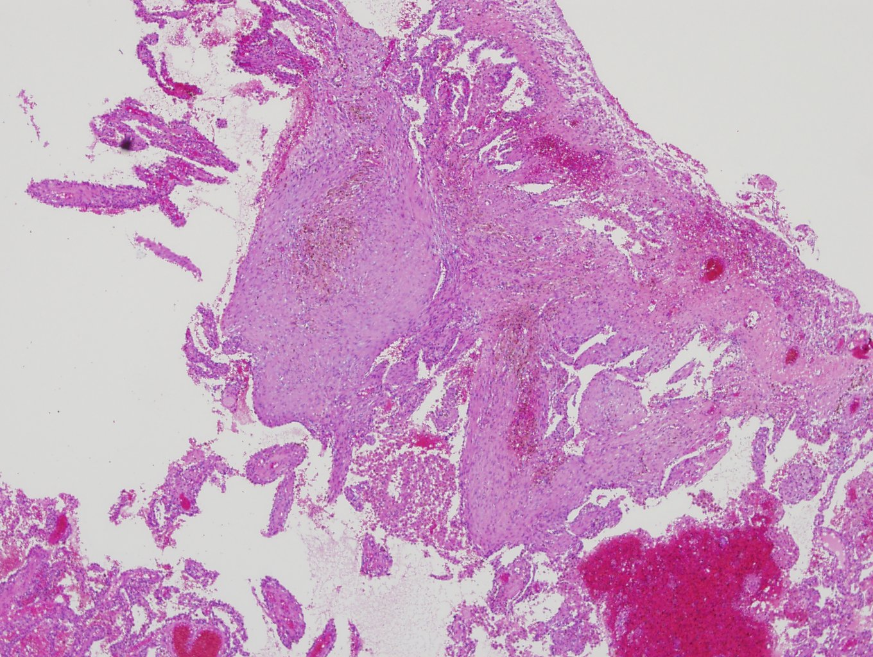

Slide 43
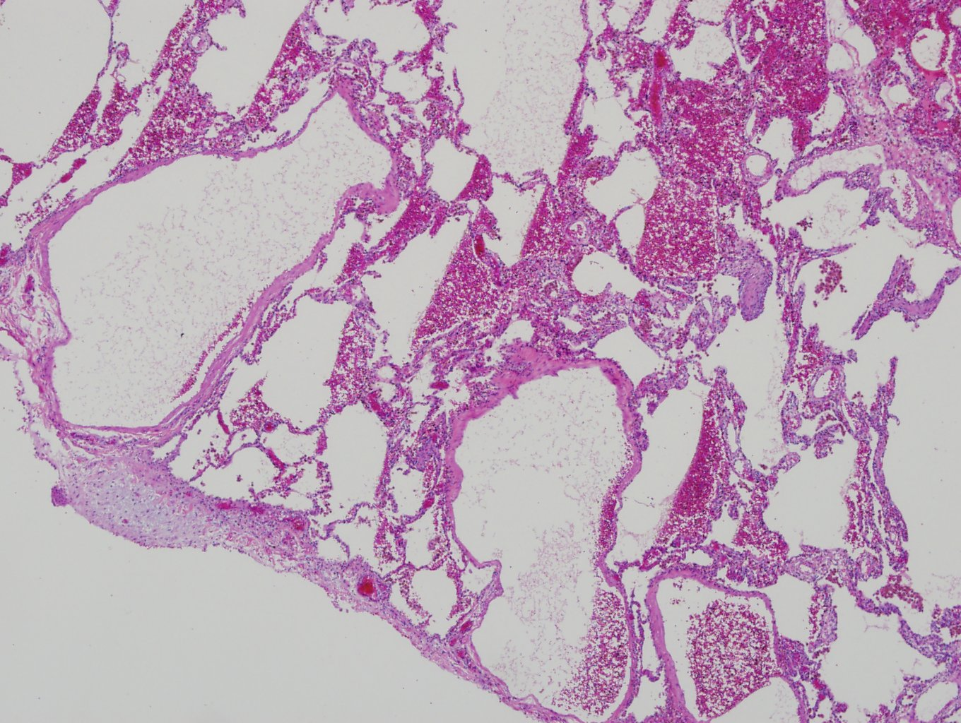

Slide 44
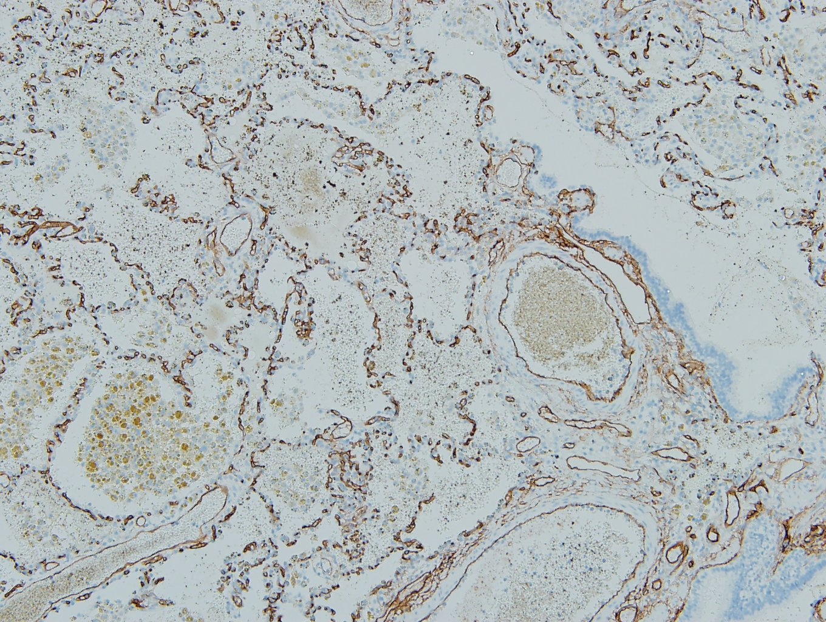
CD34

Slide 45

CD31

Slide 46

CD1a

Slide 48

Biopsy result(2016.8.30)

Slide 49
Clinical course
HD #14
8.17
HD #15
8.18
HD #21
8.24
HD #27
8.30
HRCTS
: r/o cystic lung dz
TS->IP
BAL
:Histiocytes, siderophage
CD1a+
Wedge resection via VATS
Bx. Result : pul.capillary hemangiomatosis

Slide 50
Final Diagnosis
Pulmonary Capillary Hemangiomatosis
Notes:
a rare cause of pulmonary hypertension characterized by extensive proliferation of pulmonary capillaries within alveolar septae
First described by Wagenvoort et al in1978, fewer than 100 cases have been reported
The clinical and radiographic features can be nonspecific, making histology the only reliable means of diagnosis
progressive dyspnea (m/c), cough, chest pain, fatigue, hemoptysis
age : from infancy to 71 years
PFT : normal FVC, FEV₁ w/ markedly reduced diffusion capacity
right heart catheterization : pressure elevated → pulmonary hypertension
alveolar lavage : increased hemosiderin-laden macrophages
치료는
Lung transplantation : only definitive treatment
에코안했었는데
Pul HTN 확인: normal

Slide 51

TTE(2016.8.31)
Normal RVSP (27mmHg)
Notes:
TTE를 왜 시행하였는지 설명후 슬라이드 발표합니다.

Slide 52

PFT(2016.8.31)
Notes:
Diffuse capacity 떨어짐
“PFT 상 FVC 78%로 restrictive pattern의 ventilator defect관찰되었고, DLco또한 57% 로 감소한 소견보였습니다.”

Slide 53
Lab f/u
CBC/DC
7,980/mm² - 12.8 g/dl – 37.8% - 435,000/mm³ (Seg. 64.2, E 12.0%)
Chemistry
AST/ALT | 19/11 IU/L | BUN/Cr | 12/0.7 md/dL
CRP | 1.18 mg/dL | Na/K/Cl | 142/4.2 mmol/L
CK | 161 U/L | PW Ab | (-)
Special chemistry
IgG | 1130 | C3 | (-)
IgM | 70.6 | C4 | (-)
IgE | 77.8 | C-ANCA | (-)
ANA | Non-reactive | P-ANCA | (-)
Anti-CCP | <17 units/ml | Anti ds-DNA Ab |  | 3.4
Notes:
Connective tissue dz와도 관련 있어서 autoimmune 검사도 해봤다

Slide 54


Chest X-ray f/u
8.25
8.31
Notes:
진단 후 경과 설명HD 27일째(8/30) airleak 호전되어 tube remove후 퇴원함
PCH이나 PTH은 없어서 외래서 경과관찰 하기로함
Op후 CXR및 마지막 CXR

Slide 55


Follow up
9.6
9.7

Slide 56

Follow up
9.7
9.20

Slide 57
Progress
현재 환자는 증상 없이 외래 추적관찰 중이며 f/u TTE 및 HRCT시행 예정임.
HR CT상 병변악화 또는 PTH발생할 경우 치료 고려.

