Slide 1
Bronchoscopic lung volume reduction using endobronchial valves
Presenter : Eung gu Lee
Division of Pulmonary, Allergy and Critical Care Medicine
Department of Internal Medicine
Bucheon St. Mary’s Hospital
The Catholic University of Korea

Slide 2
Chief Complaint
M/65
Dyspnea
“집에서 식사하거나 화장실 갈 때도 쉬어서 가야 합니다.”

Slide 3
Present Illness
COPD, emphysematous type 으로 home O2 3.5L 유지하며 본과 f/u
하는 환자로 점차 악화되는 dyspnea 를 주소로 내원함.
- “숨이 차서 집 밖으로 나가기 어렵다＂
- mMRC dyspnea scale: 4

Slide 4
Past History
DM/HTN/Tuberculosis/Hepatitis (-/-/-/-)
# COPD, emphysematous type
# BPH
Family Hx. : non-specific
Social Hx. :
- Smoking : 1년 반 전 중단. 하루 2갑, 40년 / - Alcohol : (-)
Medication Hx.
Inhaler: Xoterna (Indacaterol/Glycopyrronium) + PRN Foster (Beclomethasone/formoterol),
erdosteine, desloratadine, tamsulosin, dutasteride

Slide 5
Review of System
General | Fever / Chilling / Dizziness (-/-/-) Generalized weakness / Fatigue (-/-) Generalized edema / Weight change (-/-) Headache / Poor oral intake (-/-)
HEENT | Headache / Vertigo / Dizziness / tinnitus (-/-/-/-) Vision / Glasses / Discharge (-/-/-)
Respiratory | Cough / Sputum / Rhinorrhea / Dyspnea (+/+/-/+) Sore throat (-) / Rt. Pleuritic chest pain (-)
Cardiovascular | Chest pain / Palpitation / Cyanosis (-/-/-)
Gastrointestinal | Anorexia / Nausea / Vomiting (-/-/-) Diarrhea / Constipation (-/-) Abdominal pain (-) Dyspepsia (-) Hematemesis / Hematochezia / Melena (-/-/-) Bowel habit change (-)
Genitourinary | Dysuria / Frequency / Nocturia / Hematuria (-/-/-/-) Urgency / Incontinence / Remnant (-/-/-)
Extremities | Grossly free Lower extremity pretibial pitting edema (-/-)

Slide 6
Physical Examination
Vital Sign | 100/60mmHg – 84회/min – 20회/min – 36.8℃
Mental Status | Alert
General Appearance | Chronic ill-looking appearance
HEENT | Normocephaly / No neck vein engorgement No carotid bruit / No cervical lymphadenopathy Isocoria with phasic pupillary light reflex (++/++) Not Anemic conjunctivae / Anicteric sclearae Pharyngeal injection / Tonsillar enlargement (-/-) Palpable mass (-) / Alopecia (-) / Oral ulcer (-)
Chest | Regular heart beat without murmur Decreased breath sound s crackle
Abdomen | Soft and flat / Normoactive bowel sound / Organomegaly (-) Tenderness (-) / Rebound tenderness (-) / knocking tenderness (-)
Extremities | Both leg pretibial pitting edema (-/-)
Skin | Grossly free

Slide 7
Laboratory Findings
Complete Blood Count
WBC count (10⁹/L) | 6,870
Hb (g/dL) / Hct (%) | 16.1/49.6
Platelet count (10⁹/L) | 222
WBC Diff. Count
Seg. Neutrophil (%) | 58.4
Lymphocyte (%) | 25.6
Monocyte (%) | 6.8
Eosinophil (%) | 6.3
Blood Chemistry
Urea nitrogen (mg/dL) |  | 12.0
Creatinine (mg/dL) |  | 0.74
Albumin (g/dL) |  | 4.6
AST (U/L) / ALT (U/L) /ALP (U/L) |  | 27/18/78
Total / Direct bilirubin (mg/dL) |  | 0.5/0.2
Sodium / Potassium / Chloride (mEq/L) |  | 143/4.6/100
Calcium / Phosphorus (mg/dL) |  | 9.4/3.6
LDH (U/L) / CPK (U/L) |  | 583/42
CRP (mg/L) |  | 0.16
ABGA(room air) | 7.413 - 53.8 - 65.4 - 33.7 - 94.5

Slide 8
Laboratory Findings
Urine analysis
Routine Urine Analysis
Glucose | -
Color | Yellow
Bilirubin | -
Ketone | -
Specific gravity | 1.007
Occult blood | -
pH | 8.0
Protein | -
Urobilinogen | -
Nitrate | -
WBC (HPF) | 0-1
RBC (HPF) | 0-1
Coagulation profile
Prothrombin time
PT ( )% of normal | 111.0
INR | 0.94
PT Test (sec) | 11.0
Activated PTT
Activated PTT test (sec) | 25.5

Slide 9
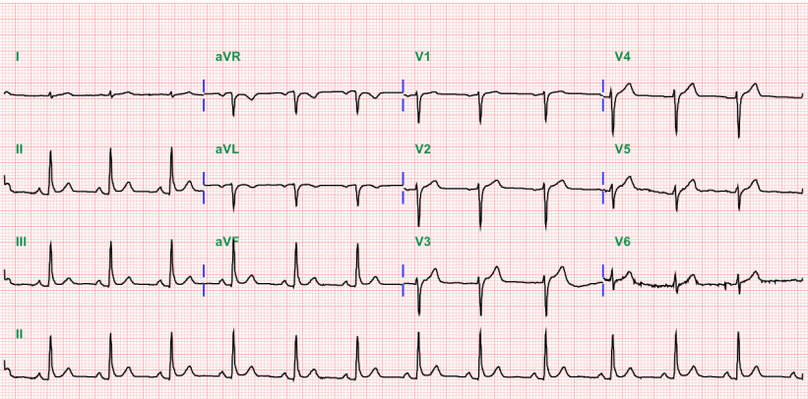
Electrocardiogram

Slide 10
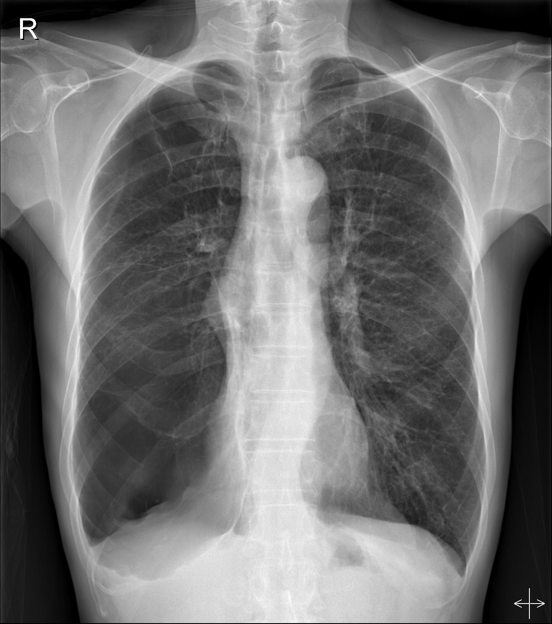
Chest PA

Slide 11
COPD progression
2012. 6.
2013. 10.
2014. 6.
2016. 3.
2016. 7.
FEV1 0.70(25%)
FVC 2.76(71%)
FEV1/FVC 25%
DLCO/VA 61%
Pneumo-coccal vaccination
FEV1 0.46(17%)
FVC 1.83(48%)
FEV1/FVC 25%
DLCO/VA 51%
Foster/Xoterna
(ICS + LABA
/LAMA + LABA)
PFT
Inhaler
Home
O2
Symbicort
/Spiriva
(ICS + LABA
/LAMA)
Foster
/Spiriva
(ICS + LABA
/LAMA)
Montelukast, doxofylline,
erdos
Roflumilast
→ Diarrhea 로 중단.
1 L
1.5 L
3.5 L, smoking cessation

Slide 12
COPD progression
2016. 12.
2017. 1.
2017. 5.
2017. 10
2017. 11.
FEV1 0.43(14%)
FVC 1.13(28%)
FEV1/FVC 38%
Hospitalization d/t Acute exacerbation
Hospitalization d/t Acute exacerbation
FEV1 0.41(13%)
FVC 1.40(35%)
FEV1/FVC 29%
DLCO 23%
RV 275%
Admission
PFT
Inhaler
Home
O2
Xoterna/Foster
(LAMA + LABA
/ICS + LABA)
Onbrez/Spiriva
(LABA/LAMA)
3.5 L

Slide 13
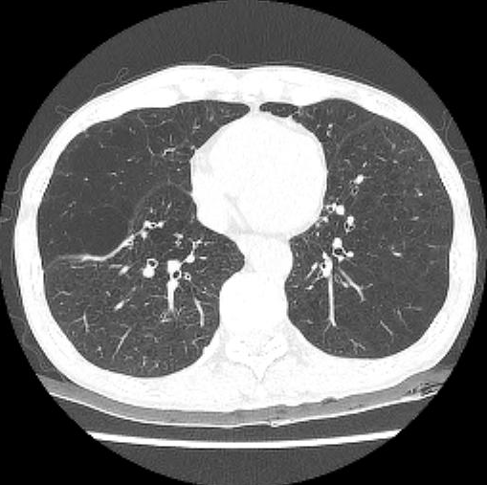
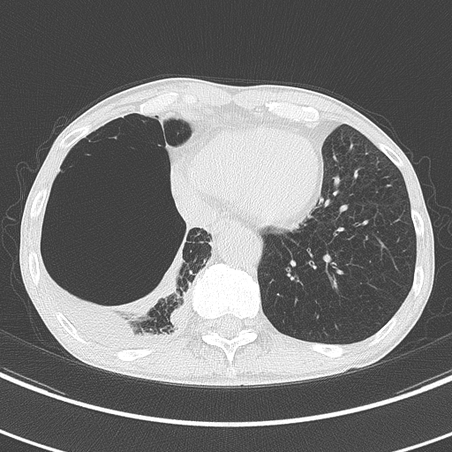
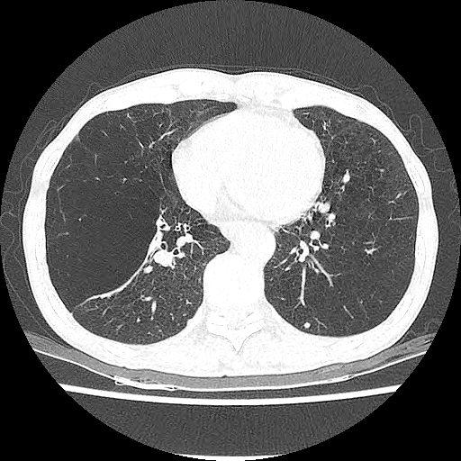
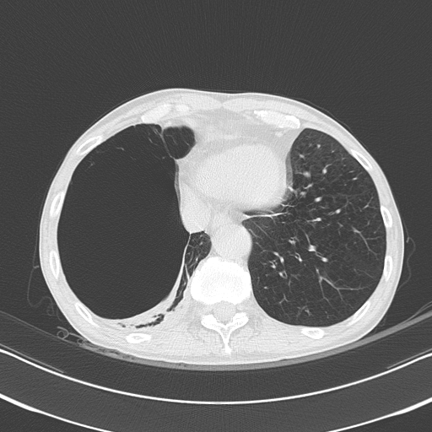
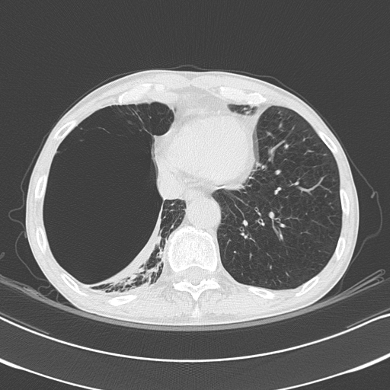
Chest CT
2012. 9.
2014. 10.
2016. 8.
2017. 1.
2017. 5.

Slide 14
Pulmonary function test
 | 2012. 5. 16. | 2013. 10. 18. | 2015. 11. 13. | 2016. 12. 1. | 2017. 10. 20.
FVC | 2.76 (71%) | 2.79 (72%) | 1.83 (46%) | 1.13 (28%) | 1.40 (35%)
FEV1 | 0.70 (25%) | 0.78 (28%) | 0.46 (17%) | 0.43 (14%) | 0.41 (13%)
FEV1/FVC | 25 | 28 | 25 | 38 | 29
TLC |  |  |  |  | 8.23 (135%)
RV |  |  |  |  | 6.43 (275%)
RV/TLC |  |  |  |  | 78
DLCO/VA | 61 % | 57 % | 52% | 50% | 39%

Slide 15
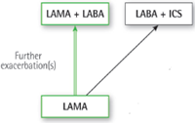
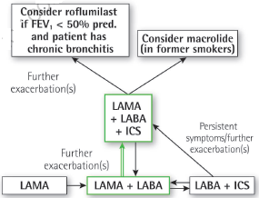
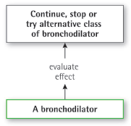
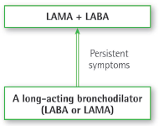
Pharmacologic treatment by GOLD grade
Group C
Group D
≥ 2 / year or
≥ 1 leading to hospital admission
Risk
(Exacerbation history)
Group A
Group B
1 (not leading to hospital admission)
mMRC < 2
CAT < 10
mMRC ≥ 2
CAT ≥ 10
Symptoms – mMRC, CAT

Slide 16
Prevention and Maintenance Treatment
Smoking cessation
Pharmacologic treatment: inhaler, mucolytics, PDE4 inhibitor
Vaccination: Pneumococcal and Influenza vaccination
Pulmonary rehabilitation: 실내 자전거
Long-term administration of oxygen (> 15 hours per day)
Ventilatory support: noninvasive ventilation (NIV)
→ Interventional treatments
- Lung volume reduction surgery (LVRS)
- Bronchoscopic lung volume reduction (BLVS)
- Lung transplantation

Slide 17
Interventional Treatments
Lung volume reduction surgery
- Upper lobe predominant emphysema, Low exercise capacity
→ Survival↑, Exercise capacity↑, Quality of life↑
- Non-upper lobe predominant emphysema
→ Operative mortality↑
- FEV1 ≤ 20%, homogeneous pattern of emphysema, DLCO ≤ 20%
→ Postoperative mortality↑, lung function↓, exercise capacity↓
→ Consider less invasive therapeutic options
FEV1 0.41 (13%)
FVC 1.40 (35%)
FEV1/FVC 29
DLCO 23
TLC 8.23 (135%)
RV 6.43 (275%)
RV/TLC 78
Criner GJ. Alternatives to lung transplantation: lung volume reduction for COPD.
Clin Chest Med. 2011;32(2):379–97

Slide 18
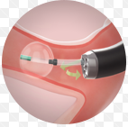
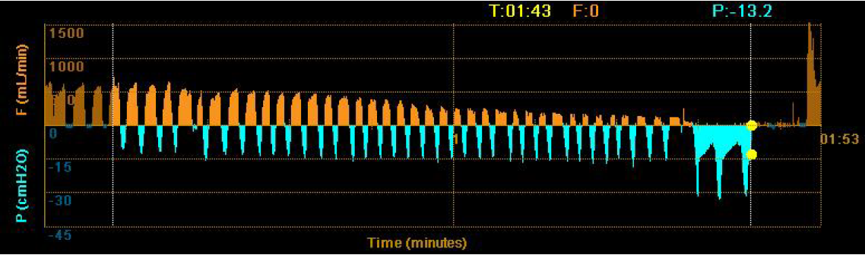
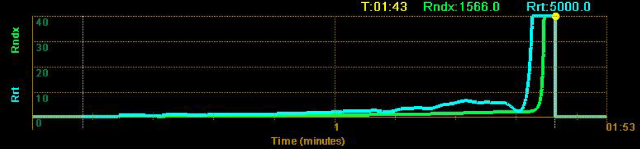
Bronchoscopic lung volume reduction
Interlobar fissures were intact in chest CT scan.
Chartis system: Evaluation of collateral ventilation
1. Entrance of RML bronchus → catheter with a balloon and distal tip
2. Balloon inflated → Airway is blocked for 2 minutes
3. Assess expiratory airflow
Flow↓, Airway pressure →
Airway resistance ↑
→ No Collateral ventilation

Slide 19
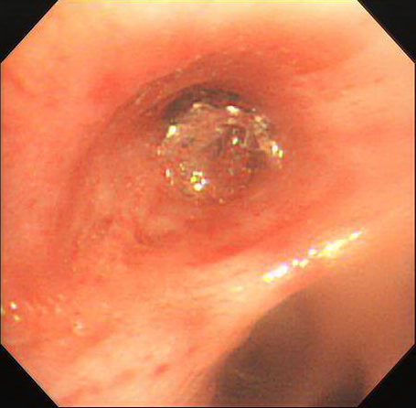
Bronchoscopic lung volume reduction
Unidirectional endobronchial valve insertion at RML bronchus
: Zephyr 5.5 mm EBV
RML
RLL

Slide 20
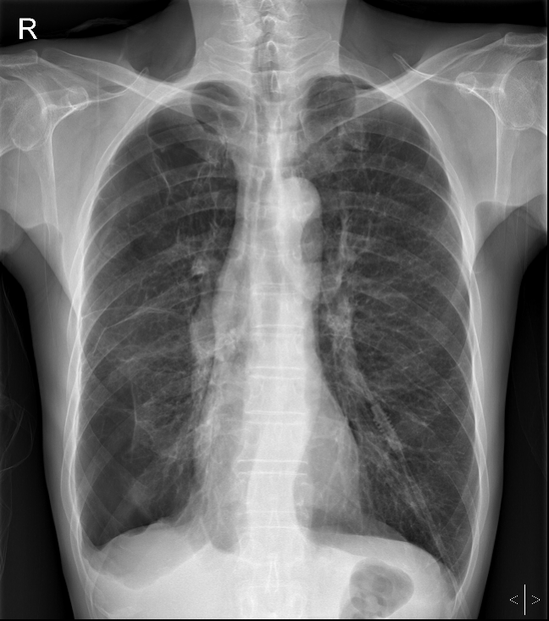
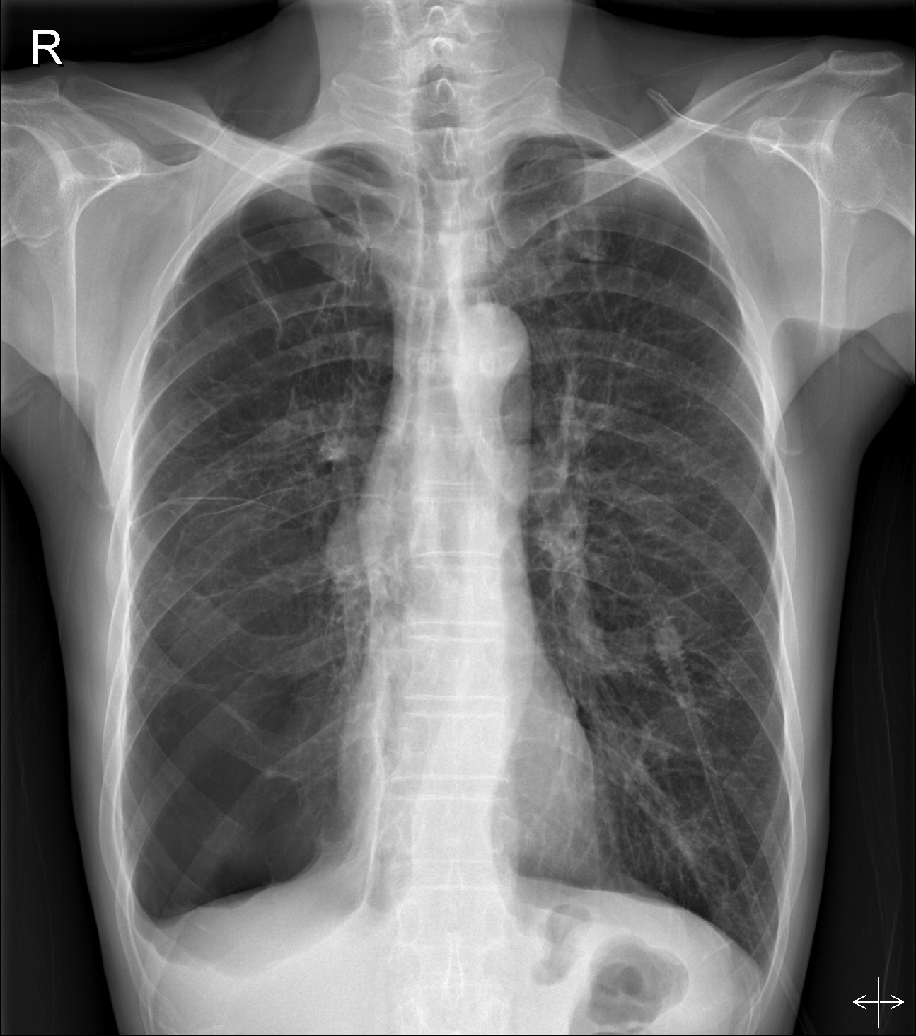
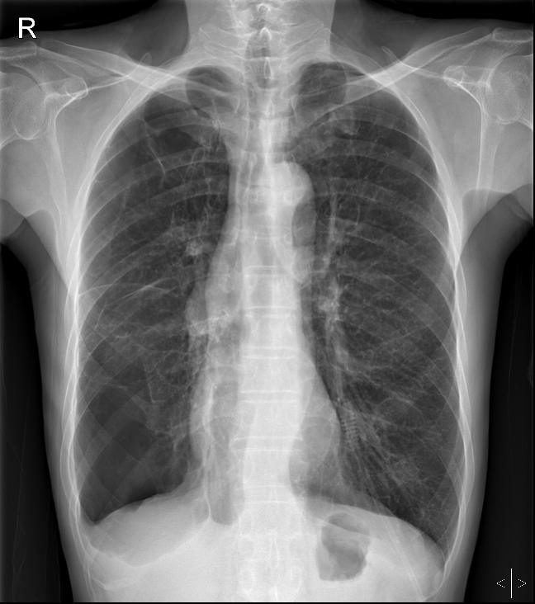
Chest X-ray
시술 전
POD #1
POD #2

Slide 21
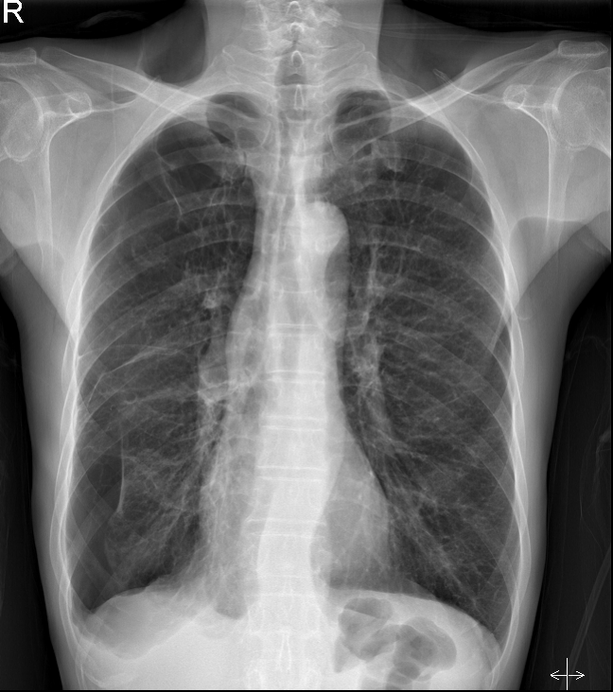
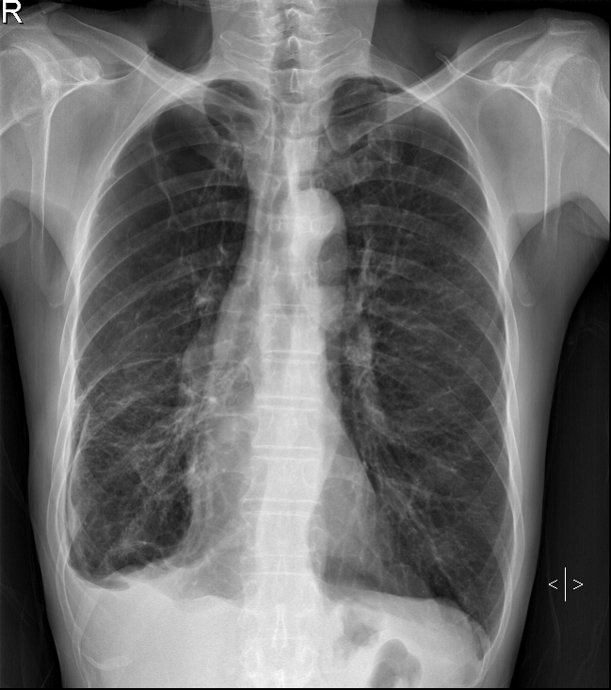
Chest X-ray
POD #3
POD #8

Slide 22
Outpatient visit (POD #8)
Subjective
“ 이제는 집 안에서 다니는 데는 큰 지장 없습니다.”
“ 집 밖으로도 조금씩 다닙니다.”
Objective
- Home O2 : 1.5L in home ~ 2L in exercise
- No complication : pneumothorax, pneumonia, valve obstruction
Assessment
COPD with huge emphysematous bulla s/p bronchoscopic
endobronchial valve insertion

Slide 23
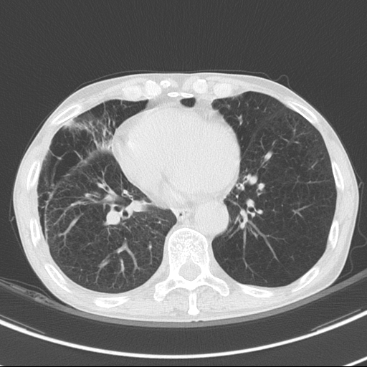
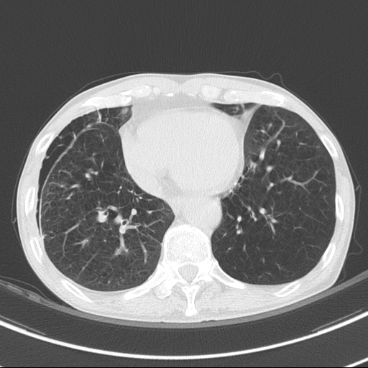
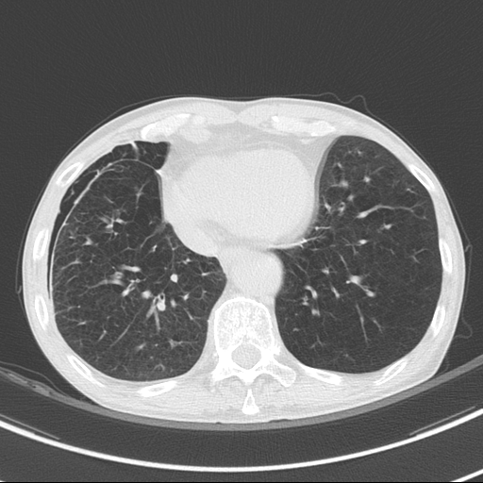
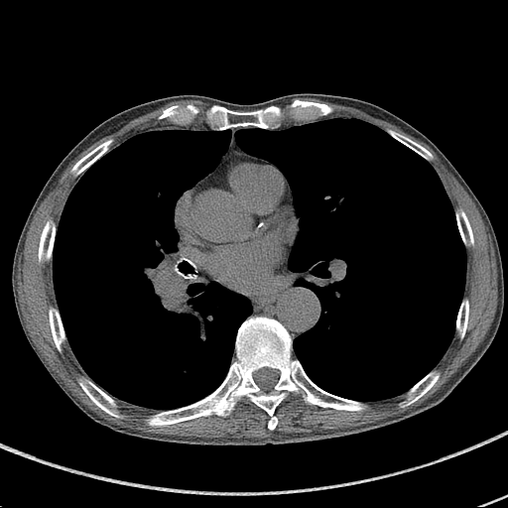
Chest CT
2017. 5.
2018. 1. (POD #66)

Slide 24
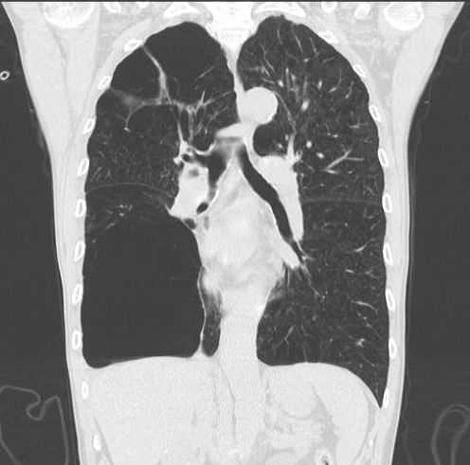
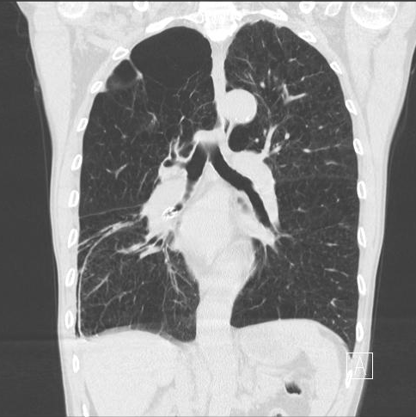
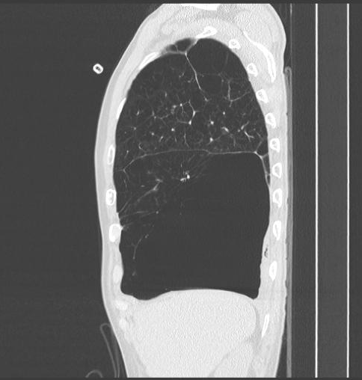
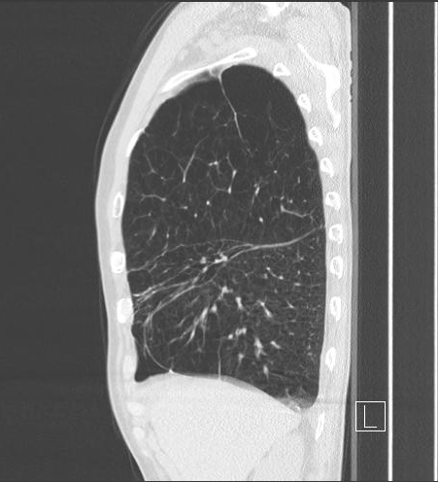
Chest CT
2017. 5.
2018. 1. (POD #66)

Slide 25
PFT (2018. 1. 18.)
 | 시술 전 (2017. 10. 19.) | 시술 후 (2018. 1. 18.)
FVC | 1.40 (35%) | 1.82 (45%)
FEV1 | 0.41 (13%) | 0.58 (19%)
FEV1/FVC | 29 | 32
TLC | 8.23 (135%) | 6.61 (108%)
RV | 6.43 (275%) | 4.74 (201%)
RV/TLC | 78 | 72
DLCO/VA | 39% | 43%

Slide 26
Outpatient visit (POD #66)
Subjective
“ 집에서 일상생활은 많이 편해졌어요. 집 밖에서도 100m 정도는 걷습니다.”
“ 추가 시술 해 보고 싶습니다.”
Objective
- Home O2 : 1.5L in home, 2L in exercise
- mMRC dyspnea scale : 4 → 3
- No complication : pneumothorax, pneumonia, valve obstruction, valve migration
Plan : Pharmacologic treatment,
Endobronchial valve insertion at LLL bronchus

Slide 27
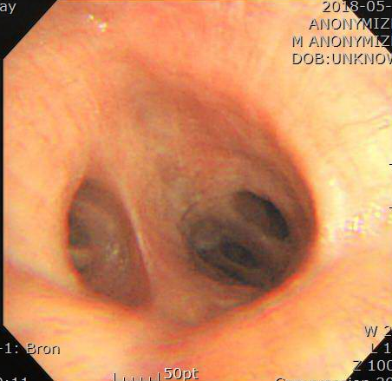
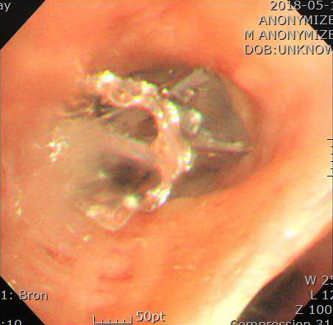
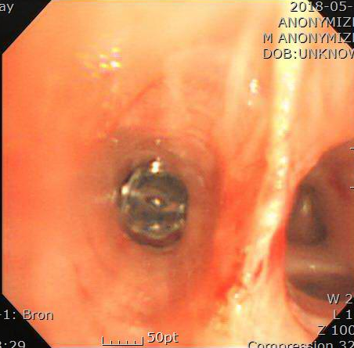
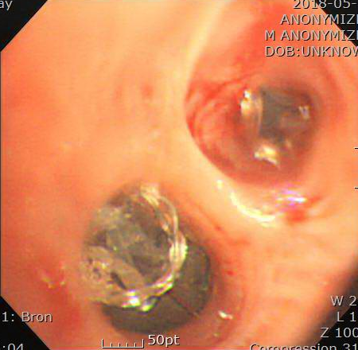
Bronchoscopic lung volume reduction
Fissure integrity on chest CT: Intact
Chartis system: No collateral ventilation
Endobronchial valve insertion at LLL bronchus (2018. 5.)
: LLL sup. segmental bronchus (Zephyr EBV 5.5 mm x 1)
LLL basal segmental bronchus (Zephyr EBV 4.0 mm x 4)

Slide 28
PFT (2018. 7. 두 번째 시술 2개월 후)
 | 시술 전 (2017. 10. 19.) | 첫번째 시술 2개월 후 (2018. 1. 18.) | 두번째 시술 2개월 후 (2018. 7. 5.)
FVC | 1.40 (35%) | 1.82 (45%) | 2.01 (49%)
FEV1 | 0.41 (13%) | 0.58 (19%) | 0.53 (17%)
FEV1/FVC | 29 | 32 | 26
TLC | 8.23 (135%) | 6.61 (108%) | 6.42 (105%)
RV | 6.43 (275%) | 4.74 (201%) | 4.39 (186%)
RV/TLC | 78 | 72 | 68
DLCO/VA | 39 % | 43 % | 47 %

Slide 29
PFT (2018. 7. 두 번째 시술 2개월 후)

Slide 30
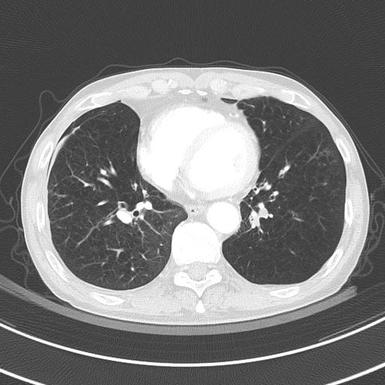
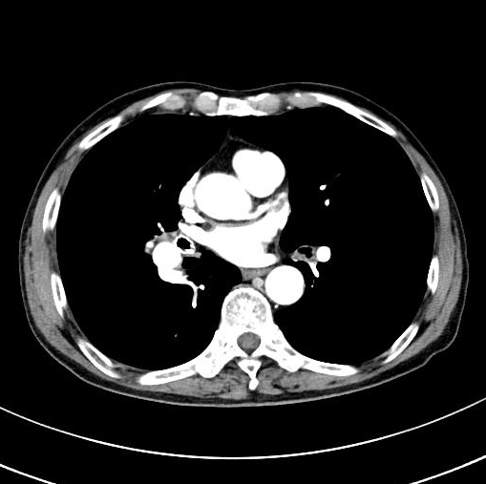
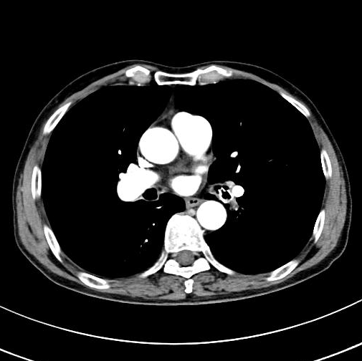
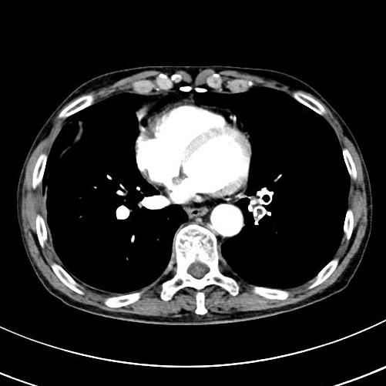
Chest CT (2019. 3. 두 번째 시술 10개월 후)

Slide 31
Review
Bronchoscopic lung volume reduction (BLVR) treatment using endobronchial valves (EBV)

Slide 32
Bronchoscopic lung volume reduction (BLVR) treatment using endobronchial valves (EBV)
- Effective and safe nonsurgical alternative for a selected patients
- Increasing evidence that patients with advanced emphysema can
experience meaningful clinical benefit
→ US FDA approval and inclusion in GOLD recommendations
- Four types of valves reported
- RCT results are only published for the Zephyr one-way EBV and
Spiration valve system

Slide 33
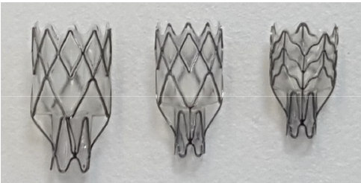
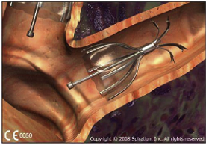
Unidirectional valves
- Occlusion of target lobe
→ atelectasis and volume reduction in the target area
- Silicone and metal alloy of neckel and titanium
- Introduced through the working channel of 2.8 mm therapeutic
bronchoscope
- Main advantage : valves can be removed if no clinical benefit or
complications
Spiration valve
Zephyr valve

Slide 34
Unidirectional valves
Airtight seal with the bronchial wall
Only trapped air and secretions to exit the valve during exhalation
Crucial for treatment: emphysematous target lobe, fully occluded lobe (intact fissure), absence of interlobar collateral ventilation
Four RCTs with total 448 patients using Zephyr EBV
→ significant improvement in lung function, exercise capacity,
dyspnea severity and quality of life

Slide 35
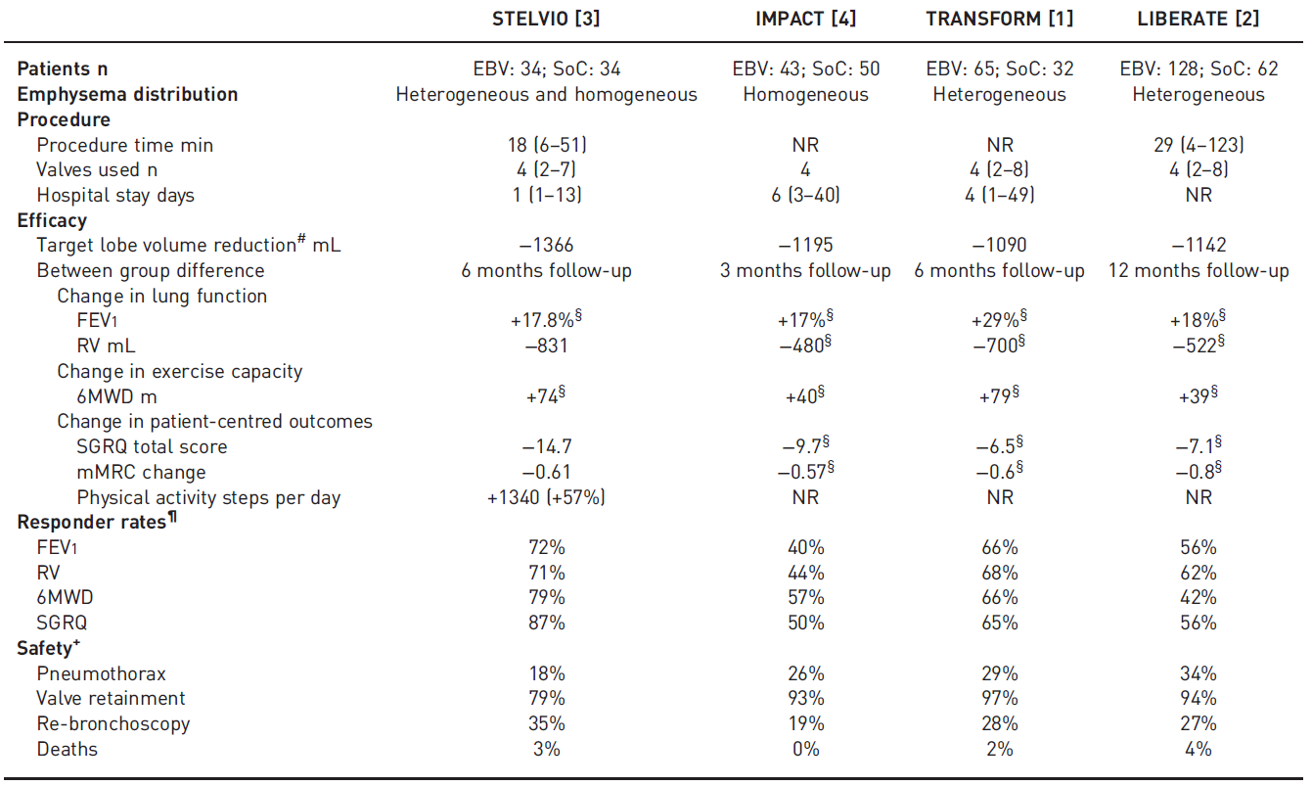

Slide 36
Optimal patient selection is a key factor affecting final outcomes.
1. Inclusion criteria for bronchoscopic lung volume reduction
- Symptomatic COPD, emphysema predominant phenotype
- mMRC dyspnea scale > 1
- COPD exacerbations ≤ 2 / year
- No interlobar collateral ventilation
- Complete fissure
Flandes et al. Bronchoscopic lung volume reduction. Clin Chest Med 39 (2018) 169–180

Slide 37
- Severe airflow obstruction as determined by spirometry
→ 20% ≤ FEV1 ≤ 50%, No significant bronchodilator response
→ 20% ≤ DLCO ≤ 50%
- Hyperinflation and air trapping determined by plethysmography
→ TLC > 100% and RV >175 %
- No smoking for at least 6 months prior to the intervention
Flandes et al. Bronchoscopic lung volume reduction. Clin Chest Med 39 (2018) 169–180

Slide 38
2. Exclusion criteria for bronchoscopic lung volume reduction
- Positive bronchodilator test (increase in FEV1 > 12% or >200 mL)
- COPD exacerbations > 2 / year
- Chronic hypercapnia with BiPAP assistance needed (PCO2 >60 mmHg)
- Previous lung surgery
- Significant comorbidities affecting long-term survival
- Giant bullae corresponding to >1/3 of the total lung volume
- PH with estimated PASP >50 mm Hg
Flandes et al. Bronchoscopic lung volume reduction. Clin Chest Med 39 (2018) 169–180

Slide 39
Complications
1. Pneumothorax
- Approximately 20-30% in experienced centers
- Approximately 80% of pneumothoraces occur in the first 48 h,
10% within days 3-5, and 10% after day 6
2. Pneumonia, COPD exacerbations, and valve migrations
Slebos DJ, Shah PL, Herth FJ, et al. Endobronchial valves for endoscopic lung volume reduction: best practice recommendations from Expert Panel on Endoscopic Lung Volume Reduction. Respiration 2017; 93: 138–150

Slide 40
References
Hartman JE, Vanfleteren LEGW, van Rikxoort EM, et al. Endobronchial valves for severe emphysema. Eur Respir Rev 2019; 28: 180121
Javier F, Francisco JS, et al. Bronchoscopic lung volume reduction. Clin Chest Med 39 (2018) 169–180
Slebos DJ, Shah PL, Herth FJ, et al. Endobronchial valves for endoscopic lung volume reduction: best practice recommendations from Expert Panel on Endoscopic Lung Volume Reduction. Respiration 2017; 93: 138–150
Valipour, Slebos, Herth, et al. Endobronchial Valves in Homogeneous Emphysema. Am J Respir Crit Care Med Vol 194, Iss 9, pp 1073–1082, Nov 1, 2016

Slide 41
감사합니다

