Slide 1
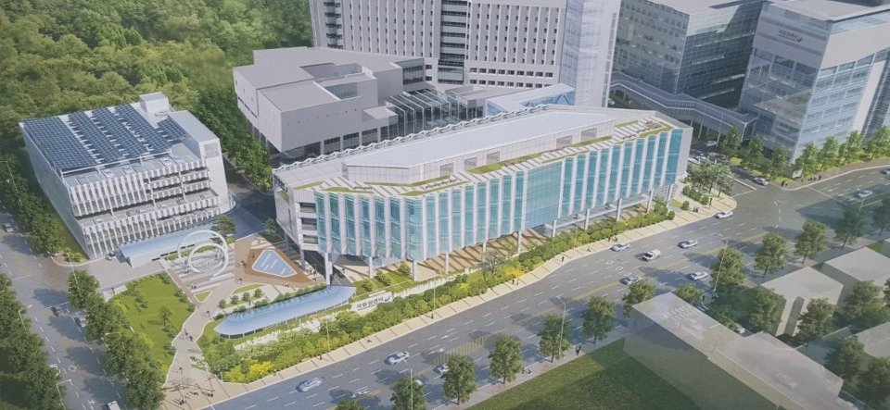
조기 폐암의 치료에서
Cryotherapy의 역할 - 증례
국립암센터
호흡기내과 강효재

Slide 2
Cryotherapy
CASE
Endobronchial treatment of early-stage lung cancer

Slide 3
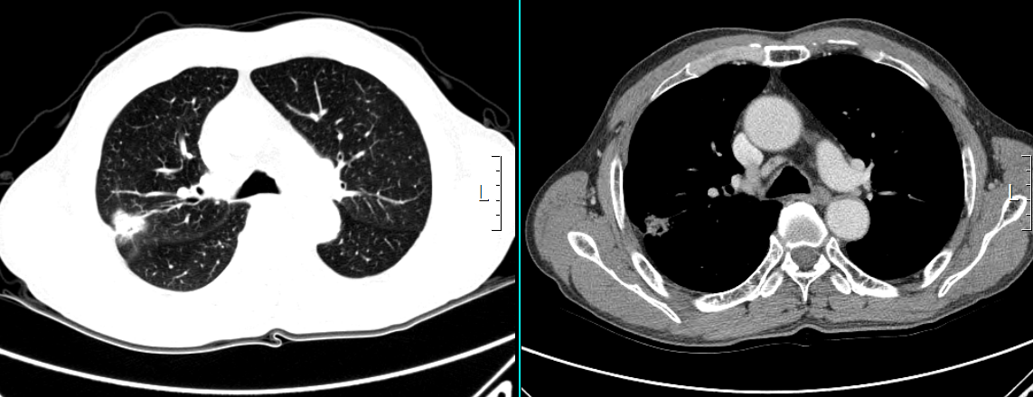
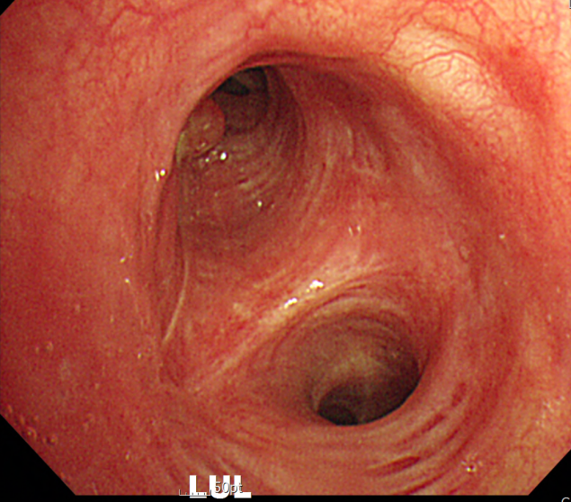
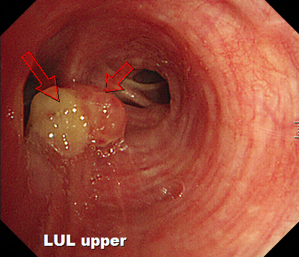
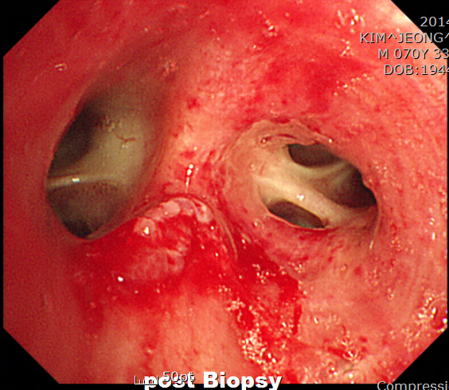
Case 1 – M/70, NSCLC (double primary)
C-CT 2014.12.9 : Lung cancer, RUL(T1a, R/O T2).
Bronchoscopy 2014.12.10
  Lt. Bronchus : LUL upper division에 polypoid nodule
  Biopsy로 tumor를 거의 제거함
#1. Adenocarcinoma Of Lung, RUL, T1aN0M0 Stage1A
- s/p 2014. 12.19 RUL Lobectomy of lung
#2. Squamous cell carcinoma, double primary, LUL
ADC
SqCC

Slide 4
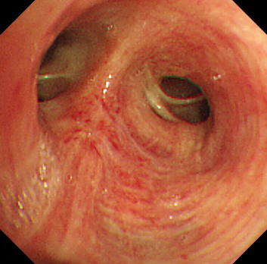
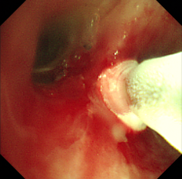
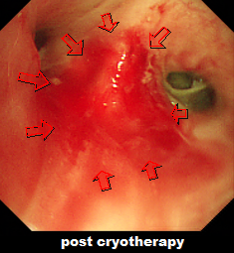
2015.1.9 Cryotherapy
Case 1
SqCC

Slide 5
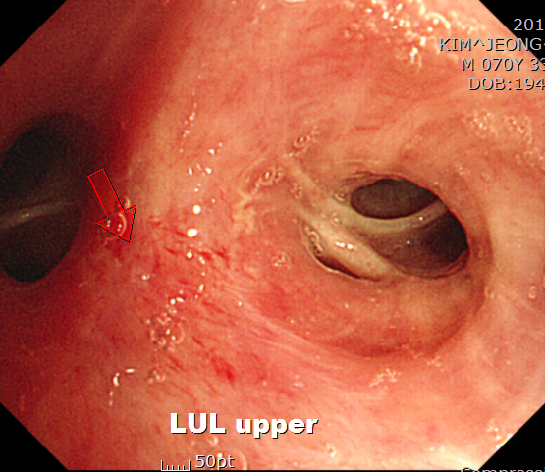
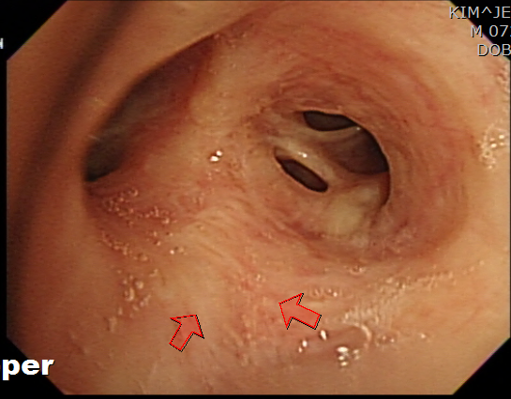
F/U Bronchoscopy
2015. 1.30 (3week)
Case 1
2017.1.4 (2years)
2019.1.16 C-CT(4years)
s/p right upper lobectomy.
No new lesion
squamous metaplasia
Nonspecific inflammation

Slide 6
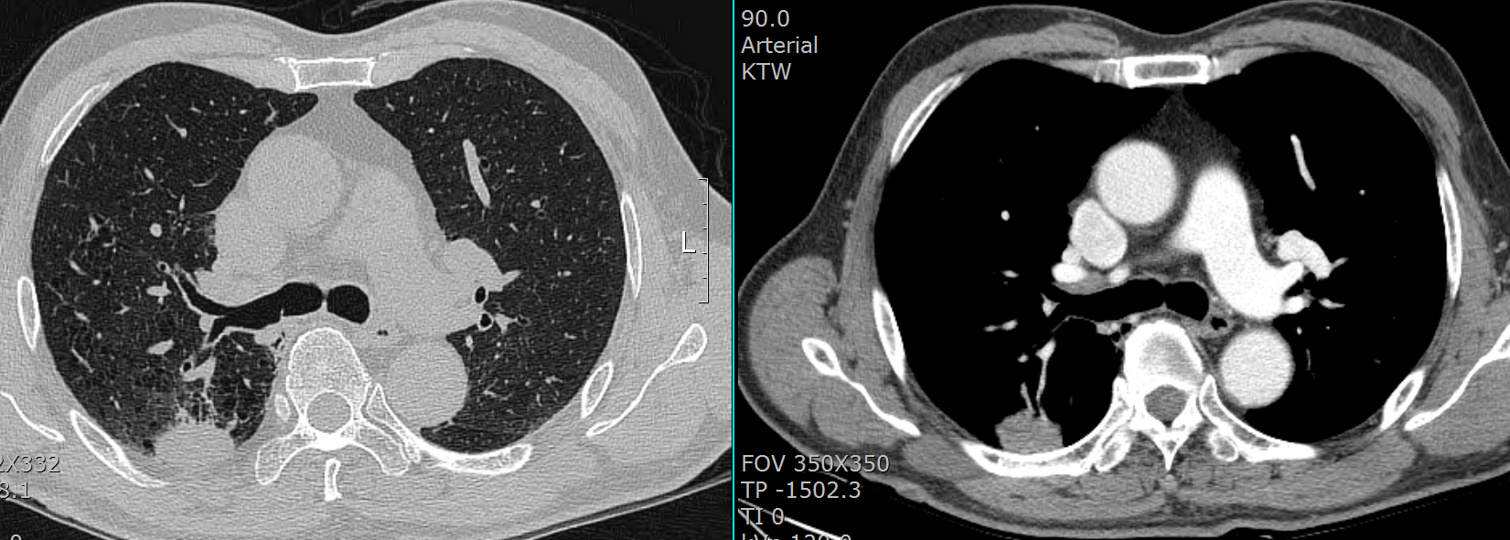
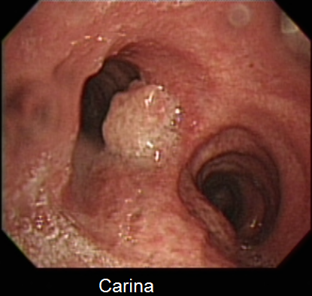
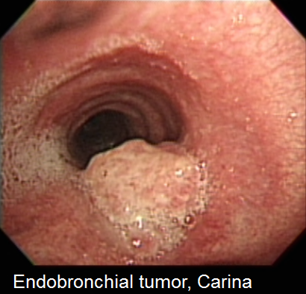
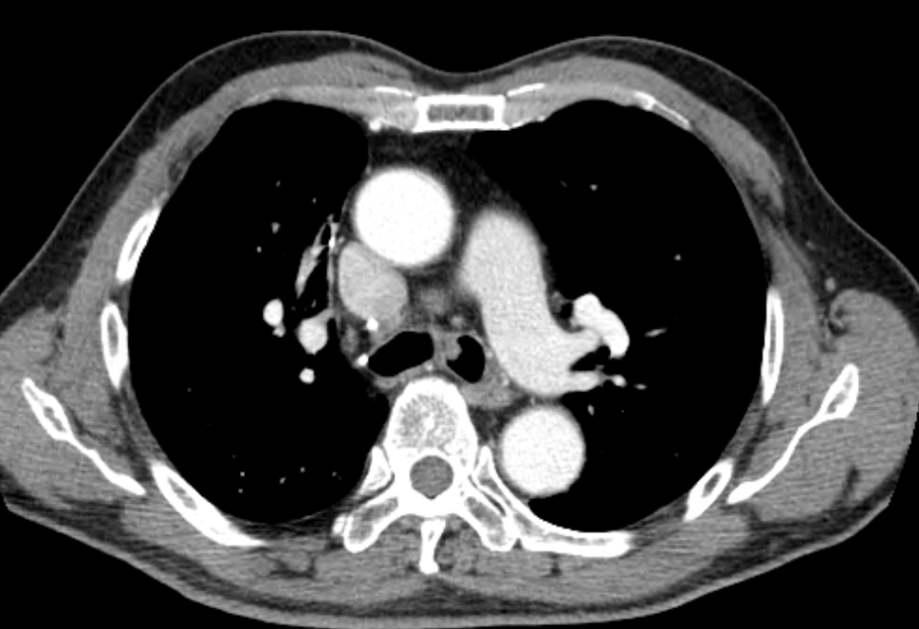
Case 2- M/78, recurred SqCC
RUL, Squamous cell carcinoma, pT2aN0
- 2010-05-28 RULobectomy
CT상 LMB lesion 2012.7.4
r/o recurred tumor
Bronchoscopy 2012.7.6
  carina left side에 polypoid tumor가 관찰됨. Endobronchial metastasis의 소견으로 판단됨. Biopsy를 시행함.
SqCC
SqCC

Slide 7
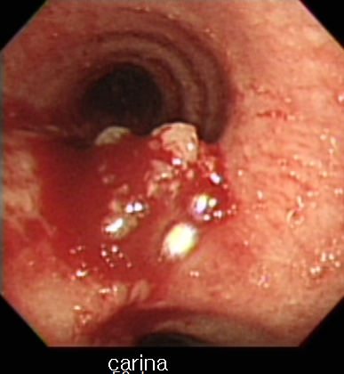
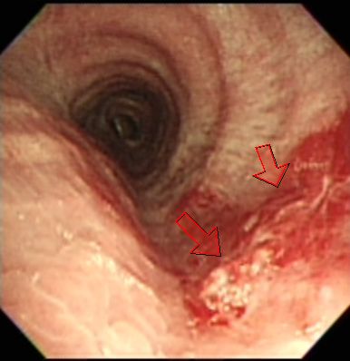
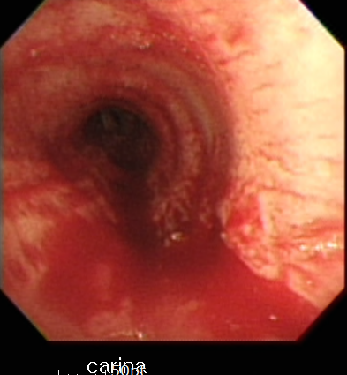
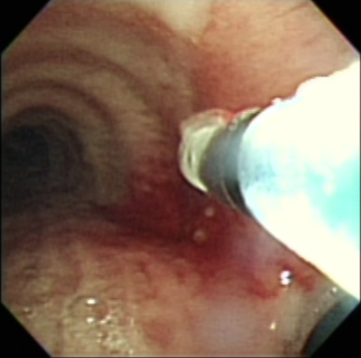
Cryotherapy 총 2회 시행
Case 2
2012. 7.13 Cryotherapy #1
2012. 7.20 Cryotherapy #2

Slide 8
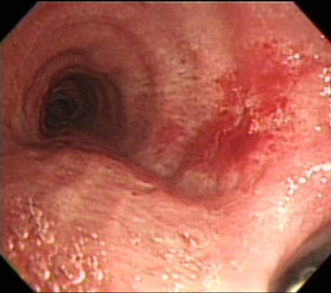
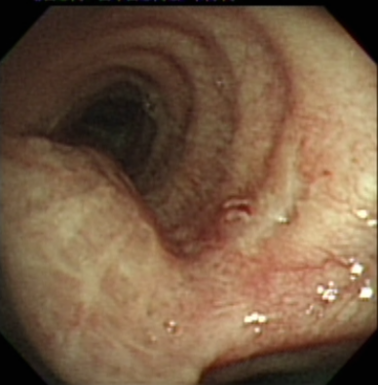
Case 2
F/U Bronchoscopy
2012. 8. 10 (3weeks)
2012. 9. 14 (2month)
Non-neoplastic bronchial epithelium

Slide 9
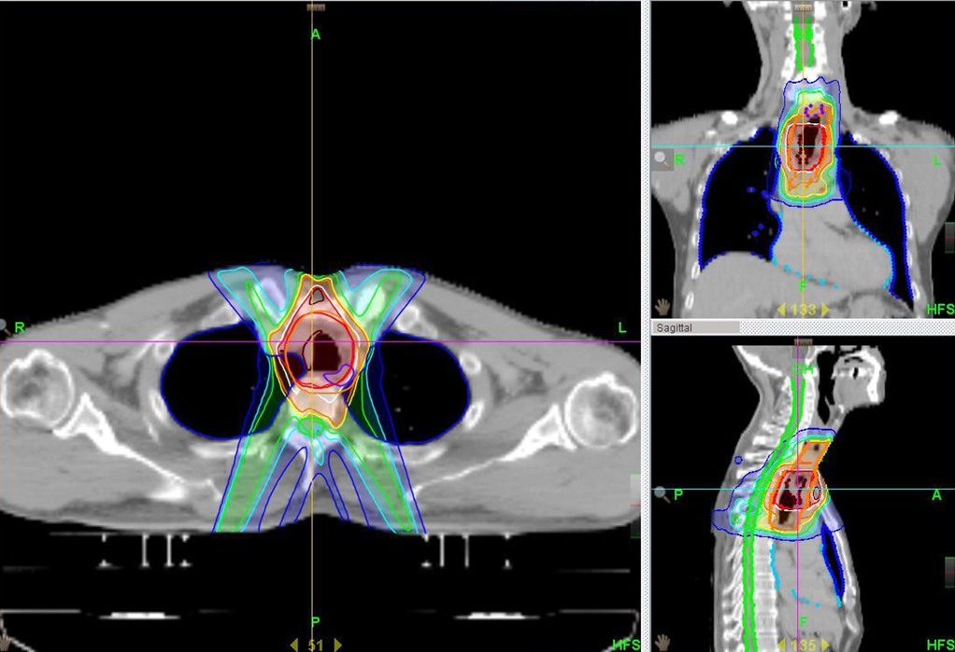
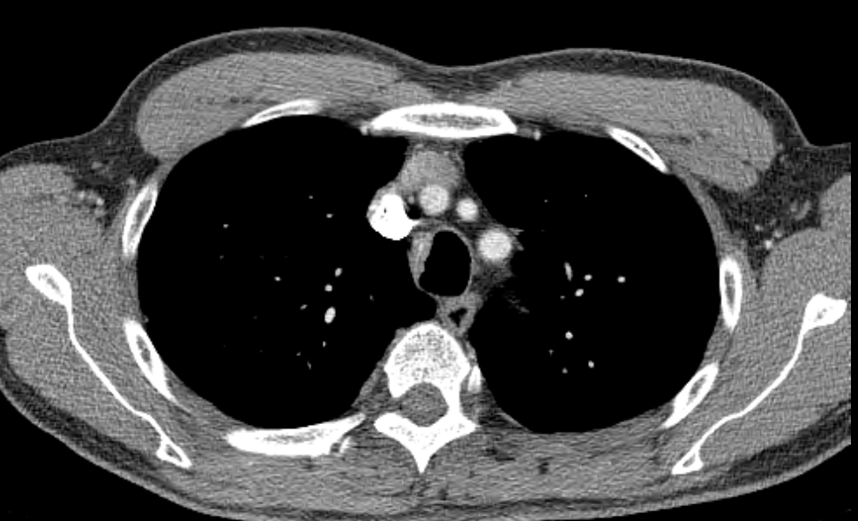
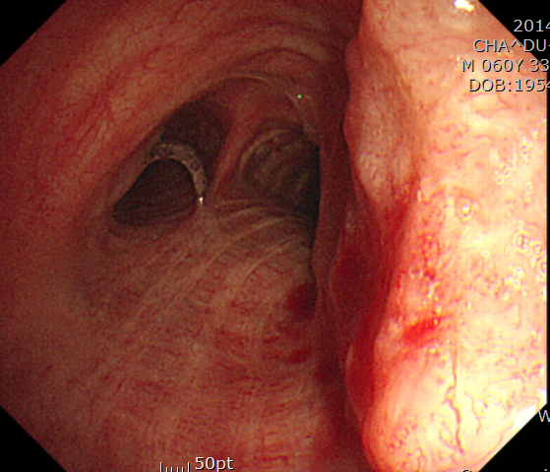
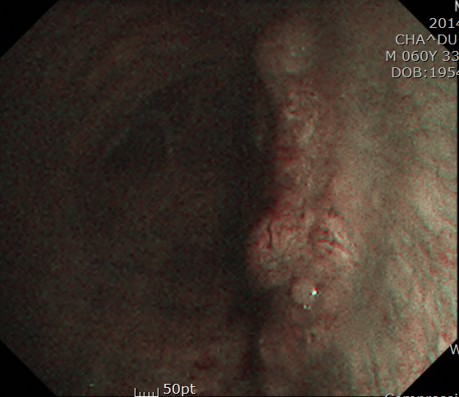
Case 3 - M/62, Tracheal cancer
#1. Base of tongue cancer, Lt.
s/p TORS, base of tongue resection. right neck dissection(level 2,3),
left neck dissection (level 2a, 2b, 3, 4, 5, sac SCM, SAN, IJV)
Tracheotomy (2012.11.1)
: sqcc, T1N2bM0
s/p PORT 65 Gy/30Fx(2012.12.03-2013.2.13)
C-CT F/U 2014.11.3 : Tracheal wall thickening
Bronchoscopy 2014.11.20 ; vocal cord 에서 7cm 하방에 Rt sided wall 에 1cm 정도 크기의 flat tumor 가 관찰됨, carina 에서는 3cm 상방임
#2. Tracheal cancer : sqcc
s/p RT 6000 cGy/ 25 fx (2014.12.11-1.19)
SqCC

Slide 10
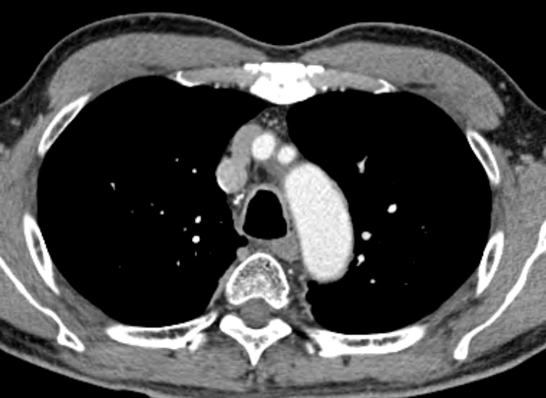
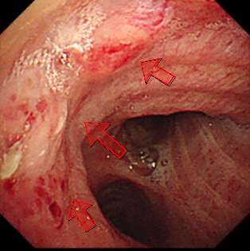
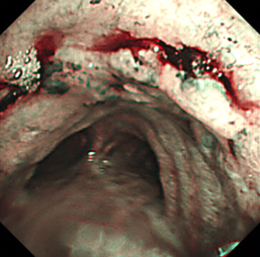
Recurred tracheal cancer
Case 3
2017.6.12 C-CT
Mucosal nodularity, trachea and both main bronchus
2017.6.21 Bronchoscopy ; endobronchial tumor, distal ant. trachea
SqCC

Slide 11
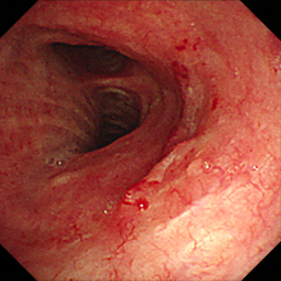
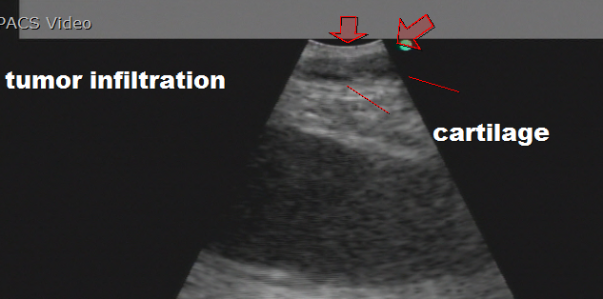
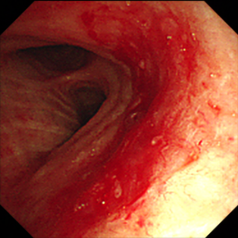
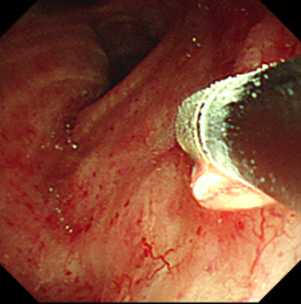
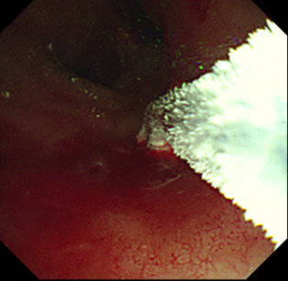
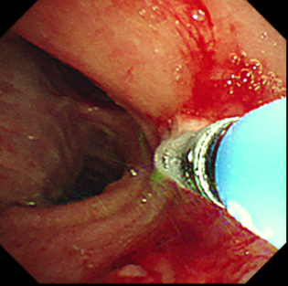
2017.7.7 Cyotherapy #1
Case 3
EBUS로 trachea tumor를 관찰 시 깊이는 3-4mm 정도이며 trachea cartilage바깥쪽으로 침범하고 있지는 않음

Slide 12
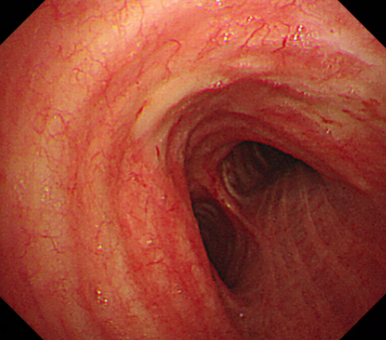
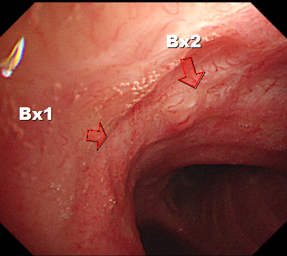
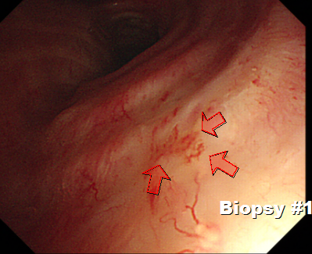
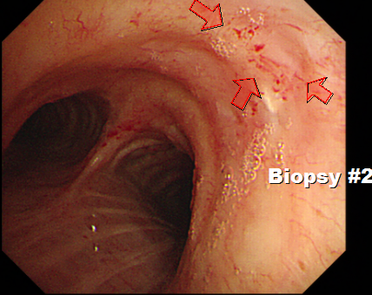
F/U bronchoscopy
2017.8.25 ( 6week)
Case 3
2018.6.11 (1year)
Distal trachea의 lat (#1) 및 ant (#2)에 hypervascular lesion 관찰되어 각각 biopsy 시행함
SqCC
submucosal fibrosis
Recurred tracheal cancer
submucosal fibrosis
submucosal fibrosis

Slide 13
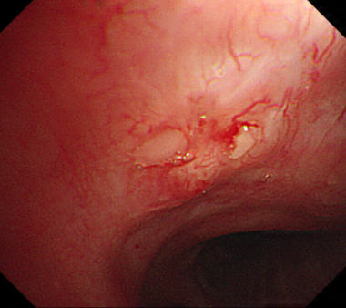
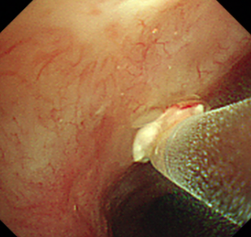
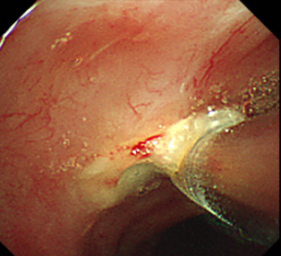
2018.6.25 Cryotherapy #2
Case 3
Distal trachea ant. wall에 기존에 있던 RT change 및 cryotherapy scar 부위에 tumor가 recur하여 re-cryotherapy를 시행함.

Slide 14
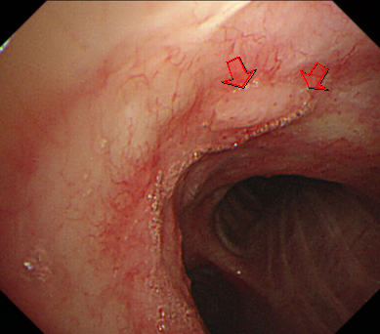
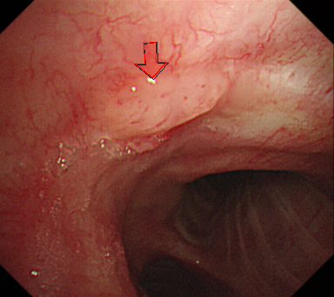
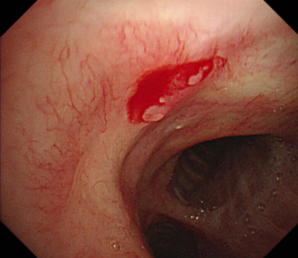
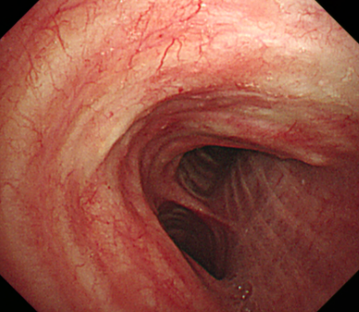
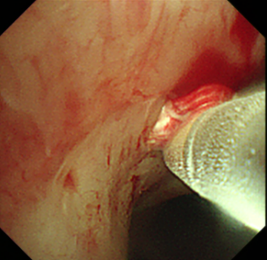
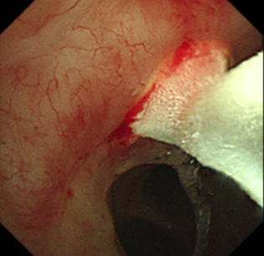
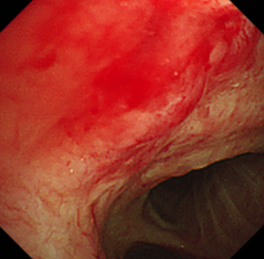
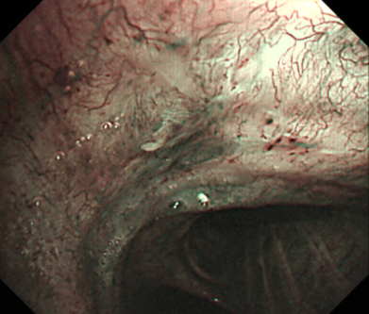
2018.9.28 Cryotherapy #3
Case 3
F/U bronchoscopy
2018.11.30
SqCC

Slide 15
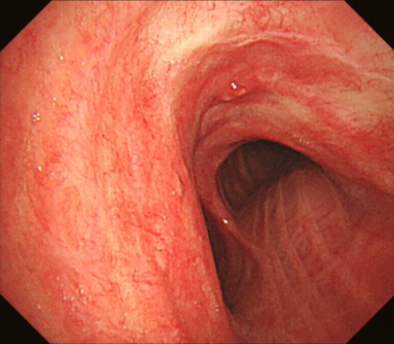
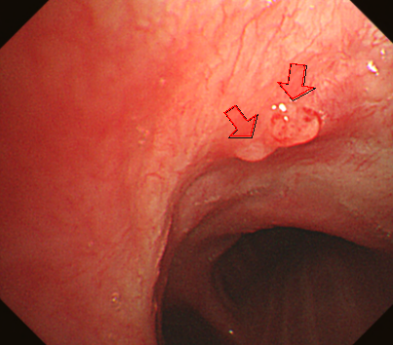

2019.1.21 Cryotherapy #4
Case 3
SqCC
PET 2019.2.1
  No discernable hypermetabolic lesion in the trachea
C-CT 2019.2.1
  Mucosal nodularity, trachea and both main bronchus, no change.
  Small nodule, RML, no change.
  Radiation fibrosis, BUL mediastinal side, no change

Slide 16




Case 4 - M/75 NSCLC + epithelial-myoepithelial carcinoma
NSCLC (SQCC: T2bN2M0 Stage3A)
1) TC X 6: PR
2) Lung RT: 6040 cGy until 2016/1/29
SqCC
epithelial-myoepithelial carcinoma

Slide 17



2015.12.17 Cryotherapy
Case 4
RB3에 관찰되는 tumor를 forceps로 제거한 이후, base에 남은 병변에 대하여 cryotherapy를 시행함

Slide 18



F/U Bronchoscopy
2016.1.28 (6week)
Case 4
2018.12.23 (3yrs)
Benign bronchial tissue
with chronic inflammation and fibrosis

Slide 19




Case 5 - M/64 typical carcinoid
C-CT 2015. 5.29
Endobronchial nodule,
left upper lobar bronchus
Bronchoscopy 2015. 6.1
Benign looking endobronchial tumor, LUL
Pathylogy ;
Well differentiated neuroendocrine carcinoma,
suggestive of typical carcinoid
with 1) mitotic count: <1/10HPF
2) necrosis: absent
typical carcinoid

Slide 20




2015. 6.22
Snare-electrocautery
Case 5
2015. 6.25
Cryotherapy
Lt. Bronchus : LUL를 거의 막고 있는 round tumor가 관찰됨. EBUS로 관찰 시 vasularity는 높지 않음. Snare-electrocautery를 이용한 polypectomy 시행함.
LUL lobar bronchus inf part에 polypectomy site에 secretion이 붙어 있고 mucosal thickening이 관찰됨. Tumor bed에 cryotherapy를 시행함

Slide 21


2018.10.17
Case 5
F/U bronchoscopy
2015.7.23(1mo)

Slide 22



Case 6 - M/54, Leiomyoma
C-CT 2015. 1.30
Endobronchial low attenuation
lesion, right upper lobe
posterior segment
Bronchoscopy
RB2를 막고 있는 tumor관찰됨
- pathology; leiomyoma
Leiomyoma

Slide 23




Electrocautery snare + Cryotherapy + APC
Case 6

Slide 24



F/U bronchoscopy
2015.3.18
Case 6
2018.10.13

Slide 25
Review
Endobronchial treatment of early-stage lung cancer

Slide 26
Interventional Pulmonology
Interventional Bronchoscopy
Therapeutic bronchoscopy
- Endobronchial treatment of early stage lung cancer
- Endobronchial debulking of tumors
- Tracheobronchial stents
- Lung volume reduction
Advanced Diagnostic Bronchoscopy
- EBUS
- Navigation bronchoscopy
Pleural and ICU interventions
Sonography
Thoracoscopy
Indwelling pleural catheter
Pleural preasure measuring
Others
Lung RFA
Notes:
Interventional pulmonlogy라는 개념이 있는데. 크게 나누어 interventional bronchoscopy, 그리고 ICU에서의 ventilation, 등이 있습니다.
그중에서도 오늘 말씀드릴 부분은 interventional bronchoscpy중에서도 그동안 진단목적의 EBUS에 대해서는 많이 들어 보셨을테고,
치료적 목적의 내시경 중에서 Lung cancer와 연관된 부분으로 early stage lung cancer의 치료, tumor의 debulking, stent에 대하여 간략히 살펴보도록 하겠습니다.

Slide 27

  Endobronchial treatment of early-stage lung cancer
For patients with superficial limited mucosal lung cancer in the central airway who are not candidates for surgical resection
➔ Endobronchial treatment with photodynamic therapy, brachytherapy, cryotherapy, or electrocautery is recommended
CHEST 2013; 143(5)(Suppl):e263S–e277S
Notes:
2013년도 ACCP guideline에 따르면 early lung cancer에서의 치료에 있어서 PDT. Brachy, cryo, electrocautery등의 치료가 recommend 되고있습니다.

Slide 28

Outcomes of endobronchial treatment of early-stage lung cancer
CHEST 2013; 143(5)(Suppl):e263S–e277S
Notes:
실제 그간의 연구를 살펴볼때, pdt. Brachy, electocautery등에 의해 치료했을때 PDT의 경우 70-80이상의 좋은 결과를 보여줌이 증명된바있습니다.

Slide 29

  Endobronchial treatment of early-stage lung cancer
Cryotherapy

Slide 30
Cryotherapy
History
  Documents from 3500 BC described the use of cold as treatment for swelling and war wounds, and Hippocrates noted the use of cold to treat orthopedic injuries.
  Endobronchial cryosurgery for the endobronchial tumors was first reported in 1986

Slide 31

Cryotherapy
Therapeutic application of extreme cold for local destruction of living tissue.
In contrast to laser or electrosurgery, cryodestruction is delayed, occurring from a few hours to a few days after application
Using low temperature, -70°C at its tip
Cryosensitive | Cryoresistant
Skin | Fat
Mucous membrane | Cartilage
Nerve | Nerve sheath
Endothelium | Connective tissue
Granulation tissue | Fibrosis

Slide 32

Mechanism of cryotherapy
The area of destruction through cryotherapy
  The diameter <1 cm
  (when a 3mm diameter probe)
  The depth of tissue penetration is approximately 3 mm
Notes:
This image is representative of a how tissue freezes using a cryoprobe. Cold pressurized gas is delivered via the airway to the target tissue (dashed arrow) resulting in a freeze zone (roughly 3 mm) with the greatest effect occurring closer to the probe head.
Basic principles and mechanisms of action — Freezing tissue to -20ºC or below, at a rapid rate (-100ºC per minute) results in the development of intracellular ice crystals which induce more than 90 percent cell death [6-13]. Tissue is thawed slowly to allow intracellular crystals to increase in size before they melt, resulting in further tissue destruction.
Intracellular ice crystals cause cell death by the following mechanisms:
●Damaging mitochondria or other micro-organelles
●Cellular dehydration
●Increased concentration of intracellular electrolytes
●Denaturation of membrane lipoproteins resulting in cellular swelling and increased permeability targ
Cryoablation also induces ischemic necrosis, independent of the direct cellular damaging effect. Vascular changes include initial vasoconstriction of arterioles and venules, altered vascular endothelium, increased permeability of vascular walls, increased blood viscosity, lower intracapillary hydrostatic pressure, decreased blood flow, and formation of platelet plugs. Ischemic necrosis from thrombosis of the et tissue microcirculation is thought to be responsible for the minimal bleeding associated with this modality. The end result is a clear line of demarcation between previously frozen tissue and unfrozen tissue.

Slide 33
Mechanism of cryotherapy
Repeated freezing and thawing of target tissue
  Freezing
    Quickly because this forces the ice crystals to form intracellularly, where they are most lethal
    The core temperature : to be destroyed, -20ºC and -40ºC
    Freezing to -40ºC or below at a rapid rate (-100ºC per minute) : more than 90 % cell death
  Thawing
    Thawed slowly.
    Intracellular ice crystals to increase in size before they melt (rapid thawing leads to immediate melting).
    cause cell death directly by damaging mitochondria or other micro-organelles : cell swelling and rupture.
Microvascular changes
  Thrombosis of the feeding vessels : microcirculation of the target tissue to cease soon after thawing
Notes:
Cryotherapy의 가장 주된 기전은 바로 tumor cell을 빠르게 얼리고 그과정에서 만들어 지는 icer trystal을 통하여 cell을 파괴하고, 천천히 녹이면서 mitochondria손상을 주어 cell을 파괴하는것
또한 얼리는 과정에서 thorombosis를 형성하는 기전을 통하여 microvascular change를 가져와 이를 통하여 tumor파괴

Slide 34


Equipment
  Bronchoscope ; Rigid or flexible bronchoscope
  Cryosurgery device
  Cooling agents ; nitrous oxide (N2O) and liquid nitrogen (N2).
    Nitrous oxide
      Equilibrium temperature of -89ºC in the distal two centimeters of the cryoprobe
Notes:
장비는 내시경
Cryosurgery device및 clloing agent
주로 N20사용하고 영하 89도까지 빠르게 얼림

Slide 35

Step of procedure
Cryotherapy exploits the cooling caused by rapid expansion
of liquid gas to cool the tip of the cryoprobe (Joule-Thompson principle)
The tip of the probe is cooled to a working temperature of -40℃, which is sufficient to destroy living tissue.
The cryoprobe is placed on or inserted into the lesion treatment if necessary.
Notes:
Two to three freeze-thaw cycles, each lasting one minute (30 second freeze followed by a 30 second thaw), are applied to the same or adjacent area.

Slide 36
Step of procedure
Two to three freeze-thaw cycles
  each lasting one minute (30 second freeze followed by a 30 second thaw) are applied to the same or adjacent area.
The probe is then moved 5-6 mm, and another three cycles of cryotherapy are carried out in the new area.

Slide 37
Step of procedure
Repeat bronchoscopy
  Repeat bronchoscopy (usually flexible bronchoscopy) is generally performed eight to ten days ( >1week) after bronchoscopic cryoablation.
  the extent of tissue destruction to be assessed, assure a clear and clean airway, and removal of devascularized cryoablative debris by forceps, aspiration, or cryoadhesion.
  Additional bronchoscopic cryotherapy

Slide 38

Indications
Central airway obstruction
  Malignant lesions
    Airway malignancy is the most common indication for bronchoscopic cryotherapy
  Benign lesions

Slide 39
Indications
Inoperable microinvasive carcinoma
  Histologically proven carcinoma of the trachea and bronchi
  Inoperable carcinoma based on the position of the tumor, performance status or poor respiratory function.
  Intraluminal tumors
  Extraluminal elements of tumors which do not cause occlusion from external pressure of more than 75% of the normal diameter
  Recurred tumor following radiotherapy, chemotherapy or lung resection.
J Thorac Dis 2012;4(4):408-419

Slide 40
Complications
Complications can be expected in <5% of cases
  Hemorrhage
    Specific to cryoablation, tumor necrosis and the delayed hemostatic effect can result in hemoptysis in up to 4 percent of patients
  Airway wall ulceration and perforation
    This complication is less common with cryoablation
    Any resulting pneumothorax may require a chest tube or significant airway perforation may need to be repaired
  Airway edema and mucus plugging
    Mild reactive airway edema can occur that is usually not severe because the cartilaginous armature limits swelling.
    Mucus plugging and atelectasis from cellular debris commonly occurs in the few weeks following the procedure necessitating repeat bronchoscopy for pulmonary toileting

Slide 41
Endobronchial treatment of early stage lung cancer : SUMMARY
Cryotherapy
  Ice
  Repeated freezing and thawing of target tissue
  Bronchoscope + Cryosurgery device + Cooling agent (Nitrous oxide)
  Indication
    Surgical resection of some early stage tumors may be contraindicated
    second primary lung neoplasm
      The cryoprobe is placed on or inserted into the lesion 2–3 times to apply repeated cycles of freezing and thawing at the same location before moving to an adjacent site.

Slide 42
감사합니다.

Slide 47

  Endobronchial treatment of early-stage lung cancer
Photodynamic therapy
Notes:
이러한 Early stage lung cancer중에서도, 가장 많이 사용하는 방법 두가지를 살펴볼 예정으로
하나는 PDT; photodynamic therapy, 하나는 cryo입니다.
이것은 여러 논문들에서 fire and ice로 표시가 되며. 먼저 fire를 살펴보도록하겠습니다.

Slide 48


PDT in Lung cancer
The first endoscopic PDT treatment of lung cancer ; performed in 1980s
Chest. 1982 Mar;81(3):269-77.
Notes:
폐암에서는 1980년대 초에 lung cancer 에서의 사례가 보고가 된바 있고, 그 이후에 조기 폐암의 치료에서 널리 활용이 되고 있습니다.

Slide 49
PDT for Curative treatment of superficial endobronchial tumors
  Surgical resection of some early stage tumors may be contraindicated
    reduced postoperative pulmonary function
  Up to 10 percent of successfully resected patients with lung cancer subsequently develop a second primary lung neoplasm
    a second operation may not be feasible at that point.
Notes:
이러한 치료 목적의 PDT가 사용되는데는 크게 두가지 경우가 있는데.
하나는 조기 폐암이나 Surgical indication이 되지 못한 환자로 lung function등이 좋지 않은 경우이고
하나는 환자중에 secondary primary lung cancer로 진단된 환자에 있어, second operation이 여의치 않은 경우에 사용이 됩니다.

Slide 50

PDT in early central lung cancer
  Early central lung cancer defined as :
    Confined to the bronchial lumen
    No lymph node involvement or metastasis ( N0 and M0)
    Not a clear pathological definition
Thorax 2007;62:391–395
Notes:
이러한 연구들에서는 “Early central lung cancer” 라는 개념이 등장했는데, 이는 기관지 내에 국한된, 다른 전이소견이 없는 암을 말합니다. TNM staging 과는 명확히 매칭하기 어려운 개념입니다.
작은 암임에도 불구하고 수술하기 어려운 부위였던 바 광에너지 요법을 시행하였고, 5년의 추적관찰 기간 중 21명 중에서 16명이 사망하였습니다. 5년간의 평균 생존기간은 50개월이었습니다.
Twenty-nine bronchoscopic treatments were undertaken in
the 21 patients; 14 patients had one treatment, 6 had two, and
1 had three treatments. All treatments were carried out as a day
case procedure and no patient needed re-admission to hospital
following PDT other than pre-arranged visits. There was no
procedure-related or 30 day mortality. One patient presented
with a mild photosensitivity skin reaction (skin burn) with
slight erythema of hands and face that settled after 3 days.
Every patient, including the one who had skin burn, expressed
satisfaction with the treatment.
We need better risk stratification tools in lung cancer. With an annual worldwide population of 1.6 million individuals diagnosed and 1.4 million killed, lung cancer is the most lethal cancer in humans (2). The overall 5-year survival rate is only about 16%, but this varies from 73% in patients ostensibly with the earliest stage, IA, to 2% in those with stage IV (3). The vast majority of long term survivors of non-small cell lung cancer (NSCLC) have had surgery as part of their treatment. Currently, for these patients (most of whom have had distant metastasis excluded), the most powerful prognostic factor is the N-category of the TNM staging system: The status of their intrapulmonary, hilar and mediastinal lymph nodes. However, 29% of patients with stage IA disease and 48% of patients with node-negative disease die within five years, most with distant recurrence (4).

Slide 51
Result of PDT in early lung cancer
Maximum dimension | Lesions | CR
Superficial type ( 123 lesions in 110 patients) <0.5cm <1.0cm <2.0cm >2.0cm | 64 25 20 14 | 61 (95%) 22 (88%) 9 (45%) 6 (43%)
Nodular type (45 nodular cancers in 43 patients) <0.5cm <1.0cm >1.0cm | 29 9 7 | 27 (93%) 6 (67%) 1 (14%)
Interventional bronchoscopy, 2000. ISBN 3-8055-6851-7
Notes:
PDT 병변의 성상과 크기에 따른 PDT 결과들역시 보고가 되는데,
이들 중 1cm보다 작을때는 더 좋은 결과. 88%이상

Slide 52

Mechanism of action
Photosensitizer
  Retention in tumor cells and in vascular endothelium
After a set time interval (usually 48 hours), the tumor is exposed to light energy : triggers the cytotoxic reaction.
Type II photo-oxidative process
  Molecular oxygen is transformed to a cytotoxic singlet oxygen species
The neovascular endothelium of tumors
  Loss of capillary integrity
Type II 반응이란?
활성화된 광감작제와 산소분자 사이의 에너지 전달 반응으로 singlet oxygen이 생성되는 반응
Photodiagnosis and Photodynamic Therapy (2008) 5, 10—18
Notes:
PDT mechanism은 이러한 photosensitizer들이 주로 tumor와 vascular endothelium에 retention되는 것을 이용하는 것입니다.
특히나 48시간 경과후에 빛에 노출이 되었을때 특히나 cytotoxic reaction
특히나 Type 2 oxidative process가 PFT치료의 주된 기전이 되어 oxygen radical발생시의 cytotoxic effect
또한 neovascular endotherlium에 작용하여 capillary integrity 손상하여 tumor cell파괴한다고 알려져있습니다.

Slide 53

Photosensitizer
First generation photosensitizer
  HPD (Hematoporphyrin derivative)
  Photogem (630nm, Lomonosov Institute of Fine Chemicals, Russia)
  Photofrin® (630nm, Axcan, Canada)
    Despite certain shortcomings of the porphyrin family of photosensitisers related to the wavelength of light at which they are activated
    The standard dose : 2 mg/kg/bw has become
The drug is cleared from most organ systems within 72 hours
retained longer in tumors, skin (up to 30 days), liver, and spleen
Photodiagnosis and Photodynamic Therapy (2008) 5, 10—18
Notes:
Photosensitizer로 사용된는 물질로 1세대
Hematophorphryn derivative
우리 병원 본래 러시아산 photogem → 현재는 photofrin만 사용중 , 원내수가만 250만원이상.
고가의 치료법임
이것의 standard dose는 2mg/kg/bwt

Slide 54



Several types of fiber systems
Diffuser tips vary in length from 1.0 to 2.5cm
The length used is determined by estimating the axial length of the tumor
Tumor destruction to a depth of 5 to 10 mm
Interventional bronchoscopy, 2000. ISBN 3-8055-6851-7
Notes:
이때 빛을 내어주는 opticfiber의 경우 종류가 매우 다양함
이중 많이 쓰이는 두가지가 microlens와 cylindertube로
Microlens는 이 앞쪽으로만 조사되는 빛
Cylindertube는 360도로 옆쪽으로 조사되는 빛을 낸다. 이것은 1-2.5cm로 다양한 길이를 나타냄
대개는 내시경의 작업구를
통하여 광섬유를 삽입하여 종양에 조사하게 되나, 경우에
따라 종양에 직접 찔러 조사할 수도 있다.

Slide 55
Optical fibers
Microlens
  Employed to focus light in a forward direction
  Surface illumination
  The tip is also fairly rigid, permitting it to be embedded directly into a tumor if necessary
  Small superficial tumors that are end-on to the bronchoscopy
  Stump recurrence
Cylindrical diffuser
  Emitting the light laterally in a 360 degree arc near its tip
  The chosen tip length depends upon the length of the lesion.
  Parallel to the bronchoscope
  Nodular or polypoid
  Tumor involving smaller branches of the bronchial tree
Interventional bronchoscopy, 2000. ISBN 3-8055-6851-7
Notes:
이들 각각의 사용처를 보면.
Microlens의 경우는 빛이 forward하게 나가게 되며 주로 bronchoscopy끝에 small superfical tumor나 stump recurrece에 써서
Surface를 조사하거나 아니면 아예 tumor위에 embed시켜서 조사
Cylindrical diffusion는 360도로 조사가됨. 병변의 길이에 따라 선택
이것은 tumor가 bronchoscopy와 parallel하게 진행되는 경우나, nodular하거나 polypoid한 경우 주로 선택이 되는 diffuse임.

Slide 56


Procedure
Photofrin : a dose of 2mg/kg in 5% dextrose solution IV
24-48hr later, PDT can be performed
  Safely and conveniently with the flexible bronchoscope and moderate sedation
    The use of a rigid bronchoscope : for the unstable or hypoxic patient
A ‘clean up ‘ bronchoscopy
  Required ~2 days after treatment to remove debris
  It is recommended initially to apply 200 J/cm treated; additional energy may be applied during a follow-up bronchoscopy 2 days later.
Photodiagnosis and Photodynamic Therapy (2008) 5, 10—18

Slide 57
Light source and dosage
A wavelength of 630 nm : therapeutic applications
The literature light doses : 150—300 J/cm²
  The majority of authors recommend a light dose ; 200 J/cm² of the tumor for Photofrin®
    Typically 200J/cm : carcinoma in situ( CIS) or for smaller airway tumors
    Up to 300J/cm :more advanced disease in large airways
Tight sources : KTP (potassium-titanyl-phosphate)-pumped tunable dye lasers
Power (mW/cm²)×time (in seconds) ; 200J/cm²
  Experience is needed to apply an optimal light dose to the pre-sensitised tissue since, in the calculation of the dose, one needs to take into account that 200 J/cm of the lesion can be derived from two variables: 400mW × 500 s = 200mW × 1000 s = 800mW × 250 s.
Interventional bronchoscopy, 2000. ISBN 3-8055-6851-7
Photodiagnosis and Photodynamic Therapy (2008) 5, 10-18
Notes:
Light sourse에서, 특히나 630mn의 파장이 주로 이용됨
문헌에서 150-300j/cm의 빛을 이용한 치료 주된.
Photofrin에서는 가장 많이 사용되는 light dose는 200j/CM
CIS나 Small airway에서는 200j/CM,좀더 진행될때는 300J/CM까지도 사용함
도한 이것은 Watt x time으로 이루어짐
200j은 한 예로 1cm diffusion로 400mW X500s
이건 실제로 치료를 시행할 때 계산을 해서 몇정도로 몇초간을 줄지 결정을 함.
200j로 준다고 정할 때 mw에 따라 몇초를 줄것인지 결정.
광역학치료 효과에서 광선(laser)의 영향은 파
장(wave length)과 에너지 밀도(laser energy density)인
광량(dose)에 의해 좌우된다.
광량은 단위 면적당 에너지량
으로 표시하며 조사에너지 밀도(dose; J/cm2)로 나타낼 수
있는 광생물학적 단위이며, 조사 강도(power)는 단위면적
당 광선의 세기(W/cm2)로 나타내는 물리적인 단위라고 말
할 수 있다. 광량은 다시 얼마만한 면적(cm2)에 어느 정도
세기(W)의 광선으로 얼마 동안(sec) 조사 하나로 나타내게
되며, 조사 강도(W/cm2)에 조사시간(second)을 곱한 것이
며, 종양의 조건에 따라 최종 광량(J/cm2)을 계산하여 시술
하게 된다

Slide 58
Complications of PDT
The main adverse effect of PDT
  Photesensitivity reaction(23%)
  Cough with some blood-streaked sputum
  Chest discomfort related to the inflammatory response
Within 24 to 48 hours after treatment
  Edema and secretions may lead to airway compromise.
    if the procedure was performed in the trachea or with higher energy levels
  Respiratory compromise -> Immediate therapeutic bronchoscopy
기관이나 주기관지 종양을 치료 부종에 의한 호흡곤란 예방 : 스테로이드를 단기간 사용
국소 염증반응 : 약 1주간 항생제, 거담제, 소염제 등을 경구 투여
Notes:
가장 흔한 합병중 중 하나가 부종
-> 기관이나 주기관지 종양을 치료한 경우에는 부종에 의한 호흡곤란을 예방하기
위하여 스테로이드를 단기간 사용하는 것이 좋다. 일반적으
로 필요하지는 않지만 폐 기능이 나쁘거나 가래의 양이 많
은 폐암 환자에게는 국소 염증반응에 대하여 약 1주간 항생
제, 거담제, 소염제 등을 경구 투여한다. 광역학치료 후 점막
하 출혈을 동반한 종양괴사가 일어나며 삼출성 물질의 분비
도 많아지면서 가래의 양이 많아지고 혈담이나 객혈이 발생
하기도 한다. 치료받은 종양 부위에서 발생 가능한 가장 치
명적인 합병증은 대량 객혈이다

Slide 59
Case : M/62, NSCLC(SqCC), cT1aN0M0, Stage I
C.C. ; BTS during 1month
30py current smoker
PFT
  FVC : 2.12 ( : 64% ) : 2.27 ( : 69% )
  FEV1 : 0.88 ( : 37% ) : 0.93 ( : 39% )
  FEV1/FVC : 42% : 41%
  DLCO/VA : 3.38 ( : 88% )
Initial PET : no distant meta
Initial C-CT : Eccentric wall thickening, right lower lobe superior segmental bronchus origin.
Bronchoscopy : RB6에 tumor infiltration이 관찰되며 tumor는 distal BI까지 extension 되어있음. RB6에 대하여 Bx 시행함
EBUS : 4R, 4L, 7, 11Ri, 11Rs, 11L : all negative
Pathology report : Squamous cell carcinoma
Notes:
그렇다면 한명의 예를들어 보도록 하겠습니다.
62세 남자 환자로 Clinical stage I환자분임
BTS로 오신 30PY PFT상에 FEV1 0.88 COPD GOLD3
CT.PET. Bronchoscopy시행후 early lung cancer
But op불가능…

Slide 60



2014. 7.14 am 11:50
Phtofrin 108mg with 50% N/S iv ( 54kg)
45hr later
2014. 7.16 am 9:00
PDT 1
PDT Site #1 : RB6 and distal BI
소견
Cylindrical diffuser Distal BI 1cm에 30J/cm2, RB6 2cm에 100J/cm2 PDT시행함
Notes:
Initially RB6에 위치하고 BI일부에도 involve
이환자의 경우 photofrin주사이후에 45시간이 경과하여 PDT시행함
Clyndrical diffusion로

Slide 61


2014. 7. 18 ( 2days later from first PDT) distal BI, RB6 mucosa가 edematous 함. PDT change 소견임.
PDT 2
PDT Site #1 : RB6& distal BI
소견
3cm, 50J/cm, cylindrical diffuser
Notes:
2일 지나서 시행한 bronchoscopy
Edmatous mucosa -. PDT change
추가적으로 PDT done

Slide 62




F/U bronchoscopy
3month later
6month later
Bronchus, RB6, BFS biopsy:
Nonspecific inflammation with submucosal fibrosis
Bronchus, BI, BFS biopsy:
Chronic nonspecific inflammation
Bronchoscopy
Distal BI, RB6에 PDT scar가 관찰됨
Notes:
3개월후에 biopsy
Inflammtorylesion
6개월후 PDT Scar only
CT등에서도 No recur

Slide 63
Endobronchial treatment of early stage lung cancer : SUMMARY
  Surgical resection of some early stage tumors may be contraindicated
  Up to 10 percent of successfully resected patients with lung cancer subsequently develop a second primary lung neoplasm
Cryotherapy
  Ice
  Repeated freezing and thawing of target tissue
  Bronchoscope + Cryosurgery device + Cooling agent (Nitrous oxide)
      The cryoprobe is placed on or inserted into the lesion 2–3 times to apply repeated cycles of freezing and thawing at the same location before moving to an adjacent site.
PDT
  Fire
  Type II photo-oxidative process
  Tumor-selective photosensitizer + laser light
    Photofrin® (630nm, Axcan, Canada)
  A wavelength of 630 nm : therapeutic applications
  Recommend a light dose ; 200 J/cm² of the tumor for Photofrin®
  Optic fibers(Microlens/ cynlindrical diffuser)

