Slide 1
결핵 및 호흡기학회
월례 집담회
서울성모병원 호흡기내과
이화영

Slide 2
Chief Complaint | Cough for 2months
Present illness | 특이병력 없던 분으로 내원 2개월전부터 지속된 기침과 객담을 주소로 외래경유 입원함
Past history | DM/HBP/Tbc/hepatitis (-/-/-/-) Smoking history : Ex-smoker, 20pyrs, 20년전 금연

Slide 3
Review of System | fever / chilling (-/-), resting dyspnea (-) cough / sputum / rhinorrhea (+/+/-) nausea / vomiting (-/-) diarrhea / constipation (-/-), arthralgia (-)
Physical exam | Vital sign 110/70 mmHg-112회/분-20회/분-36.5 ℃ Mental status Alert Chest mild crackle, BLF Abdomen Soft & flat abdomen Skin & Extremity rash (-), grossly free

Slide 4
LAB FINDINGS (1)
CBC
WBC count (10^9/L) | 8,430
seg. neutrophils(%) | 43
lymphocytes(%) | 24
monocytes(%) | 5
eosinophils(%) | 26
basophils(%) | 2
Hemoglobin(gm/dL) | 14.5
Hematocrit(%) | 42.8
Platelet count(10^9/L) | 187
MCV(fl) | 85.1
MCH(pg) | 28.8
MCHC(%) | 33.9
Blood Chemistry
Glucose (mg/dl) | 150
BUN/Cr (mg/dl) | 8.5/ 1.09
T-Protein/Albumin (g/dl) | 7.6/4.0
AST/ALT (U/L) | 43/37
LDH/CPK (U/L) | 466/196
Total bilirubin (mg/dL) | 0.8
Na/K/Cl (mEg/L) | 135/4.2/101
Amylase(U/L) | 135
CRP (mg/dL) | 0.31
Influenza rapid test
Flue A | Negative
Flue B | Negative

Slide 5
LAB FINDINGS (2)
Urinalysis
Color | yellow
pH | 7
Specific gravity | 1.012
Protein | ++
Glucose | normal
Leukocyte | (-)
Bilirubin | (-)
Ketone | (-)
Occult blood | -
Urobilinogen | Normal
Nitrate | (-)
Urine Sediment Exam
WBC | 0-1
RBC | 1-4

Slide 6
Hypereosinophilia study
Autoimmune study
ANA | Cytoplasmic, 1:400
Anti-dsDNA Ab (IU/mL) | 2.5 (<7.0)
Anti SS-A/Ro | Negative
Anti SS-B/La | Negative
Anti Scl 70 Ab | Negative
Anti Jo-1 Ab | Negative
Anti centromere Ab | Negative
RF factor (IU/mL) CH50 (U/mL) | < 8 55 (32-58)
ANCA C-ANCA P-ANCA | Negative Positive (1.38)
micro-ELISA Test Cysticercus IgG Paragonimus IgG Sparganum IgG Clonorchis IgG | Negative Negative Negative Negative
Immunoglobulin E (IU/mL) | > 2000
MAST assay (inhalent) D.farinae D.pteronyssinus Japanese hop Ragweed Aspergillus | 3.2 2.5 2.1 2.1 (-)

Slide 7
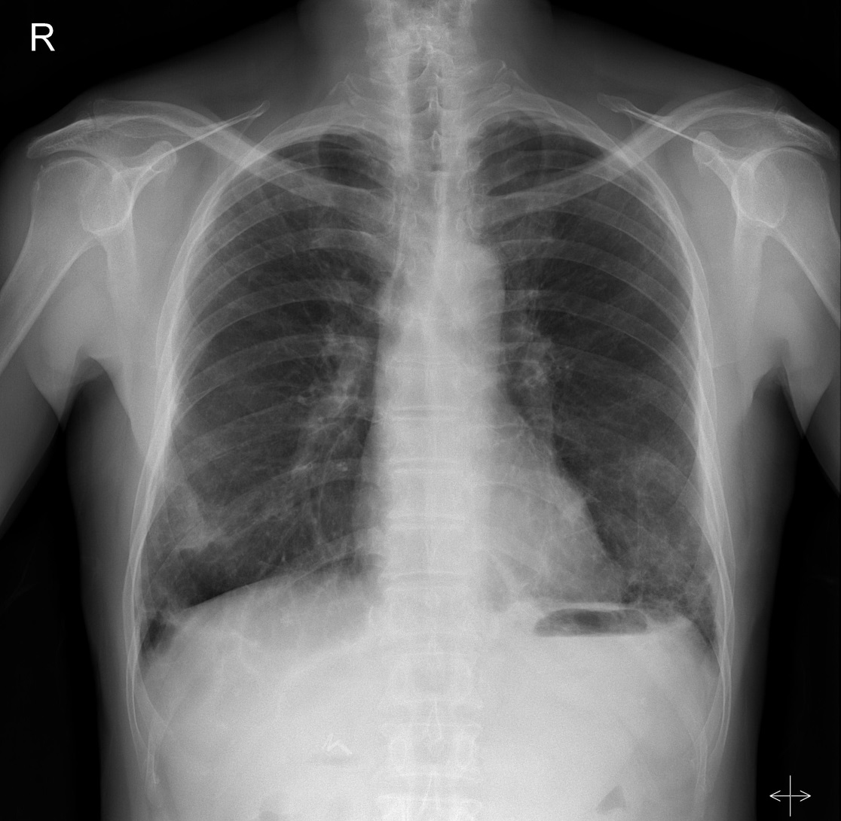
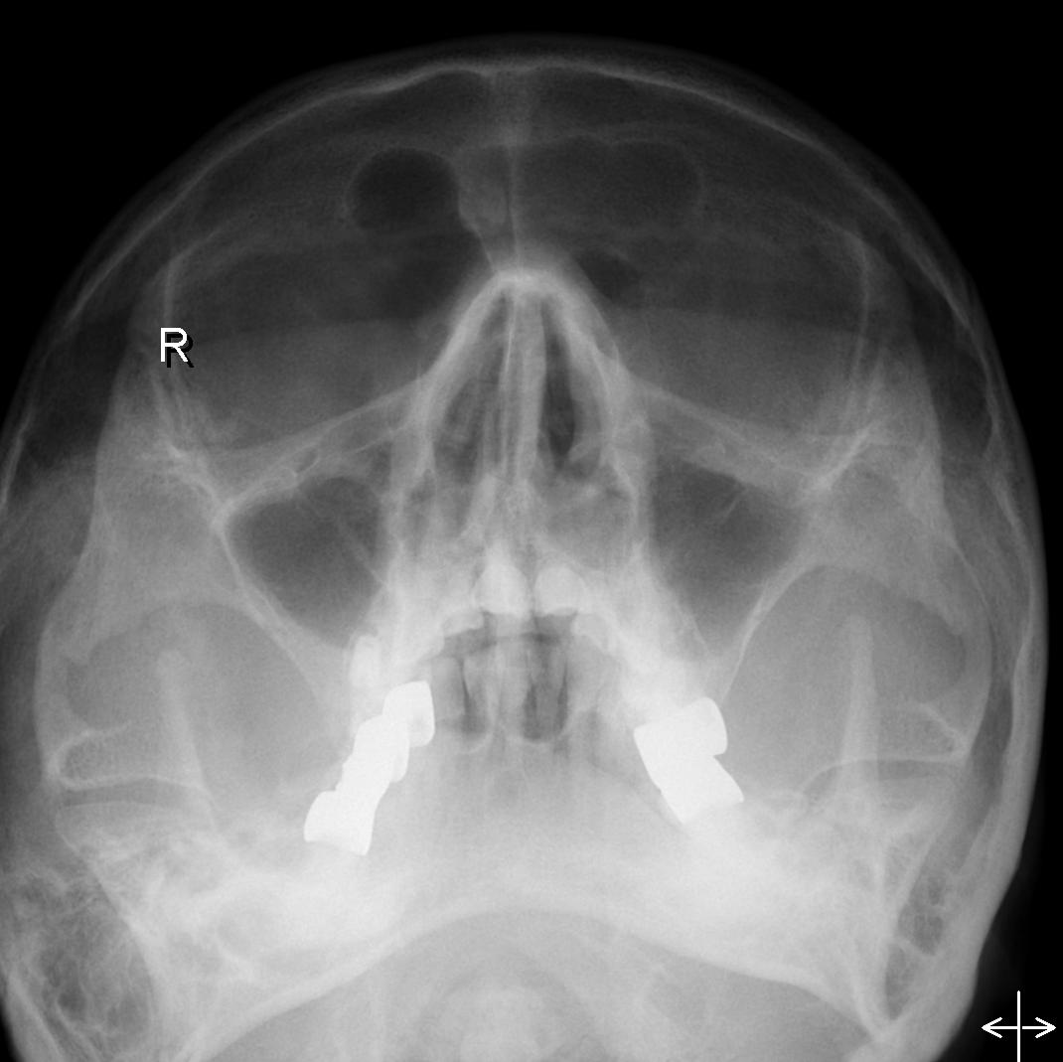
Initial x-ray (2018.1.2)
Notes:
Subpleural GGOs and reticulations in B lungs with BLL predominancy.
Patchy and perilobular consolidations in BLLs and small consolidations in lingula, RML.
: R/O undelrying Interstitial lung disease
DDx. combined pneumonia
Head/neck : Mild mucosal thickenings in the both maxillary antra.

Slide 8
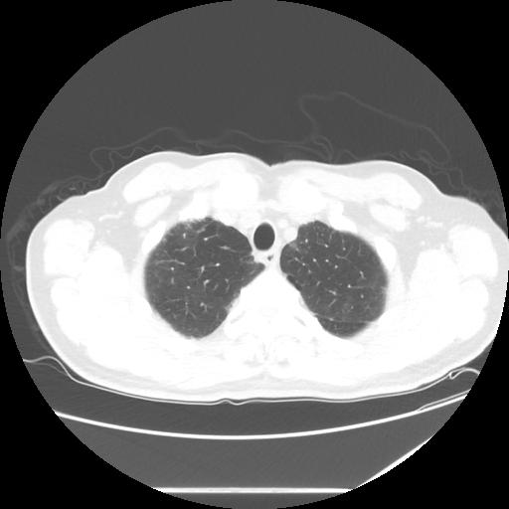
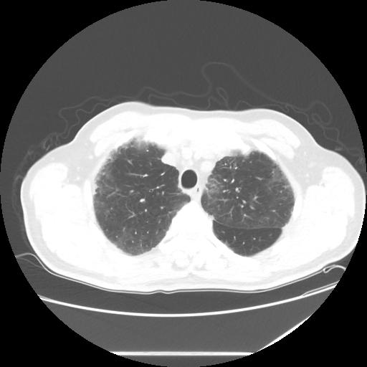
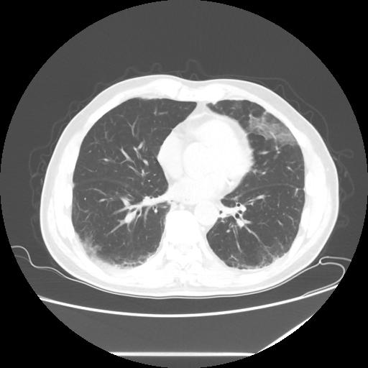
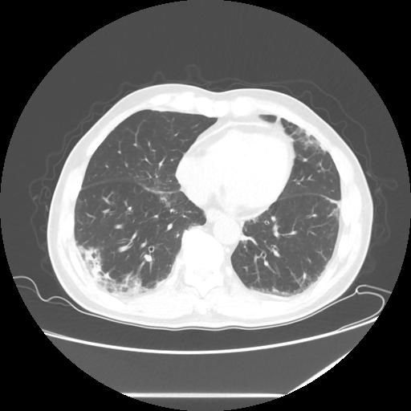
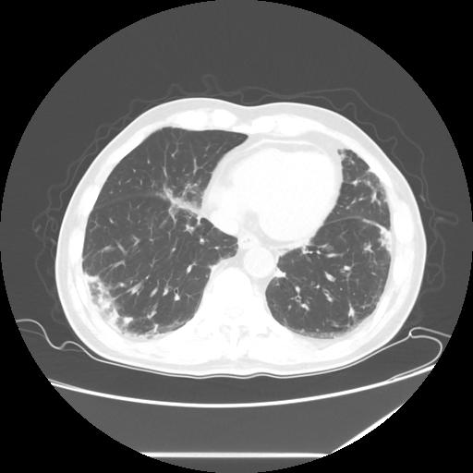
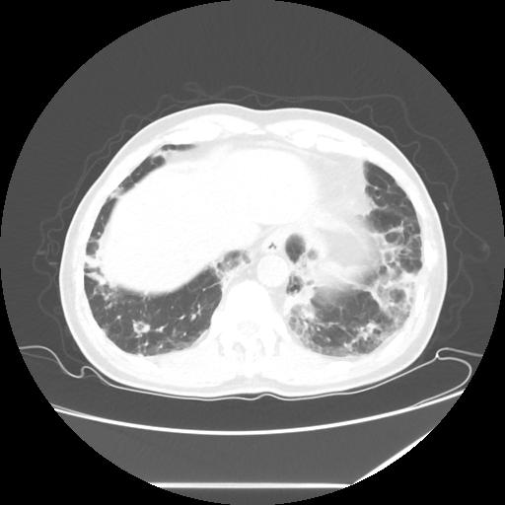
Initial chest CT (2018.1.3)
Notes:
1.Subpleural GGOs and reticulations in B lungs with BLL predominancy.
Combined with fibroatelectasis with minimal bronchiectasis
Patchy and perilobular consolidations in BLLs and small consolidations in lingula, RML.
: Interstitial lung disease such as OP or NSIP
DDx) CEP
2. Multiple enlarged lymph nodes at lowe paratracheal, subcarina, both hilar and interlobar region
; probabel reactive hyperplasia
3. Centrilobular and paraseptal emphysema in B lungs.
복부 )
Cholecystectomy sate
A few hepatic cysts and calcifications

Slide 9
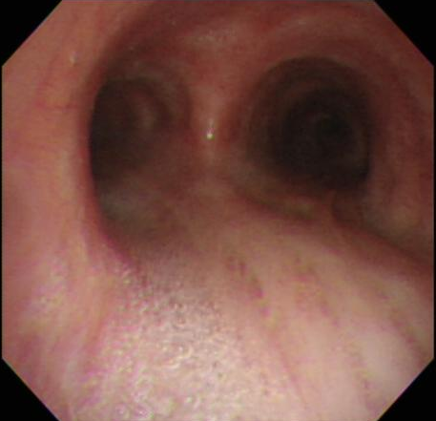
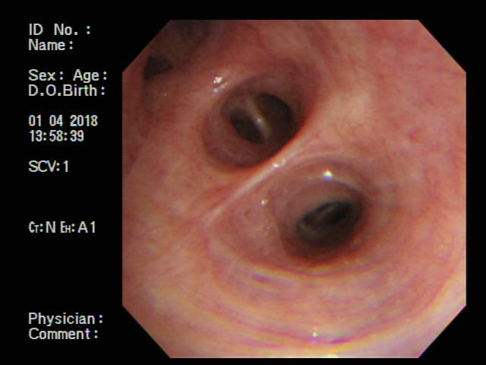
Bronchoscopy (2018.1.4)
There was no endobronchial lesion in both bronchi
BAL was done at LUL lingular bronchus (70ml/150ml drained)
- Colorless, WBC 260 (eosinophil 70%, lymphocyte 9%, mesothelial cell 12%), RBC 30
- Bronchial washing fluid : AFB neg, Tbc-PCR neg, bacterial cx no growth

Slide 10
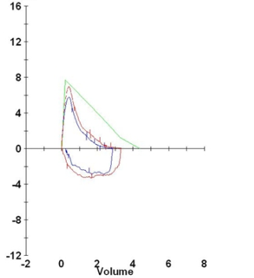
PFT (2018.1.5)
Ratio 65,
FEV1 1.91 L (59%) -> 2.17 L (67%), BDR 14%
FVC 2.88 L (66%) -> 3.33 L (76%)
TLC 4.91 L (84%), VC 2.96 L (74%), RV 1.95 L (86%)
(provocation test failed)

Slide 11
Impression
1. Chronic cough d/t
r/o Churg-strauss syndrome
with bronchial asthma
peripheral eosinophilia (> 10% of WBC count)
pulmonary infiltration
paranasal sinus abnormality
DDx. Chronic eosinophilic pneumonia
Organizing pneumonia
Bronchial asthma with UACS
2. Naïve DM

Slide 12
Treatment
Systemic steroid
Inhaler (ICS/LABA)
Antihistamine & LTRA

Slide 13
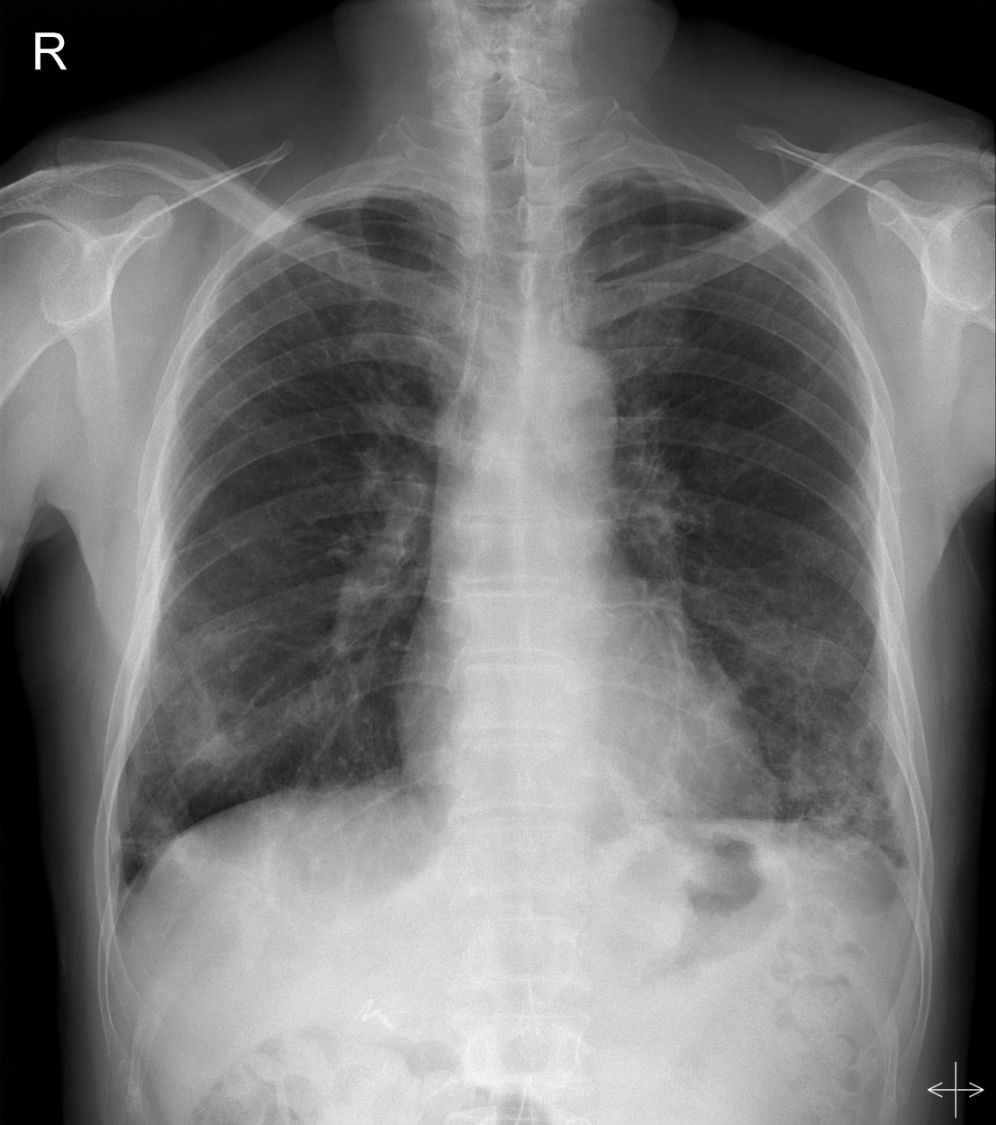
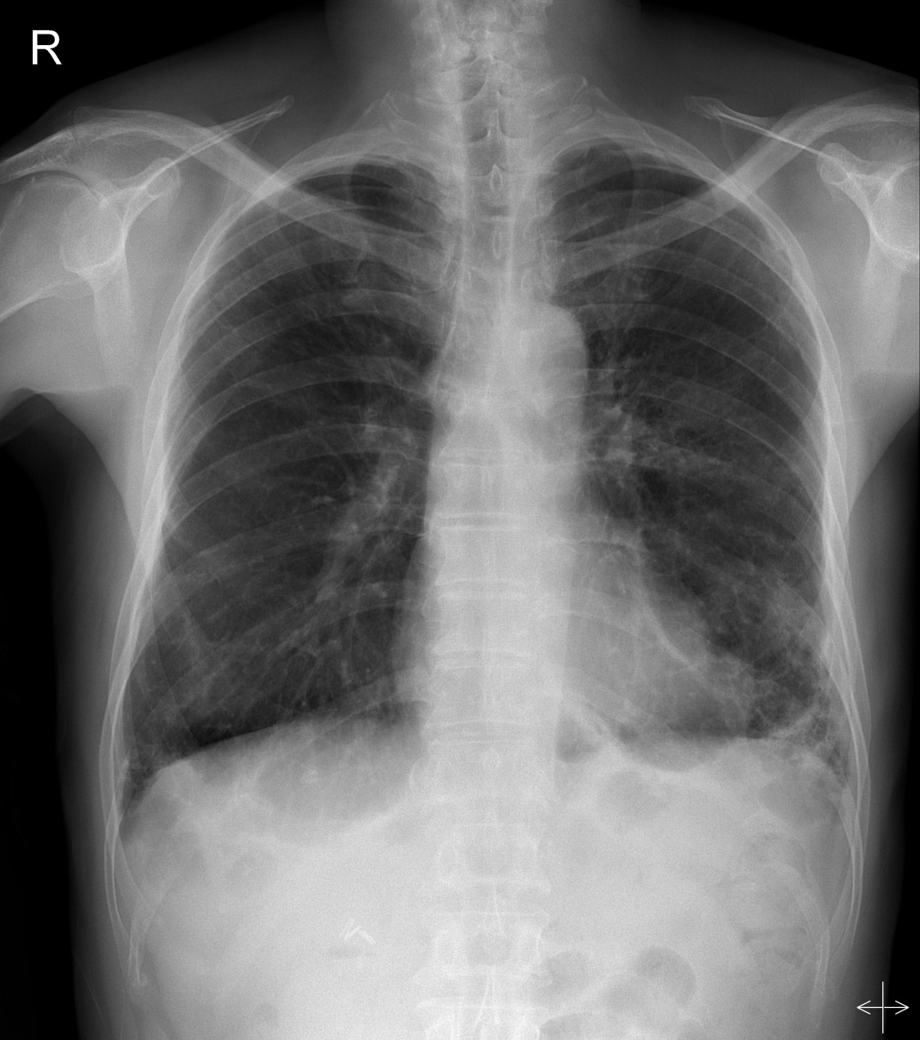
Prognosis
(2018.1.8)
(2018.1.29)

Slide 14
Review
Pulmonary manifestation of
Chrug-Strauss Syndrome

Slide 15
Churg strauss syndrome
Systemic vasculitis, extravascular granulomas and eosinophilia, occurs in patients with asthma or history of allergy.
3/100,000 adults per year
asthma, allergic rhinitis
(6 - up to 30 yrs)
marked peripheral eosinophilia and eosinophilic infiltrates, recur over several years
life-threatening vasculitis phase
Notes:
다 이 순서에 따르는건 아님….

Slide 16
Diagnosis
American college of Rheumatology, 1990
Asthma
Eosinophilia > 10% of differential white blood cell count
Mononeuropathy (including multiples) or polyneuropathy
Nonfixed pulmonary infiltrates on X-ray
Paranasal sinus abnormality
Extravascular eosinophilia revealed at biopsy
≥ 4/6 criteria : sensitivity 85%, specificity 99.7%

Slide 17
Pulmonary manifestation
27 to 93%
Eosinophilic infiltration of alveoli/interstitium -> necrotizing vasculitis in late phase
(1) Subpleural consolidation – vasculitis involving small to medium sized arteries
(2) Centrilobular perivascular densities – 89% of pts
(3) Multiple larger nodules, reversed halo sign – 44% of pts

Slide 18
(1) GGO along bronchovascular bundles or periphery
(2) Nodular lesions
(3) Reversed halo sign
(3)
(1)
(1)
(2)
(2)
Eur Radiol 2007, 17:3157-3165
Notes:
Reversed halo sign : central GGO with peripheral consolidation

Slide 19
(2)
(3)
(2)
Necrotizing granuloma
Eosinophils at peribronchiolar interstitium
Eur Radiol 2007, 17:3157-3165

Slide 20
Differential diagnosis
Chronic eosinophilic pneumonia
Cryptogenic organizing pneumonia
Fungal infection…

Slide 21
Extrathoracic manifestation
GI involvement – eosinophilic gastroenteritis, polyarteritis nodosa, mucosal or submucosal eosinophilic involvement
Skin rash – purpura, macular or popular erythematous rash, urticarial, subcutaneous nodules
Neuropathy – mononeuritis multiplex in 75%
Renal involvement – infrequent, focal segmental GN, generally benign nature
Notes:
Mononeuritis multiplex : asymmetrical, asynchronous sensory and motor peripheral neuropathy involving isolated damage at least 2 separate nerve areas.

Slide 22
Treatment
Assessment organ involvement
- Localized to upper and/or lower respiratory tract
- Generalized or renal involvement
- Severe / refractory
Prognostic factors : Five-factor score (FFS)
Scr > 1.58ml/dL / Proteinuria > 1g/24hr / Cardiomyopathy
GI tract involvement / CNS sign
≥ 1 → glucocorticoid + cyclophosphamide
0 → glucocorticoid alone
Medicine (Baltimore) 1996,75(11):17-28

Slide 23
Treatment
Glucocorticosteroid if localized, FFS = 0
- 1mg/kg, high dose for 1month
- > 15mg/day for 3months
- 10mg/day during maintenance
Combination of cyclophosphamide or MTX
- Generalized, FFS ≥ 1

Slide 24
Thank You for listening

