Slide 1
증 례 발 표
결핵 및 호흡기학회 5월 심포지엄
2019.5.27
인제의대 부산백병원 호흡기,알레르기내과
이 현 경
Notes:
0491256 이 양 O

Slide 2
증 례 (F/63) adm date : 2018.4
Chief complaint : cough, sputum
P.I : 2012년 tongue base lymphoma (DLBCL)로 진단 후 R-CHOP 6주기 치료 후 CR 상태였던 분으로 일주일전부터 발생한 기침,가래로 타병원에서 폐렴 치료 후 혈액종양내과 외래 방문함.

Slide 3
과거병력
Thymectomy d/t Myasthenia gravis (1992)
Autoimmune hemolytic anemia (2000)
NHL : DLBCL, tongue base, stage IE (2012)
- R-CHOP 6-cycle : CR state
- BM Bx (2014) : normo-cellular marrow
DM/HTN/Hepatitis/PTB : none
Smoking hx (-)

Slide 4
ROS & P.Ex
ROS : cough (+) sputum (+) DOE (+) dry mouth (+)
P/Ex
  V/S 130/90 mmHg, 88/min, 38.3°C, 24/min
  Both lower lung crackles

Slide 5
Lab. findings
ABGA (RA) : 7.53-30-62-25.1 (94%)
CBC : 5390-10.9-212K (N 53%, L 28%)
LFT : T.P 9.1 g/dL, alb 3.2 g/dL
CRP 7.38 mg/dL
Influenza B : positive

Slide 6
Radiologic findings
Chest CT

Slide 7
Problem lists
#1. cough, sputum, dyspnea
2. dry mouth for 6yrs
3. H/O lymphoma : CR for 6yrs
4. BLL crackle
5. A/G reverse, influenza B (+), CRP elevated
6. Multifocal patch consolidations, GGO, nodules

Slide 8
Therapeutic and diagnostic plans
#1. antibiotics
2. Osteltamivir
3. prednisolone : r/o OP
4. TBLB or VATS
5. FANA, autoABs
6. Salivary gland scan

Slide 9
Progress
FANA 1:640, anti-Ro/La (+/+)
Salivary scan
  severely decreased function of salivary gland

Slide 10
Impression
#1. influenza with combined pneumonia
2. r/o Sjogren syndrome with lung involvement
3. r/o lymphoma

Slide 11
Progress
Prednisolon 20mg 10일 사용 후 외래에서 호흡기증상 및 lung parenchymal consolidation 약간 호전보임. Prednisolone 중단하고 경과관찰하기로 함.

Slide 12
Radiologic findings : 2018.6
Chest CT

Slide 13
Progress
2018.6 prednisolone 중단 후 호흡기증상 및 both lung consolidation, GGO 악화보여 TBLB & BAL 시행을 위해 입원함.
BAL : Macrophage 40%, N 33%, L 27%

Slide 14
Pathology (fluoro-guided TBLB) 1st

Slide 15
Progress
MALToma of lung 으로 진단되어 혈액종양내과로 재의뢰됨.
CVP #6 시행 후 Chest CT FU 함 (2018.11)

Slide 16
Progress (2019.4)
Cough, sputum 이 일주일 전 부터 발생하여 호흡기내과 외래 방문함.
Lymphoma 재발감별이 필요하여 BFS, TBLB and BAL 시행함
BAL : M 16%, N 20%, L 60%
BW : MSSA cultured

Slide 17
Radiologic findings : 2019.4
Chest CT

Slide 18
Pathology (fluoro-guided TBLB) 2nd

Slide 19
Final diagnosis
Sjogren’s syndrome
Recurrent extranodal marginal zone lymphoma of MALT (of lung)
r/o combined LIP

Slide 20
Review
Pulmonary manifestations of Sjogren’s syndrome

Slide 21
What is Sjögren’s syndrome ?
Second most common multisystem autoimmune disease after RA
Characterised by eye and mouth dryness and lymphocytic infiltration of the salivary glands
Several (genetic, environmental, impaired immune response) factors : trigger an innate immune response leading to activation of glandular cells, followed by activation of B and T lymphocytes within the glands.
Systemic manifestations : vasculitis, lung, renal or neurological involvement

Slide 22
Pulmonary manifestations of SS

Slide 23
ILDs in Sjögren’s syndrome
Ramos-Casals M et al. Rheumatology 2015; 54: 2230–2238

Slide 24
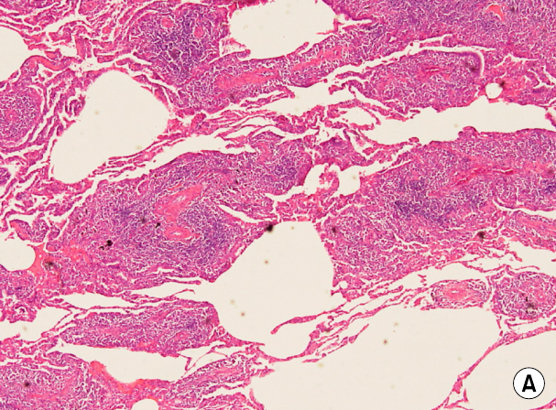
Lymphocytic Interstitial Pneumonia (LIP)
: Definition
Benign lympho-proliferative disease limited to the lung.
Diffuse proliferation of polyclonal lymphocytes and plasma cells in the pulmonary parenchymal interstitium, with lymphoid follicles and germinal centers
28~53% of LIP
ass with Sjogrens’s syndrome
Notes:
multiple thin-walled air cysts (white arrowheads) in both lungs, mild intralobular reticular attenuation (black arrowheads), and slight bilateral cystic changes in the subpleural area of the lower lobes.
A. H and E severe lymphoid cell infiltration with some plasma cells in the interstitium and alveolar walls

Slide 25
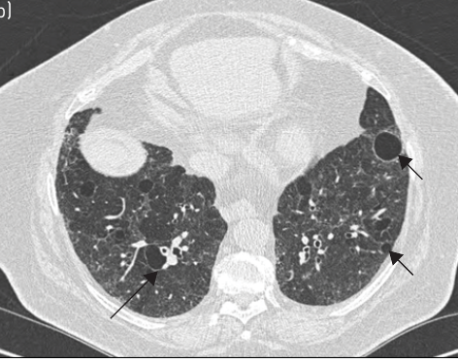
Radiologic Findings of LIP

Slide 26
Progress and Prognosis of LIP
seems to be a reversible lung disease with a potential risk of progression
The majority of patients treated with corticosteroids remain clinically stable or show improvement
can worsen with the development of honeycombing

Slide 27
MALT lymphoma in SS : Definition
A tumor characterized by a predominance of small B cells
Derive from bronchus-associated lymphoid tissue
It mainly grows in the marginal zone
At histopathologic analysis, infiltration of lymphoid cells and follicles and fibrosis of the adjacent interstitium are seen
Invasion of epithelia by atypical is characteristic of MALT lymphoma

Slide 28
MALT lymphoma in SS : Epidemiology
Non Hodgkin’s lymphoma develops in approximately 5% of SS patients
In the majority of patients, the histopathologic type of lymphoma is MALT lymphoma
The origin of NHL is extranodal in approximately 80-85% of SS patients; with the salivary gland being the most frequent site
MALT lymphoma in the lung is reported to evolve in 10-30% of the SS patients
5YR survival rate of pulmonary lymphoma : 65-90%
Watanabe et al. ntern Med 51: 491-495, 2012

Slide 29
MALT lymphoma
Notes:
(indicated by ground-glass attenuation), a finding that represents either infiltration by lymphoplasmacytes or fibrous change in the alveolar septa.
Interlobular septal thickening and intralobular reticular areas of attenuation (arrowheads) correspond to lymphocytic infiltration and mild fibrosis of inter- or intralobular septa.
reticular attenuation superimposed over ill-defined areas of groundglass attenuation (arrows), air space consolidation ( * ), and interlobular septal thickening (arrowheads) in the right lung.

Slide 30
Key point of LPDs
MALT lymphomas have the same or similar HRCT features as benign lymphoproliferative disorders (LPD)
Alternatively, such benign lesions may develop into a MALT lymphoma

Slide 31
CASE REPORT
Pulmonary Mucosa-associated Lymphoid Tissue (MALT) Lymphoma in Sjögren’s Syndrome Showing Only the LIP Pattern Radiologically
Watanabe et al. ntern Med 51: 491-495, 2012

Slide 32
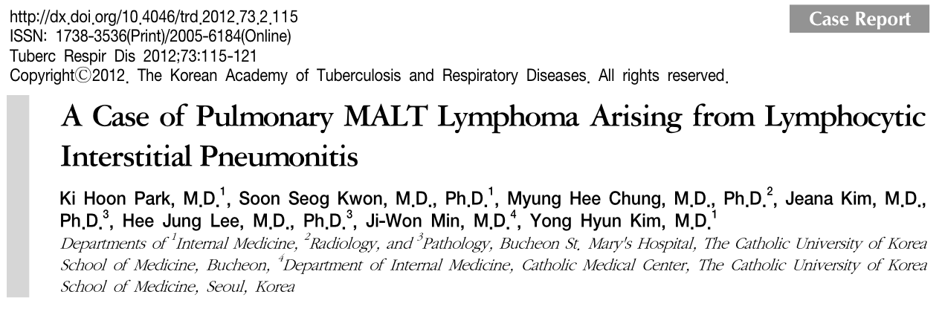
A case of a patient with LIP that developed into pulmonary MALT lymphoma, six years after diagnosis.

Slide 33


Thank you.

