Slide 1
Severe adenovirus infection
고려의대 호흡기내과
이 영 석

Slide 2
Case 1
22세/남자
주 소: 내원 7일 전부터 시작된 발열
생체 징후: 110/80mmHg-24회/분-90회/분-38.5°C

Slide 3
Case 1
현병력
  특이 병력 없는 환자, 군 복무 중임
  내원 7일전 발열, 기침, 인후통 시작
  내원 3일전 복통과 설사 시작 – Ciprofloxacin IV
  간헐적인 발열 지속
  내원 당일 호흡곤란 및 저산소증 발생하여 내원
  최근 동일 부대에 비슷한 증상 환자들이 발생하여 치료 중임

Slide 4
Case 1
과거력: 특이 병력 없음
흡연력: 2 pack-year
계통 문진
  Fever/chill (+/+)
  Headache/Dizziness (+/+)
  Cough/Sputum /Rhinorrhea (+/+/-)
  Chest pain/Dyspnea (-/+)
  Abdominal pain/Tenderness (+/-)
  Nausea/Vomiting/Diarrhea/Constipation (-/-/+/-)
  Urinary frequency/urgency/dysuria (-/-/-)

Slide 5
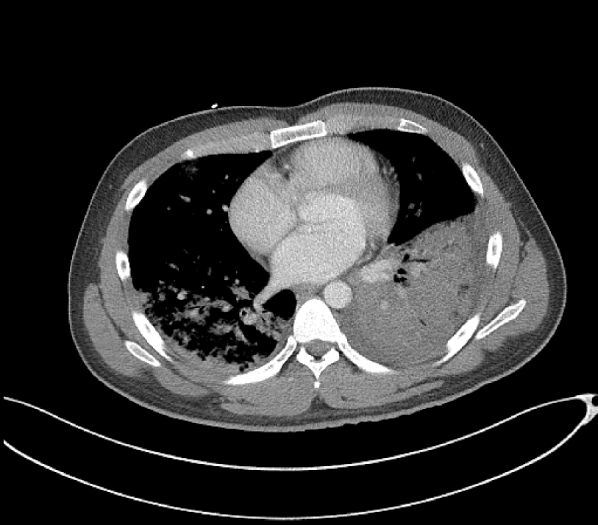
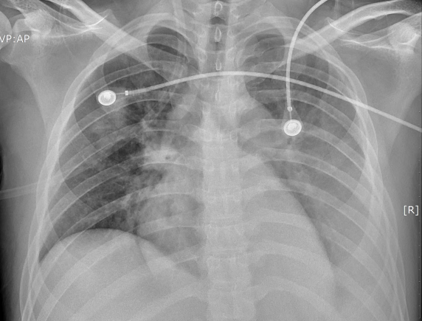
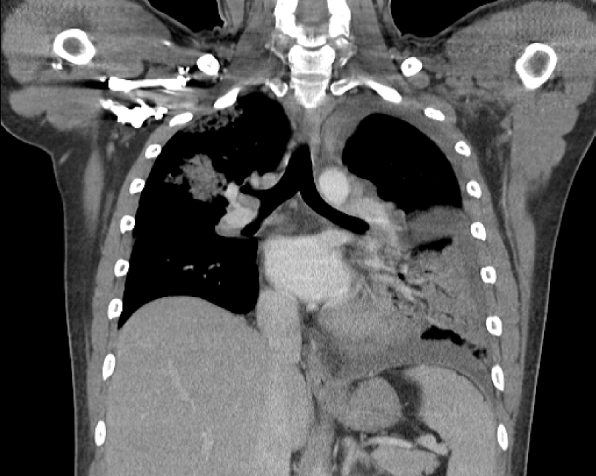
Case 1

Slide 6
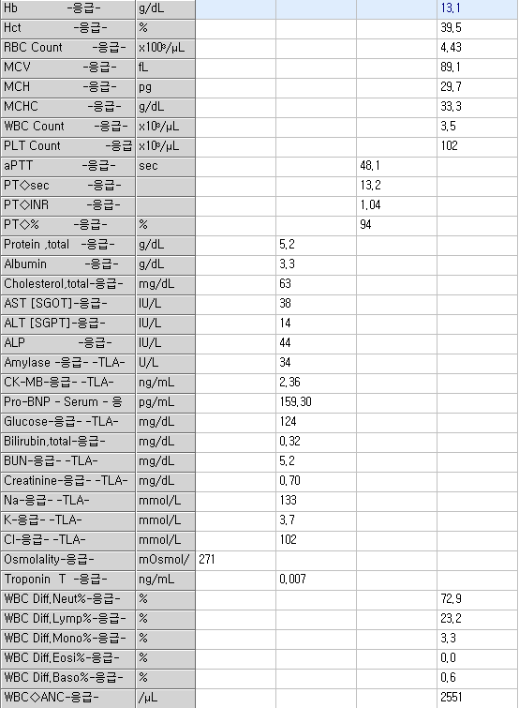
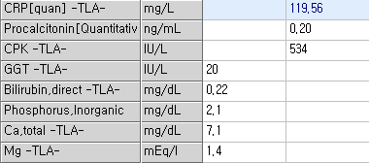
Laboratory finding

Slide 7
Case 1
진 단: Atypical pneumonia
계 획
  Bronchoscopy c BAL
  Antibiotics (ceftriaxone+levofloxacin)
  Intubation & Ventilator care

Slide 8
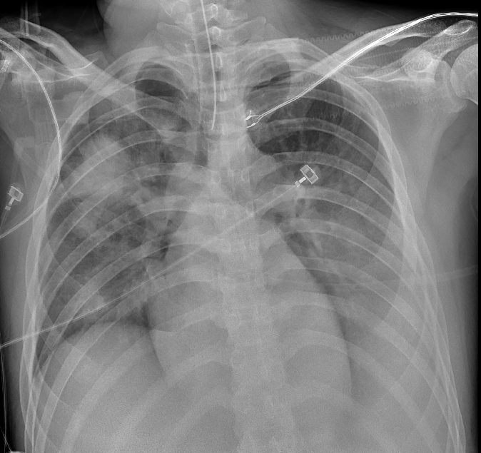
HD #4
Intubation

Slide 9
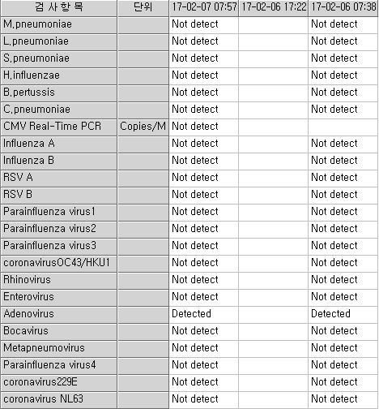
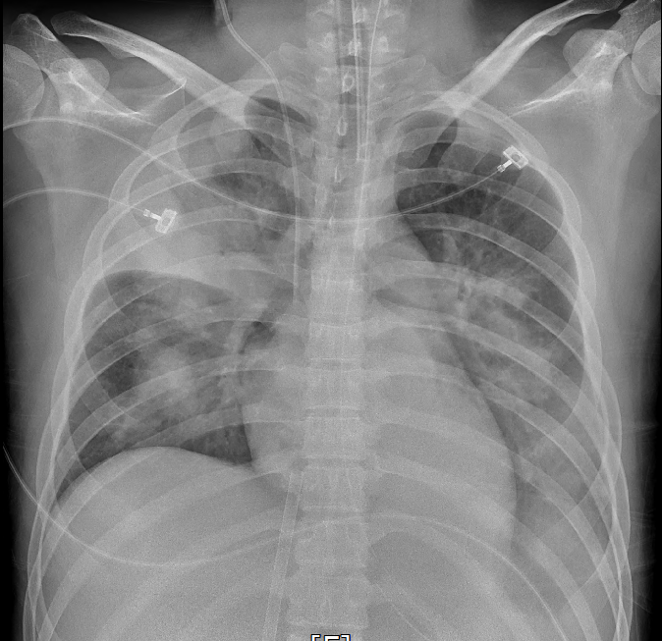
HD #5
ECMO & Cidofovir

Slide 10
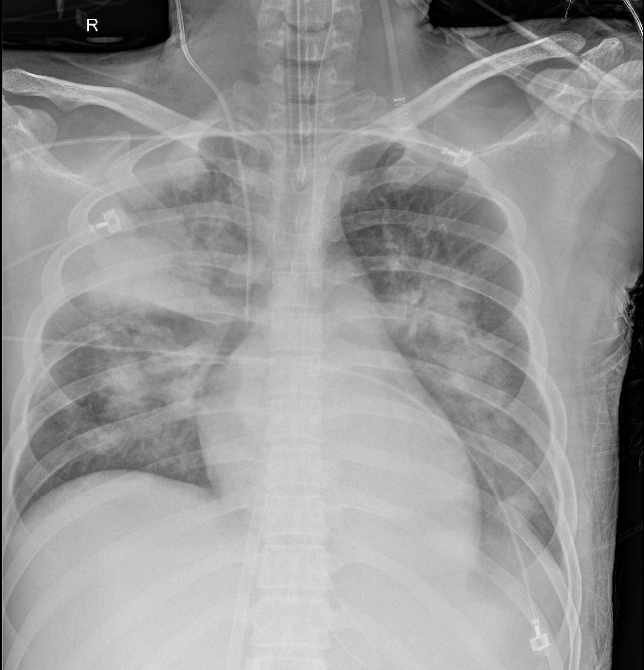
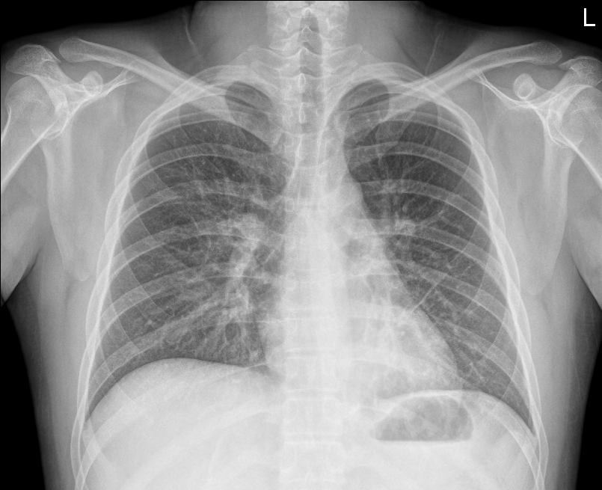
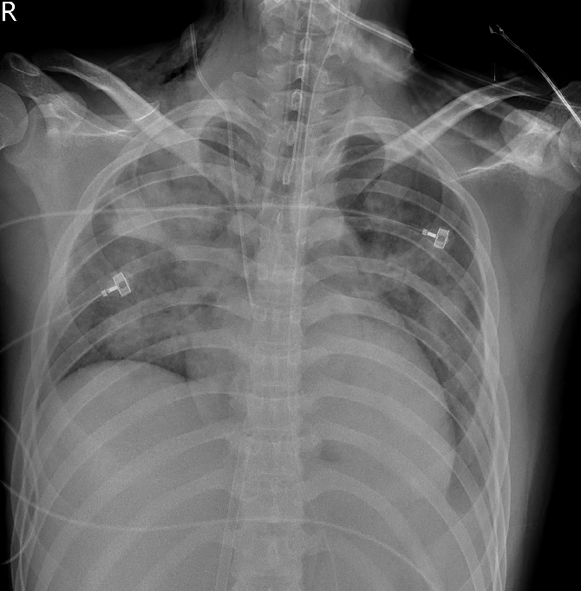
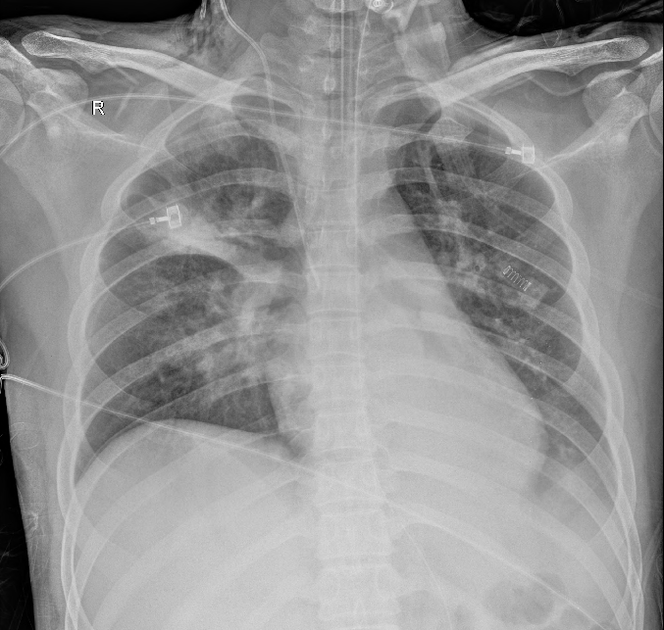
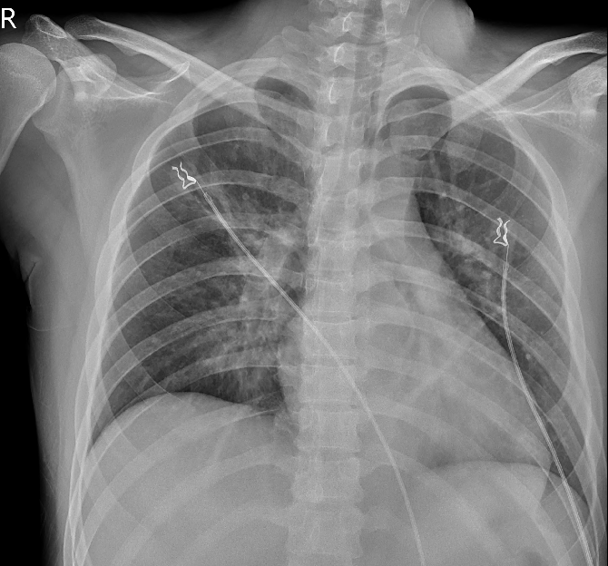
Improvement

Slide 11
Summary
HD | Procedure | Antiviral agent
#1 | High flow nasal cannula
#4 | Intubation
#5 | ECMO | Cidofovir
#10 | ECMO weaning
#11 | Extubation
#12 | General ward | Cidofovir
#31 | Discharge
Cidofovir: 5mg/kg, 1-2 주 간격으로
Probenecid: 투여 3시간 전 2g, 투여 후 2시간 1g, 투여 후 8시간 1g

Slide 12
Case 2
58세/여자
주 소: 내원 7일 전부터 시작된 호흡곤란
생체 징후: 140/90mmHg-30회/분-75회/분-37.6°C

Slide 13
Case 2
현병력
  고혈압 외 특이 병력 없음
  내원 7일전 발열, 기침, 인후통, 호흡곤란 시작
  타원 입원 후 폐렴으로 항생제 치료 시작 (tazocin+cravit)
  내원 3일전 복통과 설사 시작
  내원 당일 호흡곤란 악화 및 chest x-ray 악화로 전원

Slide 14
Case 2
과거력
  고혈압
  13년전 Breast cancer OP.
흡연력/음주력: 없음
계통 문진
  Fever/chill (+/+)
  Headache/Dizziness (+/-)
  Cough/Sputum /Rhinorrhea (+/+/-)
  Chest pain/Dyspnea (-/+)
  Abdominal pain/Tenderness (+/-)
  Nausea/Vomiting/Diarrhea/Constipation (-/-/+/-)
  Urinary frequency/urgency/dysuria (-/-/-)

Slide 15
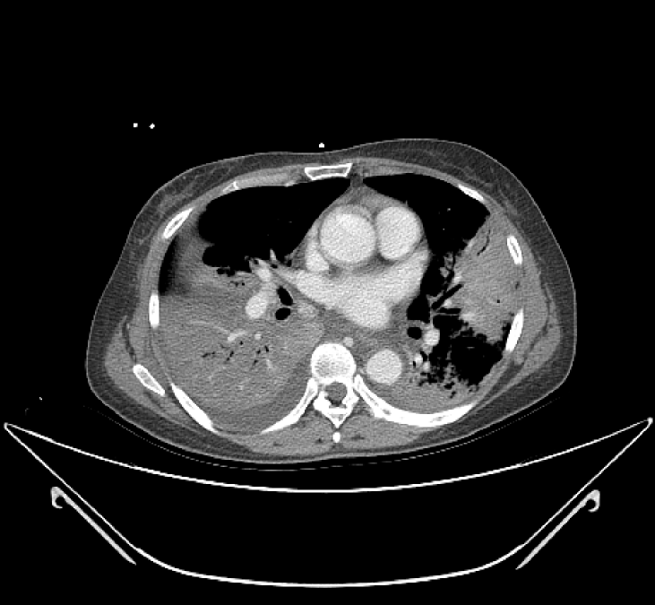
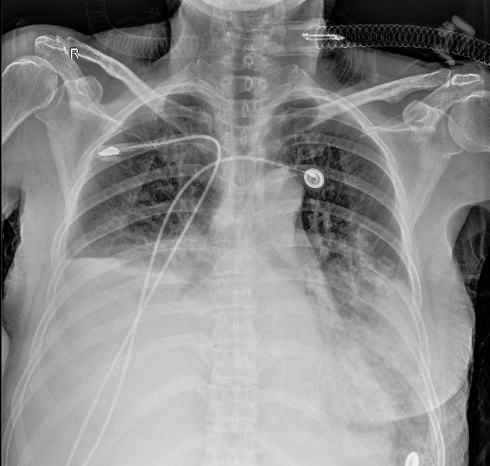
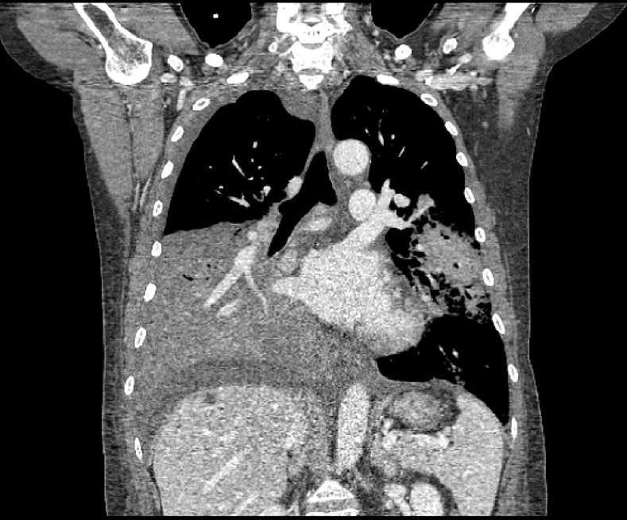
Case 2

Slide 16
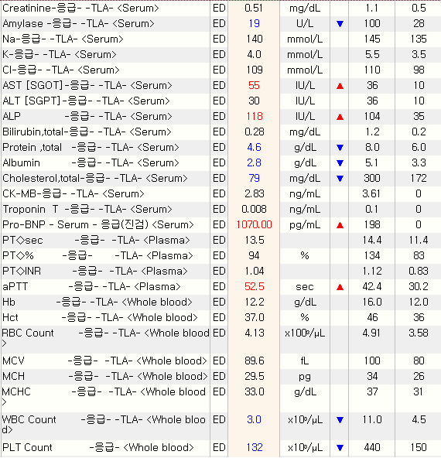
Case 2

Slide 17
Case 2
진 단: Atypical pneumonia
계 획
  Bronchoscopy c BAL
  Antibiotics (Meropenem+Levofloxacin)
  Intubation & Ventilator care

Slide 18
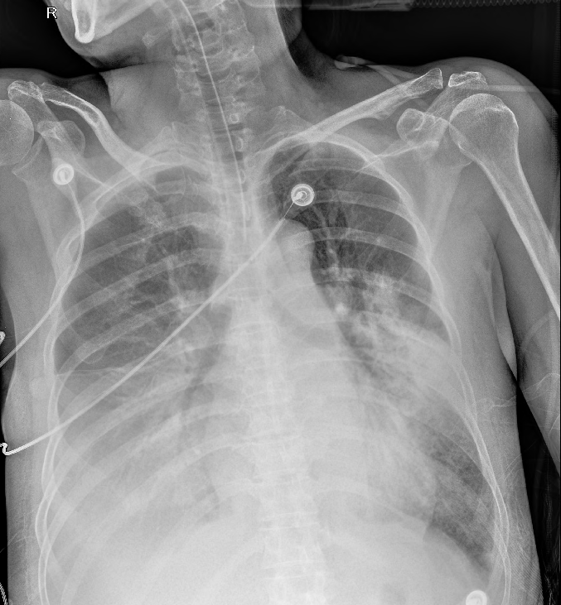
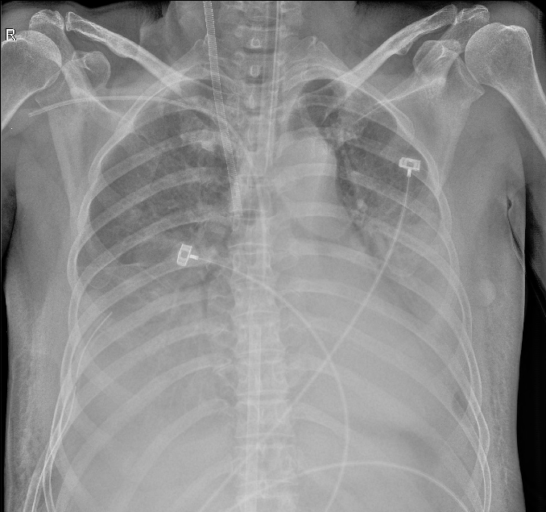
HD #1
Intubation & ECMO

Slide 19
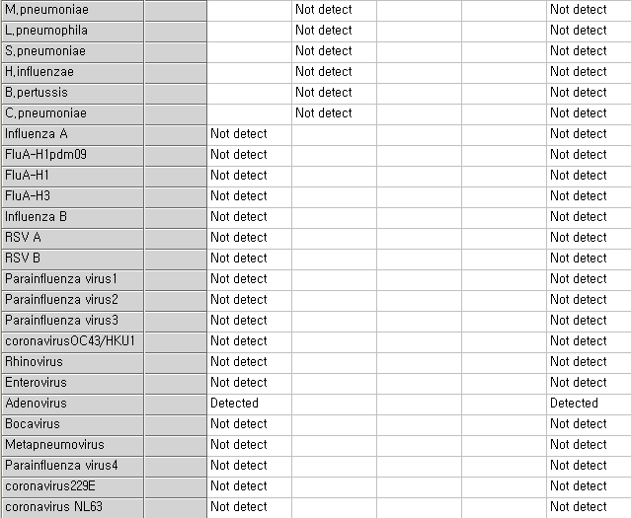
HD #2

Slide 20
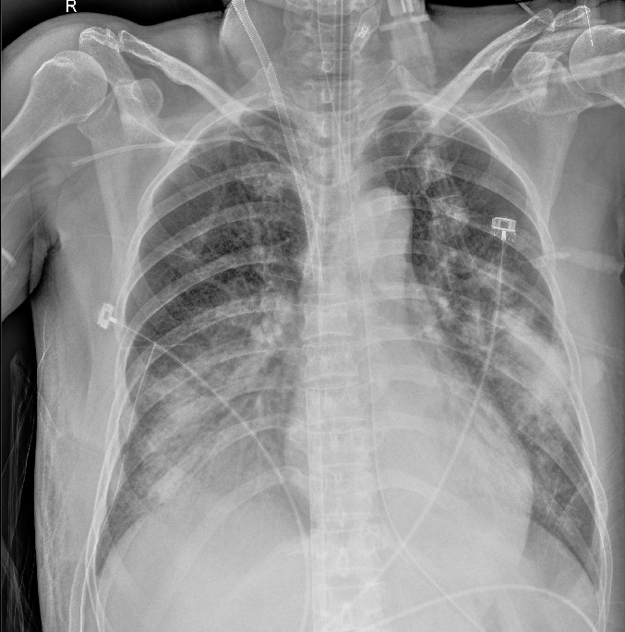
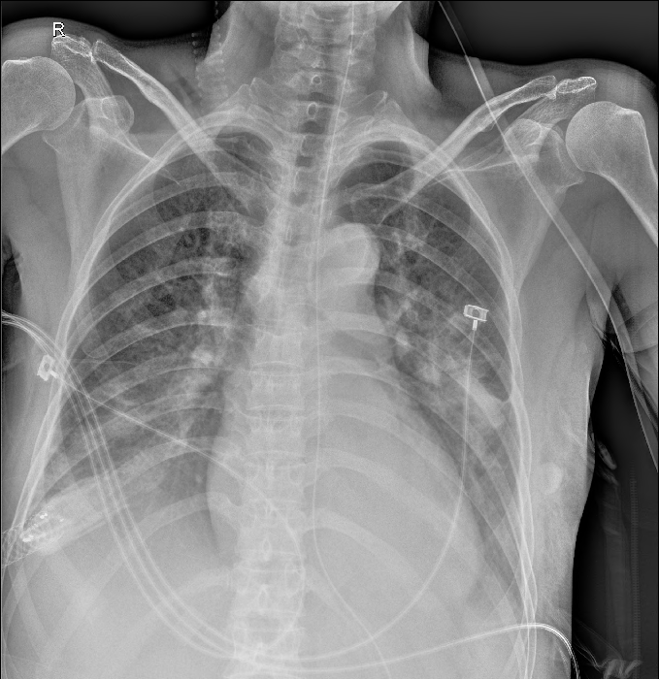
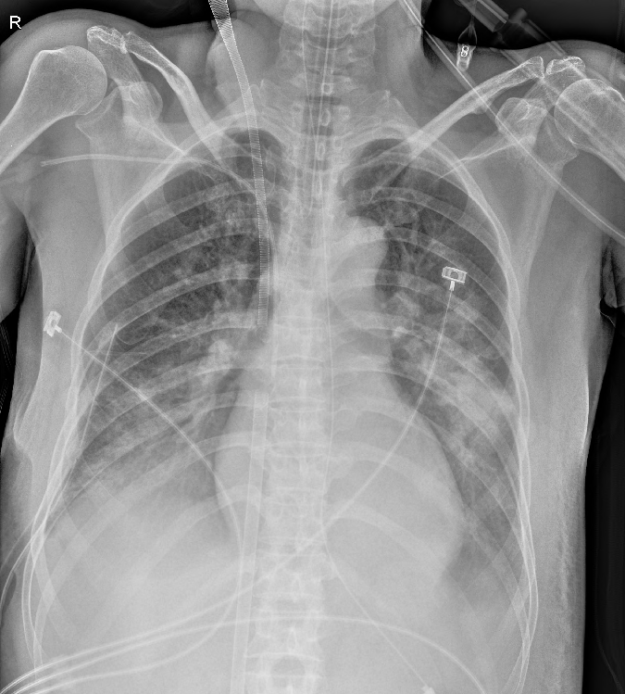
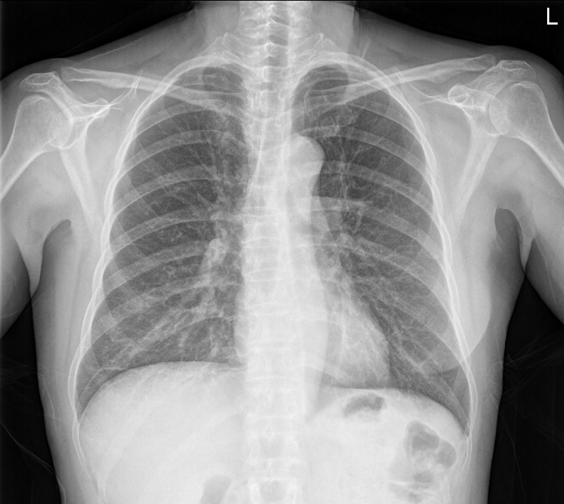
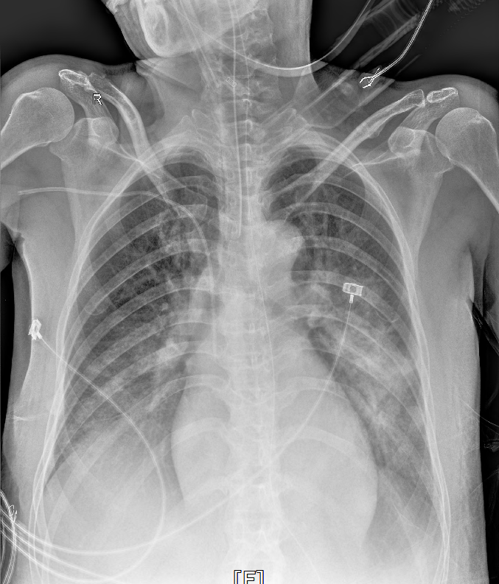
Improvement

Slide 21
Summary
HD | Procedure
#1 | Intubation
#2 | ECMO
#6 | ECMO weaning
#7 | Extubation
#11 | General ward
#19 | Discharge

Slide 22
Adenovirus Infection

Slide 23
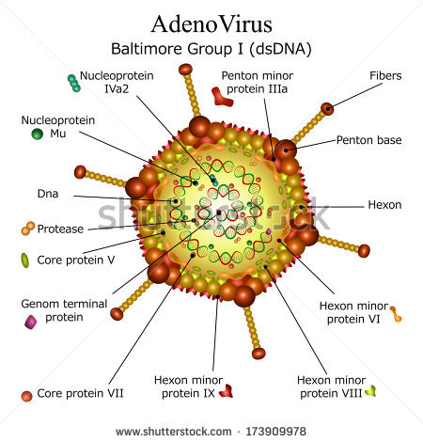
Adenovirus
DNA virus
51 serotypes
70 genotypes

Slide 24
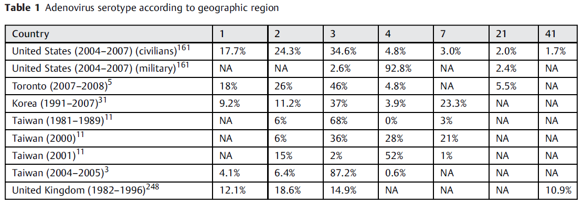
Serotypes
Semin Respir Crit Care Med 2016;37:586-602

Slide 25
Epidemiology
Diseases
  Febrile respiratory illness
  Keratoconjunctivitis
  Gastroenteritis
Infection focus
  Inhalation of aerosolized droplets
  Conjunctival inoculation
  Fecal oral spread
  Exogenous sources (pillows), Reactivation
Incubation period: 2-14 days

Slide 26
Epidermiology
Closed populations
  Hospitals, Neonatal nurseries, Psychiatric, Long term care
  Job training centers
  Children’s home, Orphangae
  Public swimming pools
  Military
95% ethanol solution

Slide 27
Respiratory Infection
1-7% of adult respiratory tract infections
Symptoms: Fever, Pharyngitis, Tonsilitis, Cough , Sore throat
Immunocompetent: Self-limited (within 2 weeks)
Fatal infections – rare
Sequale: Bronchiectasis, Bronchiolitis obliterans

Slide 28
Diagnosis
Affected sites
  Nasopharyngeal aspirates, swab
  Bronchoalveolar lavage, washings
  Urine, Stool, Blood
Gold standard: Viral cultures (insensitive, long duration)
Most frequently: PCR of AdV DNA

Slide 29
Therapy
No antiviral drug has been approved to treat AdV
Cidofovir
  Preferred therapeutic agent
  Only intravenously
  Standard doses: 5mg/kg every 1-2 weeks
  Duration of therapy: weeks to months (clinical response)
  Adverse effects: nephrotoxicity, Myelosuppression, Uveitis
  Minimize nephrotoxicity: Hydration+Probenecid

Slide 30
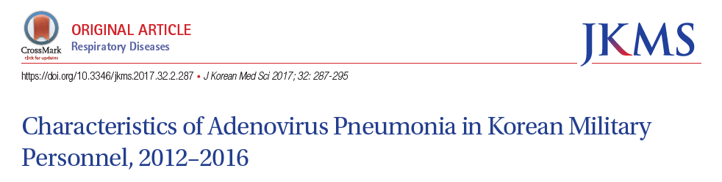
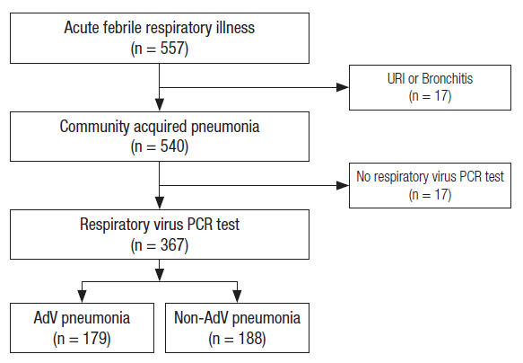
In Korea

Slide 31
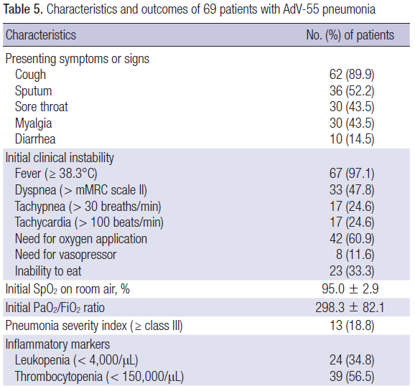
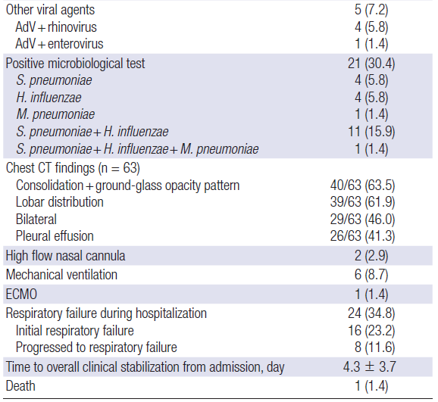
In Korea

Slide 32
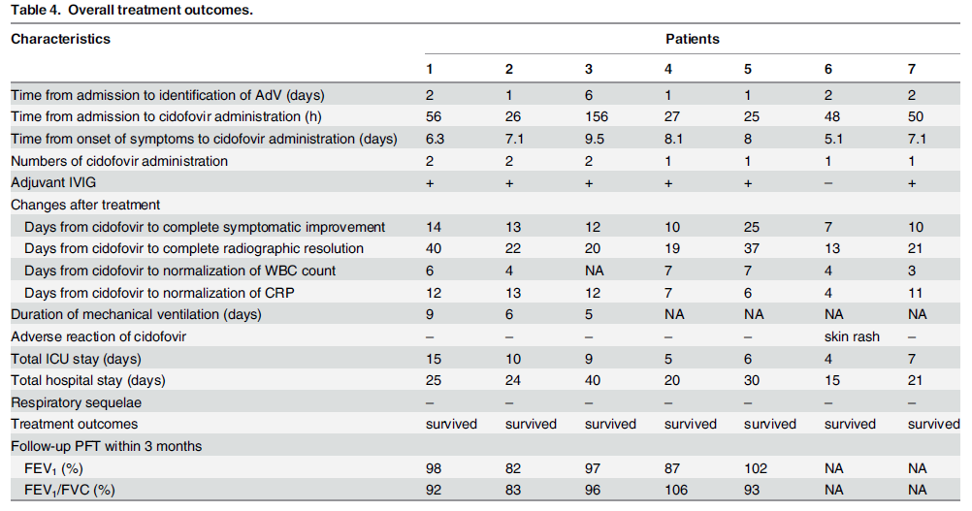
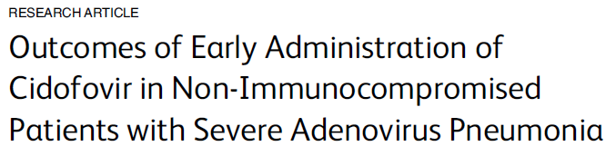
In Korea
PLoS One 2015;10:e0122642

Slide 33
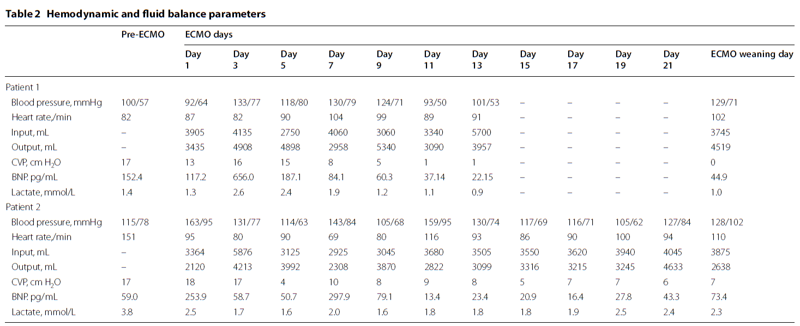
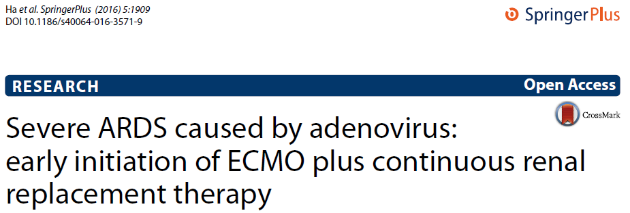
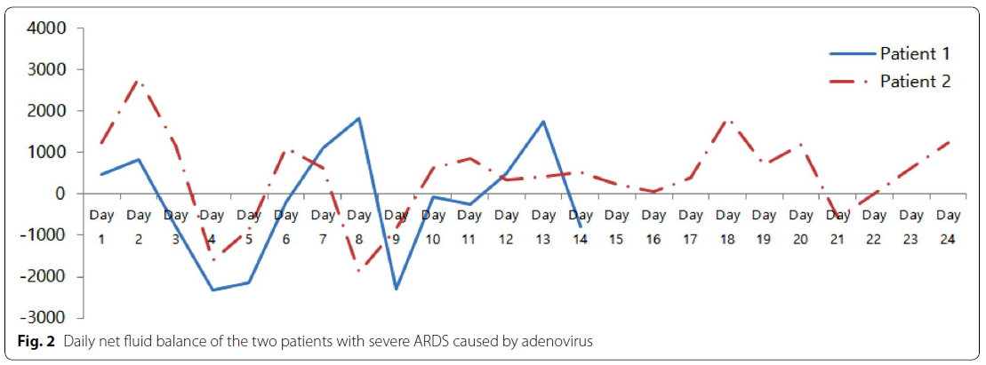
Severe ARDS

Slide 34


