Slide 1


기관절개술 후 Decannulation 및
발성 Training 증례
제 265회 KATRD 심포지엄
- 호흡재활연구회 증례
삼성서울병원
호흡기내과 임상강사
길현일
2019.03.18

Slide 2
F/56
2018.01.27 ER visit
Chief complaint
  Abdominal discomfort, poor oral intake, oliguria
  Onset: 5 days ago
Past history
  ESRD due to chronic GN
  s/p Kidney transplantation (1990) due to chronic GN → graft loss
  s/p Kidney transplantation (2017.08)
  On immunosuppressive agents

Slide 3
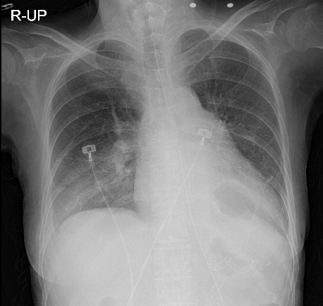
Initial V/S : 113/69 – 77 – 18 – 37.5 – 95%(room air)
CBC : 3980 (61.7%)-9.0-200K
Na/K 135/3.9
BUN/Cr 12.2/0.71
T.bil/AST/ALT 0.4/36/37
CRP 10.51
U/A: LE (-), nitrite (-), pyuria (-), GNB at 6000 CFU/ml
Chest X-ray: Rt.pleural effusion
Empirical antibiotics treatment for UTI

Slide 4
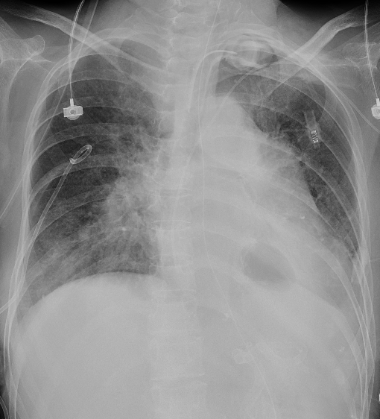
POD #15 Progressive confused mentality & Respiratory distress
Dx: HAP with parapneumonic effusion
→ ICU transfer & Intubation
POD #17 Weaning screening passed, but
Frequent suction requirement and poor expectoration
→ Percutaneous Dilated Tracheostomy
PDT, ID 7.0mm, Suction aid type

Slide 5
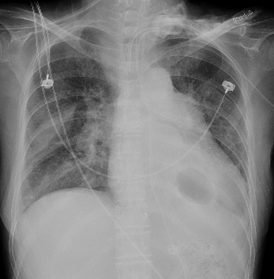
On ICU care with antibiotics therapy for HAP
Tracheostomy day #7, ID 7.0mm
  Improving, FiO2 0.28, O2 5L/min via T-piece inhalation
  Sputum : Loose and whitish, but frequent suctioning (3-4/hr)
  Coughing power : Moderate
  [Consultation for Decannulation]
  기관절개술 시행 7일 이상 : OK
  의식이 명료 : OK
  혈역학학적으로 안정 : OK
  구강 분비불을 뱉을 수 있으며, 상기도 개방성이 유지 : NO
  기관절개관 cuff deflation 시 호흡곤란, 흡인 등의 증상
  : 발성가능하나 가래 뱉지 못하고 T-cannular통해 다량 배출됨.

Slide 6
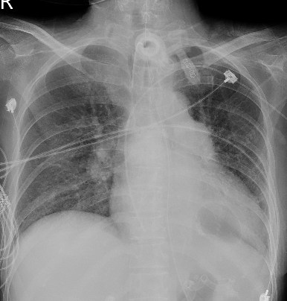
Tracheostomy day #7~ #21: Tx for K.pneumonia and S.maltophilia pneumonia
Tracheostomy day #25 [Consultation for Decannulation]
  기관절개술 시행 7일 이상인 환자 : Yes
  의식이 명료한 환자 : Yes
  혈역학학적으로 안정적인 환자 : Yes
  구강 분비불을 뱉을 수 있으며, 상기도 개방성이 유지 : Yes
  기관절개관 cuff deflation 시 호흡곤란, 흡인 등의 증상이 없음 : Yes
  Ventilator settings : FiO2 ≤ 40%, PEEP ≤ 5 : Yes
  → PM (Passy-Muir) valve apply (1-2 hours/day)

Slide 7
PMV day #1 ~ #10 : PMV 적용 시간 서서히 증량
Tracheostomy day #35, PM valve day #10 : Passy-Muir valve with Room air inhalation overnight state
[Decannulation checklist]
  Alert mentality : Yes
  Tracheostomy 시행 7일 이후 : Yes
  인공호흡기 이탈 5일 후 : Yes
  Suction 간격 4시간 이상인가? Yes
  산소요구도 FiO2 0.4 이하 : Yes
  Oropharynx로 secretion을 올릴 정도의 강한 기침이 있는가? Yes
  Cuff deflation 후 손가락으로 막고 air trapping 없이 1분 동안 편안하게 호흡할 수 있는가? Yes
T-stomy ID 6.0으로 변경.
Tracheostomy capping with Room air inhalation 시 SpO2 100% 측정.

Slide 8
Tracheostomy day #36, ID 6.0mm, PM valve day #11
[ Decannulation day ]
  T-stomy ID 6.0 Remove 시행
  기침시 공기가 누출되지 않고 stoma 보이지 않게 steri-strip 적용
  거즈를 ball 모양으로 만들어 steri-strip 위에 누르듯이 놓음
  Skinpore 를 이용해 단단히 고정
  환자에게 말하거나 기침할 때 stoma를 누르도록 교육함
After decannulation
  Saturation (100)% with Room air inhalation
  Phonation & self expectoration good

Slide 9
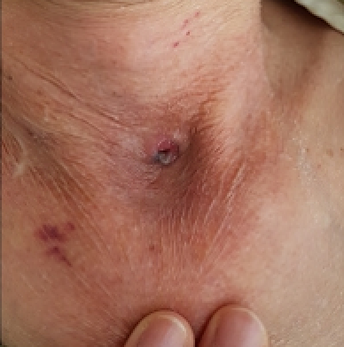
Tracheostomy day #37, Decannulation day #1
  General ward 전동
    Coughing power : Strong
    Breathing sound : Vesicular
    Room air SpO2 100%
    Stoma size 0.5cm 미만
Tracheostomy day #38, Decannulation day #2
  Sputum : 양상 – Whitish / 점도 - Loose
  Breathing sound : Vesicular
  Self expectoration : Yes
  room air SpO2 100%

Slide 10
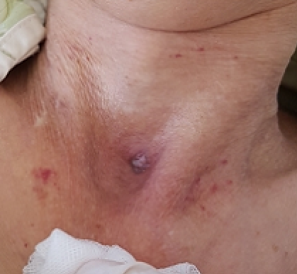
3/26 (Tracheostomy day #42, Decannulation day #6)
  Sputum: "가래 거의없어요." 라고 환자가 표현함.
  Stoma closure(+)
  Air-leak(-)
  Skin defect(+)
  Dressing and FU 종료

Slide 11
Decannulation and Speech training for tracheostomy patient

Slide 12
Tracheostomy
  Inability to communicate
  → disengagement, depression, and non-adherence to treatment
  Feeling of frustration, fear, anxiety, and powerlessness related to the loss of voice
Early decannulation !!

Slide 13
일반병동 전실후 기관절개술후 환자 라운딩
RCP 구성: ICU 전담 1명, Genearl ward 전담 1-2명
ICU 담당 RCP
  ICU rehabillitation 참여
  Daily MV setting, frequency of suction, secretion 등 monitoring
  SBT, weaning process
GW 담당 RCP
  Regular follow-up on GW-transfer day 1 & 2 → After day 2, follow-up every 7 days till day 30
  Tracheostomy site evaluation/management
  Home ventilator setting

Slide 14
Figure 1. Clinical course of patients with post-tracheostomy care
Overall (N=118)
(Post tracheostomy care in General ward
between 2016.3.01 and 2017.12.31)
Percutaneous Tracheostomy (N=90)
Surgical Tracheostomy (N=16)
Prior Tracheostomy (N=12)
Mechanical ventilator (N=114)
(N=102)
Home ventilator (N=16)
Large volume nebulizer (N=116)
HME* (N=77)
Met criteria for weaning
Attempt SBT*
Met criteria for decannulation
Assess decannulation by ICU CNS (N=41)
Fail (N=2)
Pass (N=14)
Fail (N=14)
Pass (N=27)
Attempt decannulation by ENT (N=14)
Double T-tube
with capping for 24 hours ~ 7 days
Attempt decannulation by ICU CNS (N=27)
T-tube ID 6mm, cuff deflation
with capping for 24 hours
(N=25)
Fail (N=1)
Pass (N=13)
Fail (N=2)
Pass (N=26)
Decannulation (N=13)
Exam, ENT (N=1)
Decannulation (N=26)
SBT* : Spontaneous breathing trial HME* : Heat and moisture exchanger CNS: Clinical nurse specialist

Slide 15
Table 1. Patient characteristics and clinical outcomes
Characteristics
Age, mean±SD y |  | n=118 |  | 65±12.4
Sex, n (%) |  |  | Male | 92 (78.0)
 |  |  | Female | 26 (22.0)
Percutaneous Tracheostomy, n (%) |  |  |  | 90 (76.3)
Surgical Tracheostomy, n (%) |  |  |  | 16 (13.5)
Prior Tracheostomy, n (%) |  |  |  | 12 (10.1)
Initial SOFA score, median (IQR) |  |  |  | 8 (5-11)
24hr SOFA score, median (IQR) |  | n=117 |  | 8 (5-10)
48hr SOFA score, median (IQR) |  | n=111 |  | 7 (4-11)
SAPS 3 score, median, (IQR) |  |  |  | 58 (46-67)
SAPS 3 score (prediction of mortalty, %), median (IQR) |  |  |  | 30.5 (12-50)
APACHE II score, median (IQR) |  |  |  | 25 (21-32)
Hospital, LOS, median (IQR) day |  |  |  | 48 (34-84)
ICU, LOS, median (IQR) day |  |  |  | 13 (7-22)
Duration of ventilator, median (IQR) day |  | n=114 |  | 11 (5-18)
Duration of ETT, median (IQR) day |  | n=106 |  | 5 (3-8)
Duration of TT (by RCP), median (IQR) day |  | n=26 |  | 27 (17-44)
Duration of TT (by ENT), median (IQR) day |  | n=14 |  | 56 (35-90)
ETT = Endotracheal tube to Tracheostomy tube TT = Tracheostomy tube to decannulation

Slide 16
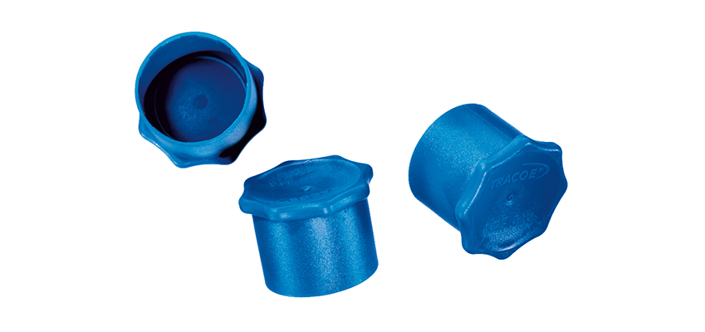
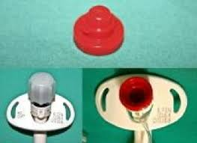

Slide 17
1 minute occlusion test

Slide 18
Return of Voice (Speaking)
Early communication and early speaking intervention
  Improved quality of life
  Improved engagement → Reduced delirium
Quality of life improves for tracheostomy patients with return of voice: A mixed methods evaluation of the patient experience across the care continuum
  17 patients completed the study
  Significant positive change occurred in 6 items of the self esteem related to communication from baseline to return of voice
  Positive changes in overall QoL were observed
A.L. Freeman-Sanderson et al./Intensive & Critical Care Nursing 46 (2018) 10–16

Slide 19
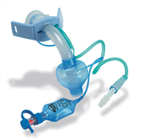
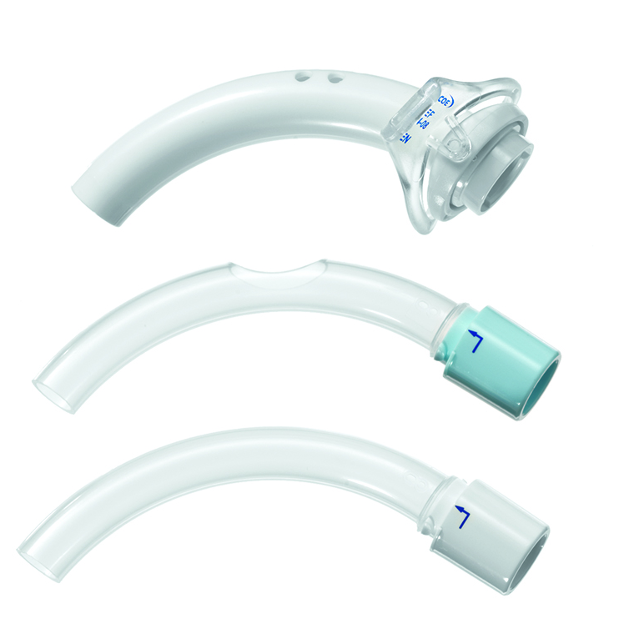
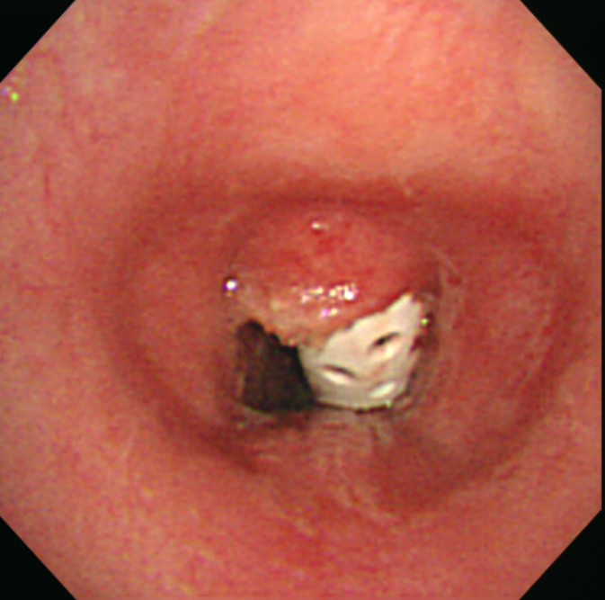
Vocalaid and Fenestrated tube

Slide 20
Passy Muir Speaking valve
Invented by a patient named David Muir, the Passy Muir Valve is a simple medical device used by tracheostomy and ventilator patients.
When placed on the hub of a tracheostomy tube or in-line with the ventilator circuit, the Passy Muir Valve redirects airflow through the vocal folds, mouth, and nose, enabling voice and improved communication.

Slide 21
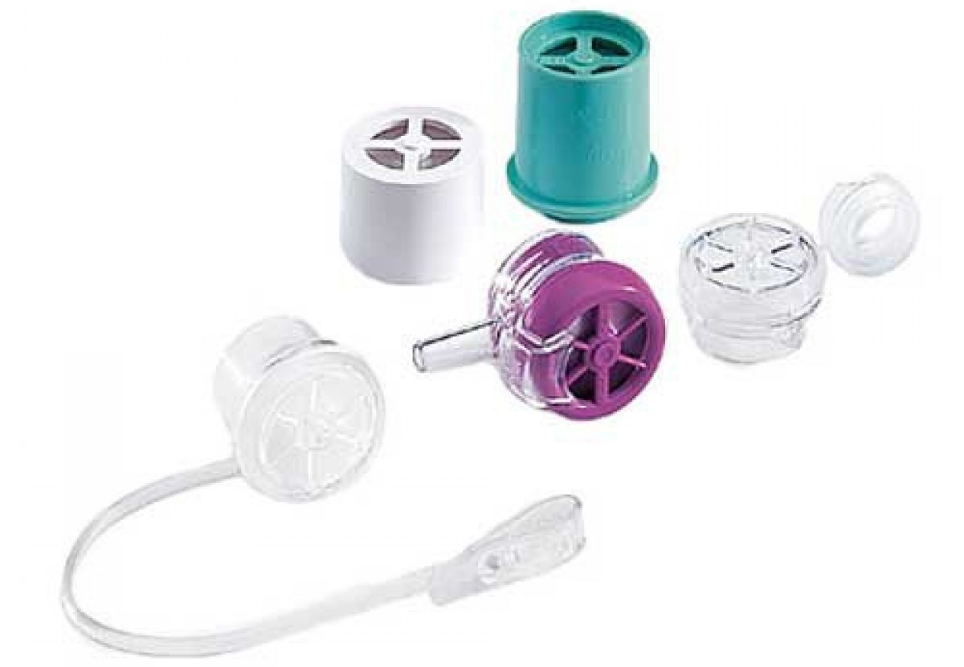
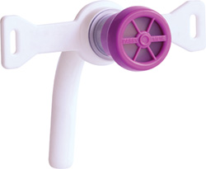

Slide 22
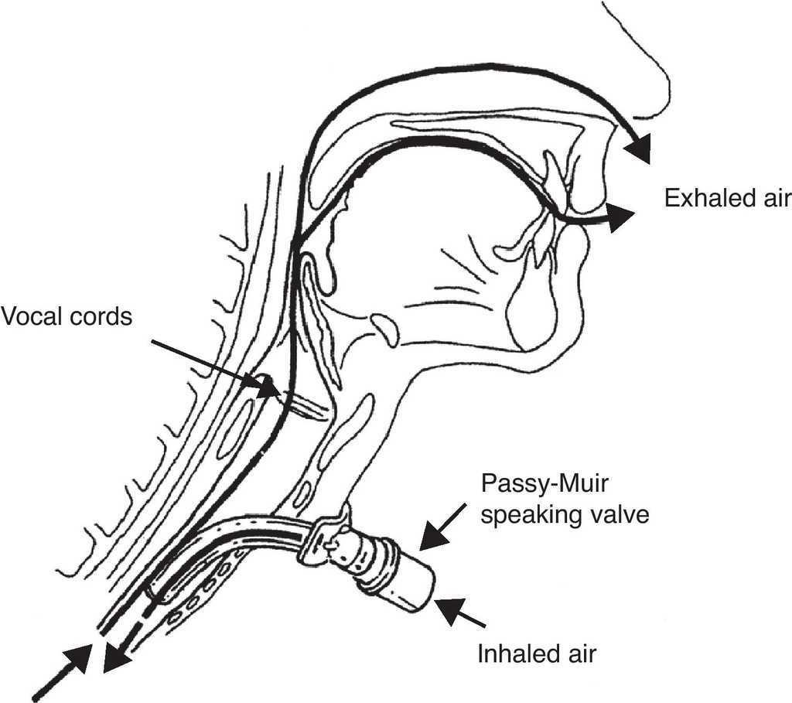

Slide 23
PMV at Tracheostomy
https://www.passy-muir.com/

Slide 24
PMV with mechanical ventilator circuit

Slide 25
Benefits of PMV
Restores Positive Airway Pressure
  Allows the patient to create positive airway pressure without the need for manual occlusion of the tracheostomy tube. This promotes louder voice, improved swallow, stronger cough, and may increase oxygenation, because all exhaled airflow is redirected up past the vocal folds.
Improves Swallow & May Reduce Aspiration
  Valve restores the patient to a more normal closed system which facilitates increased pharyngeal and laryngeal sensation and restores positive subglottic air pressure.

Slide 26
MBS with/without PMV
https://www.passy-muir.com/

Slide 27
Expedites Weaning
  Passy Muir Valves reestablishes physiologic PEEP, which in turn may improve oxygenation. As the patient becomes accustomed to exhaling through the upper airway, patient confidence is improved and respiratory muscle retraining is facilitated.
Reduces Decannulation Time
  Passy Muir Valves may be used as an interim step in the decannulation process by allowing the patient to begin to adjust to a more normal breathing pattern through the upper airway on exhalation.
  This allows the patient to gain confidence and the physician to assess for airway patency and can significantly shorten the decannulation process.

Slide 28
Improves Olfaction
  Improve the sense of smell by re-establishing airflow through the oral and nasal cavities during exhalation. This improved sense of smell may lead to an increase in sense of taste, appetite, and caloric intake.
Facilitates Secretion Management
  Enables the patient to produce a stronger, more effective cough and improves swallowing due to restored positive subglottic pressure. It also facilitates evaporation of secretions.
  As a result, suctioning needs may be reduced.
Facilitates Infection Control
  The Passy Muir Valve eliminates the need for finger occlusion of the tracheostomy tube.

Slide 29
Indication
Post-operative tracheostomy day > 7 days
Medically stable
Awake and responsive
Patent upper airway
Reasonably able to manage oral secretions
Able to tolerate cuff deflation
If on MV: FiO2 < 60%, PEEP < 12mmHg

Slide 30
Contraindication
Inability to tolerate full cuff deflation
Airway obstruction or thick and copious secretions
Unstable medical/pulmonary status
Laryngectomy
Severe anxiety/cognitive dysfunction/unconscious and/or comatose patients
Anarthria
Severe trachea/laryngeal stenosis
End stage pulmonary disease/severely reduced lung elasticity that may cause air trapping

Slide 31
Interview

Slide 32
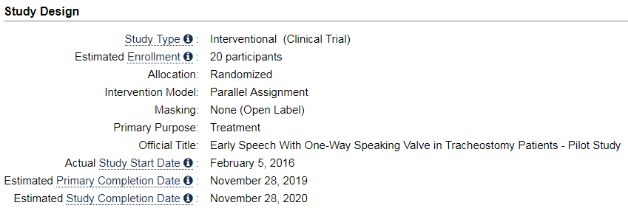
Early Speech With One-Way Speaking Valve in Tracheostomy Patients (ClinicalTrials.gov Identifier: NCT03008174)

Slide 33
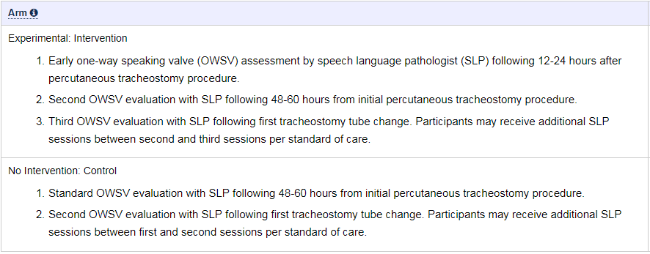
Early Speech With One-Way Speaking Valve in Tracheostomy Patients (ClinicalTrials.gov Identifier: NCT03008174)

Slide 34
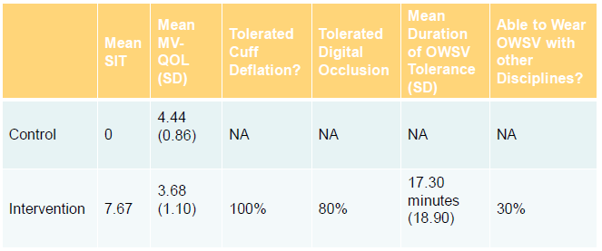
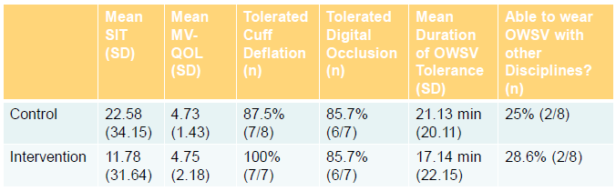
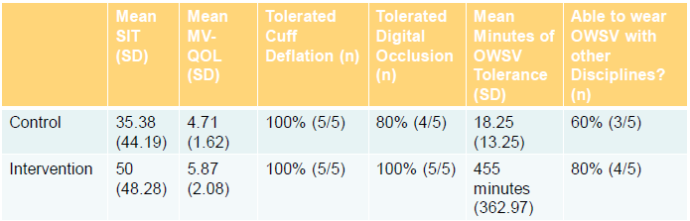
Session #1
12-24hrs
Primary outcome
: SPI (Speech Intelligibility Test) Scores
Session #2
24-48hrs
s/p 1st trach change
Preliminary data

Slide 35
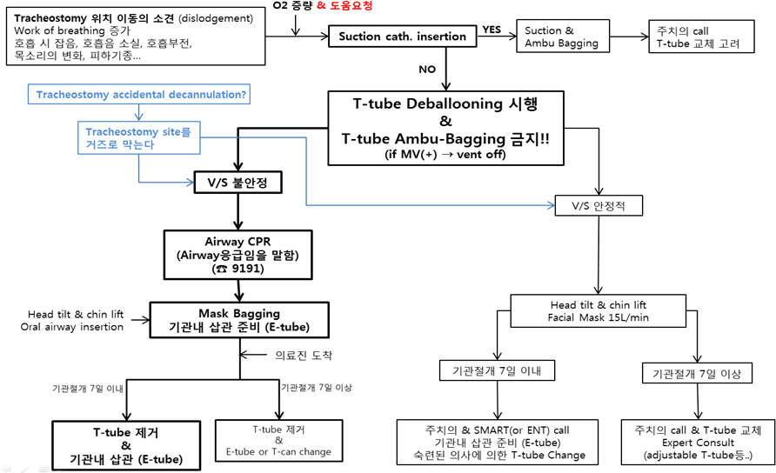
기관절개관 환자 응급상황 대처

Slide 36
Thank you

