Slide 1
Small Cell Lung Cancer in IPF patients
연세대학교
호흡기내과 강사
송명진

Slide 2
M/62 박O순 (#7927542)
Chief complaint
  특발성 폐섬유증으로 추적관찰 중 우하엽 폐 종괴 발견
Present Illness
  당뇨로 약물치료 중이었으며 2011.9 타병원에서 시행한 흉부 CT상 UIP pattern 의 간질성폐렴 소견보였고 치료 없이 추적 관찰하던 중 2014.12 본원 외래 내원하였다. 2014년 9월 시행한 타병원 흉부 CT상 양측 폐하부 흉막하 망상음영, 벌집모양 확인되었고 특발성폐섬유증 진단 하 N-acetylcysteine 복용 시작하였다. 2-3개월마다 흉부 엑스레이, 폐기능검사 시행하며 외래 추적 관찰하였으며 2016년 3월 5일 ~ 3월 11일 입원하여 우측상엽, 우측하엽에서 쐐기절제술 시행하였다. 조직검사상 Usual interstitial pneumonia에 합당한 소견 확인되었고 2016년 8월 19일부터 pirfenidone 복용 시작하였다. 2017년 1월 12일 특발성폐섬유증 추적 관찰위해 시행한 흉부CT상 우측하엽에 새롭게 직경 13cm의 종괴 확인되었다.

Slide 3
M/62 박O순 (#7927542)
Past History
  DM / HTN / Hepatitis / Pul Tbc ( + / - / - / - )
Smoking History : ex smoker, quit 8yrs ago, 25pys
Occupational History : 지하철 역무원 30년
Family History
  아버지 폐렴 사망, 어머니 위암 생존
  폐암 가족력 없음.

Slide 4
Review of system & Physical examination
Review of system
  General weakness / Fever / Myalgia (-/-/-)
  Dyspnea (+) : mMRC 1
  Cough / Sputum / Rhinorrhea (+/-/-)
  Arthralgia/ dry mouth/ dry eyes (-/-/-)
Physical examination
  Lung sound : fine crackles on BLLF
  No clubbing
  Raynaud’s phenomenon (-)
  Distal digital tip ulceration/Distal digital fissuring (-/-)
  Skin rash/Oral ulcer (-/-)

Slide 5
Lab (2017.01.24)
CBC 9660(Neu 49.1)/16.4/224k
BUN/Cr 9.2/0.89
AST/ALT 75/21
T.ptn/Alb 7.6/4.1
T.bil 0.7
CEA 6.54 (0.0~5.0)
CYFRA 21-1 4.70 (0.0~3.3)
PFT (2017.01.12)
  FVC 2.89L (70%), FEV1 2.38L (81%), FEV1/FVC 82%, DLCO 65%

Slide 6
영상소견

Slide 7
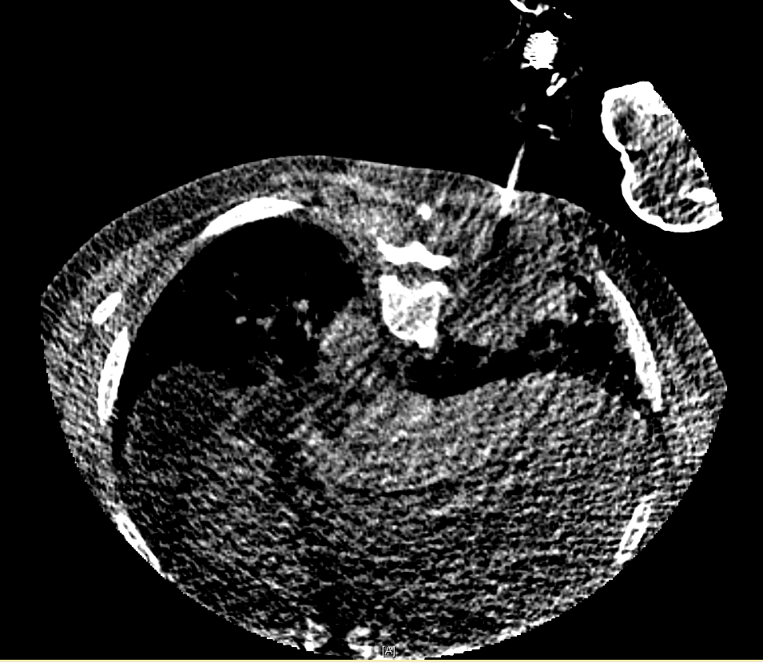
CT guided NAB (2017.01.25)

Slide 8
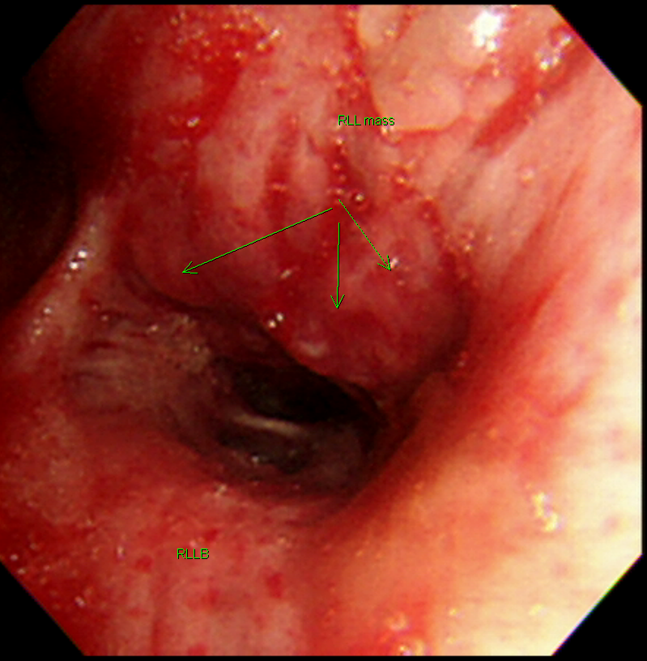
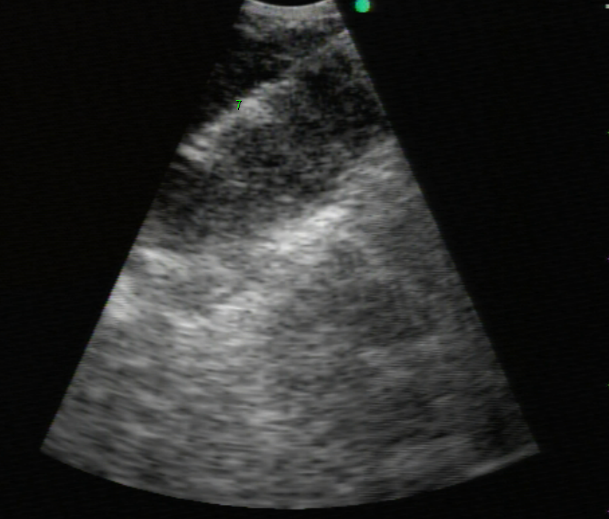
FOB, EBUS (2017.01.26)
Notes:
RB6

Slide 9
병리소견

Slide 10
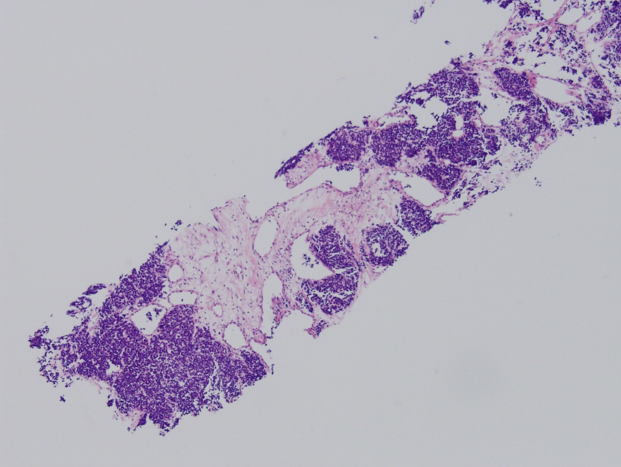
SS17-05901 Lung, right lower lobe, CT guided lung biopsy

Slide 11
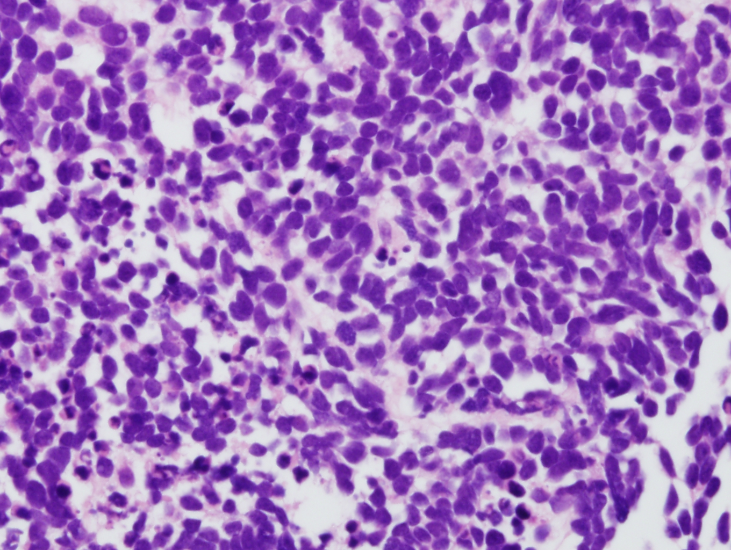
H&E staining
Notes:
HE staining

Slide 12
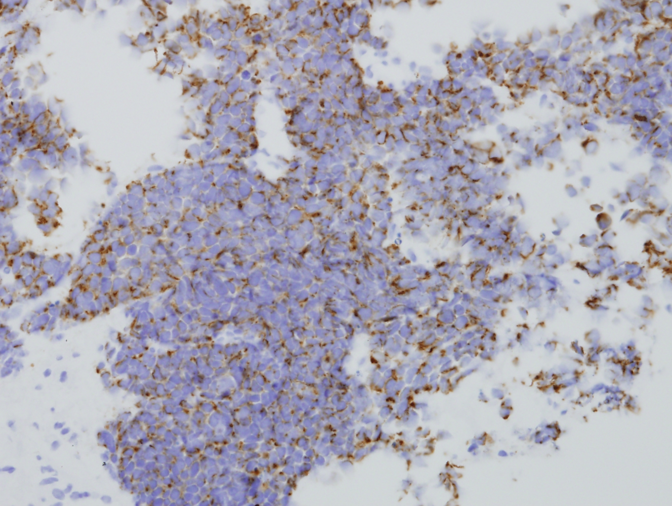
Cytokeratin positive
Notes:
# Synaptophysin: Focal weak positive in tumor cells
Cytokeratin (AE1/AE3): Positive in tumor cells with perinuclear dot pattern
TTF-1: Negative in tumor cells

Slide 13
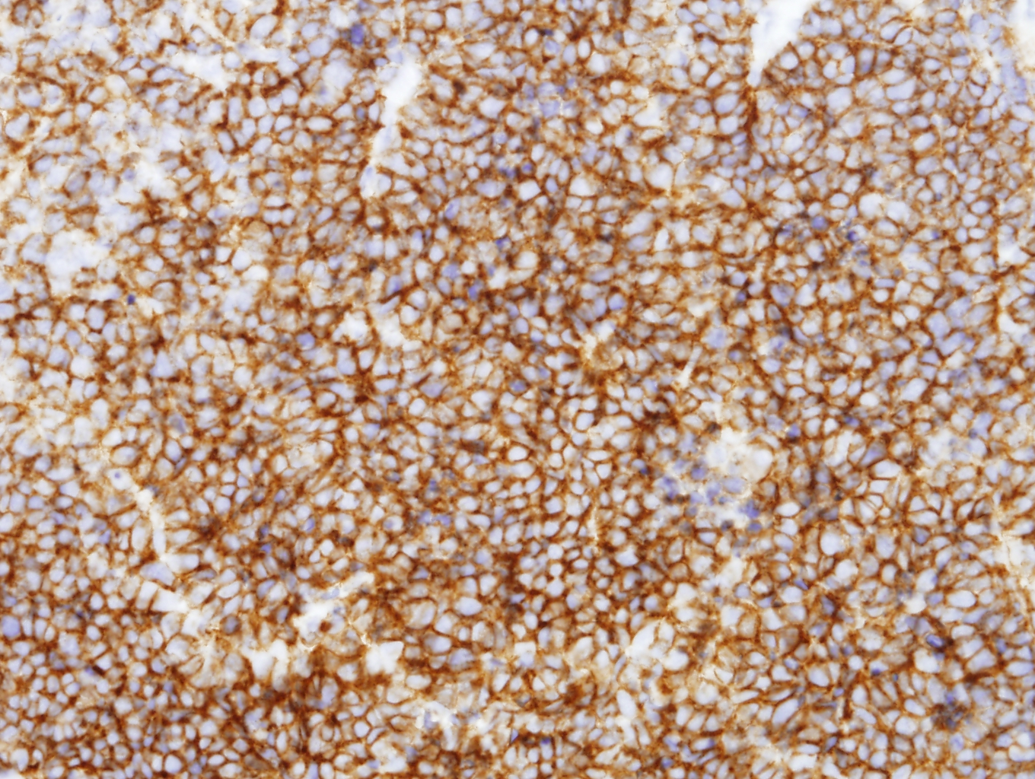
CD56 Positive
Notes:
# CD56 (SCLC): Positive in tumor cells

Slide 14
Diagnosis
  Small cell carcinoma
  limited stage

Slide 15
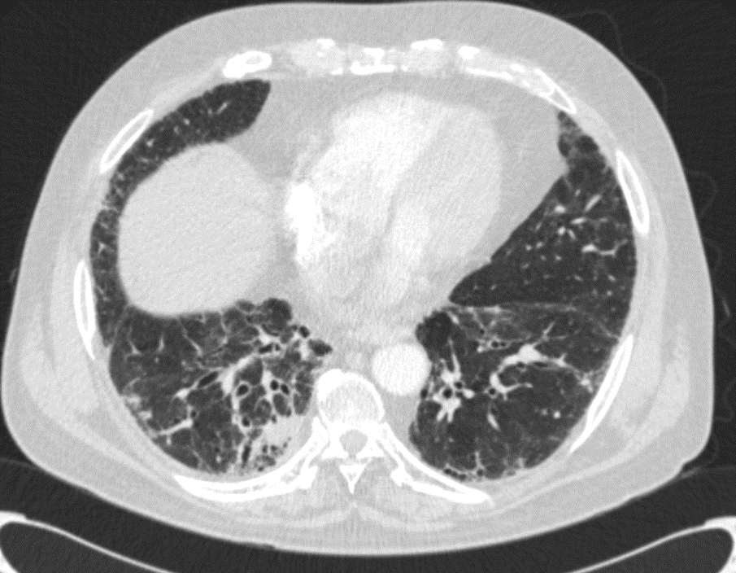
Progress
Etoposide/Cisplatin based Definitive CCRT (2017.02.14-03.23)
  Lung mass + LN : 54.6Gy/26fx
→ Response evaluation (2017.4.26 Chest CT): PR
Prophylactic Cranial Irradiation 25Gy/10fx (2017.05.16-29)
Follow up every 2months
IPF 에 대한 치료로
Pirfenidone 6T 복용

Slide 16
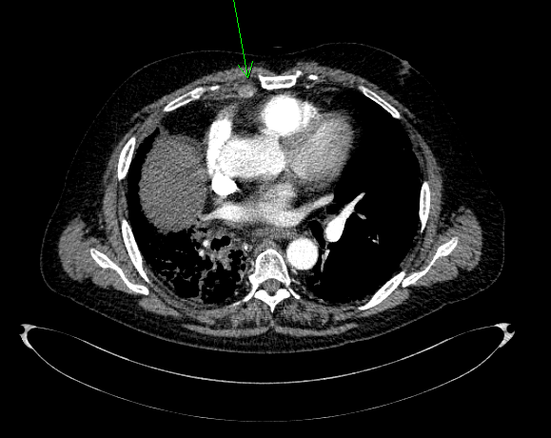
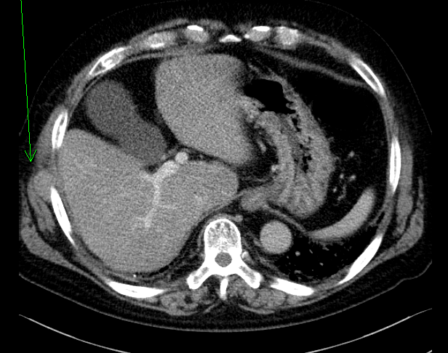
Progress
2018.04.04 Chest CT
  Progression after 14 months, since first diagnosis of LC
  → 종양내과에서 임상연구 enroll 계획중
Notes:
No remarkable change in the extent of suspicious increased soft tissue density in Rt perihilar post RTx lesion with persistent filling defect in the Rt main pulmonary artery with contrast enhancement, r/o RPA thrombus
Increased size of enlarged LNs in the Rt internal mammary chain, likely metastatic LNs.
Underlying ILD in both lungs without remarkable change.
Increased size of nodular lesion in the Rt lateral chest wall, r/o metastasis
Rovalpituzumab vs topotecan

Slide 17
REVIEW
Contents
  Epidemiology of LC with IPF
    Prevalence, Incidence, Risk factors
  Histological Features, Radiological Characteristics
  Common pathways between IPF and LC
  Survival and current therapeutic approach in patients with IPF and LC
  IPF with Small cell Lung cancer

Slide 18
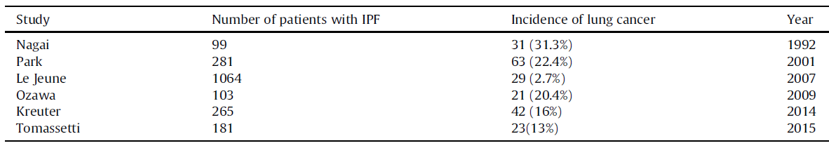
Epidemiology of lung cancer in IPF
Prevalence of lung cancer in IPF is reported to be 3 ~ 45.7%.
Lung cancer prevalence compared to control subjects
  The General Practice Research Database (GPRD) , the largest primary care population database in the United Kingdom
  The prevalence of lung cancer was markedly increased among patients with IPF (OR=7.31, 95% CI=4.47 to 11.93, p<0.001)
  adjustment for previous smoking history had little effect on this odds ratio (adjusted OR= 8.25, 95% CI =4.70 to 11.48, p<0.001)
RICHARD HUBBARD et al. AM J RESPIR CRIT CARE MED (2000)

Slide 19
Incidence of LC during IPF follow-up
Incidence density of 36 cases per 1000 person-years of LC in 121 patients with IPF - Hyldgaard C et al. Respir Med (2014)
Incidence density of 11.2 cases per 1000 person-years of LC in 1064 patients with IPF in a longitudinal computerised healthcare dataset in the UK - Le Jeune I et al. Respir Med (2007)
Increased markedly over time, with rates of 3.3%, 15.4% and 54.7% at 1, 5 and 10 years, respectively - Yuichi OZAWA et al. Respirology (2009)
Cumulative incidence of 41% and 82%, respectively, at 1 and 3 years -Tomassetti S et al. Chest (2015)

Slide 20
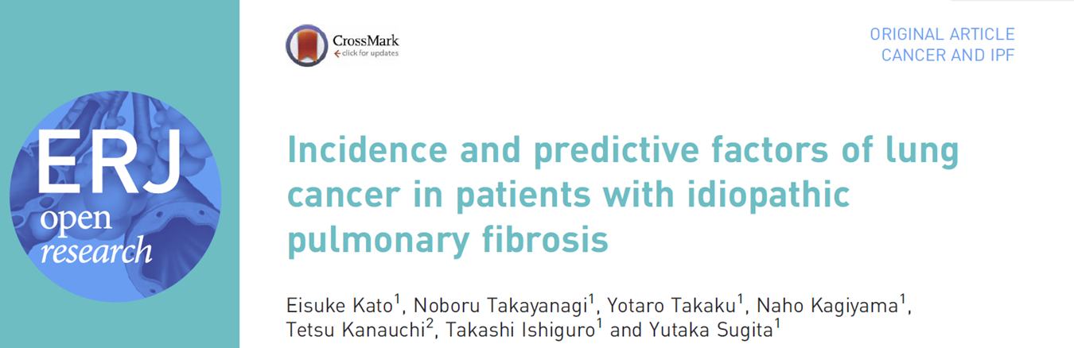
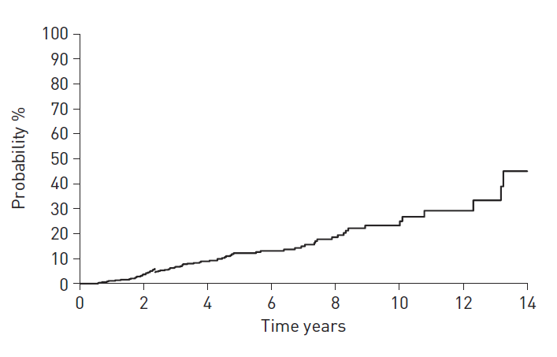
Of the 632 patients with IPF, 70 (11.1%) developed LC during median (range) follow-up periods of 3.8 (0.25–15.2) years.
The 5- and 10-year cumulative LC development rates were 12.2% and 23.3%, respectively.

Slide 21
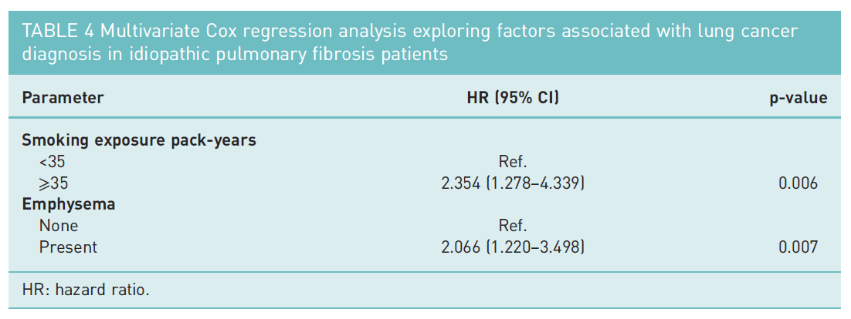
Risk factors for LC development

Slide 22
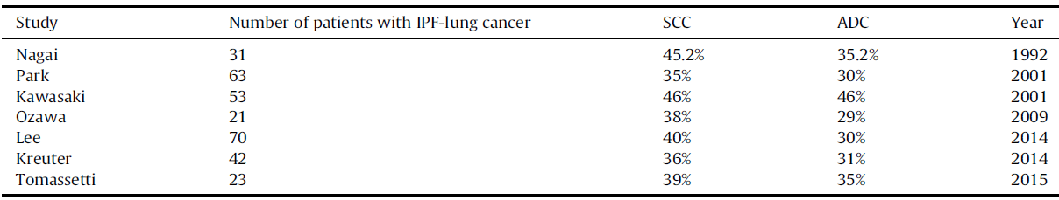
Histological Features, Radiological Characteristics
Histological features
Radiological Characteristics
  Lower lobes 59%, Middle lobe 3%, upper lobes 38%
  Relation to fibrosis : Within fibrosis 82%, abutting 15%, separate 3%
  Peripheral 76%, central 24%
Theodoros Karampitsakos et al. Pulmonary Pharmacology & Therapeutics (2017)
Sara Tomassetii, CHEST (2015)
K. A. Khan et al. Lung (2015)

Slide 23
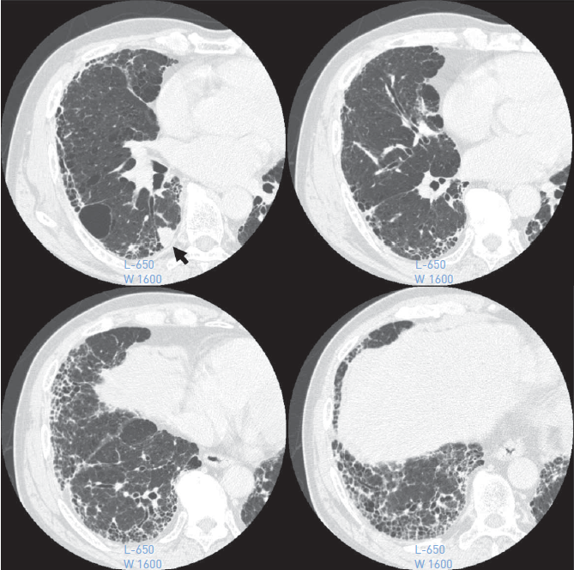
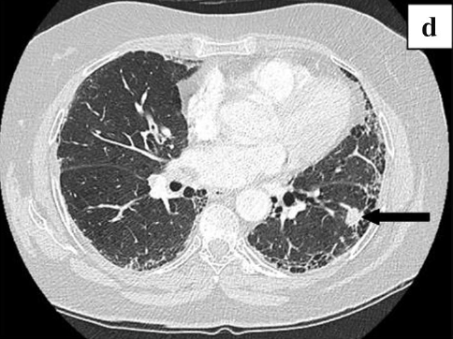
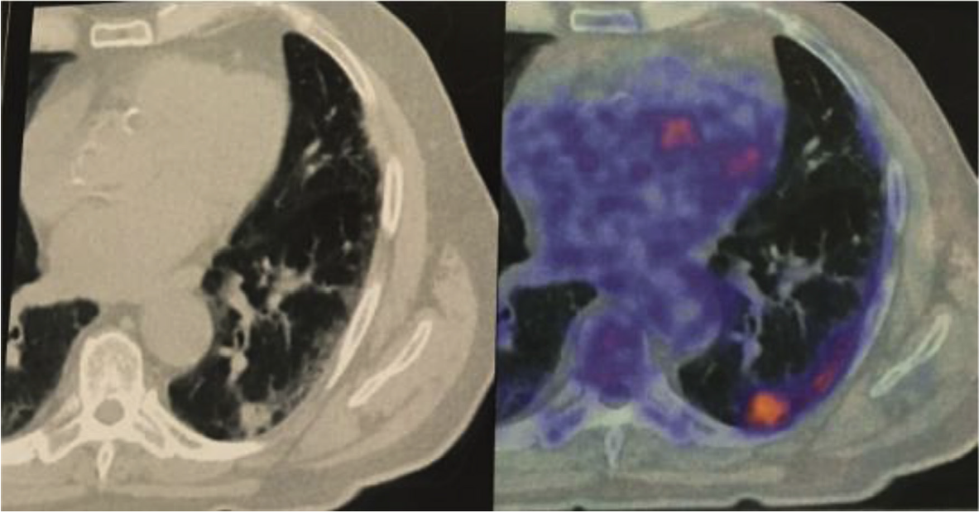

Slide 24
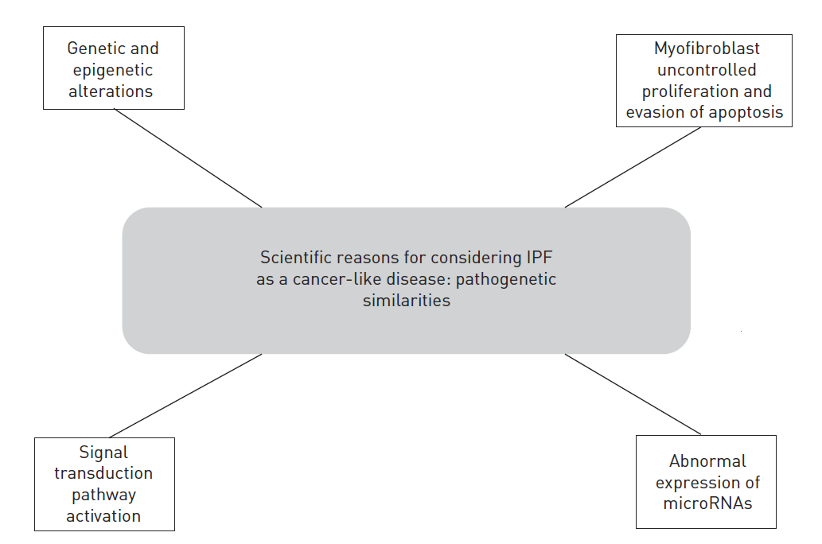
Common pathways in IPF and cancer
Genetics
  p53, fragile histidine triad, microsatellite instability, telomerase shortening
Epigenetics
  hypermethylation of the Thy-1 promoter
Signal production pathway activation
  PI3K/АKT
  Wnt/b-catenin signaling pathway
Abnormal expression of microRNAs
  Upregulation of miR-21
Carlo Vancheri. Eur Respir Rev 2013

Slide 25
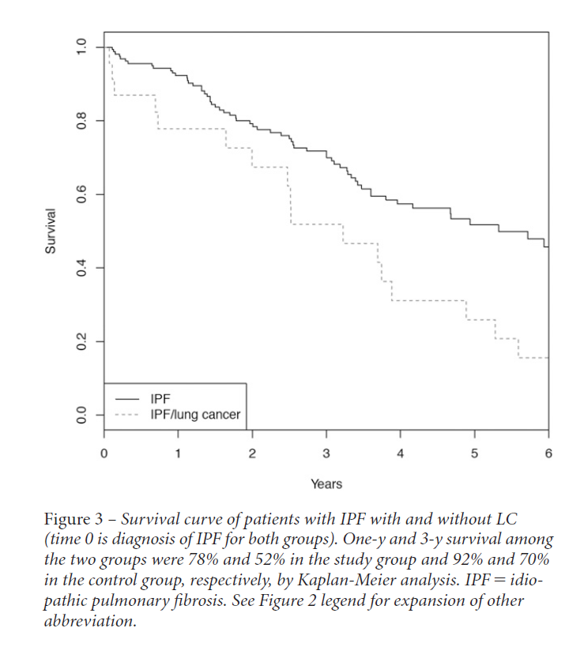
Survival in patients with IPF and lung cancer
TOMASSETTI et al.
  This study included 181 patients with IPF, and, of these patients, 23 developed LC. Among the 23 patients with LC and IPF, 7 (30%) were diagnosed as having LC at the same time of IPF diagnosis and the other 16 patients (70%) developed LC after diagnosis of IPF.
→ survival in patients with IPF with LC was significantly worse than in patients with IPF without LC
Tomassetti S et al. Chest (2015)
Ozawa Y et al. Respirology (2009)
Hyldgaard C et al. Respir Med (2014)

Slide 26
Survival in patients with IPF and lung cancer
OZAWA et al. and HYLDGAARD et al.
  studied 103 and 121 IPF patients without LC at their initial diagnoses, respectively.
  total of 21 and 6 patients with IPF developed LC during the observation period, respectively.
→ no significant differences in survival between IPF-alone and IPF-LC patients
Tomassetti S et al. Chest (2015)
Ozawa Y et al. Respirology (2009)
Hyldgaard C et al. Respir Med (2014)

Slide 27
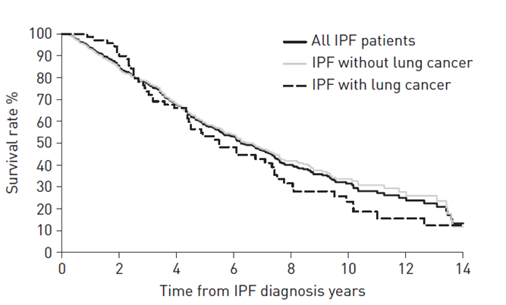
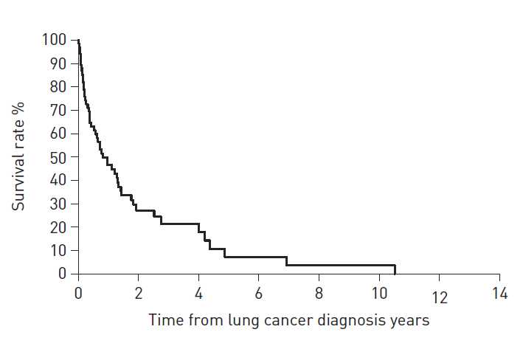
Survival in patients with IPF and lung cancer
The respective 5- and 10-year all-cause mortality rates in patients who did not develop LC were 40.4% and 66.4% versus 46.9% and 76.7% in those who developed LC (p=0.262)
The 1-, 3- and 5-year all-cause mortality rates after LC diagnosis were 53.5%, 78.6% and 92.9%, respectively.
Eisuke Kato et al. ERJ Open Res (2018)

Slide 28
Treatment related complication and outcome
Kreuter et al. (2014)
  Of the 42 patients : Surgery 12 (28.6%), radiotherapy 11 (26.2%), radio-chemotherapy 6(14.3%) , chemotherapy1 0 (23.8%) , best supportive care 4 (9.5%).
  Therapy-associated toxicities : total 55% of the patients.
    24% of irradiated patients developed radiation-induced pneumonitis, 63% of patients with chemotherapy developed chemotherapy-related toxicity.
  Despite the high incidence of LC therapy-related complications, a significant survival impact was not detected.
Kenmotsu H et al. J Thorac Oncol (2011)
Kreuter M et al. Sarcoidosis Vasc Diffuse Lung Dis (2014)

Slide 29
Treatment related complication and outcome
Kenmotsu et al. (2011)
  Patients with UIP pattern developed cytotoxic chemotherapy-related exacerbation of interstitial lung disease more frequently than those with non-UIP pattern (30% versus 8%, p=0.005).
  The incidence of grade 5 pulmonary toxicities was 9% in patients with UIP pattern, compared with 3% in those with non-UIP pattern.
  In SCLC, OS was signiﬁcantly shorter in patients with UIP pattern than those with non-UIP pattern (median OS: 9 versus 16 months, p =0.048).
  No signiﬁcant difference in patients with NSCLC (median OS: 11 versus 9 months, p =0.334).
Kenmotsu H et al. J Thorac Oncol (2011)
Kreuter M et al. Sarcoidosis Vasc Diffuse Lung Dis (2014)

Slide 30
Therapeutic approach in patients with IPF and NSCLC
Operable NSCLC
  significantly lower 5 year survival rate in patients with IPF and NSCLC than in patients without IPF (54.2% versus 88.3%).
  Patients with IPF had significantly higher postoperative morbidity
  postoperative 5-year survival (61.6%) for patients with stage I primary lung cancer c IPF, 5-year survival (63.7%) of patients with IPF after the diagnosis from the census data
  Although the long-term results of surgical resection in patients with IPF and lung cancer were worse than in patients without IPF, surgical intervention of primary lung cancer in patients with stage I lung cancer was considered effective
Y. Saito et al. Ann. Thorac. Surg (2011)
Watanabe et al. Thorac. Cardiovasc. Surg.(2008)
Schwartz DA et al. m J Respir Crit Care Med(1994)

Slide 31
Therapeutic approach in patients
with IPF and NSCLC
Patients selection in operable NSCLC
  Higher levels of KL- 6, LDH, lower values of FVC, DLCo, male gender, preoperative steroid use, history of exacerbations, presence of definite UIP pattern have been associated with unfavorable Outcomes
  Based on these factors a composite scoring system for the identification of high risk individuals has been recently suggested
Data on chemotherapy and radiation therapy are still limited and there is no consensus for the ideal strategy in patients with inoperable stages of NSCLC.
T. Sato et al. General Thorac Cardiovasc. Surg. (2015)
N. Watanabe et al. Respiration. Int. Rev. Thorac. Dis (2013)

Slide 32
IPF with SCLC
 | Design | Nation/ Period | Patients | Object
Yoko Matsumoto (2017) | retrospective | Japan/ 2011.8- 2016.5 | 204 SCLC. Chest CT상 Normal(n=57) / Emphysema(n=105) / Fibrosis(n=42) | Prognosis of SCLC based on the underlying pulmonary disease
Naohiro Watanabe (2014) | retrospective | Japan/ 2005.1-2011.12 | 11 ED-SCLC with IPF patients | efficacy CTx in ED-SCLC with IPF
Yuji Minegishi (2011) | prospective | Japan/ 2002.6-2008.10 | 17 SCLC with IIP, for whom curative radiotherapy was impossible (stage 3A, 3B, 4) | safety, efficacy of Carboplatin and etoposide CTx in advanced SCLC with IPF
YOKO MATSUMOTO et al. ANTICANCER RESEARCH (2017)
Naohiro Watanabe etal. Int J Clin Oncol (2014)
Yuji Minegishi et al. Journal of Thoracic Oncology (2011)

Slide 33
IPF with SCLC
 | Survival(median OS) |  |  |  | AE
Yoko Matsumoto (2017) |  | normal | emphysema | Fibrosis | Fibrosis 5(11.9%) Normal (0/57, 0%) Emphysema (5/105, 4.8%) (p=0.025)
 | 전체 | 21.3 | 16.4 | 10.8
 | LD-SCLC | 52.7 | 26.4 | 7.4
 | ED-SCLC | 11.4 | 13.5 | 12.7
Naohiro Watanabe (2014) | Median OS : 7.0 months (previous phase III reports 9.0 -10.6 months) Median PFS : 4.7 months (previous phase III reports 5.2 - 6.0 months) |  |  |  | 4 patients (36.4 %) 3 of 4 patients died during this study
Yuji Minegishi (2011) | Median OS : 8.7 months (JCOG 9511 :9.4months) Median PFS : 5.5 months (JCOG 9511 : 4.8months) |  |  |  | 5patients (29.4%) 4 of 5 died study period
YOKO MATSUMOTO et al. ANTICANCER RESEARCH (2017)
Naohiro Watanabe etal. Int J Clin Oncol (2014)
Yuji Minegishi et al. Journal of Thoracic Oncology (2011)

Slide 34
Summary
IPF is an independent risk factor for lung cancer.
Further studies are warranted to prove whether a linear association between lung cancer and IPF.
There’s no significant median OS difference between IPF patients with LC and IPF only.
But median OS of IPF patients with LC is shorter and treatment related complications are more frequent when it is compared to LC in general population.
Currently, there is no consensus for the treatment of patients with both IPF and lung cancer and further studies are also warranted.

