Slide 1
기침연구회 심포지엄
-증례집담회-
가톨릭대학교 부천성모병원
강혜선

Slide 2
Case
이O실
( F/58)
CHIEF COMPLAINT
cough (onset : 2 months ago)
chest discomfort c dyspnea (onset : 1 week ago)
Notes:
Case

Slide 3
Present Illness
58세 여환,
고혈압 진단 후 경구약 복용하는 것 외의 특이 질환 없는 비흡연자로
2달 전부터 기침이 지속되었고, 1주일 전부터 가슴 답답함 및 운동시
호흡곤란 발생하여 외래 경유 입원하였음.

Slide 4
Past history
Past history
  DM/HBP/Hepatitis/Tb (-/+/-/-)
  Op (-)
  Medication : atacand
Social history
  Alcohol : non
  Smoking : non-smoker
Family history
  N-S

Slide 5
Review of system
General Fever / Chilling (-/-)
Generalized weakness (-), Fatigue (-)
Generalized edema (-) Weight change(-)
Headache (-)
Respiratory Cough/Sputum/Rhinorrhea (+/-/-) Sore throat (-)
Dyspnea/Orthopnea (-/-)
chest discomfort (+), pleuritic chest pain, Lt (+)
Cardiovascular Chest pain (-), Palpitation (-), Cyanosis (-)
G-I tract Anorexia / Nausea / Vomiting (-/-/-)
Diarrhea / Constipation (-/-) Abdominal pain (-)
Hematemesis(-) Melena (-)
Genito-urinary Dysuria / Frequency / Nocturia / Hematuria (-/-/-/-)

Slide 6
Physical examination
Vital Signs 120/80 mmHg – 68/min – 16/min – 36.4℃
General not so ill-looking appearance
HEENT Normocephaly, Isocoria /c PLR (++/++)
Non- anemic conjuntivae, Anicteric sclerae
No pharyngeal injection, no tonsillar enlargement
Chest Decreased lung sounds, LLL
Regular heart beat s murmur
Abdomen Soft and flat
Normoactive bowel sound
Extremity G-F
Pretibial pitting edema (-/-)

Slide 7
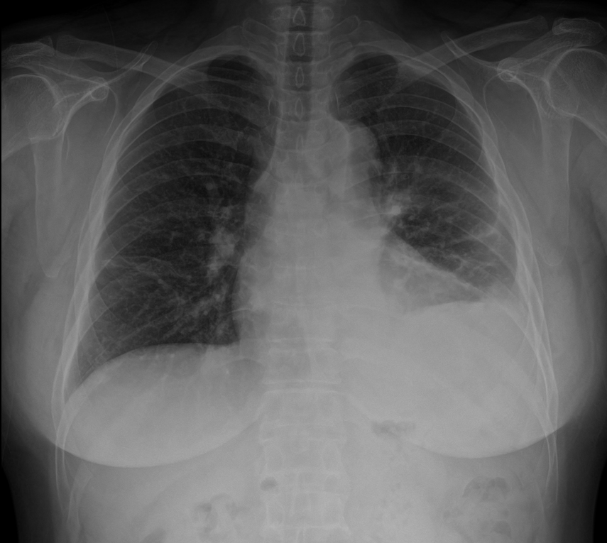
Chest x-ray
Notes:
5r/o pneumonia, LMLF, LLLF with pleural effusion, Lt

Slide 8
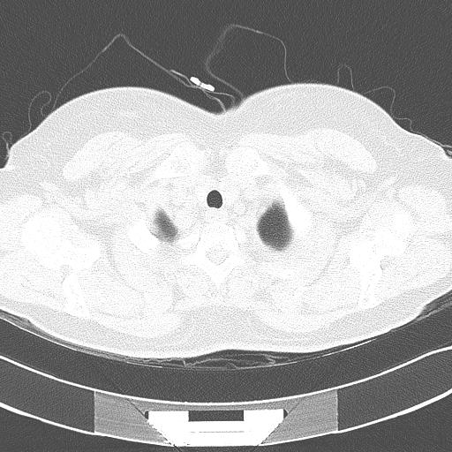
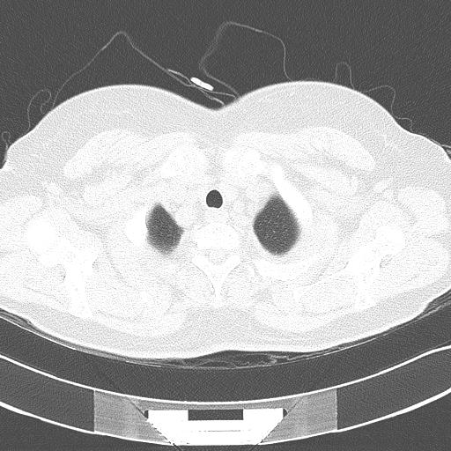

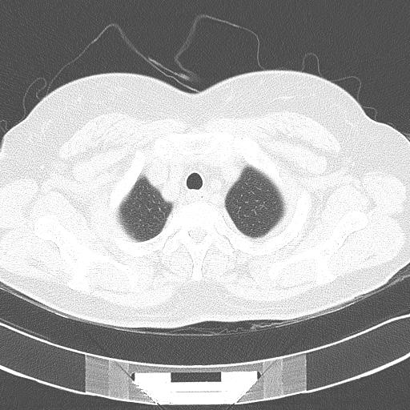
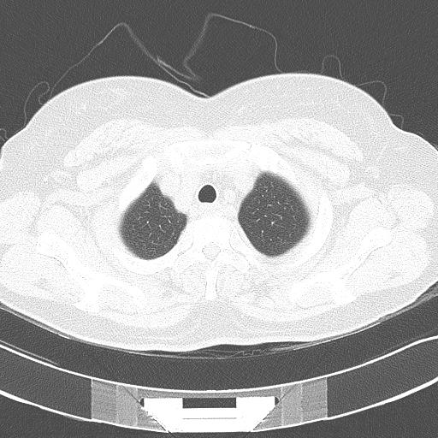
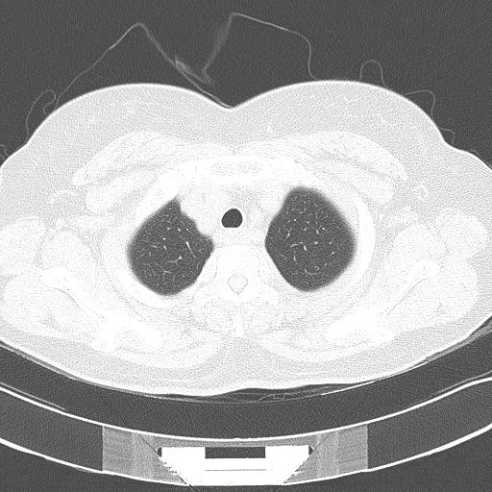
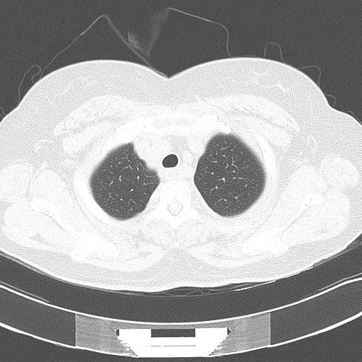

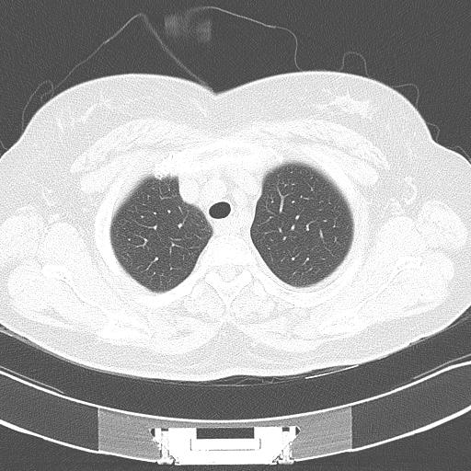
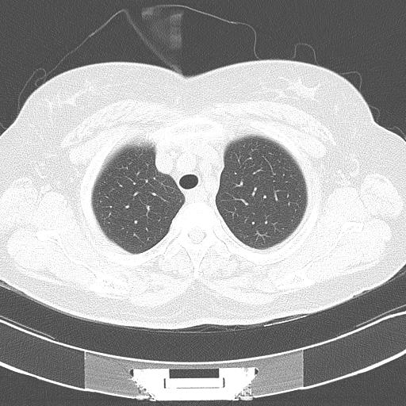
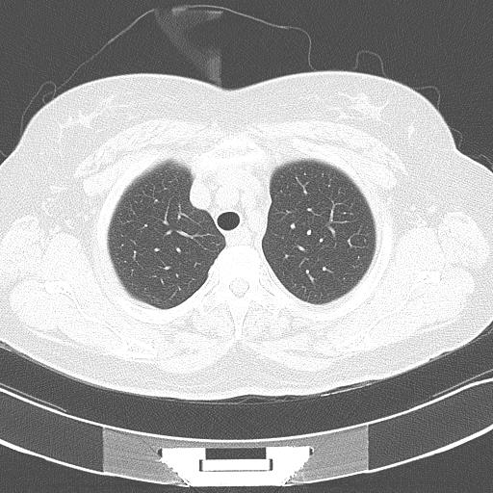
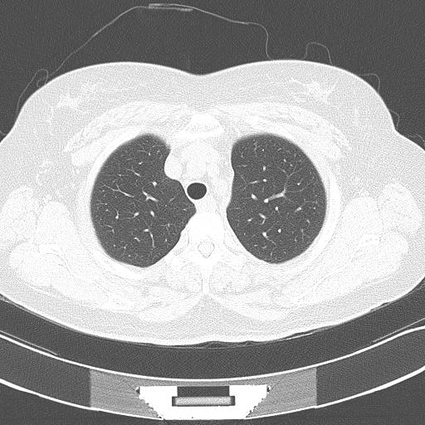
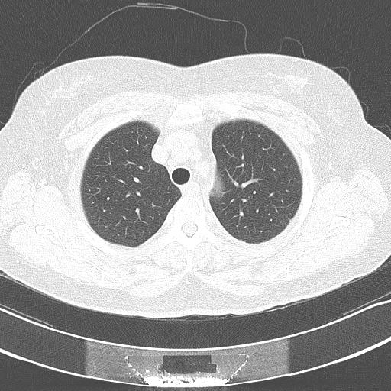
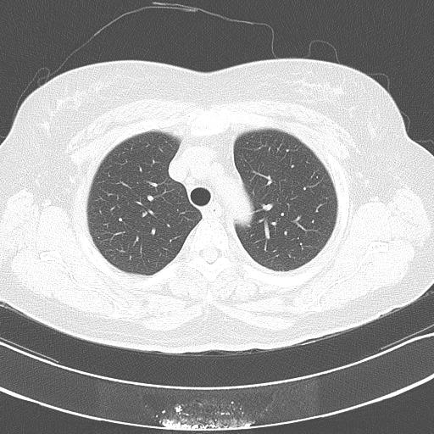
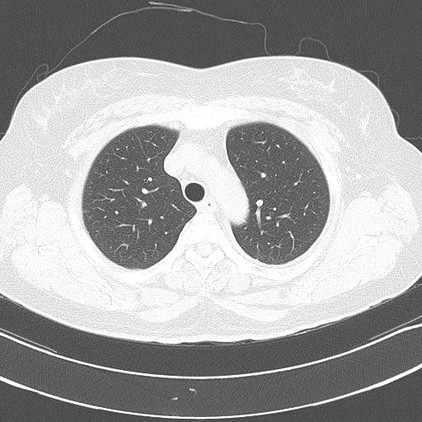

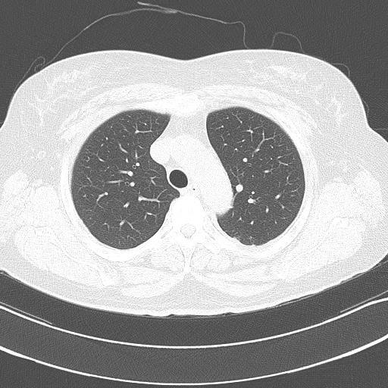
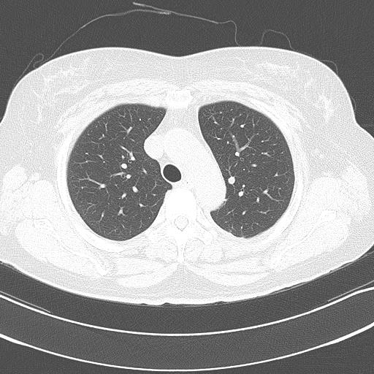

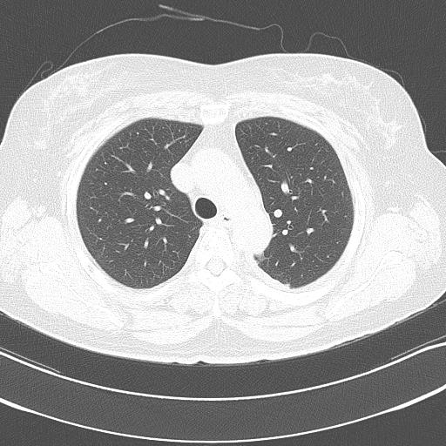
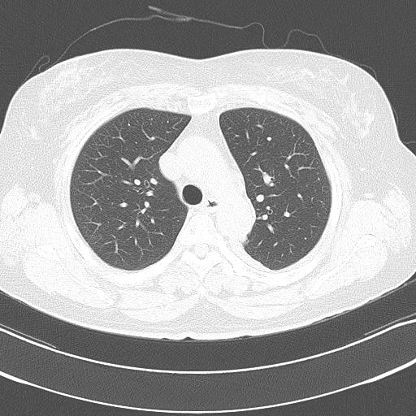
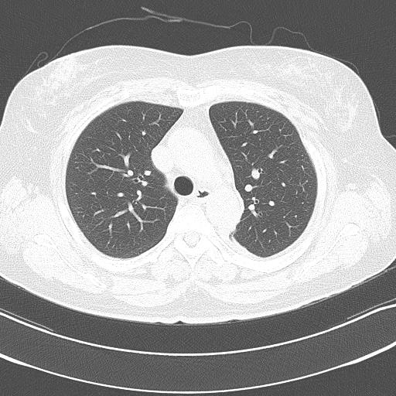
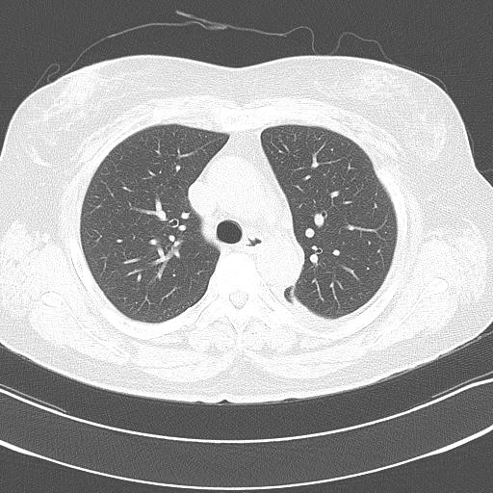
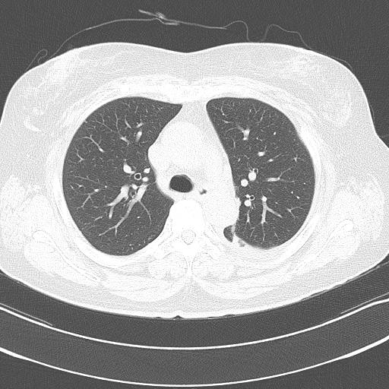
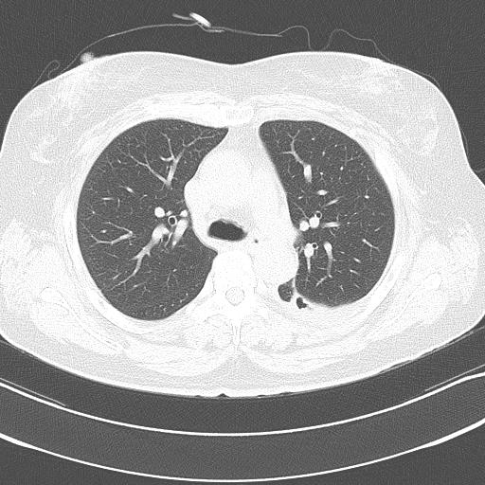

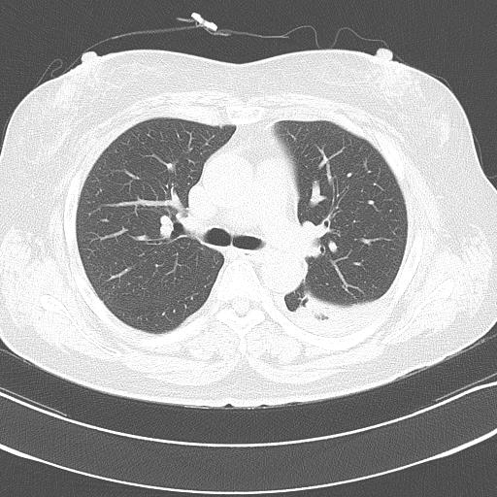
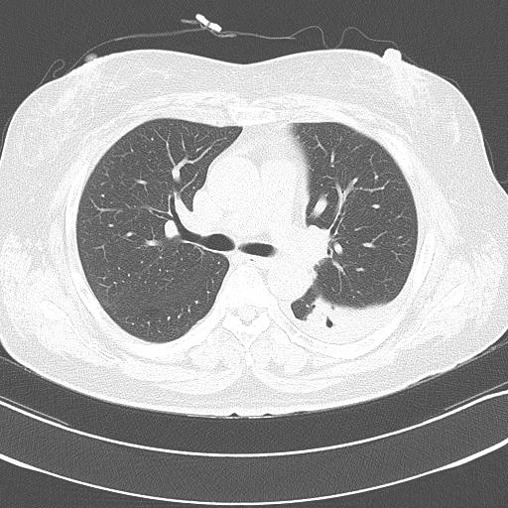

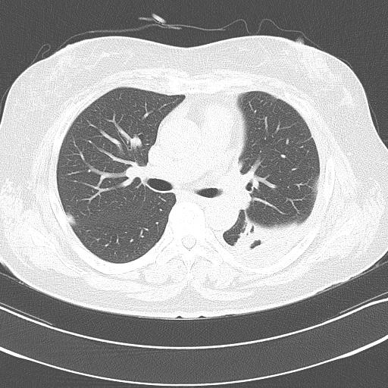
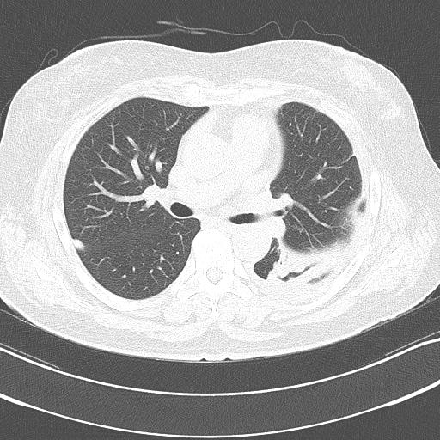
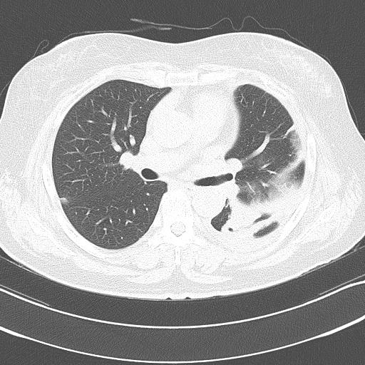
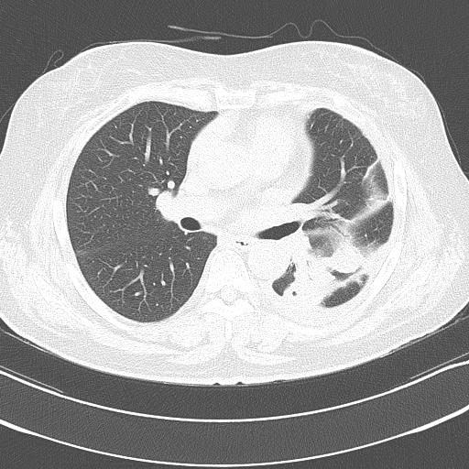
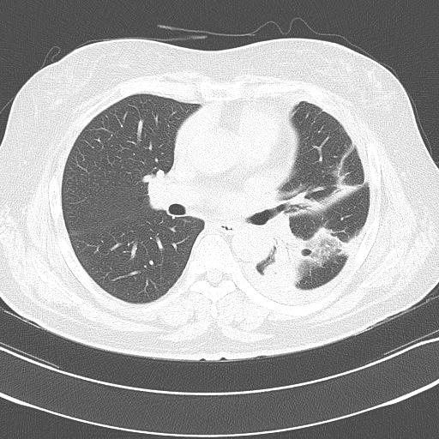
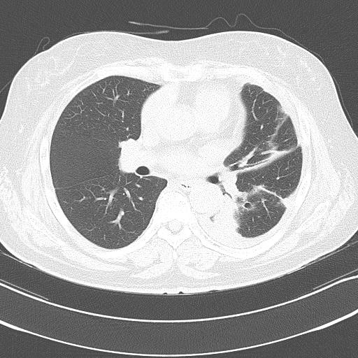
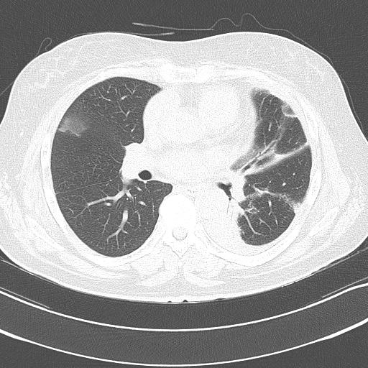
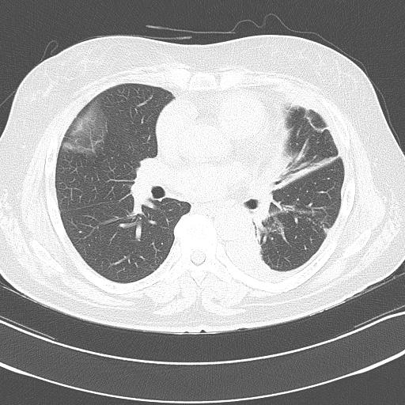
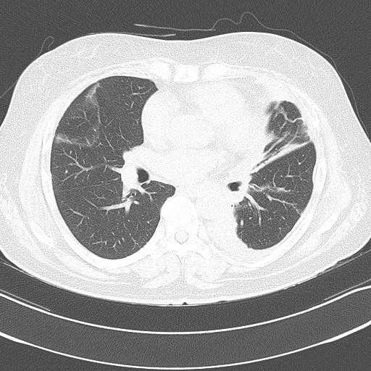
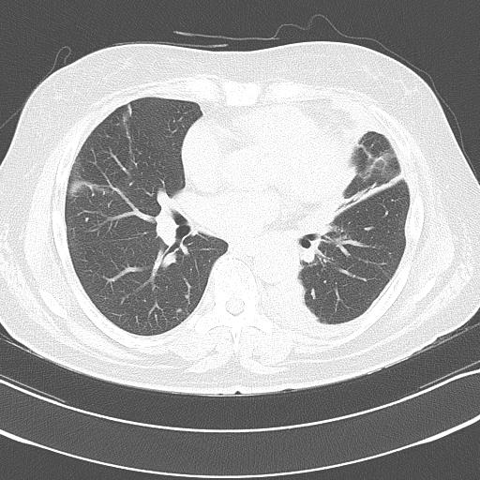
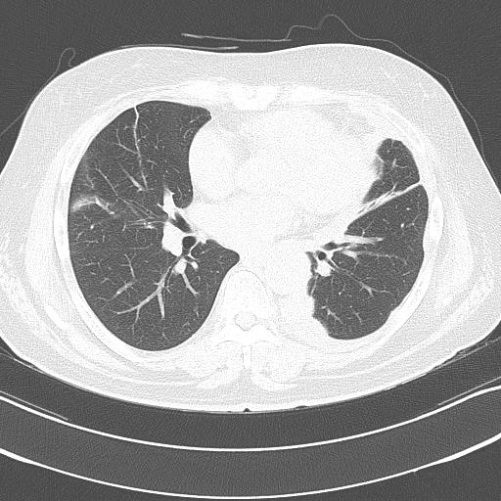
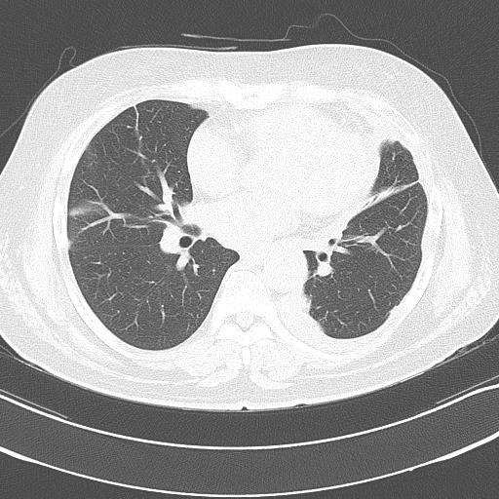
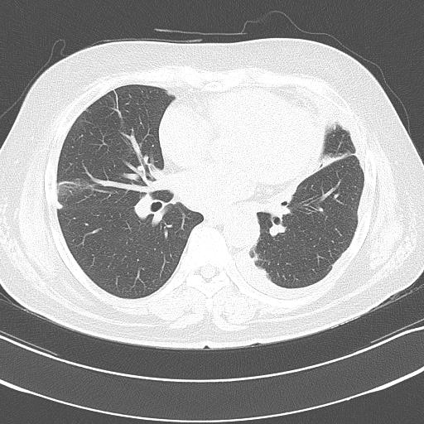
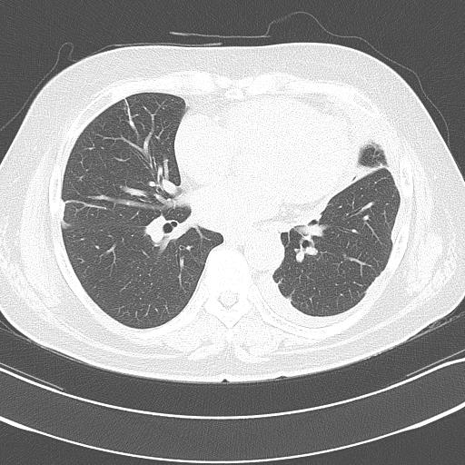
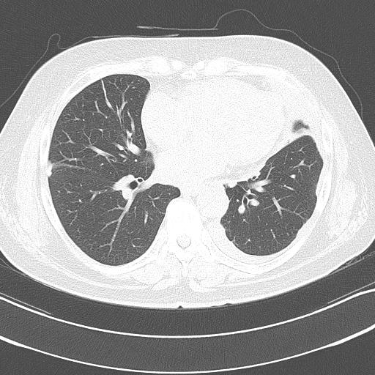

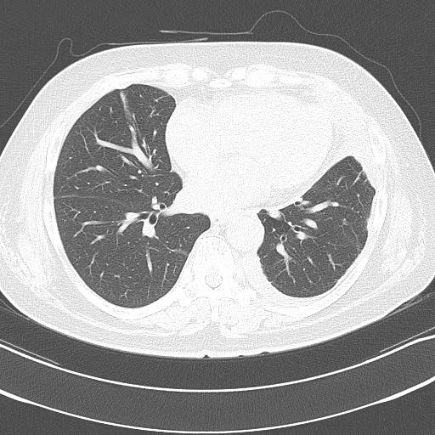

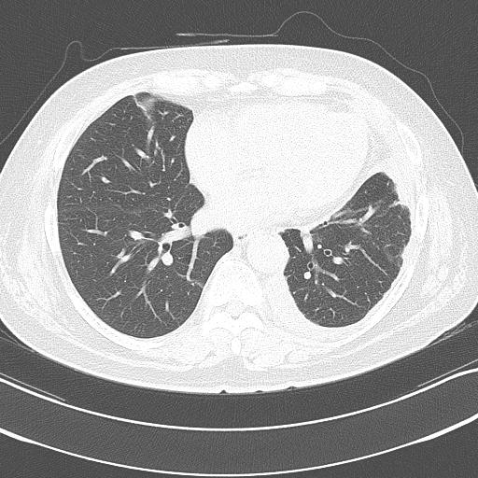

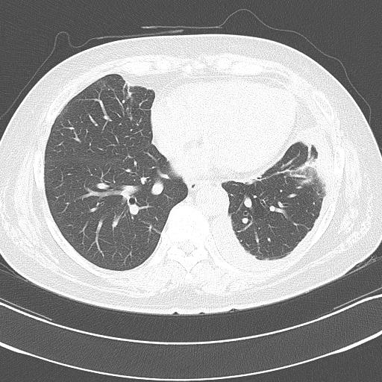
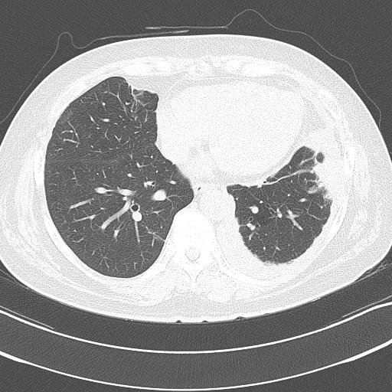
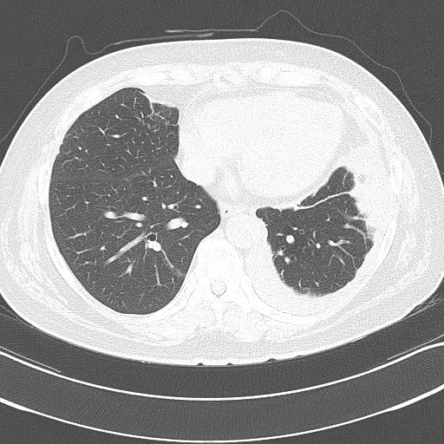
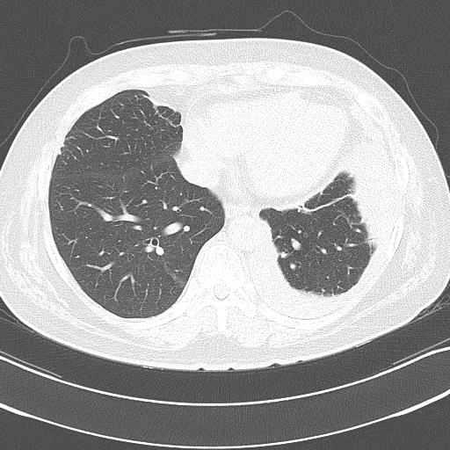

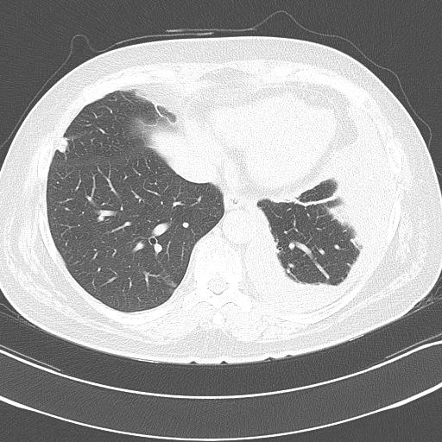
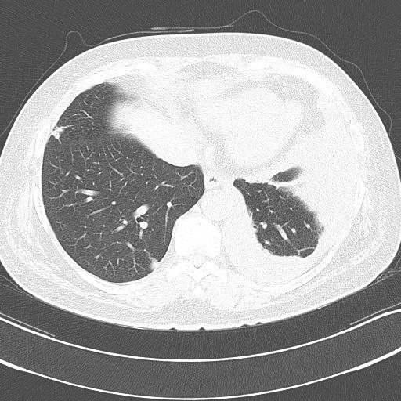
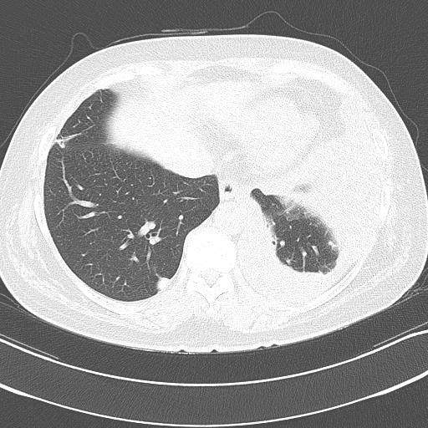
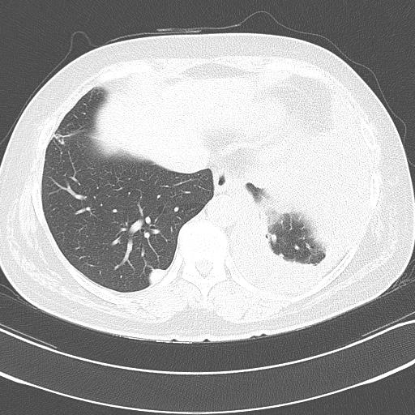
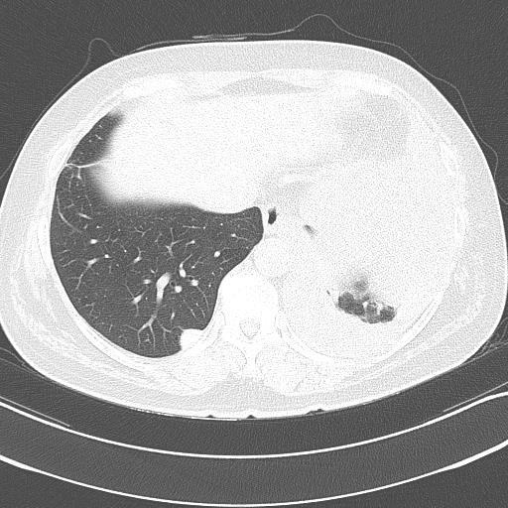










































































































Chest CT
Notes:
1. Irregular homogenous (enhancing) consolidaiton with patent central bronchus in L superior segment with elongated air cavitation about 4.5x0.9 cm
2. suspiciously, a irregular 1.7 cm sized low density lesion at lateral aspect of #1
R/O, hidden malignant tumor
ddx: abscess
3. L pleural effusion with smooth parietal pl E
4. a thin walled small air cavity, probably connected with regional central bronchus in LLL

Slide 9
Laboratory Findings
CBC
WBC count | 6940 /uL
seg. Neutrophils | 43.5 %
Lymphocytes | 32.0 %
Monocytes | 5.2 %
Eosinophils | 18.7 %
Eosinophil count | 1260
Hb/Hct | 12.2 g/dL / 36.7 %
Platelet count | 269K /uL
BC
FBS | 149 mg/dL
Bun/Cr | 18.6/0.55 mg/dL
Total Protein/Alb | 7.3 / 4.1 g/dL
Na/K/Cl | 140/4.2/108 mEq/L
CRP | 1.22 mg/dl
TB | 0.49 mg/dL
LDH | 392
AST/ALT | 22/15 U/L
PT(INR) | 1.01
ABGA | 7.414-35.4-88.0-22.9 (96.9%)
Notes:
Eosinophil count

Slide 10
Pleural effusion
 | Effusion/serum
pH | 7.0 | WBC | 6300
Protein | 7.6/7.8 | RBC | 50
LDH | 469/392 | neutrophil | 1
albumin | 2.5/4.2 | lymphocytes | 20
CEA | 0.80 | eosinophils | 58
proBNP | 44 | macrophages | 15
ADA | 58.1 | basophil | 1

Slide 11
Laboratory Findings
Eosinophilia study
FANA | 1:00 cytoplasmic
ANCA | negative
Anti-CCP | Negative
RA factor | Negative
IgG | 1541
IgM | 142
IgA | 223
IgE | >2450
IGRA | negative

Slide 12
Sputum study
AFB stain (-)
TB PCR (-)

Slide 13
Parasite study
Micro-ELISA test
  Cysticercus IgG +
  Paragonimus IgG +
  Sparganum IgG -
  Clonorchis IgG +
Toxocariosis IgG +
Stool study
  Helminth Ova (-)
  Protozoa (-)
  Fresh Amoeba (-)
Notes:
Cross=reactivity

Slide 14


bronchoscopy
No definite endobronchial lesion
Washing

Slide 15
Diagnosis
paragonimiasis

Slide 16


Clinical course
Praniquantel 75mg/kg #3 for 2 days

Slide 17
Discussion

Slide 18
Paragonimiasis
Food-borne parasitic disease
Endemic : East asia
Classic symptoms
  Chronic cough, sputum, hemoptysis, pleurisy, fever
Radiologic findings
  Nodule, pleural effusion, pulmonary cavity
  Similar to TB or lung malignancy
  50-70% : receiving anti-TB therapy
Semin Respir Med 1991; 12:35-45

Slide 19


Chest 2005; 128:1423-1430

Slide 20
경청해 주셔서 감사합니다.

