Slide 1
Pulmonary Capillary Hemangiomatosis

Slide 2
Pulmonary Capillary Hemangiomatosis
    a rare cause of pulmonary hypertension characterized by extensive proliferation of pulmonary capillaries within alveolar septae
    Extensive capillary proliferation ➔ hypertrophied & narrowed pul.vv ➔ PHTN
    First described by Wagenvoort et al in1978, fewer than 100 cases have been reported
    The clinical and radiographic features can be nonspecific, making histology the only reliable means of diagnosis

Slide 3
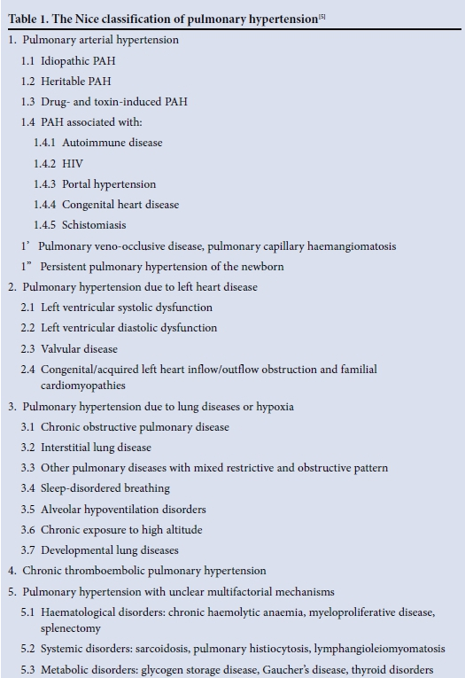
Pulmonary Capillary Hemangiomatosis
    Clinical presentation
    progressive dyspnea (m/c), cough, chest pain, fatigue, hemoptysis
    age : from infancy to 71 years
    PFT : normal FVC, FEV₁ w/ markedly reduced diffusion capacity
    right heart catheterization : pressure elevated → pulmonary hypertension
    alveolar lavage : increased hemosiderin-laden macrophages
    One of the rare cause of PHTN

Slide 4
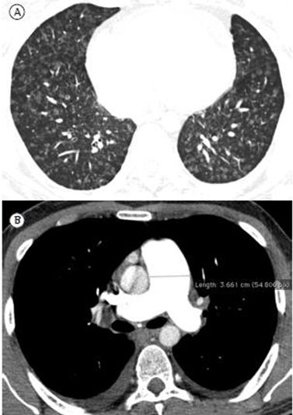
Pulmonary Capillary Hemangiomatosis
    Radiologic features
    - nonsepcific
    - include changes consistent with pulmonary hypertension
    (bilateral interstitial infiltrates, cardiomegaly, enlargement of the pulmonary artery)
    CT scan : hallmark - diffuse centrilobular ground-glass nodular opacity
    periphery is generally spared
    typically bilateral, involve all lobes
Notes:
A : HRCT - diffuse centrilobular ground-glass opacities
B : CT angiography - marked dilatation of the main pulmonary artery (diameter, 36 mm)

Slide 5
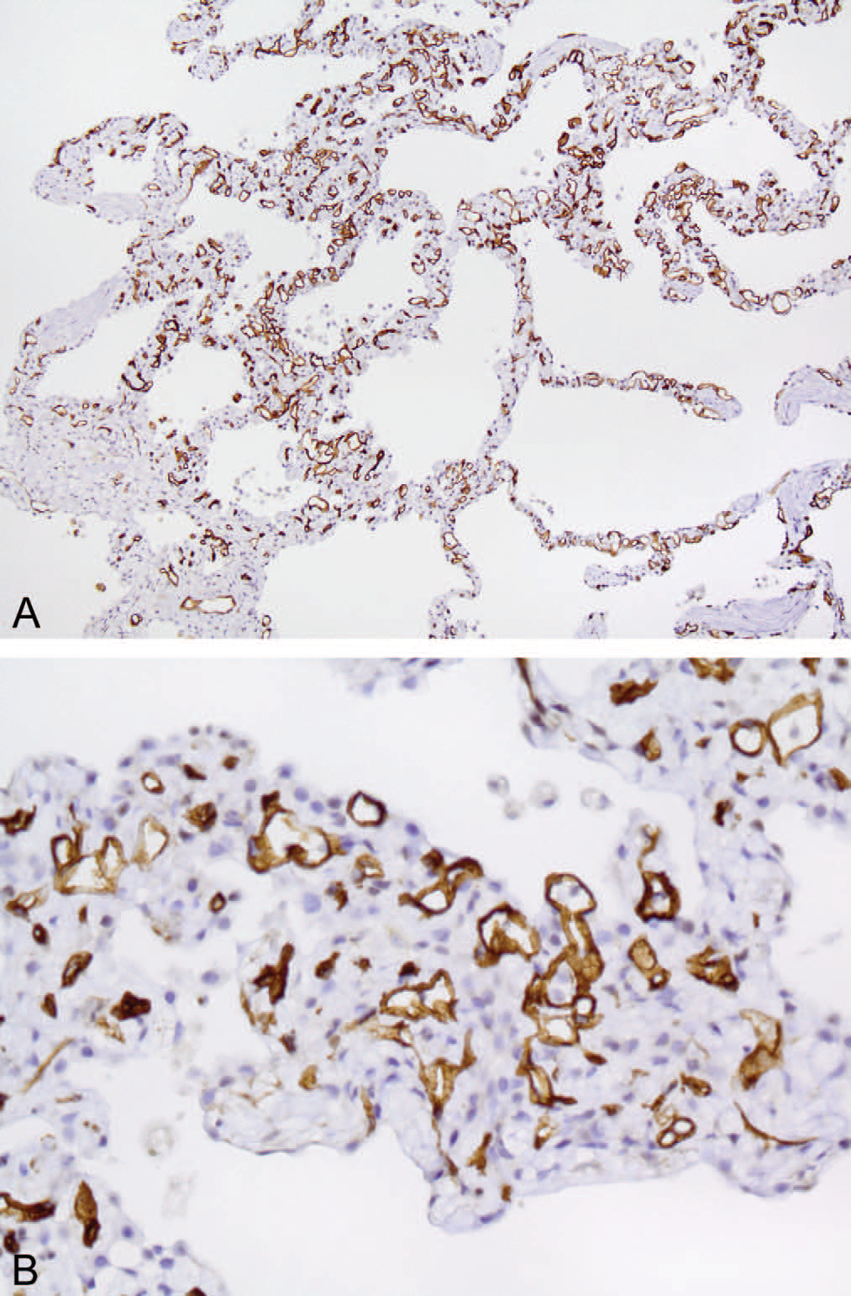
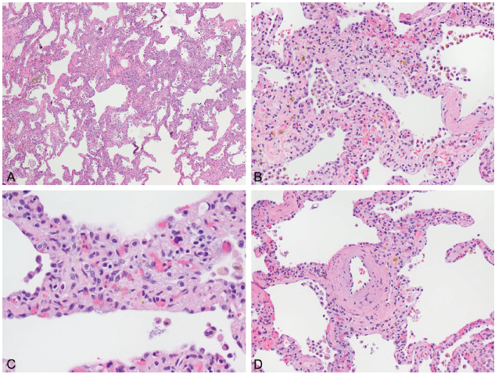
Pulmonary Capillary Hemangiomatosis
    Histopathologic features
CD34(+)
Arch Pathol Lab Med. 2015;139:274–7
Notes:
exuberant septal capillary proliferation
Septum 의 congestion
Septum의 more than 4 layers of capillary
Arteriole의 hypertrophy and luminal marrowing

Slide 6
Pulmonary Capillary Hemangiomatosis
    Differential diagnosis
    Clinically, PCH is difficult to distinguish from many other causes of pulmonary hypertension & impossible to distinguish from PVOD

Slide 7
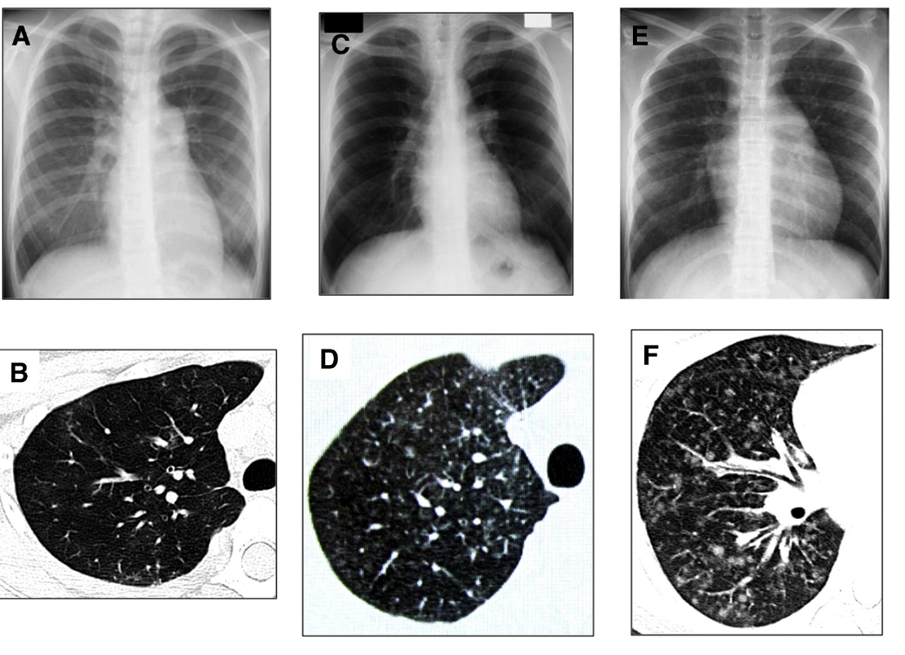
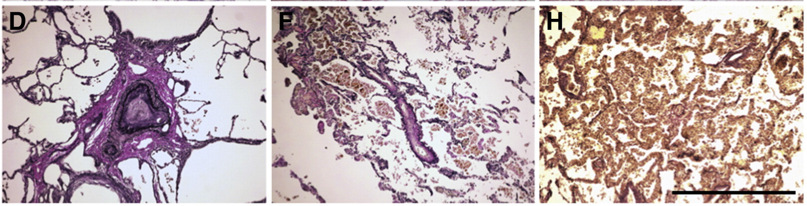
D/Dx
IPAH
PVOD
PCH
Cardiovascular Pathology 22 (2013) 287–293
Notes:
D. Intimal and medial hypertrophy
E. Stenosis of pul.arteriole w/o capillary proliferation or deficienct
F: capillary proliferation

Slide 8
Pulmonary Capillary Hemangiomatosis
    Treatment and Prognosis
    Pul.HTN treatment : ACEi, diuretics, corticosteroid, warfarin
    → relatively ineffective, poor prognosis
    Epoprostenol (prostacyclin) : ineffective
    Interferon α-2a : effective, a few cases
    Lung transplantation : only definitive treatment
    median survival : 3 yrs after onset of Sx.
Imatinib is Partially Effective for the Treatment of Pulmonary Capillary Hemangiomatosis
Intern Med 53: 603-607, 2014
: 43-year-old man presented with dyspnea on exertion, pulmonary hypertension (WHO-FC Ⅳ) in spite of treating with bosentan, sildenafil and intravenous epoprostenol.
After three months of treatment with imatinib (tyrosine kinase inhibitor), chest X-ray and echocardiography findings improved, and the WHO-FC class was III.

Slide 9
Pulmonary Capillary Hemangiomatosis
    Current case report
EIF2AK4 Mutations in Pulmonary Capillary Hemangiomatosis
CHEST 2014; 145(2):231–236
: use exome sequencing to identify a candidate gene for PCH in a family with two affected brothers
→ mutations in EIF2AK4 are likely to cause autosomal-recessive PCH in familial and some nonfamilial cases

