Slide 1
Pulmonary Rehabilitation in an ILD Patient
고려대학교 안암병원 재활의학과
이아리

Slide 2
Patient Information
M / 74
Dyspnea (mMRC 2)
cIPF (diagnosed on May, 2016)
HTN, Angina, Dyslipidemia
BPH
Medication: Perfenidone (2018.07. ~ 2018.10.), Aspirin, Nebivolol, Rosuvastatin
Notes:
528778

Slide 3
Patient Information
Smoking history: Ex-smoker, Quit 17 years ago, 1 pack X 30 years
Exercise: 매일 1시간씩 산책
Neuromuscular problems (-)

Slide 4
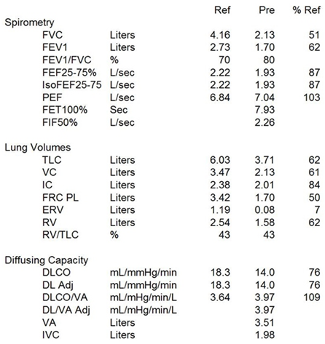
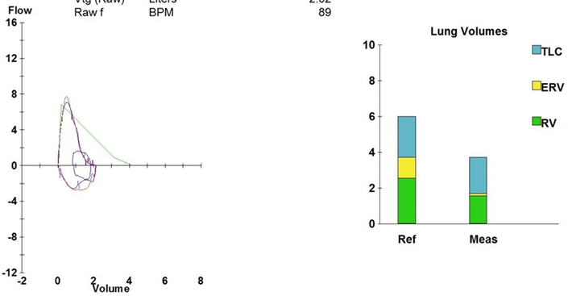
PFT (2018.07.10.)
FVC 51 %
DLCO 76 %

Slide 5
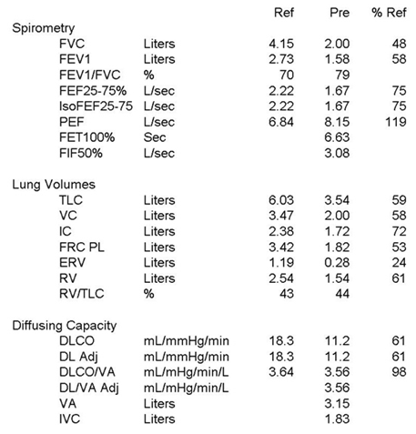
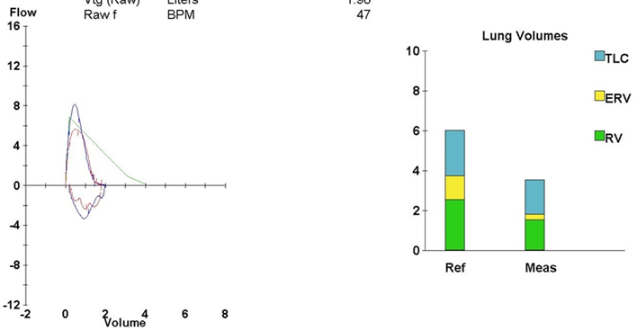
PFT (2018.10.17.)
FVC 48 % (← 51 %)
DLCO 61 % (← 76 %)

Slide 6
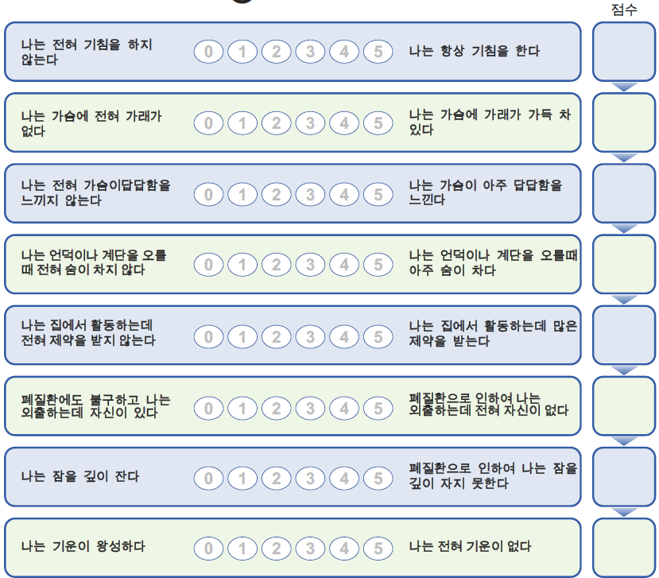

Clinical Assessment – CAT score (2018.10.18.)
1
2
3
5
2
4
4
4
25

Slide 7
Clinical Assessment – 6MWT (2018.10.18.)
440m
완주 여부: 예
검사 중 산소 공급 여부: 아니오
걷기 전
  BP: 120/70 mmHg
  Pulse rate: 75 bpm
  Saturation: 97 %
  Dyspnea 점수: 1-2 점
  Fatigue 점수 : 5 점
검사 중 저산소증 여부: 아니오
완주 후
  BP: 130/80 mmHg
  Pulse rate: 91 bpm
  Saturation: 95 %
  Dyspnea 점수: 5 점
  Fatigue 점수: 6 점

Slide 8

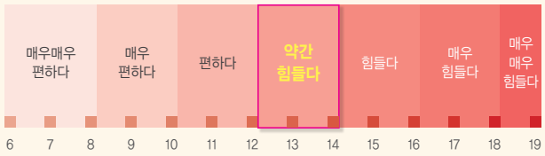
Exercise Program
Frequency
  Hospital-based PR: 2/week
  + Home-based exercise 1~2/week
Intensity: Borg scale 13
Time: 60 min (40 / 10 / 10 min)
Type: Aerobic training
Resistive exercises
Breathing training
Total 31 sessions, 22 weeks

Slide 9
Aerobic Exercises
Recumbent bicycle
  Interval training
  20 sec – 40 sec
  60 rpm
1~2w
60 – 30 Watt
5~6w
70 – 35 Watt
65 – 30 Watt
3~4w
7~12w
65 – 35 Watt
13~14w
75 – 35 Watt
17~20w
80 – 45 Watt
75 – 40 Watt
15~16w
21w~
75 – 45 Watt

Slide 10
Aerobic Exercises
Treadmill
  Interval training
1~2w
5~6w
3.0 km/h, 3 ˚
2.8 km/h, 0 ˚
3~4w
7~12w
2.8 km/h, 3 ˚
13~14w
3.0 km/h, 6 ˚
17~20w
3.8 km/h, 6 ˚
3.3 km/h, 6 ˚
15~16w
21w~
3.5 km/h, 6 ˚

Slide 11
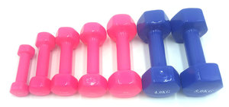
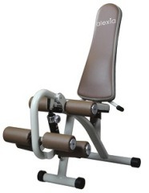
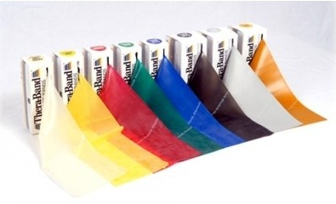
Resistive Exercises
Upper extremities
  Theraband & Dumbell
  5 minutes
Lower extremities
  Leg extensor
  5 minutes

Slide 12
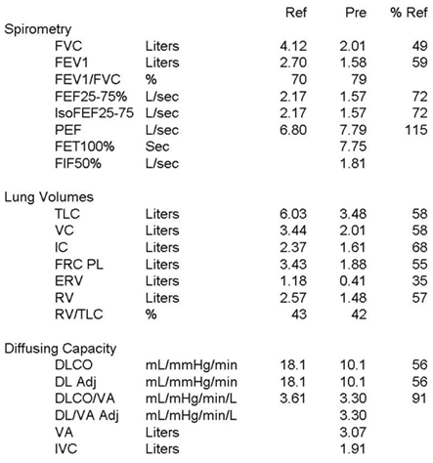
PFT (2019.02.13.)
FVC 49 % (← 48 % ← 51 %)
DLCO 56 % (← 61 % ← 76 %)

Slide 13
Clinical Assessment – CAT score (2019.03.15.)
0
0
1
2
1
1
25
↓
3
2
10

Slide 14
Clinical Assessment – 6MWT (2019.03.15.)
440m
완주 여부: 예
검사 중 산소 공급 여부: 아니오
걷기 전
  BP: 137/73 mmHg
  Pulse rate: 72 bpm
  Saturation: 96 %
  Dyspnea 점수: 0 점
  Fatigue 점수 : 0 점
검사 중 저산소증 여부: 아니오
← No interval change
완주 후
  BP: 158/72 mmHg
  Pulse rate: 81 bpm
  Saturation: 94 %
  Dyspnea 점수: 0 점
  Fatigue 점수: 0 점

