Slide 1

제259회 대한 결핵 및 호흡기학회
심포지엄 증례 보고
25-MAY-2018
Division of Pulmonary and Critical Care Medicine
Department of Internal Medicine, College of Medicine
Ewha Womans University

Slide 2
Name : 김 O 도
Age/Sex : 49/M
OPD visit date: 2017-09-06
C.C : multiple bone metastasis
on routine follow-up examination

Slide 3
Present Illness
1년 전 건진에서 시행한 흉부 전산화 단층촬영에서 좌측 상엽에 1.5cm의 결절 확인되어 좌측 폐상엽절제술 시행 후 폐 선암 (stage IIIA, pT1aN2M0) 진단받음.
8개월 전까지 보조 항암 요법으로 carboplatin + vinorelbine 5 cycle 시행 뒤 재발 증거 없이 경과 관찰 하던 자로
1주일 전 시행한 추적 흉부 전산화 단층 촬영에서 다발성 골전이 의심되어 내원함.

Slide 4
Past History
Medical history
HTN/DM/Pul Tbc/Hepatitis (-/-/-/-)
Aplastic anemia (1996)
Medication: SC G-CSF, intermittently
Social history
Smoking/Alcohol : Ex-smoker (30PYS)/none

Slide 5
Review of System
Cough / hemoptysis ( - / - )
Dyspnea / DOE ( + / - )
Fever / Chill ( - / - )
General weakness / Easy fatigue ( - / -)
Poor oral intake / Wt loss ( - / - )
Arthritis /Skin rashes (-/-) Lymphadenopathy (-)
Abdomen pain/ Nausea/ Vomiting/ Diarrhea (-/-/-/-)
Dysuria/ Urgency (-/-)

Slide 6
Physical examination
HEENT No palpable neck mass, No engorged neck vein
Chest Clear breathing sound without rale or wheezing
Symmetric expansion without retraction
Heart Regular heartbeat without murmur
Abdomen Normoactive bowel sound without distended abdomen
Hepatosplenomegaly(-) tender point (-)
Back & ext. Costovertebral angle tenderness (-/-)
Pretibial pitting edema (-/-)

Slide 7
Laboratory findings
CBC : 11.9 g/dl(36.8 %) - 3570 /L (ANC: 1600) - 124k
Chemical battery
BUN/Cr 10/1.04 mg/dL
Glucose 152mg/dL
AST/ALT 24/38
Na/K : 137/4.5

Slide 8
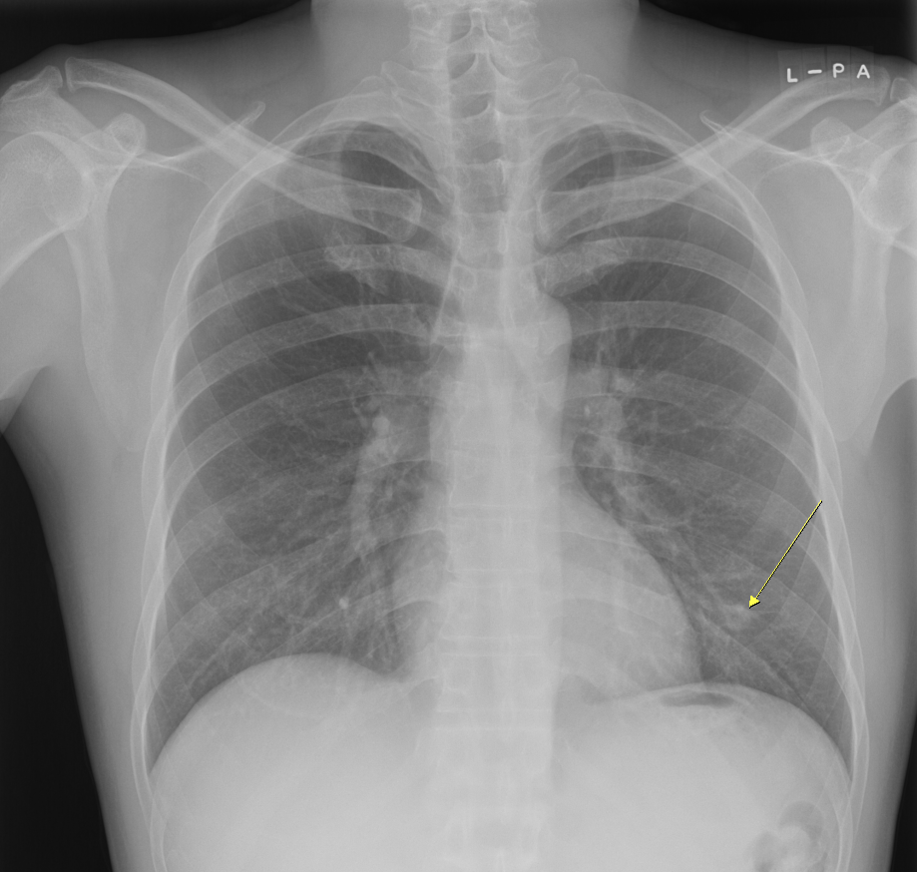
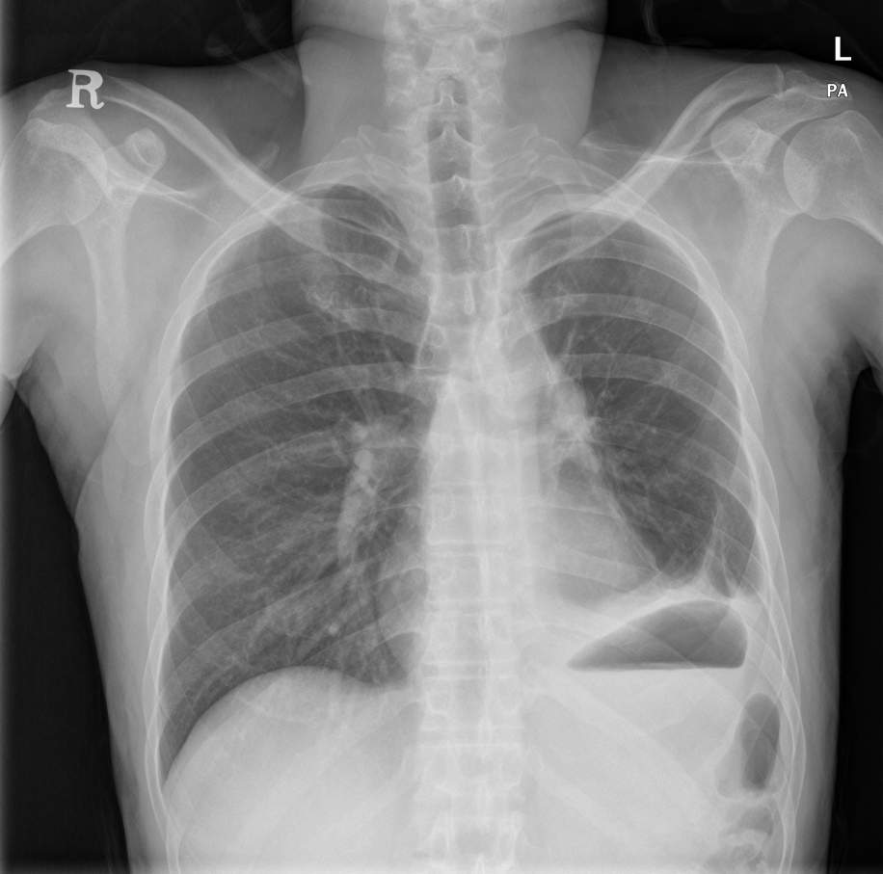
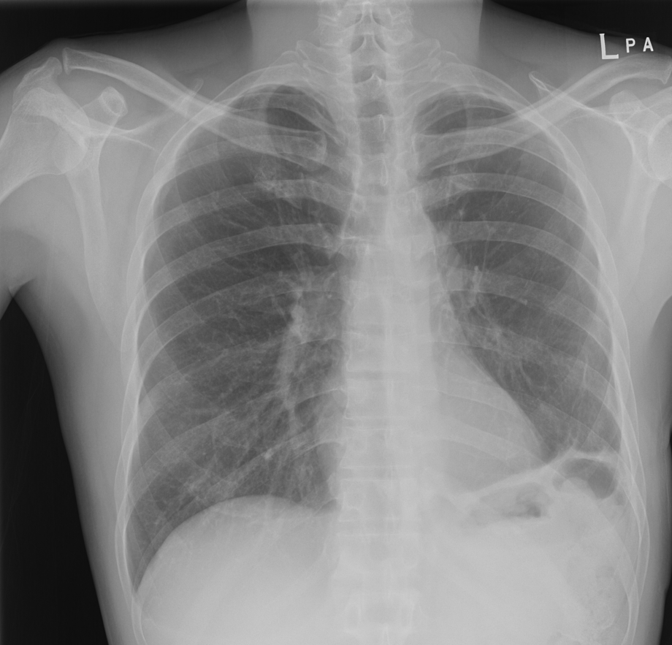
Chest radiograph
2016.9
2016.10
2017.9

Slide 9
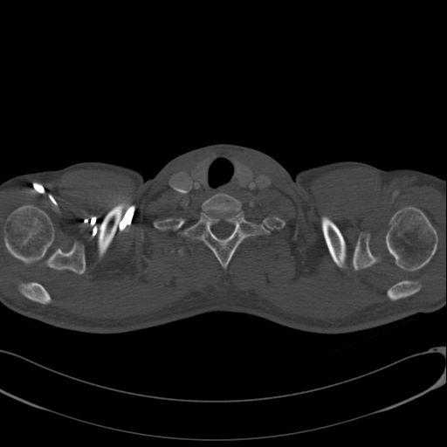
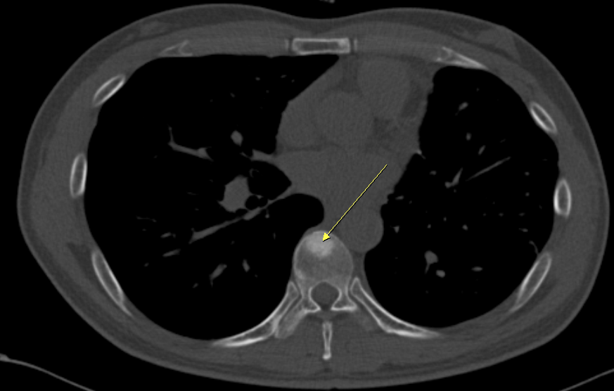
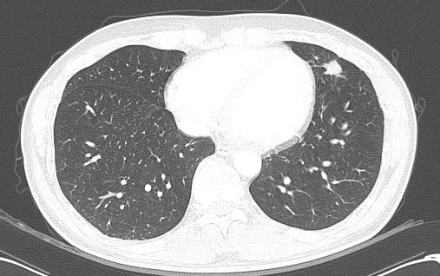
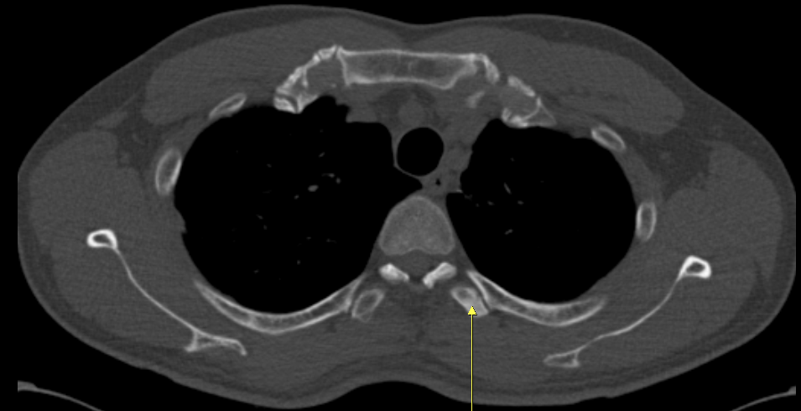
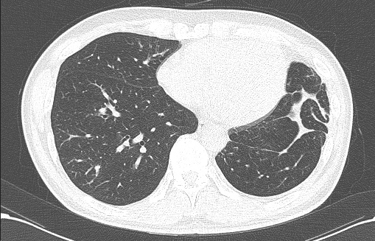
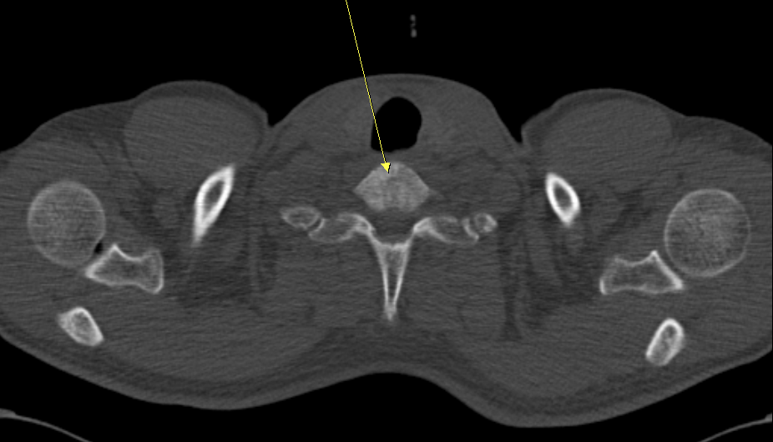
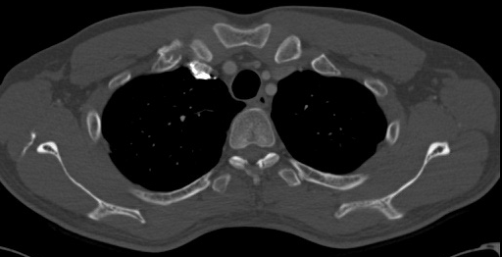
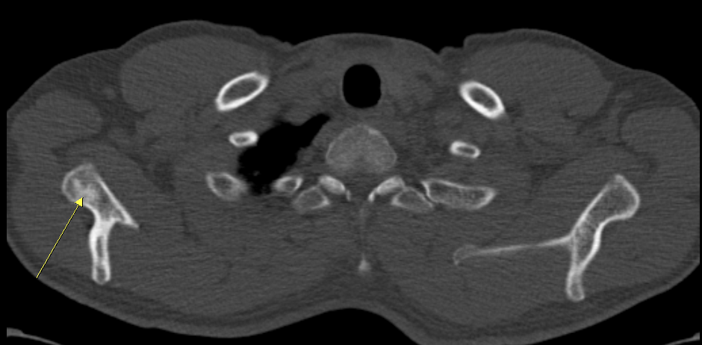
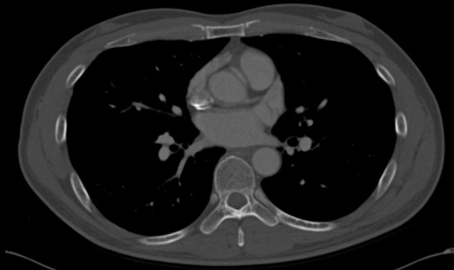
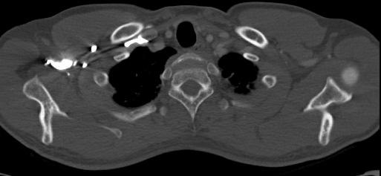
Chest CT
2016.9
2017.6

Slide 10
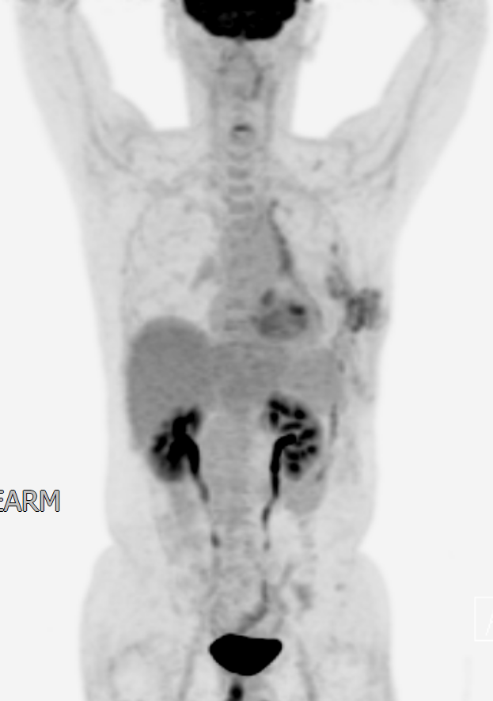
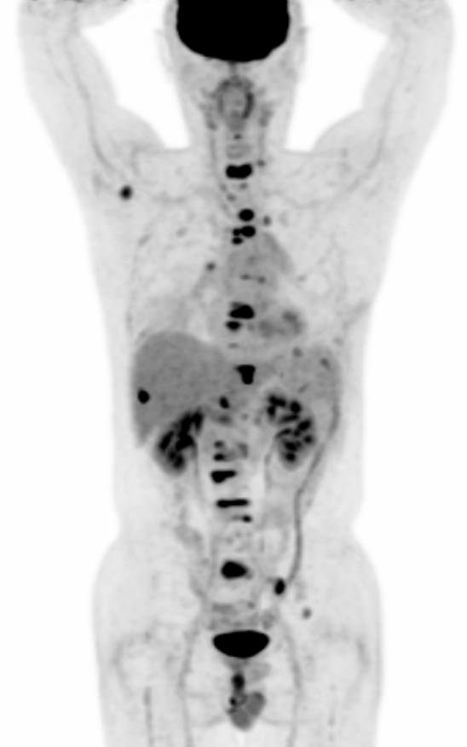
PET-CT
2016.10
2017.9

Slide 11
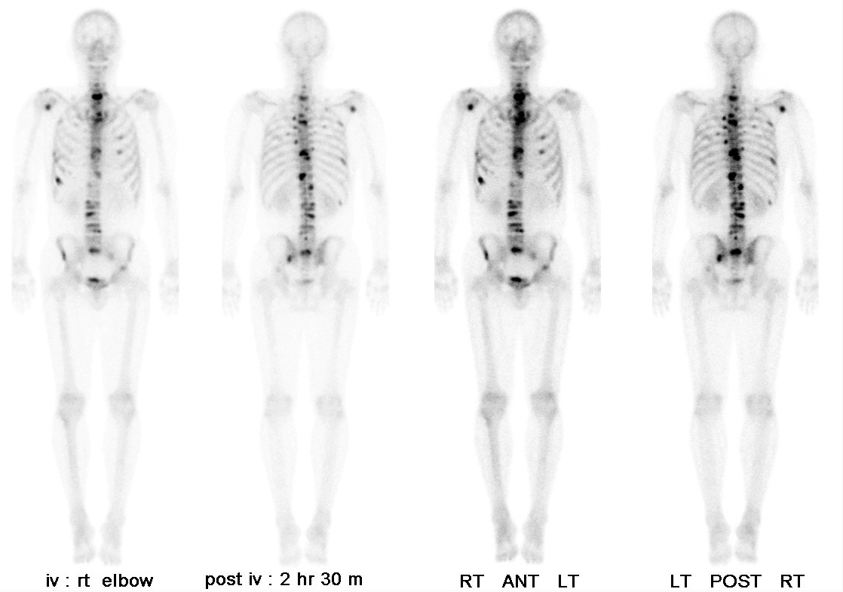
Bone scan

Slide 12
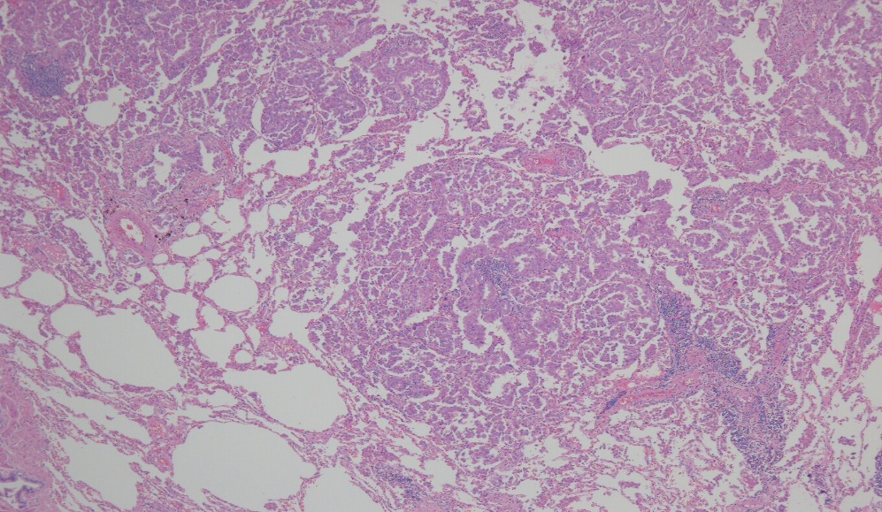
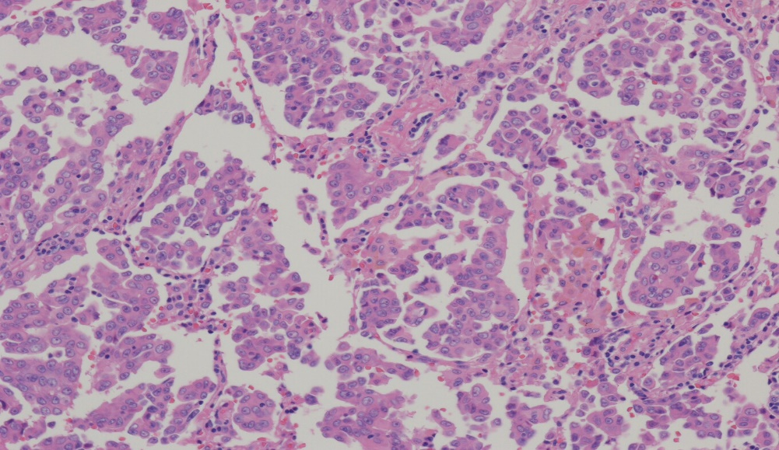
Pathology-2016.9
PATHOLOGICAL DIAGNOSIS :
Dx: I)-VI) Lung, left upper lobe, lobectomy ;
ADENOCARCINOMA, moderately differentiated
(histologic type by IASLC/ATS/ERS classification: acinar)
with 1) tumor size : 1.5 x 1.3cm (See Comment)
2) no pleural invasion (PL0)
3) lymphovascular invasion: present
4) perineural invasion: absent
5) negative bronchial resection margin
6) metastatic carcinoma in 4 out of 5 lymph nodes (4/5)
: LN2(1/1), LN4(1/1), LN5(1/1), LN9(1/1), LN10(0/1)
7) background lung: unremarkable
Tumor stage: T1A N2

Slide 13
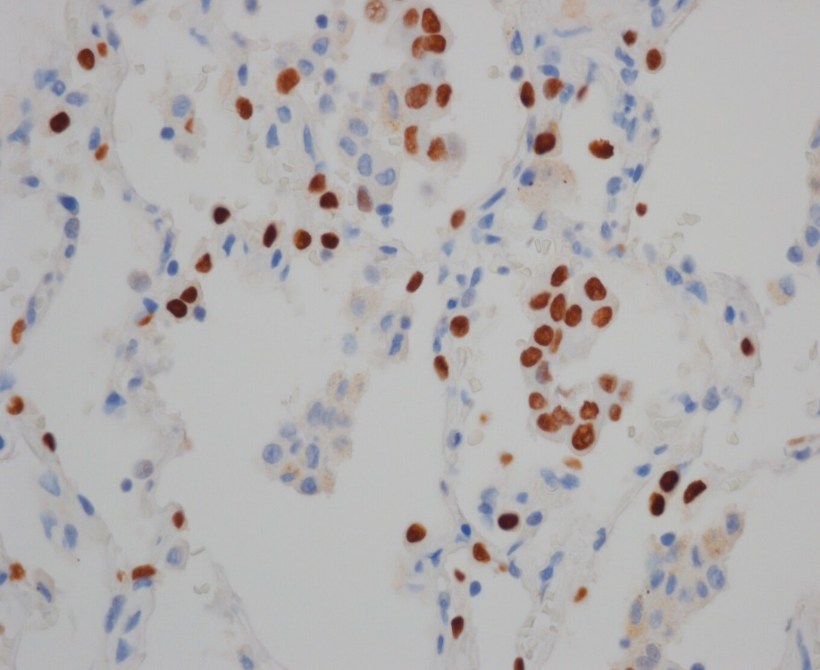
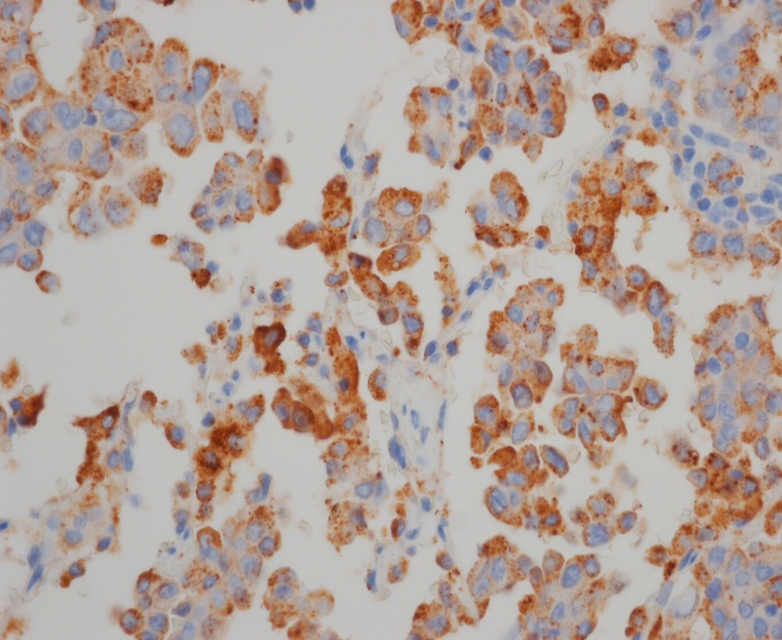
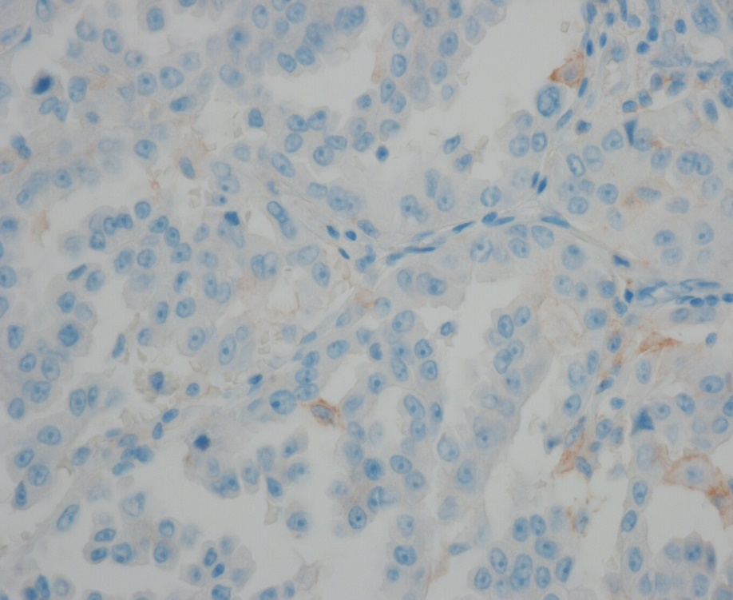
Pathology-IHC
TTF-1
Napsin A
PD-L1
ALK: positive
EGFR: negative

Slide 14
Diagnosis
: Recurred NSCLC, Adenocarcinoma, ALK (+)
with multiple bone metastasis
Treatment
: Crizotinib

Slide 15
2017.12
S> 미각이 이상해요
O>
  CBC : 12.0 g/dl(37.1 %) - 3170 /L (ANC: 1000) - 106k
  BUN/Cr 13/0.88 mg/dL
  Glucose 181mg/dL
  AST/ALT 20/21
  Na/K : 141/4.1

Slide 16
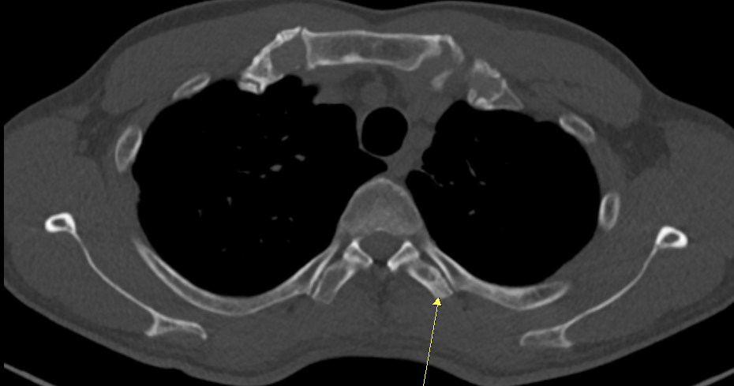
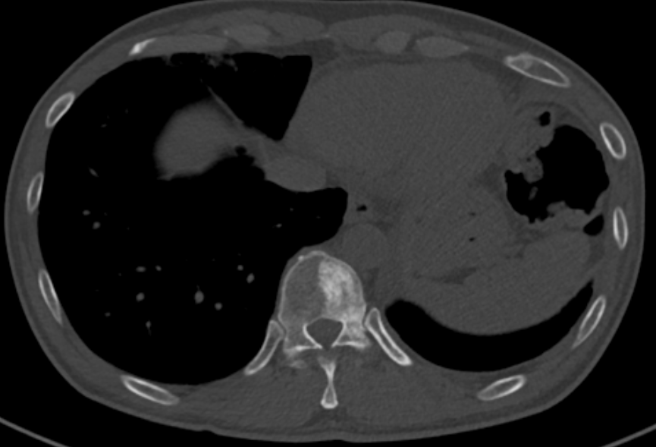
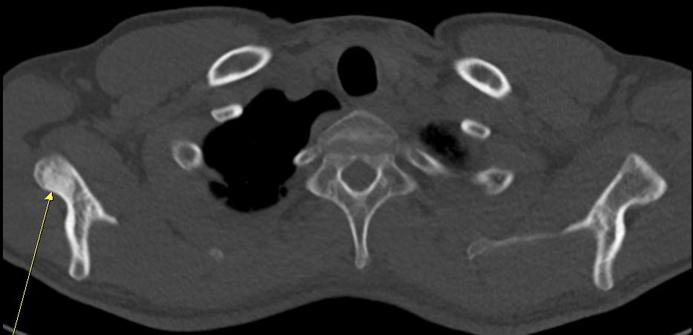
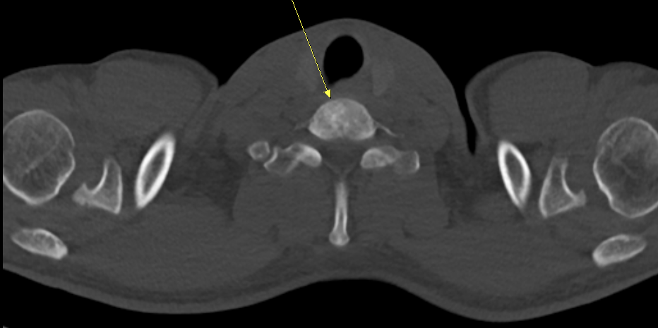
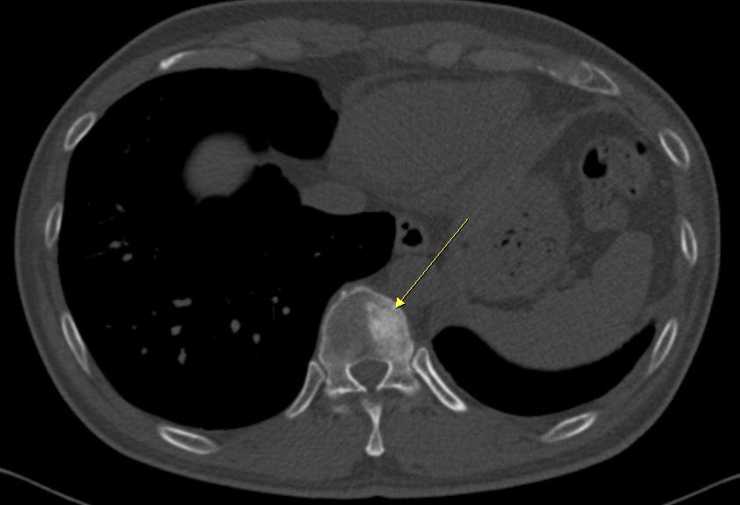
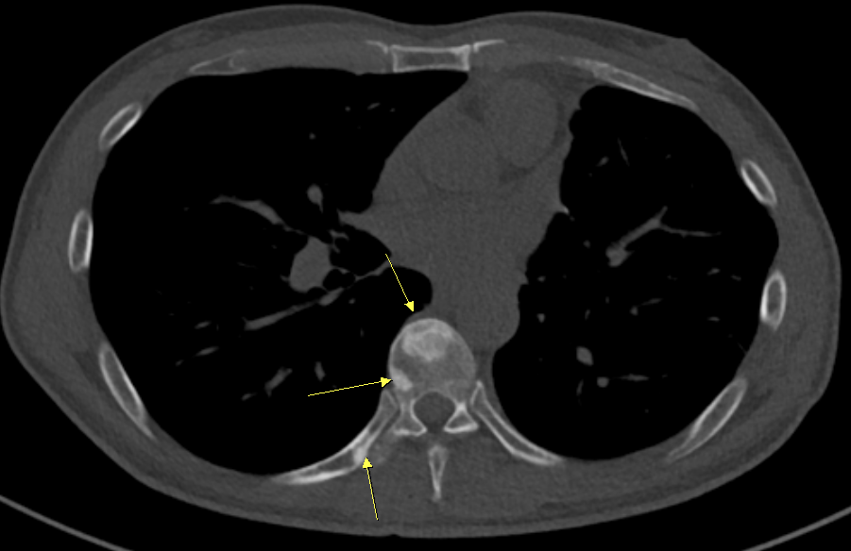
Chest CT, 2017.12
2017.9
2017.12

Slide 17
2017.12
A> NSCLC, Adenocarcinoma, ALK (+)
with interval aggravated bone metastasis
P>
  Bone biopsy recommend → refuse
  Crizotinib → Alectinib

Slide 18
2018.5
S> Not complaints
O>
  CBC : 12.4 g/dl(36.8 %) - 3430 /L (ANC: 1550) - 111k
  BUN/Cr 15/0.87 mg/dL
  AST/ALT 22/20

Slide 19
2018.5
A> NSCLC, Adenocarcinoma, ALK (+)
with improved bone metastasis
P>
  Maintain alectinib

Slide 20
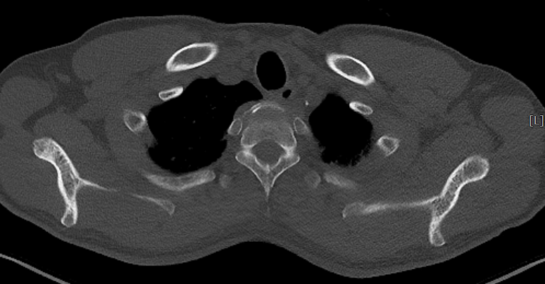
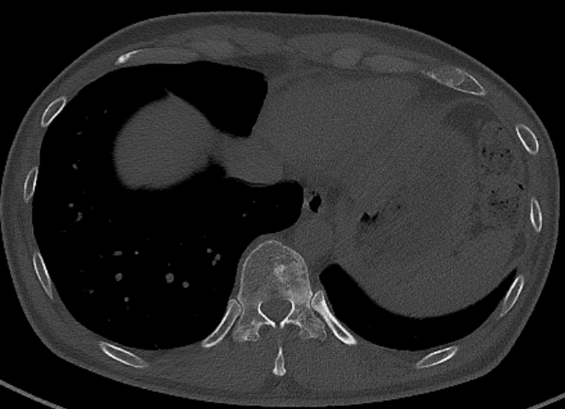
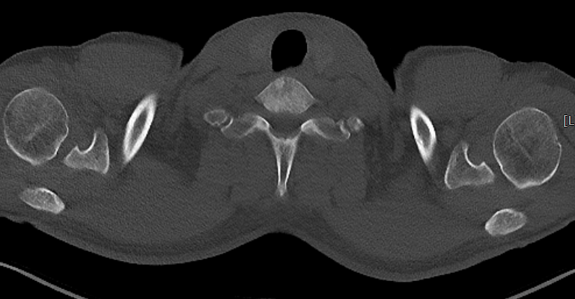
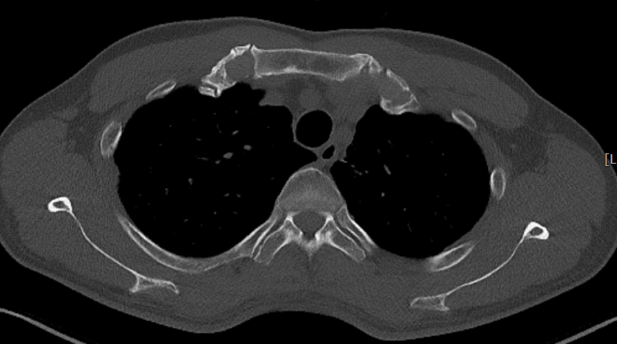
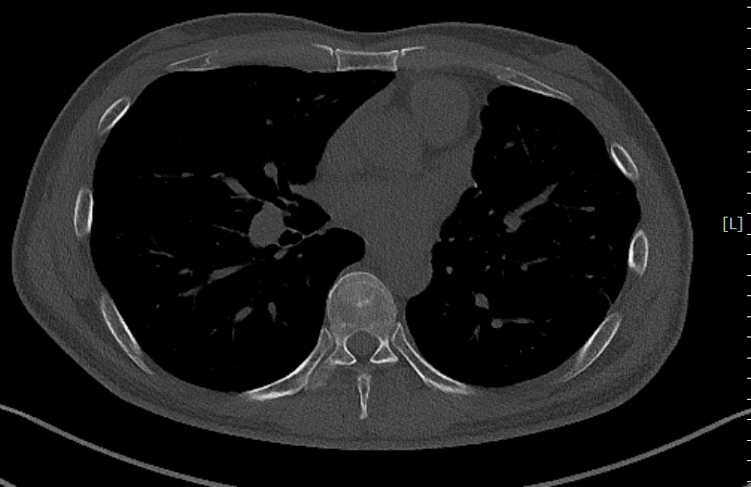
Chest CT, 2018.5
2017.12
2018.5

Slide 21
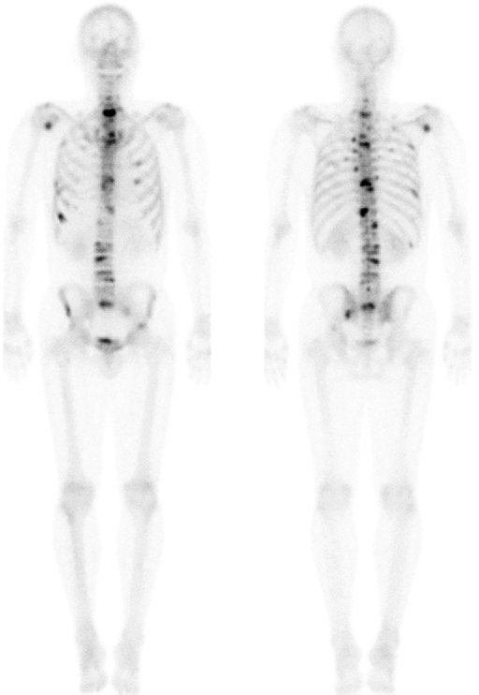
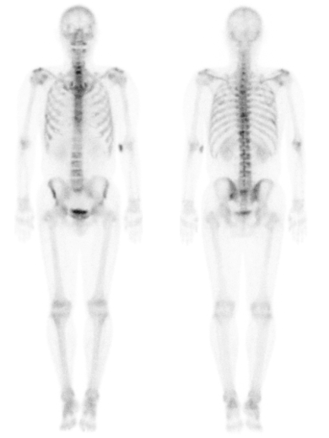
Bone scan 2018.5
2017.9
2018.5

Slide 22
Course
Improved
stage IIIA, pT1aN2M0
Bone metastasis
No recurrence
Aggravation
16’ 9
16’ 10
17’ 1
17’ 3
17’ 9
17’ 12
18’ 5
VATS-LULobectomy
Crizotinib
Alectinib
Carboplatin + vinorelbine #5

Slide 23
Review

Slide 24
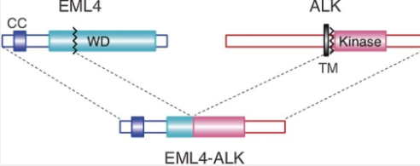
ALK (anaplastic lymphoma kinase)
ALK rearranged (ALK+)
  2 to 7%
  Sensitive to small molecule ALK inhibitors
EML4-ALK; Inv(2)(p21;p23)
Younger age
never smokers or have a very light smoking history
Mutually exclusive to EGFR and KRAS
JAMA. 2014;311:1998-2006.
Nature. 2007;448:561-566
J Clin Oncol. 2009;27:4232-4235
Proc Jpn Acad Ser B Phys Biol Sci. 2015;91(5):193-201

Slide 25
ALK Targeted treatment
Crizotinib Metastatic NSCLC with ALK + or ROS1 Approval August 2011 | Certinib ALK+ metastatic NSCLC with disease progression on or intolerability to crizotinib Approval April 2014 | Alectinib ALK+ metastatic NSCLC with disease progression on or intolerability to crizotinib Approval December 2015

Slide 26
Crizotinib vs. Alectinib
Phase 3 RCT
 | ALEX |  | J-ALEX
 | Crizotinib (250mg bid) | Alectinib (600mg bid) | Crizotinib (250mg bid) | Alectinib (300mg bid)
Target | treatment-naive ALK-positive |  | Japanese, ALK-positive, chemotherapy-naive or had received one previous chemotherapy
N | 151 | 152 | 103 | 104
Age (years) | 53.8 | 56.3 | 61.0 | 59.5
Male | 42% | 45% | 39% | 40%
Disease stage
IIIB | 4% | 3% | 3% | 3%
IV | 96% | 97% | 72% | 74%
Post op recur | ND | ND | 25% | 23%
CNS disease | 38% | 42% | 30% | 16%
N Engl J Med 2017; 377:829-838
Lancet. 2017 Jul 1;390(10089):29-39. doi: 10.1016/S0140-6736(17)30565-2.

Slide 27
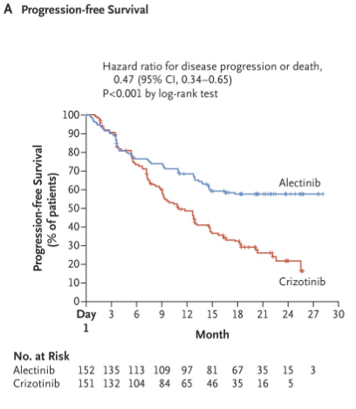
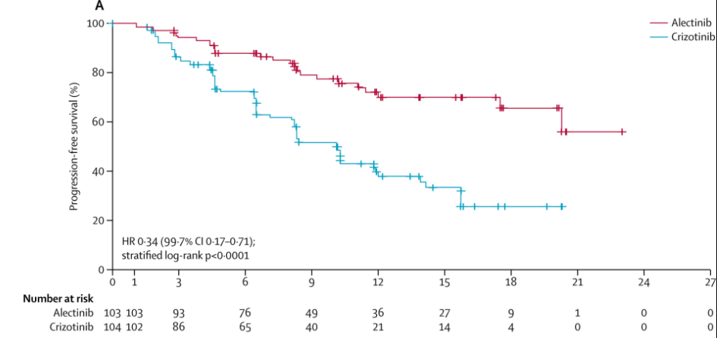
Crizotinib vs. Alectinib
Progression-free survival
N Engl J Med 2017; 377:829-838
Lancet. 2017 Jul 1;390(10089):29-39. doi: 10.1016/S0140-6736(17)30565-2.

Slide 28
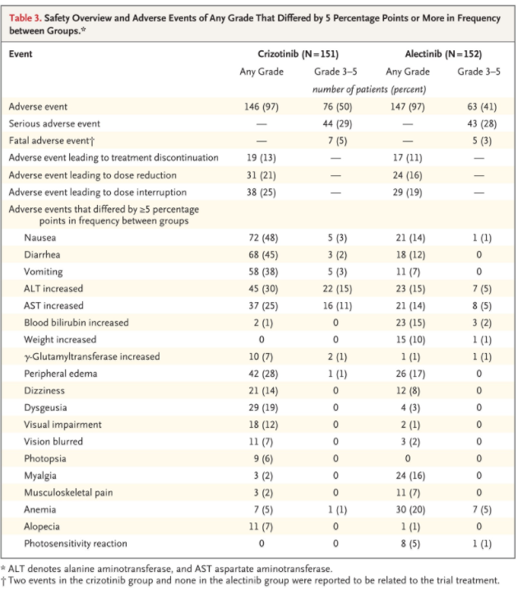
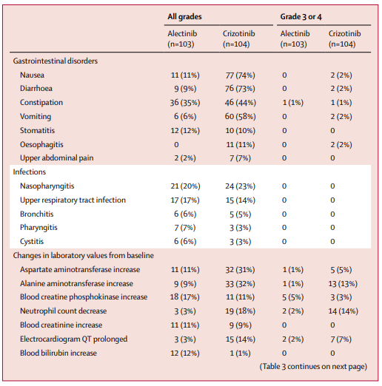
Crizotinib vs. Alectinib
Adverse events
N Engl J Med 2017; 377:829-838
Lancet. 2017 Jul 1;390(10089):29-39. doi: 10.1016/S0140-6736(17)30565-2.

Slide 29
Crizotinib vs. Alectinib
As compared with crizotinib, alectinib showed superior efficacy and lower toxicity in primary treatment of ALK-positive NSCLC.
N Engl J Med 2017; 377:829-838
Lancet. 2017 Jul 1;390(10089):29-39. doi: 10.1016/S0140-6736(17)30565-2.

Slide 30
Thank you

