Slide 1

Clinical remission in asthma: role of Single Inhaler Triple Therapy
보건의료전문가용
Dr Greg King
Royal north shore hospital
The woolcock institute of medical research
Faculty of Medicine and Health, Sydney university
PM-KR-FVU-PPTX-250047 Jun 2025

Slide 2
Disclaimer
All contents presented in this deck are owned by the speaker and do not necessarily represent the views and opinions of GSK.
GSK does not promote off-label use. Physicians should refer to the approved PI before prescription.
These slides were not developed by GSK and the external expert is solely responsible for any necessary third-party consents. Slides may not be re-used without obtaining copyright permission from GSK.
This event is organized and fully funded by GSK and contains GSK promotional materials.

Slide 3
Outline
What is clinical remission?
Why is important?
Is it achievable?
The role if inhaled therapy
Speaker’s opinion

Slide 4
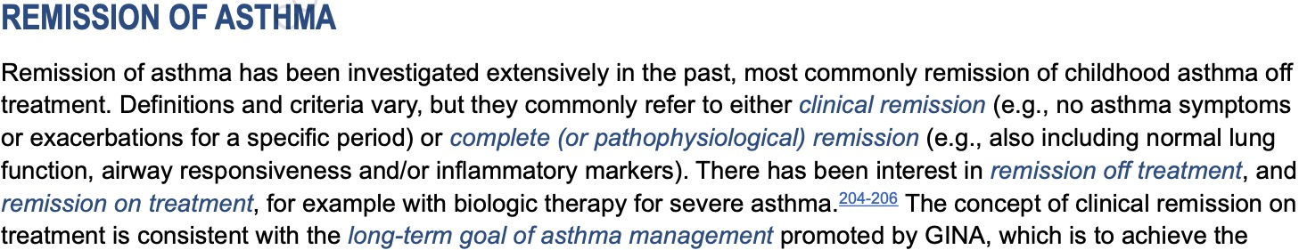
What is clinical remission?
2024 Global Initiative for Asthma

Slide 5
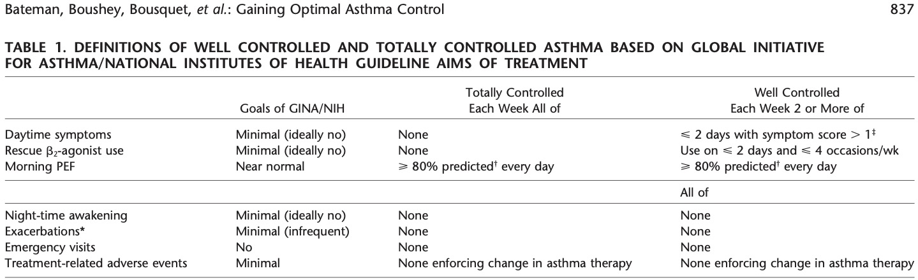
What is clinical remission?
Bateman, Eric D., et al. GOAL Study AJRCCM 2004. Vol 170. pp 836–844

Slide 6
What is clinical remission?
Feel ‘normal’
Have normal physiology
Get through RTI’s without exacerbating
Speaker’s opinion

Slide 7
Why it is important
Patients report that their asthma is controlled
However, they are still having symptoms
Nathan, Robert A., et al. J ALLERGY CLIN IMMUNOL PRACT 2015. 3(5):734-42

Slide 8
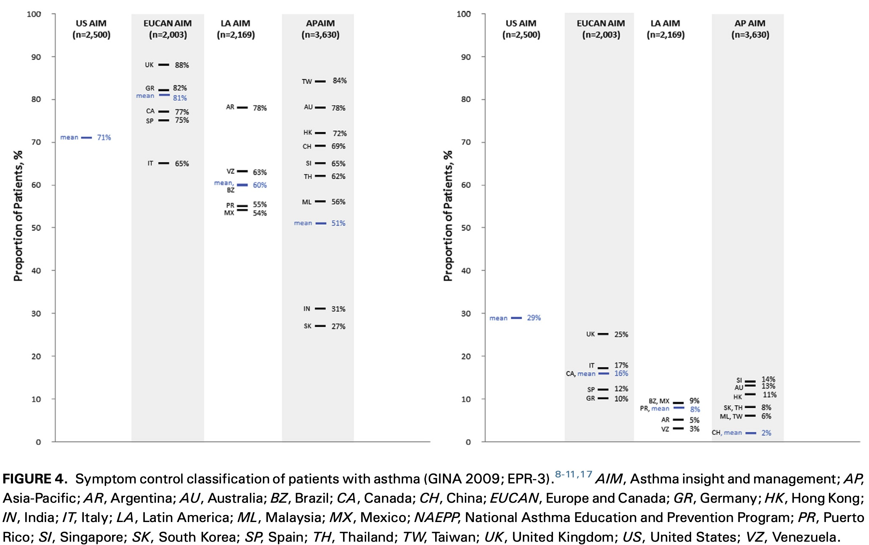
Patients’ view of their control
Patients’reported symptom control
Nathan, Robert A., et al. J ALLERGY CLIN IMMUNOL PRACT 2015. 3(5):734-42

Slide 9

1. Symptom control
Considerations are simplistic
Highly complex
Poor understanding of symptoms
  mis-diagnosis and sub-optimal management
Speaker’s opinion

Slide 10
1. Symptom control
Asthma symptoms are caused by bronchoconstriction
Symptoms can be deceiving
  hyper-perceivers and poor-perceivers
Shortness of breath on exertion
  Fixed Airflow Obstruction (FAO)
Multiple modifiers
  ‘treatable traits’
    obesity, rhinitis, GORD, bronchitis, breathing pattern disorder/upper airway
Speaker’s opinion

Slide 11

Case: Ms MC
Speaker’s opinion

Slide 12
Background
45 year-old gnocchi chef / restauranteur
19 years in the same occupation
non-smoker
increasing gnocchi production in recent months
Speaker’s opinion

Slide 13
Presenting problem
Episodic wheeze, chest tightness and cough
  triggered by exposure to flour and smoke
  small amount of clear sputum
  last 2-3 days post exposure
breathlessness on walking
  limited to 50m
  previously unlimited
no response to high dose ICS/LABA
Speaker’s opinion

Slide 14
Lung function
normal spirometry, lung volumes and diffusion
no bronchodilator responsiveness
Speaker’s opinion

Slide 15
Summary
increasing symptoms with occupational triggers
diagnosis of occupational asthma
Speaker’s opinion

Slide 16


Slide 17
Investigations
PEF 300 – 350 LPM
methacholine bronchial challenge test –ve
FeNO normal (10 ppb)
Speaker’s opinion

Slide 18
Review of symptoms
Suddenly woken from napping on cough
  gasping lasting seconds
  concerned and anxious +++
when making gnocchi
  dyspnoea
  inspiratory noises
  sudden onset
Speaker’s opinion

Slide 19
Progress
Initial assessment by Speech Pathologist in Asthma Clinic
  agreed suggestive of ILO – inducible laryngeal obstruction
provocation testing with flexible laryngoscopy
  confirmed ILO
dramatic improvement with therapy
Speaker’s opinion

Slide 20
Summary
initial assessment of symptoms led to diagnosis of asthma
physiology persistently normal
bronchial challenge test reproduced symptoms
  stridor observed
  abnormal inspiratory flow volume
symptoms typical of ILO on review
confirmed by provocation testing with laryngoscopy
Symptoms can be deceiving!
Speaker’s opinion

Slide 21
Inhaled therapy and clinical remission
Most patients can achieve ‘clinical remission’ or ‘total control’
Maneechotesuwan, Kittipong, et al. Pulmonary Therapy 10.3 (2024): 279-295.

Slide 22
Case: Ms KO’B
Speaker’s opinion

Slide 23
Background
40 year old audiologist
Asthma since 7 years of age
Hospitalised in childhood x2
Regular ICS medium dose
Excellent symptom control
Lifelong non-smoker
Speaker’s opinion

Slide 24
Presenting problem
Ongoing symptoms
  RTI 6 weeks previously
    cough, mucus ++
Wheeze, chest tightness and tiredness since then
  5 days prednisone (last was 10 years ago) with ‘some’ response
Mild breathlessness
  walking up hills
  lying down
salbutamol every 2-3 days (previously rarely)
Speaker’s opinion

Slide 25
Presenting problem
Changed to ICS/LABA very high dose
  now back to medium to high dose
On examination: well but occasional wheezes
Speaker’s opinion

Slide 26
Lung function
spirometry normal
oscillatory impedance normal
no bronchodilator responsiveness
Speaker’s opinion

Slide 28
Summary
Were her new symptoms due to asthma?
Change ‘out of the blue’
  no identified environmental factors
What this a real change in her asthma?
Speaker’s opinion

Slide 29
Investigations
Eosinophils 0.4 x10⁹/L
Total IgE 1,640 kU/L
Sensitised +++ all 4 allergens
Chest x-ray normal
Peak expiratory flow (PEF) diary normal
  440 – 480 LPM
Severe airway hyperresponsiveness to mannitol
  40% ΔFEV1 at dose 3
  reproduced typical symptoms (but mild)
Speaker’s opinion

Slide 30
More …..

Slide 31
What I did …
symptoms were well controlled (<weekly)
exercising normally
continue regular medium – high dose ICS/LABA
  already taking 1 puff PRN occasionally
  Action Plan: quadruple ICS if exacerbation
Speaker’s opinion

Slide 32
What happened?
8 months later
  exacerbation of usual symptoms
  PEF 480 LPM → 230 LPM
  Enacted Action Plan with good success
Then caught Flu A
Ongoing typical asthma symptoms since then
Speaker’s opinion

Slide 33
Lung Function
airflow obstruction
  20% decrease cf initial
mildly/moderately impaired reactance
both showed +ve bronchodilator response
Speaker’s opinion

Slide 34
What I did …
Prefers using pMDI having taken ICS/LABA pMDI
Treatment was changed to single inhaler triple therapy pMDI via spacer
Speaker’s opinion

Slide 35
Progress and Lung Function
6 months later improved but still worse with changes in weather
  increase in symptoms to 3-5 times/week
  spirometry and oscillatory impedance no better
    persisting bronchodilator response
Speaker’s opinion

Slide 36
Progress
Reluctant to use triple therapy inhaler bd
Change to high-dose, once daily, single inhaler triple therapy DPI
Amended Asthma Action Plan as appropriate
  quadrupling ICS dose
Speaker’s opinion

Slide 37
3 months later …
Much better
  almost no symptoms or SABA use
  PEF very stable
  no minor exacerbations
Speaker’s opinion

Slide 38
Follow-up lung function
Normal spirometry, lung volumes and diffusion
Normal oscillation mechanics
No bronchodilator responsiveness
Speaker’s opinion

Slide 39
Summary
Worsening asthma in atopic +++ individual
  symptoms and exacerbations
  initially normal PEF but severe AHR
symptoms settled on reduced medications
desire to minimise medication usage
  important and common ‘trait’
subsequently severe exacerbation: large drop in PEF
  ongoing symptoms with environmental triggers + abnormal function
‘clinical remission’ on once-daily single inhaler triple therapy DPI
  time will tell
Speaker’s opinion

Slide 40
2. Normal physiology
Effectiveness of inhaled therapy
  Fixed Airflow Obstruction (FAO)
  Airway hyperresponsiveness (AHR)
  Peak flow variability
  Small airway function
Speaker’s opinion

Slide 41
Improving Lung Function
Fixed airflow obstruction is common in asthma
  incomplete reversibility
associations
  severity, eosinophils, FeNO, childhood factors, AHR
Improves or resolves with inhaled therapy
Lee, Laurie A., et al. The Lancet Respiratory Medicine 9.1 (2021): 69-84.
Singh et al. ERJ 2020, 56(3), pp. 2000476.

Slide 42
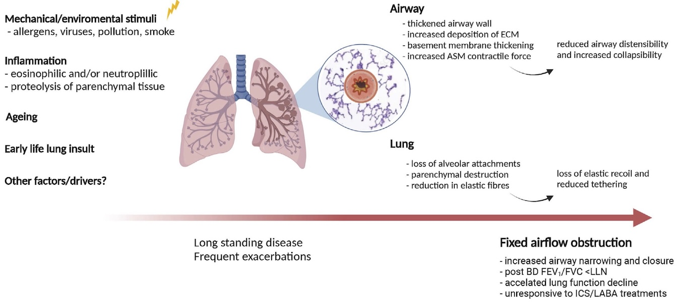
Rutting, Sandra, et al. Frontiers in Physiology 13 (2022): 898208.

Slide 43

Study design optimized ICS/LABA therapy before randomizing patients to FF/UMEC/VI or FF/VI
N=2436 (ITT population)
ICS/LABA (FF/VI)
100/25 (n=407)
ICS/LAMA/LABA (FF/UMEC/VI)**
100/31.25/25 (n=405)
Patients aged ≥18 years with an asthma diagnosis
Uncontrolled on ICS/LABA (dose equivalent to FP
>250 mcg/day)
FEV₁ ≥30 to <85% predicted with demonstrated reversibility
HRU contact for asthma in previous 12 months
5-week ICS/LABA optimization period
ICS/LAMA/LABA (FF/UMEC/VI)
100/62.5/25 (n=406)
Follow-up*
ICS/LABA (FF/VI)
200/25 (n=406)
ICS/LAMA/LABA (FF/UMEC/VI)**
200/31.25/25 (n=404)
ICS/LAMA/LABA (FF/UMEC/VI)
200/62.5/25 (n=408)
Screening
Enrollment
Randomization‡
3-week run-in
FP/SAL 250/50 BID#
2-week stabilization
FF/VI 100/25 QD†
Fixed treatment period
Variable treatment period
Follow-up
Week -5
Week -2
Week 0
Week 24
Week 52
-7 days after last study visit
Primary endpoint
**Not registered in Korea

Slide 44
Lung function and asthma control substantially improved with
FP/SAL followed by FF/VI during optimization phase
FEV₁¹
ACQ-7¹
5-week ICS/LABA optimization
5-week ICS/LABA optimization
FP/SAL
250/50 mcg
FF/VI
100/25 mcg
Clinic trough FEV₁ (mL),
mean change from Screening
Improvement
ACQ-7 total score,
mean change from Screening
Improvement
MCID³
MCID²
FP/SAL
250/50 mcg
FF/VI
100/25 mcg

Slide 45
Pooled analysis
Change from baseline in FEV₁
300
300
200
200
LS mean (95% CI) change (mL)
100
100
0
0
−100
−100
5
10
20
30
40
50
60
80
100
0.7
1.0
1.5
2.0
2.5
3.0
3.5
4.0
4.5
5.0
5.5
6.0
Baseline EOS count (cells/μl x 10)
FeNO at baseline (ppb x10)
FF/VI
FF/UMEC 62.5 mcg/VI
Pooled analysis
EOS, eosinophil; FeNO, fractional exhaled nitric oxide; FEV₁, forced expiratory volume in 1 second; FF, fluticasone furoate; LAMA, long-acting muscarinic antagonist; ppb, parts per billion; UMEC, umeclidinium; VI, vilanterol.
Lee LA, at al. Lancet Respir Med 2020.

Slide 46
Pooled analysis
Change from baseline in FEV₁
300
300
200
200
LS mean (95% CI) change (mL)
100
100
0
0
−100
−100
5
10
20
30
40
50
60
80
100
0.7
1.0
1.5
2.0
2.5
3.0
3.5
4.0
4.5
5.0
5.5
6.0
Baseline EOS count (cells/μl x 10)
FeNO at baseline (ppb x10)
FF 100 µg-containing therapies
FF 200 µg-containing therapies
Pooled analysis
EOS, eosinophil; FeNO, fractional exhaled nitric oxide; FEV₁, forced expiratory volume in 1 second; FF, fluticasone furoate; LAMA, long-acting muscarinic antagonist; ppb, parts per billion; UMEC, umeclidinium; VI, vilanterol.
Lee LA, at al. Lancet Respir Med 2020.

Slide 47

The addition of LAMA drives meaningful improvements in lung function compared with ICS/LABA
_{Unpooled analysis}
+ 110 mL
95% CI: 66, 153
p<0.001
+ 92 mL
95% CI: 49, 135
p<0.001
LS mean change (95% CI) from baseline in clinic trough FEV₁ (mL)
n=390
n=379
n=391
n=385
FF/UMEC/VI
100/62.5/25
FF/VI
100/25
FF/UMEC/VI
200/62.5/25
FF/VI
200/25

Slide 48
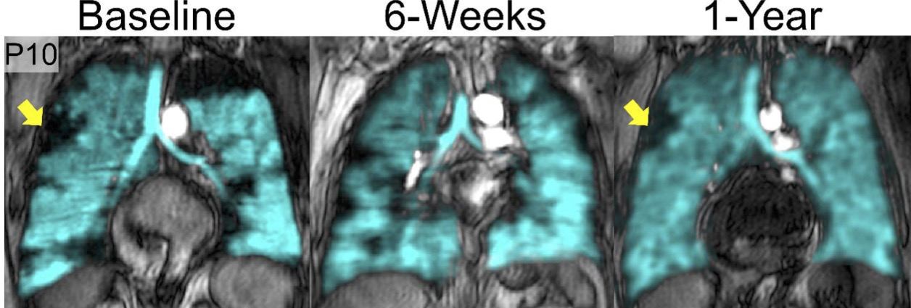
SITT Improves Regional Ventilation
*Figure shows the effect of FF/UMEC/VI on the primary endpoint, MRI VDP, in three representative participants at the baseline, 6-week and 1-year visits.
Thirty-one participants (24 females, 54±15yrs) completed baseline, 28 (21 females, 54±15yrs) completed the 6-week and 15 patients attended the 1-year visit.
At 6-weeks, there was significantly improved pre-BD VDP (P=.02), which persisted at 1-year
Mozaffaripour, Ali, et al. ERJ Open Research (2025).

Slide 49
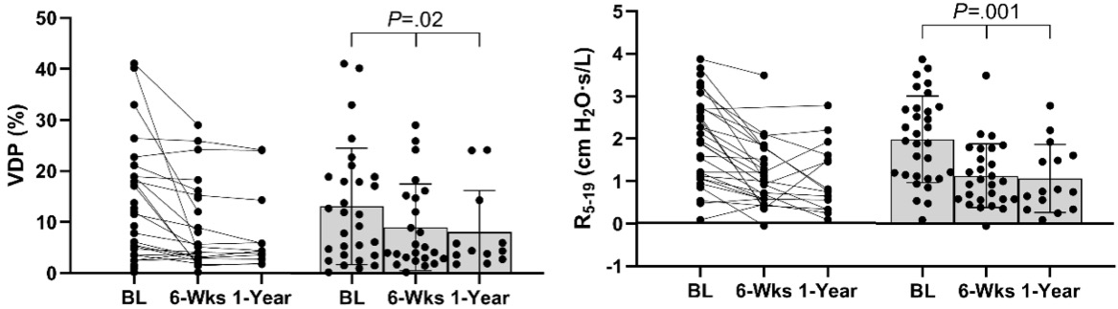
SITT Improves Regional Ventilation
Mozaffaripour, Ali, et al. ERJ Open Research (2025).

Slide 50
3. Control Of Exacerbations
Over-rely on symptoms
Differentiating between bronchitis, sinusitis and bronchoconstriction
Speaker’s opinion

Slide 51
There was no statistically significant difference on the rate of moderate/severe exacerbations with the addition of LAMA alone
_{Pooled analysis}
13% reduction
95% CI: −5.2, 28.1
p=0.151
Mean annualized rate of
moderate/severe exacerbations
n=814
n=813
FF/UMEC/VI
(100+200)/62.5/25
FF/VI
(100+200)/25

Slide 52
Attaining Clinical Remission

Slide 53
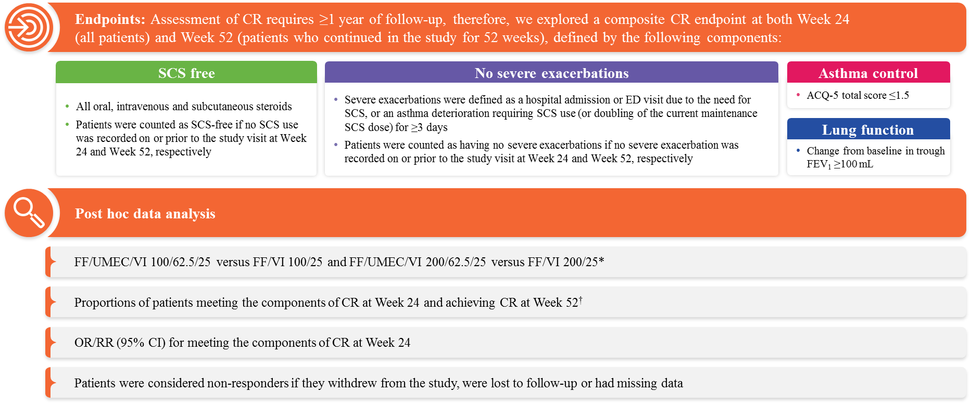
Trelegy; CAPTAIN, Post-hoc analysis
Lugogo, Njira, et al. J Allergy Clin Immunol 2024;153(2 Supplement):AB266

Slide 54
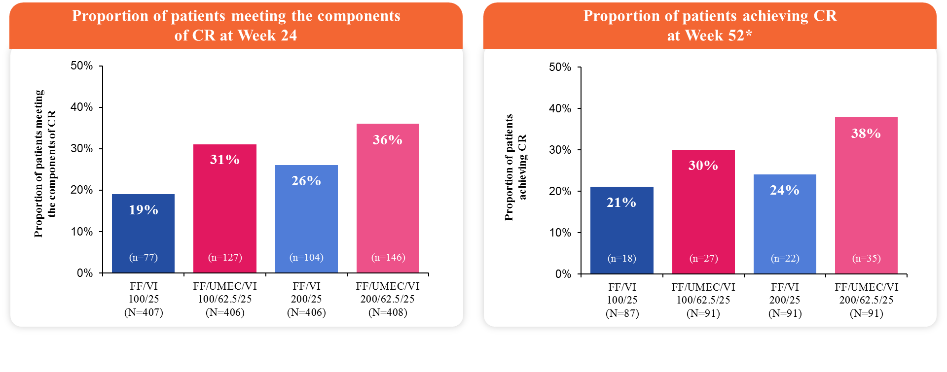
Trelegy; CAPTAIN, Post-hoc analysis
*Data at Week 52 were available from patients who continued in the study during the variable treatment period (Weeks 24–52; only a subset of patients had data available ). All doses are in µg.
Lugogo, Njira, et al. J Allergy Clin Immunol 2024;153(2 Supplement):AB266

Slide 55
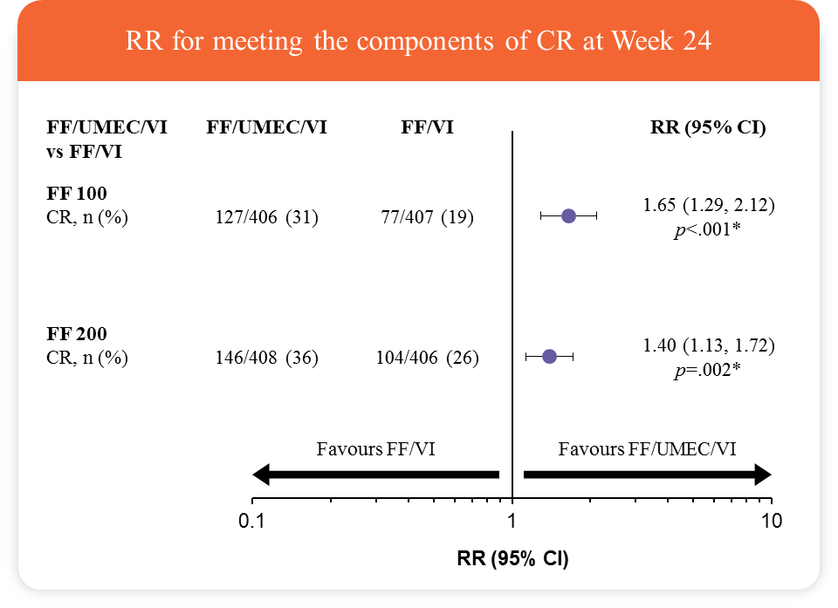
Trelegy; CAPTAIN, Post-hoc analysis
Patients who did not achieve CR represent those with disease burden & an unmet need for improved asthma management, therefore, a treatment review should be considered.
CR should be considered an ambitious but attainable treatment goal for patients with asthma irrespective of disease severity, including those receiving inhaled dual and triple therapy.
*A post hoc exploratory analysis → p values are nominally statistically significant.
Analysis was performed using a logistic model and covariates of treatment, age, sex,
region and pre-study ICS dosage at screening. All doses are in µg.
Lugogo, Njira, et al. J Allergy Clin Immunol 2024;153(2 Supplement):AB266

Slide 56
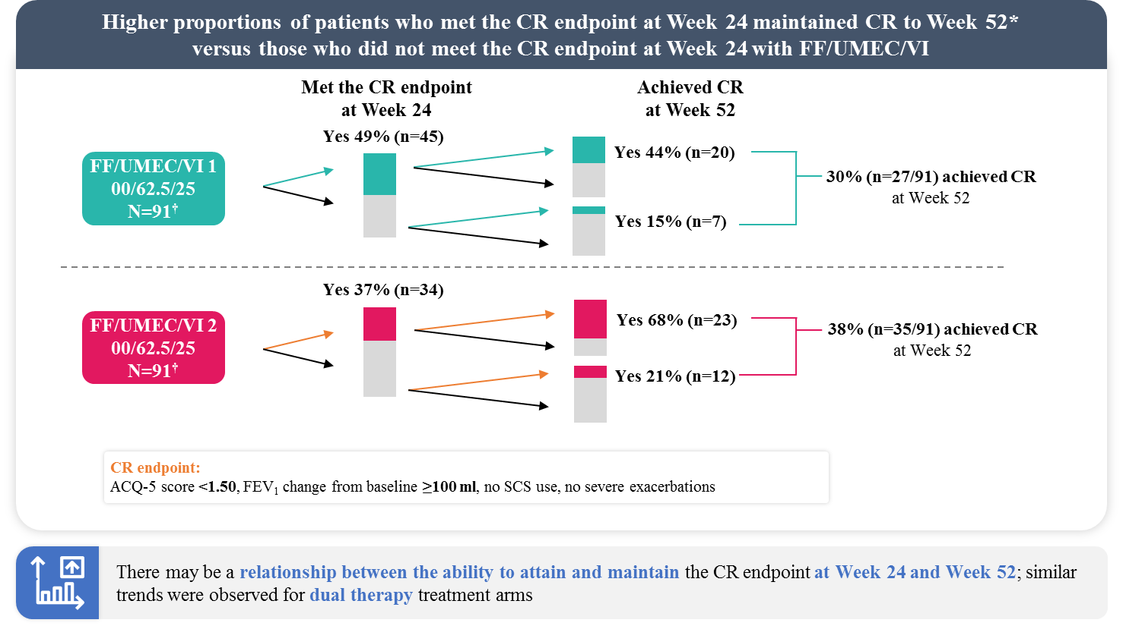
Trelegy; CAPTAIN, Post-hoc analysis
*Data at Week 52 were available from patients who continued in the study during the variable treatment period (Weeks 24–52).
Oppenheimer, John, et al. Eur Respir J 2024; 64: Suppl. 68, PA1198

Slide 57
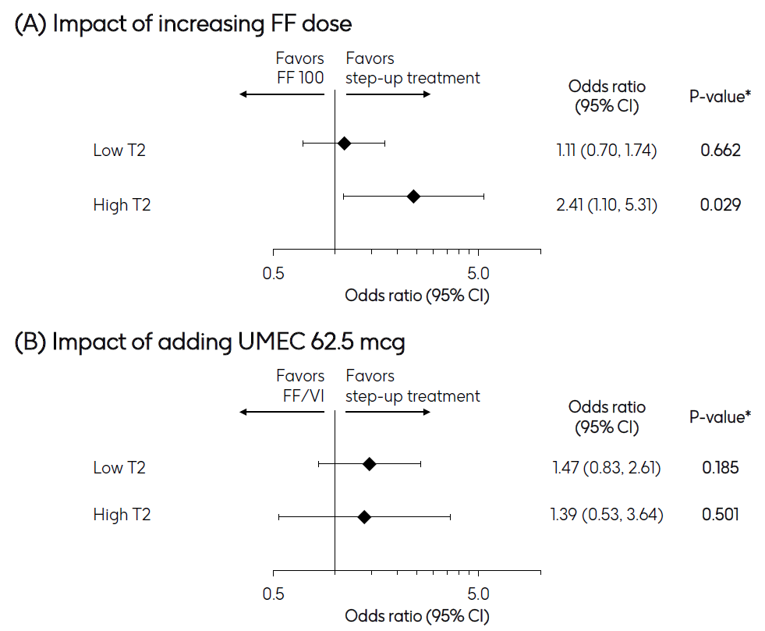
Trelegy; CAPTAIN, Post-hoc analysis
T2 inflammation
Pavord, I. D., et al. American Journal of Respiratory and Critical Care Medicine 211.Abstracts (2025): A5031-A5031.

Slide 58
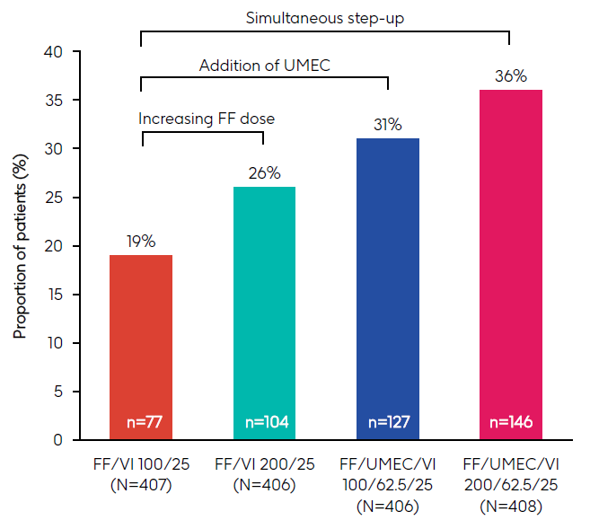
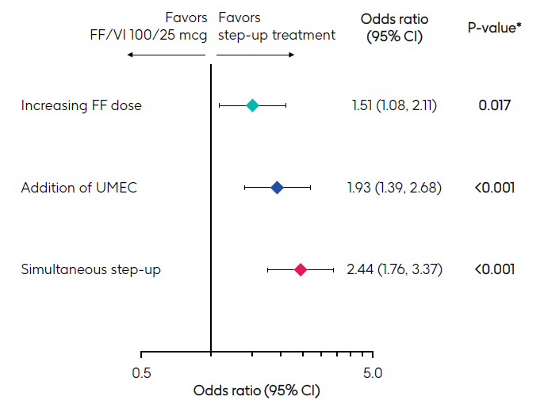
Trelegy; CAPTAIN, Post-hoc analysis
Simultaneous step-up
Pavord, I. D., et al. American Journal of Respiratory and Critical Care Medicine 211.Abstracts (2025): A5031-A5031.

Slide 59
Summary and Discussion
Asthma is a complex condition
  varied pathophysiology and clinical expression
  aiming for ‘remission or ‘total control’ is important
    requires deep understanding and comprehensive clinical assessment
  single inhaler triple therapy makes optimisation simpler
  persistently abnormal physiology means we need to better treatments
Speaker’s opinion

