Slide 1
Respiratory virus in severe pneumonia
경상대학교병원
호흡기알레르기내과
유정완

Slide 2
CONTENTS
Gyeongsang National University Hospital
01
Epidemiology
02
Characteristics of respiratory virus
03
Diagnosis
04
Treatment
05
Prognosis
06
07
08
09

Slide 3


Case
M/59
C.C: fever (1DA)
P.I: 3일전부터 cough, sputum 1일전부터 fever 발생 내원 당일 primary clinic에서 독감 진단, 발열 호전 없어 응급실 경유하여
일반병동 입원
과거력: DM (+)
직업력, 사회력: 특이 소견 없음

Slide 4
Case
Initial V/S: 110/70-123-22-38.3℃
Initial Lab finding
WBC: 2750/mm³ ( neutrophil: 87%), Hb: 16.6g/dl, Plt: 197 X10³/mm³
CRP: 10.1 mg/dl, PCT: 34.95 ng/ml, NTproBNP: 319.3 pg/ml
ABGA (RA): 7.4-33mmHg-53mmHg-87.9%, lactic acid: 3.6mmol/L
Influenza Ag test: Influenza A (+)

Slide 5
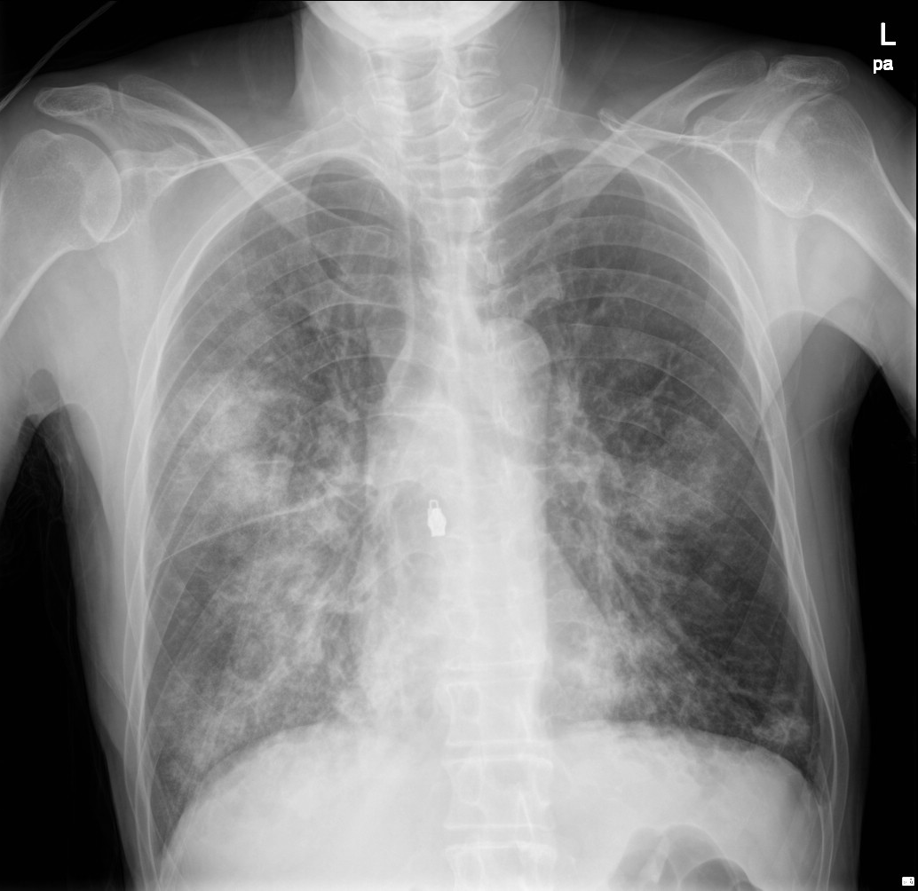
Initial CXR

Slide 6
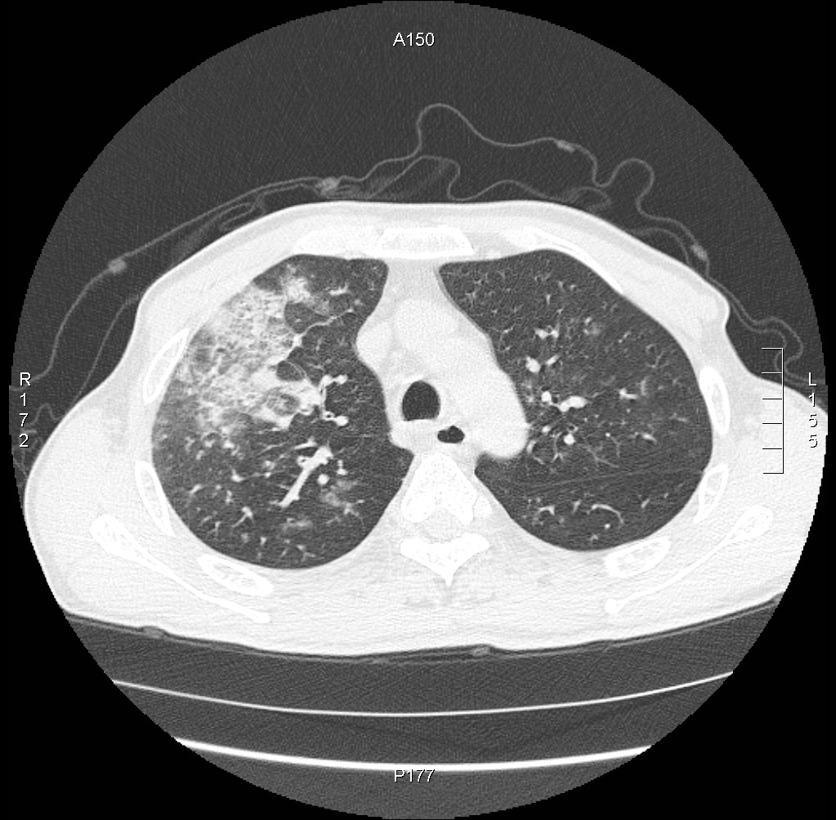
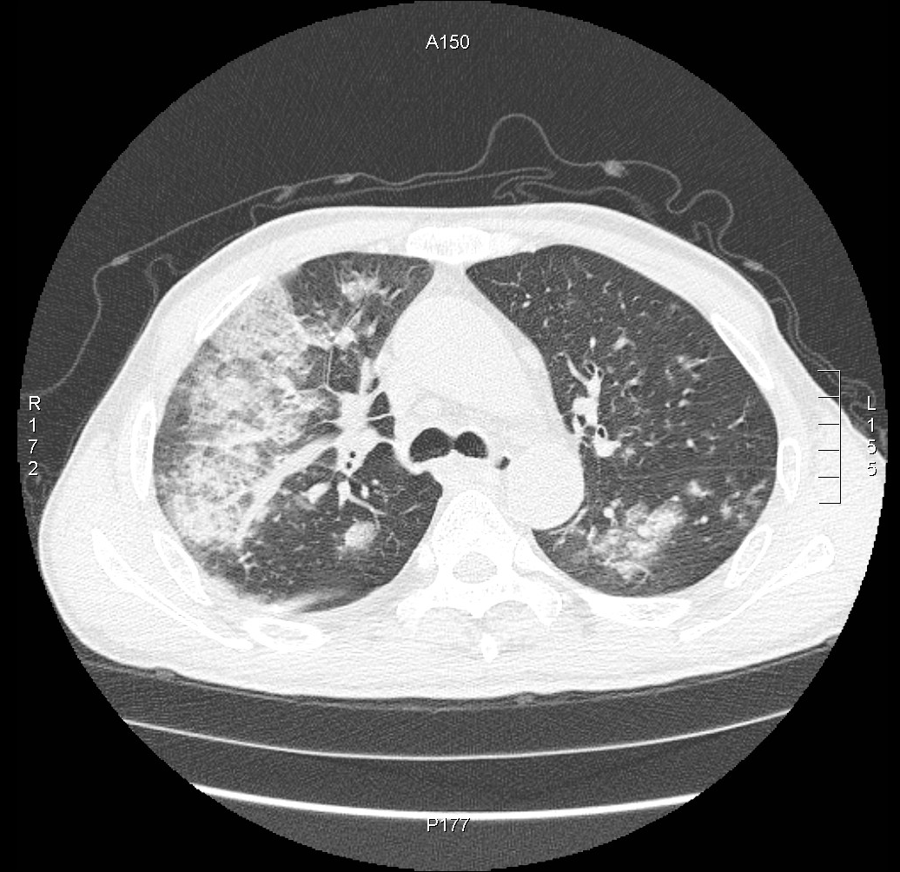
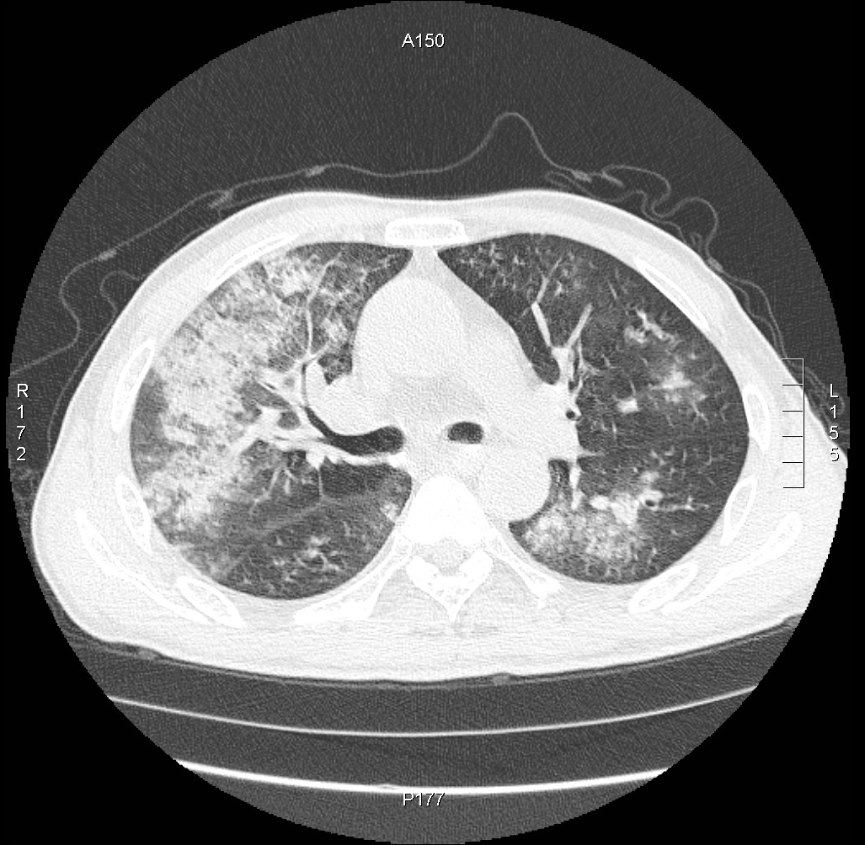
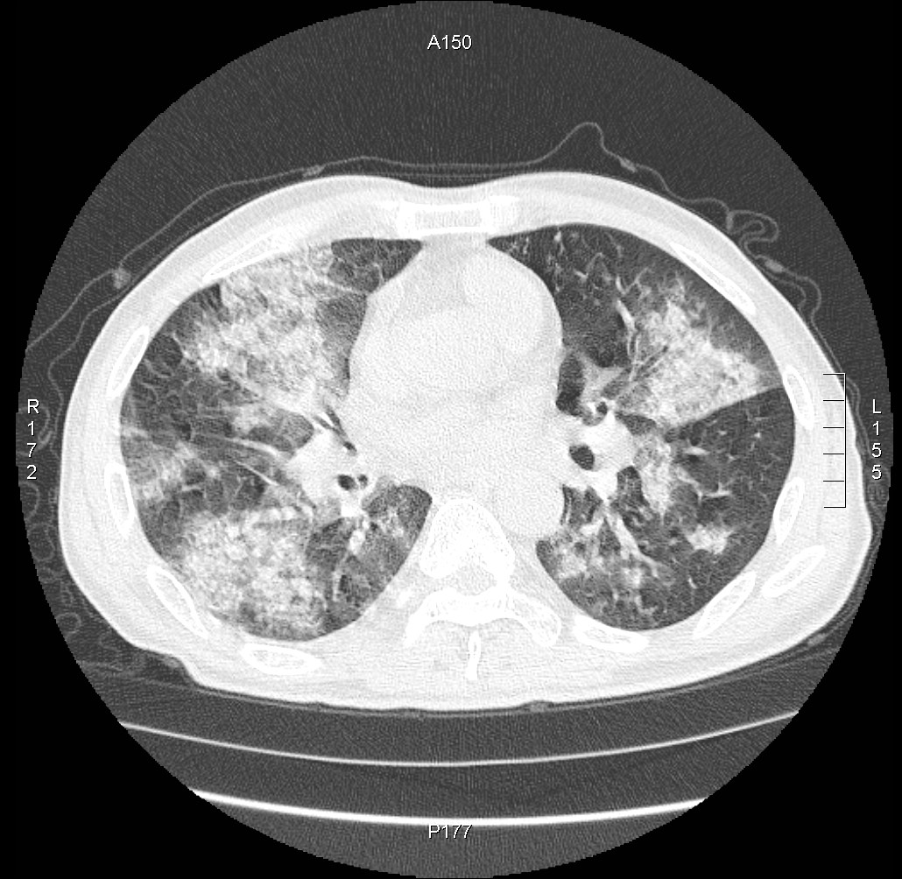
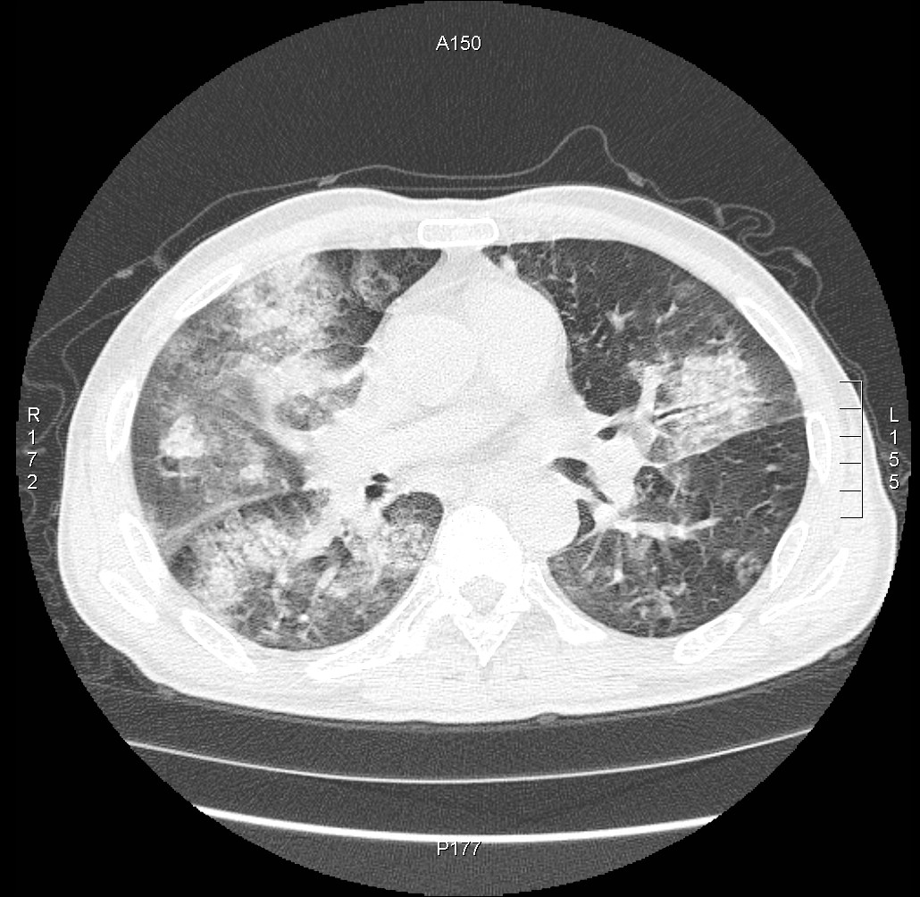
Chest CT scan

Slide 7
HD #1.
multiplex RT-PCR: influenza A 양성 확인
ER에서 항생제 ceftriaxone+azithromycin, 항바이러스제
peramivir 300mg iv 1회 투여
Blood Cx: G (+) cocci
sputum Cx: 응급실에서 취소

Slide 8
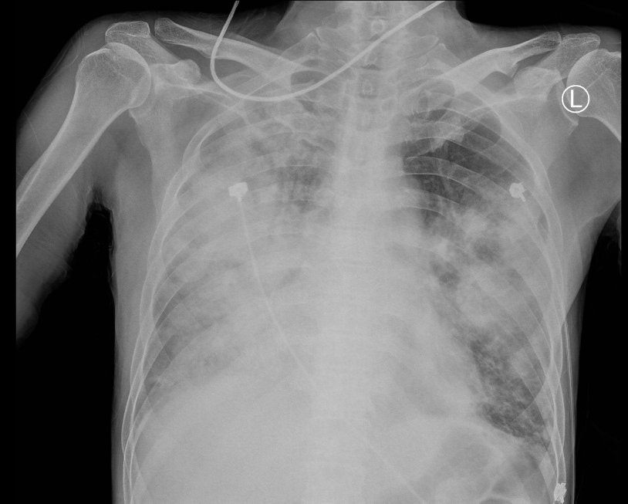
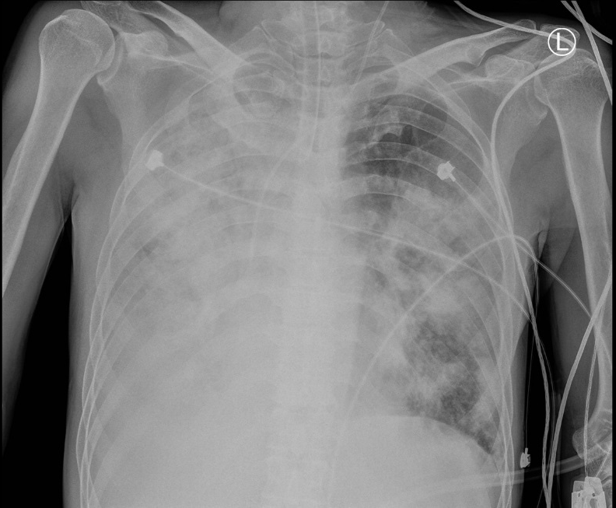
HD#4
HFNC FiO2 100%함에도 저산소증 지속되어 intubation후
MICU로 전동함

Slide 9
HD #4.
blood Cx: MRSA 동정

Slide 10
MRSA 감수성 검사
Clindamycin <=0.25 S
Ciprofloxacin <=0.5 S
Erythromycin <=0.25 S
Fusidic acid <=0.5 S
Gentamicin <=0.5 S
Habekacin <=1 S
Linezolid 2 S
Mupirocin <=2 S
Oxacillin(MIC) >=4 R
Cefoxitin Screen POS +
Penicillin-G >=0.5 R
Quinupristin/Dalfopristin <=0.25 S
Rifampin <=0.5 S
Trimethoprim/Sulfa <=10 S
Telithromycin <=0.25 S
Tetracycline <=1 S
Tigecycline <=0.12 S
Teicoplanin <=0.5 S
Vancomycin <=0.5 S

Slide 11
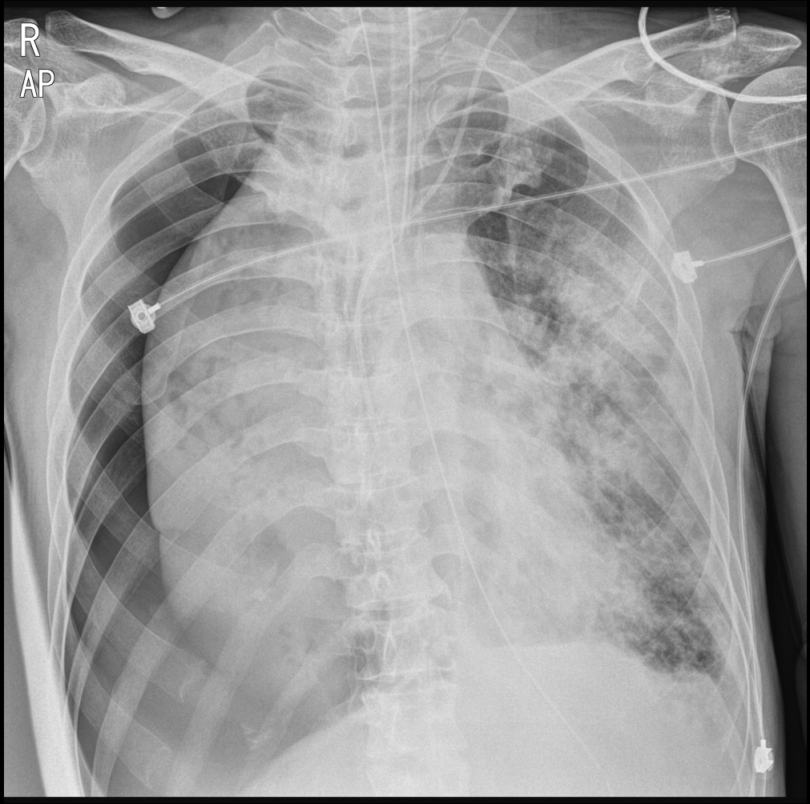
HD#5
High peak pressure, Increase of FIO2 at Routine morning CXR

Slide 12
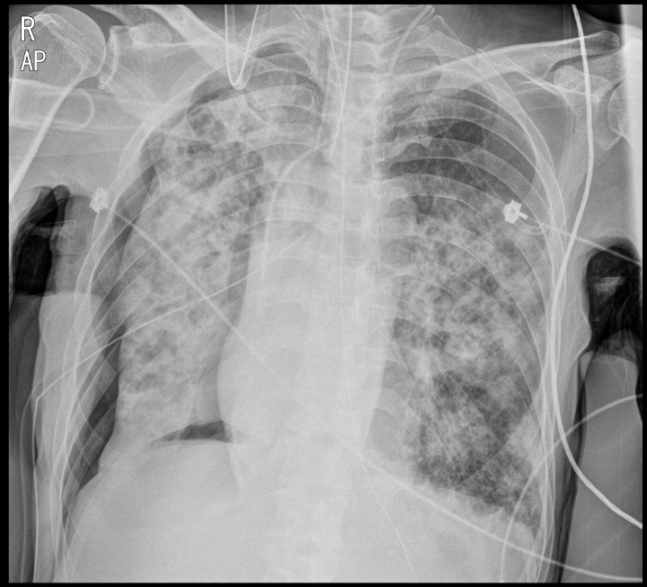
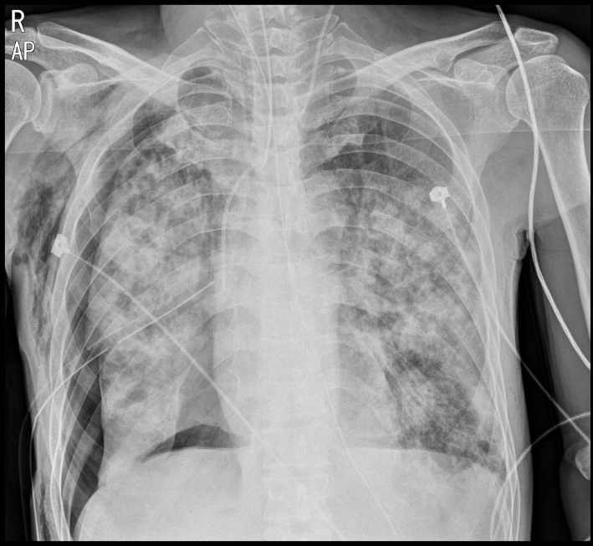
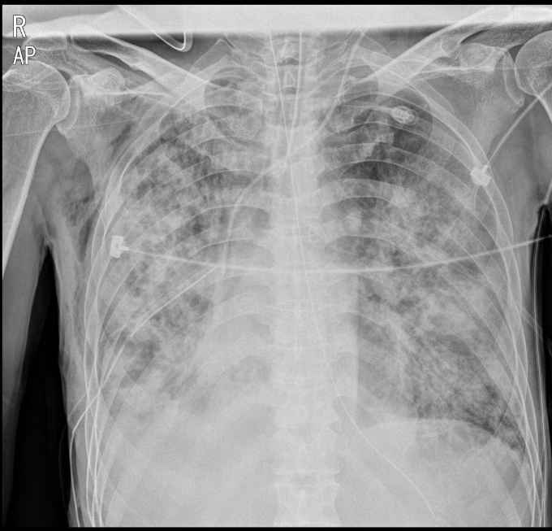
HD#5

Slide 13
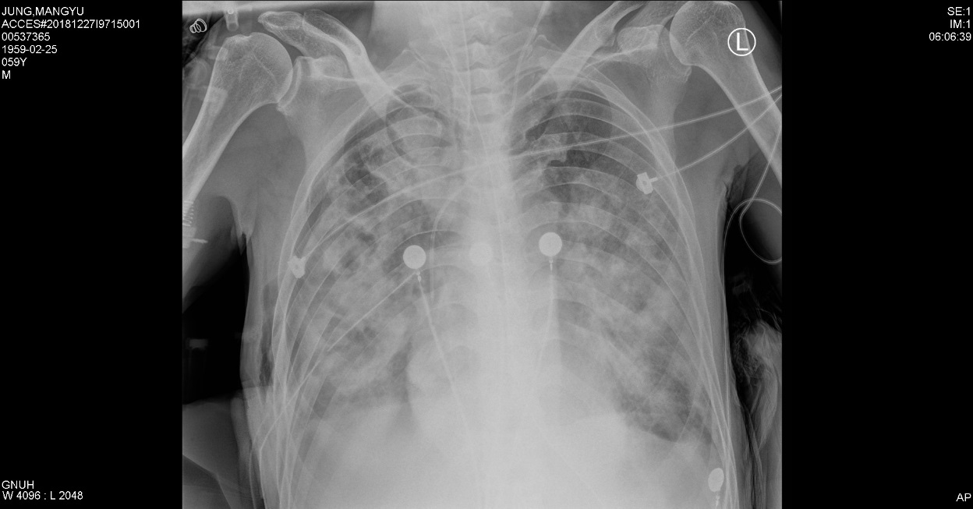
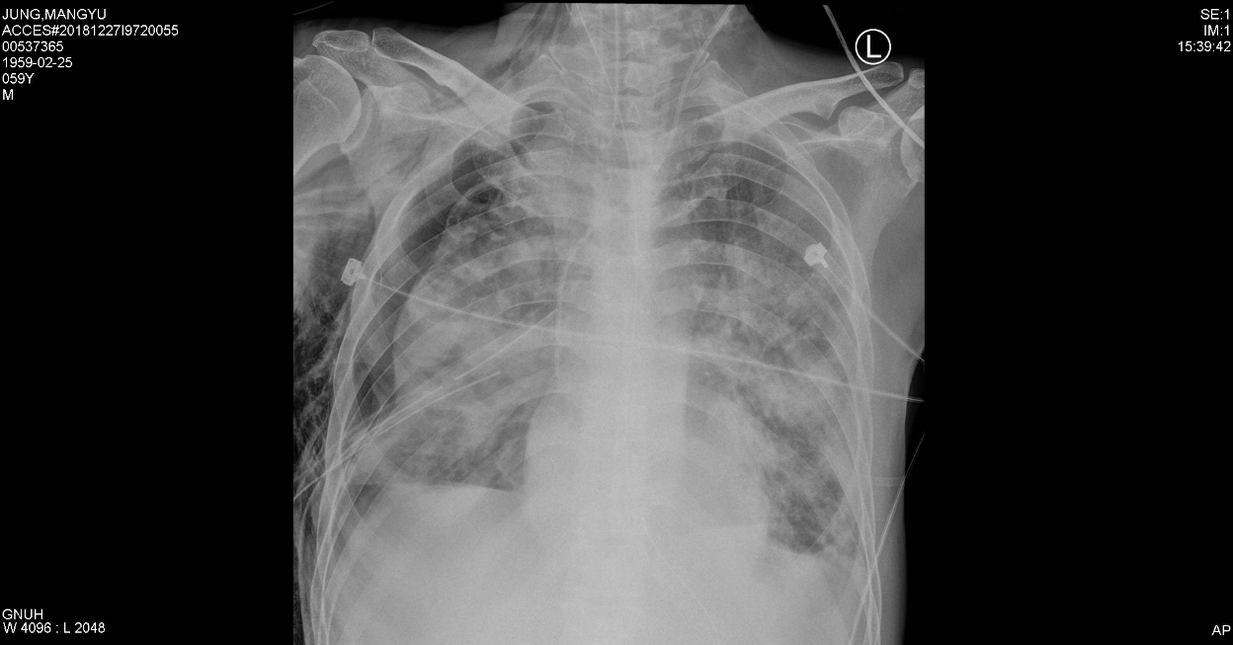
HD#7 (2018.12.27)
CXR: cystic change and pneumothorax persistence
Tracheal aspirate Cx: MRSA
산소요구량 높고, high peak pressure 유지되어 VV-ECMO 삽입하기로 결정함
이후 pneumothorax 지속적으로 해결되지 않아 흉부외과 전과함

Slide 14
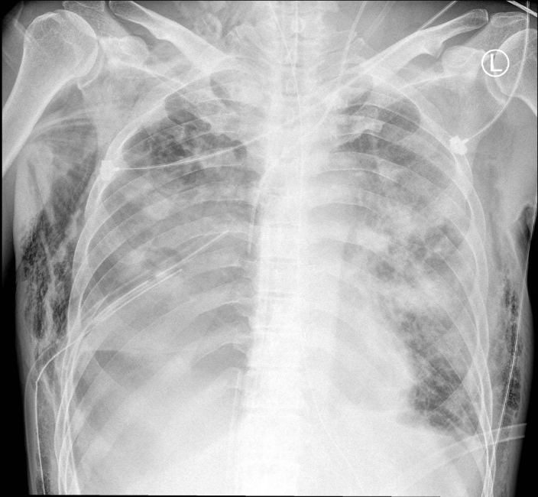
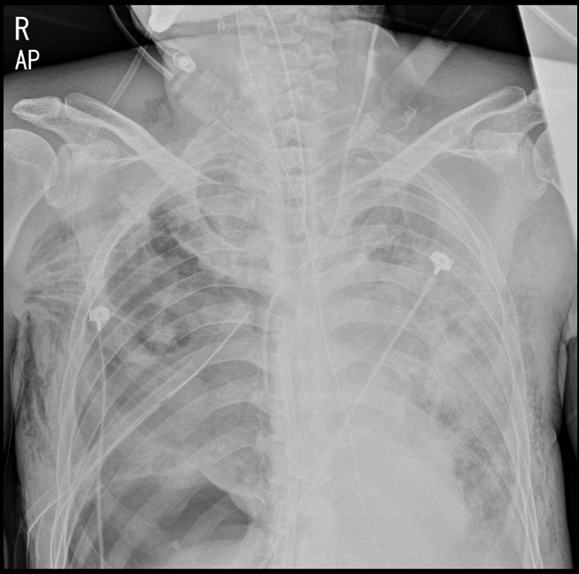
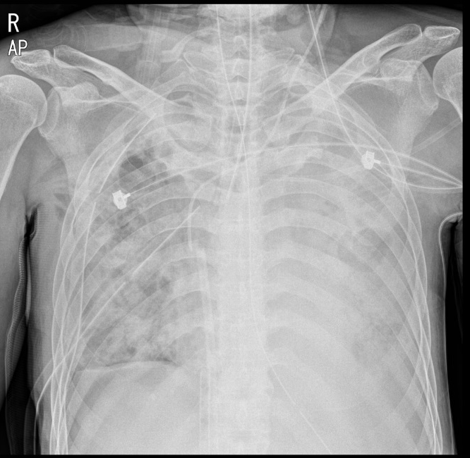
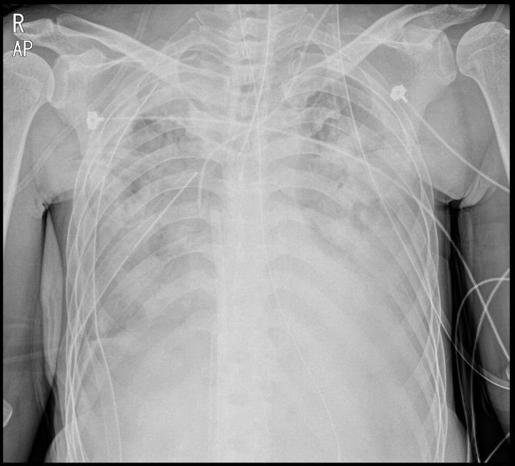

Slide 15
HD#17. 호전소견 보이지 않아 사망함

Slide 16
항생제 투여 병력
HD#1-3 (2018.12.20-2018.12.22)
Ceftriaxone+azithromycin+ peramivir 300mg iv
HD#4 (2018.12.23)
Piperacillin/tazobactam
HD#5-8 (2018.12.24-27)
Meropenem+vancomycin+ciprofloxacin+ Peramivir 300mg
HD #9 (2018.12.28)
Cefepime+ clindamycin+linezolid+ peramivir IVIG

Slide 17
GYEONGSANG
National University Hospital
01
Epidemiology

Slide 18
27% viral detection
NEJM 2015

Slide 19
2010.3.1-2011.2.28
Retrospective analysis of prospective cohort
198 patient (64 with CAP, 134 with HCAP)
Nasopharyngeal specimen RT-PCR: 159 patients
115 patients with BAL: 104 BAL fluid RT-PCR
AJRCCM2011

Slide 20
AJRCCM2011

Slide 21
2010.3-2012.2
Prospective cohort
262 Patients with severe HAP admitted to ICU
107 patients (40.8%) with bronchoscopy with BAL
PLOSone2014

Slide 23
Epidemiology
Author | Pneumonia | Study design | Number of patients | number(%) of virus isolation | m/c virus
Choi, et al AJRCCM 2012 | CAP, HCAP | Prospective cohort | 198 | 72 (36.4%) | Rhinovirus (23.6%)
Wiemken, et al Eur J Clin Microbiol Infect Ds, 2013 | CAP | Prospective cohort | 393 | 92 (23%) | Influenza (41%)
Hong, et al PLOSone, 2014 | HAP | Prospective cohort | 262 | 59 (22.5%) | PSV and PIV
Karhu, et al CID 2014 | CAP | Prospective cohort | 49 | 24 (49%) | Rhinovirus (58%)
Voiriot, et al Crit care 2016 | CAP | Retrospective cohort | 174 | 98 (56.3%) | Influenza
Kim, et al PLOSone 2018 | CAP,HCAP ,HAP | Retrospective cohort | 515 | 69 (13.4%) | RSV (43.5%)
Shorr, et al chest 2018 | CAP, HAP | Prospective cohort | 364 | 79 (21.7%) | Rhinovirus/enterovirus
20-50% respiratory viral detection
in severe pneumonia
Rhinovrius and influenza

Slide 24
GYEONGSANG
National University Hospital
02
Characteristics of respiratory virus

Slide 25
Characteristics of respiratory virus
Virus | Genome | Family | Incubation period | Transmission | Viral shedding duration
Influenza | RNA | Orthomyxoviridae | 1-4 days | Large particle droplet | 1-2 weeks
RSV | RNA | Paramyxoviridae | 3-7 days | Direct contact, Fomites Large particle Droplets | 1-2 weeks
Rhinovirus | RNA | Picornaviridae | 2-4 days | Large particle droplets, Direct contact | 5 days to 3 weeks
Adenovirus | DNA | Adenoviridae | 4-8 days | Large particle droplets Fecal oral contamination Fomites | 1-3 weeks
Parainfluenza | RNA | Paramyxoviridae | 2-6 days | Large particle droplets Direct contact | 1-3 weeks
Metapneumovirus | RNA | Paramyxoviridae | 3-6 days | Large particle droplets Fomites, Direct contact | unknown
Coronavirus | RNA | Coronaviridae | 2-5 days | Large particle droplets Direct contact Fecal oral contamination | 1 week to 1 months
Bocavirus | DNA | Parvoviridae

Slide 26
Different scenarios for the effect of an identified viral pathogen in the setting of pneumonia
Clinical scenario
Virus does not have a pathogenic effect. | Bystander
Virus is causing pneumonia in isolation. | Pathogen or Assistant
Virus is causing pneumonia along with a bacterial pathogen.
Virus caused a recent infection that prompted a secondary bacterial infection.

Slide 27
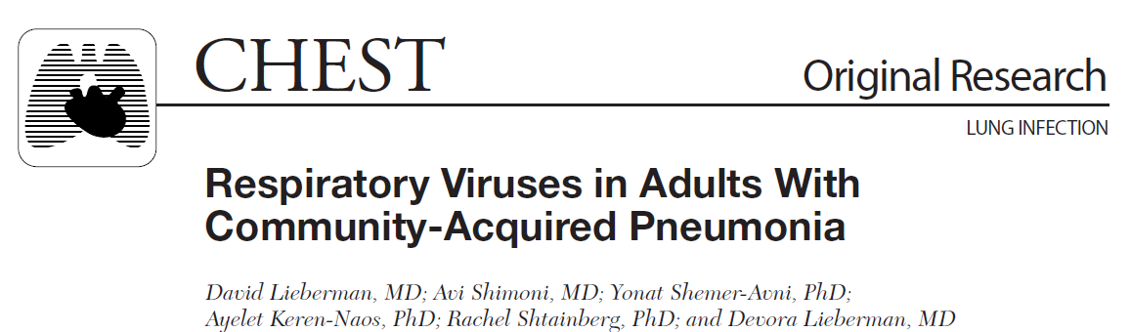
Chest 2010

Slide 28
JID 2016

Slide 29
Mechanism of co-infection
Nasopharyngeal colonization
Direct mucosal/epithelial damage
Enhanced bacterial adherence
Neutrophil response
Altered cytokine milieu

Slide 30
JAMA 2013

Slide 31
JAMA 2013

Slide 32
JAMA 2013

Slide 33
GYEONGSANG
National University Hospital
3
Diagnosis

Slide 34
Diagnosis
Viral antigen detection
Immunofluorescence, immunochromatogrphic assays
Fast (<15 min), lack of sensitivity (70%)
Serology
Acute and convalescent phase of illness
4-fold rise in antibody level
Cell culture
Gold standard but slow labor intensive
RSV, metapneumovirus: difficult to isolate in culture
limited to old patients: infection with low viral burden

Slide 35
Diagnosis
Nucleic acid amplification using PCR
DNA
high sensitivity and specificity ( 100%)
Detection of colonization or previous infection
Reverse-transcriptase PCR
use of RNA (rhinovirus, RSV, metapneumovirus)

Slide 36
Diagnosis
Multiplex RT-PCR
Rapid
Equal or better sensitivity and specificity compared with
viral culture
Expensive
Bronchoalveolar lavage, nasopharyngeal aspiration> nasal
swab

Slide 37
Chest 2018

Slide 38
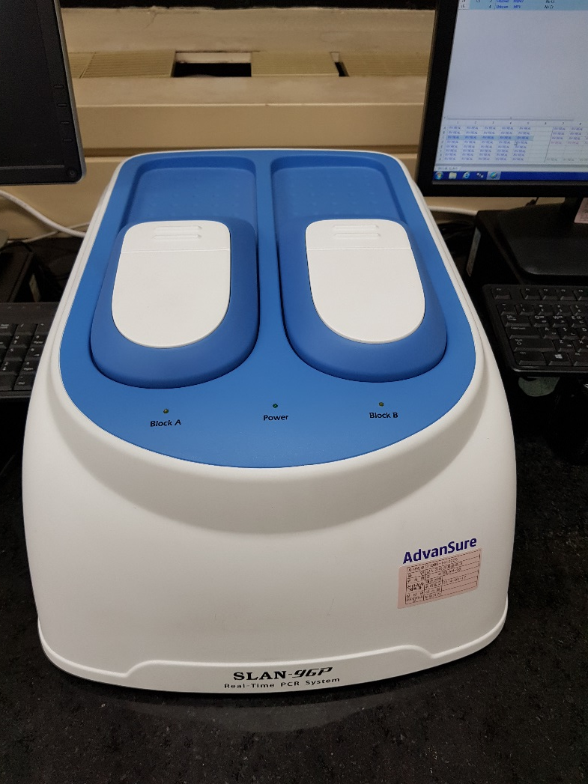
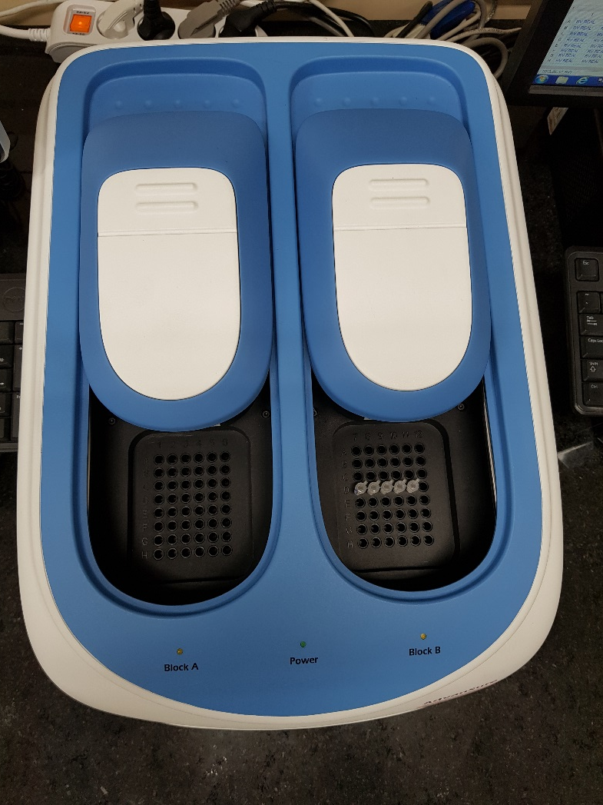

Slide 39
Diagnosis
Multiplex RT-PCR
Reduction in antibiotic exposure
More rapid initiation or discontinuation of antiviral therapy
Avoidance of unnecessary diagnostic testing
More effective use of respiratory isolation rooms

Slide 40
2015.1.15-2015.4.30, 2015.10.1-2016.4.30
Pragmatic parallel-group, open-label, RCT
720 Patients with acute respiratory illness
Intervention(FilmArray, n=362) vs control (usual care including lab PCR, n=294)
Primary outcomes: the proportion of use of antibiotics
2017 lancet respir med

Slide 43
Antibiotics use

Slide 44
POCT group | Positive for virus | Negative for virus | P-value
Antibiotic duration | 6.2 ± 4.8 | 8 ± 5.3 | 0.0033
Hospitalization duration | 4.7 ± 4.6 | 6.5 ± 7.2 | 0.0085

Slide 46
GYEONGSANG
National University Hospital
4
Treatment

Slide 47
Anti-viral agents
Influenza virus
Clin Chest med 2017

Slide 48
Anti-viral agents
Influenza virus
Clin Chest med 2017

Slide 49
Anti-viral agents
Influenza virus
Clin Chest med 2017

Slide 50
Selective inhibitor of influenza cap-dependent endonuclease
456 : Baloxavir marboxil
231: placebo
377: oseltamivir

Slide 51
Anti-viral agents
Influenza virus
26.5 hours shorter

Slide 52
Anti-viral agents
Influenza virus

Slide 53
Lancet Respir Med

Slide 59
Anti-viral agents
Influenza virus
2010-2011 to 2017-2018
Greece
1330 Adults with influenza receiving MV admitted to ICU
Early oseltamivir (<48hr)
Late oseltamivir (>48hr)
CID 2019

Slide 60
A/H3N2 cases

Slide 61
Anti-viral agents
Influenza virus
2010.9-2014.3
Retrospective cohort
ICU
60 Critically ill patients with seasonal influenza infection
JMV 2014

Slide 62
Anti-viral agents
Influenza virus

Slide 63
Anti-viral agents
Influenza virus

Slide 64
Anti-viral agents
Influenza virus

Slide 65
Anti-viral agents
Influenza virus

Slide 66




Slide 67
This study found that the short-term use of oseltamivir triggers the incidence of NPAEs. Early monitoring of NPAEs may be required when prescribing oseltamivir with careful consideration of the risk–benefit balance of oseltamivir.

Slide 68
Anti-viral Agents
Non-influenza viruses
Virus | Treatment
RSV | Ribavirin (Inhalation, IV), IVIG
PIV | Ribavirin (Inhalation, IV), IVIG, BCX 2798, BCX 2855 DAS 181
Adenovirus | IV cidofovir
Rhinovirus | Intranasal interferon
Metapneumovirus | Ribavirin (IV)
Coronavirus | Ribavirin for MERS-CoV

Slide 69
Curr Opin Infect Dis 2017

Slide 70
AAC 2013

Slide 71
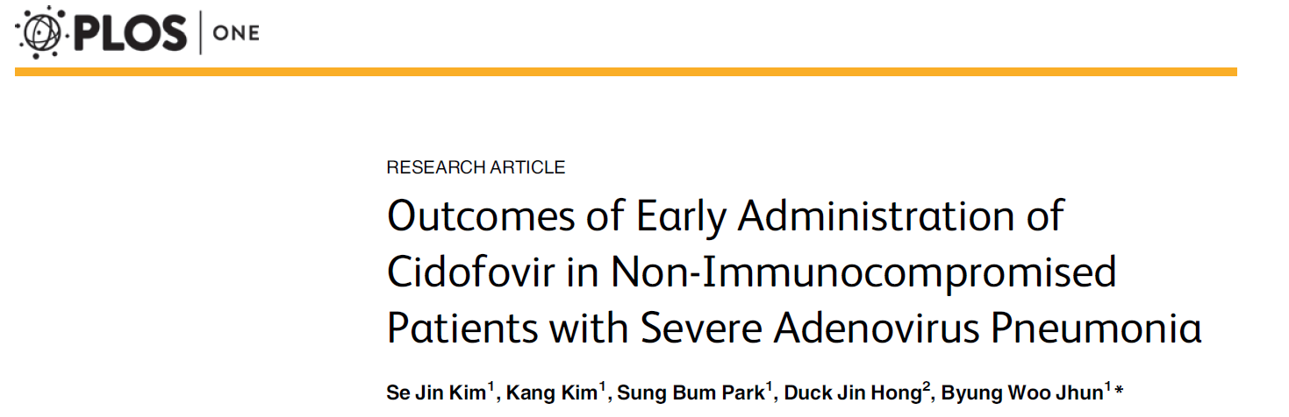
2012-2014
Seven non-immunocompromised patients with severe adenoviral pneumonia
(3 those requiring vasopressor and MV)
All patients were treated with iv cidofovir

Slide 73
Corticosteroid
Mitigating exacerbated inflammatory response
Immune-suppressing effects
Nosocomial infection

Slide 74
2004.6-2012.2
Multicenter, randomized, double-blinded placebo-controlled trial
3 Spain teaching hospitals
Patients with severe CAP and high inflammatory response (CRP>150mg/L)
IV methyPD 0.5mg/kg per 12 hrs for 5 days (n=61) vs placebo (n=59)
Primary outcomes: Tx failure (Early: shock, need for IMV, death within 72 hrs
Late: radiologic progression, severe ARF, shock, need for IMV, death within 72 hrs)
JAMA 2015; 313: 677

Slide 76
2009.9-2010.2
ICU of 28 hospitals in South Korea
245 Critically ill patients with pH1N1 infection
Retrospective cohort
107 (44%) with adjuvant steroid

Slide 78
No steroid Tx
Steroid Tx

Slide 79
ICM 2018; 44: 1470-1428

Slide 82
2012.9-2015.10
14 Saudi Arabian centers
309 ICU patients with MERs
Corticosteroid (n=151) vs non-corticosteroid (n=158)
AJRCCM 2018; 197: 757

Slide 84
Corticosteroid: significant delay in MERS-CoV RNA clearance

Slide 85
GYEONGSANG
National University Hospital
5
Prognosis

Slide 86
Prognosis
 | Pneumonia | Mortality | P-value
Choi et al 2012 AJRCCM | CAP, HCAP | Bacterial infection (25.5%) Viral infection (26.5%) Bacterial viral infection (33.3%) | 0.82
Hong et al 2014 PLOSone | HAP | Bacterial infection (29.5%) Viral infection (35.6%) Bacterial viral infection (19%) | 0.321
Shorr et al 2018 Chest | CAP, HAP | Virus (37.2%) vs Other (36.5%) | 0.999

Slide 87
Prognosis
Influenza
Total 245
53 (21.6)
80 (32.6)
97 (39.6)
AJRCCM 2011

Slide 88
Prognosis
Influenza

Slide 89
Prognosis influenza vs rhinovirus
JCV 2015

Slide 90
Prognosis influenza vs rhinovirus
JCV 2015

Slide 91
Prognosis influenza vs metapneumovirus
JCV 2019

Slide 92
Prognosis influenza vs metapneumovirus
JCV 2019

Slide 93
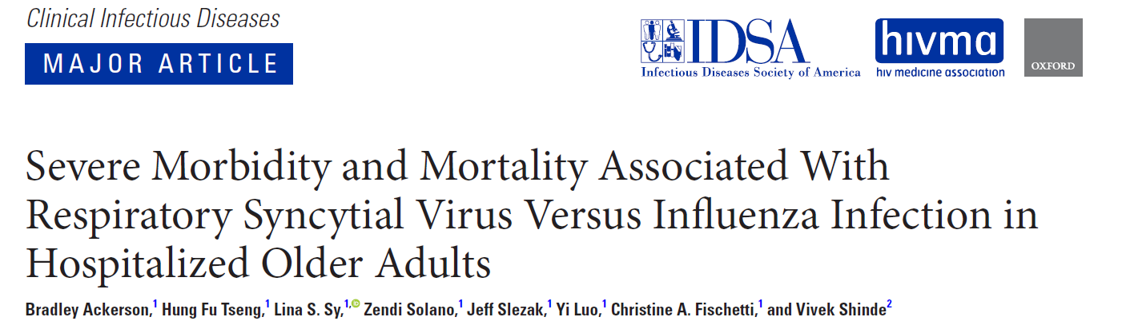
Prognosis
Influenza vs RSV
Observational retrospective cohort
2011.1.1-2015.6
Hospitalized adults≥ 60 yrs
645 RSV vs 1878 influenza
CID 2018

Slide 94
Prognosis
Influenza vs RSV
RSV vs Influenza
Length of stay ≥7 days (odds ratio [OR] = 1.5; 95% confidence interval [CI], 1.2–1.8; P < .001)
Pneumonia (OR = 2.7; 95% CI, 2.2–3.2; P < .001)
Intensive care unit admission (OR = 1.3; 95% CI, 1.0–1.7; P = .023)
Exacerbation of COPD (OR = 1.7; 95% CI, 1.3–2.4; P = .001)
Greater mortality within 1 year of admission (OR = 1.3; 95% CI, 1.0–1.6; P = .019).
CID 2018

Slide 95
Prognosis
Virus
 | Patients | Virus | Outcome |  | P-value
Falsey et al 2005 NEJM | ≥65 yrs and high risk | RSV vs influenza A | Death | 8% vs 7% | 1
Choi, et al JCV 2015 | Severe pneumonia | Rhinovirus vs influenza | 28-day mortality 60-day mortality | 29.6% vs 35.3% 51.9% vs 47.1% | 0.61 0.69
Russell, et al CID 2018 | Adults | PIV only | ICU admission Death | 23.4% 5.1%
Yoon, et al Respirology 2016 | Soldiers | Adenovirus vs non-adenovirus | Respiratory failure | 27% vs 7% | 0.005
Choi et al JCV 2019 | Severe pneumonia | Metapneumovirus vs influenza | 30-day and 60-day mortality | 24% vs 32.1% 32% vs 38.5% | 0.3 0.43
Ackerson et al CID 2018 | Patients≥60 yrs | RSV vs influenza | 1 year survival | 25.8%vs 18.8% | <0.001

Slide 96
Prognosis co-infection
Author | Pneumonia | Study design | Number of patients | Rate of viral-bacterial co infection
Choi, et al AJRCCM 2012 | CAP, HCAP (ICU) | Prospective cohort | 198 | 18 (9.1%)
Voiriot, et al Crit Care 2016 | Severe CAP | Retrospective cohort | 174 | 45 (26%)
Hong, et al PLOSone, 2014 | HAP (ICU) | Prospective cohort | 262 | 21 (8%)
Karhu, et al CID 2014 | CAP (ICU) | Prospective cohort | 49 | 19 (39%)
Loubet JCV 2017 | HAP (ICU) | Retrospective cohort | 95 | 13 (14%)
Lim, et al Diagn Microbiol Infect Dis 2019 | Sever CAP | Retrospective cohort | 64 | 14 (21.9%)

Slide 98
Prognosis co-infection
Author | Pneumonia | Mortality | P-value
Choi et al 2012 AJRCCM | CAP, HCAP | Bacterial infection (25.5%) Viral infection (26.5%) Bacterial viral infection (33.3%) | 0.82
Hong et al 2014 PLOSone | HAP | Bacterial infection (29.5%) Viral infection (35.6%) Bacterial viral infection (19%) | 0.321
Shorr et al 2018 Chest | CAP, HAP | Virus (37.2%) vs Other (36.5%) | 0.999

Slide 99
2011.10-2015.6
Single center, retrospective study
Patients with severe CAP admitted to ICU
Complicated course: hospital death or utilization of mechanical ventilation
for > 7 days
Crit Care 2016

Slide 102
Prospective observational multicenter study
2009-2015
148 Spanish ICU
2901 ICU diagnosed with influenza
16.6% (482/2901) co-infection

Slide 104
2009.1.1-2016.6.30
Retrospective multicenter cohort study
Belgium and Netherland
ICU
Patients with severe influenza with ARF
19% IPA in 432 patients with severe influenza
5% IPA in 315 with control (severe CAP )
Lancet Respir Med 2018

Slide 106
Summary
Respiratory virus
Not uncommon in severe pneumonia
Individual characteristics
Diagnosis: Multiplex RT-PCR
Treatment
Anti-viral agents: unclear efficacy of non-influenza virus
Corticosteroid: no clinical benefit and may be harmful
Prognosis
Similar to bacterial pneumonia
Significance of co-infection

Slide 107
경청해주셔서 감사합니다
Gyeongsang National University Hospital

