Slide 1
5월 호흡기지회
저널발표
Critical Care Medicine
경상대학교병원
호흡기알레르기내과 유정완

Slide 2
Clinical Trial in ARDS 2019
SUPERNOVA study (Intensive Care Med)
EPVent-2 trial (JAMA)
ROSE trial (NEJM)

Slide 3
Intensive Care Med 2019; 45: 592-600

Slide 4
Ventilator induced lung injury (VILI)
Clinically indistinguishable from ARDS
ARDSnet
Tidal volume (VT) 6ml/kg of PBW,
end-inspiratory plateau pressure (Pplat) ≤ 30cmH2O
->not fully protective in some patients
Reduction of VT to 3-4mg/kg and Pplat≤ 25cmH2O
-> minimizing VILI , but risk of respiratory acidosis

Slide 5
Extracorporeal carbon dioxide removal (ECCO2R)
Extracorporeal carbon dioxide removal (ECCO2R)
minimizing respiratory acidosis by clearing CO2
more protective than the ARDSNet strategy
Ultraprotective strategy
Vt <3-4mg/kg and Pplat<30cmH2O
decreasing respiratory rate
minimizing driving pressure or mechanical power
→ Improving outcomes

Slide 6
Strategy of Ultra-Protective lung ventilation with Extracorporeal CO2 Removal for New-Onset moderate to severe ARDS (SUPERNOVA)
Multicenter, international study
Patients with moderate ARDS
To determine feasibility and safety of ECCO2
Inclusion criteria
Patients with moderate ARDS
( PaO2/FiO2 100–200 mmHg, with PEEP ≥ 5 cmH2O)
> 18 years old
expected to receive invasive mechanical ventilation for > 24 h

Slide 7
Hemolung Respiratory Assist System (A Lung Technologies, Pittsburgh, USA
a membrane lung with a cross-sectional area of 0.59 m2 and is run at an
extracorporeal blood flow between 300 and 500 mL/min: lower extraction
ILA active (Novalung, Heilbronn, Germany) and Cardiohelp® HLS 5.0 (Getinge Cardiopulmonary Care, Rastatt, Germany)
Membrane lungs of 1.30 m2 and blood flows to 800–1000 mL/ min : higher
extraction

Slide 8
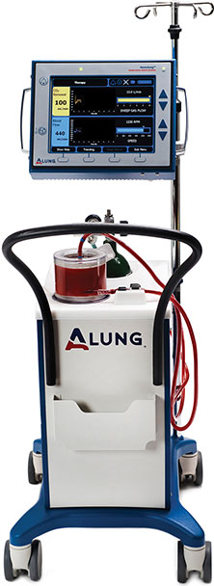
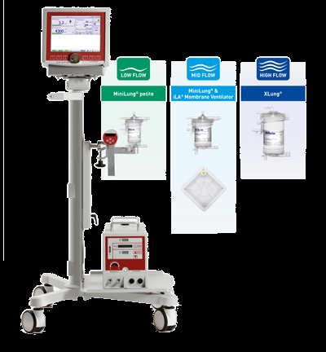
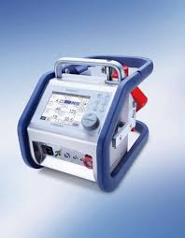

Slide 9
Sedation and neuromuscular blockade
Vt at 6 mL/kg PBW and PEEP adjusted to obtain a Pplt between 28 and 30 cmH2O .
Percutaneous vascular access using double lumen catheter (IJV or FV)
Sweep gas set to zero
Continuous infusion of unfractionated heparin
aPTT in the range 35–80 s

Slide 10
Three steps to reduce Vt to 4ml/kg PBW
From 6.0 to 5.0, from 5.0 to 4.5, and from 4.5 to 4 mL/kg PBW
PEEP titration to a target Pplateu of 23-25cmH2O
Sweep gas and blood flow
PaCO2 between 80% and 120% of the baseline value
If PaCO2 exceeded 75 mmHg and/or pH was < 7.30 despite optimal ECCO2R
settings and a respiratory rate of 35 breaths/ min, Vt was increased to the last
previously tolerated value.

Slide 11
The primary outcome
number of patients who successfully achieved a Vt of 4 mL/kg PBW with PaCO2
not increasing more than 20% from baseline with a value of arterial pH > 7.30.
Secondary endpoints
(a) assessment of physiological variables and ECCO2R settings and (b) frequency
of adverse events.

Slide 12
Severe adverse events (SAE)
(1) any fatal or immediately life-threatening event, permanently disabling, severely incapacitating, or requiring prolonged hospitalization, or any event jeopardizing
the patient and requiring medical or surgical intervention and that the attending physician perceived might be directly related
(2) any clinically important untoward medical occurrence that was different from what is expected in the clinical course of ARDS to ECCO2R

Slide 15
The proportion of patients who achieved ultra-protective setting
78% (74/95) by 8 hr and 82% (78/95) by 24 hr
5 (3-8) days of maintenance
Cannulation site: internal jugular vein (57%), femoral vein (43%)
Catheter size: 15.5 Fr in patients on the Hemolung device
18 Fr in patients on the iLA active and Cardiohelp
HLS5.0 device

Slide 16
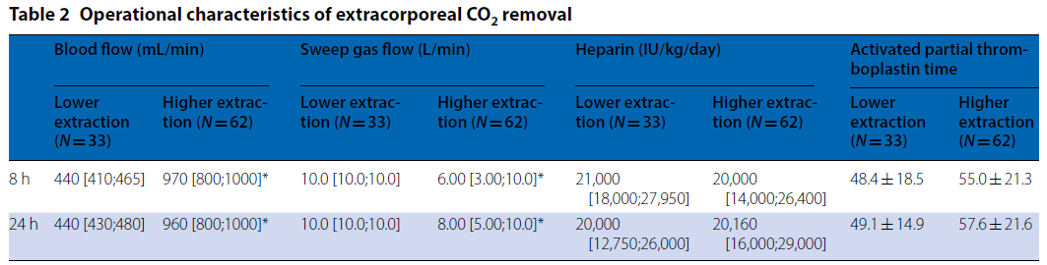

Slide 17
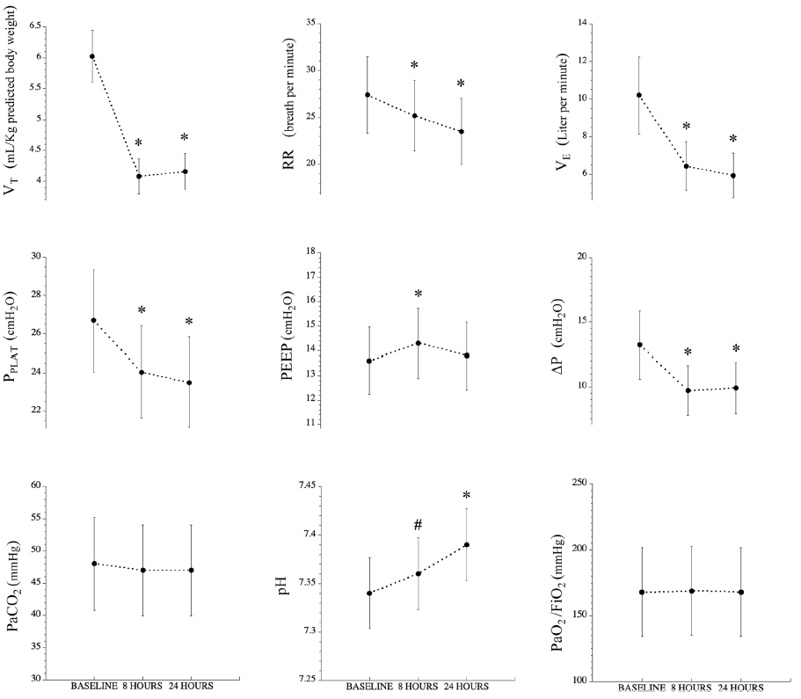

Slide 18
Mechanical ventilation duration: 17 (11-29) days
69 patients (73%) alive at day 28
59 patients (62%) alive at hospital discharge
Ventilator free day : 11 (0-17) days

Slide 19
ECCO2R-AE
37 patients (39%), first 24h of ECCO2R in 26 patients
6 Severe adverse effect
massive right frontal parenchymal hematoma, severe hematemesis and melena,
superior vena cava thrombosis, sudden death, severe hypoxemia, pneumothorax at
cannula insertion in the internal jugular vein

Slide 20
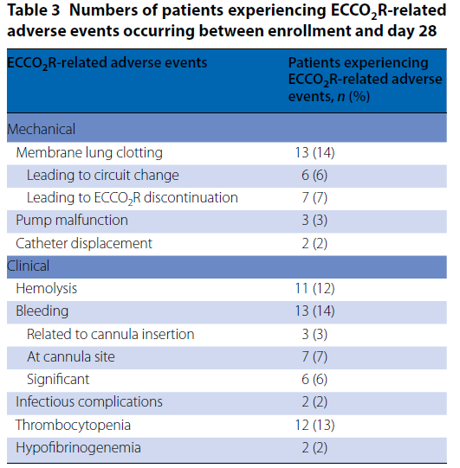

Slide 21
Conclusion
ECCO2R in patients with moderate ARDS
Feasible for ultra-protective ventilation
Mitigating respiratory acidosis
RCT is required to assess overall benefits and harms

Slide 22
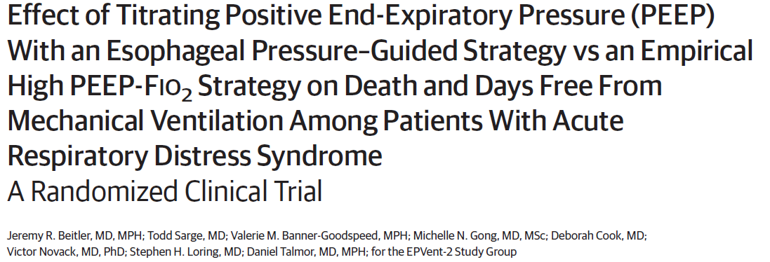
JAMA 2019 Feb

Slide 23
Limiting mechanical lung injury during invasive ventilation
: approach to improve survival from ARDS
Lower tidal volume: beneficial
Titration of PEEP: unclear
Airway pressure
insufficient to guide lung protective PEEP titration in ARDS
chest wall and abdomen: pleural pressure and respiratory system
mechanics in critically ill patients

Slide 24
Transpulmonary pressure (PL = airway pressure minus pleural pressure)
Distinguishing lung from chest wall mechanics
Airway pressure: modern ventilators
Pleural pressure: esophageal manometry using a balloon
catheter positioned in the midthoracic esophagus

Slide 25
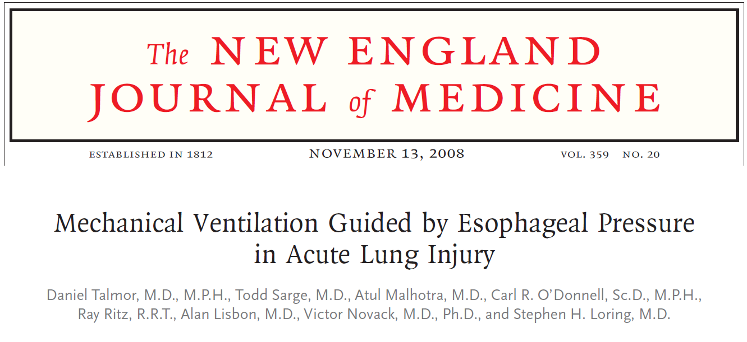
Single center randomized trial (Epvent)
Enrolled patients with any ARDS severity
Use of lower PEEP than recent trial
Esophageal pressure-guided PEEP titration
Higher PF ratio, higher respiratory system compliance and improved adjusted survival

Slide 26
EPVent-2 trial
Multicenter randomized trial at 14 hospitals across the US and Canada
PES-guided PEEP titration vs an empirical high PEEP-FiO2 titration table in patients with moderate to severe ARDS
Patients
Aged 16 years or older
Moderate to severe ARDS (PaO2:FIO2 ≤ 200mmHg)
Onset within the last 36 hours
All 4 Berlin definition criteria

Slide 28
Prespecified primary end point
a Ranked composite score: incorporated death and days free from mechanical ventilation through day 28
Each patient was compared with every other patient inthe study and assigned a score (tie: 0, win: +1, loss: −1) for each pairwise comparison
one patient survival: the other death=+1: -1
one patient survial, less MV: the other survival, more MV =+1: -1
Both patients survival and same MV: 0:0

Slide 29
Secondary end points
all-cause mortality at 28 days, 60 days, and 1 year
ventilator-free days through day 28
intensive care unit (ICU) and hospital lengths of stay through day 28 and day 60
protocol failure requiring rescue therapy
functional status at 1 year

Slide 30
Safety end point
Shock-free days (vasopressor requirement) through day 28, pneumothorax,
bronchopleural fistula, any barotrauma, acute kidney injury requiring renal
replacement therapy in the first 28 days, and any other serious adverse event.

Slide 32
PEEP change
PES-guided PEEP group (up to 36cm H2O)
from 12cmH2O↓ to 20cmH2O↑
64.3% ↑, 16.8% ↓, 18.8% →
mean 17cmH2O PEEP and 0.56 FiO2
Empirical PEEP-FIO2 group (up to 24 cmH2O)
from 5cmH2O↓ to 13cmH2O↑
57.1% ↑, 15.3% ↓, 27.6% →
mean 16 cmH2O and 0.51 FiO2

Slide 39
Pes-guided PEEP vs empirical high PEEP-FiO2 in patients with moderate to severe ARDS
No significant difference in the primary composite end point
incorporating death and days free from MV through day 28

Slide 40
EPvent-2 (JAMA 2019)
1) no difference of end- expiratory PL
2) Mean end-expiratory Pl of O2 H2O ≥
0 cmH2O until day 3
3) No driving pressure difference
4) Predominance of pulmonary risk
factor for ARDS
EPvent-1 (NEJM 2008)
1) significant difference of end-
expiratory PL
2) Mean end-expiratory Pl ≤0cmH2O
3) Driving pressure difference
4) Extrapulmonary risk factor for ARDS
(40% intraabdominal risk)

Slide 41
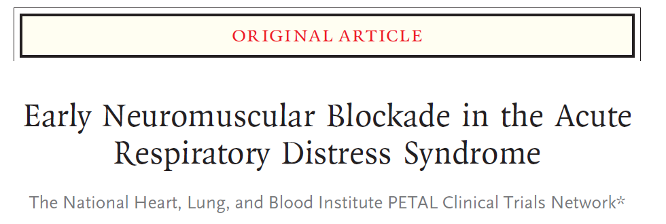
2016.1-2018.4
48 hospitals across the United States
NEJM 2019.5

Slide 42
Neuromuscular blockade
↓ Patient–ventilator dyssynchrony, the work of breathing, accumulation of
alveolar fluid
↑Neuromuscular weakness
ACURASYS trial (NEJM 2010)
the early administration of a 48-hour infusion of neuromuscular blockade in patients with moderate-to-severe ARDS (defined by a ratio of the partial pressure of arterial oxygen [Pao2] to the fraction of inspired oxygen [Fio2] of <150 mm Hg with a positive end-expiratory pressure [PEEP] of ≥5 H2Oof water)
↓ Mortality than a strategy of deep sedation without routine neuromuscular blockade

Slide 43
Lower weak recommendation in practice guideline
lack of research comparing neuromuscular blockade and deep
sedation with current practice (lighter sedation targets)
Use of neuromuscular blockade
: deep sedation, which itself can result in negative outcomes

Slide 44
Reevaluation of Systemic Early Neuromuscular Blockade (ROSE) trial
Prevention and Early Treatment of Acute Lung Injury (PETAL) Clinical Trials Network of the National Heart, Lung, and Blood Institute (NHLBI)
A multicenter, unblinded, randomized trial of patients with moderate-to-severe ARDS
the efficacy and safety of early neuromuscular blockade with concomitant heavy sedation as compared with a strategy of usual care with lighter sedation targets
Hypothesis
the use of early neuromuscular blockade would result in lower all-cause in-
hospital mortality at 90 days than usual care.

Slide 45
Reevaluation of Systemic Early Neuromuscular Blockade (ROSE) trial
Patients
Pao2:Fio2 of less than 150 mm Hg with a PEEP of 8 cm or more of water
Berlin criteria for ARDS
Intervention group (consistent with ACURASYS trial)
48 hours of continuous neuromuscular blockade with
concomitant deep sedation 4 hrs after randomization
IV bolus of 15 mg of cisatracurium, followed by a continuous infusion of 37.5 mg
per hour for 48 hours.
Control group
Usual care without routine neuromuscular blockade with lighter sedation
targets (Richmond Agitation–Sedation Scale of 0 or −1, Riker Sedation–Agitation Scale of 3 or 4, the Ramsay Sedation Scale of 2 or 3)

Slide 46
Reevaluation of Systemic Early Neuromuscular Blockade (ROSE) trial
Common trial procedure
LTV ventilation within 2 hrs after randomization
High PEEP strategy for up to 5 days after randomization
Avoiding the automatic use of neuromuscular blockade
Prone position and after 48-hour trial intervention period, use of NM blockade→ left to at the discretion of treating physician
The primary end point
in-hospital death from any cause at 90 days

Slide 47
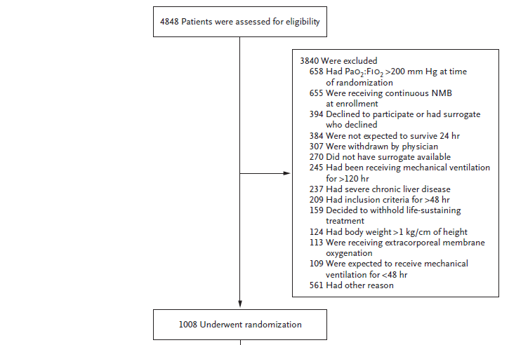

Slide 48
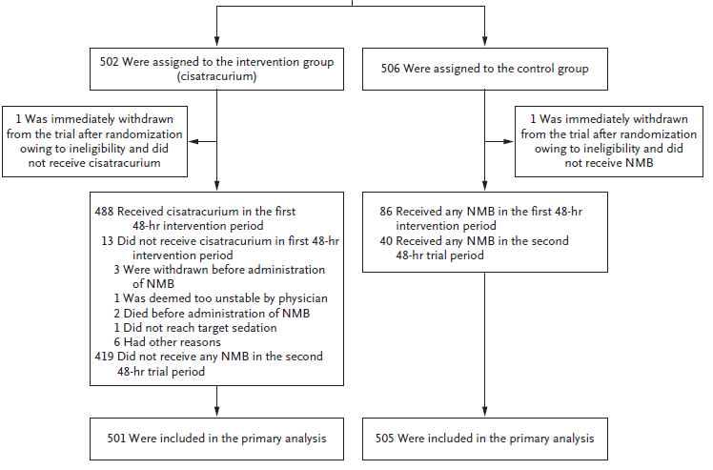

Slide 49
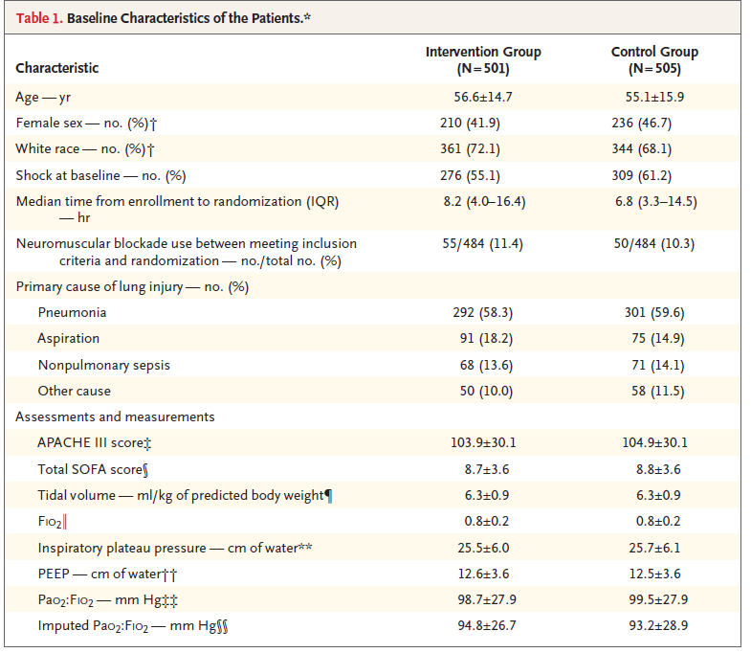

Slide 50
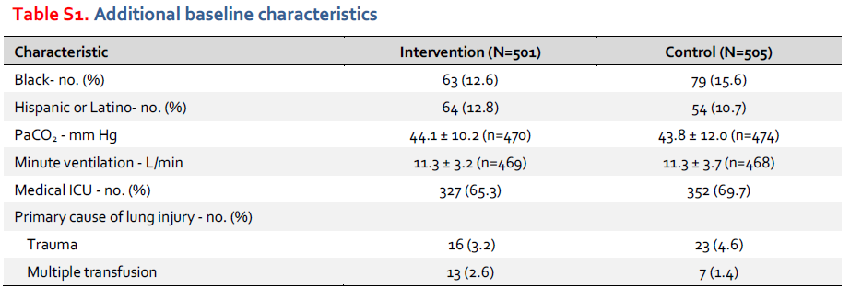
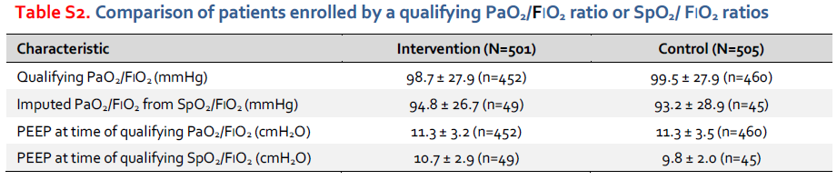

Slide 51
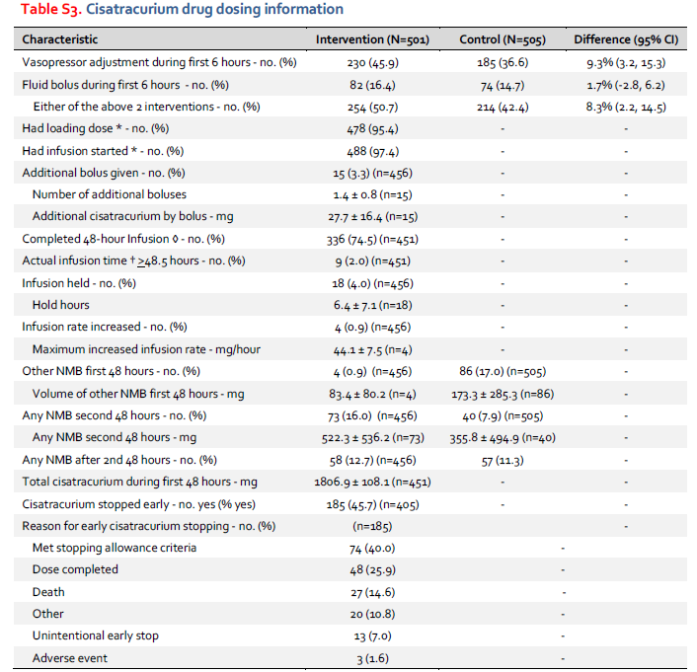

Slide 52
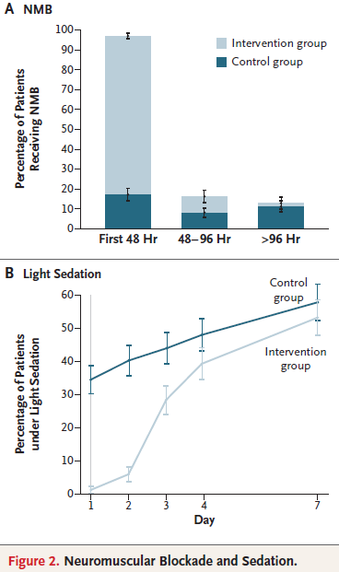

Slide 53
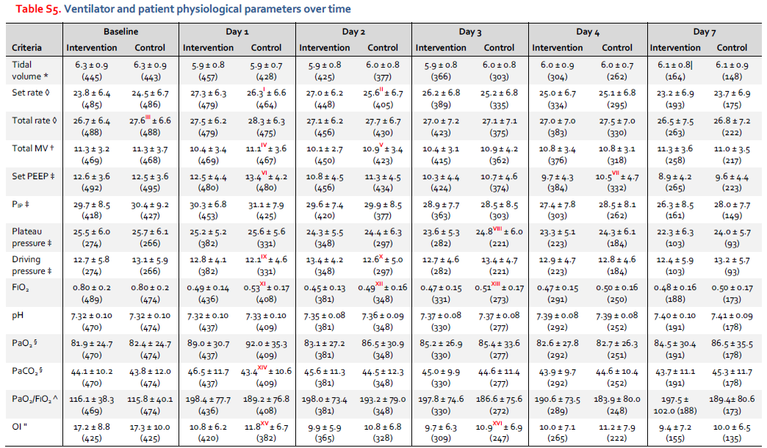

Slide 54
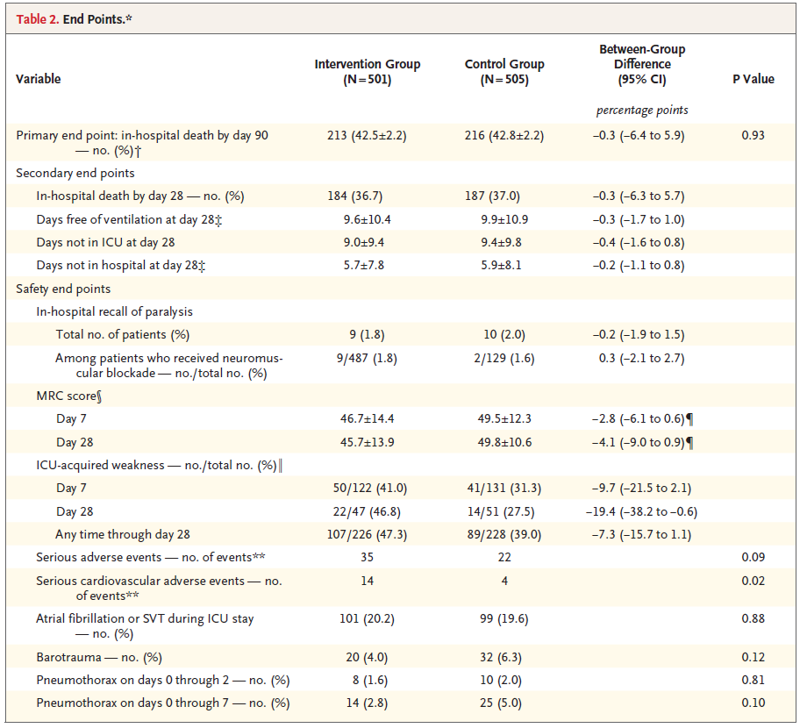

Slide 55
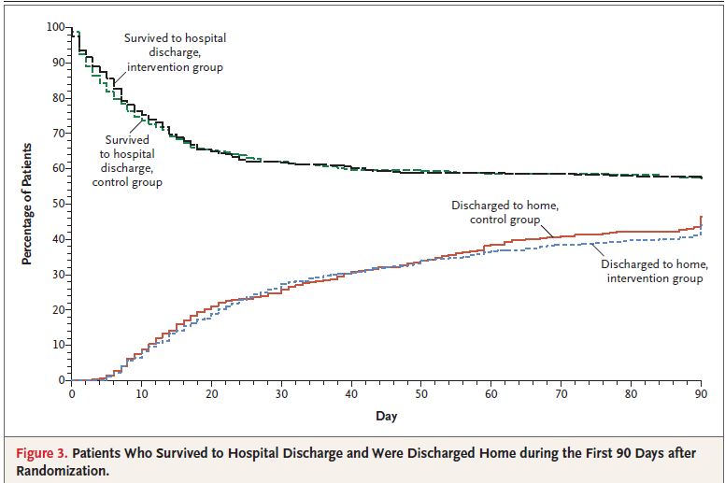

Slide 56
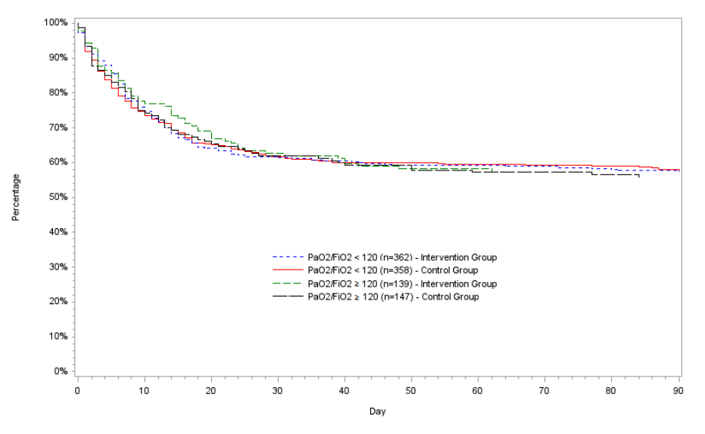

Slide 57
Difference from ACURAYS
Higher PEEP strategy in both groups
→blunting the potential treatment effect of early continuous neuromuscular
blockade
Lighter sedation in control group (deep sedation in the ACURASYS trial)
↑Cardiovascular adverse events in the intervention group
Deep sedation (hypotension, bradycardia, and other cardiovascular effects)
Similar proportion (15.8%) of prone positioning in LUNG-SAFE study (16.3%),
but lower than ACURASYS trial (18%)
Enrolled earlier (7.6 hrs) after the onset of ARDS than those in the ACURASYS
trial (16 hrs)

Slide 58
Conclusion
In Higher PEEP strategy, early continuous neuromuscular blockade with concomitant deep sedation
(vs usual care with lighter sedation)
No difference in 90-day mortality

Slide 59
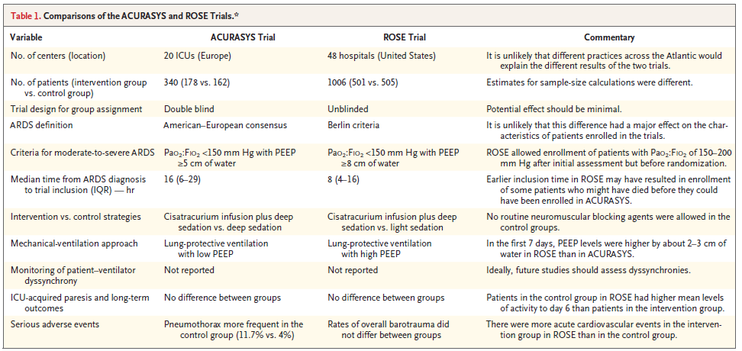

Slide 60
경청해주셔서 감사합니다.

