Slide 1

Asthma
: Guideline To Real Practice
양산부산대학교병원 호흡기알레르기내과
이승은

Slide 2
동상이몽 同床異夢
천식의 치료
환자 “얼마나 치료하면 다 나을까?”
의사 “어떤 단계의 약으로 조절할 수 있을까?”
천식의 조절
환자 “증상 있을 때 약 쓰면 좋아지니 조절된다”
의사 “아직도 증상이 있으니 더 조절해야겠네”

Slide 3
Contents
What’s new in GINA 2019?
Initial controller treatment
Difficult-to-treat & severe asthma management

Slide 4
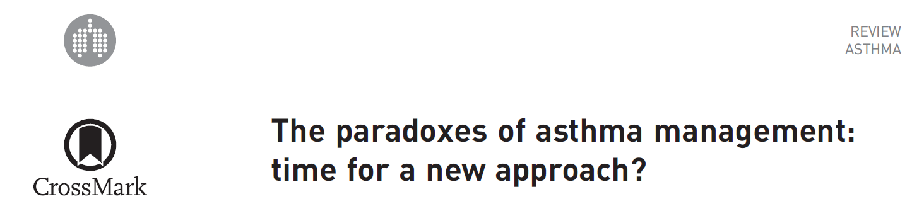
Paradoxes in the current asthma management
Still prn SABA for step 1 treatment?
O’Byrne PM, Jenkins C, Bateman ED. Eur Respir J 2017; 50
Notes:
2017년 10월

Slide 5
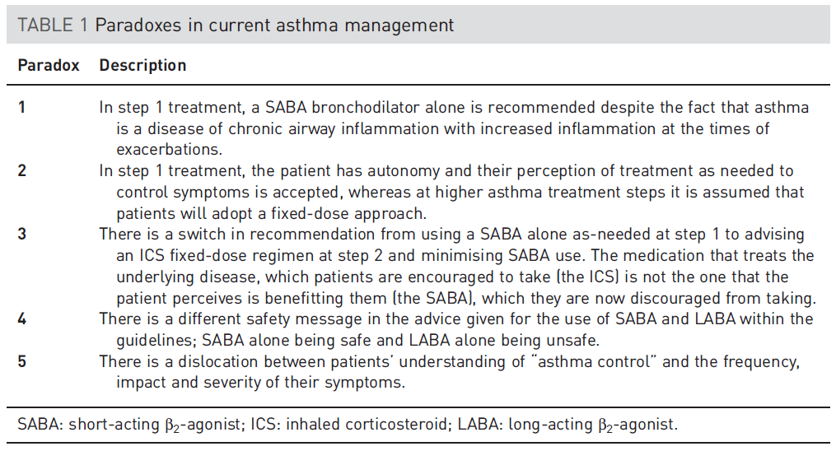
Still prn SABA in step 1 treatment?
O’Byrne PM, Jenkins C, Bateman ED. Eur Respir J 2017; 50
Notes:
Airway inflammation 치료해야 하는데 step1은 SABA?
Step1 에서는 SABA 환자 판단으로 PRN 사용, ICS도 판단으로 중단.
가장 효과적인 약물은 SABA? (ICS는 바로 나타나는 효과 없음)
LABA 단독은 안 되는데, SABA 단독은 가능, SABA가 안전 (이런 정보를 환자가 진짜 이해?)
Control에 대한 환자의 잘못된 인식, 증상이 생기면 약을 써서 조절하는 것.
알고는 있었지만 정리되어 표현되지 않았던 내용.

Slide 6
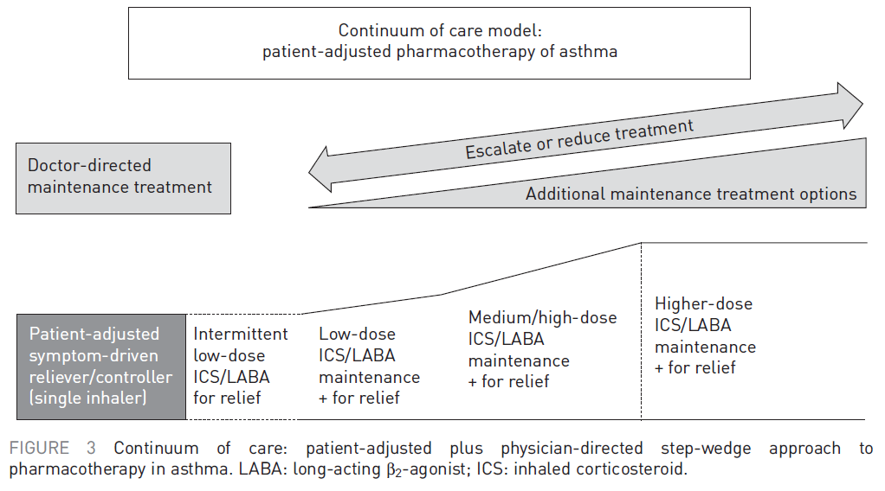
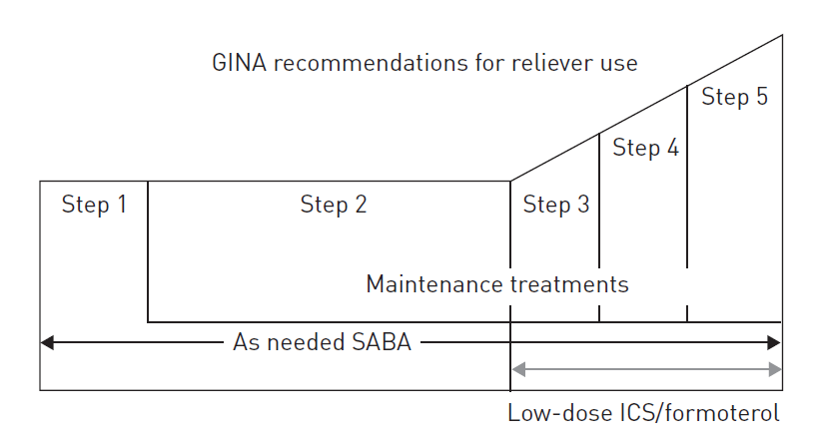
ICS/LABA in all step treatment
O’Byrne PM, Jenkins C, Bateman ED. Eur Respir J 2017; 50

Slide 7
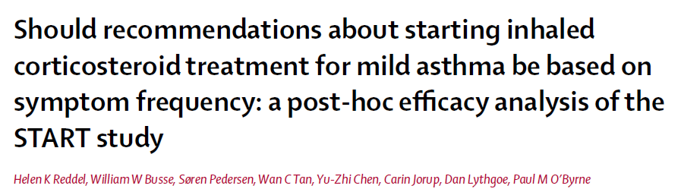
n= 7241
Mild asthma: Sx at least once per week, but not as often daily
Subgroup by Sx frequency: 0-1, 2, 2 <
Lancet 2017; 389: 157–66
Notes:
2017년 11월 3 year inhaled Steroid Treatment As Regular Therapy (START) study
Post-hoc analysis, 32 countries
mild asthma diagnosed within the
previous 2 years and no previous regular corticosteroids were randomised to receive once daily, inhaled budesonide
400 μg (those aged <11 years 200 μg) or placebo
SARE severe asthma related event

Slide 8
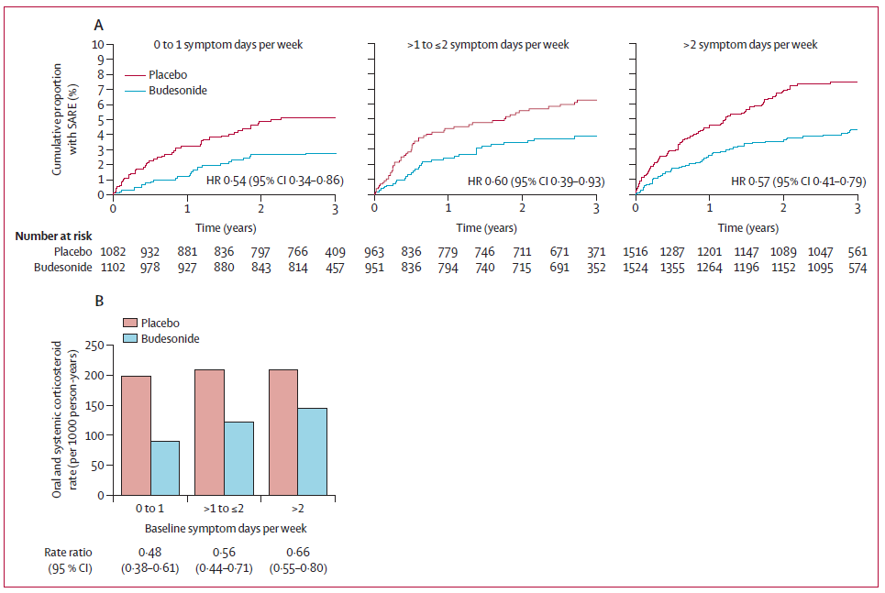
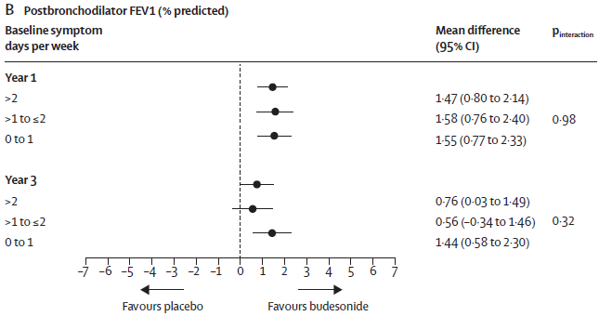

Slide 9
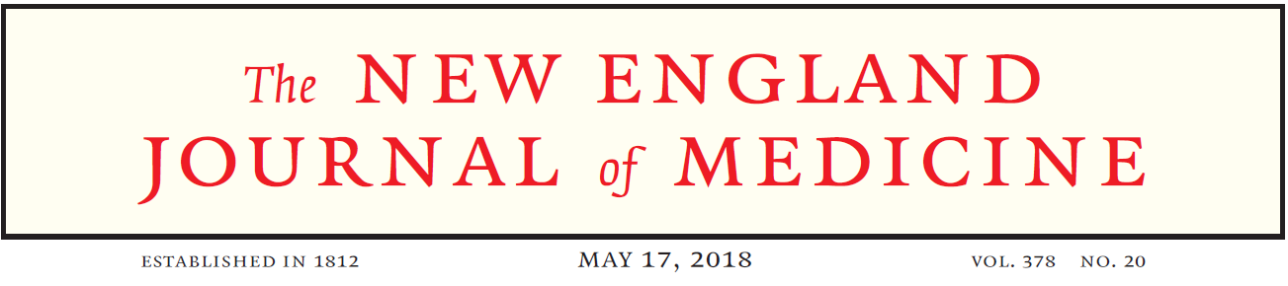
SYGMA 1
Inhaled Combined Budesonide–Formoterol as Needed in Mild Asthma
Paul M. O’Byrne et al. N Engl J Med 2018;378:1865-76
SYGMA 2
As-Needed Budesonide–Formoterol versus Maintenance Budesonide in Mild Asthma
Eric D. Bateman et al. N Engl J Med 2018;378:1877-87
Notes:
2018년 5월
Step 2 정도의 치료가 필요한 mild asthma (3836, 4176) 52주
Asthma control, severe exacerbation

Slide 10
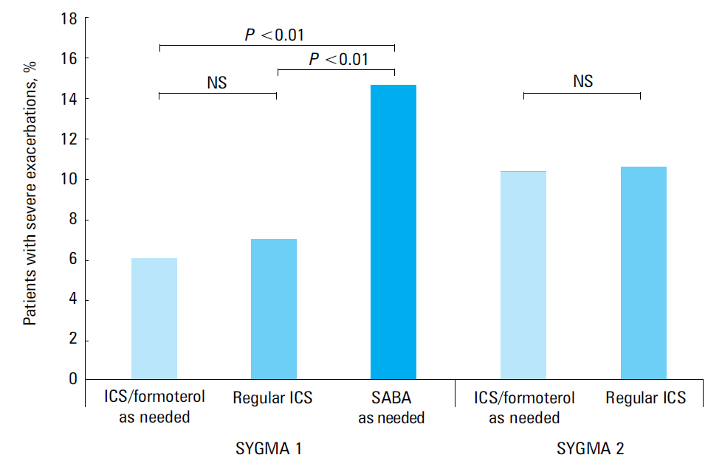
ICS/formoterol as needed
Paul M. O’Byrne, Filip Mejza Pol Arch Intern Med. 2018; 128 (9)

Slide 11
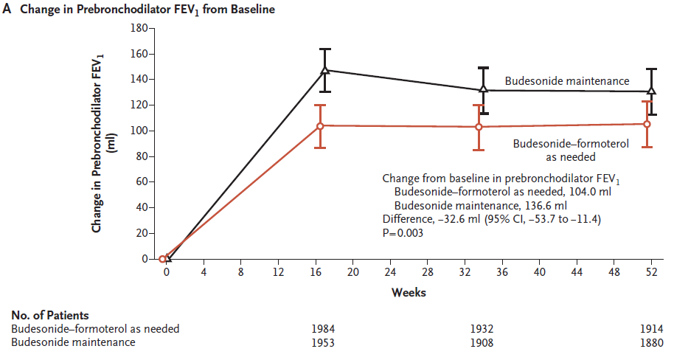
ICS/formoterol as needed
Eric D. Bateman et al. N Engl J Med 2018;378:1877-87

Slide 12
Control-based asthma management
Symptom: regular ICS > prn ICS/formoterol >> prn SABA
Exacerbation: regular ICS = prn ICS/formoterol >> prn SABA
Consider adverse reaction of ICS
Notes:
ICS/LABA를 유지해야 하는 상황에서는 문제가 되지 않으나 step down 이 가능한 상황에서는 무엇을 선택할 것인가 하는 문제가 남게 된다.

Slide 13
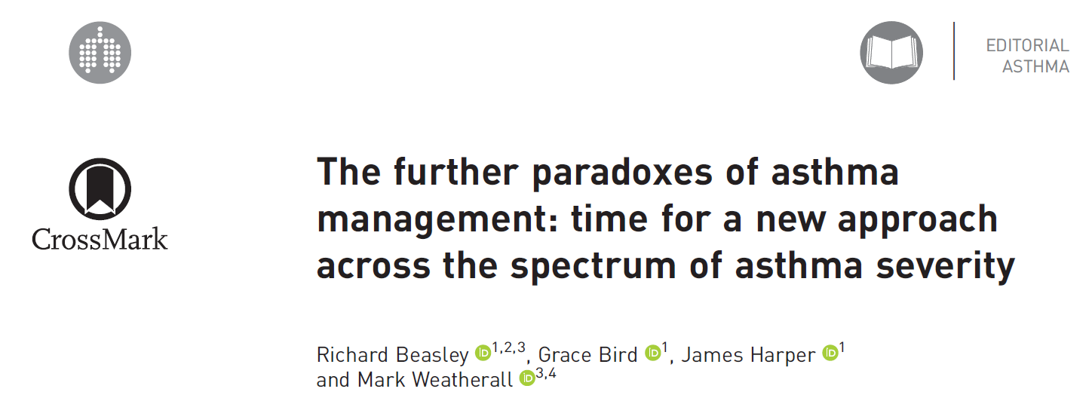
Further paradoxes in the current asthma management
Time for prn ICS/formoterol >> prn SABA
Beasley R, Bird G, Harper J, et al. Eur Respir J 2018; 52
Notes:
2018년 11월

Slide 14
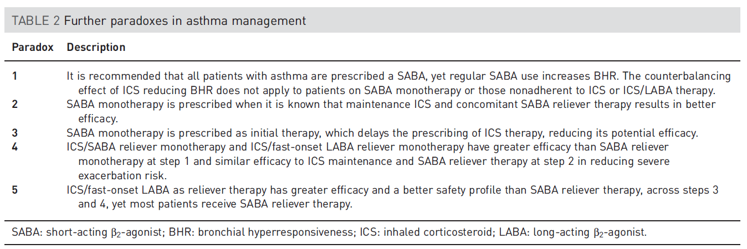
prn ICS/formoterol >> prn SABA in step 1 and 2 for reliever therapy
Beasley R, Bird G, Harper J, et al. Eur Respir J 2018; 52
Notes:
위험성: LABA 와 마찬가지로 SABA 단독도 기도염증, 과민성을 증가시켜 mortality를 증가시킬 수 있다는 근거가 있음에도 불구하고 지침 상 SABA 고수
효과: regular ICS/prn ICS+ SABA/prn ICS+formoterol 이 control과 exacerbation에서 우월하다는 data 가 있음에도 PRN SABA 고수
Prn SABA 가 1st step -> ICS 의 시작이 늦어질 수 있다. -> 문제 -> 나중에 다시 언급
prn ICS/SABA 가 step 1에서는 prn SABA 보다 우월, step 2에서는 ICS 와 동등. 이전 연구
prn ICS/formoterol이 step 1에서는 prn SABA 보다 우월, step 2에서는 악화에 있어서는 ICS 와 동등. 최근 연구
-> 진료 지침 변경되지 않음.
Step 3,4에서도 이미 SMART 연구를 통해 prn SABA 에 비해 prn ICS/formoterol 이 우월한 efficac와, safet를 가지고 있다는 것을 알고 있으면서도 지침 상 prn SABA 고수, 실제로 SABA 처방.
==============================================================================================
Exacerbation Tx를 제외하고는 SABA 퇴출?
또다른 문제점: 특정 성분의 ICS/LABA의 데이터. 모든 약제에 적용 가능한가? PRN ICS/LABA 의 적용에 있어 환자의 자율성을 어디까지 허용할 것인가 하는 문제가 남음.
ICS 용량의 문제는 ICS 용량의 문제가 SABA 사용의 위험을 상회할 정도라면 step-up을 해야하는 상황이므로 사실 문제가 되지 않는다고 판단됨.

Slide 15
Global Initiative for Asthma (GINA)
What’s new in GINA 2019?
This slide set is restricted for academic and educational purposes only. No additions or changes may be made to slides. Use of the slide set or of individual slides for commercial or promotional purposes requires approval from GINA.

Slide 16
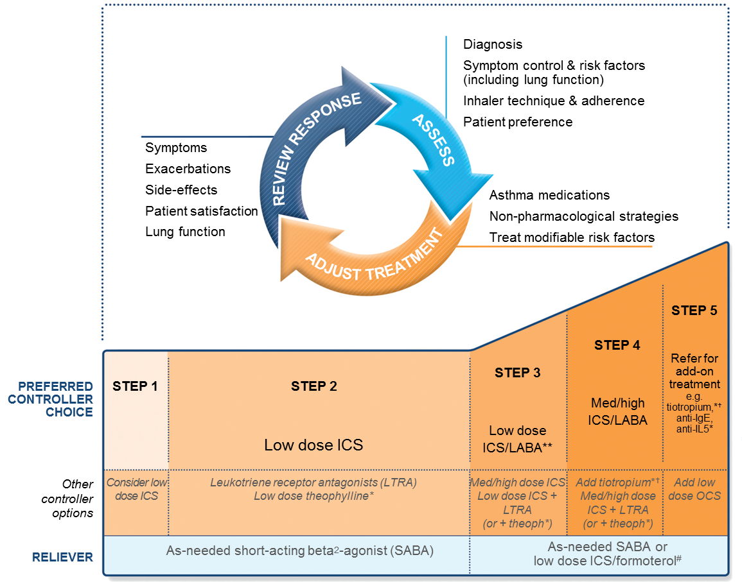
GINA 2018 – main treatment figure
Step 1 treatment is for patients with symptoms <twice/month and no risk factors for exacerbations
Previously,
no controller was recommended for
Step 1, i.e. SABA-only treatment was ‘preferred’
GINA 2018, Box 3-5 (2/8) (upper part)
Notes:
Step 1 Sx 월 1회 이하 + no risk factor
-> no controller + prn SABA

Slide 17

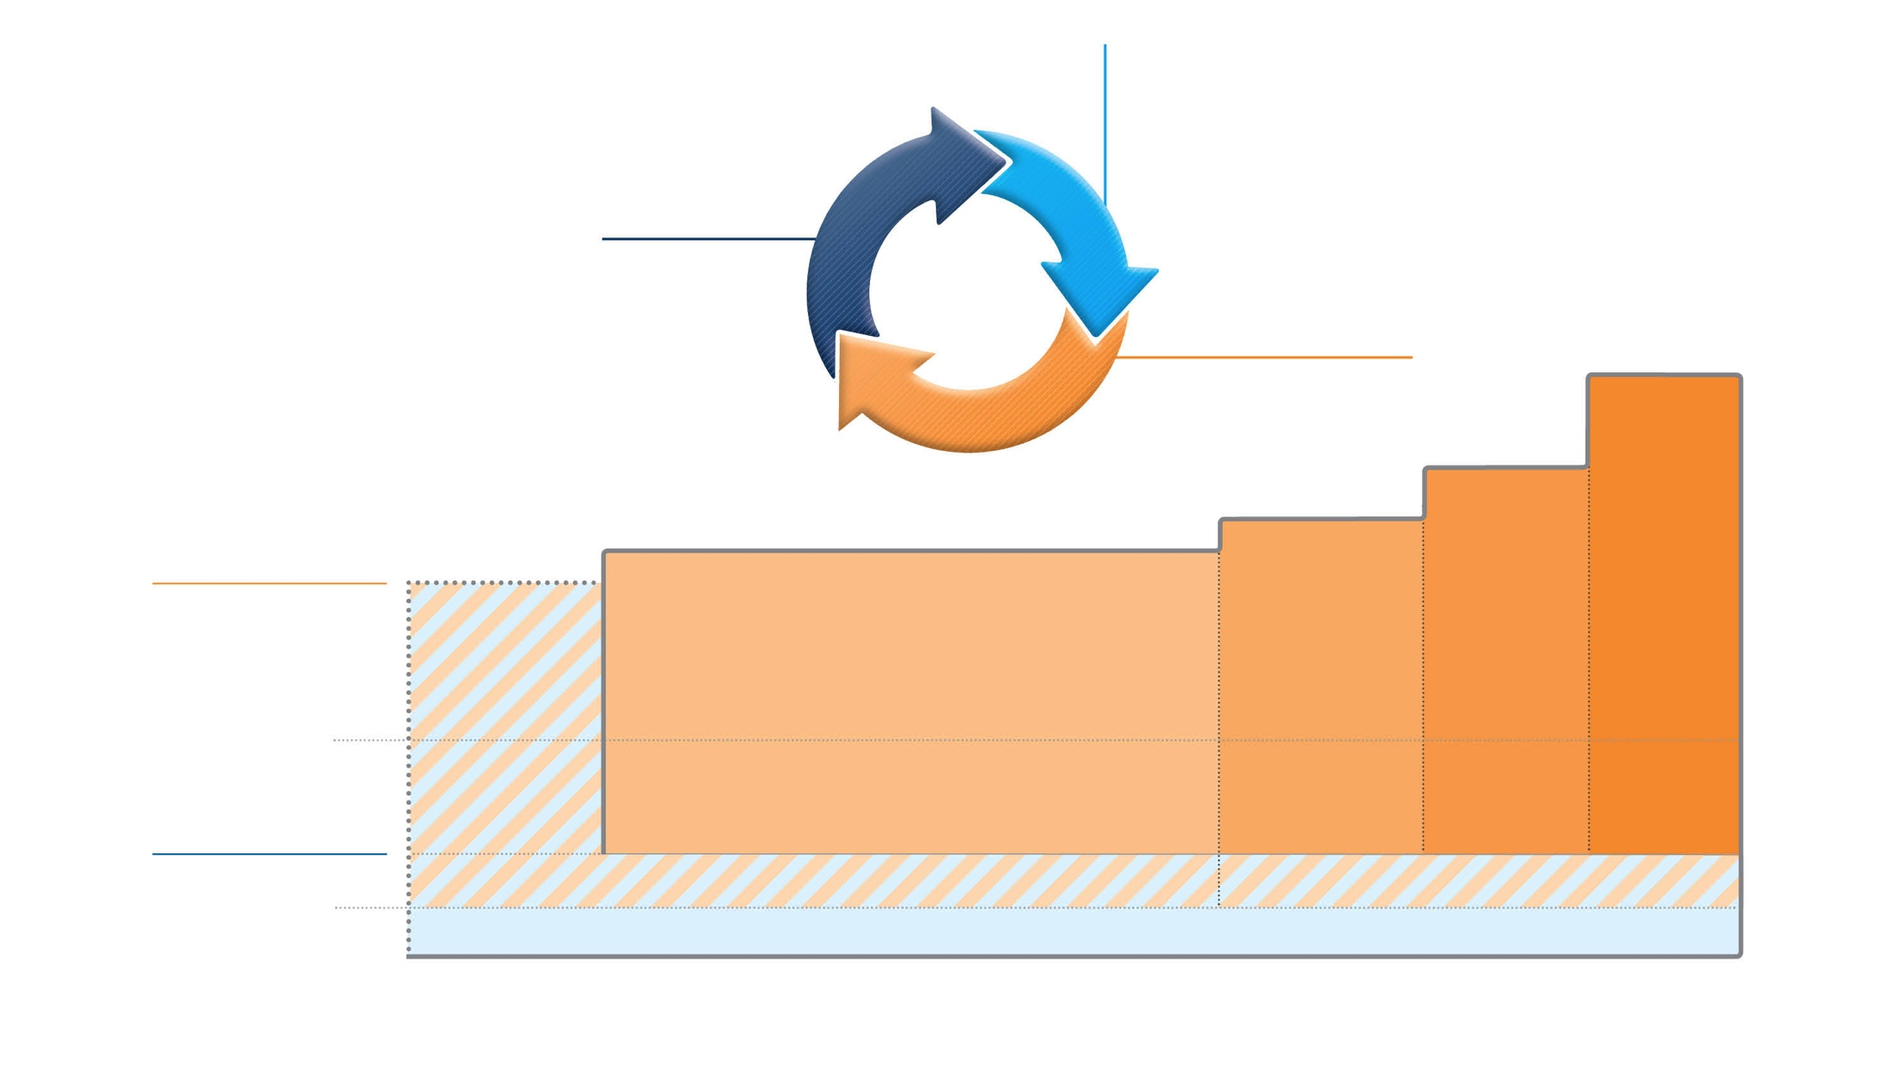
Box 3-5A
Adults & adolescents 12+ years
Confirmation of diagnosis if necessary Symptom control & modifiable
risk factors (including lung function)
Comorbidities
Inhaler technique & adherence Patient goals
ASSESS
Personalized asthma management:
Assess, Adjust, Review response
REVIEW RESPONSE
Symptoms Exacerbations Side-effects Lung function
Patient satisfaction
ADJUST
Treatment of modifiable risk factors & comorbidities
Non-pharmacological strategies Education & skills training Asthma medications
STEP 5
High dose ICS-LABA
Refer for phenotypic assessment
± add-on therapy, e.g.tiotropium, anti-IgE,
anti-IL5/5R,
anti-IL4R
Asthma medication options: Adjust treatment up and down for individual patient needs
STEP 4
Medium dose ICS-LABA
STEP 3
Low dose ICS-LABA
STEP 2
Daily low dose inhaled corticosteroid (ICS), or as-needed low dose ICS-formoterol *
PREFERRED CONTROLLER
to prevent exacerbations and control symptoms
STEP 1
As-needed low dose
ICS-formoterol *
Other controller options
Low dose ICS taken whenever SABA is taken †
Leukotriene receptor antagonist (LTRA), or low dose ICS taken whenever SABA taken †
Medium dose ICS, or low dose ICS+LTRA #
High dose ICS, add-on tiotropium, or add-on LTRA #
Add low dose OCS, but consider
side-effects
PREFERRED RELIEVER
As-needed low dose ICS-formoterol *
As-needed low dose ICS-formoterol ‡
Other reliever option
As-needed short-acting β₂ -agonist (SABA)
* Off-label; data only with budesonide-formoterol (bud-form)
† Off-label; separate or combination ICS and SABA inhalers
‡ Low-dose ICS-form is the reliever for patients prescribed bud-form or BDP-form maintenance and reliever therapy
# Consider adding HDM SLIT for sensitized patients with allergic rhinitis and FEV >70% predicted
1
© Global Initiative for Asthma, www.ginasthma.org
Notes:
Comment that we have made the figure in landscape orientation, so that the arrowed circle will always be seen

Slide 18
Box 3-5A
Adults & adolescents 12+ years
Confirmation of diagnosis if necessary Symptom control & modifiable
risk factors (including lung function)
Comorbidities
Inhaler technique & adherence Patient goals
ASSESS
Personalized asthma management:
Assess, Adjust, Review response
REVIEW RESPONSE
‘Controller’ treatment means the treatment taken to prevent exacerbations
Symptoms Exacerbations Side-effects Lung function
Patient satisfaction
ADJUST
Treatment of modifiable risk factors & comorbidities
Non-pharmacological strategies Education & skills training Asthma medications
STEP 5
High dose ICS-LABA
Refer for phenotypic assessment
± add-on therapy, e.g.tiotropium, anti-IgE,
anti-IL5/5R,
anti-IL4R
Asthma medication options: Adjust treatment up and down for individual patient needs
STEP 4
Medium dose ICS-LABA
STEP 3
Low dose ICS-LABA
STEP 2
Daily low dose inhaled corticosteroid (ICS), or as-needed low dose ICS-formoterol *
PREFERRED CONTROLLER
to prevent exacerbations and control symptoms
STEP 1
As-needed low dose
ICS-formoterol *
Other controller options
Low dose ICS taken whenever SABA is taken †
Leukotriene receptor antagonist (LTRA), or low dose ICS taken whenever SABA taken †
Medium dose ICS, or low dose ICS+LTRA #
High dose ICS, add-on tiotropium, or add-on LTRA #
Add low dose OCS, but consider
side-effects
PREFERRED RELIEVER
As-needed low dose ICS-formoterol *
As-needed low dose ICS-formoterol ‡
Other reliever option
As-needed short-acting β₂ -agonist (SABA)
* Off-label; data only with budesonide-formoterol (bud-form)
† Off-label; separate or combination ICS and SABA inhalers
‡ Low-dose ICS-form is the reliever for patients prescribed bud-form or BDP-form maintenance and reliever therapy
# Consider adding HDM SLIT for sensitized patients with allergic rhinitis and FEV >70% predicted
1
© Global Initiative for Asthma, www.ginasthma.org
Notes:
Comment that we have made the figure in landscape orientation, so that the arrowed circle will always be seen

Slide 19
Box 3-5A
Adults & adolescents 12+ years
Confirmation of diagnosis if necessary Symptom control & modifiable
risk factors (including lung function)
Comorbidities
Inhaler technique & adherence Patient goals
STEP 2 (PREFERRED CONTROLLER)
Daily low dose inhaled corticosteroid (ICS),
or as-needed low dose ICS-formoterol *
ASSESS
Personalized asthma management:
Assess, Adjust, Review response
REVIEW RESPONSE
Symptoms Exacerbations Side-effects Lung function
Patient satisfaction
ADJUST
Treatment of modifiable risk factors & comorbidities
Non-pharmacological strategies Education & skills training Asthma medications
STEP 5
High dose ICS-LABA
Refer for phenotypic assessment
± add-on therapy, e.g.tiotropium, anti-IgE,
anti-IL5/5R,
anti-IL4R
Asthma medication options: Adjust treatment up and down for individual patient needs
STEP 4
Medium dose ICS-LABA
STEP 3
Low dose ICS-LABA
STEP 2
Daily low dose inhaled corticosteroid (ICS), or as-needed low dose ICS-formoterol *
PREFERRED CONTROLLER
to prevent exacerbations and control symptoms
STEP 1
As-needed low dose
ICS-formoterol *
Other controller options
Low dose ICS taken whenever SABA is taken †
Leukotriene receptor antagonist (LTRA), or low dose ICS taken whenever SABA taken †
Medium dose ICS, or low dose ICS+LTRA #
High dose ICS, add-on tiotropium, or add-on LTRA #
Add low dose OCS, but consider
side-effects
PREFERRED RELIEVER
As-needed low dose ICS-formoterol *
As-needed low dose ICS-formoterol ‡
Other reliever option
As-needed short-acting β₂ -agonist (SABA)
* Off-label; data only with budesonide-formoterol (bud-form)
† Off-label; separate or combination ICS and SABA inhalers
‡ Low-dose ICS-form is the reliever for patients prescribed bud-form or BDP-form maintenance and reliever therapy
# Consider adding HDM SLIT for sensitized patients with allergic rhinitis and FEV >70% predicted
1
© Global Initiative for Asthma, www.ginasthma.org
Notes:
Data only with budesonide-formoterol

Slide 20
Box 3-5A
Adults & adolescents 12+ years
Confirmation of diagnosis if necessary Symptom control & modifiable
risk factors (including lung function)
Comorbidities
Inhaler technique & adherence Patient goals
ASSESS
Personalized asthma management:
Assess, Adjust, Review response
REVIEW RESPONSE
Symptoms Exacerbations Side-effects Lung function
Patient satisfaction
ADJUST
Treatment of modifiable risk factors & comorbidities
Non-pharmacological strategies Education & skills training Asthma medications
STEP 2 (OPTIONS)
Leukotriene receptor antagonist (LTRA), or low dose ICS taken whenever SABA taken
STEP 5
High dose ICS-LABA
Refer for phenotypic assessment
± add-on therapy, e.g.tiotropium, anti-IgE,
anti-IL5/5R,
anti-IL4R
Asthma medication options: Adjust treatment up and down for individual patient needs
STEP 4
Medium dose ICS-LABA
STEP 3
Low dose ICS-LABA
STEP 2
Daily low dose inhaled corticosteroid (ICS), or as-needed low dose ICS-formoterol *
PREFERRED CONTROLLER
to prevent exacerbations and control symptoms
STEP 1
As-needed low dose
ICS-formoterol *
Other controller options
Low dose ICS taken whenever SABA is taken †
Leukotriene receptor antagonist (LTRA), or low dose ICS taken whenever SABA taken †
Medium dose ICS, or low dose ICS+LTRA #
High dose ICS, add-on tiotropium, or add-on LTRA #
Add low dose OCS, but consider
side-effects
PREFERRED RELIEVER
As-needed low dose ICS-formoterol *
As-needed low dose ICS-formoterol ‡
Other reliever option
As-needed short-acting β₂ -agonist (SABA)
* Off-label; data only with budesonide-formoterol (bud-form)
† Off-label; separate or combination ICS and SABA inhalers
‡ Low-dose ICS-form is the reliever for patients prescribed bud-form or BDP-form maintenance and reliever therapy
# Consider adding HDM SLIT for sensitized patients with allergic rhinitis and FEV >70% predicted
1
© Global Initiative for Asthma, www.ginasthma.org
Notes:
Comment that we have made the figure in landscape orientation, so that the arrowed circle will always be seen

Slide 21
Box 3-5A
Adults & adolescents 12+ years
Confirmation of diagnosis if necessary Symptom control & modifiable
risk factors (including lung function)
Comorbidities
Inhaler technique & adherence Patient goals
ASSESS
Personalized asthma management:
Assess, Adjust, Review response
REVIEW RESPONSE
Symptoms Exacerbations Side-effects Lung function
Patient satisfaction
ADJUST
STEP 1 (PREFERRED CONTROLLER)
As-needed low dose ICS-formoterol
Treatment of modifiable risk factors & comorbidities
Non-pharmacological strategies Education & skills training Asthma medications
STEP 5
High dose ICS-LABA
Refer for phenotypic assessment
± add-on therapy, e.g.tiotropium, anti-IgE,
anti-IL5/5R,
anti-IL4R
Asthma medication options: Adjust treatment up and down for individual patient needs
STEP 4
Medium dose ICS-LABA
STEP 3
Low dose ICS-LABA
STEP 2
Daily low dose inhaled corticosteroid (ICS), or as-needed low dose ICS-formoterol *
PREFERRED CONTROLLER
to prevent exacerbations and control symptoms
STEP 1
As-needed low dose
ICS-formoterol *
Other controller options
Low dose ICS taken whenever SABA is taken †
Leukotriene receptor antagonist (LTRA), or low dose ICS taken whenever SABA taken †
Medium dose ICS, or low dose ICS+LTRA #
High dose ICS, add-on tiotropium, or add-on LTRA #
Add low dose OCS, but consider
side-effects
PREFERRED RELIEVER
As-needed low dose ICS-formoterol *
As-needed low dose ICS-formoterol ‡
Other reliever option
As-needed short-acting β₂ -agonist (SABA)
* Off-label; data only with budesonide-formoterol (bud-form)
† Off-label; separate or combination ICS and SABA inhalers
‡ Low-dose ICS-form is the reliever for patients prescribed bud-form or BDP-form maintenance and reliever therapy
# Consider adding HDM SLIT for sensitized patients with allergic rhinitis and FEV >70% predicted
1
© Global Initiative for Asthma, www.ginasthma.org
Notes:
비어있던 controller 자리에 prn low dose ICS-formoterol

Slide 22
Box 3-5A
Adults & adolescents 12+ years
Confirmation of diagnosis if necessary Symptom control & modifiable
risk factors (including lung function)
Comorbidities
Inhaler technique & adherence Patient goals
ASSESS
Personalized asthma management:
Assess, Adjust, Review response
REVIEW RESPONSE
Symptoms Exacerbations Side-effects Lung function
Patient satisfaction
ADJUST
Treatment of modifiable risk factors & comorbidities
Non-pharmacological strategies Education & skills training Asthma medications
STEP 5
High dose ICS-LABA
Refer for phenotypic assessment
± add-on therapy, e.g.tiotropium, anti-IgE,
anti-IL5/5R,
anti-IL4R
Asthma medication options: Adjust treatment up and down for individual patient needs
STEP 4
Medium dose ICS-LABA
STEP 1 (OPTIONS)
Low dose ICS taken whenever SABA is taken
STEP 3
Low dose ICS-LABA
STEP 2
Daily low dose inhaled corticosteroid (ICS), or as-needed low dose ICS-formoterol *
PREFERRED CONTROLLER
to prevent exacerbations and control symptoms
STEP 1
As-needed low dose
ICS-formoterol *
Other controller options
Low dose ICS taken whenever SABA is taken †
Leukotriene receptor antagonist (LTRA), or low dose ICS taken whenever SABA taken †
Medium dose ICS, or low dose ICS+LTRA #
High dose ICS, add-on tiotropium, or add-on LTRA #
Add low dose OCS, but consider
side-effects
PREFERRED RELIEVER
As-needed low dose ICS-formoterol *
As-needed low dose ICS-formoterol ‡
Other reliever option
As-needed short-acting β₂ -agonist (SABA)
* Off-label; data only with budesonide-formoterol (bud-form)
† Off-label; separate or combination ICS and SABA inhalers
‡ Low-dose ICS-form is the reliever for patients prescribed bud-form or BDP-form maintenance and reliever therapy
# Consider adding HDM SLIT for sensitized patients with allergic rhinitis and FEV >70% predicted
1
© Global Initiative for Asthma, www.ginasthma.org
Notes:
Comment that we have made the figure in landscape orientation, so that the arrowed circle will always be seen

Slide 23
Box 3-5A
Adults & adolescents 12+ years
Confirmation of diagnosis if necessary Symptom control & modifiable
risk factors (including lung function)
Comorbidities
Inhaler technique & adherence Patient goals
STEP 4 (PREFERRED CONTROLLER)
Step 4 treatment is medium dose ICS-LABA;
high dose now in Step 5
ASSESS
Personalized asthma management:
Assess, Adjust, Review response
REVIEW RESPONSE
Symptoms Exacerbations Side-effects Lung function
Patient satisfaction
ADJUST
Treatment of modifiable risk factors & comorbidities
Non-pharmacological strategies Education & skills training Asthma medications
STEP 5
High dose ICS-LABA
Refer for phenotypic assessment
± add-on therapy, e.g.tiotropium, anti-IgE,
anti-IL5/5R,
anti-IL4R
Asthma medication options: Adjust treatment up and down for individual patient needs
STEP 4
Medium dose ICS-LABA
STEP 3
Low dose ICS-LABA
STEP 2
Daily low dose inhaled corticosteroid (ICS), or as-needed low dose ICS-formoterol *
PREFERRED CONTROLLER
to prevent exacerbations and control symptoms
STEP 1
As-needed low dose
ICS-formoterol *
Other controller options
Low dose ICS taken whenever SABA is taken †
Leukotriene receptor antagonist (LTRA), or low dose ICS taken whenever SABA taken †
Medium dose ICS, or low dose ICS+LTRA #
High dose ICS, add-on tiotropium, or add-on LTRA #
Add low dose OCS, but consider
side-effects
PREFERRED RELIEVER
As-needed low dose ICS-formoterol *
As-needed low dose ICS-formoterol ‡
Other reliever option
As-needed short-acting β₂ -agonist (SABA)
* Off-label; data only with budesonide-formoterol (bud-form)
† Off-label; separate or combination ICS and SABA inhalers
‡ Low-dose ICS-form is the reliever for patients prescribed bud-form or BDP-form maintenance and reliever therapy
# Consider adding HDM SLIT for sensitized patients with allergic rhinitis and FEV >70% predicted
1
© Global Initiative for Asthma, www.ginasthma.org
Notes:
Comment that we have made the figure in landscape orientation, so that the arrowed circle will always be seen

Slide 24
STEP 5 (PREFERRED CONTROLLER)
High dose ICS-LABA
Refer for phenotypic assessment
± add-on therapy,
e.g.tiotropium, anti-IgE, anti-IL5/5R,
anti-IL4R
STEP 5 (OPTIONS)
Add low dose OCS,
but consider side-effects
Box 3-5A
Adults & adolescents 12+ years
Confirmation of diagnosis if necessary Symptom control & modifiable
risk factors (including lung function)
Comorbidities
Inhaler technique & adherence Patient goals
ASSESS
Personalized asthma management:
Assess, Adjust, Review response
REVIEW RESPONSE
Symptoms Exacerbations Side-effects Lung function
Patient satisfaction
ADJUST
Treatment of modifiable risk factors & comorbidities
Non-pharmacological strategies Education & skills training Asthma medications
STEP 5
High dose ICS-LABA
Refer for phenotypic assessment
± add-on therapy, e.g.tiotropium, anti-IgE,
anti-IL5/5R,
anti-IL4R
Asthma medication options: Adjust treatment up and down for individual patient needs
STEP 4
Medium dose ICS-LABA
STEP 3
Low dose ICS-LABA
STEP 2
Daily low dose inhaled corticosteroid (ICS), or as-needed low dose ICS-formoterol *
PREFERRED CONTROLLER
to prevent exacerbations and control symptoms
STEP 1
As-needed low dose
ICS-formoterol *
Other controller options
Low dose ICS taken whenever SABA is taken †
Leukotriene receptor antagonist (LTRA), or low dose ICS taken whenever SABA taken †
Medium dose ICS, or low dose ICS+LTRA #
High dose ICS, add-on tiotropium, or add-on LTRA #
Add low dose OCS, but consider
side-effects
PREFERRED RELIEVER
As-needed low dose ICS-formoterol *
As-needed low dose ICS-formoterol ‡
Other reliever option
As-needed short-acting β₂ -agonist (SABA)
* Off-label; data only with budesonide-formoterol (bud-form)
† Off-label; separate or combination ICS and SABA inhalers
‡ Low-dose ICS-form is the reliever for patients prescribed bud-form or BDP-form maintenance and reliever therapy
# Consider adding HDM SLIT for sensitized patients with allergic rhinitis and FEV >70% predicted
1
© Global Initiative for Asthma, www.ginasthma.org
Notes:
Comment that we have made the figure in landscape orientation, so that the arrowed circle will always be seen

Slide 25
Control-based asthma management
Well controlled on low dose ICS/LABA (formoterol)
→ step down to low dose ICS (or start with low dose ICS)
→ ?

Slide 26
Box 3-5A
Adults & adolescents 12+ years
Confirmation of diagnosis if necessary Symptom control & modifiable
risk factors (including lung function)
Comorbidities
Inhaler technique & adherence Patient goals
ASSESS
Personalized asthma management:
Assess, Adjust, Review response
REVIEW RESPONSE
Symptoms Exacerbations Side-effects Lung function
Patient satisfaction
ADJUST
Treatment of modifiable risk factors & comorbidities
Non-pharmacological strategies Education & skills training Asthma medications
STEP 5
High dose ICS-LABA
Refer for phenotypic assessment
± add-on therapy, e.g.tiotropium, anti-IgE,
anti-IL5/5R,
anti-IL4R
Asthma medication options: Adjust treatment up and down for individual patient needs
STEP 4
Medium dose ICS-LABA
STEP 3
Low dose ICS-LABA
STEP 2
Daily low dose inhaled corticosteroid (ICS), or as-needed low dose ICS-formoterol *
PREFERRED CONTROLLER
to prevent exacerbations and control symptoms
STEP 1
As-needed low dose
ICS-formoterol *
Other controller options
Low dose ICS taken whenever SABA is taken †
Leukotriene receptor antagonist (LTRA), or low dose ICS taken whenever SABA taken †
Medium dose ICS, or low dose ICS+LTRA #
High dose ICS, add-on tiotropium, or add-on LTRA #
Add low dose OCS, but consider
side-effects
PREFERRED RELIEVER
As-needed low dose ICS-formoterol *
As-needed low dose ICS-formoterol ‡
Other reliever option
As-needed short-acting β₂ -agonist (SABA)
* Off-label; data only with budesonide-formoterol (bud-form)
† Off-label; separate or combination ICS and SABA inhalers
‡ Low-dose ICS-form is the reliever for patients prescribed bud-form or BDP-form maintenance and reliever therapy
# Consider adding HDM SLIT for sensitized patients with allergic rhinitis and FEV >70% predicted
© Global Initiative for Asthma, www.ginasthma.org
1
Notes:
Comment that we have made the figure in landscape orientation, so that the arrowed circle will always be seen

Slide 27
Control-based asthma management
Well controlled on low dose ICS/LABA
→ step down to low dose ICS or prn low dose ICS/formoterol
→ well controlled
→ prn low dose ICS/formoterol or prn low dose ICS/SABA

Slide 28

prn SABA 삭제 or 유지?
prn ICS/LABA 의 허용 범위
Budesonide/formoterol 외 data
Step 3 > Step 2: ICS only or prn ICS/formoterol
치료할 뻔했다!

Slide 29
천식 치료의 시작
처음 진단된 환자 또는 치료를 중단했던 환자
어떤 흡입기를 선택할 것인가?
시작이 반이다
첫술에 배부르랴
Notes:
경과 관찰 중 방문 시 약제 조절도 중요하지만 결국 환자의 compliance나 질병에 대한 이해도는 치료 초기, 또는 면담 초기에 정해질 가능성이 높다.
따라서 처음 흡입기 치료를 어떻게 해서 조절해 주는 지가 향후 치료 경과에 영향을 줄 것으로 예상할 수 있다.
그런 의미에서 첫 조절제, 첫 흡입기의 선택이 중요하다는 의미에서 시작이 반이라고 할 수 있지만,
처음 치료 시 불필요하게 높은 단계의 약으로 시작하게 될 경우 환자는 빠른 호전을 경험하고 바로 약을 자가 중단, 추후 악화 시 같은 강도의 약을 요구하는 상황이 반복될 수 있다.
교육이 없다면.

Slide 30
Initial controller의 선택
Presenting symptoms | Preferred initial controller
증상 or SABA 사용 월 1회 이하, 지난 한 달 수면장애 없음, 급성악화 위험인자 없음, 지난 1년 급성악화 없음. | 불필요 (Evidence D)
증상은 드물지만 급성악화 위험인자 한 가지 이상 | 저용량 ICS (Evidence D)
증상 or SABA 사용 월 2회 이상, 주 1회 이하, 수면장애 월 1회 이상 | 저용량 ICS (Evidence B)
증상 or SABA 사용 주 2회 이상 | 저용량 ICS (Evidence A) (or LTRA, theophylline)
매일 증상, 주 1회 이상 수면 장애 + 급성악화 위험인자 | 중간용량/고용량 ICS (Evidence A), or 저용량 ICS/LABA (Evidence A)
조절되지 않는 중증 천식, 천식 급성악화로 시작 | 단기간 oral steroid + 고용량 ICS (Evidence A), or moderate-dose ICS/LABA (Evidence D)
GINA 2018
Notes:
증상의 빈도 부분이 불필요하게 복잡하고 옵션이 많다.
Mild asthma 의 치료 약제를 결정하는 데는 특히 risk factor의 유무가 중요.
있으면 ICS

Slide 31
Risk factor for exacerbation
High SABA use
Inadequate ICS
Low FEV1 ( < 60% )
Major psychological or socioeconomic problems
Smoking, allergen exposure
Obesity, chronic rhinosinusitis, confirmed food allergy
Sputum or blood eosinophilia
Elevated FENO
Pregnancy
GINA 2018

Slide 32
More simply
Risk factor for exacerbation
High SABA use / Inadequate ICS
Known atopy, allergic disease
Smoking, obesity, pregnancy
Low FEV1 ( < 60%)
Evidence of eosinophilic inflammation (sputum/blood/FENO)

Slide 33
Initial controller의 선택
Presenting symptoms | Preferred initial controller
증상 or SABA 사용 월 1회 이하, 지난 한 달 수면장애 없음, 급성악화 위험인자 없음, 지난 1년 급성악화 없음. | 불필요 (Evidence D)
증상은 드물지만 급성악화 위험인자 한 가지 이상 | 저용량 ICS (Evidence D)
증상 or SABA 사용 월 2회 이상, 주 1회 이하, 수면장애 월 1회 이상 | 저용량 ICS (Evidence B)
증상 or SABA 사용 주 2회 이상 | 저용량 ICS (Evidence A) (or LTRA, theophylline)
매일 증상 or 주 1회 이상 수면 장애 + 급성악화 위험인자 | 중간용량/고용량 ICS (Evidence A), or 저용량 ICS/LABA (Evidence A)
조절되지 않는 중증 천식, 천식 급성악화로 시작 | 단기간 oral steroid + 고용량 ICS (Evidence A), or moderate-dose ICS/LABA (Evidence D)
Step 2
Step 3
GINA 2018

Slide 34
Initial controller의 선택
GINA Step 2
- daily low dose ICS
- as-needed low dose ICS/formoterol
- LTRA
- low dose ICS taken whenever SABA taken
GINA Step 3
- low dose ICS/LABA
- medium dose ICS
- low dose ICS + LTRA
GINA 2019
Notes:
Initial treatment 에 PRN inhaler treatment 로 환자에게 자율성을 부과하는 것은 step1 에서 prn SABA 와 같이 환자에게 control에 대한 잘못된 인식을 줄 수 있으므로
Initial treatmen는 regular ICS 가 맞다.

Slide 35
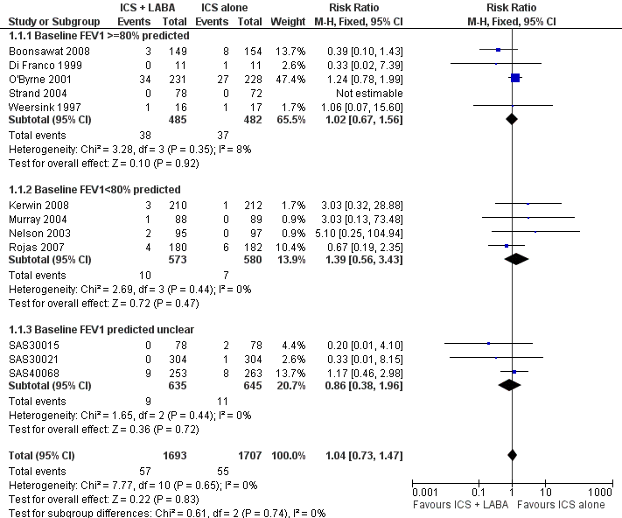
Low dose ICS vs. ICS/LABA on step 2
Ni Chroinin et al. Cochrane Database Syst Rev 2009 Oct 7;(4)

Slide 36
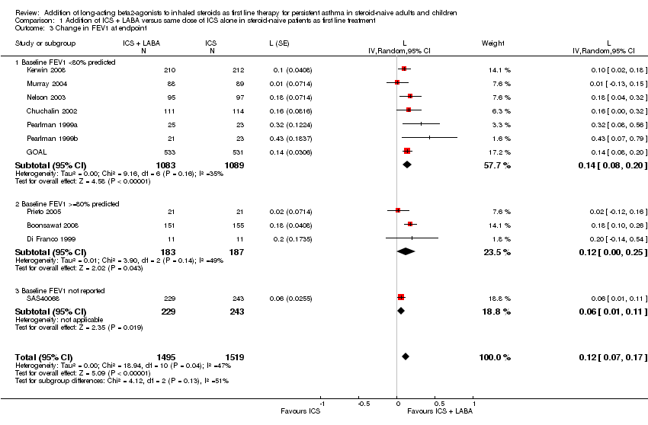
Low dose ICS vs. ICS/LABA on step 2
Ni Chroinin et al. Cochrane Database Syst Rev 2009 Oct 7;(4)

Slide 37
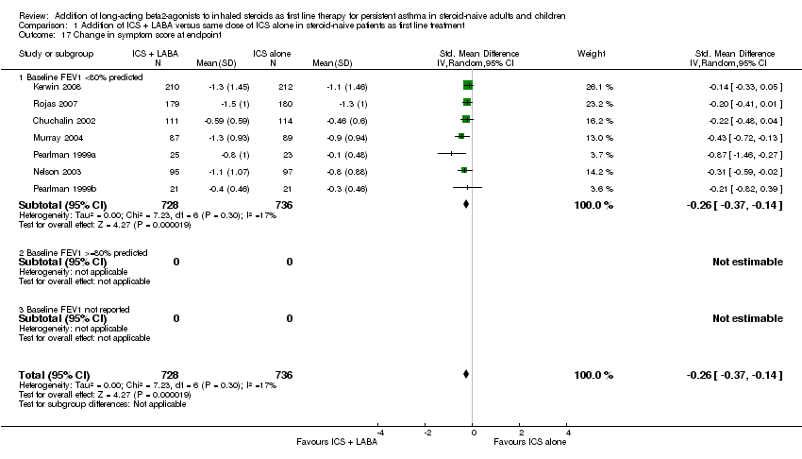
Low dose ICS vs. ICS/LABA on step 2
Exacerbation :
low dose ICS = ICS/LABA
Lung function and Sx :
low dose ICS < ICS/LABA
Ni Chroinin et al. Cochrane Database Syst Rev 2009 Oct 7;(4)
Notes:
LABA overuse에 대한 부담.

Slide 38
Initial controller의 선택
Presenting symptoms | Preferred initial controller
매일은 아니지만 증상 있음. 매주는 아니지만 천식에 의한 수면장애 있음. 증상 드물게 있지만 위험인자 있음. | Low dose ICS or Low dose ICS/LABA ( /c 폐기능 저하)
매일 증상 매주 천식에 의한 수면 장애 있음 | Low dose ICS/LABA or Medium dose ICS
급성악화 | Short course of oral steroids + Medium dose ICS/LABA

Slide 39
Control-based asthma management
uncontrolled on low dose ICS/fLABA
→ step up to 4 or 5 (controlled or need more)
Severe asthma
- 5~10% severe asthma pt requiring more extensive Tx.
- most of morbidity and mortality
- more health care cost

Slide 40
Humbert M et al. Curr Opin Pulm Med 2018;24(1):83 - 93

Slide 41
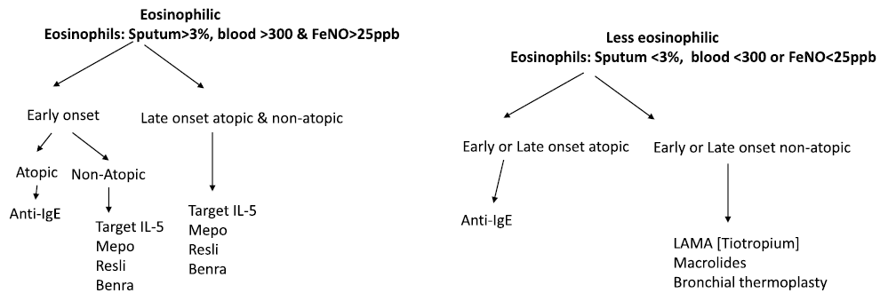
Severe asthma algorithm approach:
A simple approach
Papaioannou Al et al. Respir Med 2018;142:15 - 22

Slide 42
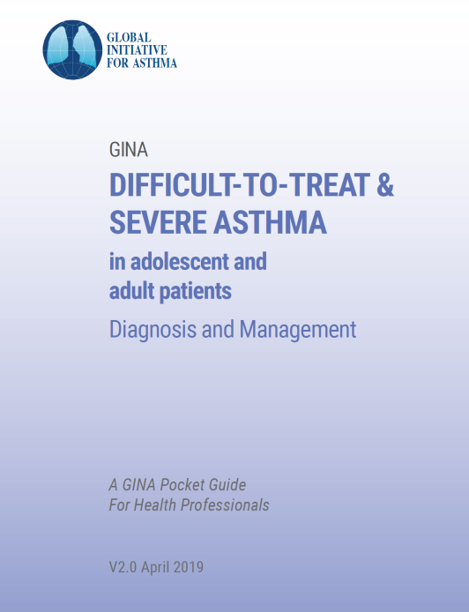
Severe Asthma
Uncontrolled asthma (one or both)
Poor symptom control (frequent symptoms or reliever use, activity limited by asthma, night waking due to asthma)
Frequent exacerbations (≥2/year) requiring oral corticosteroids (OCS), or serious exacerbations (≥1/year) requiring hospitalization

Slide 43
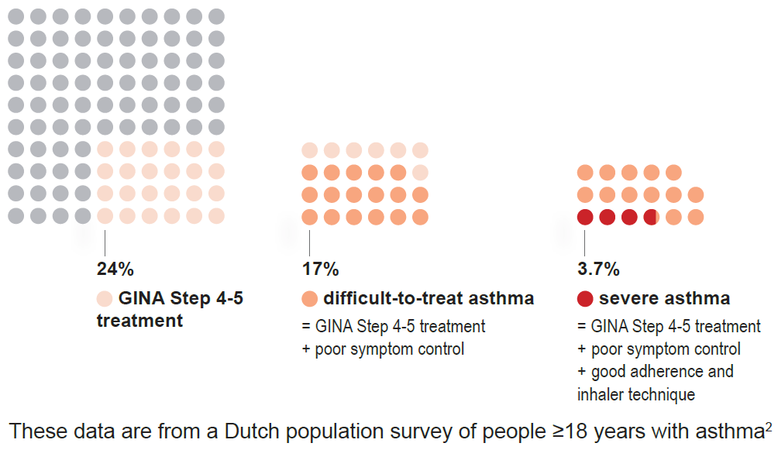
What proportion of adults have difficult-to-treat or severe asthma?

Slide 44
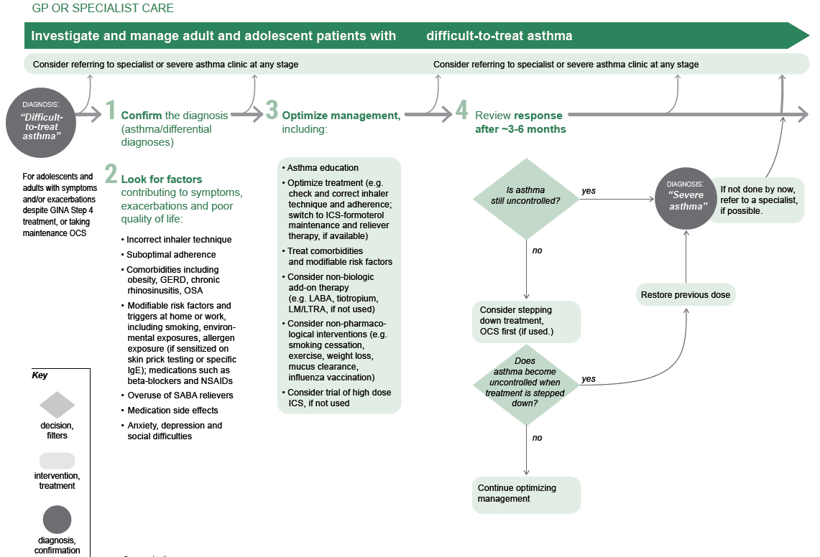
2 LOOK FOR FACTORS
Inhaler technique
Adherence
Comorbidities
Risk factors and triggers
Overuse of SABA
Medication side effects
Social/Emotional problems
3 OPTIMIZE MANAGEMENT
Correct inhaler technique and adherence
Change controller and reliever
Treat comorbidities and modifiable risk factors
Consider non-biologic add-on therapy (e.g. LABA, tiotropium, LTRA, if not used)
Consider non-pharmacological interventions
Consider high dose ICS, if not used

Slide 45
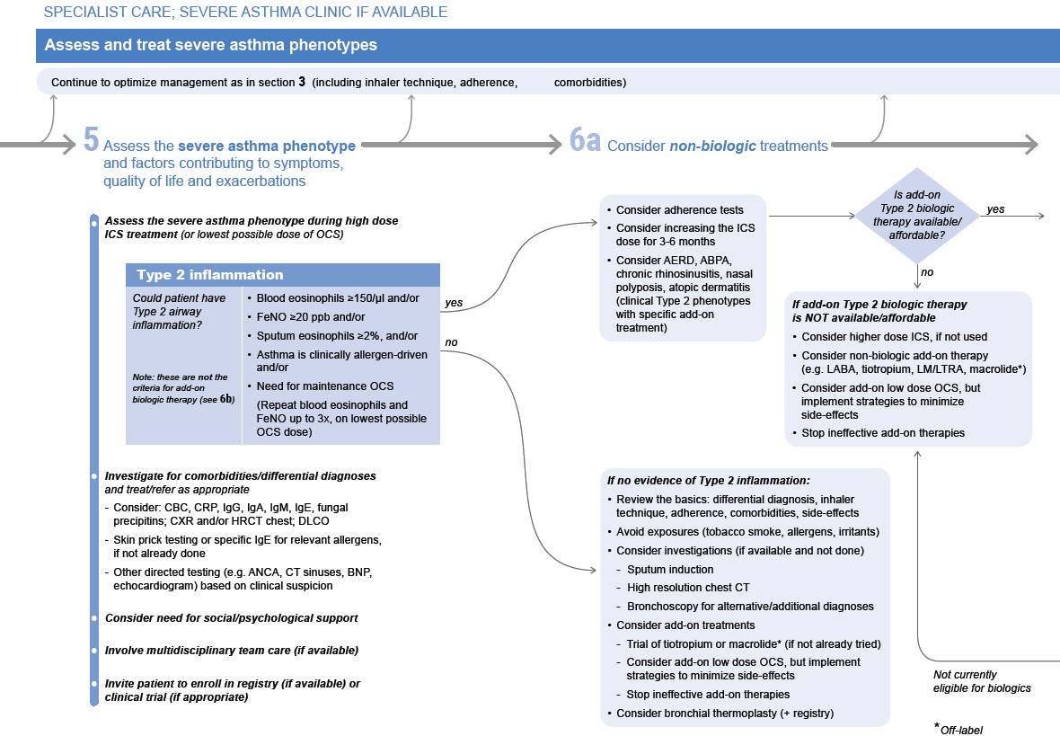
Type 2 inflammation
Could patient have Type 2 airway inflammation? | • Bl Eos ≥150/μl and/or • FeNO ≥20 ppb and/or • Sputum Eos ≥2%, and/or • Allergen-driven and/or • Need for maintenance OCS (Repeat blood eosinophils and FeNO up to 3x, on lowest possible OCS dose)
NO EVIDENCE
Review the basics
Avoid exposures
Comorbidities
Investigations (CT, broncho, sputum)
Add-on treatments (tiotropium, macrolide, low dose OCS)
Consider thermoplasty

Slide 46
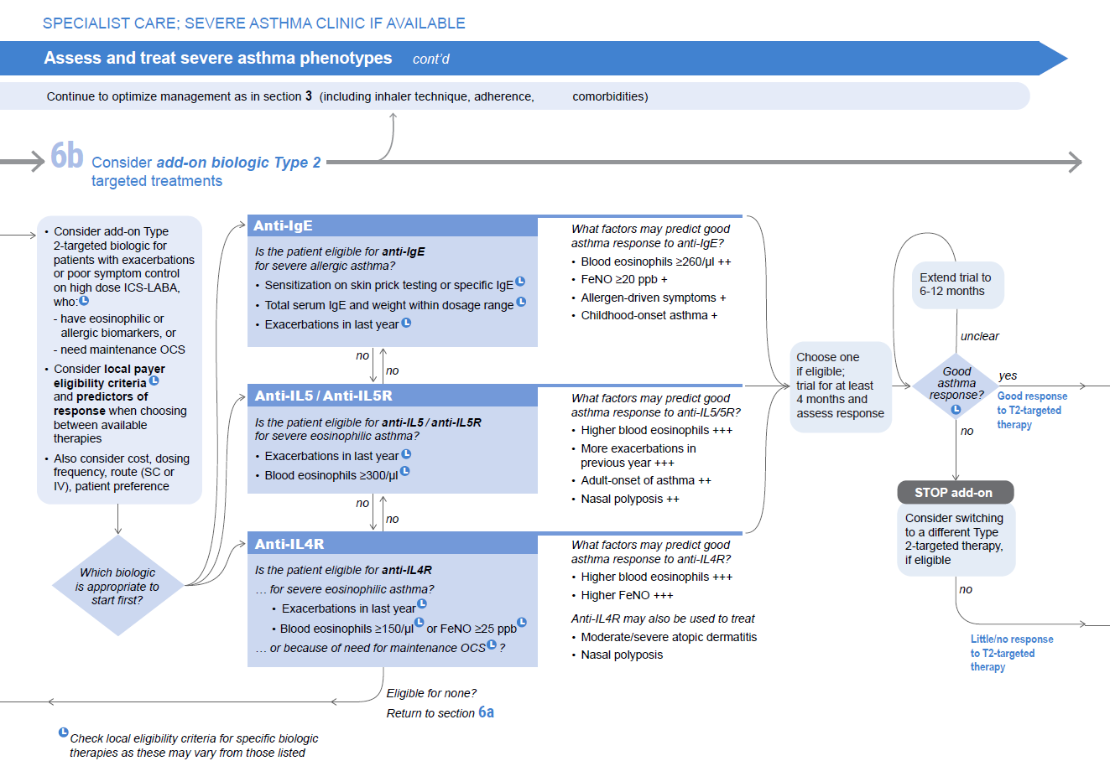

Slide 47
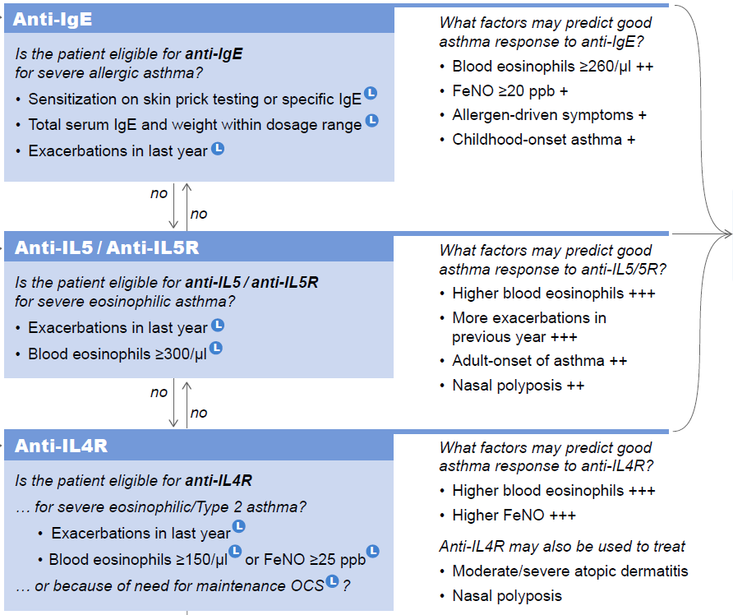

Slide 48
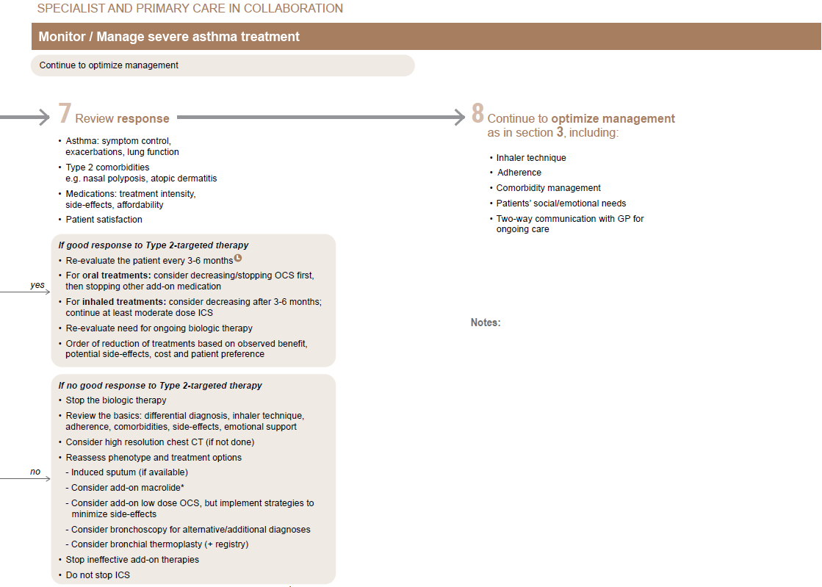
If no good response to Type 2-targeted therapy
Stop the biologic therapy
Review the basics
Consider HRCT
Reassess phenotypes and treatment options
- Induced sputum, bronchoscopy
- Macrolide, low dose OCS
- Consider thermoplasty
Stop ineffective add-on therapies
Do not stop ICS

Slide 49
Summary
What’s new in GINA 2019?
Step 2 | Step 1
two ‘preferred’ controller options | ‘preferred’ controller option
Regular low dose ICS with as-needed SABA | As-needed low dose ICS-formoterol
As-needed low dose ICS-formoterol | Low dose ICS taken whenever SABA is taken

Slide 50
Summary
Initial controller treatment
(Step 2) | (Step 3)
Infrequent Sx + risk factors or frequent Sx (not everyday) | Sx most days or night Sx ≥ 1/week ± risk factors
Low dose ICS Low dose ICS/LABA (FEV1<80%) | Low dose ICS/LABA

Slide 51
Summary
Difficult-to-treat & severe asthma management
Dx. Difficult-to-treat asthma
Look for factors
Optimize management
uncontrolled
Dx. Severe asthma
Investigate type 2 inflammation
Evidence of type 2 inflammation
If no evidence of type 2 inflammation
Consider add-on
type 2-targeted biologics
Anti-IgE
Anti-IL5/Anti-IL5R
Anti-IL4R
Review basics
Reassess Dx. and phenotype
Add-on Tx.
(tiotropium, macrolide, low dose ICS, thermoplasty)

Slide 52

Thank you for your attention!

