Slide 1
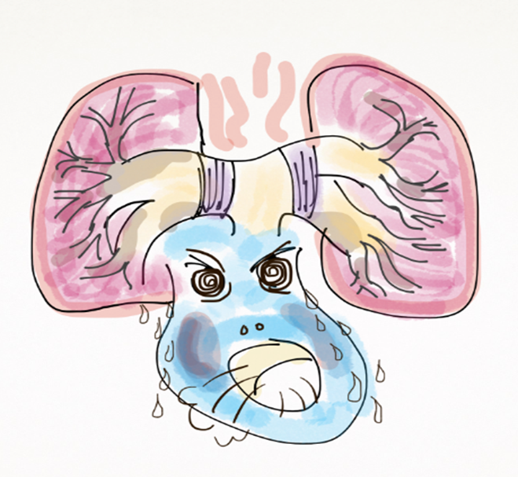
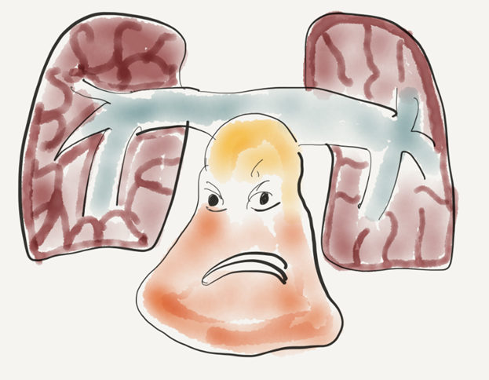
호흡기 환자의
폐고혈압
인제의대 해운대백병원
장항제

Slide 2
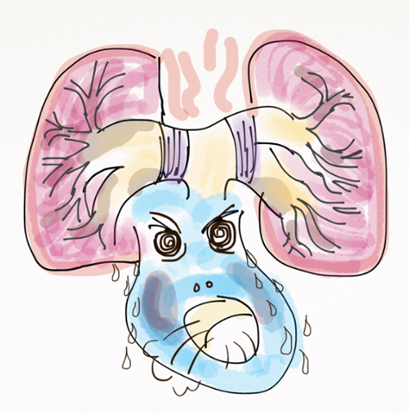

폐고혈압 Pulmonary Hypertension (PH) 정의
Too high blood pressure in ‘Lung’
in Rt. Side of heart
Normal mean PAP = 14±3 mmHg, Upper limit of mean PAP = 20 mmHg

Slide 3
폐고혈압 Pulmonary Hypertension (PH) 정의
질환명이 아니고 혈역학적 상태이다. hemodynamic status
심초음파 추정이 아닌 우심도자 검사로 측정한 압력이다.
특발성 또는 여러가지 질환과 연관되어 발생한다.
Normal mean PAP = 14±3 mmHg, Upper limit of mean PAP = 20 mmHg

Slide 4
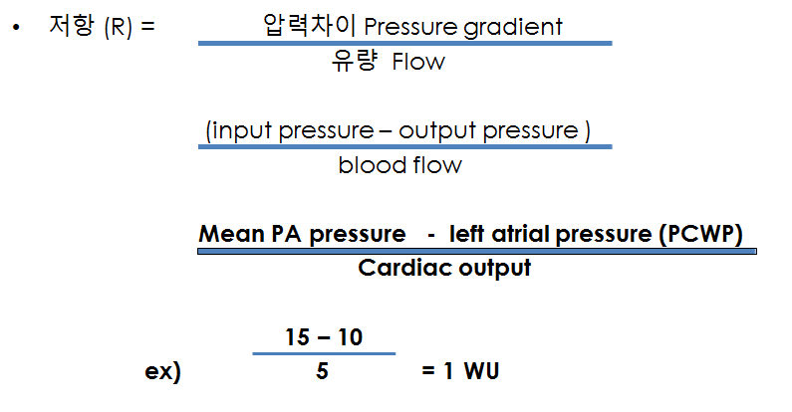
폐혈관저항 Pulmonary vascular resistance PVR
Quantitative value for right ventricular afterload.
Ohm’s law V=IR
Pressure gradient=Flow ｘ Resistance
혈관저항= 압력차이/심박출량

Slide 5
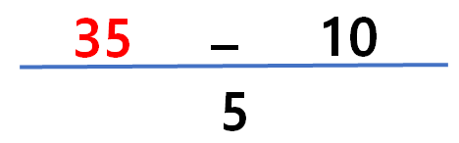
Pulmonary vascular resistance (PVR)
mPAP – PCWP
PVR =
CO
15
–
10
PVR =
= 5.0 Wood units
5
25
–
10
= 5.0 Wood units
PVR =
3
Notes:
In contrast, the pulmonary vascular resistance (PVR) is much lower, ranging between 0.6 to 1.9 Wood units. PVR can be measured in Wood units (or mm Hg/L/min), but can also be defined as dyn/sec/cm⁻⁵. To convert from Woods units to dyn/sec/cm⁻⁵, the value is multiplied by a factor of 80. At the 5th World Symposium on PH, experts noted that consistent use of one unit for PVR would be beneficial and suggested the use of Wood units.¹
The right ventricle does not need to pump as forcefully as the left ventricle, and the mean pulmonary arterial pressure (mPAP) in healthy adults is only around 15 mmHg, nearly a factor of 10 less than the pressure in the systemic circulation. Therefore, the pulmonary circulation is a low-pressure system. Blood flow through the pulmonary circulation is set by the flow through the systemic circulation, and the pulmonary circulation is primarily flow regulated.
TPR (mPAP/CO) is calculated in some cases where the PAWP can not be calculated.
¹Hoeper et al. J Am Coll Cardiol 2013;62:D42–50.

Slide 6
PH classification 폐고혈압 분류
Group 1 – Pulmonary arterial hypertension (PAH)
Group 2 – PH associated with left heart disease
Group 3 – PH associated with lung disease and/or hypoxemia
Group 4 – PH associated with pulmonary artery obstructions (CTEPH)
Group 5 – PH associated with unclear and/or multifactorial mechanisms

Slide 7
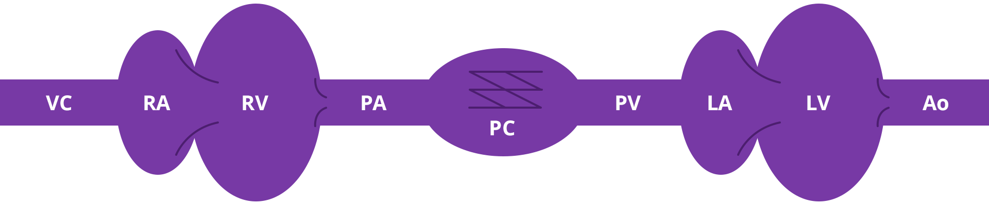
혈역학적 분류 Hemodynamic classification
Pre-capillary PH vs. post capillary PH
WHO
Group 1:
PAH
WHO
Group 4:
Chronic
thromboembolism
WHO
Group 3:
lung disease
WHO
Group 1’:
PVOD/P CH
WHO
Group 2:
left heart disease
WHO Group 5: unclear or variable mechanisms
Slide c/o Dr. Barbara LeVarge
McManus DD, et al. In: Crawford MH, ed. CURRENT Diagnosis & Treatment: Cardiology. 2009.

Slide 8
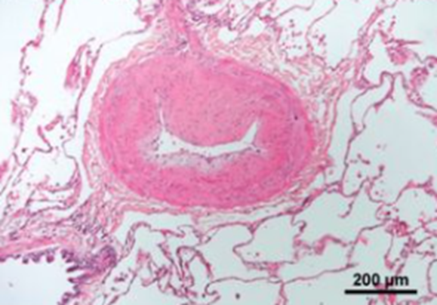

Group 1 폐동맥고혈압
Pulmonary Arterial Hypertension (PAH)
“폐 동맥이 직접 이환되어 좁아지는 질환”
“PAH specific drugs 치료 대상”
Group 1 >
1 PAH
1.1 Idiopathic PAH
1.2 Heritable PAH
1.3 Drug- and toxin-induced PAH (table 3)
1.4 PAH associated with:
1.4.1 Connective tissue disease
1.4.2 HIV infection
1.4.3 Portal hypertension
1.4.4 Congenital heart disease
1.4.5 Schistosomiasis
1.5 PAH long-term responders to calcium channel blockers
1.6 PAH with overt features of venous/capillaries (PVOD/PCH) involvement
1.7 Persistent PH of the newborn syndrome

Slide 9
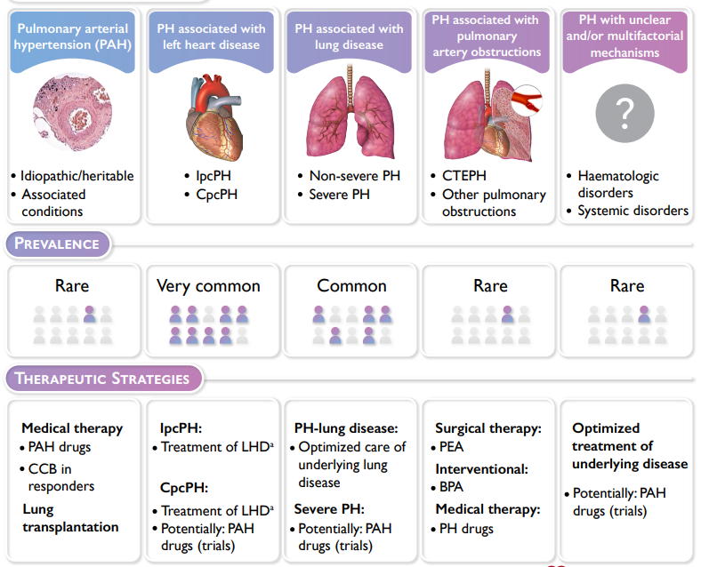
2022 ESC/ERS guidelines for PH

Slide 10
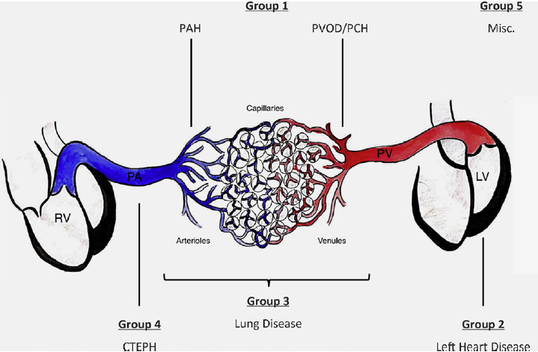
Br J Radiol 2020; 94: 20200830.
폐질환/저산소증 연관폐고혈압
만성 혈전색전성
폐고혈압

Slide 11
Prevalence of PH in COPD and IPF
COPD
IPF
Author | N | Defining PH criteria (mPAP) | Prevalence of PH (%)
Burrows | 50 | >25 mmHg | 20
Weitzenblum | 175 | >20 mmHg | 35
Weitzenblum | 93 | >20 mmHg | 34
Oswald-mammosser | 84 | >20 mmHg | 77
Scharf | 120 | >20 mmHg | 91
Thabut | 215 | >25 mmHg | 50
Author | N | Defining PH criteria (mPAP) | Prevalence of PH (%)
Lettieri | 79 | >25 mmHg | 32
Shorr | 2525 | >25 mmHg | 46
Alkukhun | 235 | >25 mmHg | 51
Minai | 124 | >25 mmHg | 44
Zisman | 60 | >25 mmHg | 39
Nathan | 118 | >25 mmHg | 41
Notes:
The prevalence of pH in COPD and IPF vary among different studies according to inclusion and defining PH criteria.
Approximately 50% of advanced COPD and ILD patients have pulmonary hypertension.

Slide 12
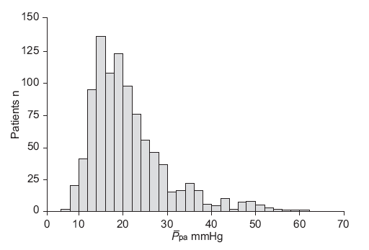
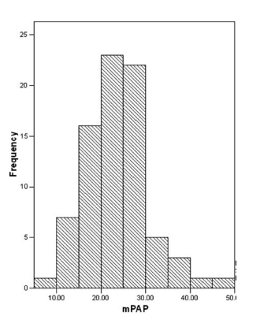
Mean PAP in patients with advanced COPD and IPF
COPD
IPF
Chaouat et al. Am J Respir Crit Care Med 2005;172: 189–194
Lettieri CJ, et al. CHEST 2006; 129:746 –752
Notes:
This figure shows mean PAP distribution in advanced COPD and IPF.
Severe pulmonary hypertension more than 35mmHg is uncommon in patients with COPD and IPF. When it occurs, another treatable cause must be sought.
COPD with severe pulmonary hypertension and no other possible cause shares features with pulmonary vascular diseases, such as idiopathic pulmonary hypertension.
Among the 998 patients with COPD, 27 had a Ppa of 40 mm Hg or greater. 16 patients had another possible cause. Only 11 (1.1%) had COPD as the only identifiable cause of PH. The criteria for PH were present in 25 subjects (31.6%) among 79 patients with IPF, with a mean mPAP of 29.5 ± 3.3 mm Hg.

Slide 13
Definition of severe PH
Associated with lung diseases
Terminology | Hemodynamics
No PH | PAPm ≤ 20mmHg
Non-severe PH | PAPm > 20mmHg PVR ≤5WU
Severe PH | PAPm > 20mmHg PVR >5 WU
2022 ESC/ERS guidelines for PH
Notes:
In the 2015 ESC/ERS Guidelines, severe PH was defined by mPAP >35 mmHg or mPAP ⩾25 mmHg with CI <2.5 L/min/m2. Recent updated ESC/ERS guideline used PVR to distinguish between non-severe PH (PVR ⩽5 WU) and severe PH (PVR >5 WU). This

Slide 14
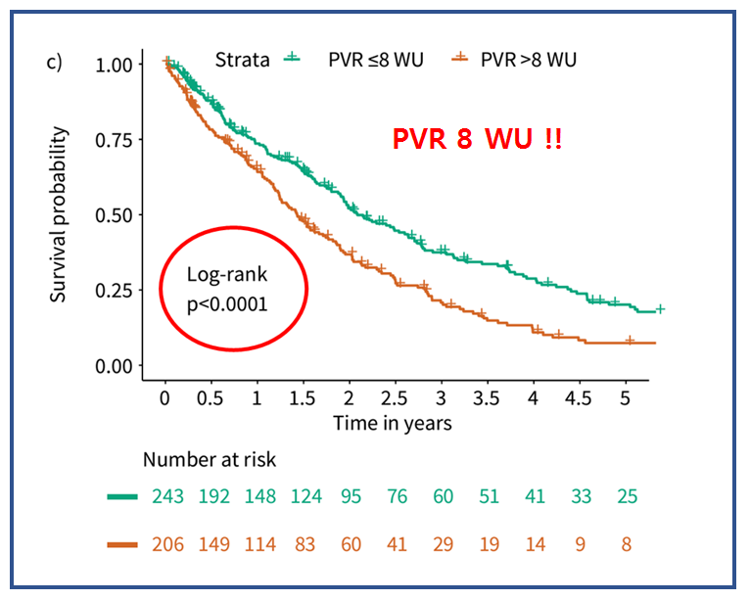
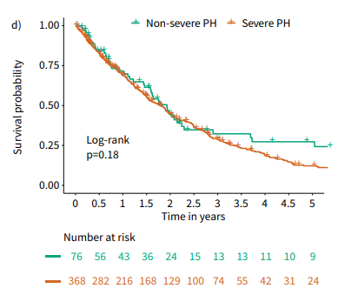
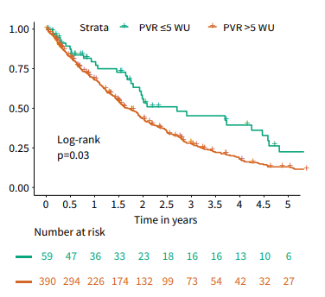
PVR provides stronger prognostic information than mean PAP in patients with PH-ILD
449 patients with PH-ILD in the COMPERA registry
(mPAP) ⩾35 mmHg or mPAP ⩾25 mmHg with cardiac index < 2.0
Olsson KM, et l. Eur Respir J 2021; 58: 2101483
Notes:
Another study with PH-ILD in the COMPERA registry, PVR provides stronger prognostic information than mean pulmonary arterial pressure. The current mPAP-based definition of severe PH was not associated with survival in this study.

Slide 15
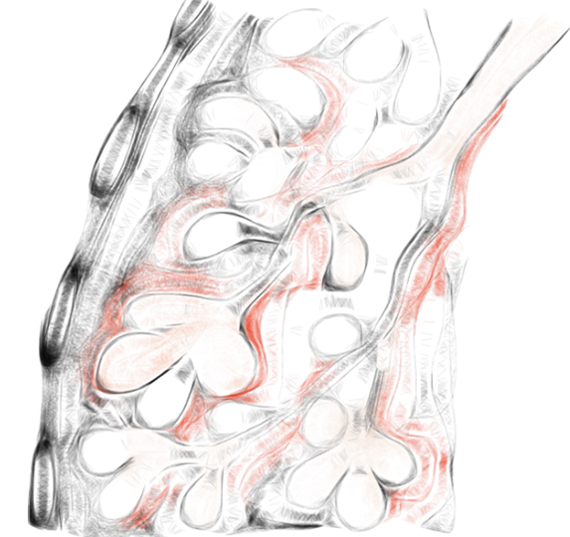
폐고혈압을 유발하는 폐질환은? 급성 acute
Hypoxia
고 위도 High alttitude : 고산 등정
Acute respiratory distress syndrome (ARDS)
pCO2 ↑, 인공환기압력 → 폐고혈압 악화요인
Pulmonary embolism
Thrombus, amniotic, fat
일시적일 수 있고 변동성이 많은 영역이므로 통과!

Slide 16
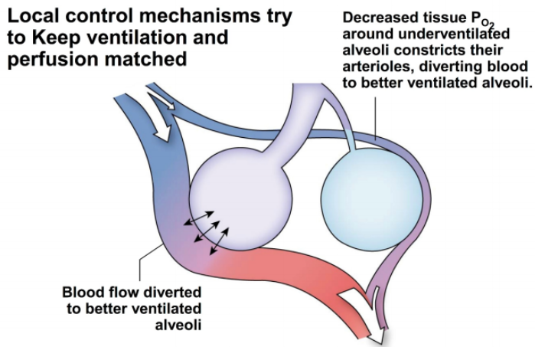
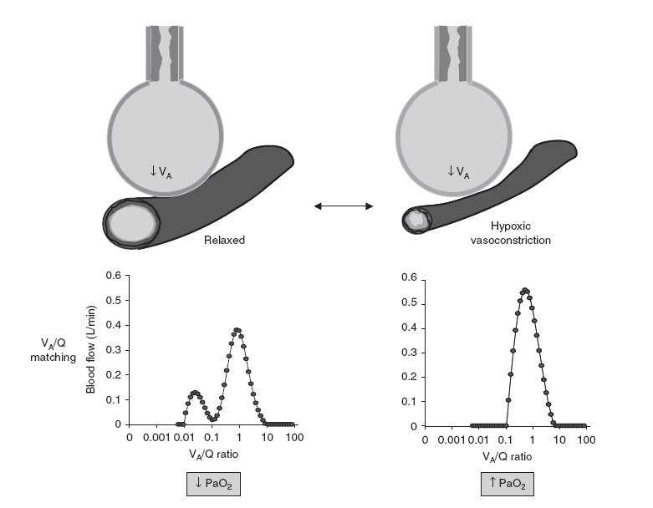
Hypoxic Pulmonary Vasoconstriction ( HPV )
P_{A}O2=150
P_{A}O2=70
P_{a}O2=95
Notes:
This is important mechanism to compensate poor gas exchange in worsening chronic lung disease and
advantage of matching ventilation-perfusion in patients with lung disease, employing vasodilatory actions mainly in areas of the lung with preserved ventilation. Preserving ventilation-perfusion matching is very important in patients with chronic lung diseasea such as ILD and COPD

Slide 17

Hypoxic pulmonary vasoconstriction
Acute PTE
Air/Fat/amniotic embolism
ARDS
Severe pneumonia
Aspiration
Chronic lung disease
: ILD
COPD
TBDL
Acute
Sub-acute
PA pressure ↑ → vascular remodeling
→ RV dilatation
Chronic
→RV Hypertrophy
RV contractility ↓ → RV failure

Slide 18
급성 Acute → 만성 Chronic
Pulmonary Hypertension

Slide 19
만성 폐질환 환자에서 폐고혈압이 있을 때
How to Approach?

Slide 20
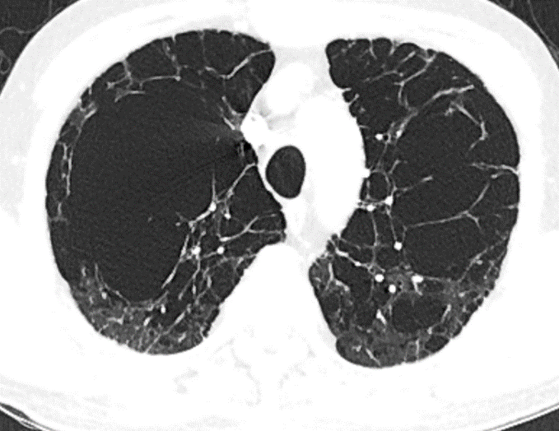
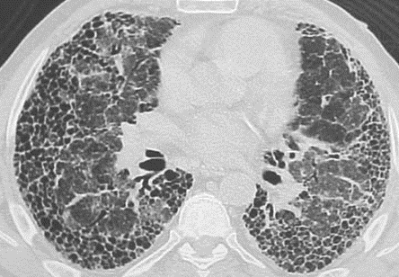
폐고혈압을 유발하는 폐질환은?
만성 chronic
만성폐쇄성폐질환 COPD 간질성폐질환 ILD
Slow progression Rapid progression
Prevalence > 50% (severe 1-5%) Prevalence 8-40% (severe < 10% )

Slide 21
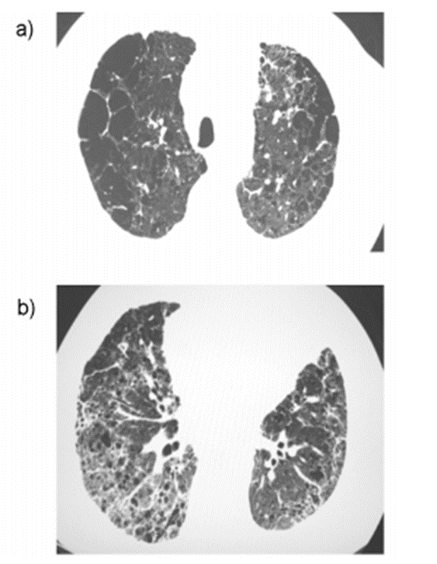
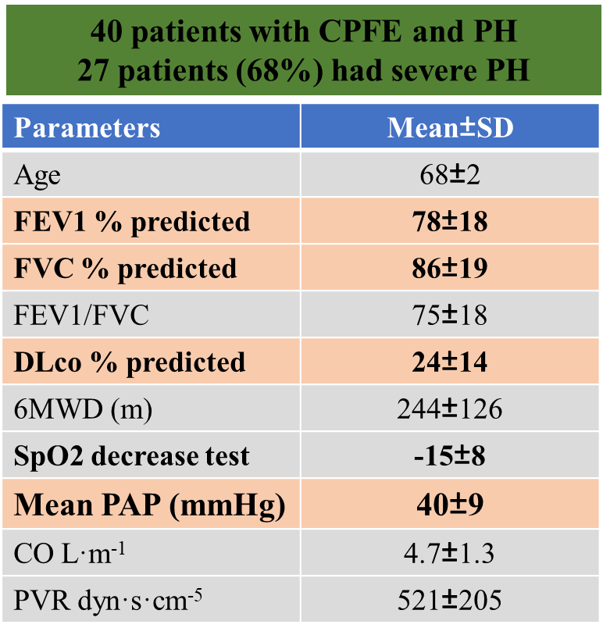
폐고혈압을 유발하는 폐질환은?
만성 chronic
Combined pulmonary fibrosis and emphysema (CPFE)
Rapid progression
Prevalence ~50%
Severe PH ∽ 70%
Cottin et al. Eur Respir J 2010; 35: 105–111

Slide 22
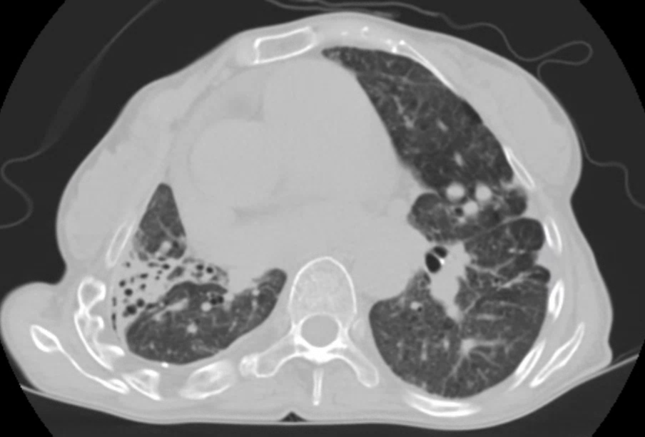
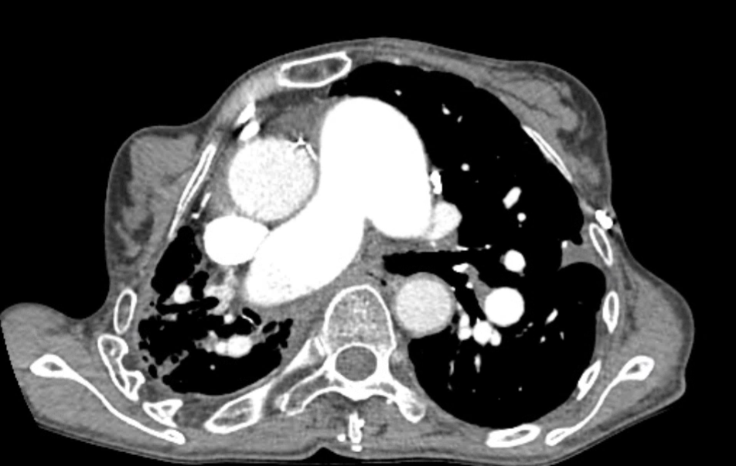
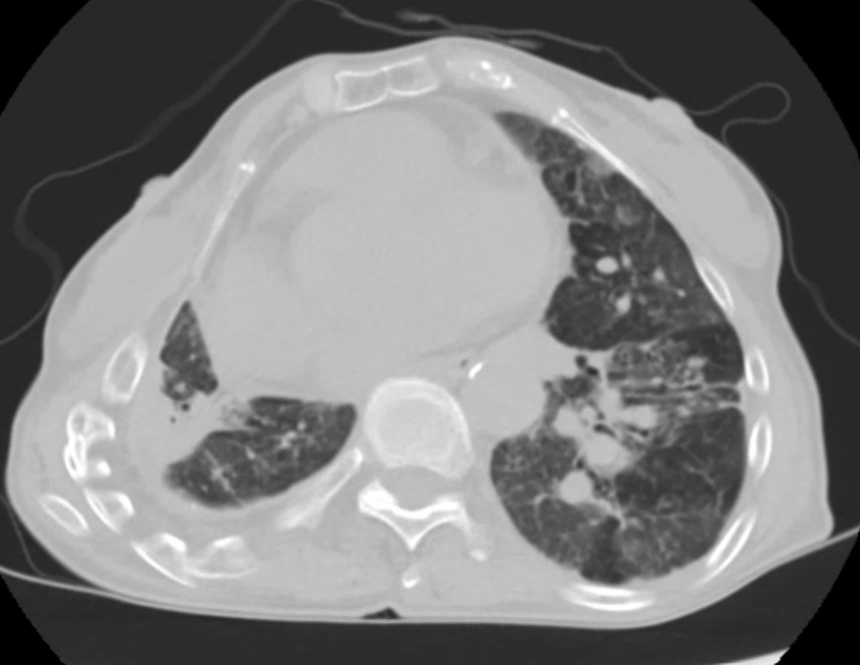
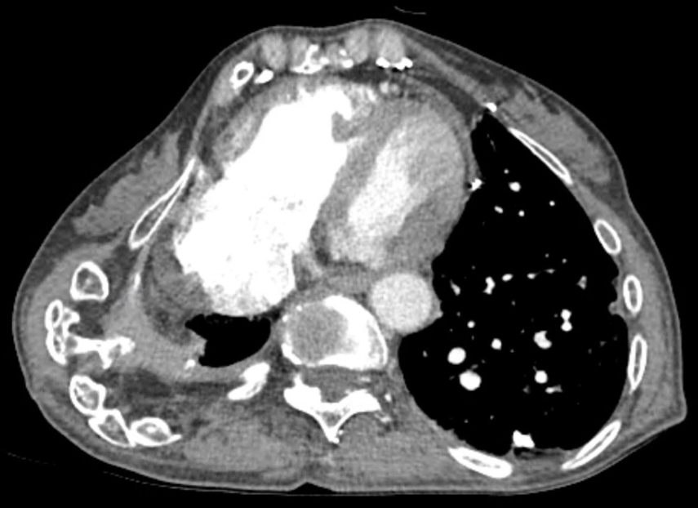
TB destroyed lung

Slide 23
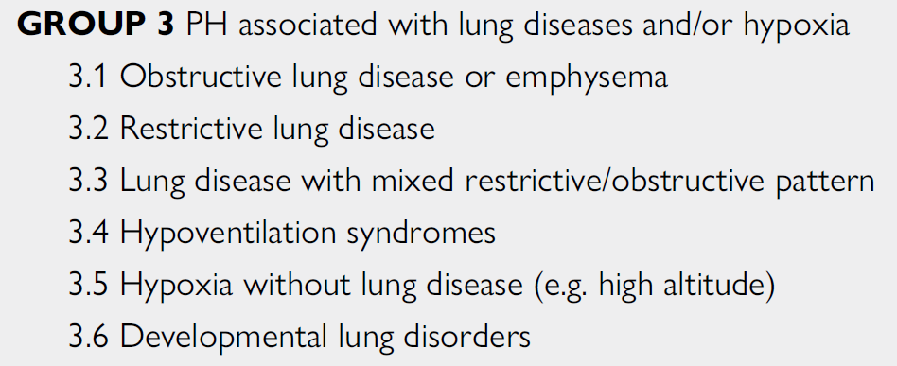
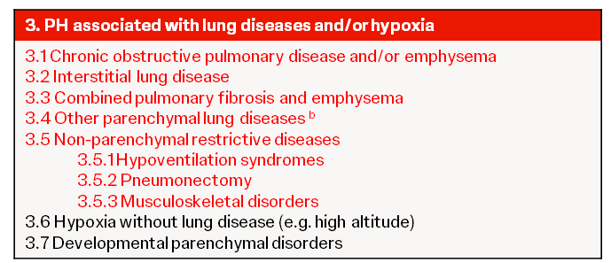
2022 ESC/ERS Guidelines
WSPH Taskforce 5, Barcelona, 2024

Slide 24
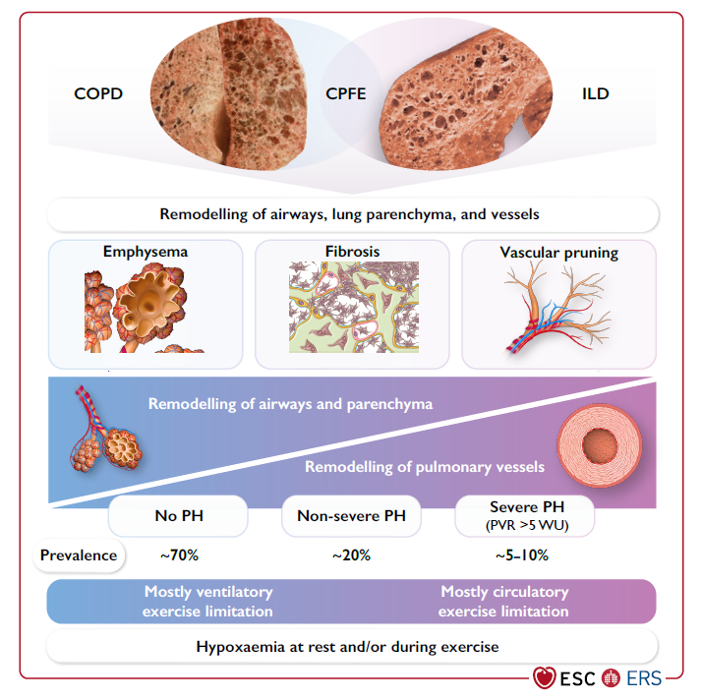
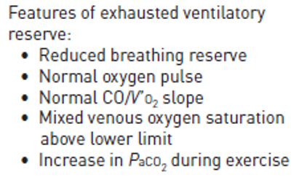
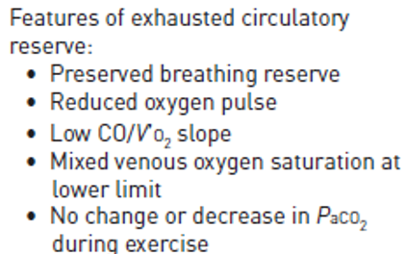
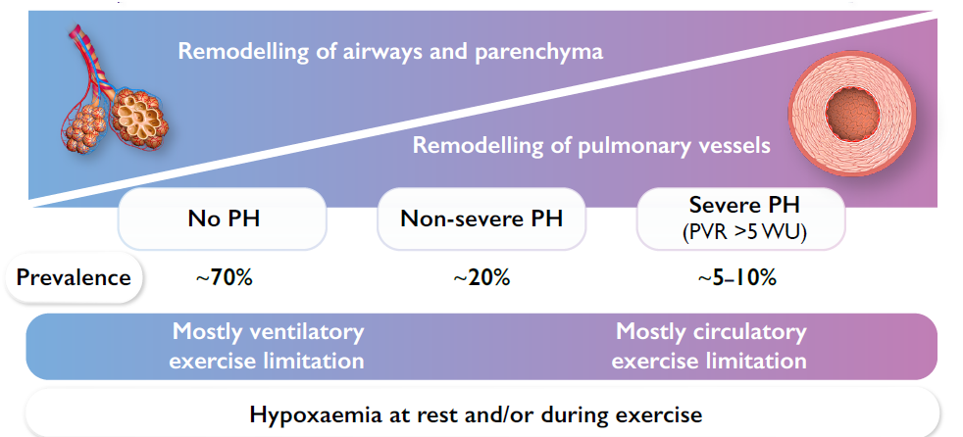

Slide 25
만성 폐질환 환자에서 폐고혈압이 있을 때,, 의미는?
폐기능이 나쁠 때 → 폐질환의 중증도 severity
: advanced, end-stage, lung transplantation 고려
하지만 severe PH 는 흔하지 않다
폐기능이 그리 나쁘지 않을 때
→ 폐질환과 별개로 다른 원인의 PH 가 있을 수 있다
eg. PAH
→ 폐질환의 혈관 침범 정도가 특별하다 또는 심하다
Vascular phenotype

Slide 26
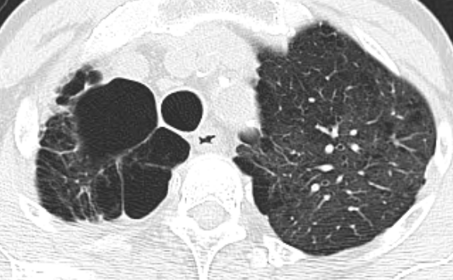
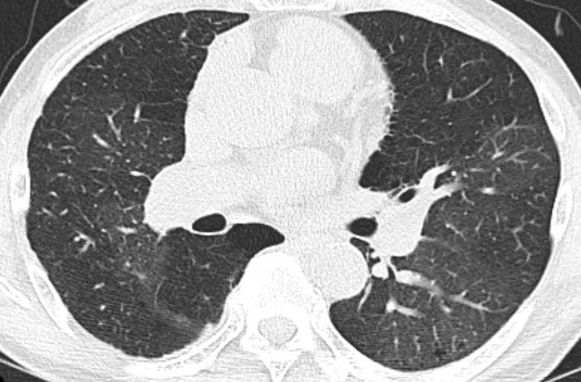
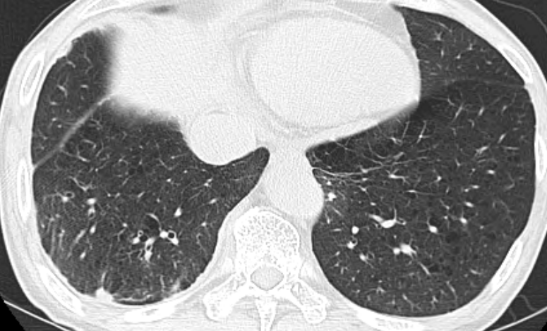
증례 #１ 67/M, Exertional dyspnea
WHO Fc III

Slide 27
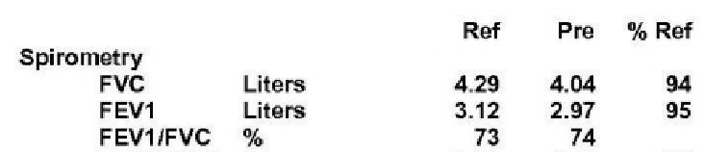
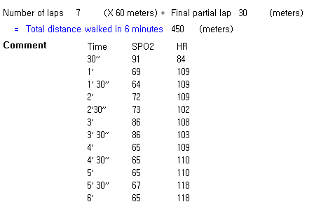

Slide 28



Slide 29
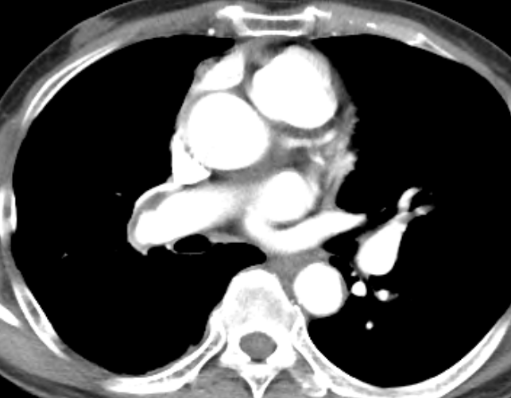
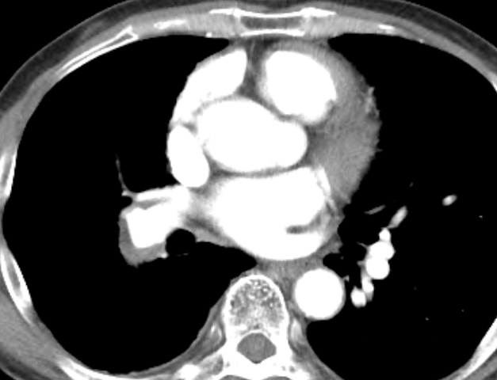
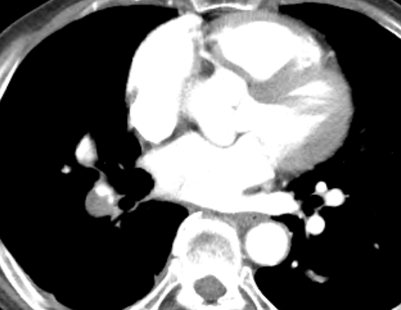
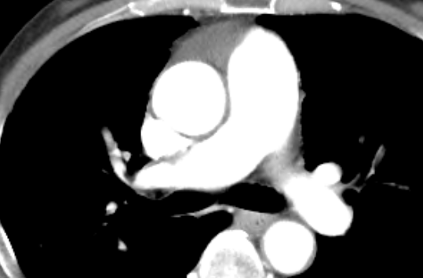
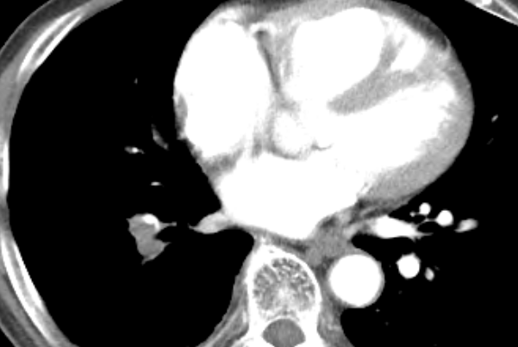

Slide 30
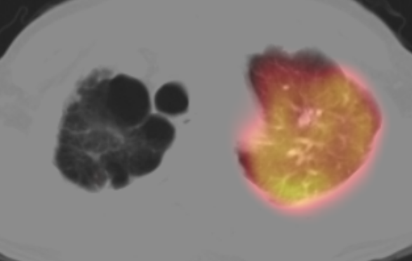
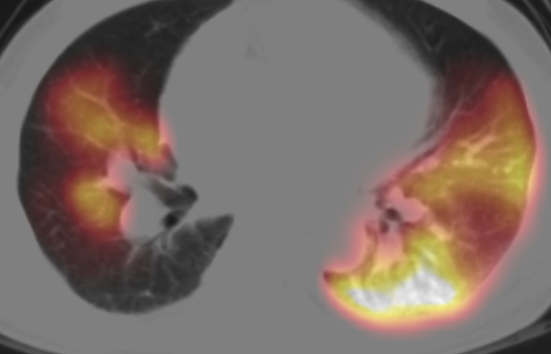
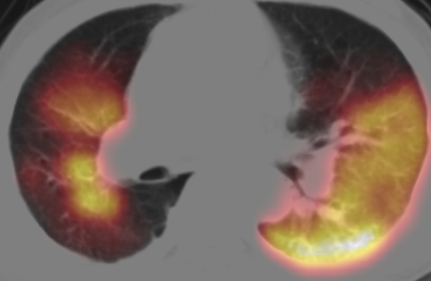
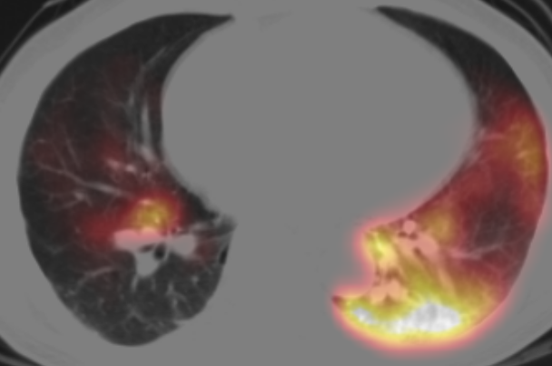
Lung perfusion scan SPECT

Slide 31
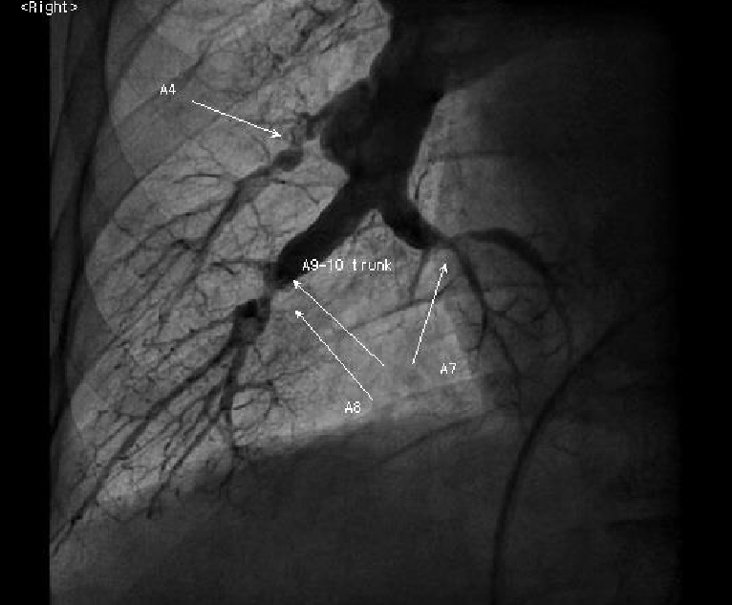
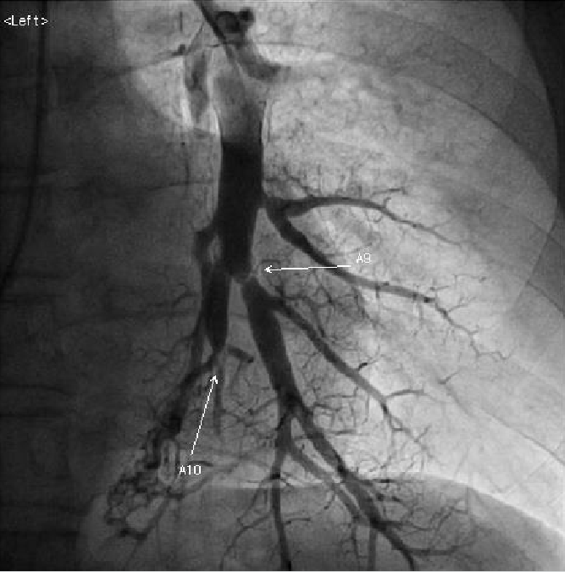
RAP 24 mmHg
PCWP 14 mmHg
PAP 106/35 mean 60 mmHg
C.O 4.2 L/min
PVR 11 wood unit

Slide 32
폐고혈압 (PH) 접근 과정
의심 Suspect
발견 / 선별 Detect/ screening
확진 confirm diagnosis → 전문센터, 우심도자

Slide 33
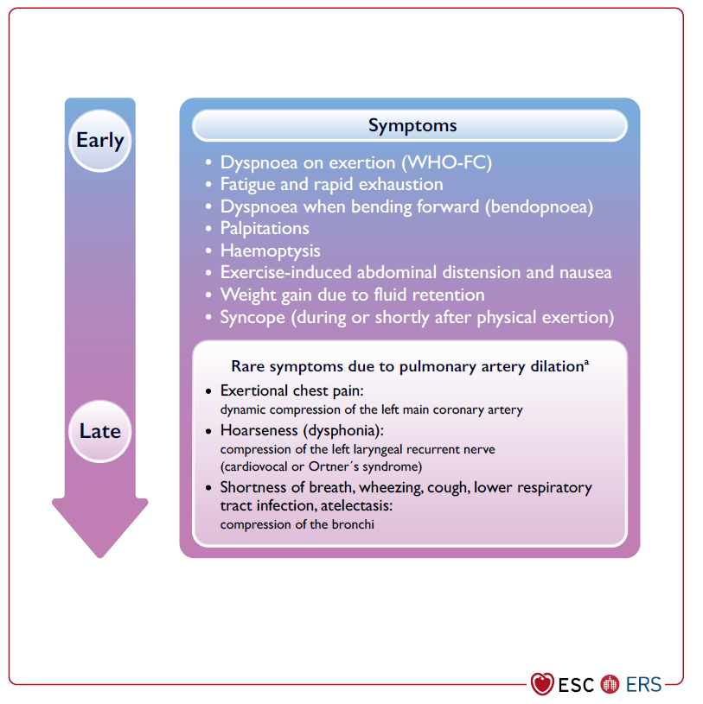
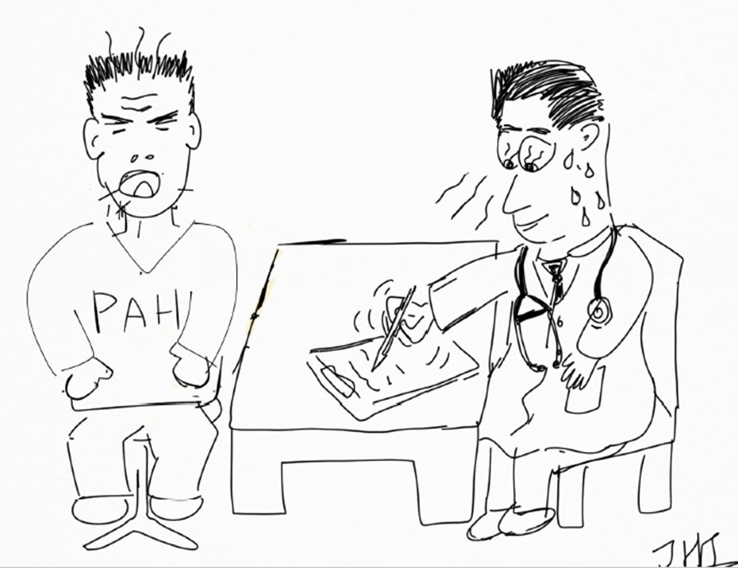
PH Symptom in chronic lung disease :
비특이적! 만성 폐질환 증상 징후와 overlap
폐질환의 폐기능에 비해 증상이 심하다
하지부종
어지럼증, 실신, 흉통
만성폐질환+PH

Slide 34
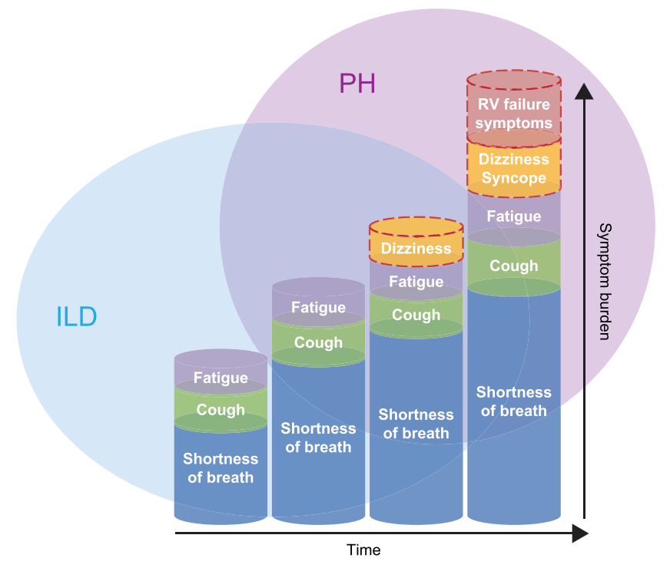
overlap of symptoms between fibrotic lung disease and PH
Nikkho et al, Pulmonary Circulation. 2022;12:e12127

Slide 35

PH in CT
Main pulmonary artery: aortic ratio >1.1
RV:LV ratio of >1.0
Br J Radiol 2020; 94: 20200830.

Slide 36
Findings Suggestive of Pulmonary Hypertension in Chronic Lung diseases
History | Syncope Dizziness
P/Ex | JVP ↑ Peripheral edema Ascites
Pulmonary function test | Severely reduced DLco
6 minute walk test | Severely reduced, worsening Marked desaturation
CT | RV:LV ratio >1 Increased PA:Ao ratio (>0.9)
Lab test | Elevated BNP or NT-proBNP

Slide 37


만성 폐질환이 임상적으로 안정적인 시기에 평가해야!
Notes:
According to the ESC/ERS PH guidelines, echocardiography represents the most important noninvasive diagnostic method for PH.
However, the accuracy of echocardiography in patients with advanced respiratory diseases is low, and there is a tendency to overestimate PAP and misclassify patients with PH.
If PH is suspected in patients with lung disease, echocardiographic results should be interpreted in conjunction with ABG, PFTs including DLCO, and CT imaging

Slide 38

The accuracy of Doppler echocardiography
systolic pulmonary artery pressure 추정
= 4[TR Vmax]2 + estimated RAP
Lv et al. BMC Medical Imaging (2022) 22:91

Slide 39


Estimation of systolic pulmonary artery pressure (sPAP)
만성 폐질환 환자에서 흔한 한계점
sPAP = 4[TR Vmax]² + estimated RAP
Poor sonic window
Commonly unmeasurable TR Vmax
Tendency to overestimate PAP
Accuracy of echo in patients with advanced respiratory diseases is low
이 추정치 만으로 Severe PH 로 단정할 수 없다
Severe PH 추정 위해서는 other echo signs of PH 중요

Slide 40




Right heart function - evaluation by echo

Slide 41




Right heart function - evaluation by echo
FAC

Slide 42

Nikkho et al, Pulmonary Circulation. 2022;12:e12127

Slide 43

Right heart catheterization (RHC)
전문센터 referral center 시행을 추천
The risk of major complications is usually < 1%,
the risk of mortality of 0.05%
# Rare complications may include:
Ventricular tachycardia
Cardiac tamponade
Infection
Air embolism
Pulmonary artery rupture

Slide 44



Direct measurement of LVEDP in case of in-conclusive PCWP
LVEDP=24 mmHg

Slide 45


Rt. Heart catheterization (RHC) 반드시 해야 하나?
Golden standard to confirm
DDx> Group 2 PH associated with Lt heart disease
Cardiac output
PCWP, direct measure of LVEDP
Group 2 이외 다른 그룹간에 hemodynamic 구별은 안됨
inconclusive echocardiographic findings in cases with a high level of suspicion and potential therapeutic implications
Candidate for lung transplantation
2022 ESC/ERS guidelines for PH

Slide 46




F/84 clinical idiopathic pulmonary fibrosis worsening exertional dyspnea, leg pitting edema
FVC 74% FEV1 80%
DLco 48%

Slide 47



TR Vmax - Overestimation of PAP
우심도자 Data
PAP 38/13 mmHg
Mean PAP 21 mmHg
4.5 m/s
Right Ventricular Systolic Pressure (RVSP) = 86 mmHg
Notes:
폐질환 환자에서 PH가 의심되는 경우, ABG, DLCO를 포함한 PFT 및 CT 영상과 함께 심초음파 결과를 해석해야 합니다.

Slide 48

２０２２ ＥＲＳ／ＥＳＣ 가이드라인 권고사항

Slide 49
증례 #２ PH associated with lung disease
우심도자술이 필요없었던 증례
하지만 시행 했던

Slide 50

증례#2
67/남자
C.C : 내원 10일 전부터 진행하는 양상의 운동성 호흡곤란, 양측 하지 부종
Present illness:
한달 전 피로감, 위약감
7-8년 전부터 동년배에 비해서 운동시 호흡곤란 쉽게
느꼈다고 함.
가족력 : 어머니 - 천식
과거력
  40갑년 현 흡연

Slide 51
증례#2
체계별 문진 (review of system)
전반적 위약 (+)
기침/가래 (+/+)
호흡곤란 (+, 움직이면)
chest discomfort/palpitaion (+/-)
소변 양 감소, 색 진해짐
신체검진 (P/Ex)
혈압 : 143/82mmHg, 체온 : 36.8℃, 맥박수 : 107회/분, 호흡수 : 20회/분)
의식 명료 천명음 (-) 수포음 (-) 심잡음 (-)
양측 하지 부종 (++/++) pitting

Slide 52


CBC WBC 52300- Hb18.5- plt 155k
pro-BNP 2872 pg/mL

Slide 53



Chest embolism CT

Slide 54



ICU admission #3 Echocardiography
Enlarged RA & RV dimension
No RWMA with normal global LV systolic function.
Decreased RV contractility(FAC = 16%).
TR Vmax 3.29 m/s (RVSP =48.3 mmHg )

Slide 55

일반병실 입원 HD#2 ,,,,
응급실 내원 직후 spO2 60% 저하 보여 nasal prong O2 투여하며 조절
Decreased mentality → intubated

Slide 56

ICU admission #3
2일 후 weaning, extubation 성공!
Intermittent Non-invasive positive pressure ventilation (NIPPV)

Slide 57



ICU admission #6 일반병실 전동 대기 중,,,,,,
Room air 로 spO2 96% → spO2 70%
Wheezing ++ in thorax ABGA : pH 7.15 pCO2 109
→ Re-intubation → ventilator care, steroid Tx
4일 후 다시 extubation
Hyper-inflated both lung field

Slide 58


Home ventilator 로 NIPPV 적용하며 일반병동 전동대기 중,,,
Room air 상태로 intermittent NIPPV 적용 중
NIPPV 적용 안하는 수면 중에 desaturation down to spO2 ~80% 자주 목격됨
-→ portable somnography (간이 수면 검진기) 시행하기로 함

Slide 59

간이수면검진기 결과

Slide 60
Diagnosis
#1 Pulmonary hypertension with Rt. heart failure
#2 COPD with asthma = probable ACOS
#3 recurrent hypercapnic respiratory failure
#4 obstructive sleep apnea
Impression >>
PH due to COPD or OSA
vs.
lung disease (COPD, OSA) + Combined idiopathic PAH ?

Slide 61


Bedside Rt. Heart catheterization in ICU
PAP 36/21 mean PAP 27 mmHg
PCWP 10 mmHg
Cardiac output ( thermodilution ) 3 회 평균 10.1 L/min
PVR 1.683 WU/㎡
SvO2 76%

Slide 62


Discharge and follow up optimizied care of underlying lung disease
Home NIV – BiPAP titration
Day – evening – night
→ Only at Nighttime
Maintaining normocapnia

Slide 63




Discharge and follow up optimized care of underlying lung disease
FEV1 %

Slide 64


Slide 65



General treatment for group 3 PH
기저 폐질환 약물 치료 최적화
Home O2 , portable O2 on ambulation
Hypercapnia → home NIPPV (NIV)
Sleep disordered breathing
Rehabilitation
Vaccination

Slide 66




적극적으로 PAH target drug 치료를 고려해 볼만한 환자군은?
Biopsy proven UIP → IPF
Suspicious symptoms and signs of Rt. heart failure

Slide 67



Take-home message
Group 3 PH 의 기본적인 치료 전략은 기저 폐질환에 대한 최적화된 치료
Lung disease and non-severe PH 에 대해서는 일반적으로 PAH target medication 이 권장되지 않는다.
환자에 따라 선택적으로 Individual decision making
필요하다
다른 원인에 의한
PH 가능성도 고려하고 배제해야 한다

Slide 68

감사합니다!
Pulmonary hypertension

