Slide 1
ECMO in adult respiratory failure
PNUYH ECMO team, 7년간의 시행착오
양산부산대학교병원
호흡기내과
여혜주

Slide 2
Contents: real world problems
Weaning period
Insertion period
Maintenance period
Patient selection
Timing
ECMO mode
Bleeding
Infection
Sedation
Rehabilitation
Awakening
Vascular complication

Slide 3
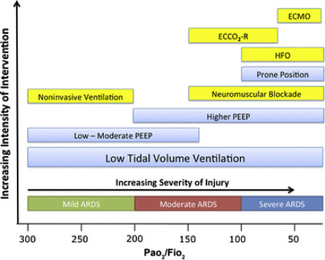
Rescue therapies
Respir Care. 2018;63(1):92

Slide 4
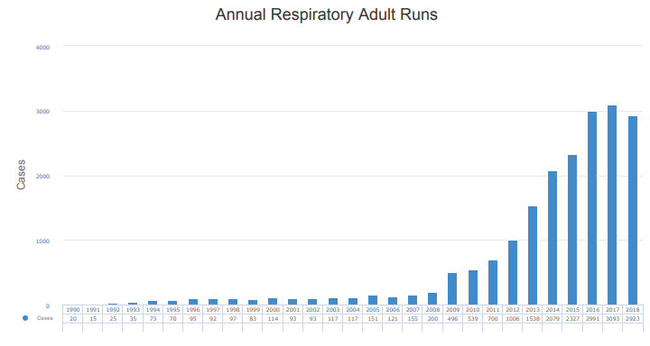
International report
2019 ELSO registry report

Slide 5
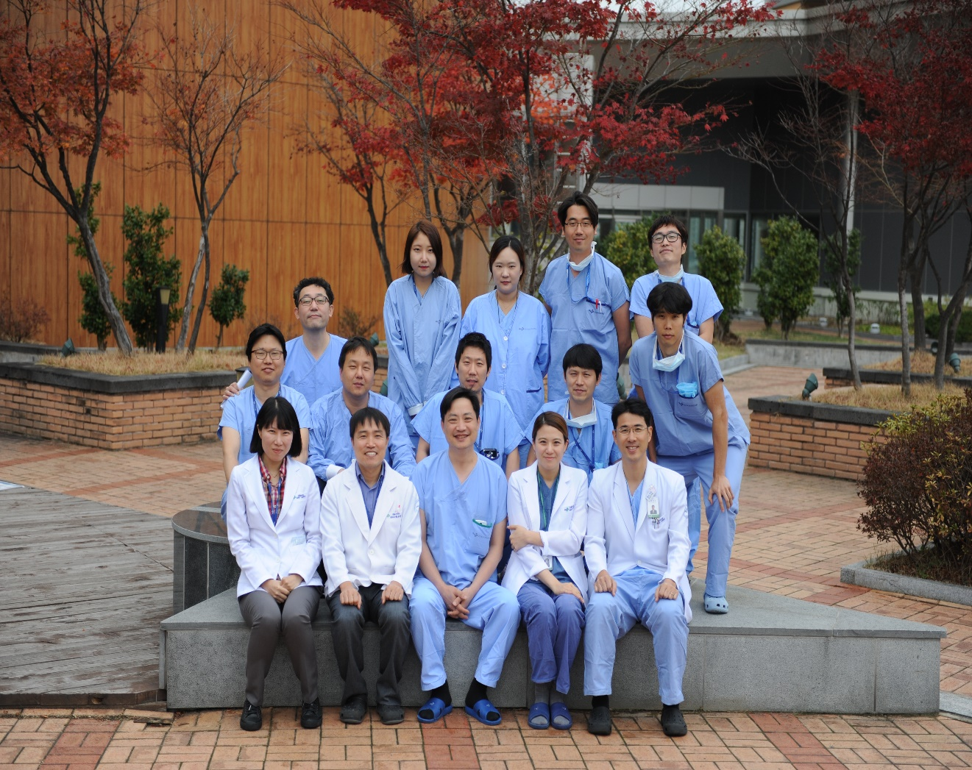
PNUYH ECMO team
PNUYH ECMO team

Slide 6
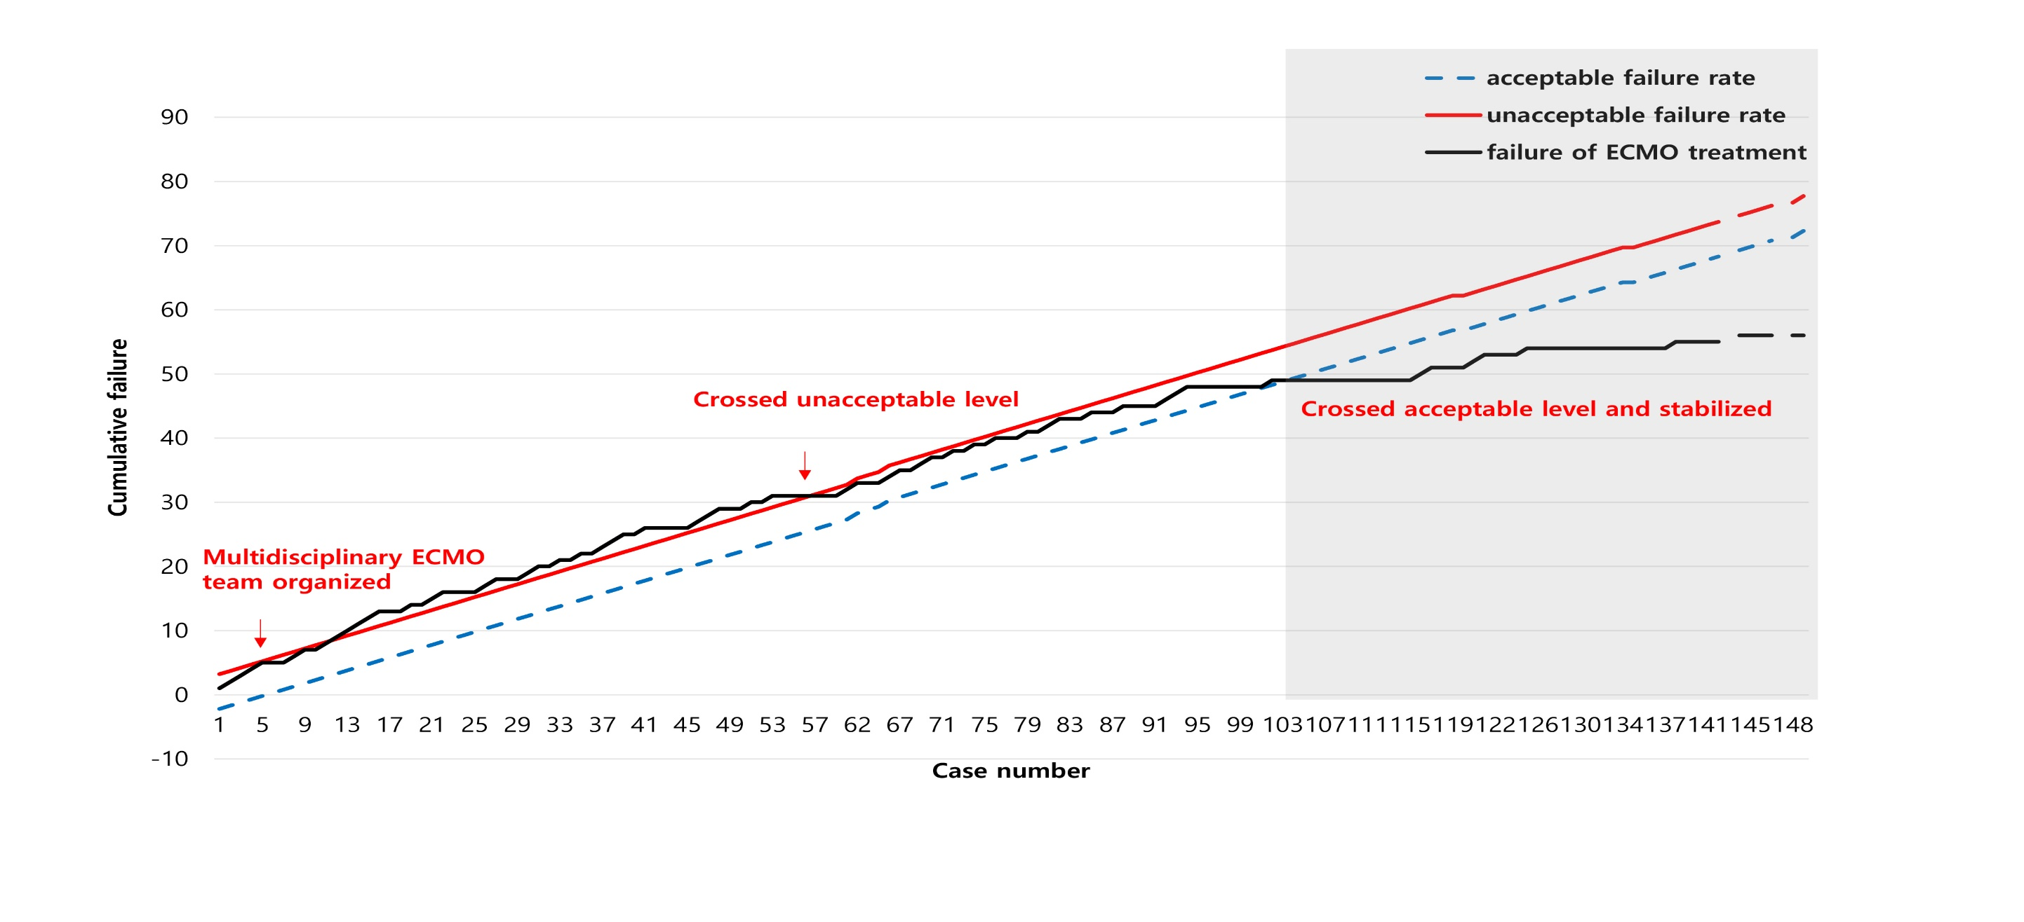
Learning curve
perfusion 2019

Slide 7
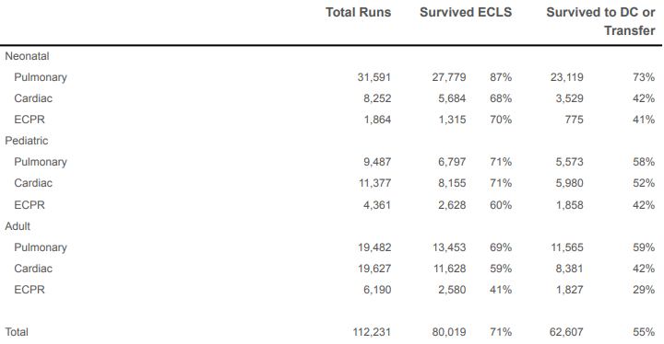
International report
most severe forms of ARDS may be associated with mortality exceeding 60%
2019 ELSO registry report

Slide 8
PNUYH
*
*
perfusion 2019

Slide 9
Patients management
Sedation
Intubation
Rest vent settings
Specialist
Lung recruitment
Bleeding/infection/vascular complication
Awake
Tracheostomy or extubation
ICU nurse, ECMO team
Bridge to recovery or transplantation
Bleeding/infection minor
Rehabilitation
Extubation/ HFN
ECMO team, protocol
Prone position/ lung resting
Nutrition
Bridge to LT
Early
Intermmediate
Recently

Slide 10
Insertion period
Patient selection
Timing
ECMO Mode
Conventional
VILI
ECMO
Blood trauma
ECMO complication

Slide 11
Patient selection
PaO2/FiO2 < 150 on FiO2 > 90% → consider
PaO2/FiO2 < 100 on FiO2> 90% → initiate
CO2 retention despite high Pplat (>30 cm H2O)
Elderly (>70y): relative contraindication
Age 보다는 body composition

Slide 12
Contraindication
Mechanical ventilation at high settings (FiO2 >0.9, Pplat >30) for 7 days or more.
immunosuppression (WBC <1000, absolute neutrophil count <400/mm3)
CNS hemorrhage
Nonrecoverable comorbidity such as major CNS damage or terminal malignancy
V. PLT < 50,000
* 교정가능한 Contraindication은 교정 후 시행
ELSO guideline 2017

Slide 13
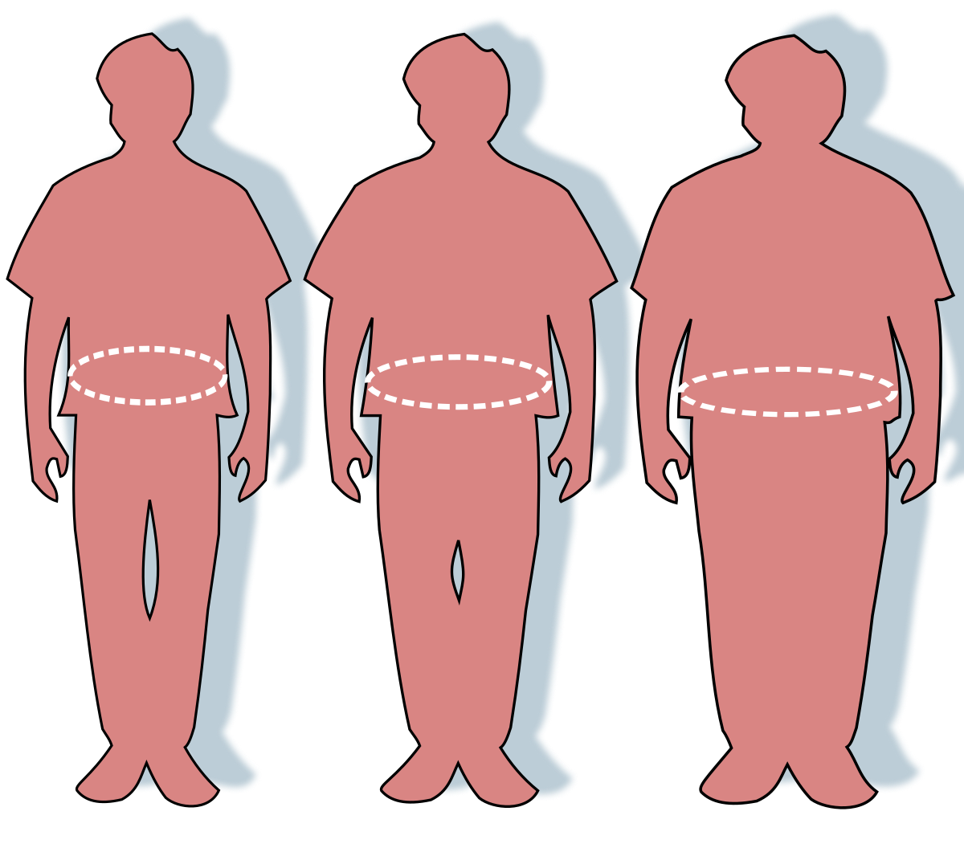
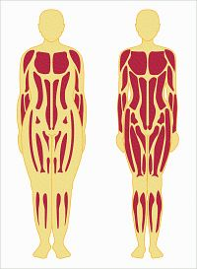
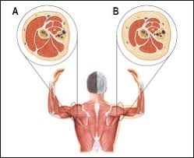
Body > age

Slide 14
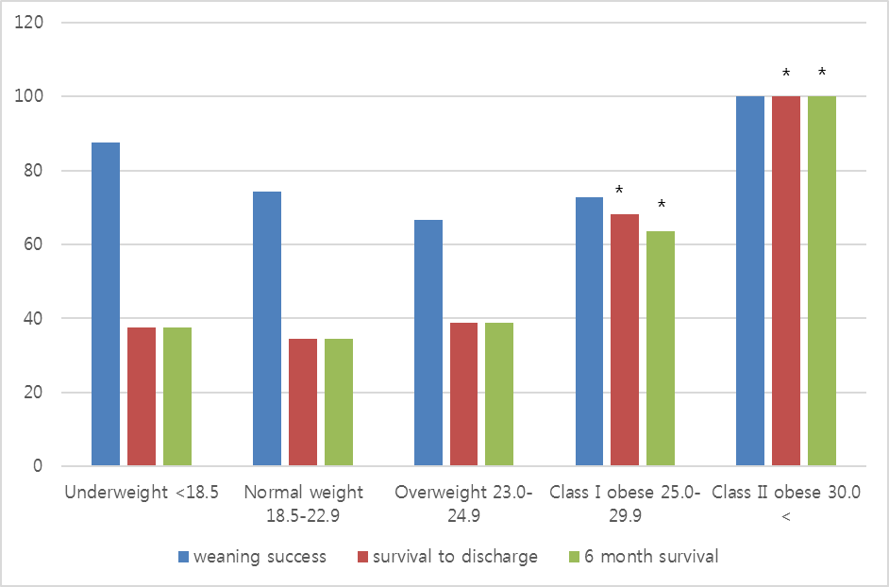
Outcomes according to the body mass index
From Korean Respiratory ECMO registry (2014-2015)
Journal of critical care 2018
Notes:
.

Slide 15
Obesity paradox in pneumonia requiring VV ECMO
Ongoing question ?
  Excess of adipose tissue
  Excess of muscle mass
χ²=7.17
p = 0.007
Journal of critical care 2018
Notes:
.

Slide 16
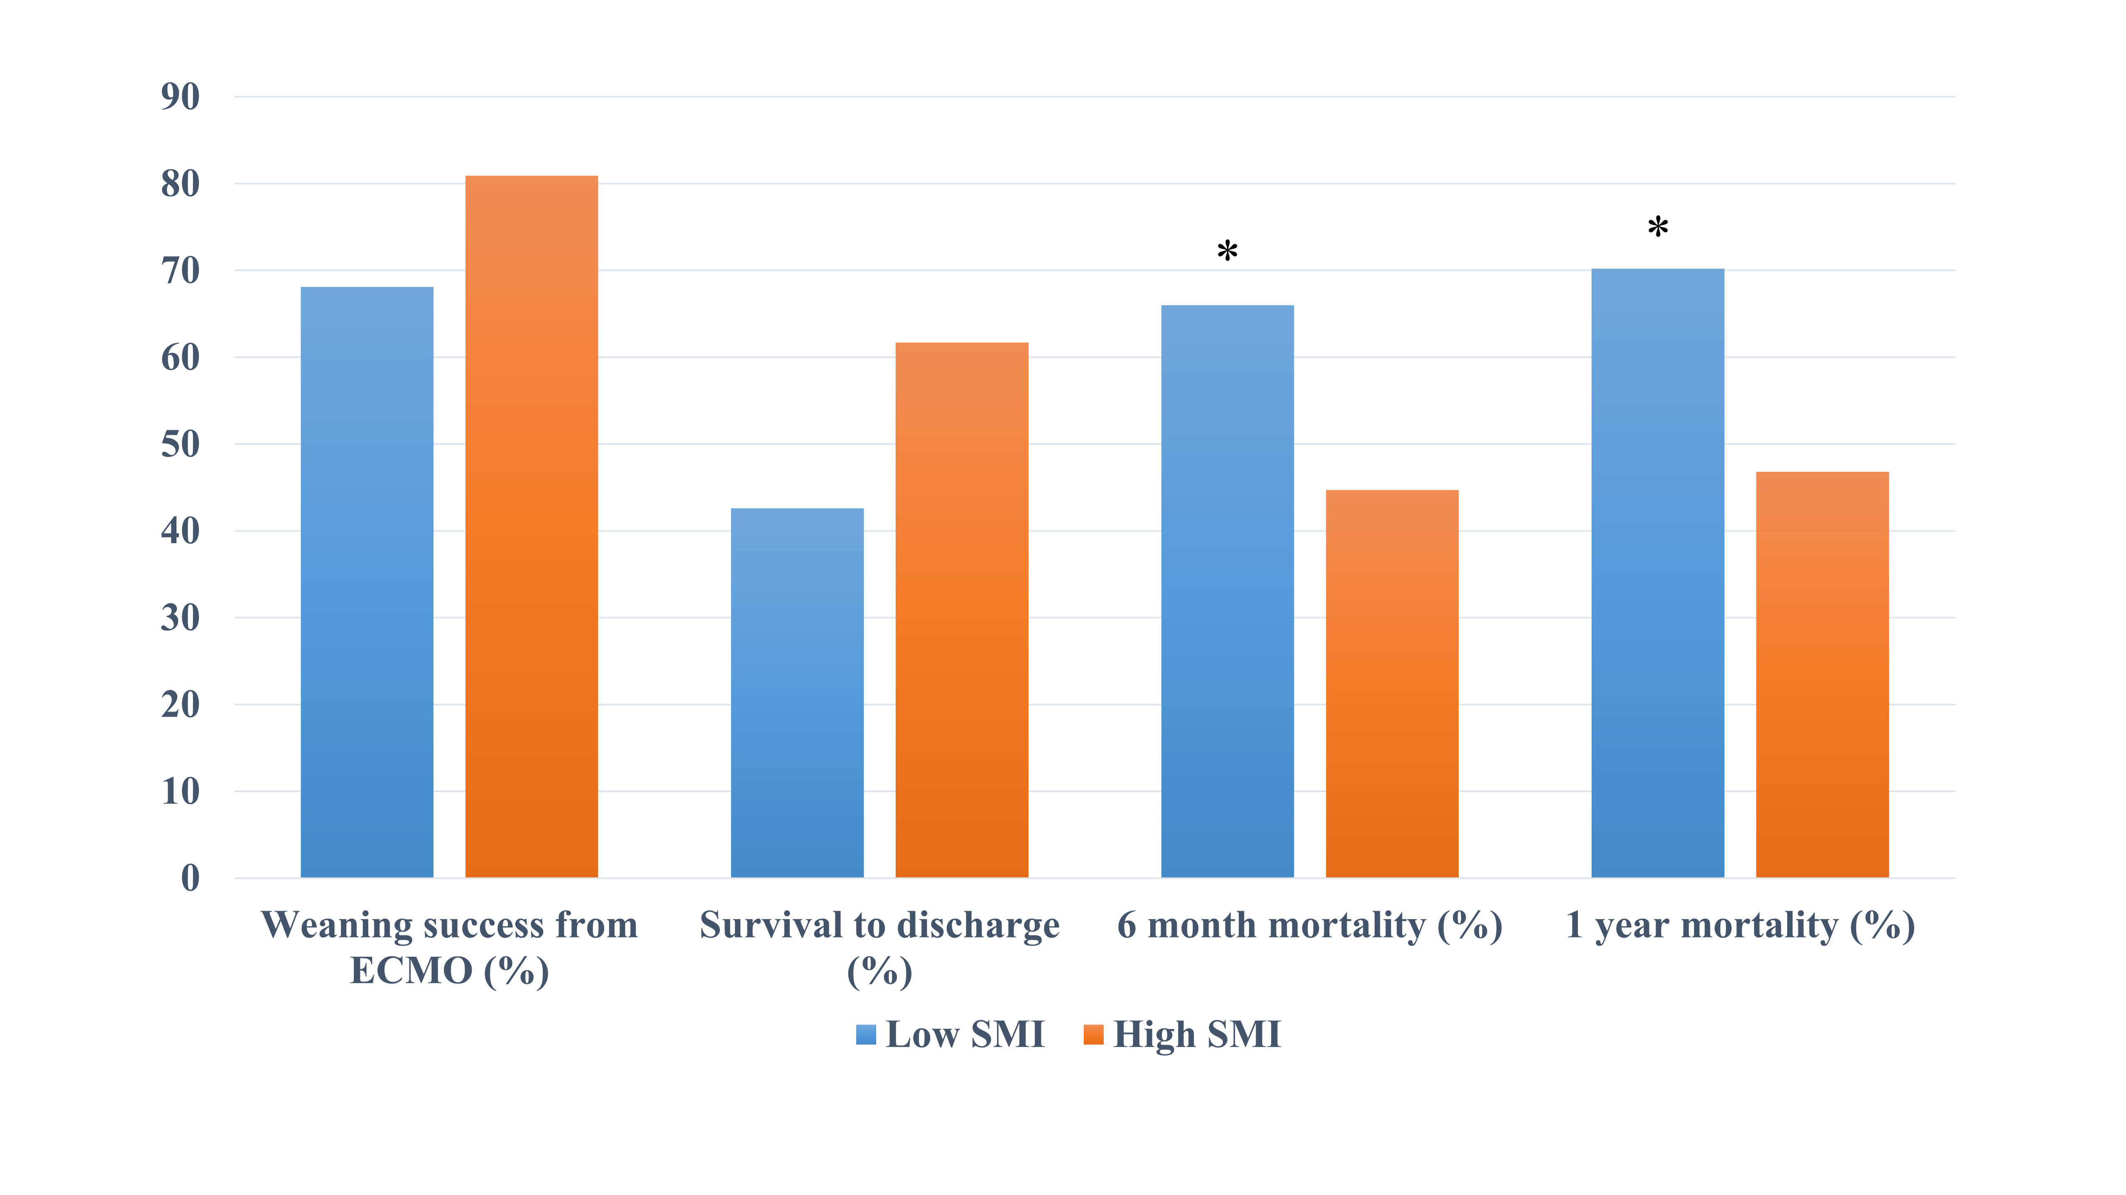
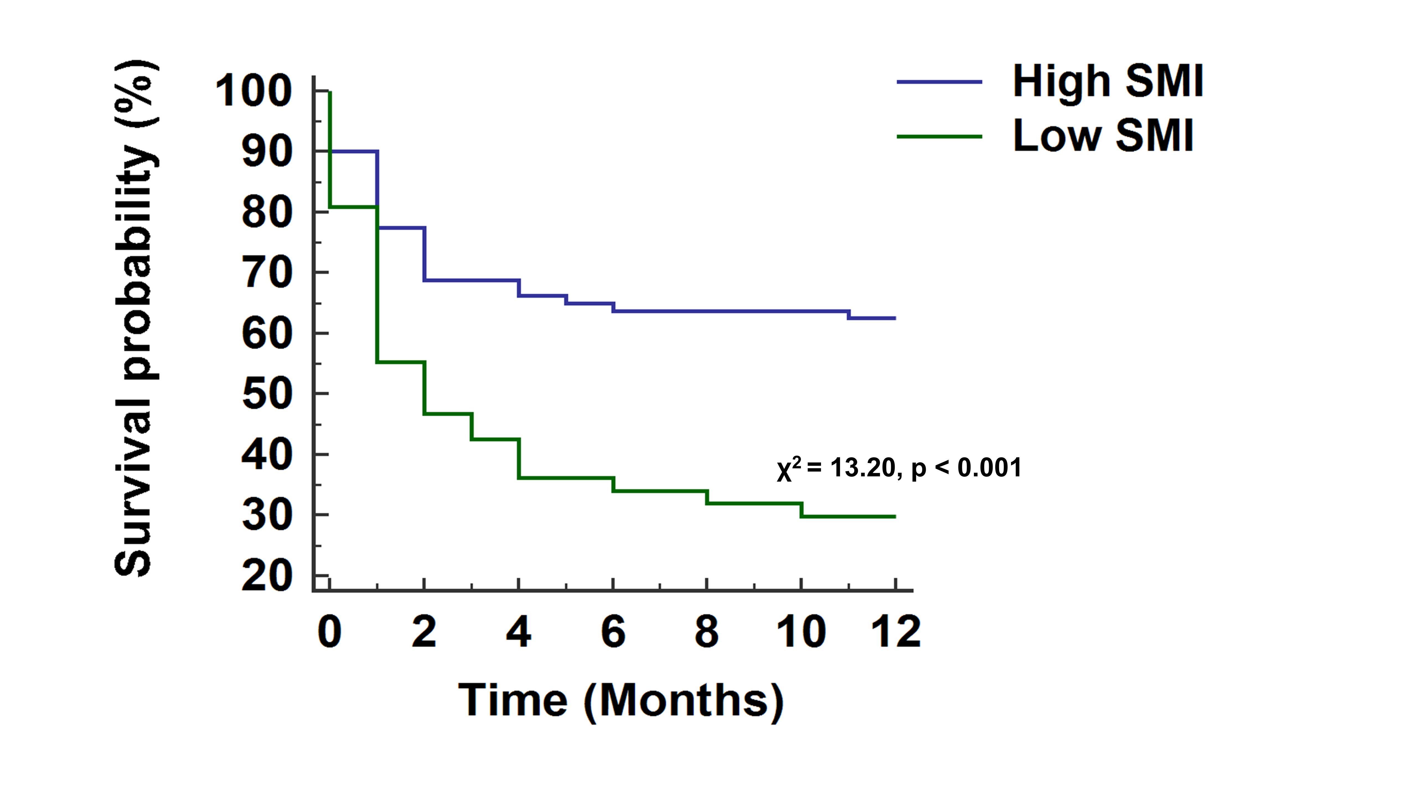
Sarcopenia for long-term mortality in VV ECMO
1-year mortality rate was higher in the low SMI group than in the high SMI group (70.2 % vs. 46.8 %, p = 0.021)
Sarcopenia predicted worse 1-year mortality in patients who underwent respiratory ECMO.
ASAIO 2019

Slide 17

Best timing?
Trend = early ECMO 2-5 days
The sooner, the better ?
hours
Intensive care med 2009

Slide 18
Pressure and volume limited MV
Optimal sedation/analgesia
Still hypoxemic? PF < 150
Higher PEEP
Neuromuscular blockade
Profound hypoxemia PF <60
Contraindication to proning
Still hypoxemic? PF<100
No contraindication to proning?
Prone positioning
Still hypoxemic? PF<100
No improvement/complication
during proning?
ECMO
PNUYH protocol
Notes:
.

Slide 19
ECMO Mode: VV or VVA
Lung
VV
Lung & Heart
VVA
Heart
VA
Refractory septic shock
successful weaning rate: 62.5 %
overall survival rate : 50.0 %
Critical Care 2016

Slide 20
Bridge to LT
IPF, ILD, AIP, postARDS fibrosis
Lung VV
RV failure VVA
Severe RV failure
Oxy RVAD
Hypoxemic
Hypercapnic
Severe hypoxemic +moderate to severe PAH
PNUYH strategy

Slide 21
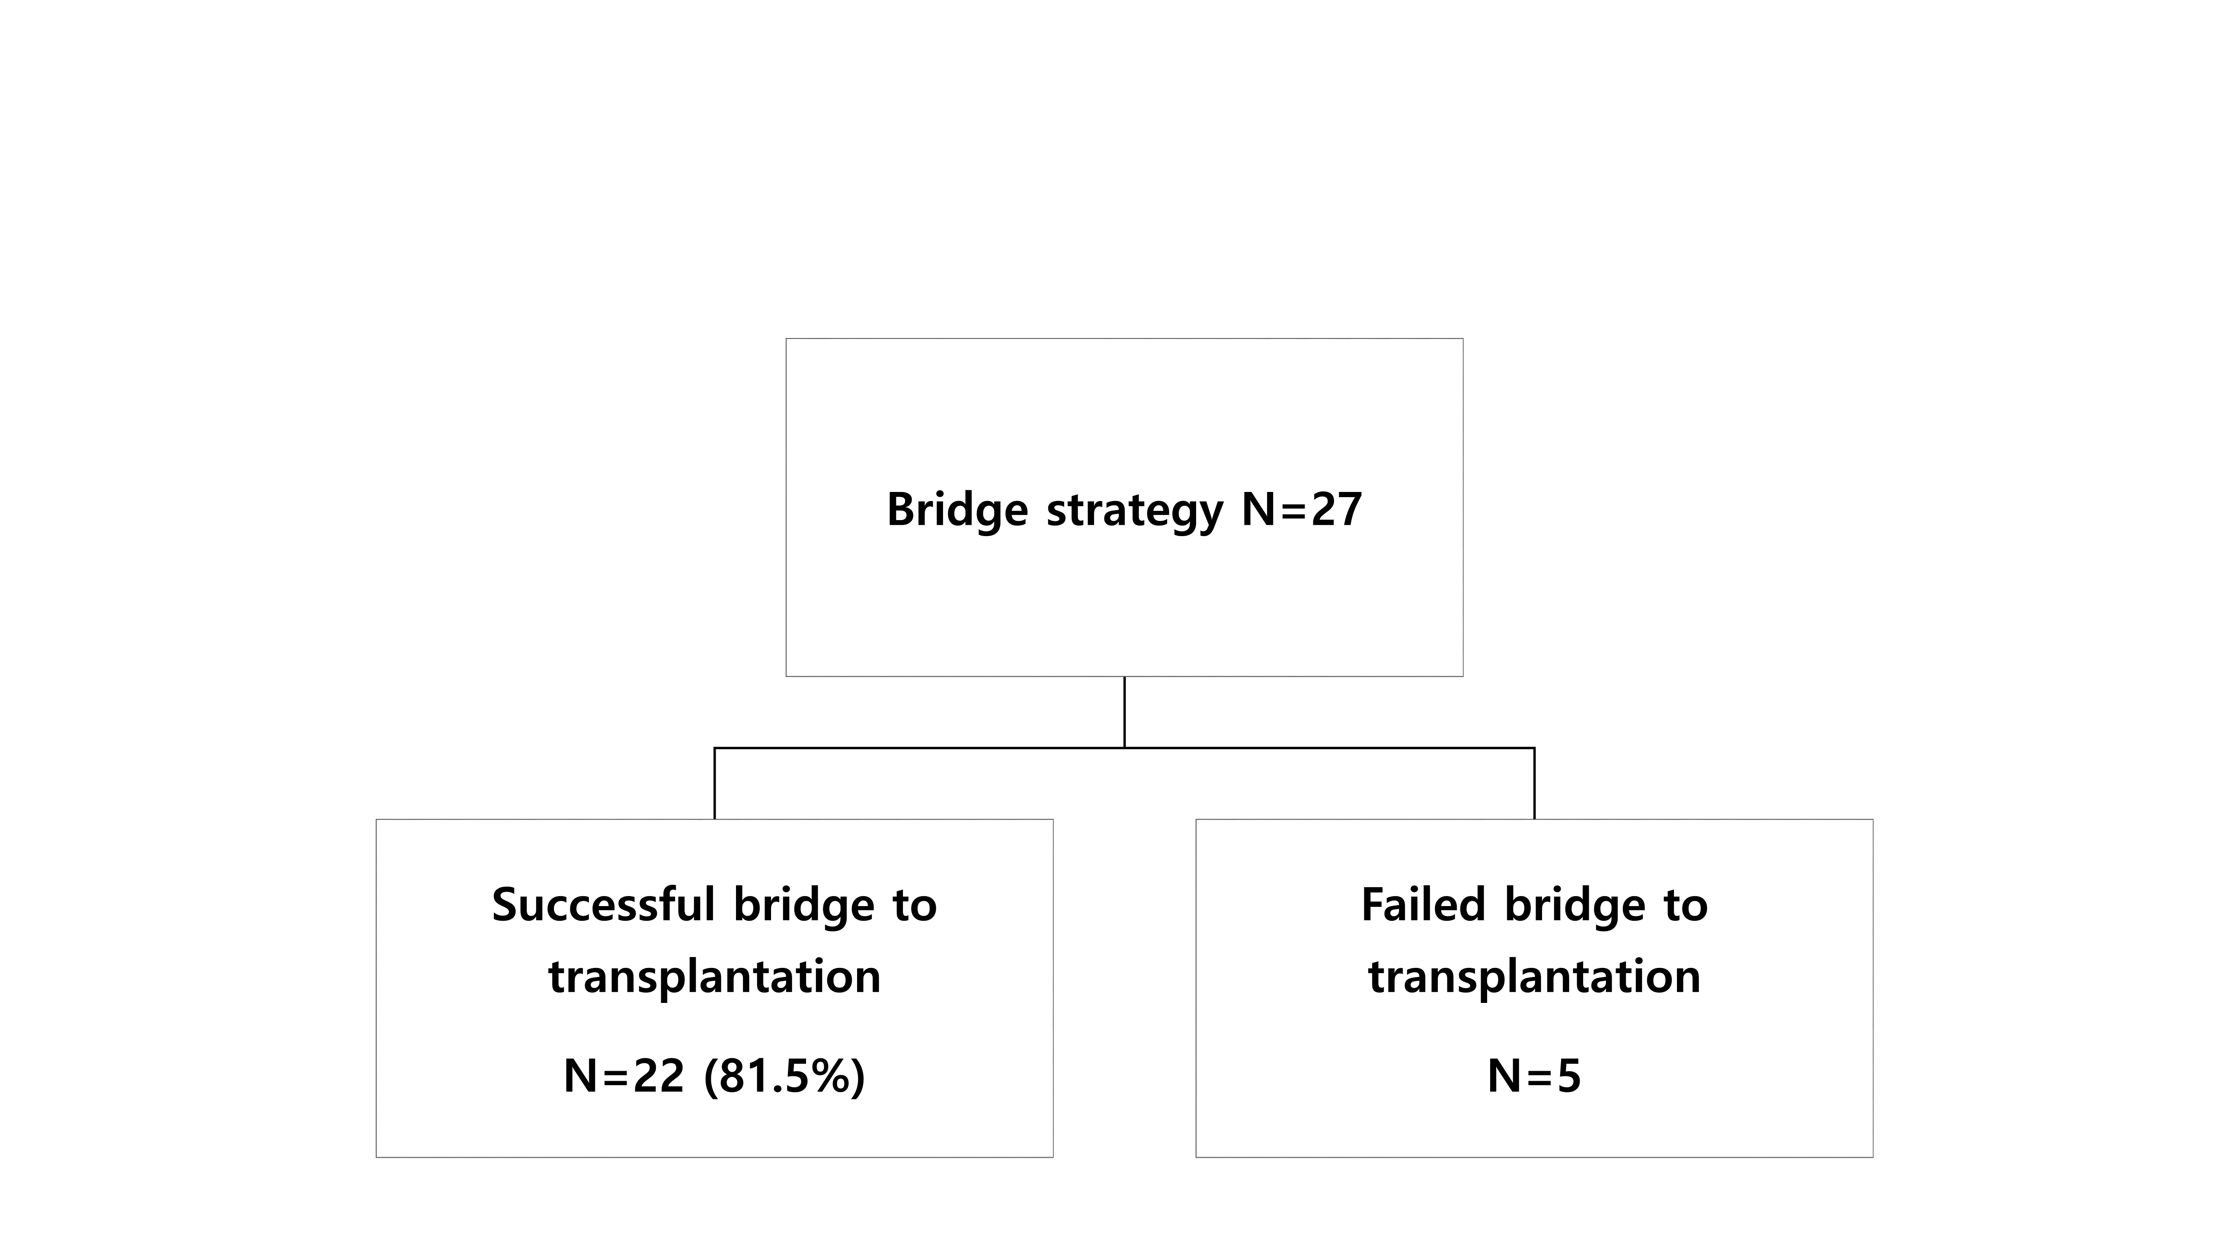
Bridge to LT (2012-2017)
 | Successful BTT
Waiting duration until transplantation | 22.0 (3-183)
ICU stay before Transplantation | 17.2 (3-58)
MV duration before ECMO | 0.5(0-17) 2 awaken ECMO
ECMO duration before transplantation | 14.5(1-57)
In-hospital mortality
1 | 2 | 3 | 4 | 5 | 6 | 7 | 8 | 9 | 10 | 11 | 12 | 13 | 14 | 15 | 16 | 17 | 18 | 19 | 20 | 21 | 22
 | x |  |  |  | x | x | x |  | x

Slide 22
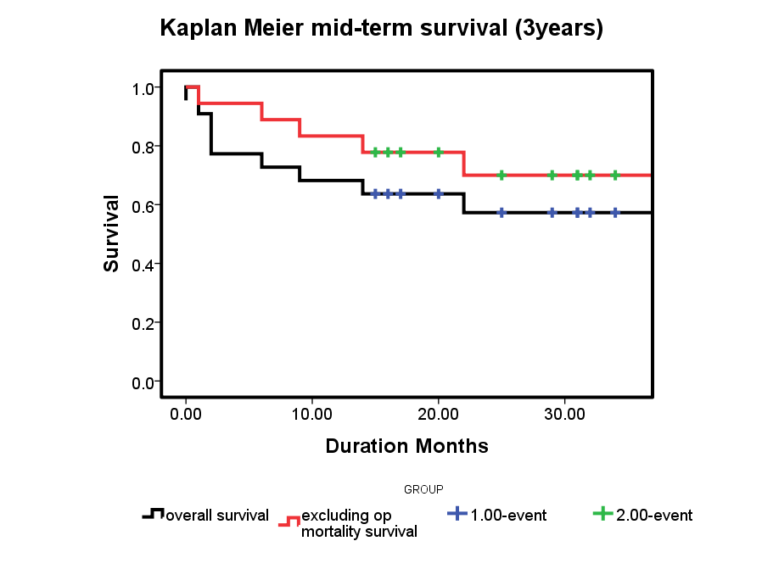
Bridge to LT (2012-2017)
70.0%
(3 years survival excluding op mortality)
57.3%
(overall 3 years survival)

Slide 23
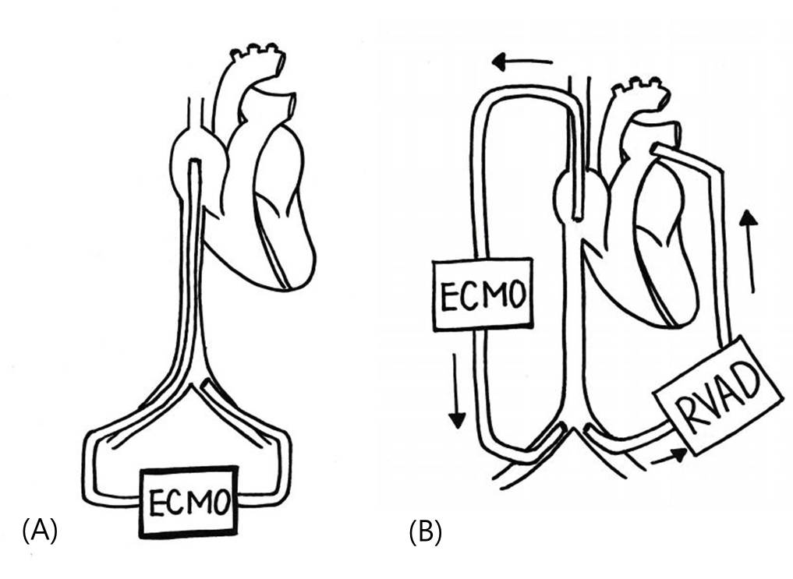
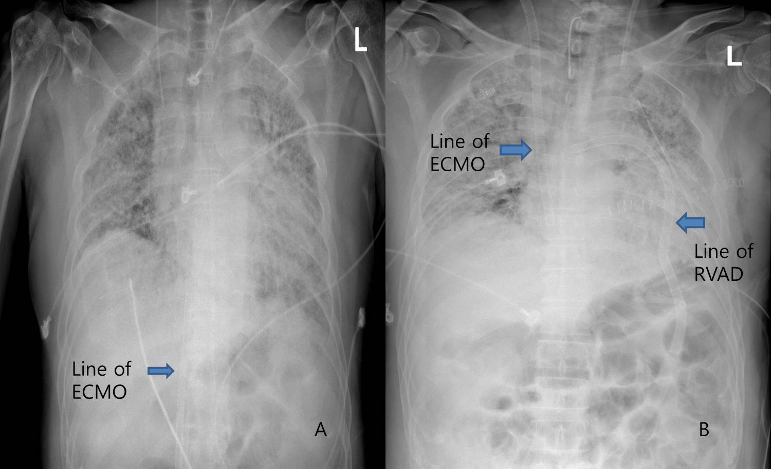
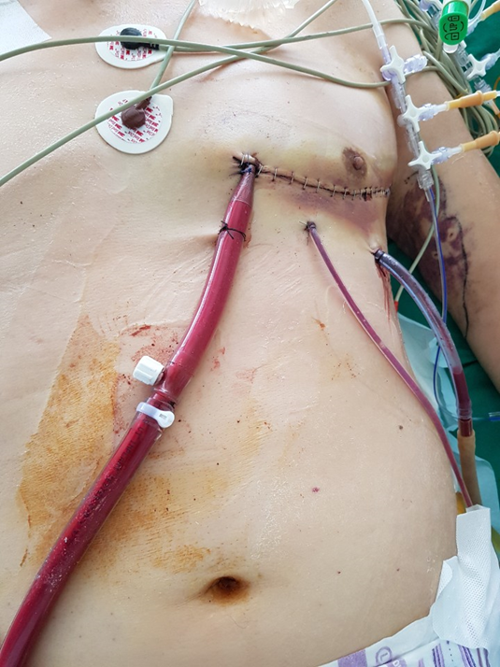
Oxy-RVAD
 | 성별/나이 | 진단명 | 시행일 | LT 대기 일수 (ECMO) | 결과
1 | M/64 | IPF | 18-09-23 | 11 | 대기중 사망
2 | M/48 | ILD | 18-10-02 | 4 | LT 후 퇴원
3 | M/64 | ILD, RVF | 19-01-03 | 5 | LT후 퇴원예정
4 | M/64 | COPD, RVF | 19-01-19 | 6 | LT후 퇴원
5 | M/69 | IPF | 19-02-11 | 21 | 대기중 사망
6 | M/68 | IPF | 19-03-04 | 24 | 이식대기

Slide 24
Maintenance period
Sedation deep or light
ECMO complications
-bleeding
-infection
-circuit problems

Slide 25
Deep or Light
Problem in Sedation on ECMO
Coughing
Tachypnea
Increased WOB
Air hunger
Unstable circuit flow
Dislodgement
of cannulas
Chattering
Hemolysis
Volume overload
Drowning syndrome
Normal O2, CO2
Chest X-ray: White out
The Will To Breath
Rapid Shallow Breathing
Deep sedation
Pulmonary HTN
Pulmonary congestion
Fall in Compliance

Slide 26
Deep sedation in early (48H)
Acute & Prolonged phase on critical ill patients
Acute phase
Hypermetabolic phase
Elevated Catecholamine
Prolonged phase
Catabolic phase
Reduced Endocrine Stimulation
Severe loss of body cell mass
Major catecholaminergic activation
Excessive Hormonal, Metabolic, Inflammatory response
Oxygen consumption
Hemodynamic instability
Intravascular fluids shifting,
Thermic increase
Altered coagulation
Current Opinion in Critical Care 2005

Slide 27
Low dose heparin may decrease bleeding complication & transfusion requirement
Intensive Care Med 2015

Slide 28
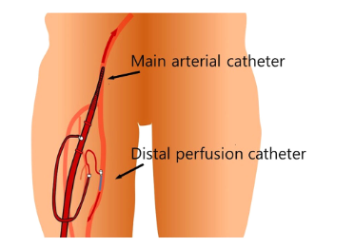
Preemptive Distal Perfusion Cannulation (2010-2015 VA 151)
 | Rescue (N=107) | Preemptive (N=44) | P
Limb Ischemia | 10 (9.3) | 0 | 0.036
Surgical intervention | 3 (2.8) | 0 | 0.262
Fasciotomy | 2 (1.9) | 0 | 0.359
Amputation | 1 (0.9) | 0 | 0.248
Cannulation site bleeding | 9 (8.4) | 5 (11.4) | 0.570
Preemptive distal perfusion cannulation is safe and effective when used to prevent lower limb ischemia. However, delayed distal cannulation increases the extent of cannulation site bleeding, without improving the ischemia.
J interventional cardiology 2016

Slide 29
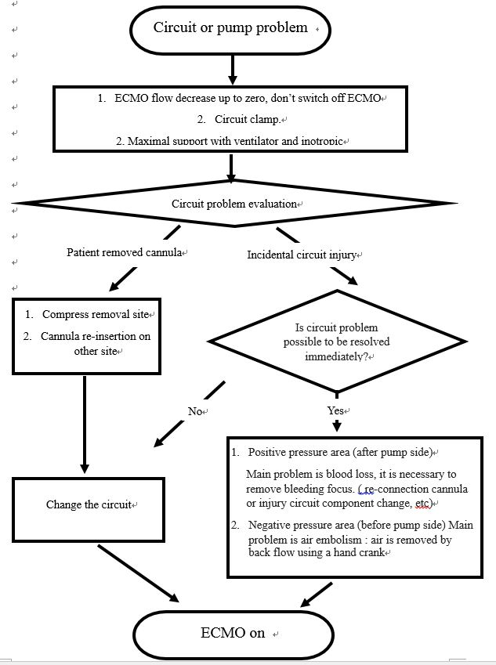
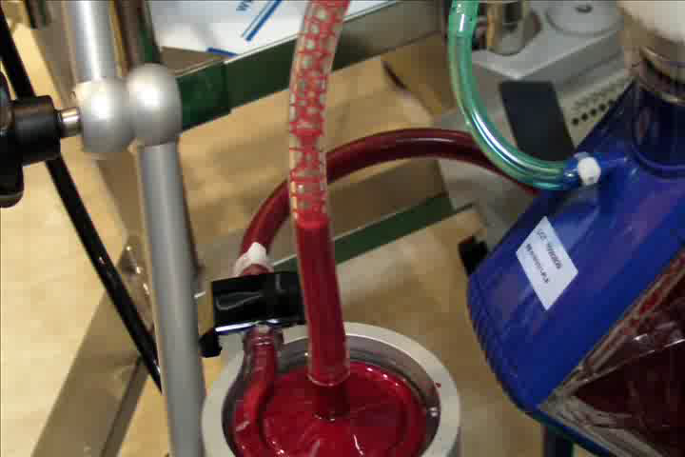
Catastrophic events
 | 11/478 (2.3%)
Self removal of cannula | 5
Disconnect venous cannula connector | 1
Air aspiration in IV bag | 1
Lur lock fracture during transport | 2
Artery cannula injury during distal cannula insertion | 1
Return cannula tearing | 1
11 cases

Slide 30
Blood stream infection was related to poor outcome.
Journal of Artificial Organs, 2015

Slide 31
Bacterial biofilms
Total
N = 81
Infection
N = 51
Biofilm
N = 22 (43.1 %)
Culture positive biofilm
N = 14 (27.5 %)
Controls
N = 30
Biofilm
N = 6 (20 %)
Culture postive biofilm
N = 2 (6.7 %)
ECMO flow, systemic infection and CRAB were associated with biofilm formation
ASAIO 2018

Slide 32
Weaning period
Awake
Early rehabilitation
Early enteral feeding
Vascular complication

Slide 33
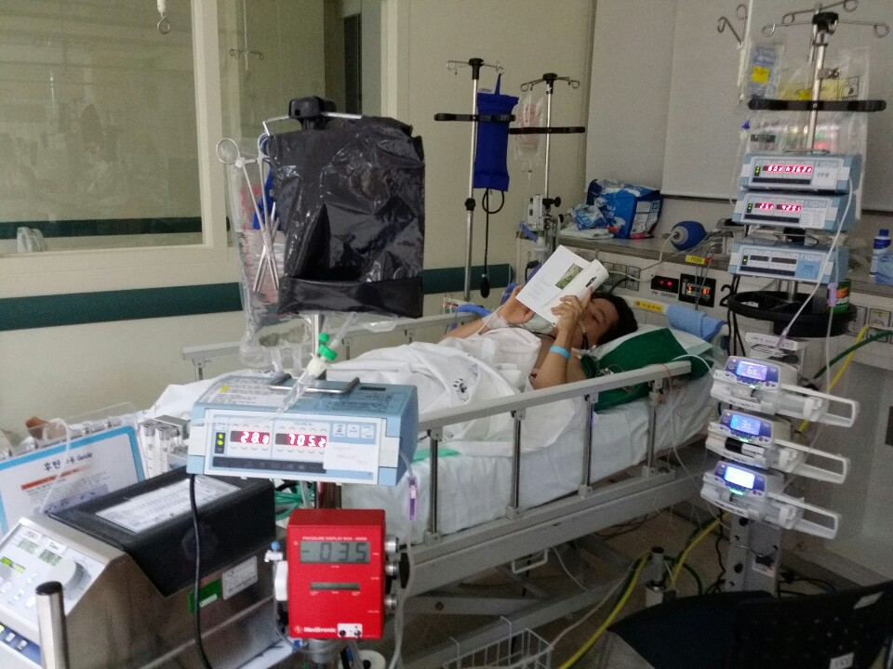
Awake ECMO
48 시간 이후
Spontaneous breathing
Early mobilization & rehabilitation
  Physical Therapy & Occupational Therapy
Analgesics
Sedatives
Anxiolytics/
Hypnotics
Antipsychotics
Safe environment
Drug side effects
Sedation scale use
Minimizing sedation
Awakening
Multimodal approach
J Thorac Dis. 2016
Crit Care Med 2012

Slide 34
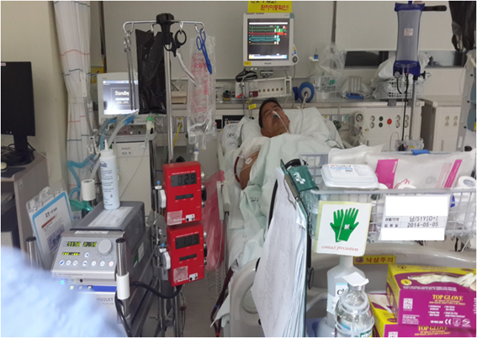
early tracheostomy significantly reduced the median ventilator day and ICU stay
2012-2016 N=38
acute and critical care 2017

Slide 35
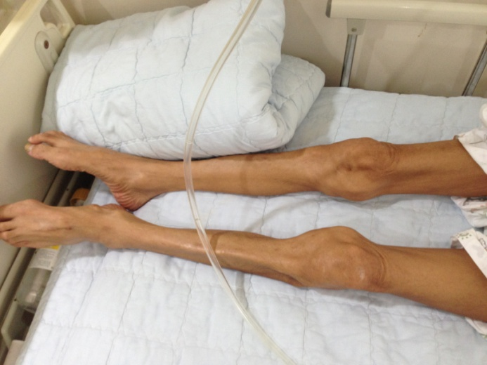
Muscle wasting
Systemic inflammation
Immobility
Multiple organ failure
Malnutrition
Derilium
ICU acquired weakness
Muscle wasting
50-100%
ECMO
Basal muscle status
J anesth 2016
Intensive care medicine 2017
Notes:
.

Slide 36
Weaning period
Early EN
Early rehab
Weaning success
High protein
NMB중단하면 시작
NMB중단하면 시작
PNUYH protocol

Slide 37
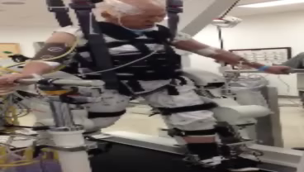
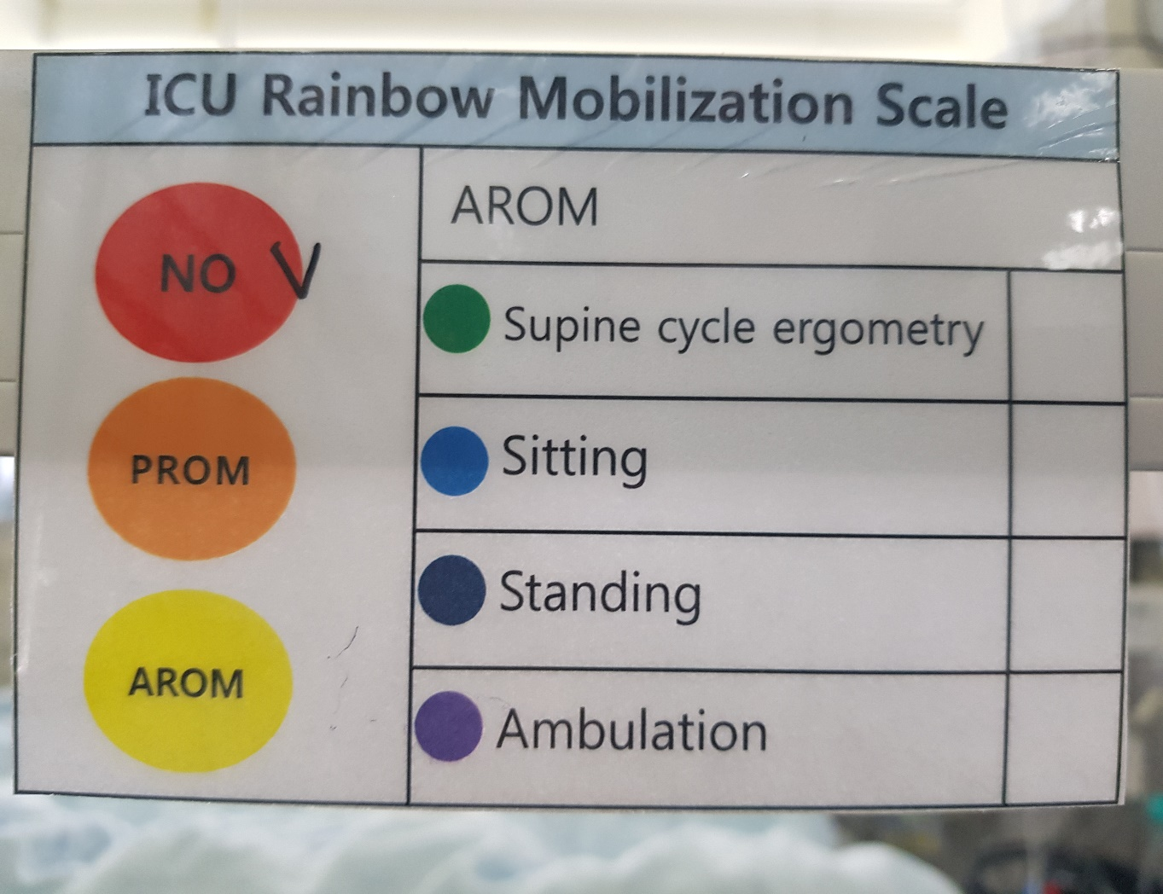
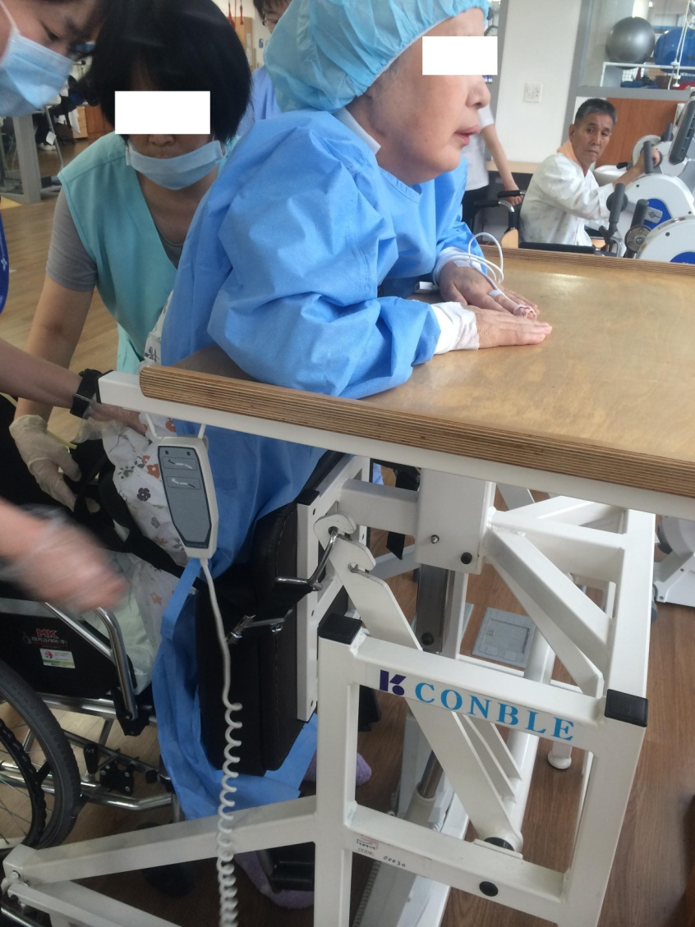
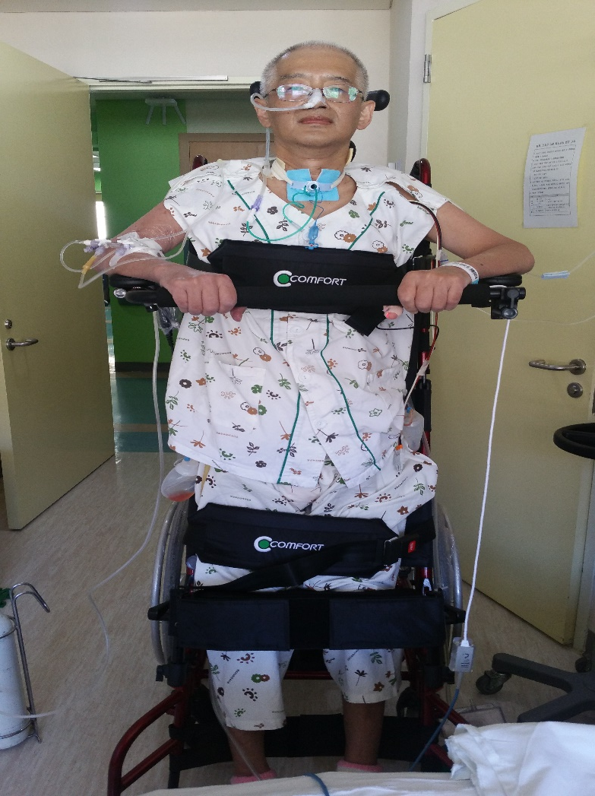
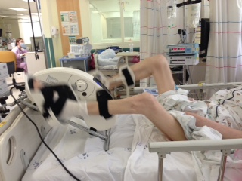
Early rehabilitation (with 보호자)

Slide 38
Vascular Complications (2010-2014 VA 63)
Vascular complications | 11 (17.5%)
Hematoma (> 5cm) | 6 (9.5%) | Repeat manual compression
Retroperitoneal bleeding | 1 (1.6%) | Hematoma evacuation and vascular repair
Access site bleeding | 1 (1.6%) | Simple suture
Arteriovenous fistula | 1 (1.6%) | Manual compression
Pseudoaneurysm | 2 (3.2%) | Sclerotherapy, manual compression
The hematoma rate was significantly higher in patients with an aPTT > 56, and in whom dual antiplatelet drugs were used (OR: 11.55, 95% CI: 1.32–100.92, p = 0.027; OR: 8.17, CI: 1.61–41.46, p= 0.011)
Journal of cardiac surgery 2016

Slide 39
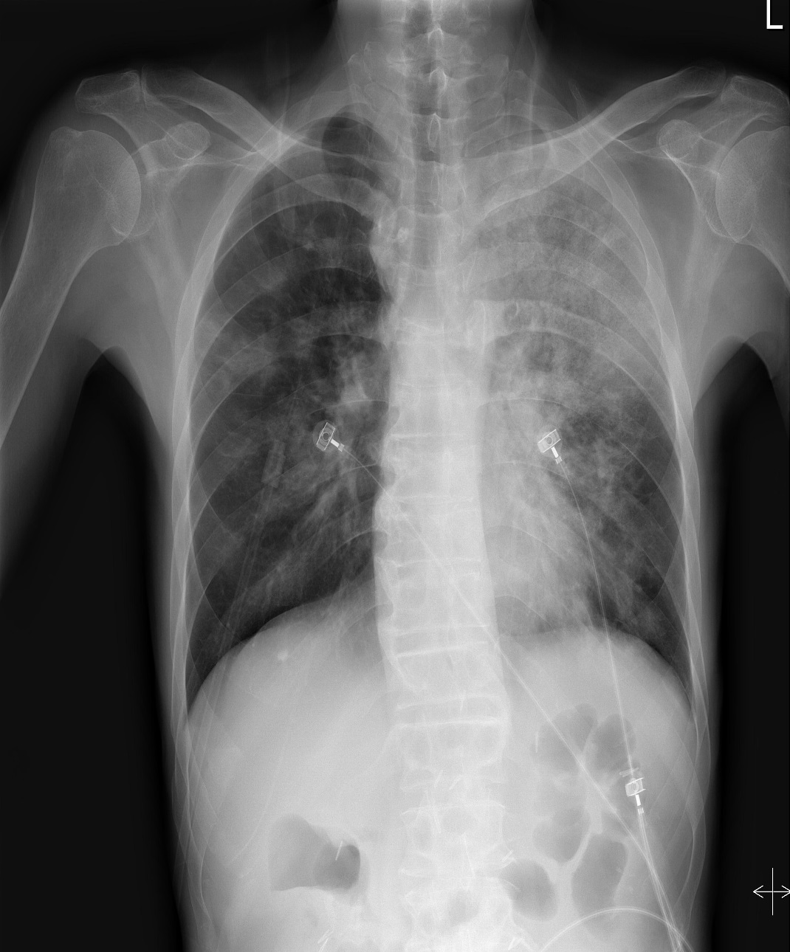
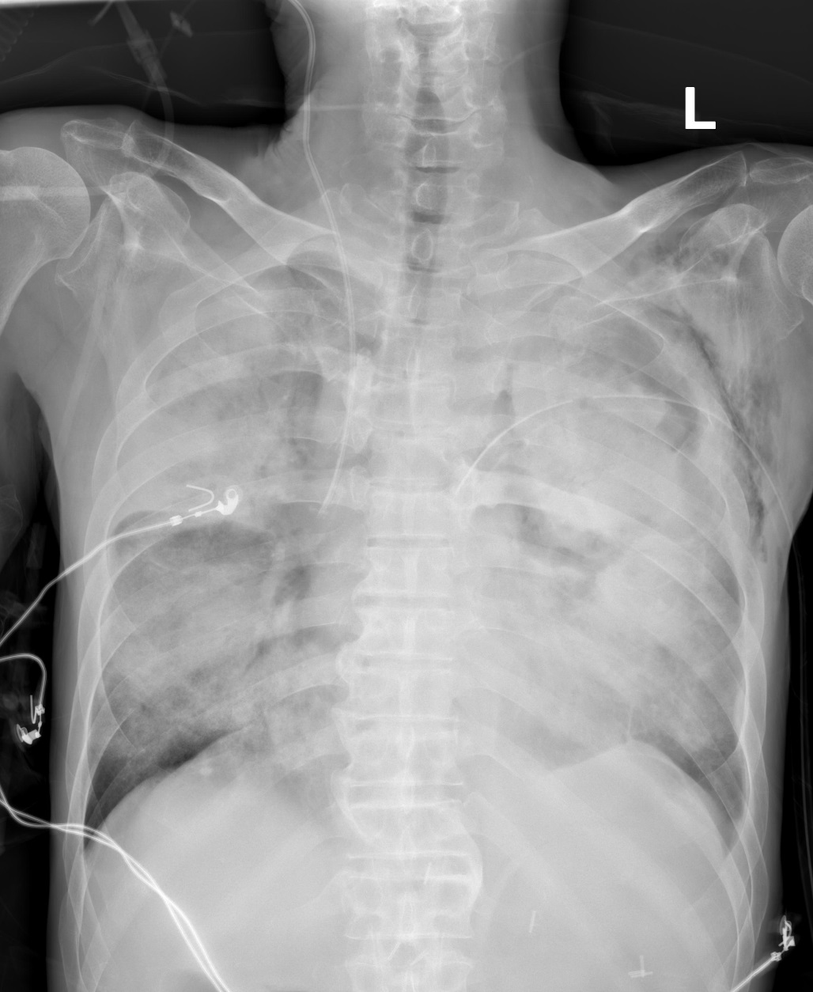
Case M/55
1 day

Slide 40
Thrombocytopenia
14일

Slide 41
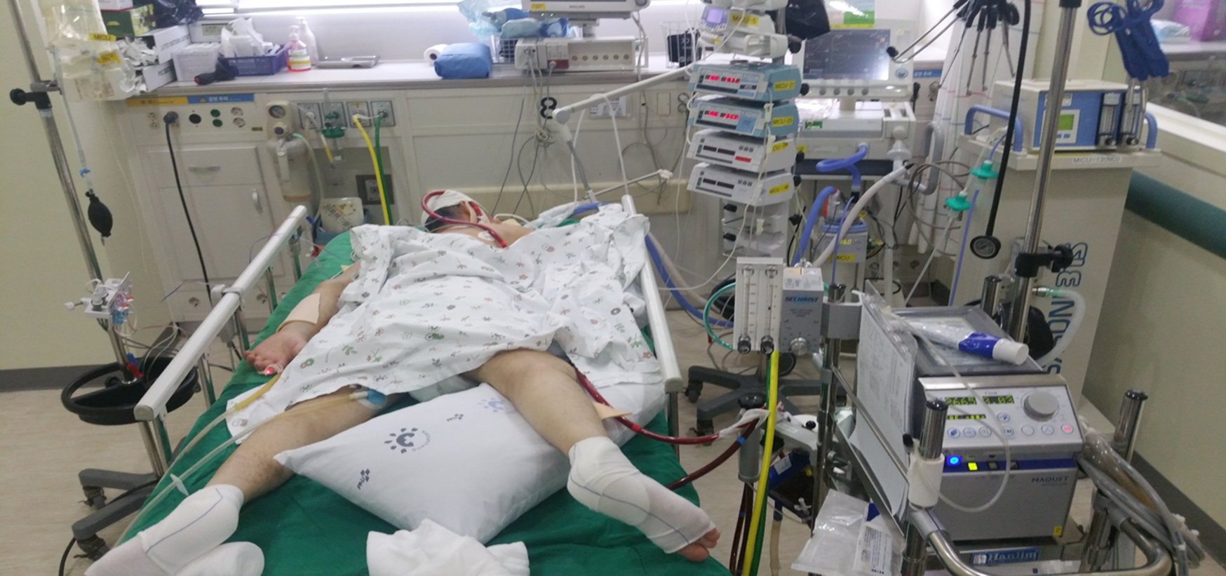
VV ECMO & prone positioning

Slide 42
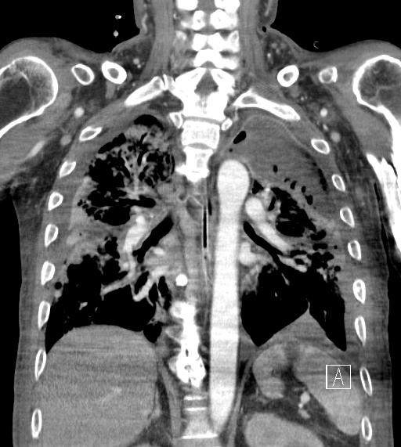
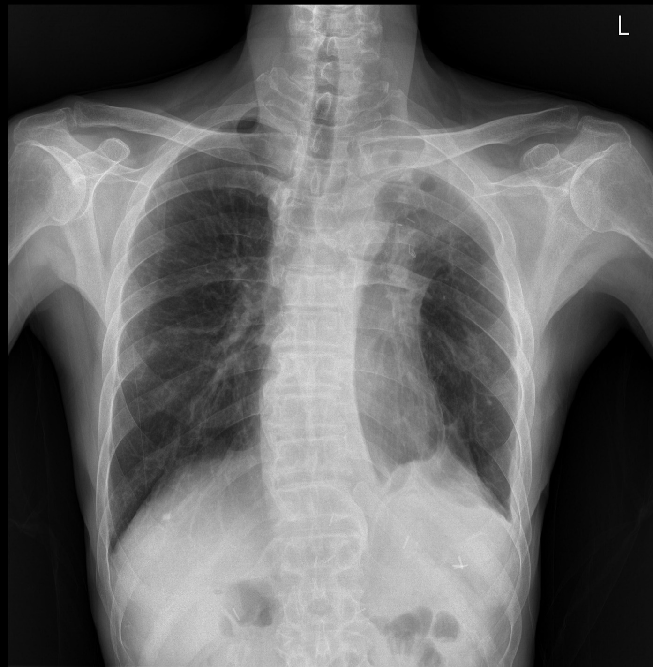
LUL lobectomy

Slide 43
No. Specialist, Yes. Multidisciplinary team approach
Take home message
Intensivist
Perfusionist
Rehabilitation team
Nutrition team
Cardiothoracic surgeon
Nurse
Individualized approach

Slide 44
감사합니다.

