Slide 1
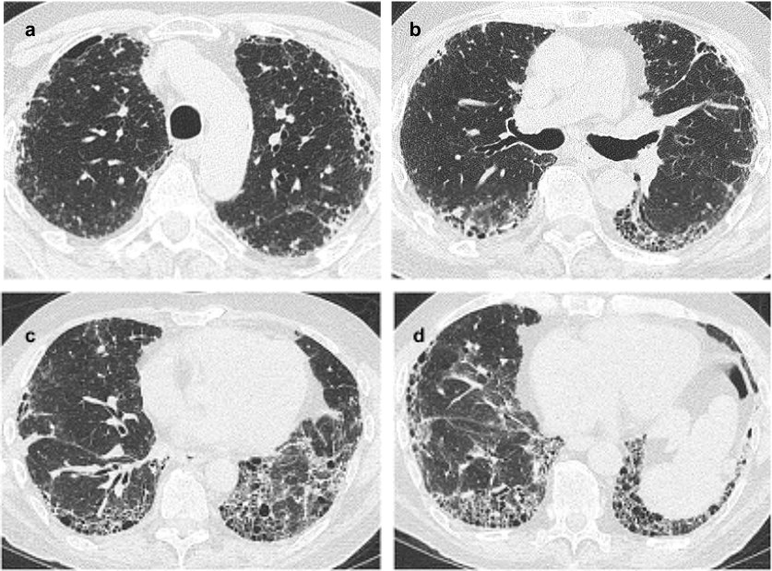
특발 폐섬유증 (IPF)
: 만남에서 헤어짐까지
2019.4.28
인제의대 부산백병원 호흡기,알레르기내과
이 현 경

Slide 2
IPF 진료과정의 흐름도
진 단
치료개시
첫 만남
추 적
이식고려? 헤어질 준비

Slide 3


상황 1 : A씨 건강검진결과
‘간질성폐질환이 의심되어 정밀진단이 필요합니다’
간질 ??
네XX 검색시작 : 폐가 굳어져 숨이차는 병 2년 내에 ….
Notes:
두려움과 좌절

Slide 4
상황 2 : B씨 서서히 진행하는 활동 시 숨찬 증상, 지속되는 기침, CXR/HRCT 촬영 후 ILD 의심되어 방문
상황 3 : C씨 류마티스내과에서 10년 전부터 RA로 치료 중, 지속되는 기침으로 CXR/HRCT 촬영 후 ILD 의심되어 의뢰됨
Notes:
다양한 상황에서 진단과 치료를 어떻게 접근해야할까를 고민하게 된다

Slide 5
첫 만남의 설명
간질성폐질환 : 폐가 굳어지는 병
수십가지 질병이 포함되어 있어 정확한 진단이 필요하다
원인이 있는 경우를 먼저 걸러내어야 한다
원인을 모르는 경우 ‘특발성’이라 한다
‘특발성’ 중 ‘특발폐섬유증’이 가장 예후가 나쁘다
‘특발폐섬유증’ 의 예후가 나쁘지만 모든 환자에서 그런 것은 아니다. 경과를 지켜봐야 판단할 수 있다.
‘특발폐섬유증’에서 완치를 기대하긴 어렵지만 병의 진행을 늦추는 약제가 있다
지속적으로 악화되는 경우 ‘폐이식’ 이 치료 option이 될 수 있다

Slide 6
IPF 진료과정의 흐름도
진 단
치료개시
첫 만남
추 적
이식고려? 헤어질 준비
Notes:
진단후 예후설명이 필요

Slide 7
간질성폐질환
ILD of Known Cause or Association
Idiopathic Interstitial Pneumonias
Sarcoidosis
& Other Granulomatous Diseases
약 제
방사선조사
결합조직병(CTD)
과민성폐렴
진폐증
Other
LAM
Pulmonary LCH
Eosinophilic Pneumonias
Alveolar Proteinosis
혈관염/폐포출혈
Genetic Syndromes
Adapted from: ATS/ERS Guidelines for IIP. AJRCCM. 2002;165:277-304.
Notes:
IIP 는 전체 ILD의 약 1/3을 차지함. 다양한 질병의 모임 (heterogeneous group)

Slide 8
특발폐섬유증 (IPF) overview

Slide 9
특발폐섬유증 (IPF)의 정의
IPF is a specific form of chronic, progressive, fibrosing interstitial pneumonia of unknown cause. It occurs primarily in older adults, is
limited to the lungs, and is defined by the
histopathologic and/or radiologic pattern of UIP.
The disease is characterized by progressive morphological changes of the lung architecture,
causing cough and worsening dyspnea and
ultimately leading to lung failure and death.
Raghu G, et al. Am J Respir Crit Care Med. 2018;198:e44

Slide 11
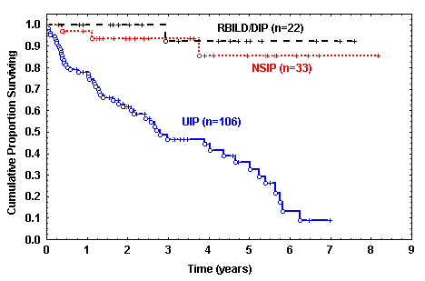
진단이 예후 예측에 가장 중요하다 !!
: IPF의 예후는? 중간생존기간 3-5년
Parameter | HR (95% CI)
IPF Dx | 28.46 (5.5, 147)
Age | 0.99 (0.95, 1.03)
Female sex | 0.31 (0.13, 0.72)
Smoker | 0.30 (0.13, 0.72)
Physio CRP | 1.06 (1.01, 1.11)
Onset Sx (yrs) | 1.02 (0.93, 1.12)
CTfib score ≥ 2 | 0.77 (0.29, 2.04)
Cumulative Proportion Surviving
Time (years)
진단이 정확해야 적합한 치료를 제공할 수 있다
Flaherty KR, et al. Eur Respir J. 2002;19:275-283.
Notes:
중간생존율 3-4년

Slide 12
IPF는 특히 나이든 남자에서 가장 흔하다
10만명 당 유병율

Slide 13
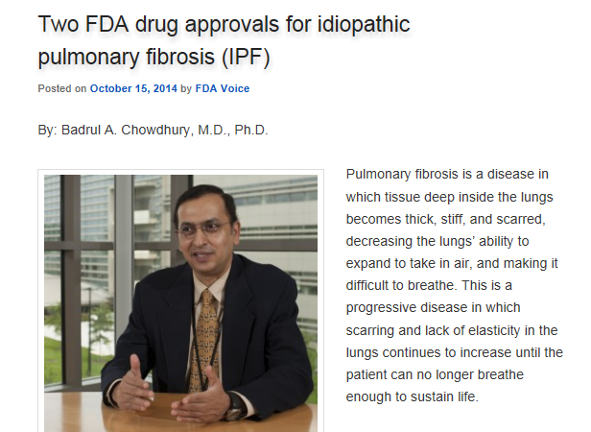
Pirfenidone 2014
Nintedanib 2015

Slide 14
ILD의 임상양상
공통점 | 차이점
Dyspnea Progressive Exertional Cough Non-productive Bibasilar crackles Restrictive ventilatory defect Exertional desaturation ILD on HRCT | Prior/current exposures Extrapulmonary findings Sarcoidosis Connective tissue disease Joint involvement Serologies HRCT Honeycombing Ground glass Distribution of abnormalities Histopathology

Slide 15
폐기능 검사
폐활량검사
  Reduced FVC and TLC
  Normal or increased FEV₁/FVC ratio
가스교환장애
  Decreased DL_{CO}, PaO₂
  Desaturation on exercise oximetry
Normal PFTs do not exclude ILD
  Emphysema + Interstitial Lung Disease

Slide 16
ILD 진단의 시작 : HRCT
Specific diagnosis
Clinical
picture
Radiologic pattern (HRCT)
Pathologic pattern
(lung biopsy)
http://www.pfdoc.org/2014/07/a-pulmonary-fibrosis-primer-for-doctors.html. Accessed August 2014.

Slide 17
High Resolution CT scan (HRCT)
Inspiratory supine and expiratory supine
Prone imaging in select cases
No IV contrast
Technical protocol : refer to ATS/ERS 2018 guideline
Raghu G, et al. Am J Respir Crit Care Med. 2018;198:e44

Slide 18
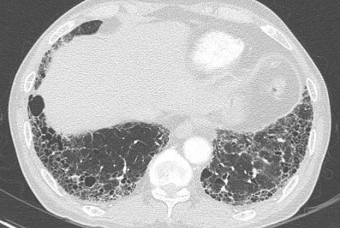
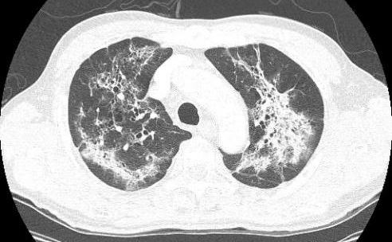
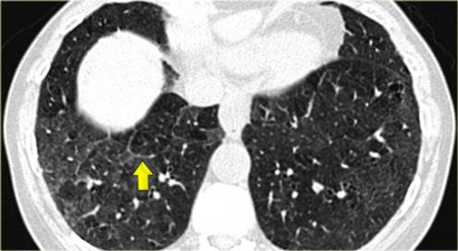
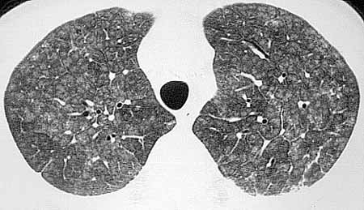
HRCT 에서 확인된 다양한 ILD 소견

Slide 19
HRCT에서 ILD가 확인되었다면 다음 단계는?
Specific diagnosis
Clinical
picture
Radiologic pattern (HRCT)
Pathologic pattern
(lung biopsy)
http://www.pfdoc.org/2014/07/a-pulmonary-fibrosis-primer-for-doctors.html. Accessed August 2014.

Slide 20
IPF 진단 : ATS/ERS Recommendation
새로 발견된 ILD에서 IPF 가 의심되는 경우
  자세한 약제, 가정 및 직장의 환경 노출력을 조사해야 한다
Raghu G, et al. Am J Respir Crit Care Med. 2018;198:e44
Notes:
Identifying an underlying aetiology is important from a clinical perspective because it often impacts treatment and prognosis
부정맥병력, 과거 현재 약물, 암진단, 항암, 방사선

Slide 21
간질성폐질환
ILD of Known Cause or Association
Idiopathic Interstitial Pneumonias
Sarcoidosis
& Other Granulomatous Diseases
약 제
방사선조사
결합조직병(CTD)
과민성폐렴
진폐증
Other
LAM
Pulmonary LCH
Eosinophilic Pneumonias
Alveolar Proteinosis
혈관염/폐포출혈
Genetic Syndromes
Adapted from: ATS/ERS Guidelines for IIP. AJRCCM. 2002;165:277-304.
Notes:
약제(bleo) rad pneumonitis, HP, 진폐 증례사진 넣기

Slide 22
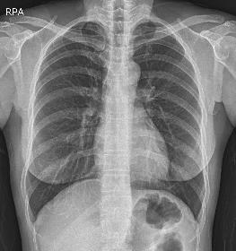
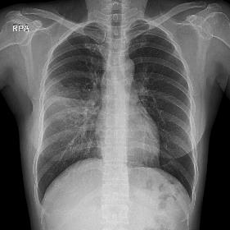
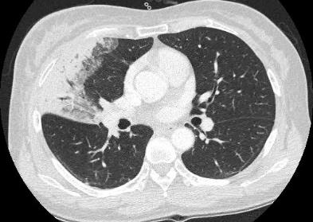
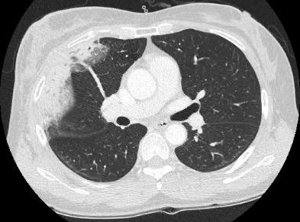
F/52 Breast ca post op / cough, dyspnea
6개월 전
방사선치료에 의해 발생한 폐경결
Notes:
Rad pneumonitis – CT 추가하기

Slide 23
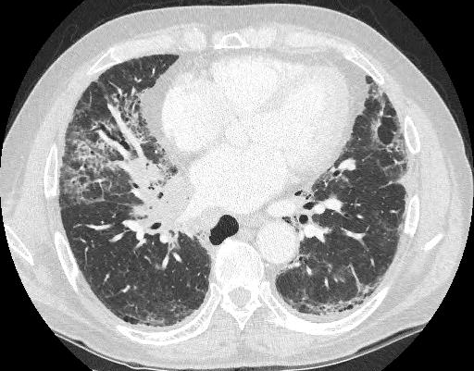
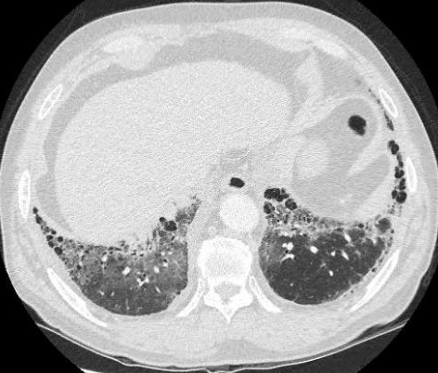
M/70 Lung ca on chemotherapy / cough
항암제 투여에 의해 발생한 폐경결

Slide 24
M/58 cough, dyspnea
새 키우는 직업, 과민성폐렴
Notes:
* up to 30% of subjects with histologic HP have no identifiable exposure
* upper lung–predominant subpleural reticulation with some confluent areas of dense opacification,
traction bronchiectasis, and patchy ground-glass opacities. Honeycombing is not identified.
* Bronchiolocentric distribution and poorly formed granulomas

Slide 25
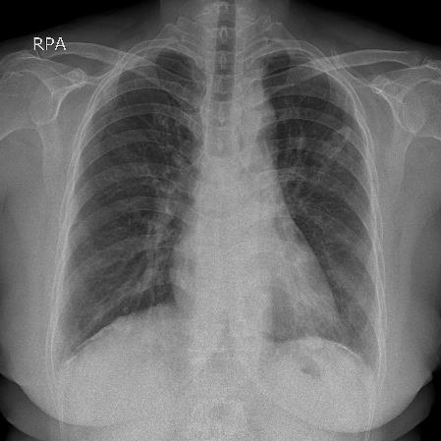
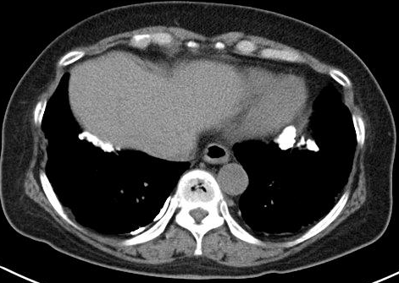
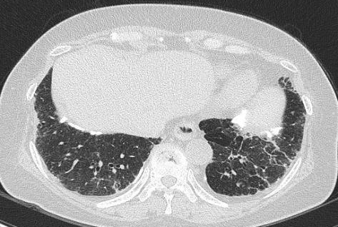
M/67 chronic cough, dyspnea
‘백석면’ 취급공장에서 15년간 근무

Slide 26
결합조직병 (Connective Tissue Diseases) 연관 간질성폐질환 (CTD-ILD)을 R/O 해야….
Established CTD
ILD
CTD – ILD
concomitantly
Clinical : Extrathoracic features of CTD
ILD
Search for clues of CTD ??
Serology : Autoantibodies
Morphology: Imaging / histopathologic features
Notes:
CTD : systemic autoimmunity and immune-mediated organ damage

Slide 27
CTD를 의심할 수 있는 주요 증상들

Slide 28
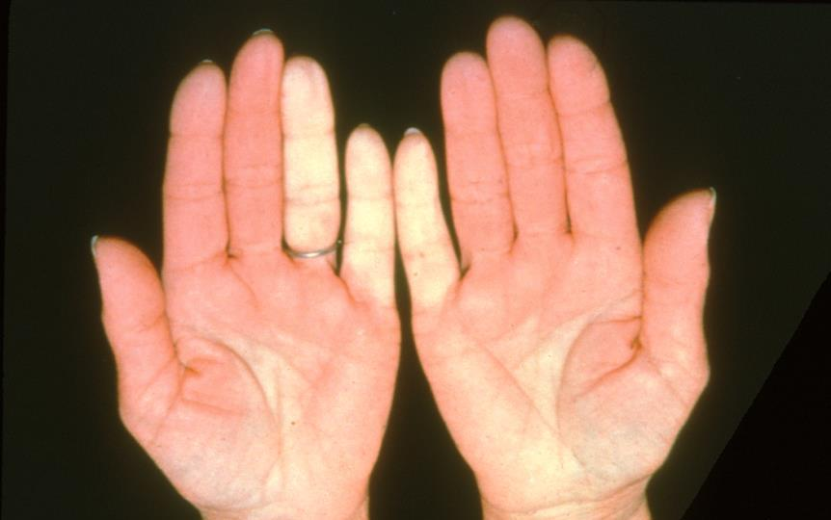
Raynaud's Phenomenon
Notes:
Scleroderma: Raynaud's phenomenon, blanching of hands
The marked pallor of the fourth and fifth digits on the left hand and of the fifth digit on the right hand is characteristic of Raynaud’s phenomenon. Vasospastic changes are common in systemic sclerosis but may also occur in rheumatoid arthritis, systemic lupus erythematosus, and idiopathic Raynaud’s disease.
#9110010

Slide 29
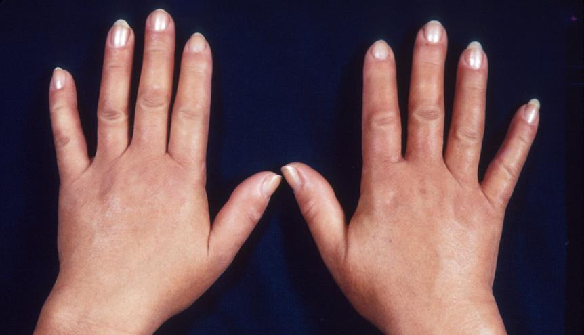
Puffy Fingers in Early Scleroderma or Mixed CTD
Notes:
Scleroderma: edematous changes, hands
Swelling of the distal limbs may develop early in the course of systemic sclerosis. Puffy hands are shown here.
#9110030

Slide 30
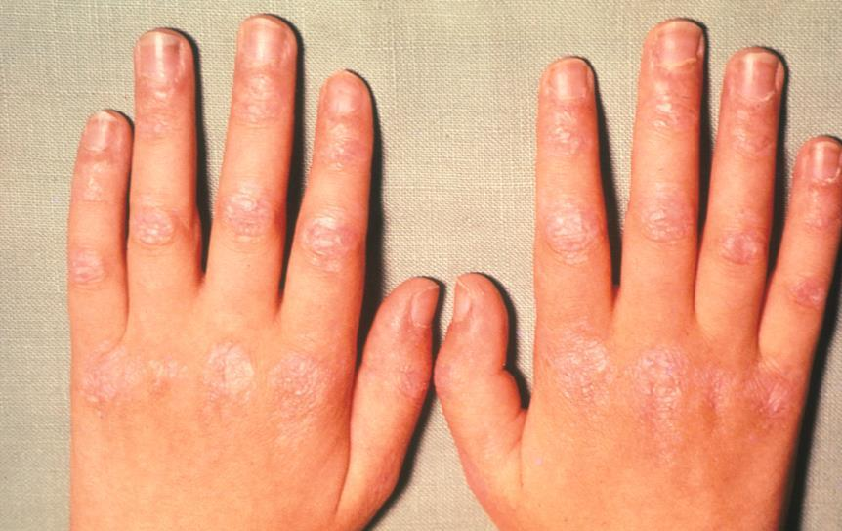
Gottron's Papules in Dermatomyositis
Notes:
Dermatomyositis: rash, hands
Typical late cutaneous involvement is seen on the extensor aspect of the joints. The lesions are reddish-white, shiny, slightly scaly, and atrophic.
#9109050

Slide 31
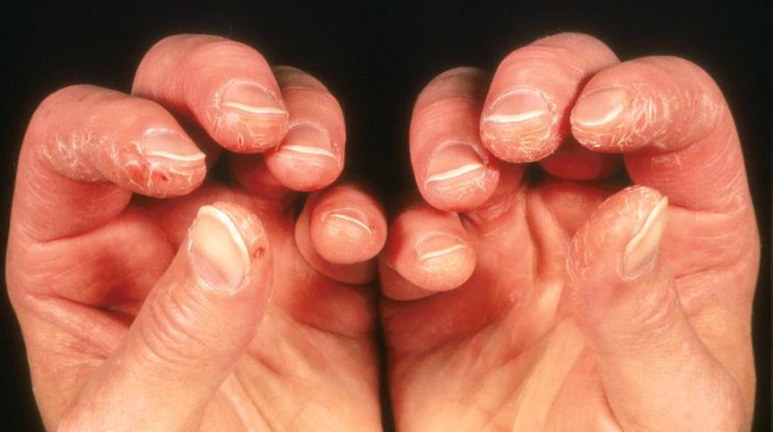
Mechanic's Hands in
Anti-Synthetase Syndrome
Notes:
Dermatomyositis: ”mechanic's hands"
Cracking of the finger pad skin, commonly involving the first, second, and third fingers, is demonstrated in this patient with dermatomyositis.
Miller FW. Myositis-specific autoantibodies: touchstones for understanding the inflammatory myopathies. JAMA 1993;270:1846-1849.
#9109060

Slide 32
IPF 진단 : ATS/ERS Recommendation
새로 발견된 ILD에서 IPF 가 의심되는 경우
  자세한 약제, 가정 및 직장의 환경 노출력을 조사해야 한다
  CTD를 제외하기 위해 혈청학적 검사를 권장한다
Notes:
Identifying an underlying aetiology is important from a clinical perspective because it often impacts treatment and prognosis
부정맥병력, 과거 현재 약물, 암진단, 항암, 방사선

Slide 33
어떤 혈청학적 검사가 필요한가 ?
Minimum: CRP, ESR, ANA, RF, anti-CCP, myositis panel (ATS/ERS guidelines)
Based on history & physical exam, consider:
  다양한 자가항체 검사 (임상적으로 의심되면)
  Anti-centromere antibody
  MPO/PR3 (ANCA) antibodies
  Anti-cardiolipin antibodies, lupus anticoagulant
Should be performed before a biopsy

Slide 35
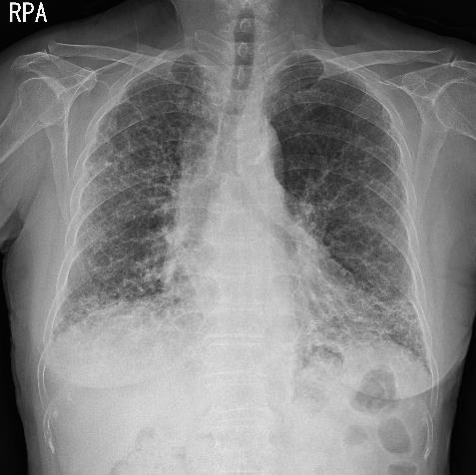
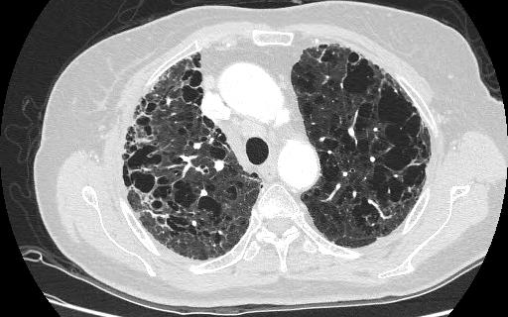
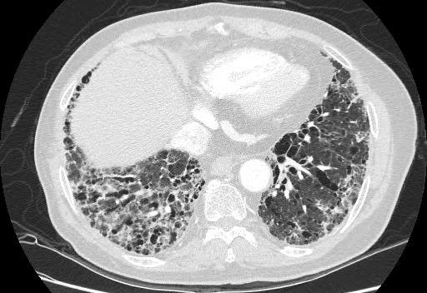
특발폐섬유증 + 폐기종 (CPFE)
77/F, DOE, mMRC 4
Notes:
When coexisting patterns occur, MDD may determine the clinical significance of individual patterns

Slide 36
Diffuse Parenchymal Lung Disease (DPLD)
DPLD of known cause, eg, drugs or association, eg, collagen vascular disease
Idiopathic interstitial pneumonias
Granulomatous DPLD, eg, sarcoidosis
Other forms of DPLD, eg, LAM, HX, etc
Idiopathic pulmonary fibrosis
IIP other than idiopathic pulmonary fibrosis
Desquamative interstitial pneumonia
Respiratory bronchiolitis interstitial lung disease
Cryptogenic organizing pneumonia
Acute interstitial pneumonia
Nonspecific interstitial pneumonia
Lymphocytic interstitial pneumonia
Pleuroparenchymal fibroelastosis
Travis WD, et al; ATS/ERS Committee on Idiopathic Interstitial Pneumonias. Am J Respir Crit Care Med. 2013;188(6):733-748.
Notes:
other idiopathic interstitial pneumonias and ILD associated with environmental exposure, medication, or systemic disease (1, 12).

Slide 37
Nonspecific Interstitial Pneumonia (NSIP)
Notes:
Non smoker, female
Low lung predominant GGO & reticular opacity, traction BE, bronchiectasis
Immediate subpleural sparing, rare H-C
Pathology : uniform distribution of fibrosis, no fibroblastic foci, preservation of alveolar structure

Slide 38
Respiratory Bronchiolitis-Interstitial Lung Disease (RB-ILD)
Notes:
Centrilobular nodules and extensive GGO. Bronchiolar wall thickening and minimal emphysema
Pigmented macrophage
(C) Histologic features: lung biopsy shows peribronchiolar pigmented macrophage accumulation and emphysema. (D) There is mild
bronchiolar fibrosis and pigmented macrophages within airspaces.

Slide 39
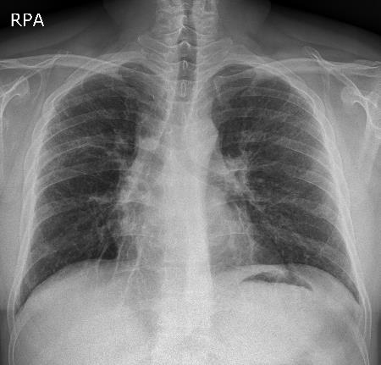
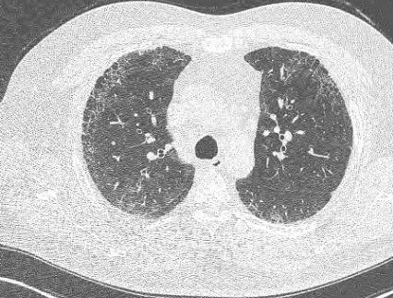
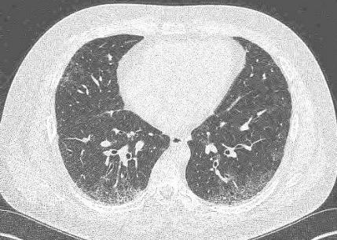
Desquamative Interstitial Pneumonia (DIP)
Notes:
widespread, patchy ground-glass opacification, with a greater predilection
for the lower-lung zone and, sometimes, peripheral predominance

Slide 40
Cryptogenic Organizing Pneumonia (COP)
Notes:
Patients with COP typically present with a subacute illness of
relatively short duration (median, less than 3 mo) with variable
degrees of cough and dyspnea (78–81). HRCT characteristically
demonstrates patchy and often migratory consolidation in a subpleural,
peribronchial, or bandlike pattern (Figures 4A–4D)
(82–84), commonly associated with ground-glass opacity

Slide 41
Idiopathic pleuroparenchymal fibroelastosis (IPPFE)
Notes:
irregular pleural thickening and “tags” in the upper zones that merge with fibrotic changes in the subjacent lung, associated with evidence of substantial upper lobe volume loss (architectural distortion, traction bronchiectasis, and hilar elevation)

Slide 42
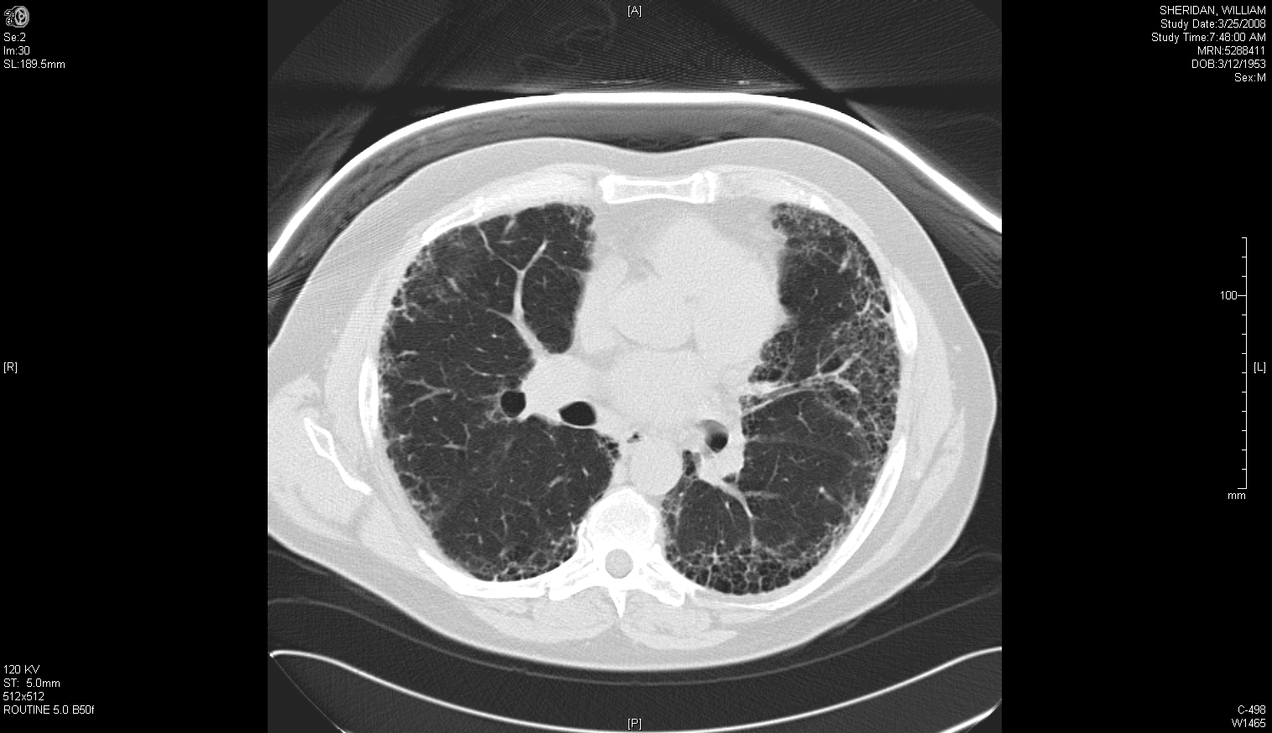
Diffuse Parenchymal Lung Disease (DPLD)
DPLD of known cause, eg, drugs or association, eg, collagen vascular disease
Idiopathic interstitial pneumonias
Granulomatous DPLD, eg, sarcoidosis
Other forms of DPLD, eg, LAM, HX, etc
Idiopathic pulmonary fibrosis
IIP other than idiopathic pulmonary fibrosis
Desquamative interstitial pneumonia
Respiratory bronchiolitis interstitial lung disease
Cryptogenic organizing pneumonia
Acute interstitial pneumonia
Nonspecific interstitial pneumonia
Lymphocytic interstitial pneumonia
Pleuroparenchymal fibroelastosis
Travis WD, et al; ATS/ERS Committee on Idiopathic Interstitial Pneumonias. Am J Respir Crit Care Med. 2013;188(6):733-748.
Notes:
other idiopathic interstitial pneumonias and ILD associated with environmental exposure, medication, or systemic disease (1, 12).

Slide 43
2018 ATS/ERS IPF 진단 알고리즘
Raghu G, et al. Am J Respir Crit Care Med. 2018;198:e44

Slide 44
HRCT Pattern (1)
UIP | Probable UIP
Subpleural, basal predominance | Subpleural, basal predominance
Honeycombing (+/- traction bronchiectasis) | Reticular pattern (+/- traction bronchiectasis)
 | May have mild GGO
Raghu G, et al. Am J Respir Crit Care Med. 2018;198:e44
Notes:
2011 possible -> probable 이유 : selected patients with a “possible UIP” pattern on HRCT according to the 2011 guidelines are highly likely to have histopathologic UIP, despite the absence of radiologic honeycombing
Probable 80%이상, indeterminate 50%정도 조직학적 UIP 나옴

Slide 45
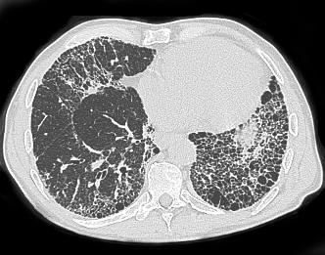
Honeycombing (벌집모양음영) 이란?
‘The Fleischner Society definition’
  clustered cystic air spaces (between 3-10 mm in diameter but occasionally as large as 2.5 cm) which are usually subpleural and basal in distribution. The walls of the cysts are well-defined and often thick (1-3 mm) ⁴.

Slide 46
UIP Pattern
Hodnett PA, et al. Am J Respir Crit Care Med. 2013;188:141-149.
Notes:
Usual interstitial pneumonia (UIP) pattern. (a–d) Sequential high-resolution computed tomography images through the lung demonstrate
a classic UIP pattern with evidence of diffuse reticulation, traction bronchiectasis, and subpleural, basilar honeycombing.
In the absence of a known underlying etiology, this appearance is diagnostic of idiopathic
pulmonary fibrosis, for which surgical biopsy is not indicated.

Slide 47
Probable UIP Pattern
traction bronchiectasis
Raghu G, et al. Am J Respir Crit Care Med. 2018;198:e44

Slide 48
HRCT Pattern (2)
Indeterminate for UIP | Alternative Diagnosis
Subpleural, basal predominance | 다른 진단을 시사하는 CT 소견 CT features ∘ Cysts ∘ Marked mosaic attenuation ∘ Predominant GGO ∘ Profuse micronodules ∘ Centrilobular nodules ∘ Nodules ∘ Consolidation Predominant distribution ∘ Peribronchovascular ∘ Perilymphatic ∘ Upper or mid-lung Other ∘ Pleural plaques ∘ Dilated esophagus ∘ Distal clavicular erosions ∘ Extensive lymph node enlargement ∘ Pleural effusions, pleural thickening
Subtle reticulation; may have mild GGO or distortion
CT features and/or distribution of lung fibrosis that do not suggest any specific etiology (“truly indeterminate for UIP”)
Raghu G, et al. Am J Respir Crit Care Med. 2018;198:e44

Slide 49
Indeterminate for UIP
Raghu G, et al. Am J Respir Crit Care Med. 2018;198:e44
Notes:
ground-glass opacity and subtle reticulation in the subpleural areas (arrows) with a basal predominance. (E) Transverse CT section of the lower lung zones in prone position showing persistence of lung
infiltration in nondependent areas, thus excluding gravitational abnormalities. UIP was proven at histology.

Slide 50
Alternative Diagnosis
만성 과민성폐렴 가능성 높은 소견
Raghu G, et al. Am J Respir Crit Care Med. 2018;198:e44
Notes:
Figure 5. Computed tomography (CT) pattern suggestive of an alternative diagnosis for lung fibrosis. (A and B) Transverse CT sections obtained at deep inspiration showing disseminated lung infiltration, sparing some secondary pulmonary lobules in lung bases. (C) Transverse CT section obtained at expiration confirming lobular air trapping, all findings being highly suggestive of chronic hypersensitivity pneumonitis.

Slide 51
2018 ATS/ERS IPF 진단 알고리즘
* MDD : 다학제논의
Raghu G, et al. Am J Respir Crit Care Med. 2018;198:e44
Notes:
언제 SLB를 해야하나?

Slide 52
IPF 진단 : ATS/ERS Recommendation
새로 발견된 ILD에서 IPF 가 의심되는 경우
  자세한 약제, 가정 및 직장의 환경 노출력을 조사해야 한다
  CTD를 제외하기 위해 혈청학적 검사를 권장한다
  HRCT pattern이 probable, indeterminate, or alternative diagnosis인 경우 외과적폐생검을 권장한다 (조건부)
  HRCT pattern이 UIP인 경우 외과적폐생검을 권장하지 않는다 (강력권유)
  다학제논의(MDD)를 권장한다 (조건부)
Notes:
Identifying an underlying aetiology is important from a clinical perspective because it often impacts treatment and prognosis
부정맥병력, 과거 현재 약물, 암진단, 항암, 방사선

Slide 53
외과적 폐생검 시행이 꼭 필요한가?
바람직한 이유들
바람직하지 않은 이유들
폐생검의 사망률 낮고, 적절한 조직을 얻을 확률높음
IPF진단 시 적절한 치료, 질병진행 늦춤, 사망율감소
치료가능한 다른 질환진단가능
수술의 합병증
  호흡기감염
  급성악화
  출혈
  공기누출지속
  신경통
  상처치유지연
사망가능성
Notes:
사망률 1.7% (0.8-3.5) 호흡기감염 6.5%

Slide 54
Histopathology Patterns
Raghu G, et al. Am J Respir Crit Care Med. 2018;198:e44
Notes:
Surgical lung biopsy specimens demonstrating UIP pattern. (A)
Scanning power microscopy showing a patchy process with honeycomb
spaces (thick arrow), some preserved lung tissue regions (thin arrow), and
fibrosis extending into the lung from the subpleural regions. (B) Adjacent
to the regions of more chronic fibrosis (thick arrow) is a fibroblast focus
(asterisk), recognized by its convex shape and composition of edematous
fibroblastic tissue, suggestive of recent lung injury

Slide 55
HRCT와 조직검사를 조합한 IPF 진단

Slide 56
IPF 진료과정의 흐름도
진 단
치료개시
첫 만남
추 적
이식고려? 헤어질 준비

Slide 57
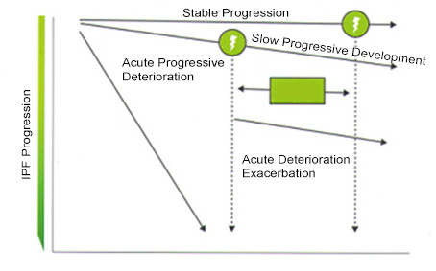
IPF의 자연경과
폐기능
시간
Am J Respir Crit Care Med. 2011;183:788

Slide 58
IPF의 자연경과를 바꿀 수 있는 항섬유화제

Slide 59
Pirfenidone: Brand Names
Esbriet (US) : 267 mg → upto 2403mg/day
Pirespa (FYBRO, Piresco) (Japan, Korea) : 200mg → upto 1800mg/day
(200mg tid 2w → 400mg tid 2w → 600mg tid)
Pirfenex (India) : 200mg
Pirfetab (India) : 200mg

Slide 60
Pirfenidone 보험인정기준 변경대비표
구)보험인정기준 | 새로운 보험인정기준
HRCT 와/또는 수술적 폐조직생검으로 확진된 특발성폐섬유증 환자 FVC ≥ 50% predicted and DLco ≥ 35% predicted 6분 보행검사거리 ≥ 150m 제외: 폐쇄성기도질환, 및 폐이식대기등록 환자 교원성질환, 다른 원인으로 설명되는 간질성 폐질환 | HRCT 와/또는 수술적 폐조직생검으로 확진된 특발성폐섬유증 환자 FVC ≤ 90% predicted or DLco ≤ 80% predicted FVC > 90% predicted and DLco >80% predicted - 아래 두 가지 이상에 해당되는 경우 가) 폐기능 저하: 연간 Predicted FVC 감소량이 10% 이상이 거나 연간 Predicted FVC 200ml 이상 감소 나) 임상증상 악화 다) 흉부영상 악화 소견 제외: 교원성질환, 다른 원인으로 설명되는 간질성 폐질환
PIR-BR10-1812-1Y
1. 보건복지부 고시 제2018-280호 기준 (시행일자 2019.1.1)

Slide 61

Pirfenidone의 확대된 급여기준 (19.1.1)
★폐 기능이 많이 저하된 중증도(Severe)의 특발성 폐섬유증 환자
FVC 정상 예측치가 50% 미만 또는 DLco가 35% 미만인 중증도 환자도 급여가 가능합니다. ¹
(개정안에서는 FVC 90% 미만, DLco 80% 미만 조건 중 하나만 만족해도 급여를 인정합니다.)
★폐 기능이 저하되지 않은 경도(Mild)의 특발성 폐섬유증 환자
FVC 정상 예측치가 90%을 초과하고, DLco가 80%을 초과한 경도의 환자도 특정 조건에 해당 시 급여가 가능합니다. ¹
(임상증상의 악화가 보이는 환자의 경우 폐기능 저하 또는 흉부영상 악화 소견을 통해 급여가 가능합니다.)
★폐쇄성 기도질환(FEV₁/FVC ratio 0.7 미만)을 가지고 있는 특발성 폐섬유증 환자
- PFT 결과상으로 FEV1/FVC ratio가 0.7 미만인 폐쇄성 기도질환 환자도 급여가 가능합니다. ¹
(폐쇄성 기도질환[FEV₁/FVC ratio < 0.7]이 급여 제한 대상에서 삭제되었습니다.)
★6분 보행검사 결과가 150 m 미만인 환자 / 폐 이식 대기등록 환자
- 보행이 어려워 6분 보행검사가 불가능한 환자, 폐 이식 대기등록 환자 또한 이제 급여가 가능합니다. ¹
(6분 보행검사 조건이 보험인정기준에서 삭제되었으며, 폐 이식 대기등록 환자가 급여 제한 대상에서 삭제되었습니다.)
1. 보건복지부 고시 제2018-280호 기준 (시행일자 2019.1.01)

Slide 62
IPF 임상시험의 inclusion criteria
 | ASCEND (Pirfenidone) | INPULSIS (Nintedanib)
Age, years | 40-80 | ≥ 40
Diagnosis | IPF(UIP) by central review
FVC, % pred. | 50-90 | ≥ 50
DLco,% pred. | 30-90 | 30-79
6MWT, meter | ≥ 150
FEV₁/FVC | ≥ 0.8 | ≥ 0.7
Extent of emphysema | Emphysema < fibrosis
Lung TPL | Not being on a waiting list for LTPL
NEJM 2014;370:22
NEJM 2014;370:22
Notes:
Shionogi corporate R&D report released 3/22/07. Available at: http://www.shionogi.co.jp/ir_en/explanatory/pdf/e_p070322.pdf. Accessed May 2007.

Slide 63
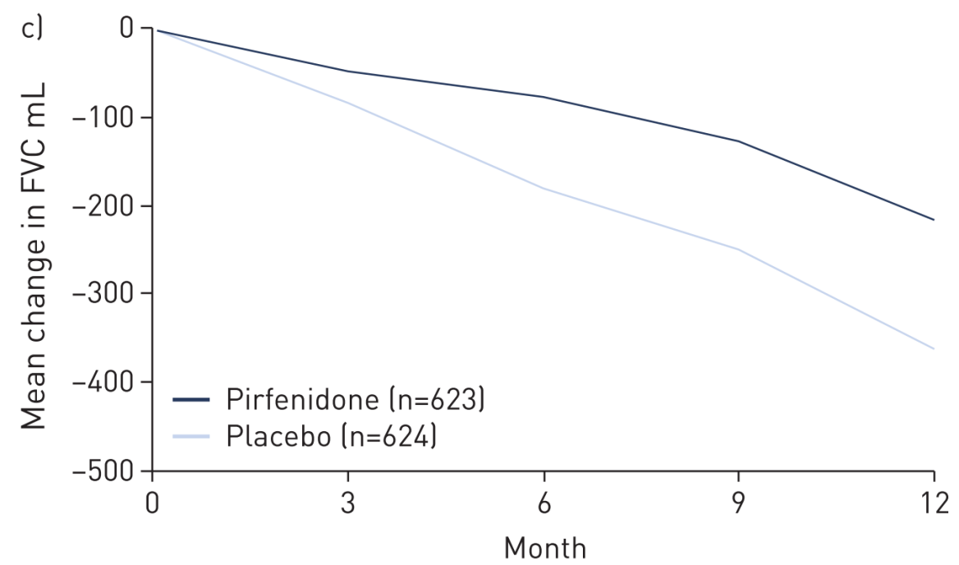
Pirfenidone(항섬유화제)은 폐기능저하속도를 늦춘다
Change in FVC
Change in FVC
40.7%
* ASCEND + CAPACITY (N=1247)
Eur Resp J 2016;47:243
Notes:
Pooled analysis demonstrated a reduction of all-cause mortality at 1 year by 48% (hazard ratio (HR) 0.52, 95% CI 0.31–0.87; p=0.01) in the group treated with pirfenidone compared to placebo, as well as a reduction of the risk in treatment-emergent IPF-related
mortality at 1 year by 68% (HR 0.32, 95% CI 0.14–0.76; p=0.006) compared to placebo [

Slide 64
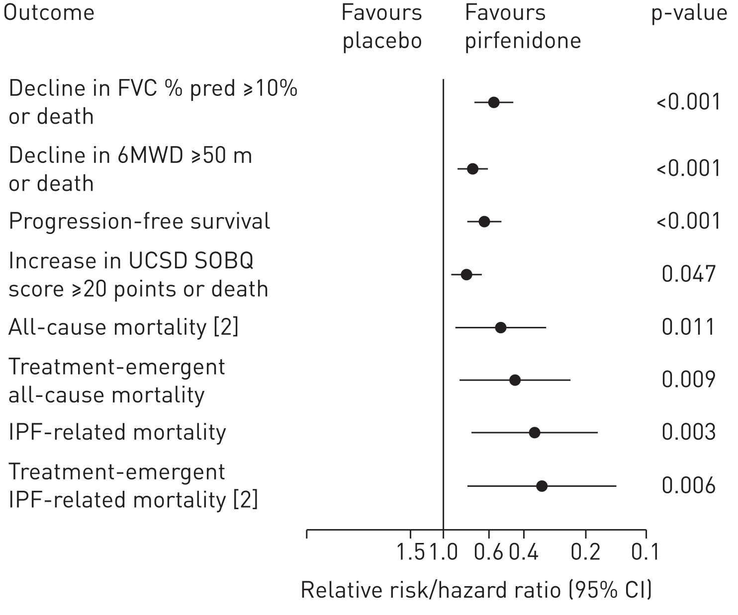
Pirfenidone은 생존율을 향상시킨다
48% ↓
68% ↓
* ASCEND + CAPACITY (N=1247)
Eur Resp J 2016;47:243
Notes:
Shionogi corporate R&D report released 3/22/07. Available at: http://www.shionogi.co.jp/ir_en/explanatory/pdf/e_p070322.pdf. Accessed May 2007.

Slide 65
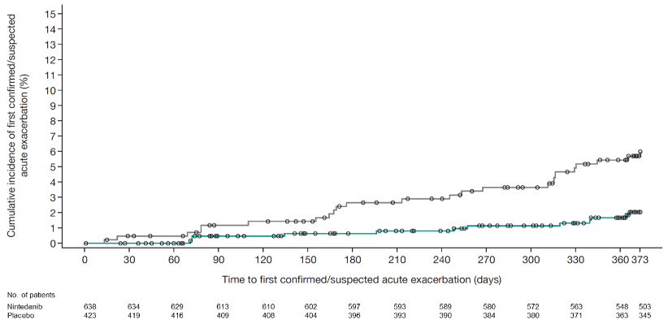
Nintedanib(항섬유화제)는 급성악화를 예방한다
Nintedanib 150 mg bid
Placebo
HR 0.32
(95% CI; 0.16, 0.65)
p=0.0010
 | Nintedanib 150 mg bid (n=638) | Placebo (n=423)
Patients with ≥1 acute exacerbation, n (%) | 12 (1.9) | 24 (5.7)
Richeldi L, et al. NEJM 2014; 370: 2071
Notes:
The numerical difference in favour of nintedanib on investigator-reported acute exacerbations based on the pooled dataset was confirmed by the results of the pre-specified sensitivity analysis of adjudicated exacerbations. Based on the pooled analysis, the proportion of patients with events adjudicated as a ‘confirmed’ or ‘suspected’ acute exacerbation was smaller in the nintedanib group than in the placebo group, and the hazard ratio of 0.32 (95% CI 0.16, 0.65) indicated a significantly lower risk of having a first acute IPF exacerbation (based on adjudication) in the nintedanib group than in the placebo group at any time point over 52 weeks.

Slide 66
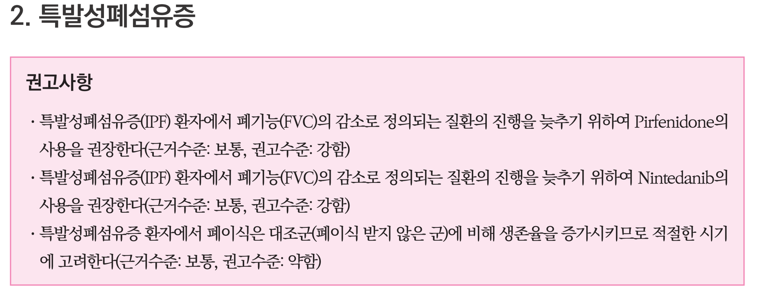
대한결핵및호흡기학회
간질성폐질환 진료지침 2018
2018 간질성 폐질환 임상진료지침

Slide 67

IPF 임상시험의 범위
mild
moderate
severe
FVC
FVC 50–90%
DLCO 30–80%
Typical clinical trials spectrum
Typical reimbursement spectrum

Slide 68
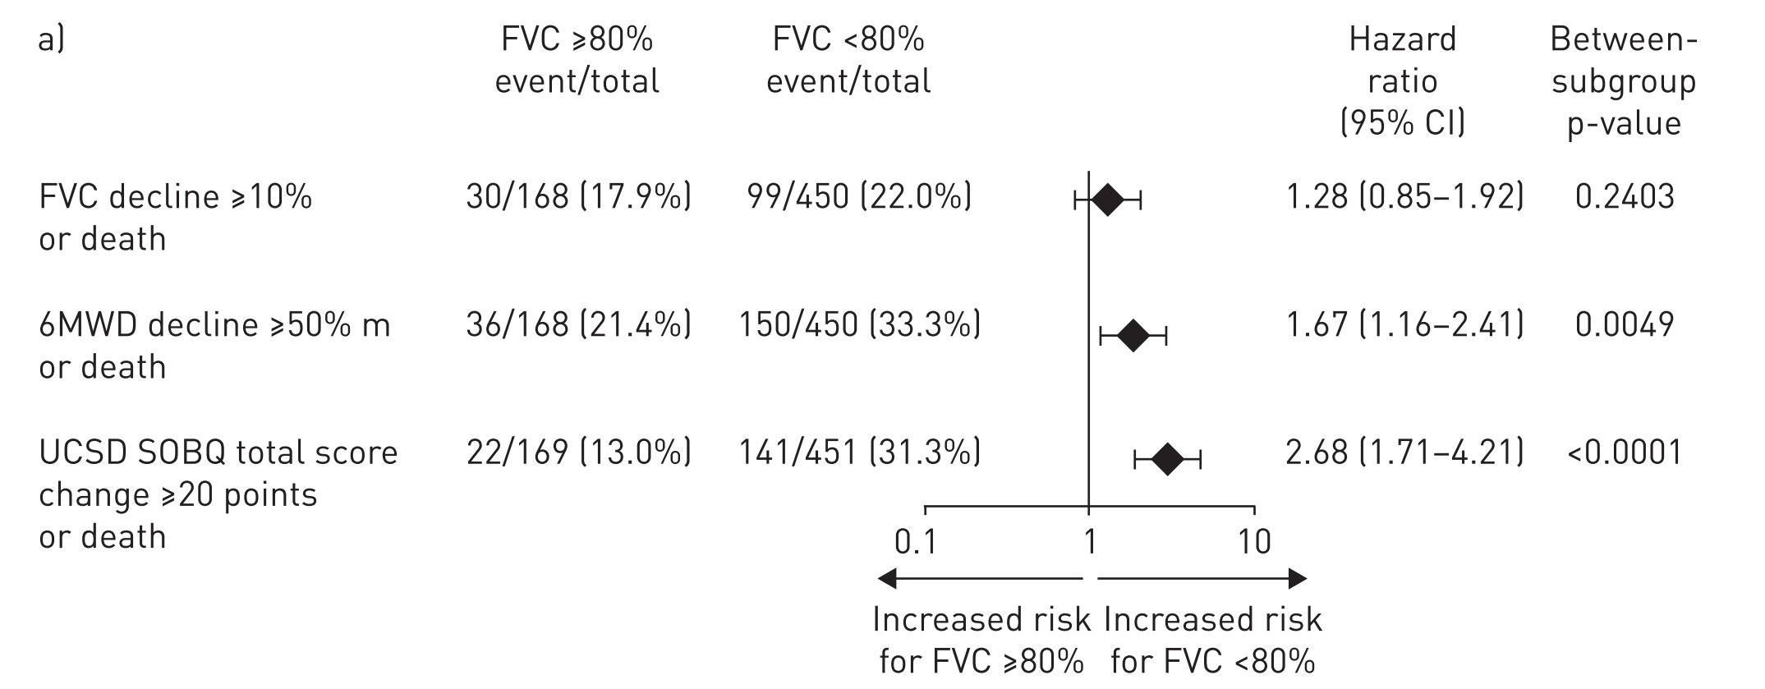
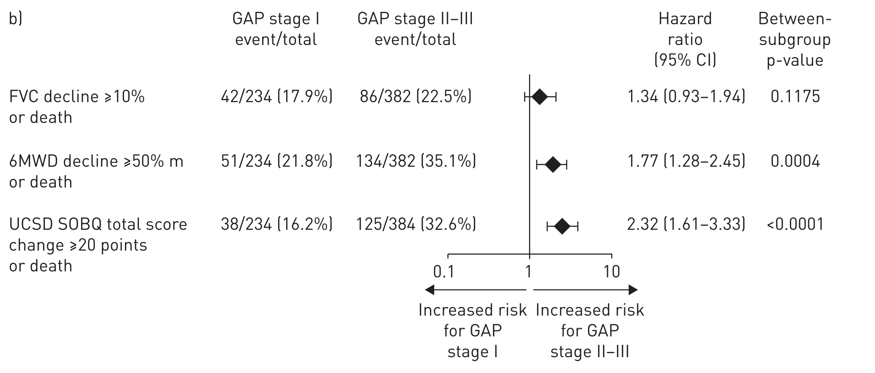
폐기능이 보존된 IPF vs 감소된 IPF 폐기능저하속도와 사망율에 차이가 없었다
ERJ 2016;48:843, CAPACITY + ASCEND pooled analysis

Slide 69
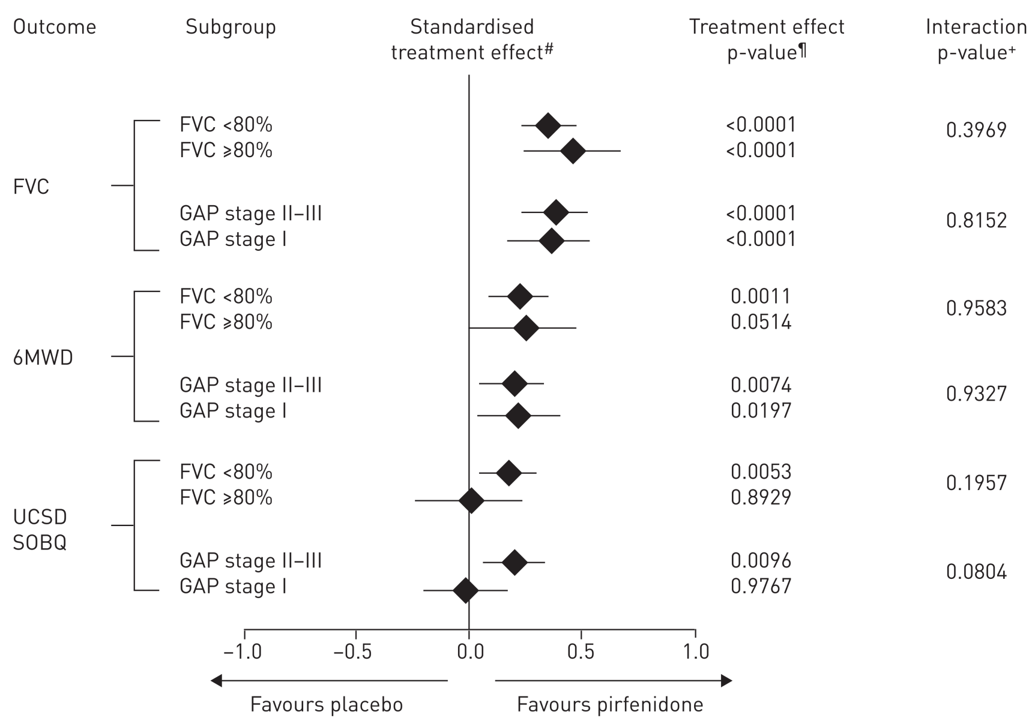
폐기능이 보존된 IPF vs 감소된 IPF
Pirfenidone투여효과는 동일하다
ERJ 2016;48:843, CAPACITY + ASCEND pooled analysis

Slide 70
IPF : 조기치료가 필요한가 ? (ASAP vs wait & watch)
나쁜 예후 (중간생존기간 3-5년) : 암보다 나쁨
질병경과를 예측할 수 없다
FVC (노력성폐활량) 감소는 연평균 200 mL 정도다 (vs 정상인 20-30 mL)
FVC 감소는 사망률 증가와 관련있다
  10% 이상감소 : 1년내 사망률 5배 증가
  2-6%의 작은 감소도 나쁜 예후를 예측할 수 있다
Notes:
천천히 진행하는 경우, 늦게 진단이 되어 치료개시가 늦어질 수 있다

Slide 71
조기 항섬유화 치료의 현실적 걸림돌
증상이 없거나 진행이 느린 경우
  기다리고자 함 (의사, 환자)
  질병의 경과를 정확히 모르고 막연히 희망적으로 생각
  부작용에 대한 염려
  증상이 없기 때문에 부작용 발생시 쉽게 중단, 포기
Notes:
천천히 진행하는 경우, 늦게 진단이 되어 치료개시가 늦어질 수 있다

Slide 72
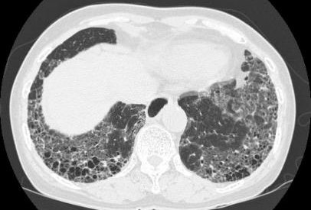
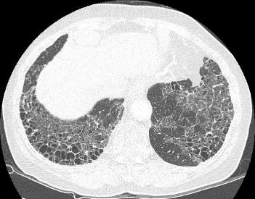
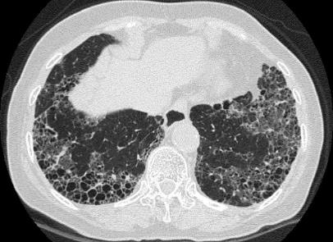
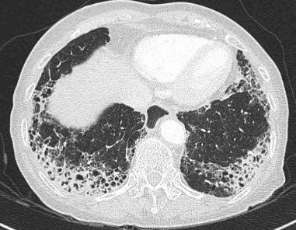
증례 1 : 76/F
진단 시 (FVC 94%)
3년째 (92%)
5년째 (89%)
8년째 (74%)
Notes:
천천히 진행하는 경우, 늦게 진단이 되어 치료개시가 늦어질 수 있다

Slide 73

IPF 임상시험의 범위
mild
moderate
severe
FVC
FVC 50–90%
DLCO 30–80%
Typical clinical trials spectrum
Typical reimbursement spectrum

Slide 74
More advanced vs Less advanced IPF
Pirfenidone 장기투여 후 폐기능저하속도는 유사함
FVC 연간 저하속도
FVC< 50% or DLco <30%
FVC ≥ 50% and DLco ≥ 30%
n=100
n=87
n=225
n=184
Adjusted annual rate (SE) of decline in FVC (mL/year)
Previous pirfenidone
Previous placebo
Respiratory Research 2019;20:55
Notes:
29%

Slide 75
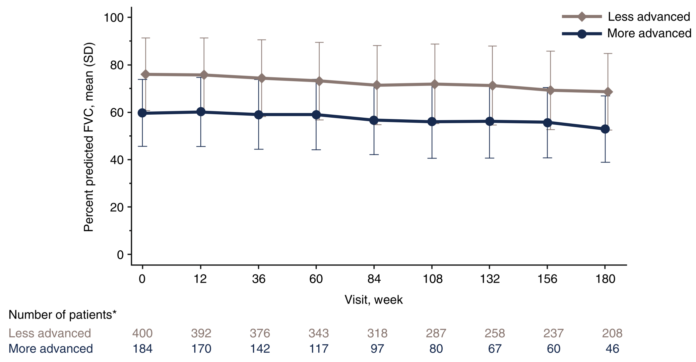
More advanced vs Less advanced IPF
Pirfenidone 장기투여 후 폐기능저하속도는 유사함
Respiratory Research 2019;20:55

Slide 76
Adverse events
Pirfenidone의 부작용 (AEs)
Characteristics | Advanced | Non-advanced
Patient, no (%) | 187 | 409
Total | 187 (100) | 408 (99.8)
Cough | 96 (51.3) | 209 (51.1)
Dyspnea | 105 (56.1) | 162 (39.6)
Fatigue | 68 (36.4) | 164 (40.1)
Worsening of IPF | 109 (58.3) | 112 (27.4)
Nausea | 56 (29.9) | 154 (37.7)
Diarrhea | 44 (23.5) | 123 (30.1)
Dizzness | 39 (20.9) | 105 (25.7)
Headache | 37 (19.8) | 98 (24.0)
Back pain | 36 (19.3) | 91 (22.2)
Dyspepsia | 26 (13.9) | 96 (23.5)
Respiratory Research 2019;20:55

Slide 77
Pirfenidone 투약 중단사유
Reasons for discontinuation
Characteristics | Advanced | Non-advanced
Patient, no | 187 | 409
All reasons | 134 (71.7) | 177 (43.3)
Adverse events | 81 (43.3) | 110 (26.9)
related to IPF | 26 (13.9) | 21 (5.1)
not related to IPF | 55 (29.4) | 89 (21.8)
Withdrawl by patient | 16 (8.6) | 35 (8.6)
Death | 20 (10.7) | 13 (3.2)
Lung transplantation | 12 (6.4) | 14 (3.4)
Physician decision | 5 (2.7) | 3 (0.7)
Other | 0 (0.0) | 2 (0.5)
Respiratory Research 2019;20:55

Slide 78
항섬유화제 치료를 언제 중단할 것인가?
효과가 없을 때 ??
  FVC 감소 ≥ 10%
견디기 힘든 부작용이 지속될 때

Slide 79
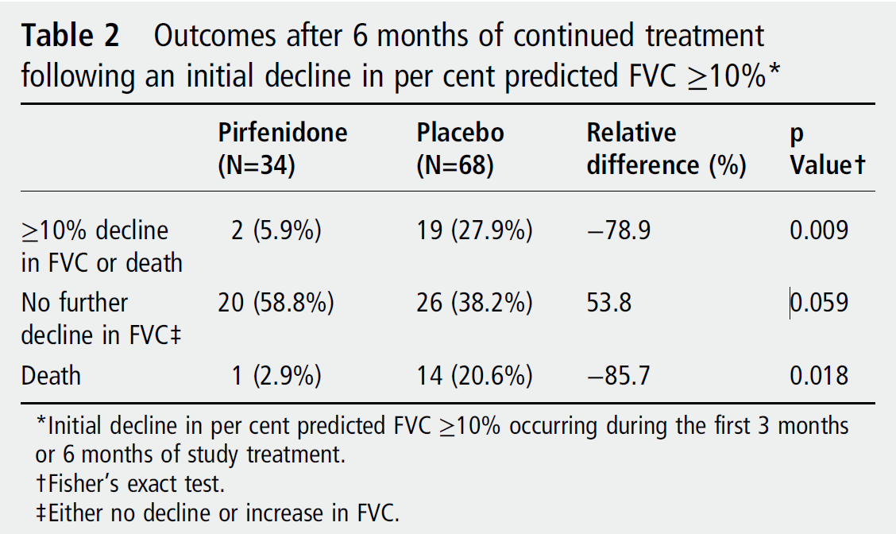
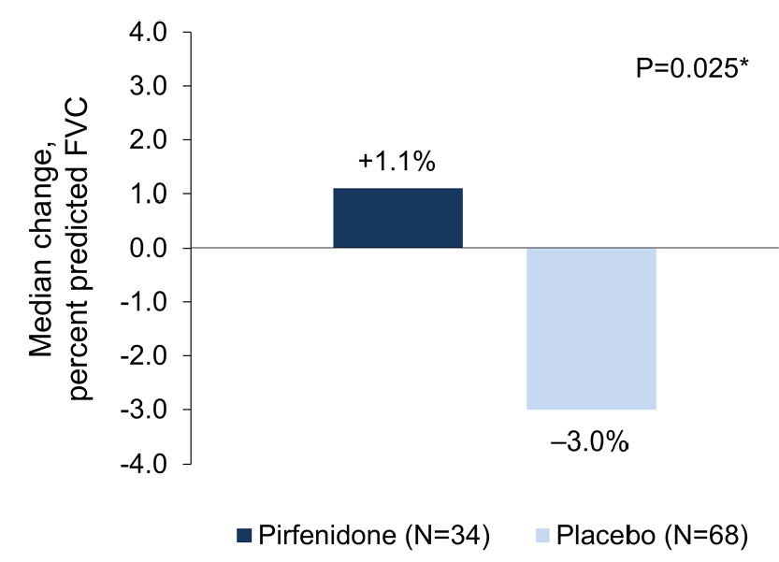
CAPACITY+ASCEND
Pirfenidone치료 6개월 후 FVC 10% 이상 감소한 경우
Pirfenidone 지속치료의 효과는?

Slide 80
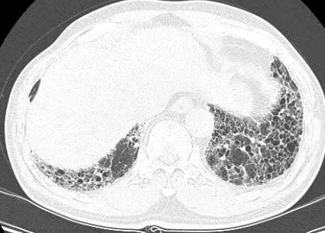
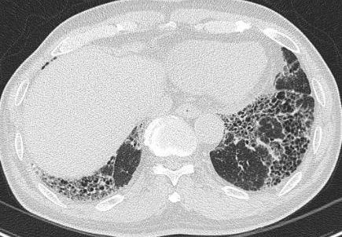
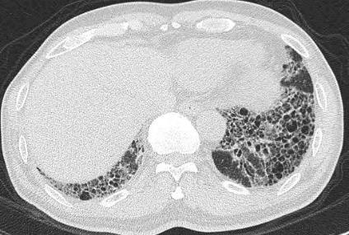
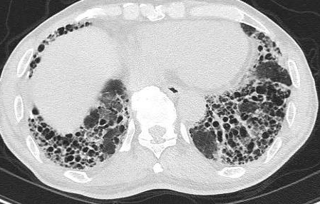
증례 2 : 65/M
2014.11 (FVC 65%) Pirfenidone
2015.11 (67%) Nintedanib 150mg bid
2017.3 (62%) -> 2017.9 (59%)
2018.7 (51%) -> 2019.2 (37%)

Slide 81
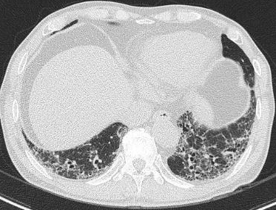
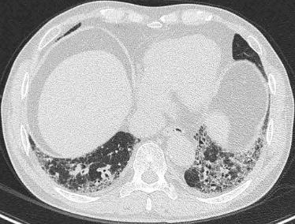
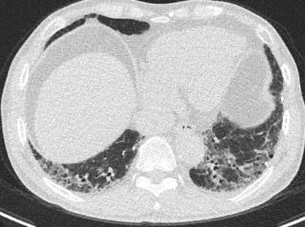

증례 3 : 66/M
2017.2 (67%) 외과적폐생검 : UIP
Pirfenidone started
2016.7 (FVC 81%)
2018.2 (70%)
2019.2 (71%)

Slide 82

Pirfenidone 안전성 및 내약성관련 장기관찰연구들

Slide 83

Summary of ADRs With Incidence in ≥ 5%
RECAP vs.CAPACITY 004/006 and ASCEND Trials
Rate per 100 PEY (100명의 투여환자가 1년간 약제투여 시 부작용 발생빈도)
  GI : nausea, dyspepsia, anorexia, diarrhea, GERD
  Skin : rash, photosensitivity reaction
  Others: Decreased appetite, headache, dizziness
Notes:
관찰연구 : 자주 추적안하니 보고율이 떨어질 수 있다

Slide 84

US Expanded Access Program (EAP)

Slide 85

US EAP
Multicenter, open-label, single-arm Expanded Access Program
To further evaluate the safety of pirfenidone in patients with IPF in real-world clinical practice in the US
2014.04-2015.05
Pirfenidone 2403 mg/day
Mean (SD) duration: 22.8 (9.6) weeks

Slide 86

Total 1620 patients
Complete: 1221 (75.4%)
Discontinuation: 399 (24.6%)
  ADR/SADR: 210 (13.0%)
Dose reduction: 364 (22.5%)
Interruption: 227 (14.0%)
  Mean duration of interruptions: 13.4 days
*EOS: End of study

Slide 87

Pirfenidone의 약물 부작용

Slide 88

약물부작용의 발생율 new-onset nausea, fatigue, or diarrhea
Notes:
Skin, photosensitivity는 첫발생 median 80-90일 (투여 2-3개월째 발생)

Slide 89

나이에 따른 약물 부작용의 빈도
Severe ADRs
: those causing marked limitation in activity, some assistance usually required, medical intervention/therapy required, hospitalization possible
Notes:
patients with ⩾1 ADR was observed, with the highest percentage
in patients aged ⩾80 years

Slide 90

항섬유화제를 투여를 장기적으로 유지하는 비결은 ?
IPF
Mild
Moderate
Severe
부작용에 대한 적절한 대응과 조치

Slide 91
Pirfenidone 투여관련 약물부작용의 단계적 예방과 대처
1
Patient education, AE prevention and management with prophylactic therapy
2
If AEs occur and symptoms to not resolve: dose adjustment until symptoms are resolved
3
If AEs persist: temporary therapy interruption
4
Once symptoms have resolved or become tolerable: slow re-escalation to the recommended daily dose as tolerated

Slide 92

Pirfenidone 용량을 줄여도 효과는 있을까? YES

Slide 93

용량강도(dose intensity) 90% 이상, 90% 미만군에서 FVC의 시간에 따른 변화 (사후분석)
>90% Pirfenidone
≤ 90% Pirfenidone
>90% Placebo
≤ 90% Placebo
105.5 (P<0.001)
102.1 (P=0.0191)
Notes:
The mean±SEM difference in annual rate of FVC decline between pirfenidone and placebo over 52 weeks was 105.5±18.4 mL for a dose intensity of >90% (p<0.0001) and 102.1±43.4 mL for ⩽90% (p=0.0191), indicating that the benefit of pirfenidone on FVC was maintained when dose modification was needed.

Slide 94
Pirfenidone 투여관련 부작용 : 소화기
Pirfenidone-related AEs | Prevention | Management
Gastrointestinal | Taking pirfenidone with a substantial meal, specifically the full dose at the end of a meal or spreading out during a meal | Dose reductions/interruptions with a slow titration back to full dose Reduce the morning dose if nausea is experienced at that time of day Proton-pump inhibitors
Notes:
GI events, such as
nausea, vomiting and diarrhoea, typically occur early in the course of pirfenidone treatment and decline
after the first 6 months, whereas skin-related AEs, such as rash and photosensitivity, exhibit more
variability in their time course [

Slide 95


산분비억제 치료가 pirfenidone 관련 anorexia and/or nausea에 미치는 영향
Antacid: H2RA or PPI
* P<0.05

Slide 96


피부발진과 광과민성

Slide 97
Pirfenidone 투여관련 부작용 : 피부
Pirfenidone-related AEs | Prevention | Management
Skin | Continuous skin protection with clothing and broad-spectrum SPF 50 sunscreen Avoid use of other medications associated with phototoxicity | With severe phototoxicity, treat with steroids or silver sulfadiazine Dose reductions for a rash followed by discontinuation if the rash persists and a slow titration back to full dose Discontinuation if an allergic reaction to pirfenidone occurs

Slide 98
Pirfenidone 투여관련 부작용 : 간기능
Pirfenidone-related AEs | Prevention | Management
Liver | Perform AST, ALT and bilirubin tests before pirfenidone initiation Monitor at monthly intervals for the first 6 months and then every 3 months thereafter | If AST and ALT elevations (3~5 times of ULN) without symptoms or hyperbilirubinaemia ➔ reduced or interrupted until values return to normal If AST and ALT elevations 3~5 times of ULN) with hyperbilirubinaemia ➔ permanently discontinue If patients exhibit >5× ULN ➔ permanently discontinue

Slide 99
Pirfenidone 투여관련 부작용 : 약물상호작용
Pirfenidone-related AEs | Prevention
Important considerations with drug–drug interactions | For strong CYP1A2 inhibitors, such as fluvoxamine and enoxacin, pirfenidone should be reduced to 267 mg three times daily (801 mg/day) For moderate CYP1A2 inhibitors, such as ciprofloxacin at a dosage of 750 mg twice daily, pirfenidone should be reduced to 534 mg three times daily (1602 mg/day)

Slide 100
US FDA: CYP1A2
Inhibitors → Pirfenidone 혈중농도 증가
Strong inhibitors | Moderate inhibitors | Weak inhibitors
Ciprofloxacin, enoxacin, fluvoxamine, zafirlukast | Methoxalen, mexietine, oral contraceptives | Avyclovir, allopurinol, cimetidine, peg-INF a-2a, piperine, zileuton
Inducers → Pirfenidone 혈중농도 감소
Strong inducers | Moderate inducers | Weak inducers
- | Phenytoin, rifampin, ritonavir, smoking, teriflunomide | -
Notes:
Tobacco smoking : pirfenione level 을 감소시킴

Slide 101

CYP1A2 substrates, inhibitors, and inducers

Slide 102

약물 상호 작용 - Pirfenidone

Slide 103



흡연/ 브로콜리
: pirfenidone 혈중 농도 감소
자몽주스
: pirfenidone 혈중 농도 증가

Slide 104

Conclusions: Diagnosing & Treating IPF
HRCT로 ILD가 확인되면 자세한 임상정보를 수집하여 ILD의 원인요인을 배제하여야 한다
특발간질폐렴(IIP)과 비특발간질폐렴을 구분하는 것은 치료와 예후예측에 매우 중요하다
항섬유화제 치료는 다양한 IPF 군 모두에서 효과를 보이며 최대한 빨리 시작해야 한다
성공적인 항섬유화제 치료를 위해서는 환자 교육과 부작용의 예방과 대처가 필수적이다

Slide 105
끝까지 들어 주셔서 감사드립니다

