Slide 1
Personalized Medicine in Asthma
양산부산대학교병원 호흡기알레르기내과
이 승 은

Slide 2
Case (F/39)
CC) 야간 호흡곤란
PI) 3년 전 천식 진단. Seretide 100 qd 1회 유지 + 추가 사용
한 달 뒤 본원 이비인후과 ESS op 예정.
최근 일주일 야간 호흡곤란, 기침, 가래. 주간 증상 +
6개월 전 초여름에 악화되어 추가 약 복용한 적 있음.
PHx) 알레르기 비염 (본원 이비인후과 AR, CRS /c NP), Avamys 사용 중, 경구약 없음.
SHx) non-smoker, 과외
PEx) wheezing +

Slide 3
검사 소견
PFT FEV1/FVC 73% FEV1 92% FVC 105% normal
MBPT + PC 20 8.01
FeNO 196 ppb
Chest PA NALL
Blood eosinophil 100/uL
IgE 711 IU/ml
MAST allergy Dp 4+ Df 5+ peach 2+ apple 1+ birch 0

Slide 4
Assessment/Plan
Asthma (uncontrolled, atopic, non-smoker, eosinophilia (-), exacerbation x1/yr)
CRS /c NP
Seretide 250 bid로 증량 + prn SABA + LTRA

Slide 5
Concept

Slide 6
Personalized medicine in asthma
Personalized medicine in asthma
= Identifying and managing various treatable traits in an individual with asthma
Specific clinical characteristics에 근거한 천식 치료제의 선택
+ 다양한 천식의 합병증, 동반 질환, 이와 연관된 생활 습관이나 환경의 조절
> > 천식 증상의 조절, 악화 감소, 삶의 질 향상
Notes:
개인 맞춤의학
규명하고 조절가능한 phenotypic, endotypic 특성 > treatable trait

Slide 7
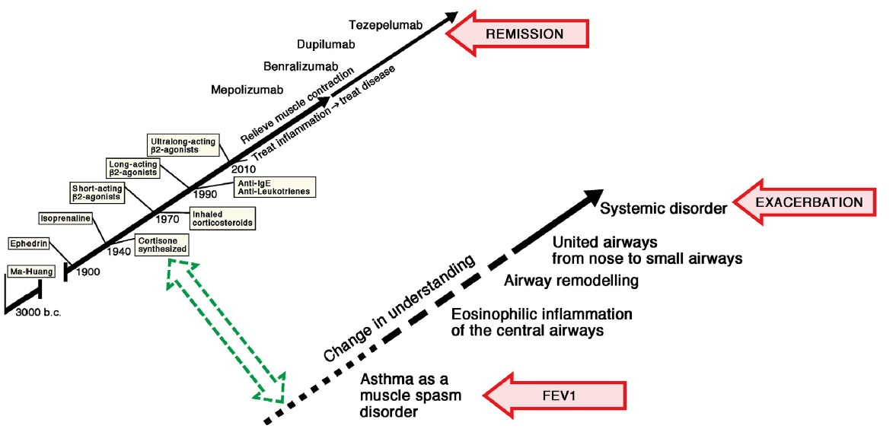
Evolution of asthma treatment and evaluation outcome
J Allergy ClinImmunol 2023;152:835-40

Slide 8

Role of the advent of biologics in asthma treatment
Identification of variable
clinical and immunopathologic
characteristics
Introduction of the concept of
disease-modifying and
asthma remission
Precise targeting of specific
immunopathological
mechanisms
Efficacy와 safety에 대한 evidence, cost effectiveness를 넘어선 biologics 사용
J Allergy ClinImmunol 2023;152:835-40, J Allergy Clin Immunol Pract 2023;11:1771-2

Slide 9
Contents
Treatable traits (TTs) 정의, 특성, 종류
TTs prevalence
TTs intervention의 effect
TT strategy의 임상적 적용
Notes:
어디까지, 문제인지, 어떤 방향으로 가야하는지

Slide 10
Treatable traits in chronic airway diseases
Treatable trait (TT)
= A recognizable phenotypic or endotypic characteristic that can be assessed and
successfully targeted by therapy to improve a clinical outcome in a patient with airway disease
TTs can coexist in the same patient, so they are not mutually exclusive
TT strategy proposes to investigate in each individual patient with chronic airway disease the number and type of TTs present and to treat each of them according to guideline recommendations
J Allergy Clin Immunol Pract 2023;11:713-23
Notes:
호흡기 질환 환자의 임상 결과를 개선하기 위해 평가되고 치료의 타겟이 될 수 있는 인식 가능한 표현형적 또는 내적 특성
TT는 같은 환자에서 공존할 수 있으므로 서로 배타적이지 않습니다.
TT 전략은 만성 호흡기 질환이 있는 각 개인 환자에서 존재하는 TT의 수와 유형을 조사하고, 이를 지침 권장사항에 따라 각각 치료할 것을 제안합니다.

Slide 11
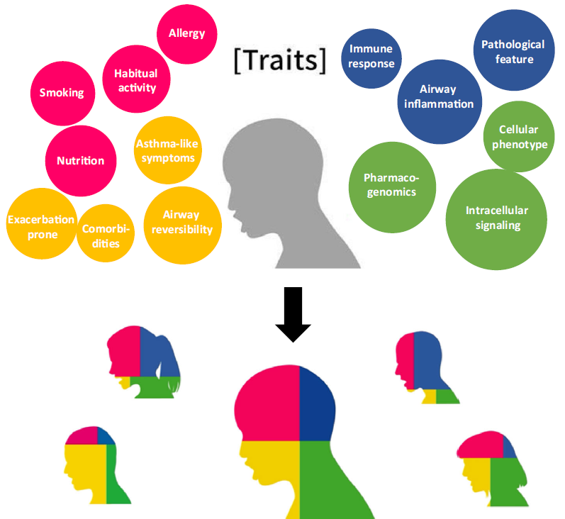
Key components of treatable traits
Relevant
(clinical relevance with outcome)
2. Detectable
(through validated trait identification markers)
Treatable
(effective treatment is available and accessible)
J Allergy Clin Immunol Pract 2023;11:713-23, Internalmedicine.3353-23
Notes:
임상적 관련성, 즉 악화, 삶의 질 또는 폐 기능 저하와 같은 중요한 임상적 결과와 연관되어 있다는 것을 의미한다; (2) "표현형적으로"(즉, 임상적으로; 예를 들어, 컴퓨터 단층촬영에서 발견된 폐기종의 존재) 탐지 가능하며, 검증된 특성 식별 마커(TIMs)를 통한 중요한 인과 경로(엔도타입)에 대한 깊은 이해를 바탕으로 할 수 있다(예를 들어, 혈중 호산구 수치, 후술됨); (3) 치료 가능성, 즉 효과적인 치료가 이용 가능하고 접근 가능하며, 시행 시 기도 질환 환자에게 임상적으로 중요한 결과를 가져온다는 것을 의미한다.
A well-recognized example of a TT is eosinophilic airway inflammation.

Slide 12
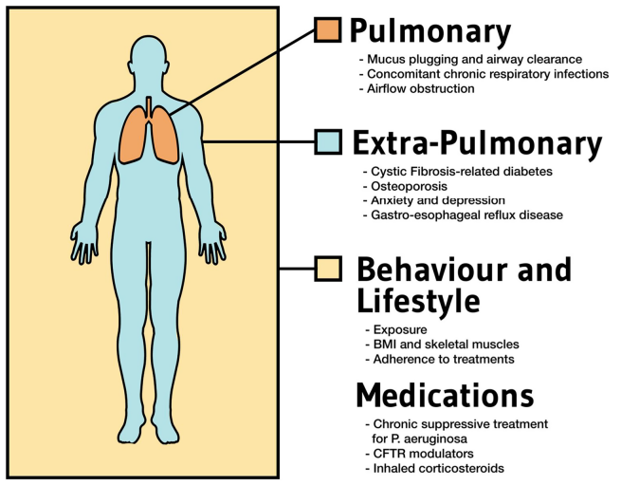
Potential TTs
Pulmonary traits
Extrapulmonary traits
Behavioral/risk factors traits
Respiratory Research (2023) 24:316

Slide 13
Targeting treatable traits in severe asthma
Traits |  | Trait identification marker
Pulmonary | airflow limitation, airway inflammation, frequent chest infection, pathogen colonization, mucus hypersecretion, oxygen desaturation, dyspnea, systemic allergic inflammation | FEV1/FVC, FEV1, sputum eosinophil, sputum neutrophil, antibiotics Tx Hx, sputum culture, mucus volume, SpO2 during 6MWT, MMRC, serum IgE
Extrapulmonary | dysfunctional breathing, anemia, systemic inflammation, daytime sleepiness, obesity, depression or anxiety, significant medical history, cardiac history, vocal cord dysfunction | Hb, hsCRP, Epworth sleep score, BMI, Hospital Anxiety and Depression scale, patient self-reported other medical conditions
Risk factors and behavioural | absence of written action plan, exercise tolerance, bone density, smoking, sarcopenia, inhaler device polypharmacy, inadequate inhaler device technique, nonadherence | 6MWT, T-score on BMD, smoking PY, muscle mass index, number of inhaler devices, inadequate inhaler technique, reported inhaler use < 80%
Eur Respir J 2020; 55: 1901509
Notes:
Methods: Participants (n=140) with severe asthma were recruited to a cross-sectional study and underwent a multidimensional assessment to characterise treatable traits. Eligible participants with severe asthma (n=55) participated in a 16-week parallel-group randomised controlled trial to determine the feasibility and efficacy of management targeted to predefined treatable traits, compared to usual care in a severe asthma clinic. The patient-reported outcome of health-related quality of life was the trial’s primary end-point. Main results: Participants with severe asthma had a mean±SD of 10.44±3.03 traits per person, comprising 3.01±1.54 pulmonary and 4.85±1.86 extrapulmonary traits and 2.58±1.31 behavioural/risk factors. Individualised treatment that targeted the traits was feasible and led to significantly improved health-related quality of life (0.86 units, p

Slide 14
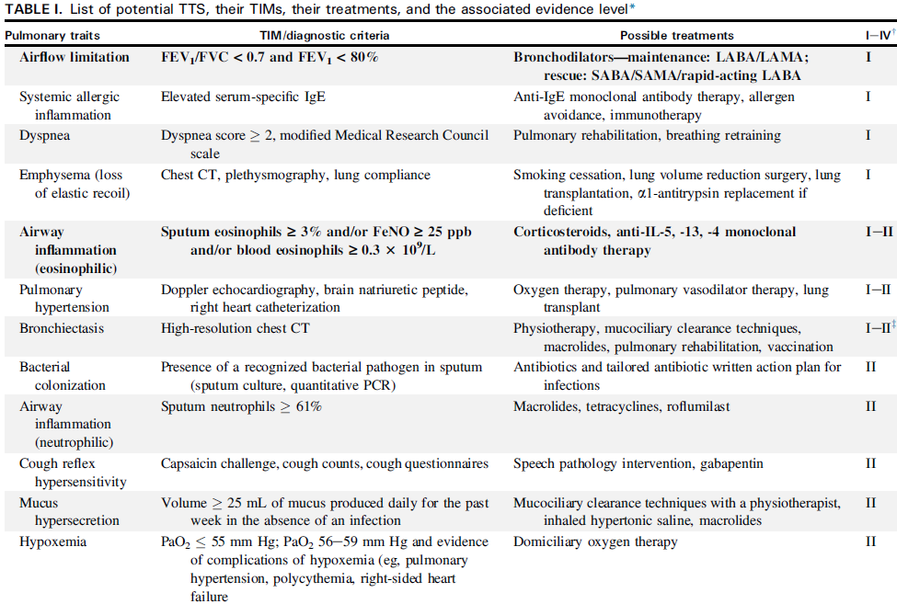
J Allergy Clin Immunol Pract 2023;11:713-23
Notes:
prevalence

Slide 15
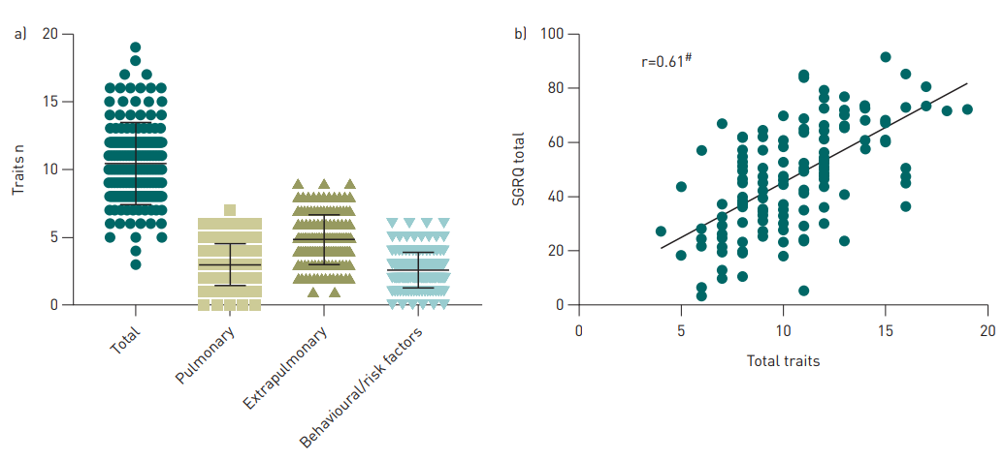
Targeting treatable traits in severe asthma
10.44
4.85
3.01
2.58
Eur Respir J 2020; 55: 1901509
Notes:
Methods: Participants (n=140) with severe asthma were recruited to a cross-sectional study and underwent a multidimensional assessment to characterise treatable traits. Eligible participants with severe asthma (n=55) participated in a 16-week parallel-group randomised controlled trial to determine the feasibility and efficacy of management targeted to predefined treatable traits, compared to usual care in a severe asthma clinic. The patient-reported outcome of health-related quality of life was the trial’s primary end-point. Main results: Participants with severe asthma had a mean±SD of 10.44±3.03 traits per person, comprising 3.01±1.54 pulmonary and 4.85±1.86 extrapulmonary traits and 2.58±1.31 behavioural/risk factors. Individualised treatment that targeted the traits was feasible and led to significantly improved health-related quality of life (0.86 units, p

Slide 16
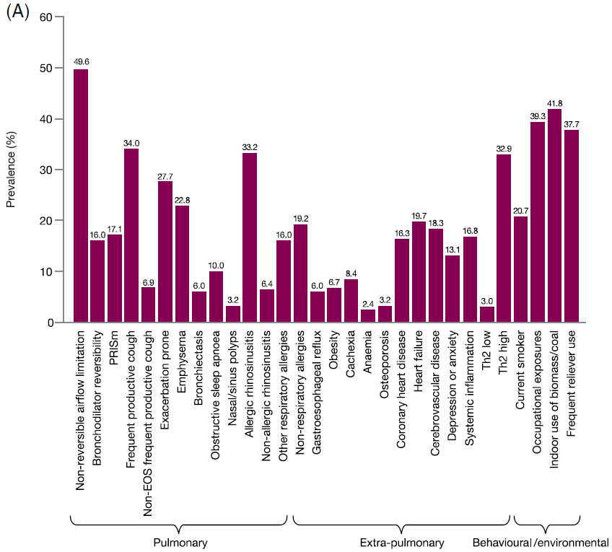
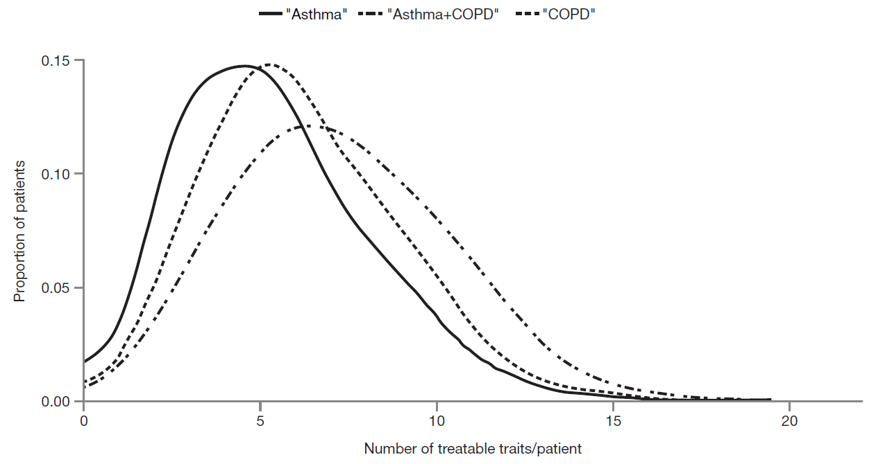
Prevalence of TTs in NOVELTY study
4.6
5.4
6.4
Respirology 2022;27:929–940
Notes:
배경 및 목적: 천식과 만성 폐쇄성 폐질환(COPD)은 흔하고 복잡한 질환으로, 개인 맞춤형 관리가 필요합니다. 치료 가능한 특징(Treatable Traits, TTs)에 기반한 전략이 제안되었으나, 실제 임상 환경에서 담당 의사가 진단한 질병의 레이블과 중증도와 TTs의 유병률 및 관계는 알려져 있지 않습니다. 우리는 특정 TTs의 존재 또는 부재가 ‘천식’, ‘COPD’ 또는 ‘천식 + COPD’의 진단 및 중증도와 어떻게 관련되는지를 평가했습니다.
방법: 저자들은 대규모 글로벌 연구인 NOVELTY 연구 코호트(NOVEL Observational Longitudinal Study; NCT02760329)에서 자주 발생하는 30개의 TTs를 선택했습니다. 이 연구는 실제 임상 환경에서, 1차 의료 기관과 전문 센터에서 모두 ‘천식’(n = 5932, 52.8%), ‘COPD’(n = 3898, 34.7%) 또는 두 가지 모두 (‘천식 + COPD’; n = 1396, 12.4%)를 가진 환자의 데이터를 체계적으로 수집했습니다.
결과: 결과는 다음을 나타냅니다. (1) 평가된 30개의 TTs의 유병률은 크게 다양했으며, 환자당 평균 ± 표준편차는 ‘천식’에서 4.6 ± 2.6, ‘COPD’에서 5.4 ± 2.6, ‘천식 + COPD’에서 6.4 ± 2.8로 나타났습니다(p < 0.0001); (2) 전 세계적으로 큰 지리적 차이는 없었지만, 1차 진료소와 전문 클리닉에서의 TTs 유병률은 달랐습니다; (3) 여러 TTs는 질병의 진단 및 중증도와 관련이 있었지만, 많은 TTs는 그렇지 않았습니다; (4) TTs의 존재 및 부재는 임상의가 진단을 내리고 중증도를 평가하는 데 인식되는 패턴을 형성했습니다.
결론적으로, 이 분석은 현재까지 실제 임상 환경에서 기도 질환을 가진 환자들의 TTs에 대한 가장 크고 세밀한 특성을 제공합니다. 이 연구는 몇몇 TTs가 ‘천식’(알레르기 및 비알레르기성 비부비동염, 비강 용종 및 여러 알레르기) 또는 ‘COPD’(비가역적 기류 제한 및 폐기종)라는 질병 레이블과 밀접하게 연결되어 있음을 보여주는 한편, 많은 다른 TTs는 진단 레이블과 무관하게 발생한다는 것을 시사합니다. 마찬가지로, 일부 TTs의 유병률은 담당 의사가 평가한 질병 중증도에 따라 달라지지만, 모든 TTs가 그렇지는 않습니다.

Slide 17
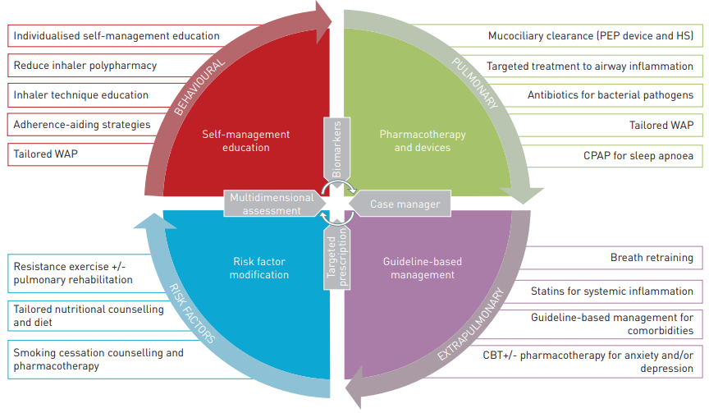
Components of the multidimensional assessment intervention
Eur Respir J 2020; 55: 1901509
Notes:
TT strategy effect?

Slide 18
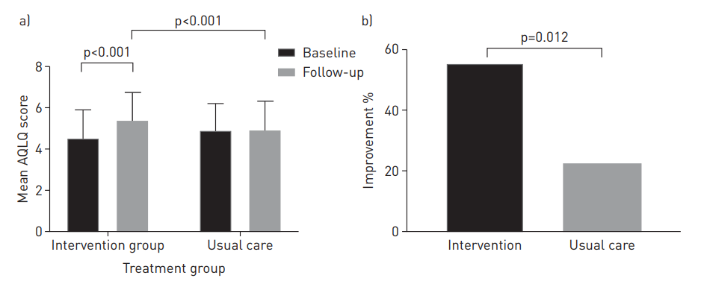
Effect of multidimensional assessment intervention
Eur Respir J 2020; 55: 1901509

Slide 19
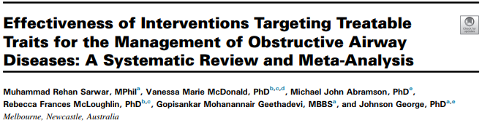
Added treatable traits
pulmonary: chronic bronchitis, emphysema, bronchiectasis, lung structure abnormality
extrapulmonary: GERD, sinusitis, DM, cancer, arthritis, underweight, malnutrition, disability
behavioral/lifestyle risk factors: poor family and social support
Trait identification marker
FeNO, HRCT…
J Allergy Clin Immunol Pract 2022;10:2333-45
Notes:
BACKGROUND: The management of obstructive airway diseases (OADs) is complex. The treatable traits (TTs) approach may be an effective strategy for managing OADs. OBJECTIVE: To determine the effectiveness of interventions targeting TTs for managing OADs. METHODS: Ovid Embase, Medline, CENTRAL, and CINAHL Plus were searched from inception to March 9, 2022. Studies of interventions targeting at least 1 TT from pulmonary, extrapulmonary, and behavioral/lifestyle domains were included. Two reviewers independently extracted relevant data and performed risk-of-bias assessments. Meta-analyses were performed using random-effects models. Subgroup and sensitivity analyses were carried out to explore heterogeneity and to determine the effects of outlying studies. RESULTS: Eleven studies that used the TTs approach for OAD management were identified. Traits targeted within each study ranged from 13 to 36. Seven controlled trials were included in meta-analyses. TT interventions were effective at improving health-related quality of life (mean difference [MD] [ L6.96, 95% CI: L9.92 to L4.01), hospitalizations (odds ratio [OR] [ 0.52, 95% CI: 0.39 to 0.69), all-cause-1-year mortality (OR [ 0.65, 95% CI: 0.45 to 0.95), dyspnea score (MD [ L0.29, 95% CI: L0.46 to L0.12), anxiety (MD [ L1.61, 95% CI: L2.92 to L0.30), and depression (MD [ L2.00, 95% CI: L3.53 to L0.47). CONCLUSION: Characterizing TTs and targeted interventions can improve outcomes in OADs, which offer a promising model of care for OADs

Slide 20
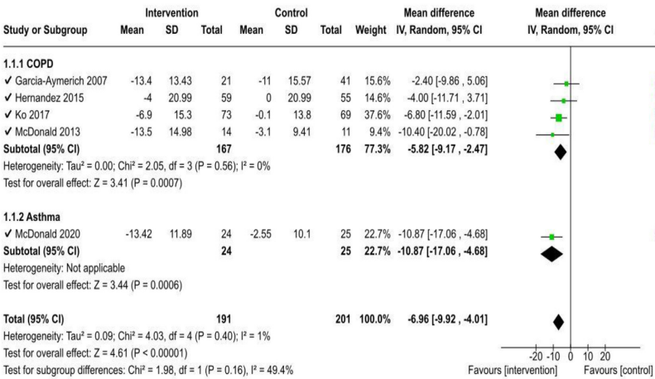
Effects of the interventions on health outcomes
J Allergy Clin Immunol Pract 2022;10:2333-45
Notes:
FIGURE 2. Health-related quality of life (HRQoL): St. George’s Respiratory Questionnaire (SGRQ) total score and subgroup analysis based on the study population
Subgroup analyses based on the study population, duration of follow-up, and study settings were performed. Statistically and clinically significant favorable effects of intervention on changes in SGRQ total scores were found for both COPD (MD ¼ 5.82, 95% CI: 9.17 to 2.47) and asthma (MD ¼ 10.9, 95% CI: 17.1 to 4.68, Figure 2). Significant (statistically and clinically) favorable effects of the intervention on HRQoL were observed for both shortemedium term (6 months) (MD ¼ 11.3, 95% CI: 16.6 to 5.97) and long-term studies (>6 months) (MD ¼ 5.19, 95% CI: 8.76 to 1.62, see Figure E1 in this article’s Online Repository at www.jaci-inpractice.org). Only studies conducted in tertiary care settings had statistically and clinically significant effects on HRQoL (MD ¼ 7.48, 95% CI: 10.92 to 4.05
Hospitalization, all-cause mortality, Sx (dyspnea, anxiety, depression) 호전도 보였다.
# Asthma에서건 COPD에서건 Th2 inflammation 에 대한 biomarker가 증가되어 있을때 이를 targeting 하는 치료가 단순히 증상의 중증도에 따른 약제의 조절보다 exacerbation 을 감소시킨다는 것은 흡입기 임상 시험에서 보여주고 있다 ex captain study > marker 올라간 환자에게 더 higher dose ICS를 썼을 때 exacerbation을 줄여줬다. Moderate asthma

Slide 21
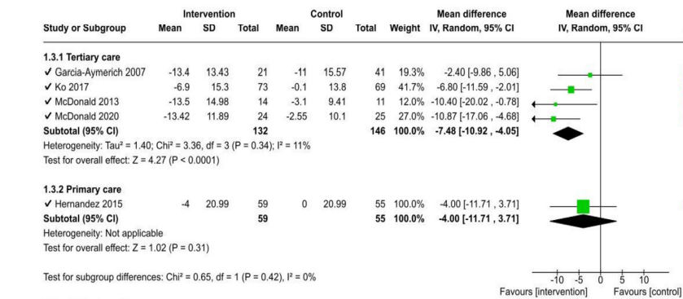
Effects of the interventions on health outcomes
J Allergy Clin Immunol Pract 2022;10:2333-45

Slide 22
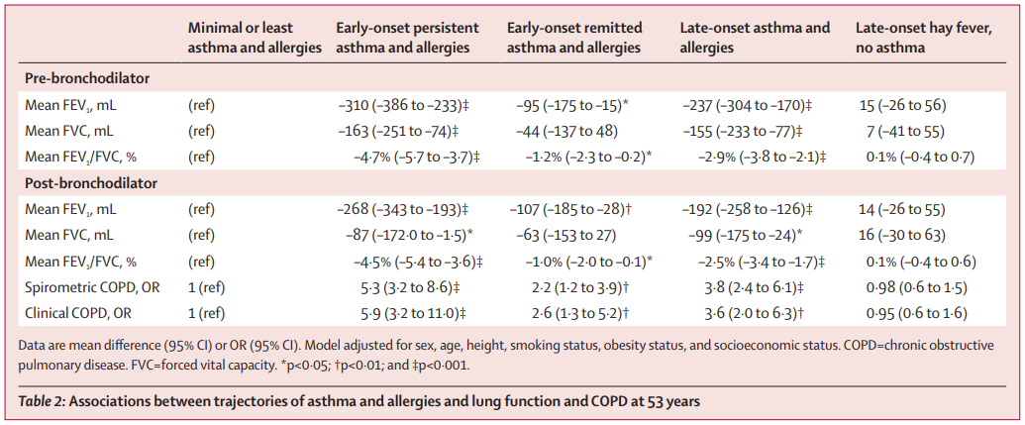
Future risk: Reduced lung function and extrapulmonary comorbidity
In the Tasmanian Longitudinal Health Study
Lancet Respir Med 2020; 9: 387–96
Notes:
TT strategy의 효과, 3600명, 7 – 53 allergy, asthma onset, PFT
Both spirometrically defined and clinical COPD were most strongly associated with the early-onset persistent asthma and allergies trajectory (odds ratio [OR] 5·3 [95% CI 3·2–8·6]) and also with the late-onset asthma and allergies trajectory (OR 3·8 [2·4–6·1]).

Slide 23
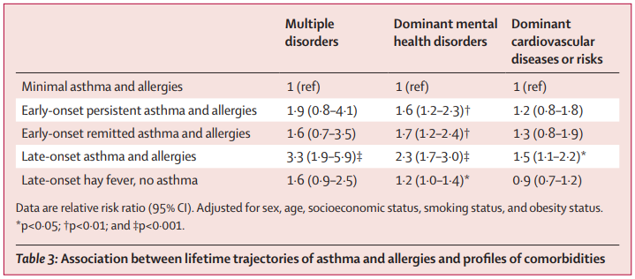
Future risk: Reduced lung function and extrapulmonary comorbidity
In the Tasmanian Longitudinal Health Study
Lancet Respir Med 2020; 9: 387–96
Notes:
The late-onset asthma and allergies trajectory was predominantly associated with the multiple disorders profile (relative risk ratio 3·3 [95% CI 1·9–5·9]),
늦게 발병한 천식 및 알레르기 경로는 다중 장애 프로파일과 주로 연관이 있었으며(상대위험비 3.3 [95% CI 1.9–5.9]), 다른 천식 및 알레르기 경로는 주로 지배적인 정신 건강 장애 프로파일과만 연관이 있었습니다.
Likewise, a study in the Framingham Offspring
Cohort showed that young adults (25 years of age) with reduced
lung function were at higher risk of cardiovascular and metabolic
comorbidities and premature death.29 This highlights the potential
role of spirometry as a global health marker.
마찬가지로, Framingham Offspring 코호트 연구에서는 폐 기능이 저하된 25세의 젊은 성인들이 심혈관 및 대사 동반 질환과 조기 사망의 위험이 더 높다는 것이 밝혀졌습니다. 이는 스피로메트리(폐 기능 검사)가 전반적인 건강 지표로서 잠재적인 역할을 할 수 있음을 강조합니다.

Slide 24
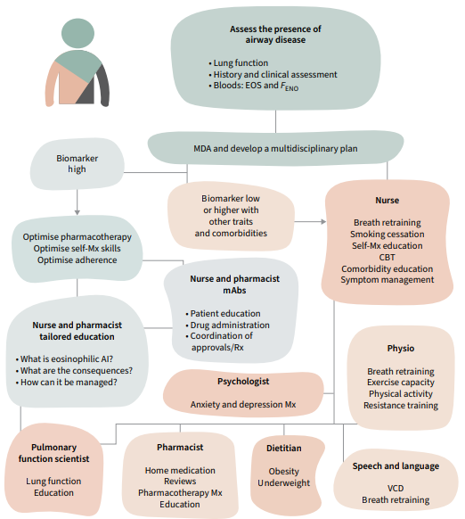
Multidisciplinary care in chronic airway diseases
In primary care or LMIC,
minimum number of traits:
T2 inflammation, airflow limitation,
smoking, inhaler device technique
/adherence, and key comorbidities/risk
factors,such as high body mass index
(BMI) and physical inactivity
vs.
ERJ Open Res 2022; 8: 00215-2022
Notes:
Example of a patient’s journey and how different members of the multidisciplinary team are involved in the patient’s care. AI: airway inflammation; CBT: cognitive behavioural therapy; EOS: eosinophils; FENO: exhaled nitric oxide fraction; MDA: multidisciplinary assessment; mAb: monoclonal antibody; Mx: management; Rx: prescription; VCD: vocal cord dysfunction. Content reproduced with permission from the Centre of Excellence in Treatable Traits, originally developed as part of the Centre of Excellence in Treatable Traits (https://treatabletraits.org.au) the Newcastle model

Slide 25
Emerging concept: Supertraits
Adherence/inhaler device technique
T2 inflammation
High BMI/obesity
Smoking
+……
J Allergy Clin Immunol Pract 2023;11:713-23
Notes:
이러한 특성들은 다른 특성을 효과적으로 관리하기 위해 반드시 식별하고 치료해야 하는 중요한 요소들이며, 치료 효과가 매우 커서 관리가 필수적인 특성들입니다. 이 특성들은 한 번 식별되고 치료되면 겉보기에 관련이 없어 보이는 다른 특성들의 개선으로 이어질 수 있습니다. 이러한 특징들을 지닌 초특성(supertraits)의 예는 다음과 같습니다.

Slide 26
To Practice

Slide 27
What is challenging about implementation?
TT strategy가 연구를 통해 증명되고 실제 임상에 적용되려면 17 ~ 20년?
1차 진료에서 적용하기 어렵다?
Cost?
J Allergy Clin Immunol Pract 2023;11:713-23

Slide 28
What is challenging about implementation?
TT strategy가 연구를 통해 증명되고 실제 임상에 적용되려면 17 ~ 20년?
CVD risk assessment (blood pressure, cholesterol, age, smoking): 1990년대 1차 진료에서 성공적으로 구현
유사한 방식으로 FeNO, blood eosinophil, asthma control, smoking, FEV1, adherence, beta 2 overuse 등으로 annual asthma attack rate를 예측
https://www.oraclescore.com/en/quiz
J Allergy Clin Immunol Pract 2023;11:713-23

Slide 29
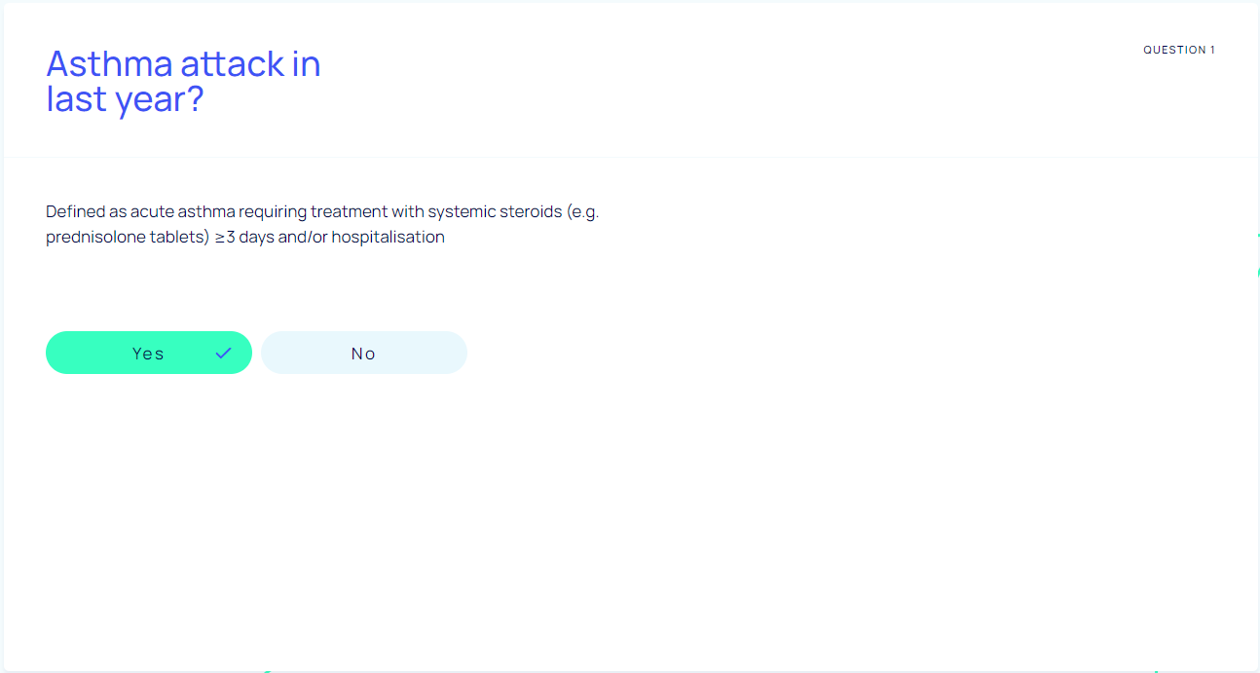
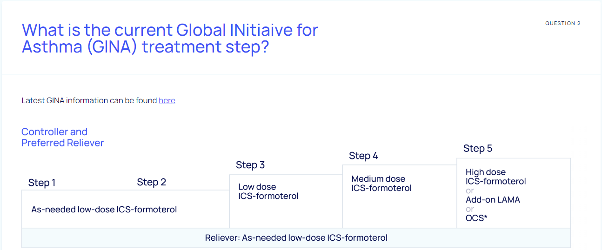
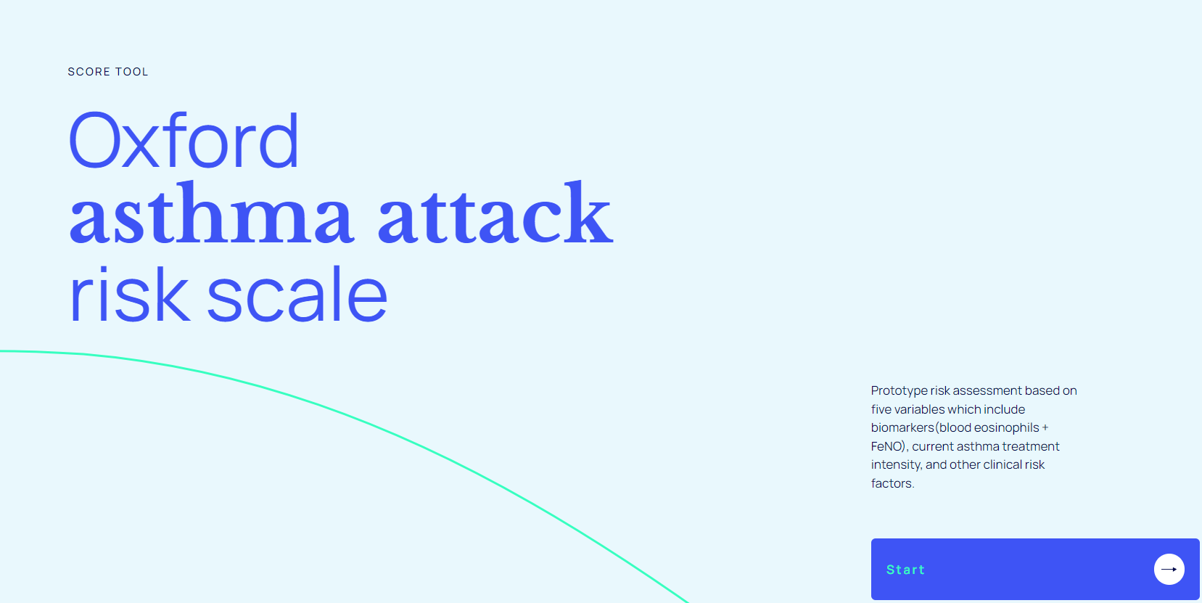
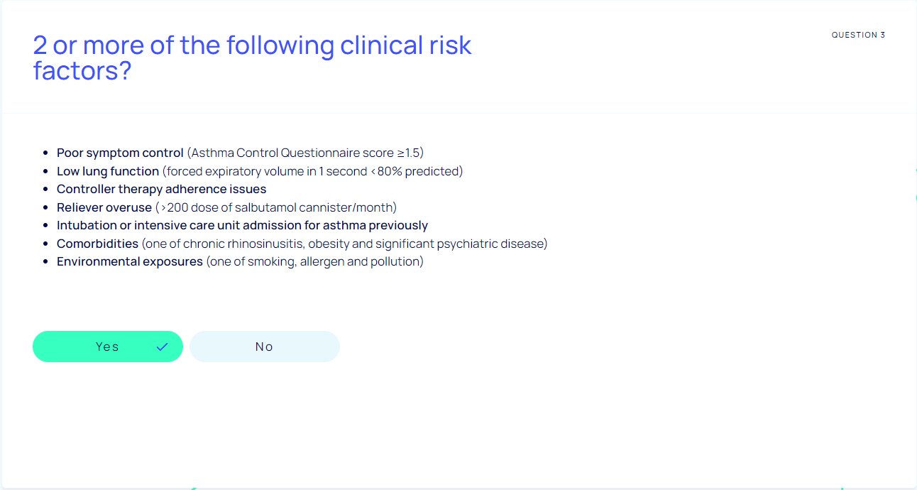
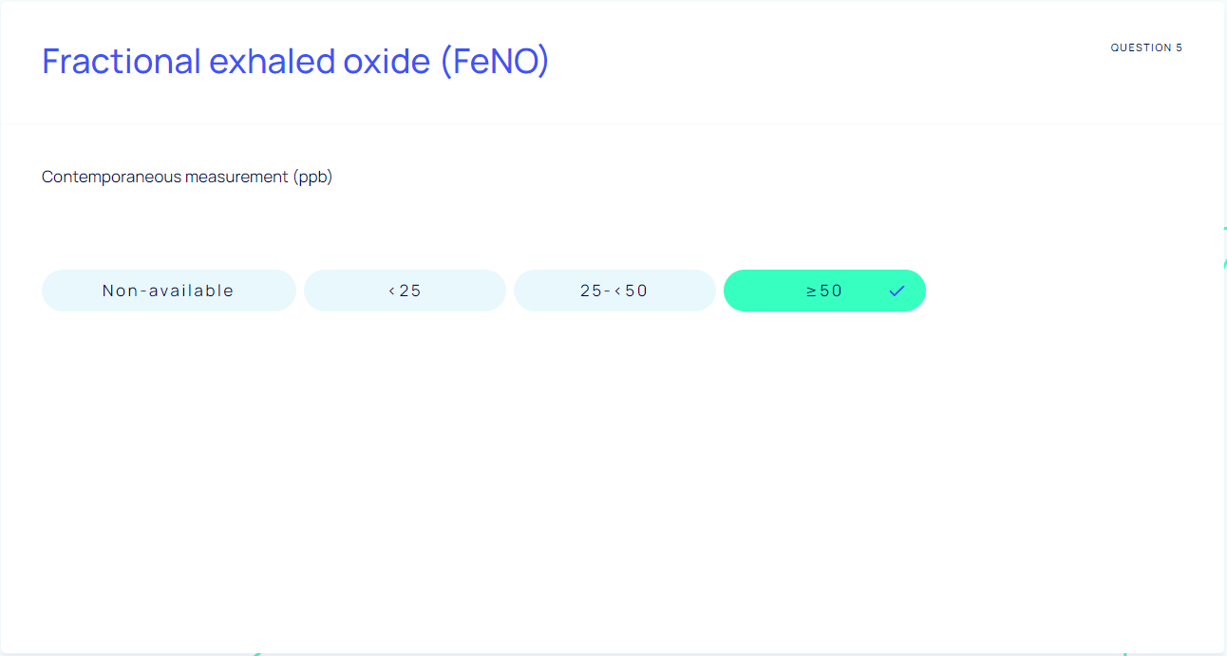
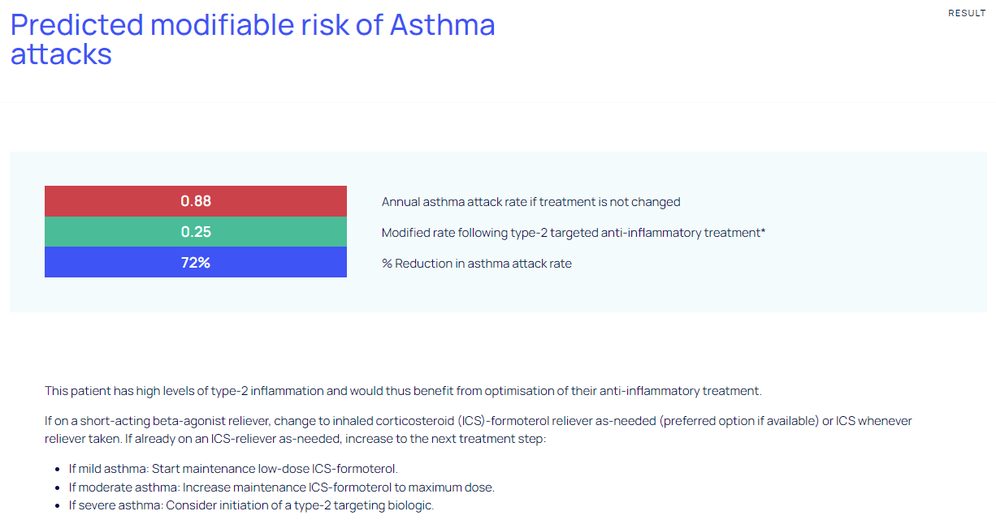
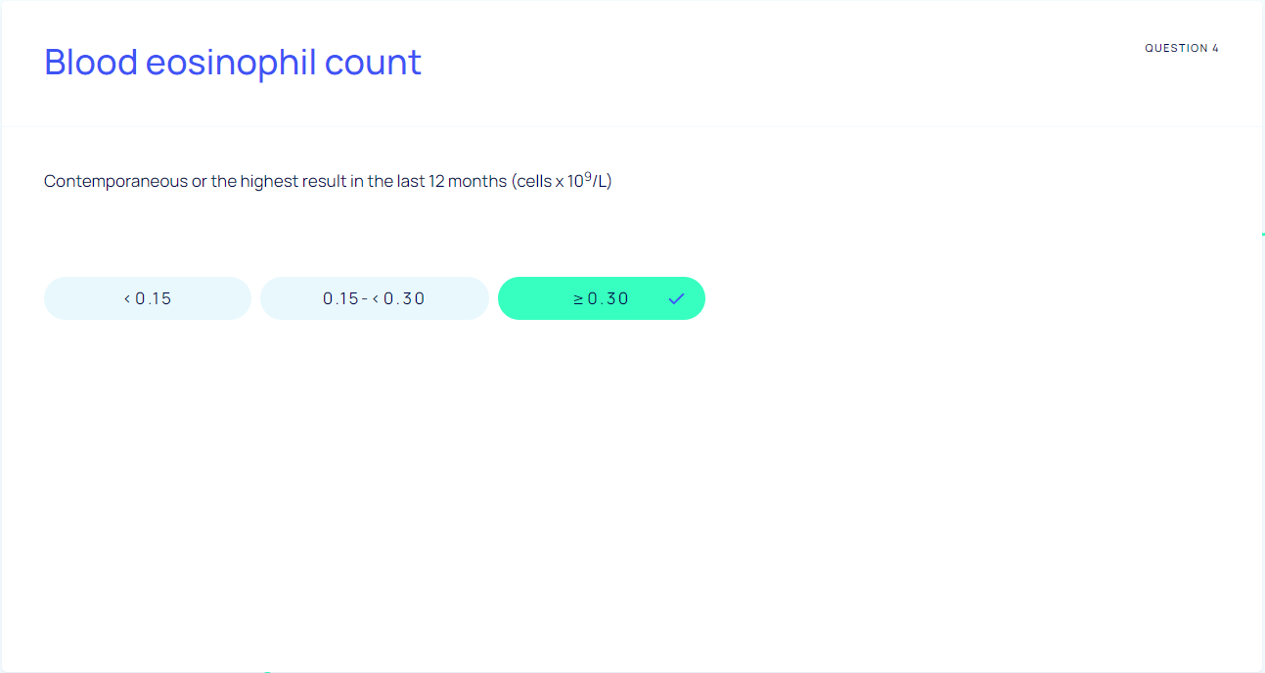
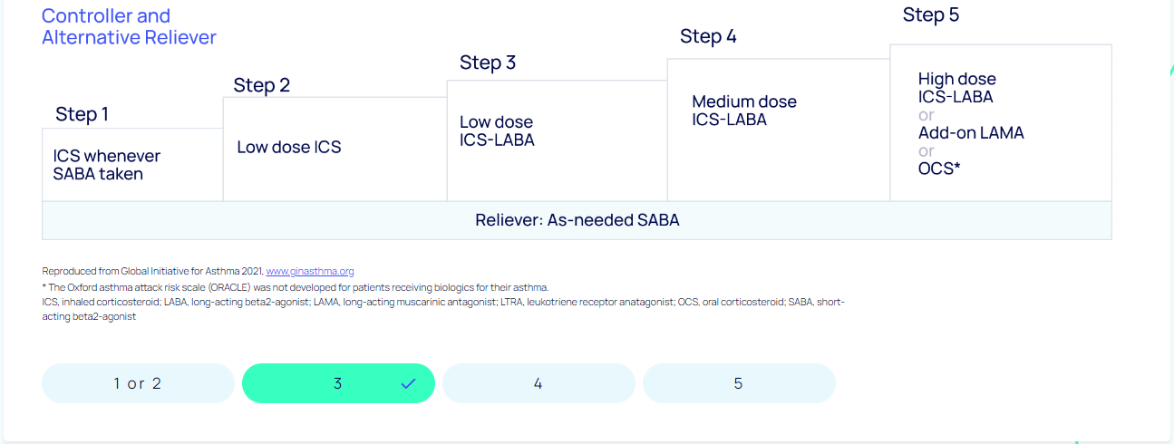

Slide 30
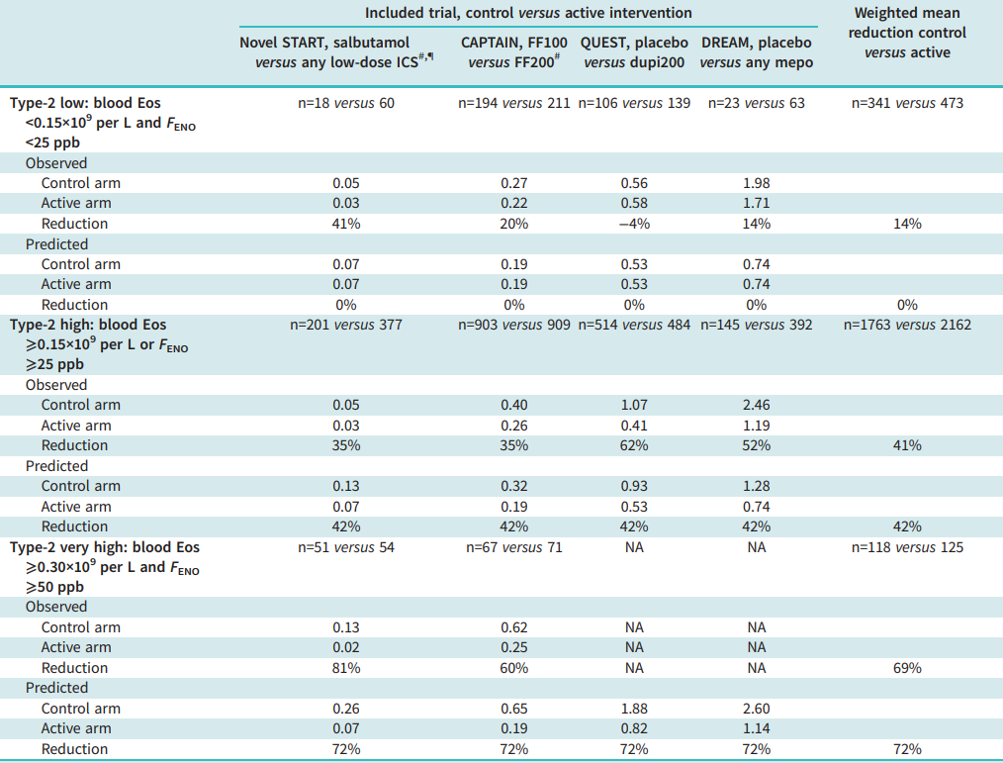
ERJ Open Res 2022; 8: 00570-2021

Slide 31
What is challenging about implementation?
1차 진료에서 적용하기 어렵다?
TT strategy model 자체가 환경과 이용 가능한 자원에 따라 달라져야 함.
위험도 예측에 우선 순위가 있는 TTs, primary care에서도 평가 가능한 TTs
1차 기관에서 적용 후 조절 안되면 referral
supertraits
J Allergy Clin Immunol Pract 2023;11:713-23

Slide 32
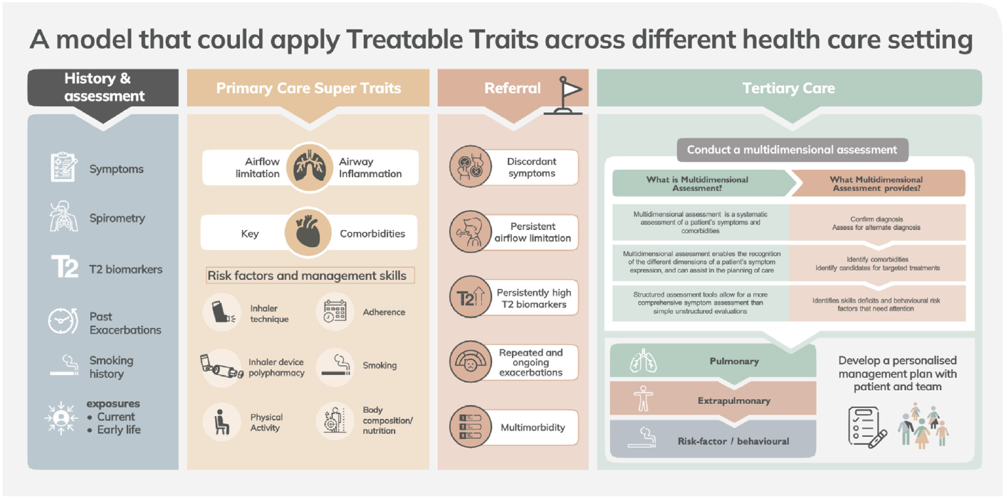
Centre of Excellence in Treatable Traits [https://treatabletraits.org.au] J Allergy Clin Immunol Pract 2023;11:713-23

Slide 33
What is challenging about implementation?
Cost?
no health economic analysis of TTs versus usual care
초기 비용 증가
exacerbations, health care utilization, QALY 등을 고려하면 cost-neutral
J Allergy Clin Immunol Pract 2023;11:713-23
Notes:
질보정수명(QALY)에 미치는 영향

Slide 34
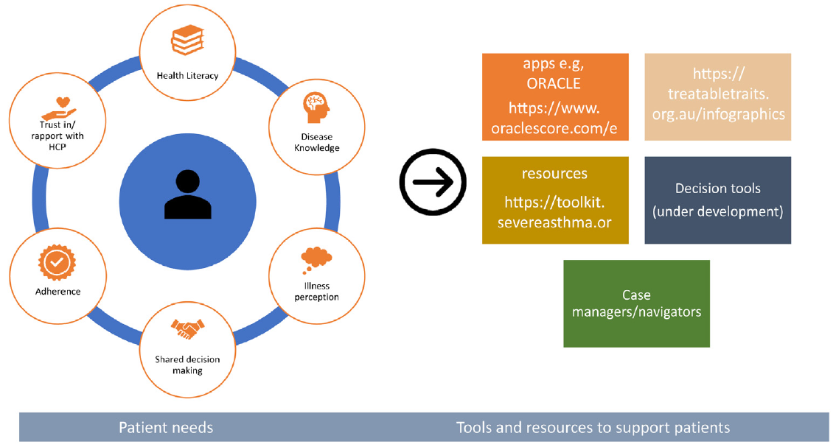
What are the key elements for implementation?
시스템 + 환자 + 제공자
Centre of Excellence in Treatable Traits [https://treatabletraits.org.au] J Allergy Clin Immunol Pract 2023;11:713-23

Slide 35
Summary
Personalized medicine in asthma
= Identifying and managing various treatable traits in an individual with asthma
Treatable trait (TT)
= A recognizable phenotypic or endotypic characteristic that can be assessed and
successfully targeted by therapy to improve a clinical outcome in a patient with airway disease
TT strategy proposes to investigate in each individual patient with chronic airway disease the number and type of TTs present and to treat each of them according to guideline recommendations
TT strategy can improve disease-associated QOL, asthma control status and future risk

Slide 36
Case (F/39)
CC) 야간 호흡곤란
PI) 3년 전 천식 진단. Seretide 100 qd 1회 유지 + 추가 사용
한 달 뒤 본원 이비인후과 ESS op 예정.
최근 일주일 야간 호흡곤란, 기침, 가래. 주간 증상 +
6개월 전 초여름에 악화되어 추가 약 복용한 적 있음.
PHx) 알레르기 비염 (본원 이비인후과 AR, CRS /c NP), Avamys 사용 중, 경구약 없음.
SHx) non-smoker, 과외
PEx) wheezing +

Slide 37
검사 소견
PFT FEV1/FVC 73% FEV1 92% FVC 105% normal
MBPT + PC 20 8.01
FeNO 196 ppb
Chest PA NALL
Blood eosinophil 100/uL
IgE 711 IU/ml
MAST allergy Dp 4+ Df 5+ peach 2+ apple 1+ birch 0

Slide 38
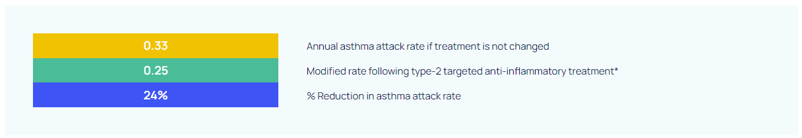
Assessment/Plan
Asthma (uncontrolled, atopic, non-smoker, eosinophilia (-), exacerbation x1/yr)
CRS /c NP
Seretide 250 bid로 증량 + prn SABA + LTRA

Slide 39
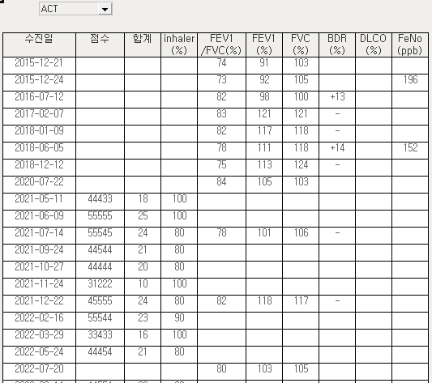
경과
이후 1년 동안 OCS 요구되는 악화 4번
High dose ICS/LABA 변경, H1RA po 추가
===========================================================================
여름 3개월 과일 도매 업무 보조, 주로 복숭아 취급
ESS 후에도 nasal Sx 조절되지 않음.
업무 많으면 흡입기 사용 감소, OCS 의존성 발생
Eosinophil 730 > 140 > 1420 > 990 /uL

Slide 40

경과
Asthma (uncontrolled, atopic, non-smoker, eosinophilia +, exacerbation x4/yr, allergen exposure, low compliance)
CRS /c NP, depressive disorder
LAMA add > Omalizumab

Slide 41
경청해 주셔서 감사합니다.

