Slide 1
Lurbinectedin
: A Jouney Towards the Future of SCLC Treatment
부산대병원
폐암센터/호흡기내과
엄중섭

Slide 2
Current Treatment of Small Cell Lung Cancer

Slide 3
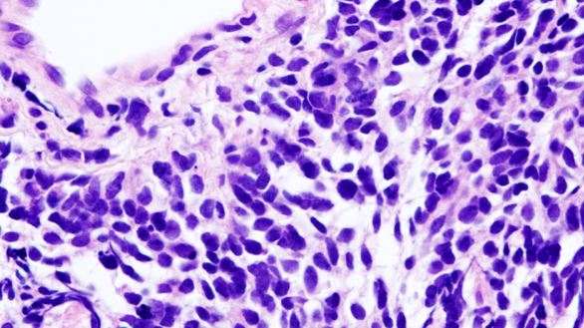
Highly sensitive to initial chemotherapy
Poor prognosis
Early metastasis
Smoking
Aggressive tumor
Comorbidities
Neuroendocrine tumor
Notes:
▪ Disease characteristics of SCLC
1. Aggressive: fast-growing tumour characterised by high mitotic rate and early metastasis, requiring rapid intervention

Slide 4
SCLC
NSCLC
Up to 100
75–90
90
80
Frequency (%)
Frequency (%)
20
29
<10
5
11
5
2
2
~2
1
Genes
Genes
Lancet. 2016 Apr 2;387(10026):1415-1426.
Clin Lung Cancer. 2016 Sep;17(5):325-333.
Crit Rev Oncol Hematol. 2015 Aug;95(2):154-64.
Notes:
▪ SCLC is characterised by multiple genetic alterations. Expression of genetic alterations can overlap since they are not mutually exclusive.
▪ Unlike NSCLC, where driver mutations have been identified and successfully treated with targeted therapy, there are no approved targeted therapies for alterations in SCLC. Mutations in SCLC are often poor therapeutic targets.

Slide 5
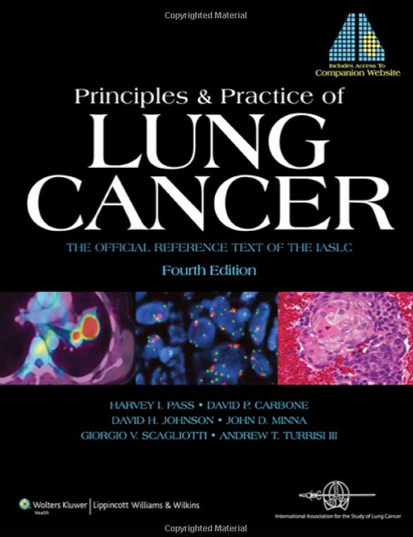
▪ Survival of Small Cell Lung Cancer
Stage | Median survival
Limited-stage disease | 16~22 mo
Extensive-stage disease | 9~11 mo
Principles and Practice of Lung Cancer. 4th edition.

Slide 6
10%
4.9%
4.6%
1.5%
J Clin Oncol. 2006 Oct 1;24(28):4539-44.
Notes:
▪ SEER database에서 1970년대와 2000년 사이의 비약적인 발전이 있었다라고 기술하지만 여전히 survival data는 좋지 않아 보인다.
시간이 지나면서 같은 병기라도 tumor burden이 작을 때 발견되지 않을까?
Supportive care 발전, 영양상태 개선 등으로 performance status가 좋아진 것 때문이지 않을까?

Slide 7
<
Limited-stage SCLC
Extensive-stage SCLC
<
<
Surgery
Chemotherapy + Thoracic irradiation
Platinum-based chemotherapy
Notes:
1/3이 LS-SCLC이고.. 이중에서 수술을 받는 사람은 드물다. 따라서 chemotherapy가 치료의 근간이 된다.
Alvarado-Luna and Morales-Espinosa. Transl Lung Cancer Res 2016
NCCN Clinical Practice Guidelines in Oncology: SCLC v2.2018
Früh, et al. Ann Oncol 2013

Slide 8
Limited-stage SCLC
Extensive-stage SCLC
Mediastinal staging
: All negative
Surgery
(or SBRT)
Chemotherapy +/- Thoracic irradiation
Platinum-based chemotherapy
if pN+
PCI or
MRI brain
surveillance
Chemotherapy +/- Mediastinal RT
(sequential or concurrent)
PCI = prophylactic cranial irradiation
Notes:
1/3이 LS-SCLC이고.. 이중에서 수술을 받는 사람은 드물다. 따라서 chemotherapy가 치료의 근간이 된다.
참고문헌)
Alvarado-Luna and Morales-Espinosa. Transl Lung Cancer Res 2016
Früh, et al. Ann Oncol 2013

Slide 9
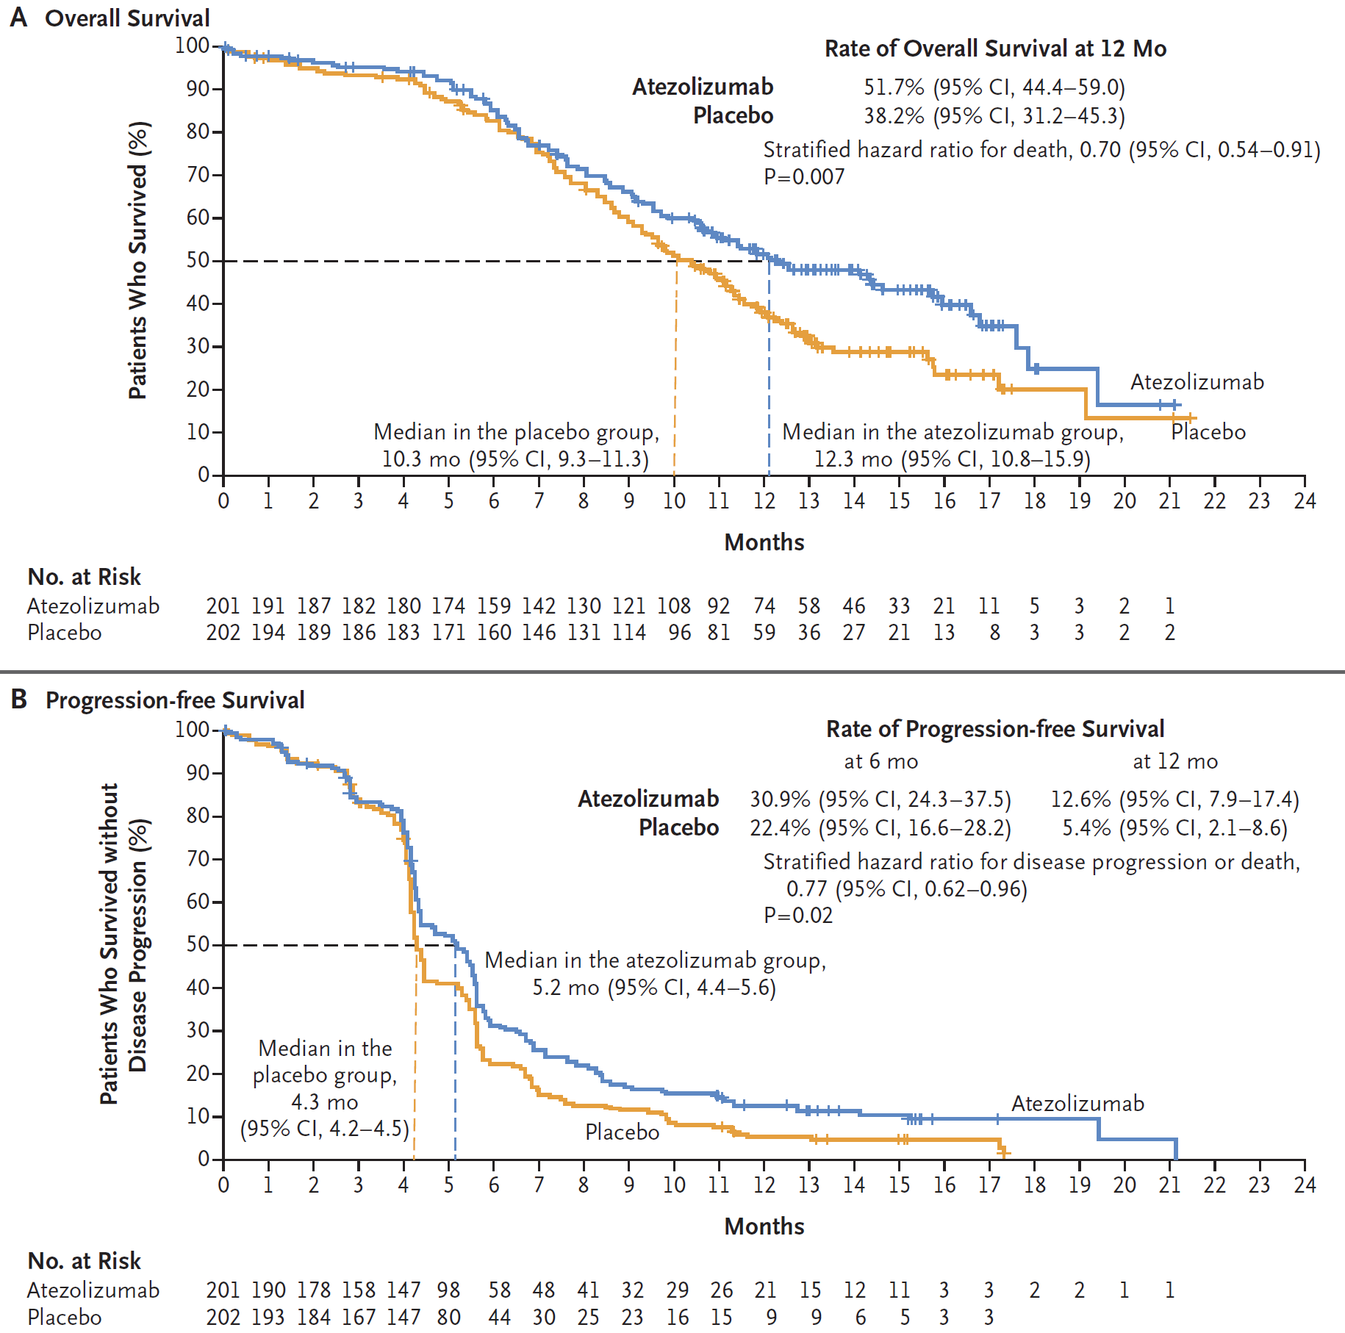
1st line treatment of ES-SCLC − IMpower 133
▪ PFS
▪ OS
N Engl J Med. 2018 Dec 6;379(23):2220-2229.

Slide 10
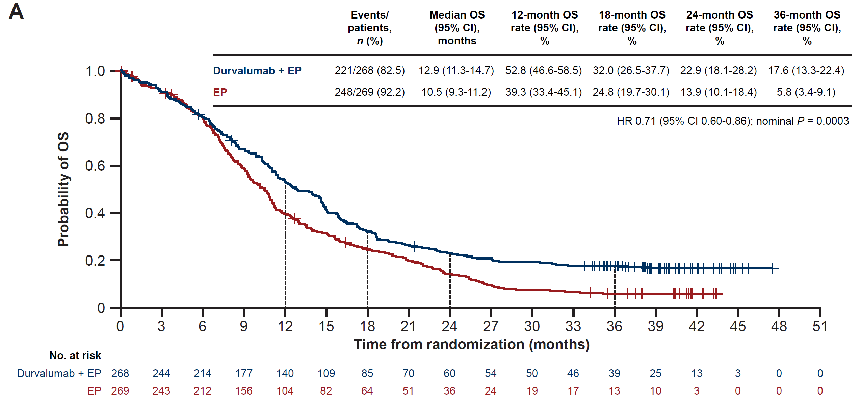
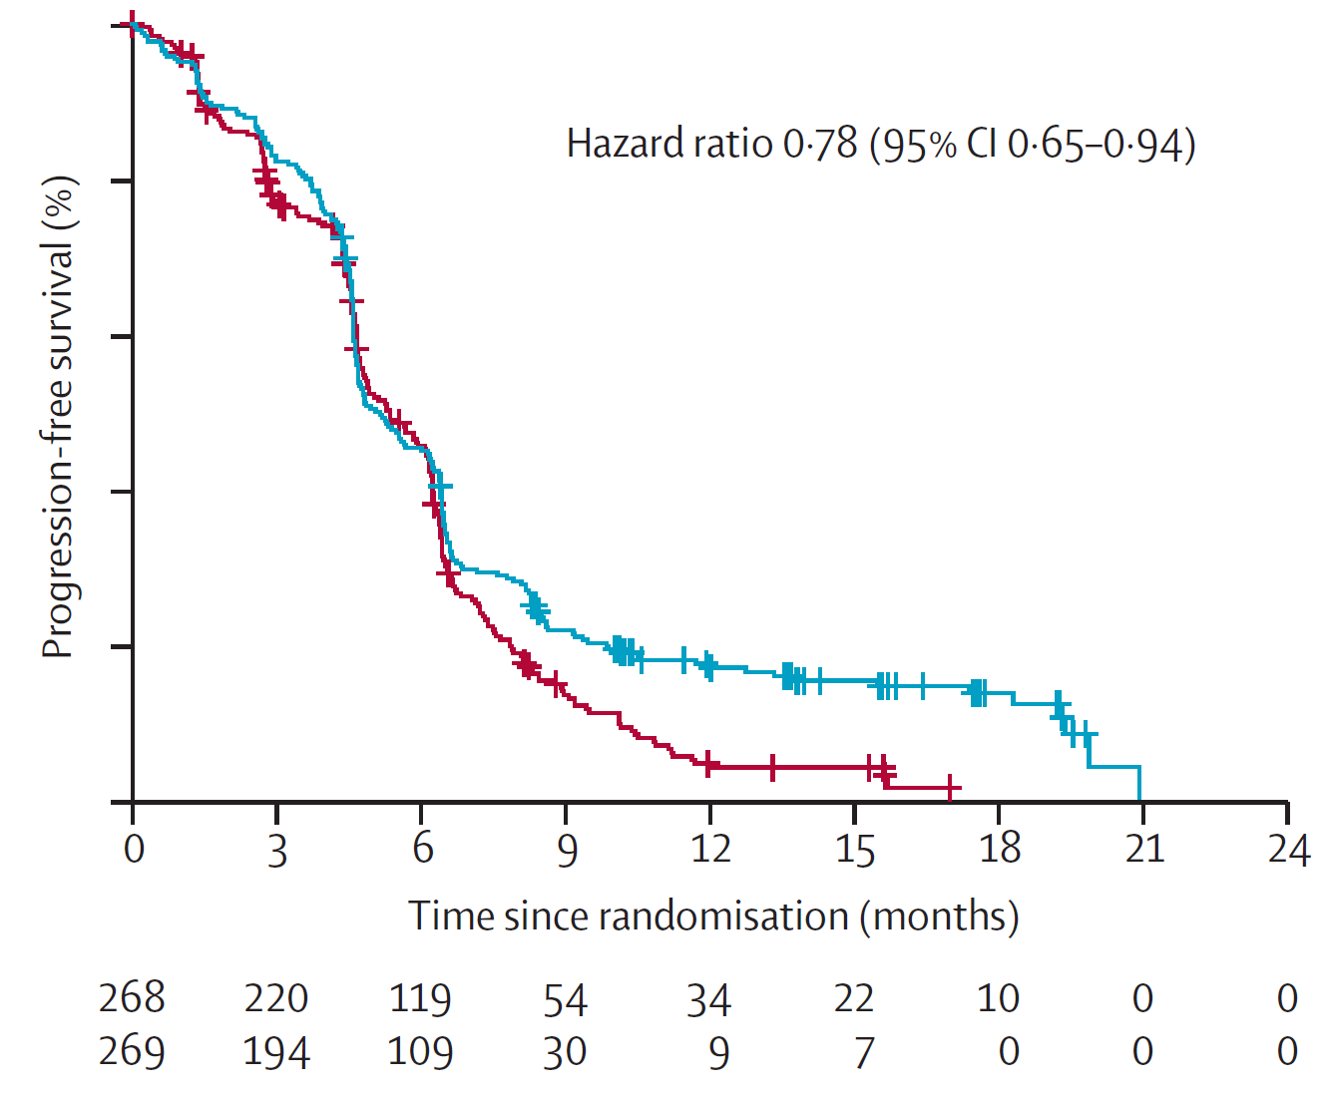
1st line treatment of ES-SCLC − CASPIAN
▪ PFS
▪ OS
ESMO Open. 2022 Apr;7(2):100408.
Lancet. 2019 Nov 23;394(10212):1929-1939.

Slide 11
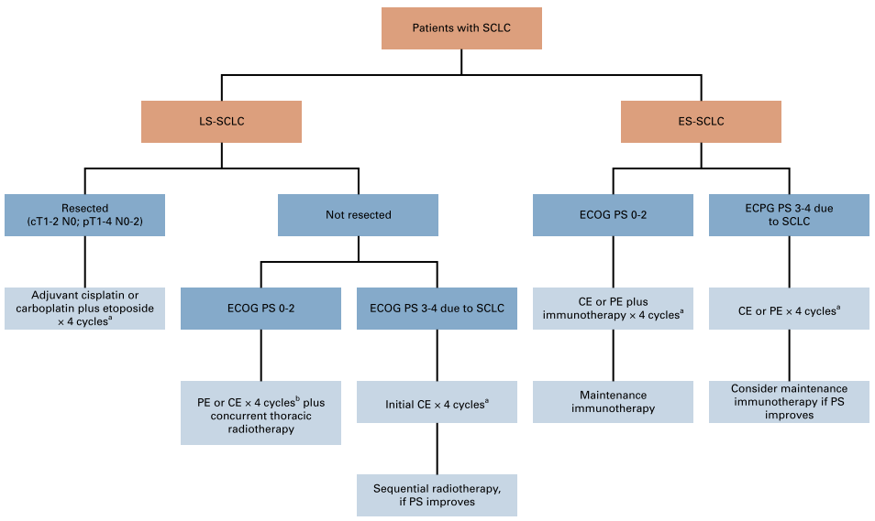
ASCO-Ontario Health Guideline
J Clin Oncol. 2023 Dec 10;41(35):5448-5472.

Slide 12
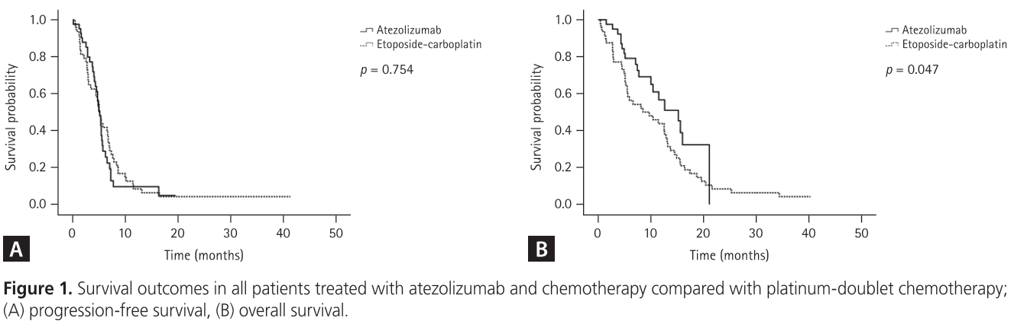
Real-world data
: Atezolizumab+Carboplatin/Etoposide
mPFS 5.1 vs 5.0 mon
mOS 15.2 vs 8.5 mon
Korean J Intern Med. 2023 Mar;38(2):218-225.

Slide 13
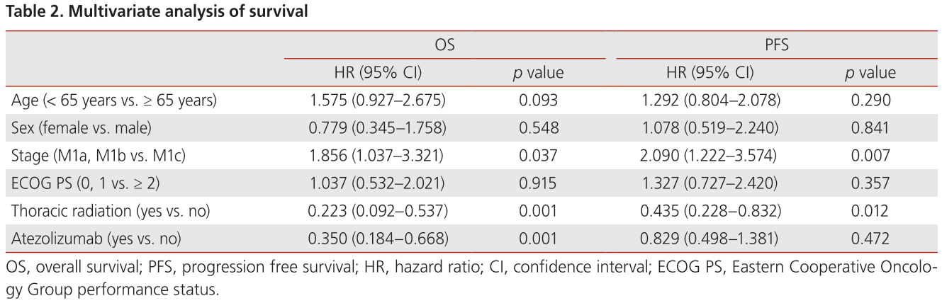
Real-world data
: Atezolizumab+Carboplatin/Etoposide
Korean J Intern Med. 2023 Mar;38(2):218-225.
Notes:
Favorable prognostic factor

Slide 14
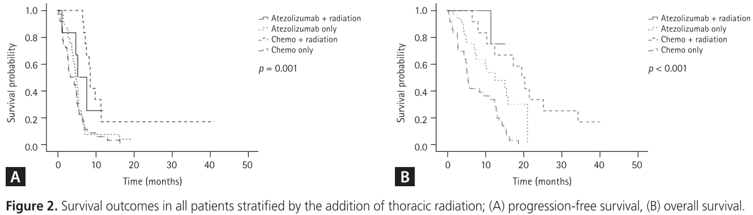
Real-world data
: Atezolizumab+Carboplatin/Etoposide
mPFS 5.3 vs 4.9 vs 8.6 vs 3.4 mon
mOS not reached vs 12.6 vs 19.6 vs 5.5 mon
Korean J Intern Med. 2023 Mar;38(2):218-225.
Notes:
N

Slide 15
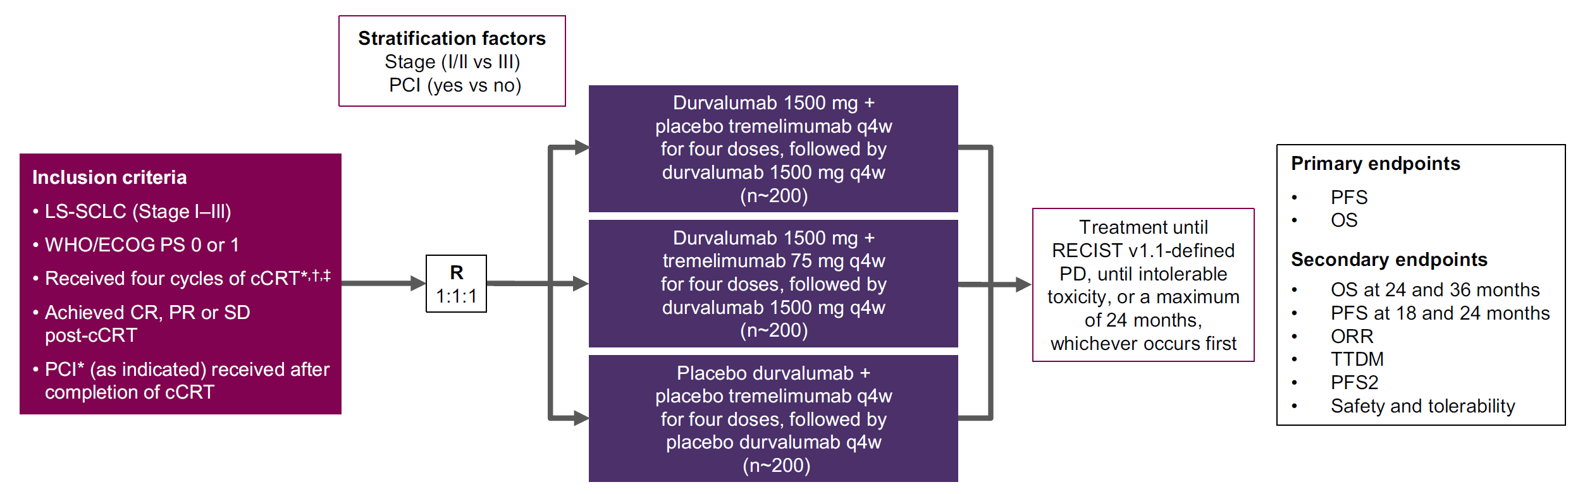
LS-SCLC & Durvalumab − ADRIATIC
Clin Lung Cancer. 2020 Mar;21(2):e84-e88.

Slide 16

Limited-stage SCLC
Extensive-stage SCLC
Mediastinal staging
: All negative
Surgery
(or SBRT)
Chemotherapy +/- Thoracic irradiation
Platinum-based chemotherapy
if pN+
PCI or
MRI brain
surveillance
Chemotherapy +/- Mediastinal RT
(sequential or concurrent)
Relapse?
Primary progressive disease?
PCI = prophylactic cranial irradiation
Notes:
1/3이 LS-SCLC이고.. 이중에서 수술을 받는 사람은 드물다. 따라서 chemotherapy가 치료의 근간이 된다.
참고문헌)
Alvarado-Luna and Morales-Espinosa. Transl Lung Cancer Res 2016
Früh, et al. Ann Oncol 2013

Slide 17
1985
1990
1995
2000
2005
2010
Temozolomide
Irinotecan
Recurrent/refractory treatment
Gemcitabine
Topotecan
Docetaxel
Paclitaxel

Slide 18
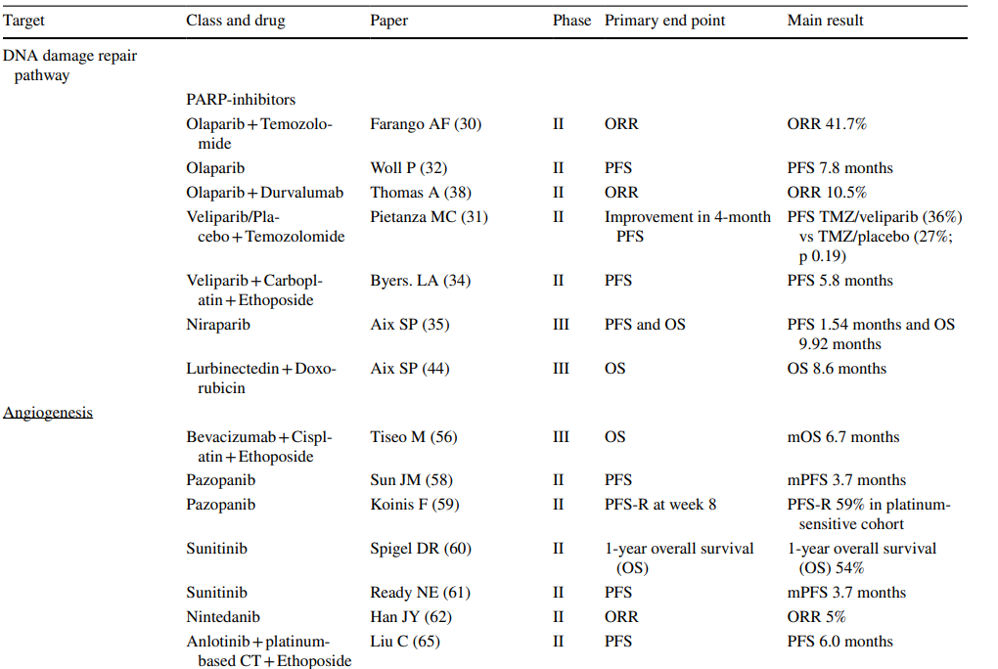
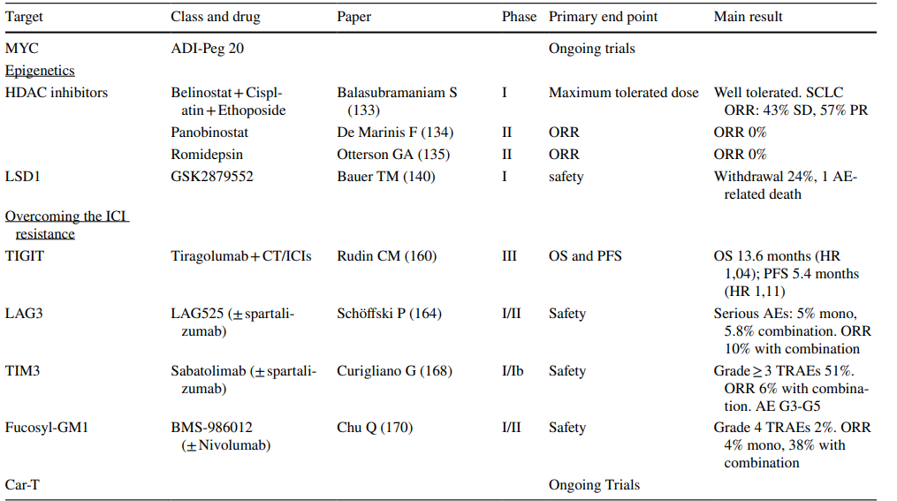
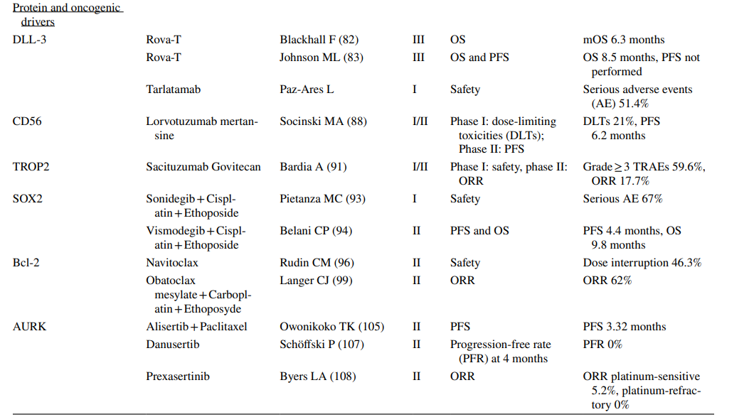
Curr Oncol Rep. 2023 Nov;25(11):1277-1294.
Notes:
Synoptic review of the most relevant clinical trials with new emerging agents in advanced SCLC.

Slide 19

Urgent Medical Needs to New Agents
Notes:
새로운 무기가 필요하다.
Lurbinectidin, DLL3-targeted ADC (tarlatamab 등)

Slide 20
Lurbinectedin

Slide 21
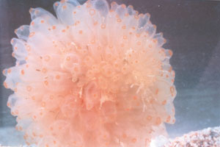
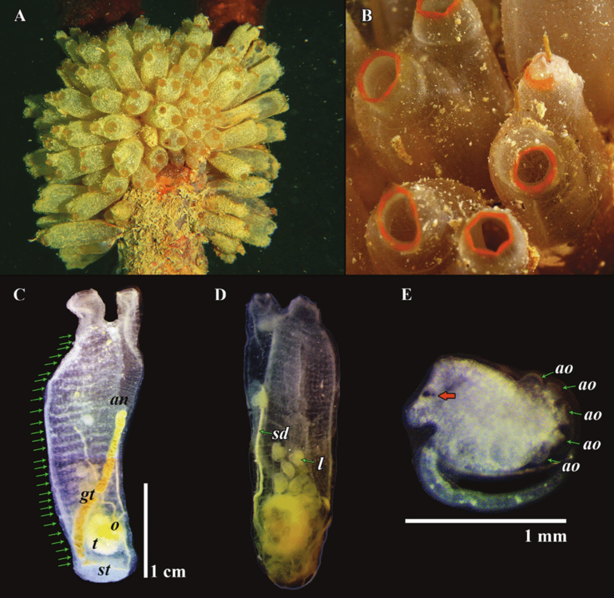
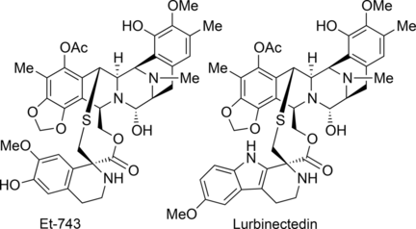
Lurbinectedin from Ecteinascidia turbinata
▪ Ecteinascidia turbinata
− 군체멍게의 추출물
− Trabectedin (Yondelis®)
− Lurbinectedin (Zepzelca®)
Br J Pharmacol. 2010 Nov;161(5):1099-110.
Notes:
카리브해 각지에서 망그로브 등에서 사는 군체멍게 Ecteinascidia turbinata의 추출물
Trabectedin과 Lurbinectidin은 효과와 부작용이 비슷하다.

Slide 22
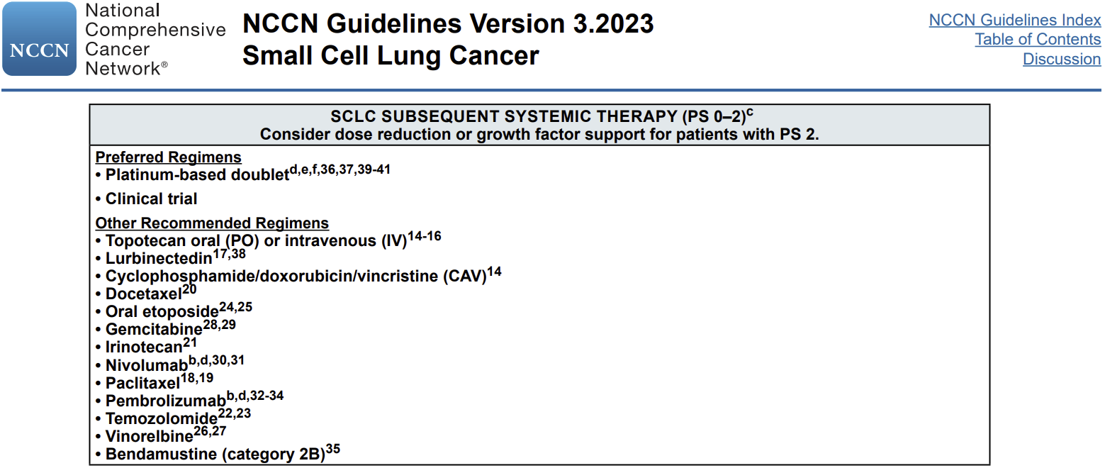
NCCN Guidelines Version 1.2023
Notes:
2023년 NCCN guideline
The NCCN Guidelines recommend Lurbinectedin as a category 2A treatment option.

Slide 23
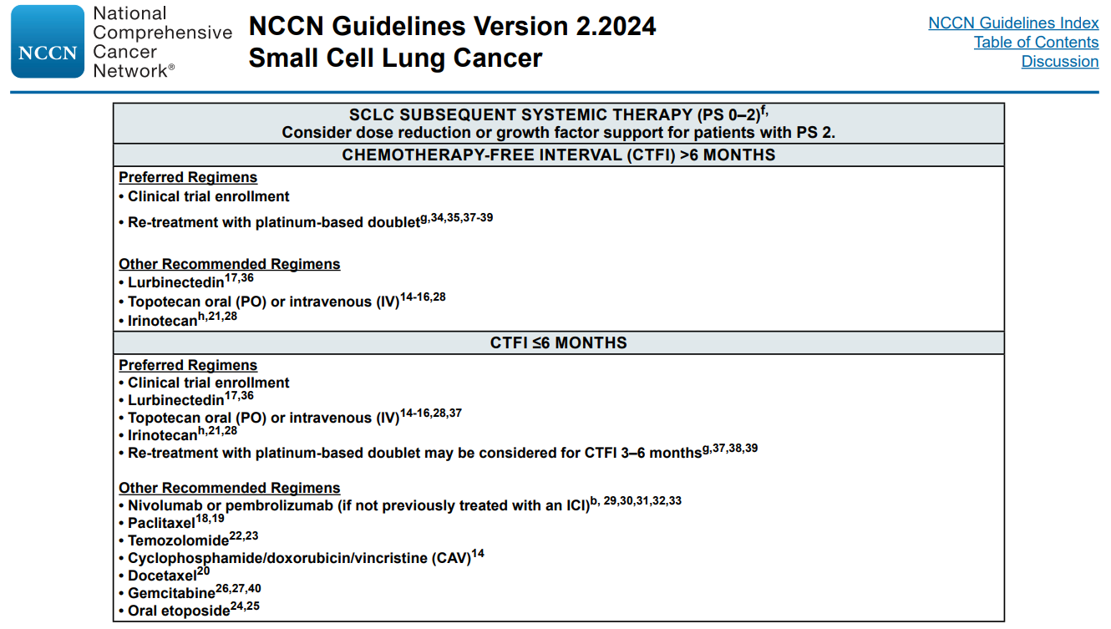
NCCN Guidelines Version 2.2024

Slide 24
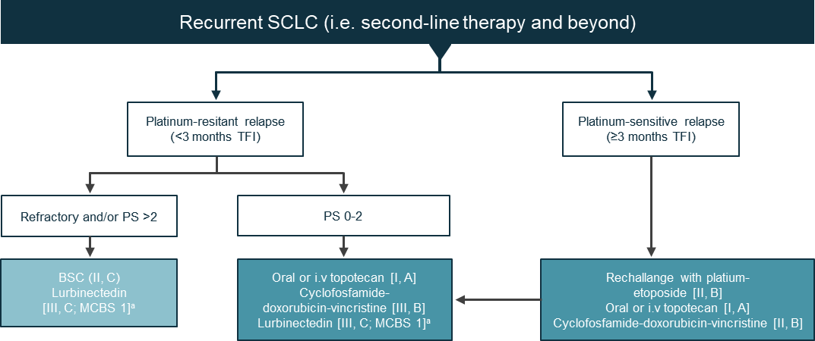
Lurbinectedin in the ESMO guidelines
Ann Oncol. 2021 Jul;32(7):839-853.
Notes:
ESMO guideline full ref:
Dingemans, A. M. C., Früh, M., Ardizzoni, A., Besse, B., Faivre-Finn, C., Hendriks, L. E., Lantuejoul, S., Peters, S., Reguart, N., Rudin, C. M., de Ruysscher, D., van Schil, P. E., Vansteenkiste, J., & Reck, M. (2021). Small-cell lung cancer: ESMO Clinical Practice Guidelines for diagnosis, treatment and follow-up☆. Annals of Oncology, 32(7), 839–853. https://doi.org/10.1016/j.annonc.2021.03.207

Slide 25
Lurbinectedin as second line SCLC
105 patients with SCLC
with disease progression on or after platinum based chemotherapy
One prior chemotherapy line
Prior immunotherapy was allowed
Active CNS mets excluded
Lurbinectedin 3.2mg/m²
1-hour i.v. infusion
every 3 weeks
Treatment continued until disease progression
or unacceptable toxicity
Primary Objective
Secondary Objectives
  Overall Response (RECIST v.1.1)
  DoR
  Disease control
  PFS
  PFS at 4 and 6 months
  OS at 6 and 12 months
  PK
  Pharmacogenomics
  Pharmacogenetics
  Safety
Lancet Oncol. 2020 May;21(5):645-654.
Notes:
Single-arm, open-label, phase 2 basket trial

Slide 26
Response by Investigator assessment
RECIST Response | All patients (n=105) | CT-free interval < 90 days (n=45) | CT-free interval ≥ 90 days (n=60)
Complete response | 0% | 0% | 0%
Partial response | 35% | 22% | 45%
Stable disease | 33% | 29% | 37%
Progressive disease | 27% | 40% | 17%
No evaluable | 5% | 9% | 2%
Overall response | 35% | 22% | 45%
Disease control | 69% | 51% | 82%
Lancet Oncol. 2020 May;21(5):645-654.

Slide 27
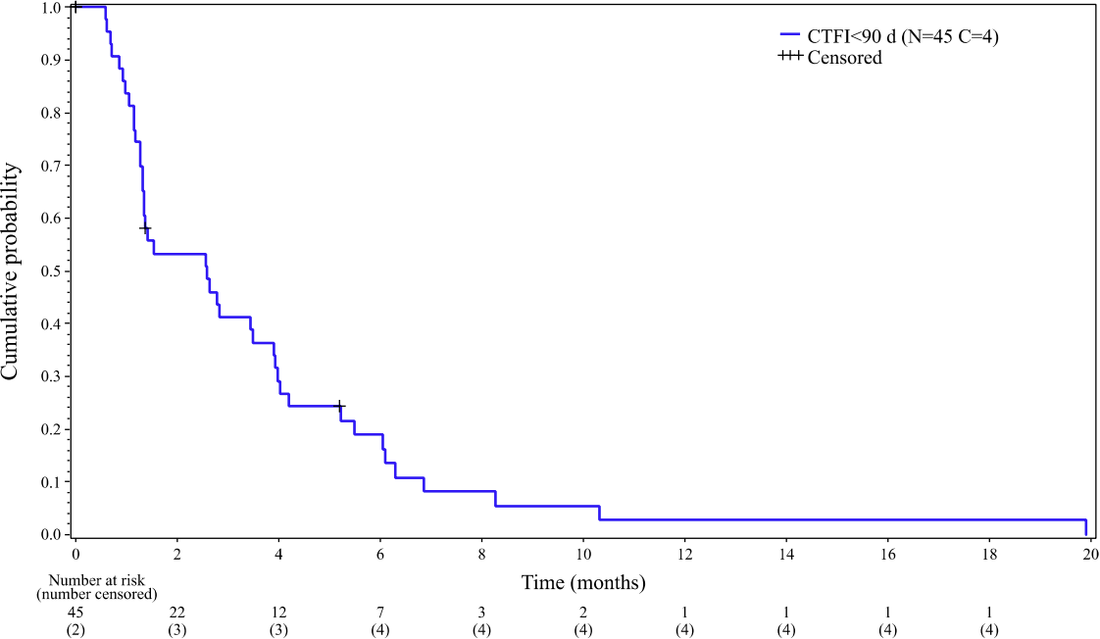
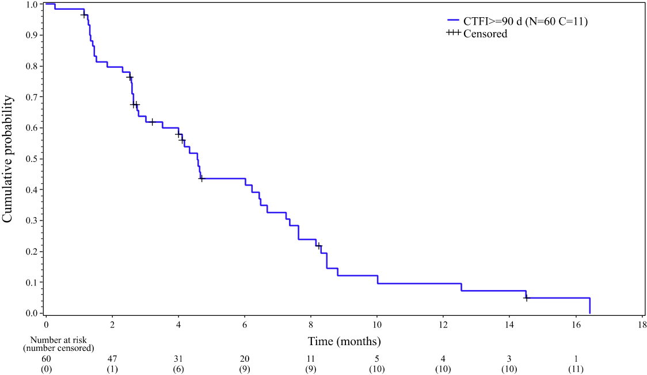
Progression-free survival (PFS)
 | All patients (n=105) | CTFI < 90 days (n=45) | CTFI ≥ 90 days (n=60)
PFS events | 86% | 91% | 82%
Median PFS | 3.5 months | 2.6 months | 4.6 months
CTFI < 90 days
CTFI ≥ 90 days
mPFS: 2.6 months
(95% CI, 1.3-3.9 months)
mPFS: 4.6 months
(95% CI, 2.8- 6.5 months)
Lancet Oncol. 2020 May;21(5):645-654.

Slide 28
Overall survival (OS)
 | All patients (n=105) | CTFI < 90 days (n=45) | CTFI ≥ 90 days (n=60)
Median OS | 9.3 months | 5.0 months | 11.9 months
6-month OS | 67% | 46% | 84%
12-month OS | 34% | 16% | 48%
Lancet Oncol. 2020 May;21(5):645-654.

Slide 29
Safety
AE, n (%) | Grade 1-2 | Grade 3 | Grade 4
Haematological abnormalities (regardless of relation to study drug*)
Anemia | 91 (87%) | 9 (9%) | 0
Leukopenia | 53 (50%) | 20 (19%) | 10 (10%)
Neutropenia | 27 (26%) | 22 (21%) | 26 (25%)
Thrombocytopenia | 39 (37%) | 3 (3%) | 4 (4%)
Biochemical abnormalities (regardless of relation to study drug)*
Creatinine | 86/104 (83%) | 0 | 0
Alanine aminotransferase | 69/103 (67%) | 5/103 (5%) | 0
γ-glutamyl transferase | 52/103 (50%) | 13/103 (13%) | 2/103 (2%)
Aspartate aminotransferase | 44/103 (43%) | 2/103 (3%) | 0
Alkaline phosphatase | 31/103 (30%) | 3/103 (3%) | 0
AE, n (%) | Grade 1-2 | Grade 3 | Grade 4
Treatment-related adverse events
Fatigue | 54 (51%) | 7 (7%) | 0
Nausea | 34 (32%) | 0 | 0
Decreased appetite | 22 (21%) | 0 | 0
Vomiting | 19 (18%) | 0 | 0
Diarrhoea | 13 (14%) | 1 (1%) | 0
Febrile neutropenia | 0 | 2 (2%) | 3 (3%)
Pneumonia | 0 | 2 (2%) | 0
Skin ulcer | 0 | 1 (1%) | 0
Lancet Oncol. 2020 May;21(5):645-654.

Slide 30
Lurbinectedin vs. Topotecan
− Indirect Comparison

Slide 31
Efficacy − Lurbinectedin vs. Topotecan
Investigator Assessment | Lurbinectedin (n=105) | Topotecan (n=213)
ORR | 35% | 17%
Median DoR | 5.3 months | 4.2 months
Median OS | 9.3 months | 7.8 months
OS at 12 months | 39% | 25%
J Clin Oncol. 2014 Dec 10;32(35):4012-9.
Notes:
Baseline characteristics는 양군에서 유사

Slide 32
Efficacy − Lurbinectedin vs. Topotecan
Investigator Assessment | Chemotherapy-sensitive |  | Chemotherapy-resistant
 | Lurbinectedin (n=60) | Topotecan (n=120) | Lurbinectedin (n=45) | Topotecan (n=93)
ORR | 45.0% | 23.1% | 22.2% | 9.0%
Median OS | 11.9 months | 9.9 months | 5.0 months | 5.7 months
OS at 12 months | 48.3% | 39.0% | 15.9% | 8.0%
J Clin Oncol. 2014 Dec 10;32(35):4012-9.

Slide 33
2nd line Lurbinectedin
− Treatment for CTFI ≥ 180 days

Slide 34
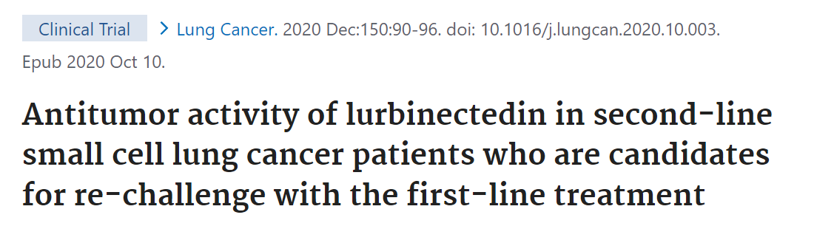
Lurbinectedin
3.2mg/m²,
1h IV infusion
Q3W
Subset of patients
CTFI ≥ 180 days
(Basket trial)
N=20
Until PD or unacceptable toxicity
▪ International, multicenter, single-arm, open-label, phase 2 basket Trial
▪ Pre-planned subset of patients with CTFI ≥ 180 days.
Lung Cancer. 2020 Dec:150:90-96.

Slide 35
Efficacy
Outcomes | Investigator | Independent review
ORR | 60% | 50%
DCR | 95% | 80%
Median DoR | 5.5 months | 5.5 months
Median PFS | 4.6 months | 4.6 months
Lung Cancer. 2020 Dec:150:90-96.
Notes:
Lurbinectedin is an effective treatment for platinum-sensitive relapsed SCLC, with remarkable activity in patients with CTFI ≥ 180 days.

Slide 36
Recent Data

Slide 37
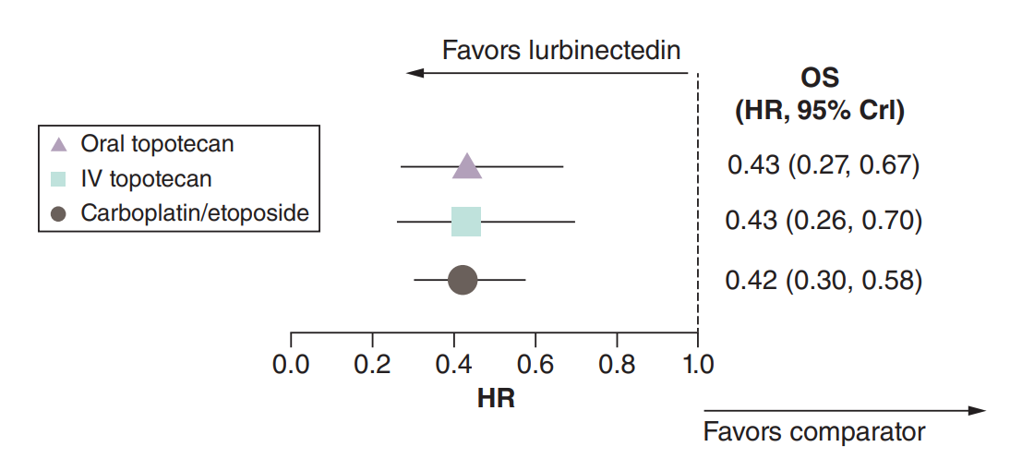
Meta-analysis for OS
▪ Forest plot of estimated odds ratios for OS for the base case analysis of patients with platinum-sensitive disease
J Comp Eff Res. 2023 May;12(5):e220098.

Slide 38
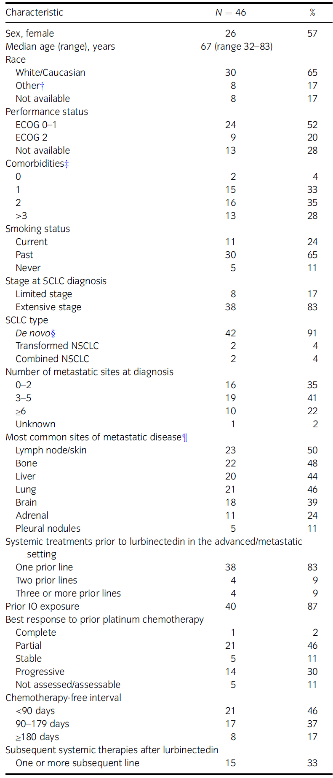
Real-world experience of EAP
Intern Med J. 2024 Feb 18. doi: 10.1111/imj.16348. Online ahead of print.
Notes:
호주

Slide 39
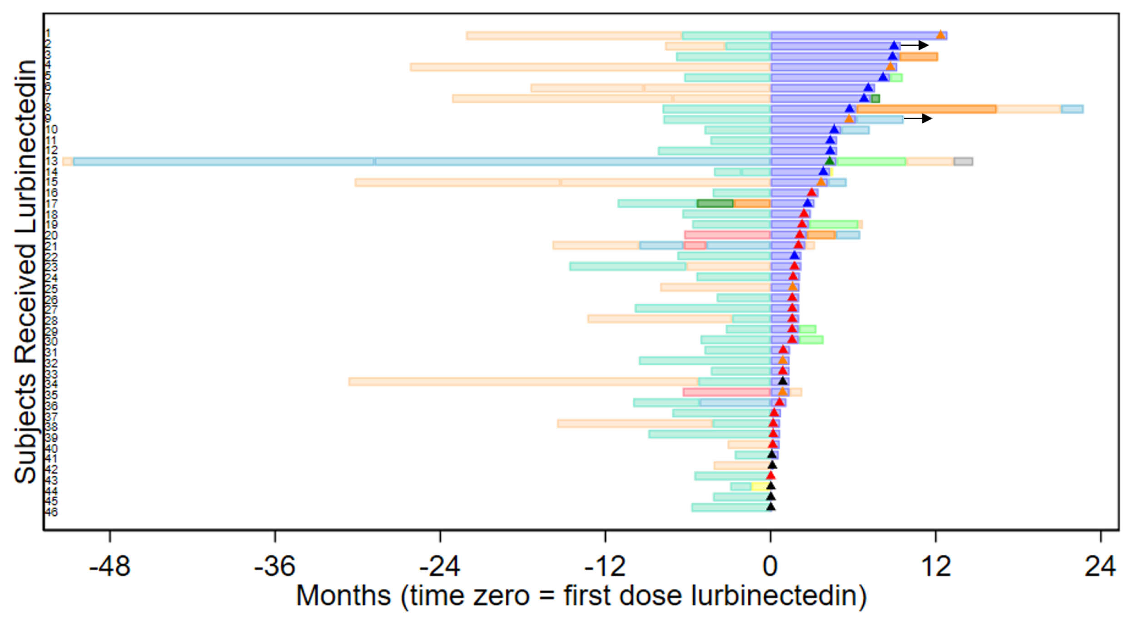
Real-world experience of EAP
: Best response to lurbinectedin
▪ ORR = 33%
▪ DCR = 50%
Intern Med J. 2024 Feb 18. doi: 10.1111/imj.16348. Online ahead of print.

Slide 40
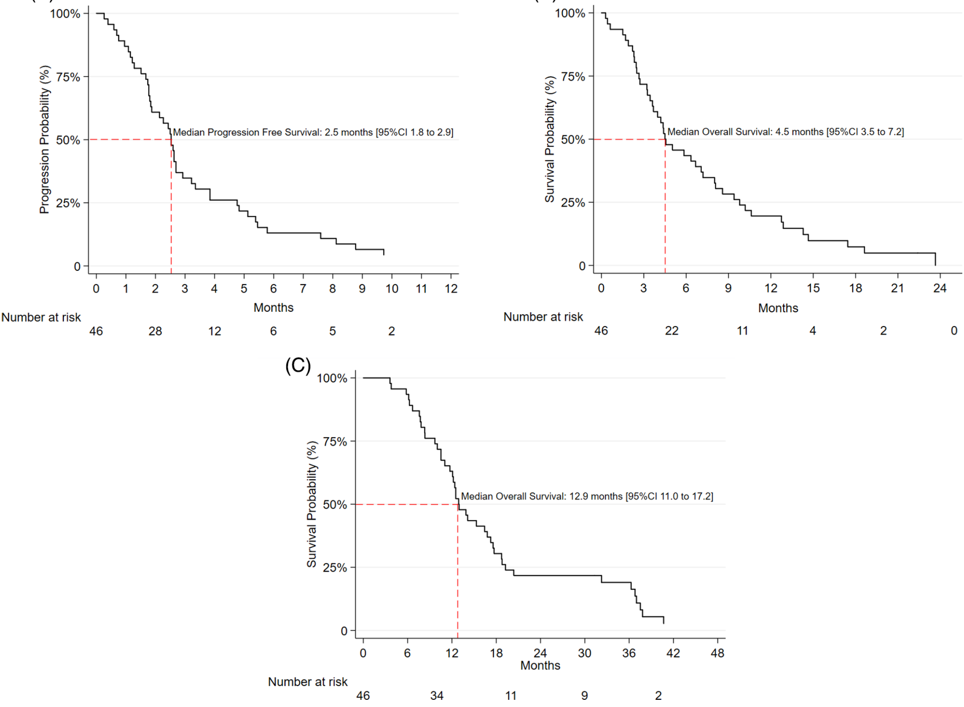
Real-world experience of EAP
: PFS
Intern Med J. 2024 Feb 18. doi: 10.1111/imj.16348. Online ahead of print.

Slide 41
Real-world experience of EAP
: OS
Intern Med J. 2024 Feb 18. doi: 10.1111/imj.16348. Online ahead of print.

Slide 42
Real-world experience of EAP
: OS
Intern Med J. 2024 Feb 18. doi: 10.1111/imj.16348. Online ahead of print.

Slide 43
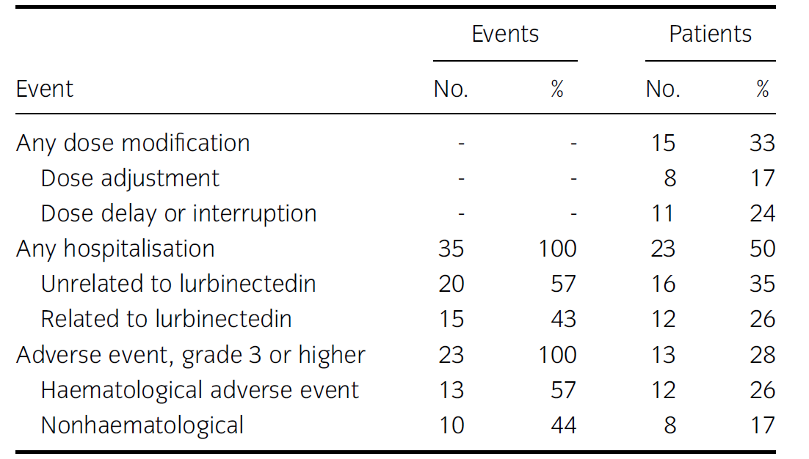
Real-world experience of EAP
: Dose Modifications & Adverse Events
Intern Med J. 2024 Feb 18. doi: 10.1111/imj.16348. Online ahead of print.

Slide 44
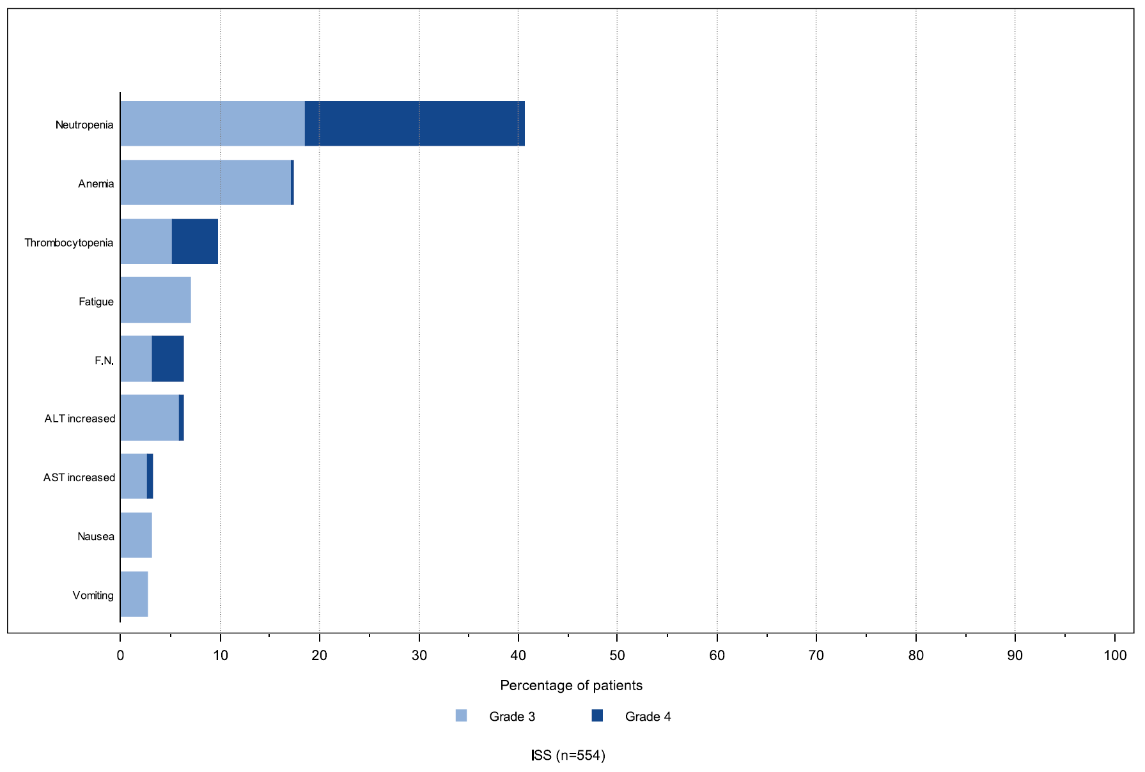
Pooled Safety Analysis of Lurbinectedin
Eur J Cancer. 2023 Oct:192:113259.

Slide 45
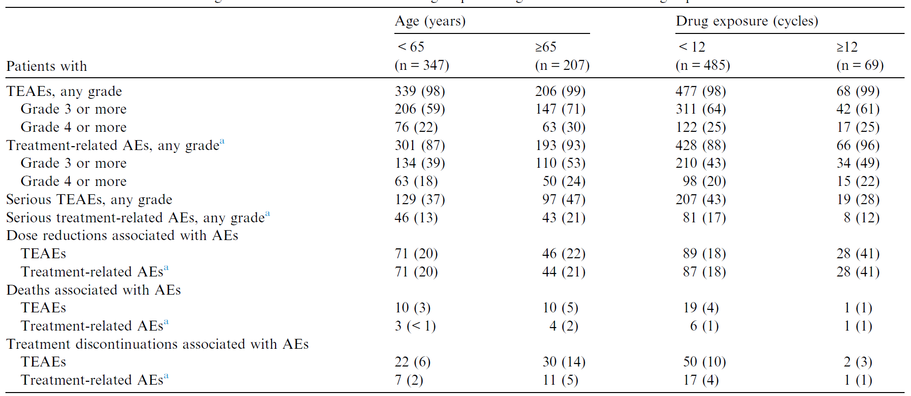
Pooled Safety Analysis of Lurbinectedin
AE, adverse event; TEAE, treatment-emergent adverse event.
Eur J Cancer. 2023 Oct:192:113259.

Slide 46
ZEPZELCA dosing and administration
Initial Dose | 1st Dose Reduction | 2nd Dose Reduction | 3rd Dose Reduction
3.2 mg/m² | 2.6 mg/m² | 2.0 mg/m² | Stop
^{100%} | ^{81.3%} | ^{62.5%}

Slide 47
Lurbinectedin in SCLC
Category | Study | Reference | Phase | Patient | RR | PFS | OS
Maintenance | Imforte (maintenance) | Ongoing | III
Lurbinectedine | Lurbinectedine : FDA accelerated approval | Trigo (Lancet onc2020) | II | 105 | 35.2 | 3.5 | 9.3
 | Lurbinectedine + irinotecan (A-014-15 trial) | Ponce-aix IASLC 2020 | I/II | 21 | 62 | 6.2
 | Lurbinectedine + atezolizumab (2SMALL) | Ponce (SITC 2021) | I/II | 26 | 57.7 | 4.47
 | Lurbinectedine + doxorubicine ATLANTIS | Lancet RM 2023 | III | 307 | 32 | 4.0 | 8.6
 | Lurbinectedine+pembrolizumab | Calles (ESMO 2023) | I/II | 28 | 46.4 | 5.3
 | LAGOON study | Ongoing | III
 | DeLLphi-304 Tarlatamab vs Lurbine or Topo | Ongoing | II

Slide 48
Summary
▪ Unmet needs in the treatment of SCLC
▪ Lubinectedin
: Median PFS – 3.5 months
(CTFI < 90 days: 2.6 months, ≥ 90 days: 4.6 months)
: Median DoR – 5.3 months
: Valuable treatment option for both chemo-sensitive or -resistant SCLC

Slide 49
경청해 주셔서 감사합니다.

