Slide 1
다재내성균 폐렴의 치료전략
동아대학교 병원
호흡기내과 강보형

Slide 2
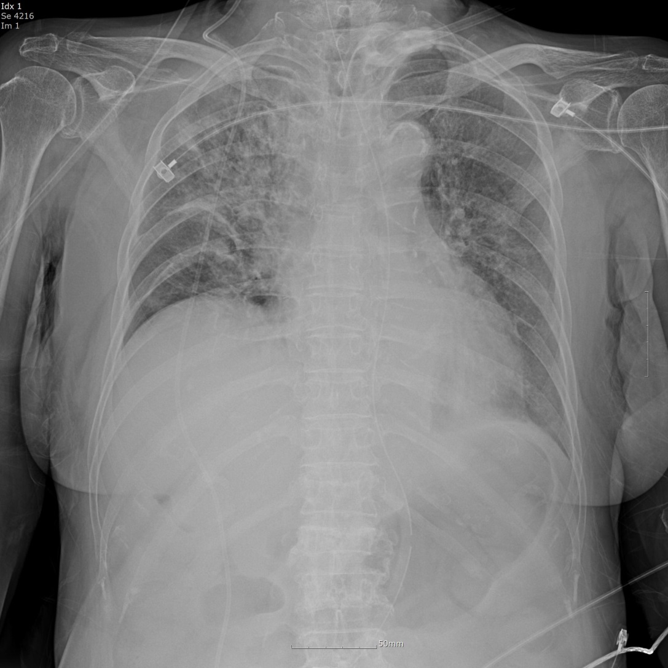
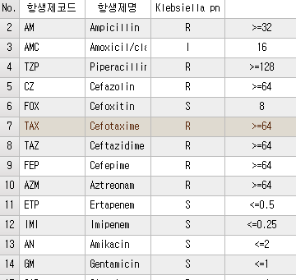
Meningioma/ Bed-ridden, tracheostomy state로 요양병원 입원
Vomiting 후 tachypnea, hypoxia 발생하여 내원, ICU 입실
CRE Rectal Not found CRE
Sputum Klebsiella pn. (ESBL +)
Notes:
CFIM -> meropenem

Slide 3
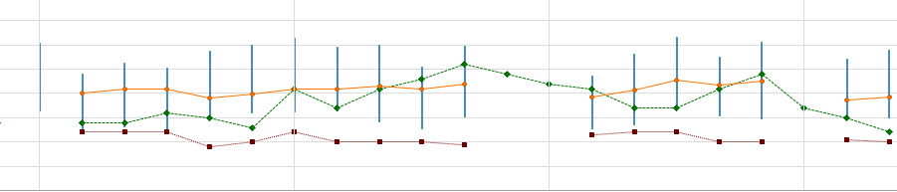
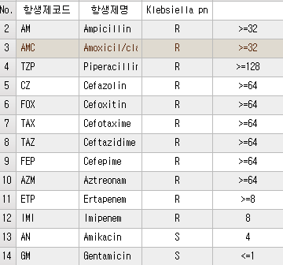
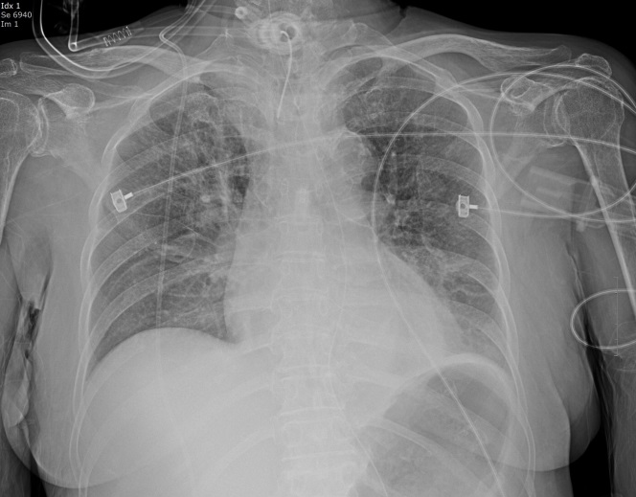
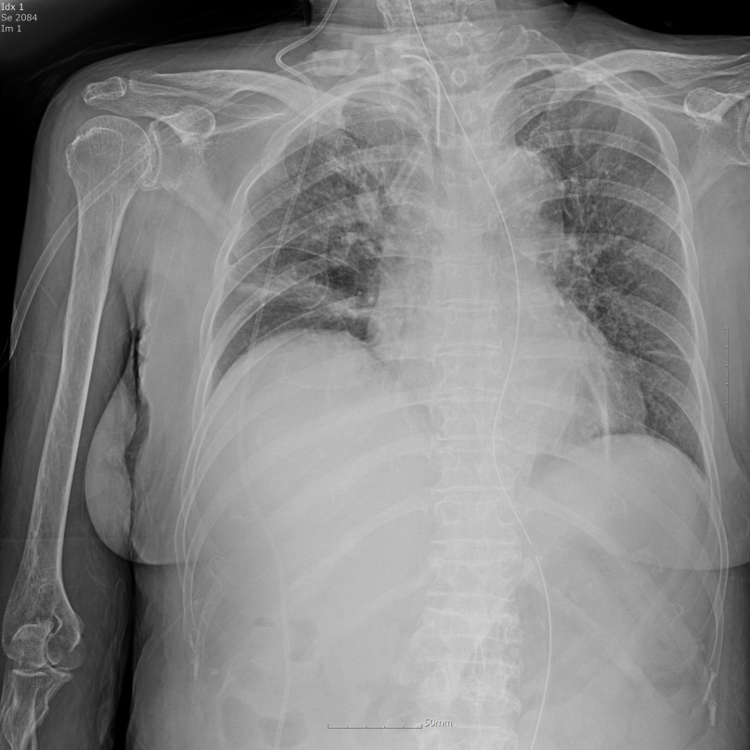
일반병실 입원 중, Mild fever, secretion 증가
CRP 3.37->14.75
Notes:
2주 meropenem -> 중단 중

Slide 4
HAP guideline (IDSA, ATS)
1) major concepts
2) MRSA/carbapenem-resistant pathogen
3) inhaled colistin
2. Infection control

Slide 5
1. HAP/VAP Guidelines

Slide 6
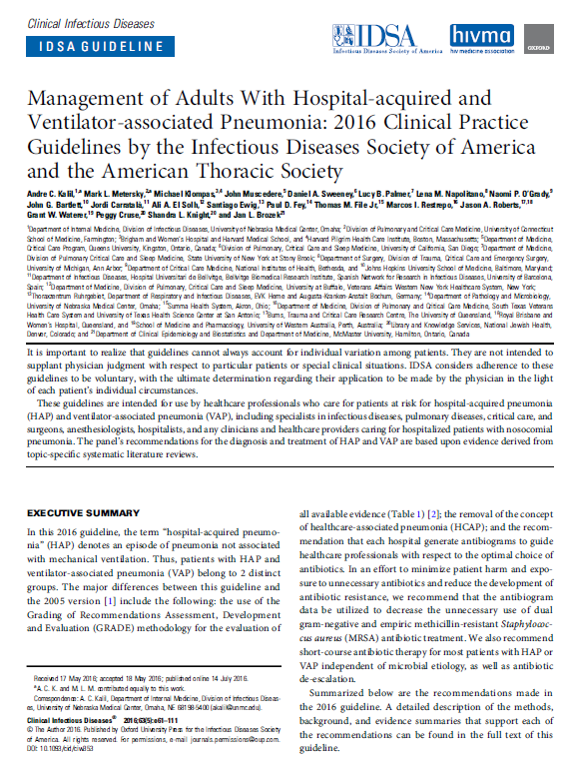
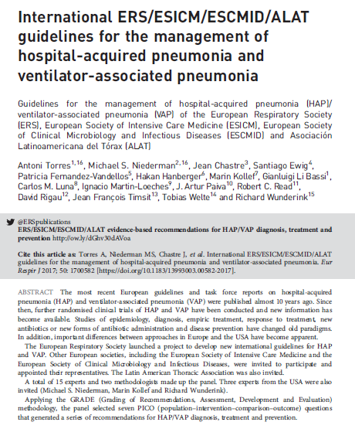

Slide 7
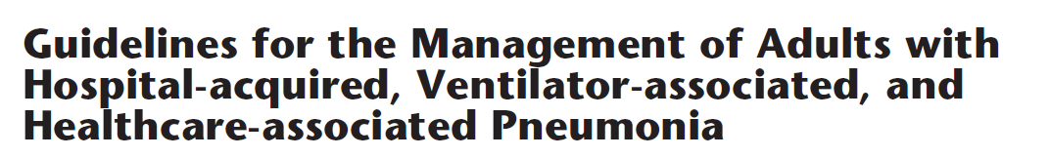
Hospital associated pneumonia
Community acquired pneumonia
Healthcare associated pneumonia
Ventilator associated pneumonia
AJRCCM 2005;171:388-416

Slide 8
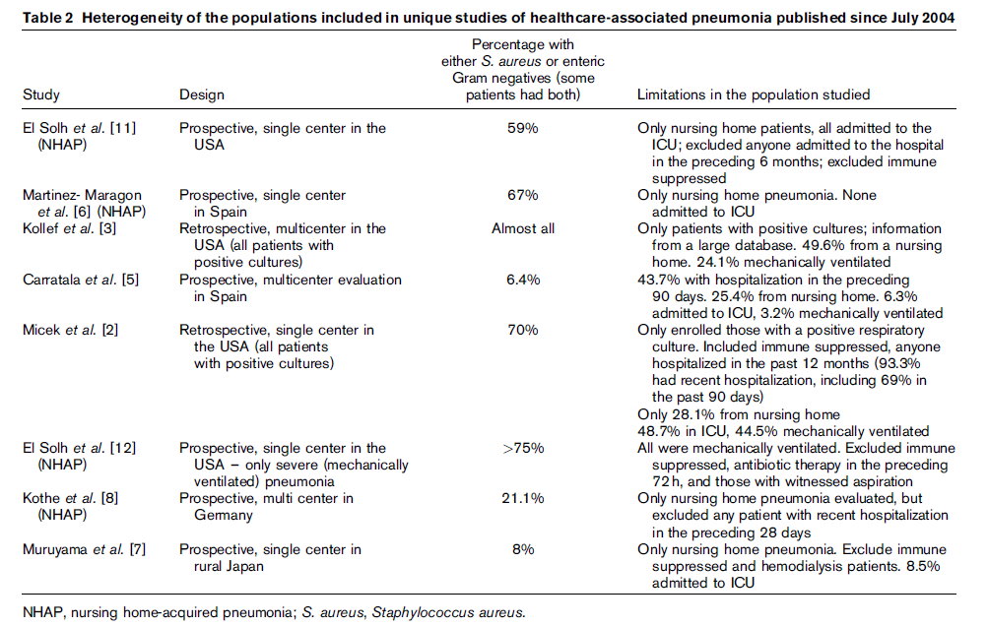
Too heterogeneous population
Curr Opin Infect Dis 20019;22:316

Slide 9
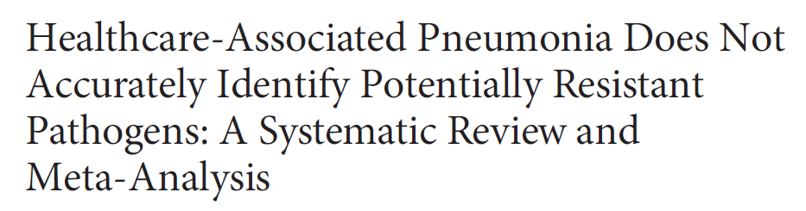
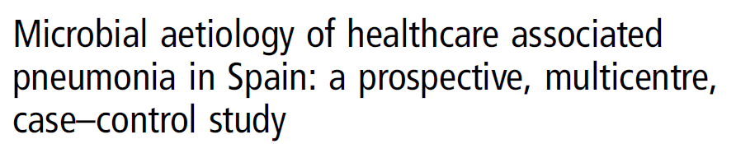
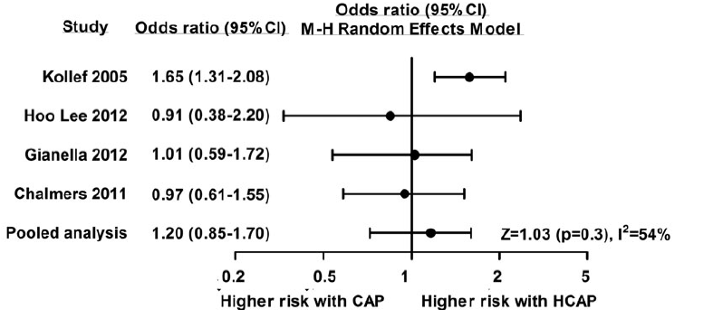
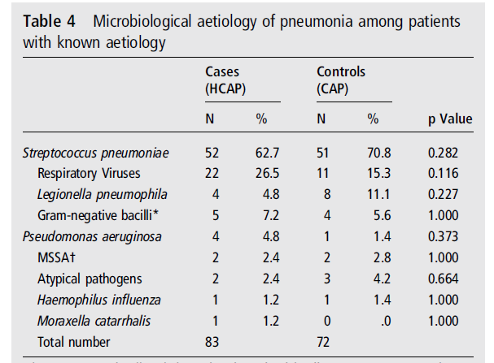
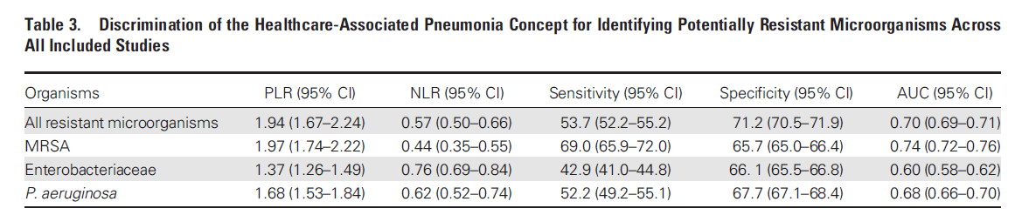
CID 2014:58;330-339
Thorax 2013:68:1007-1014

Slide 10
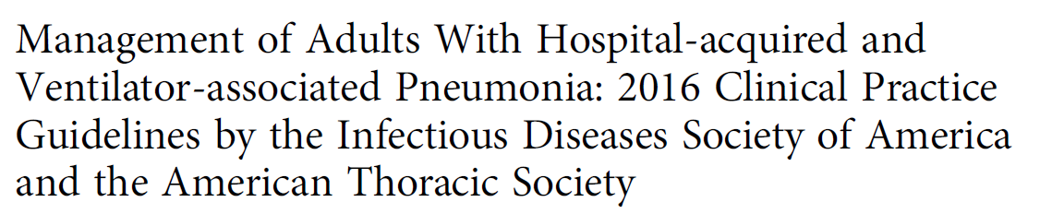
HAP and VAP belong to 2 distinct groups
removal of the concept of HCAP from HAP/VAP guideline
Community onset pneumonia
Community acquired pneumonia
Healthcare associated pneumonia
Hospital associated pneumonia
Ventilator associated pneumonia
Antimicrobial resistance ↑
CID 2016:63(5):e61-111

Slide 11
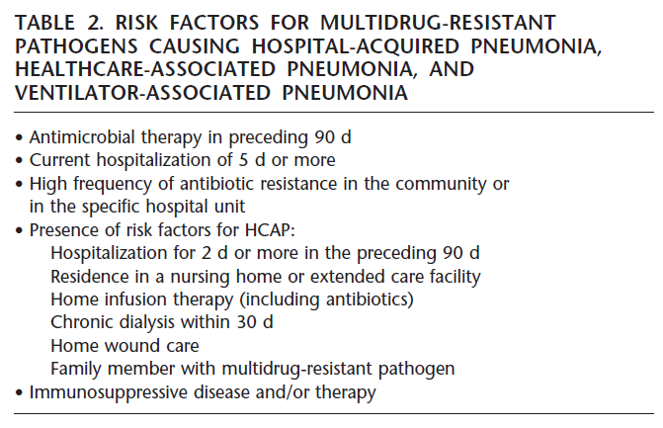
Risk factors for multidrug-resistant pathogens
AJRCCM 2005;171:388-416

Slide 12
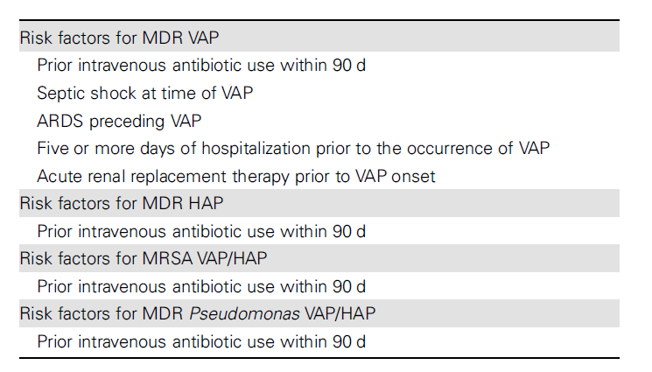
Risk factors for multidrug-resistant pathogens
CID 2016:63(5):e61-111
Notes:
Coma present at the time of ICU admission decreased risk of MDR
Use of systemic steroid increased in one study
Several factors for MRSA

Slide 13
Risk factors for MRPA
Prior use of antibiotics
Mechanical ventilation
History of chronic obstructive pulmonary disease
Cystic fibrosis and bronchiectasis
-> the evidence of others is scarce and of low quality.
CID 2016:63(5):e61-111

Slide 14
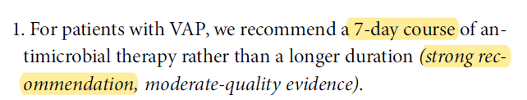
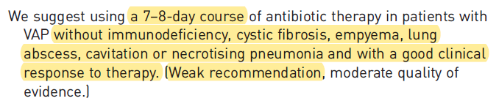
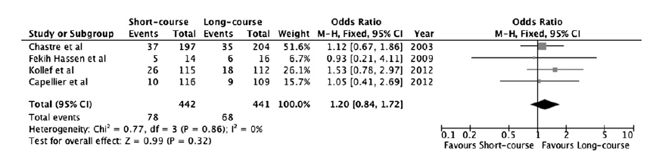
Length of therapy
Chest 2013;144:1759

Slide 15
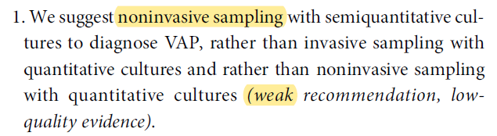
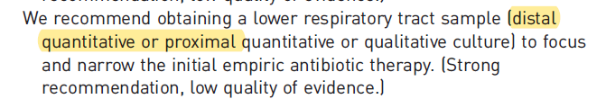
Invasive sampling
Cultures of respiratory secretions should be obtained

Slide 16
2. Antibiotics choice of MDR pathogens
(MRSA, Carbapenem-resistant pathogens)
Notes:
MRSA, carbapenem resistatnce pathogen

Slide 17
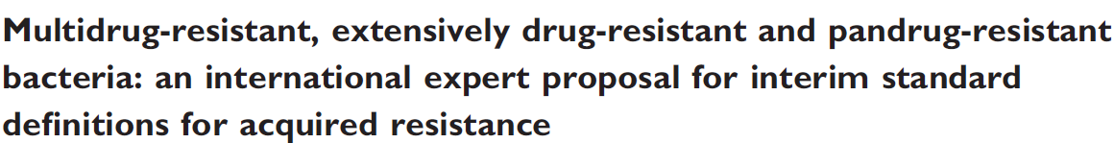
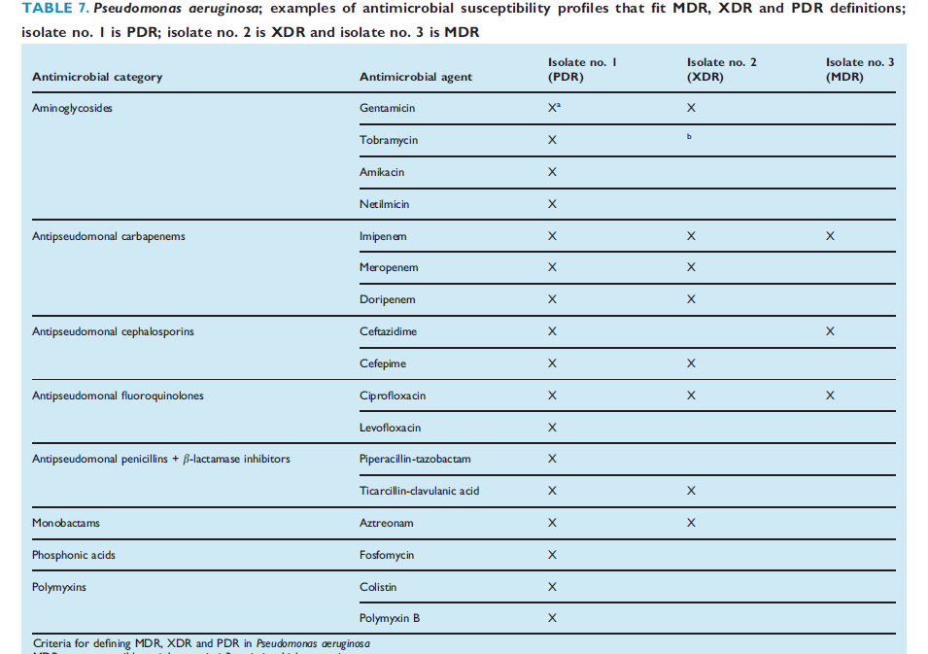
MDR: non-susceptible to at
least 1 agent in ≥ 3
antimicrobial categories
XDR: non-susceptible to at
least 1 in all but ≤ 2
antimicrobial categories
PDR: non-susceptible to all
antimicrobial agents
Magiorakos et al. Clin Microbiol Infect 2012; 18: 268

Slide 18
Methicillin-resistant S. aureus
Therapeutic options
- Vancomycin
- Linezolid
- Teicoplanin
- vancomycin plus rifampin

Slide 19
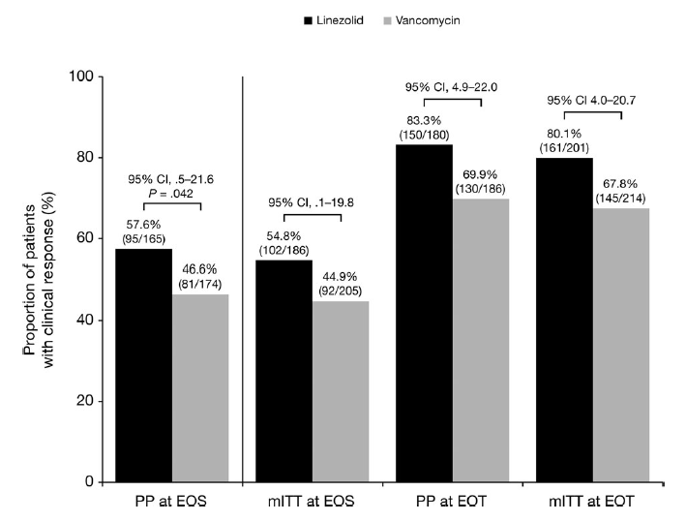
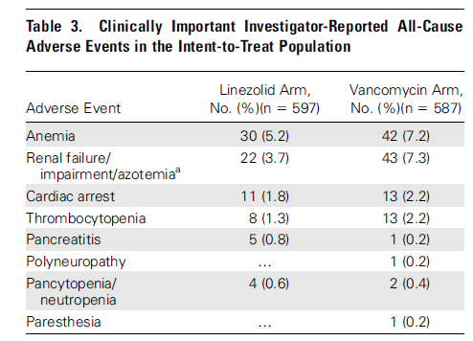
Vancomycin versus linezolid
Clin Infect Dis 2012;54:621-9
Notes:
Clinical response rate

Slide 20
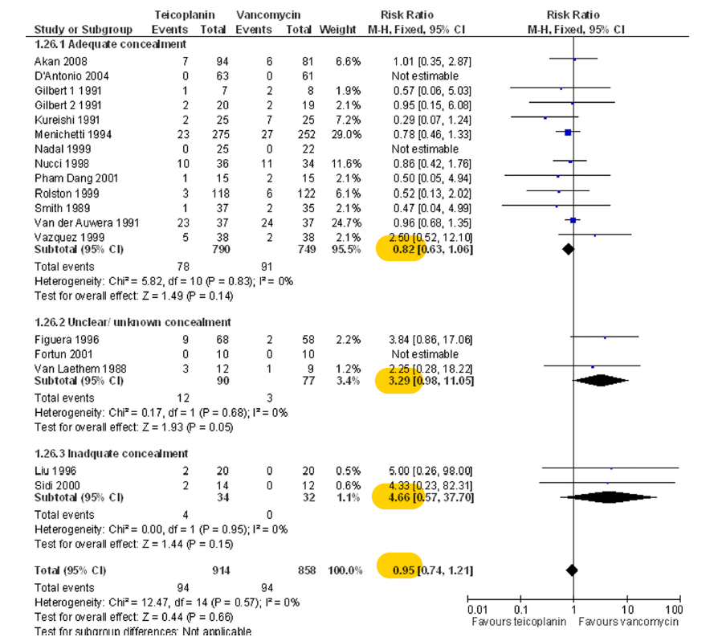
Vancomycin/linezolid versus teicoplanin
Notes:
Vancomycin/teicoplanin

Slide 21
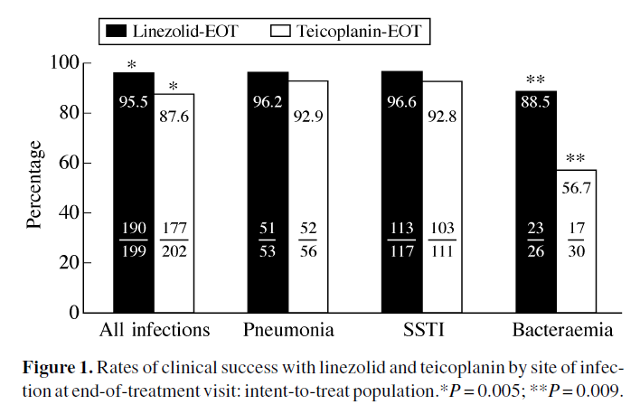
Vancomycin/linezolid versus teicoplanin
J antimirob chem 2004;53:335-334
Notes:
Linezolid/teicoplanin

Slide 22
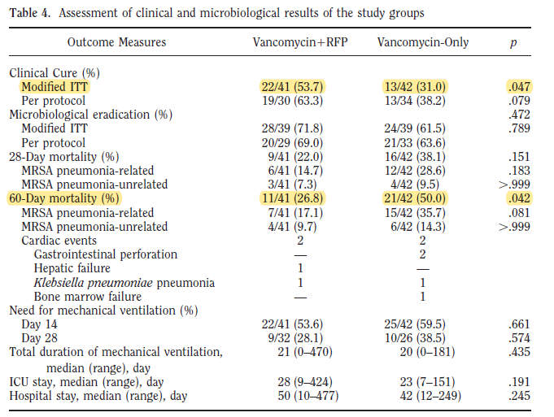
Vancomycin versus vancomycin + rifampin
RFP 내성: 34.1%
Crit Care Med 2010;38:175-80

Slide 23
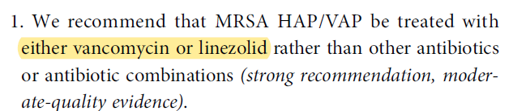
Methicillin-resistant S. aureus
Therapeutic options
- Vancomycin
- Linezolid
- Teicoplanin
- vancomycin plus rifampin
vancomycin trough level 15-20 mg/L

Slide 24
Carbapenem resistant pathogens
(P. aeruginosa, A. baumanni, enterobacteriaceae)
Therapeutic options
- colistin
Other options
- ampicillin/sulbactam
- tigecycline
- colistin +α
- double carbapenem (in vitro)
Notes:
A.baumanni-> carbapenem, sulbactam, colistin
Double carbapenem 은 증거가 미약

Slide 25
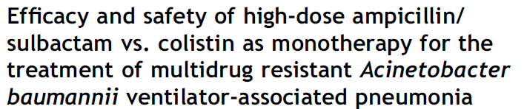
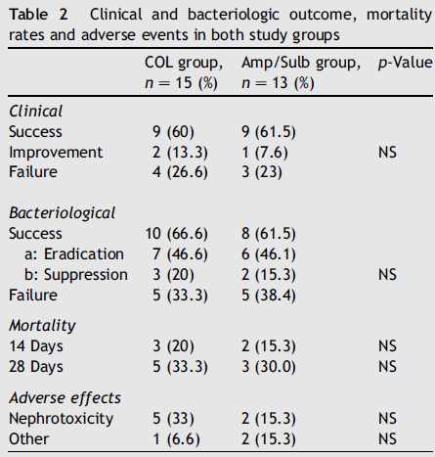
J Infect 2008;56:432-6
Notes:
RCT, small sample size

Slide 26
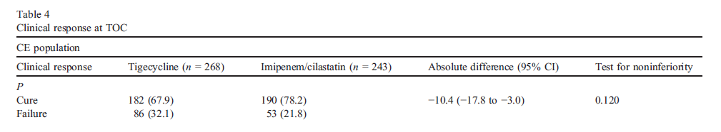
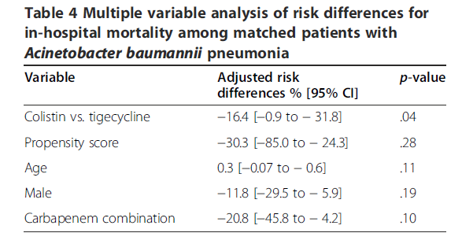
Concern of tigecycline
Diagn Microbiol Infect Dis 2010;68:140-51
BMC Infect Dic 2014;14:102
Notes:
TG vs. imipenem: phase 3 RCT
TG vs. colistin
3. P.Aerugionsa 효과 약함.

Slide 27
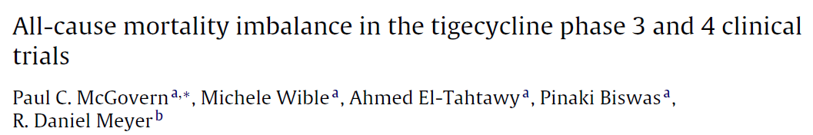
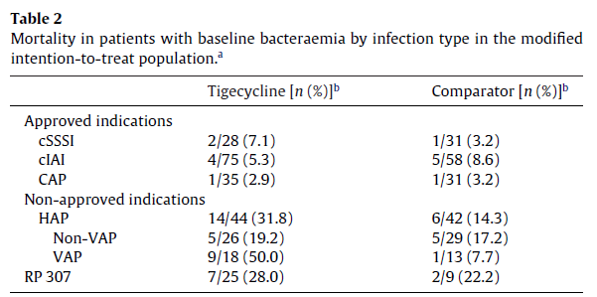
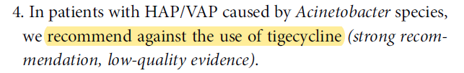
Int J Antimicrob Agents 2013;41:463-7

Slide 28
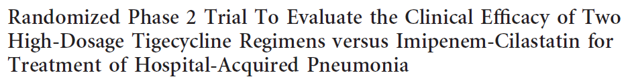
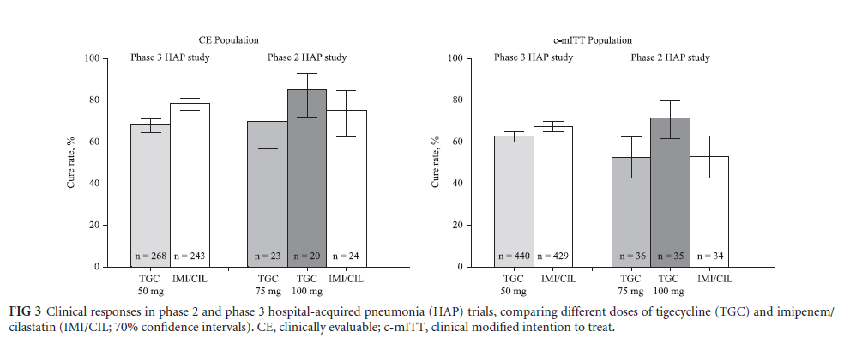
AAC 2013;57:1756-62
Notes:
100 mg bid

Slide 29
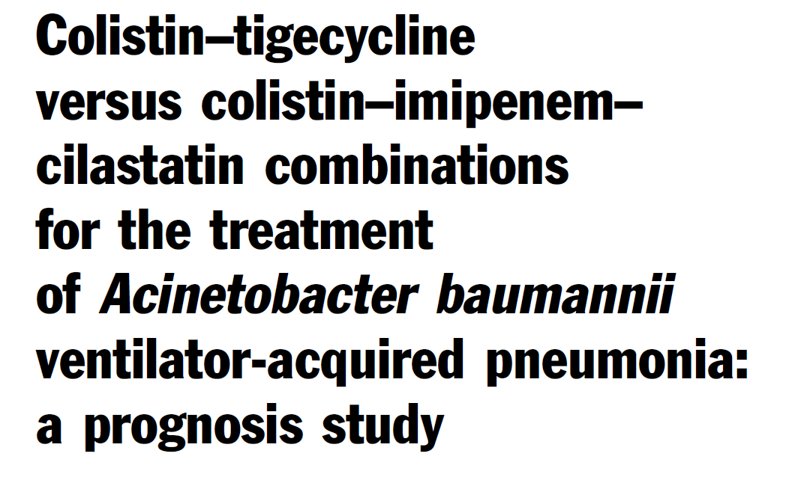
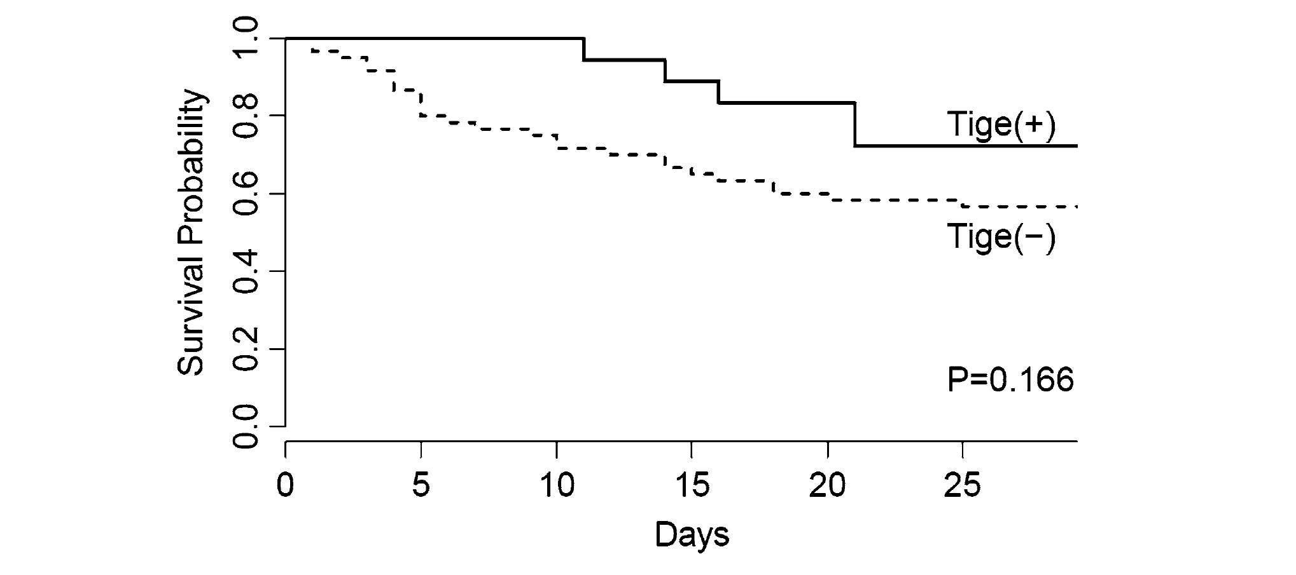
Chaari et al. Intensive Care Med. 2015; 41: 2018
Notes:
Imipenem 내성일시에 colistin+TG
High dose TG during first 48 hr (100mg bid)

Slide 30
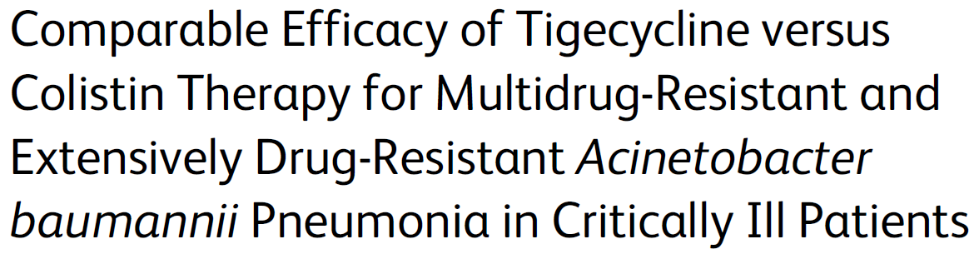
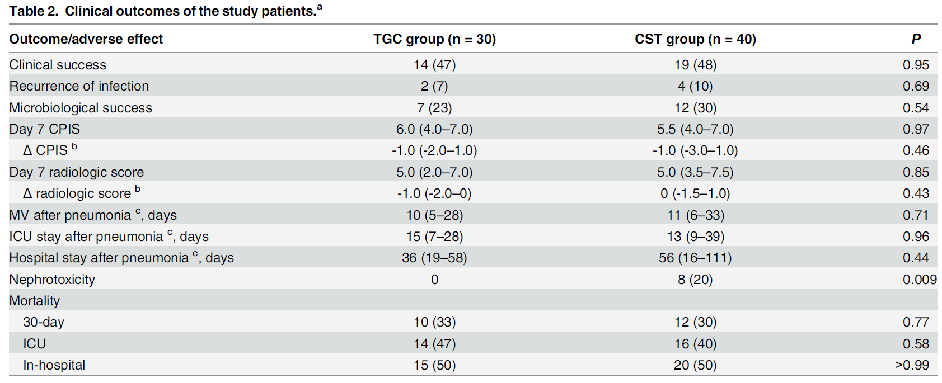
PLoS ONE. 2016; 11: e0150642

Slide 31
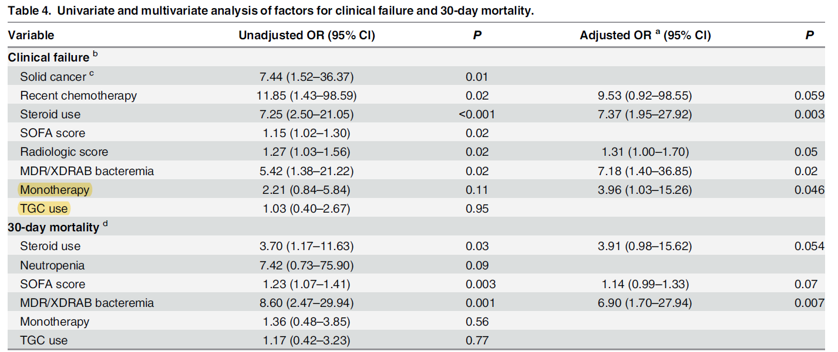
Notes:
Trend toward higher clinical and microbiological success rates and lower 30-day, ICU, and in-hospital mortality rates in the combination therapy

Slide 32
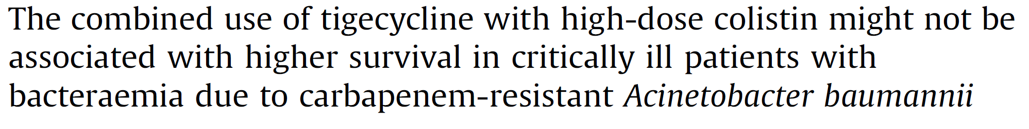
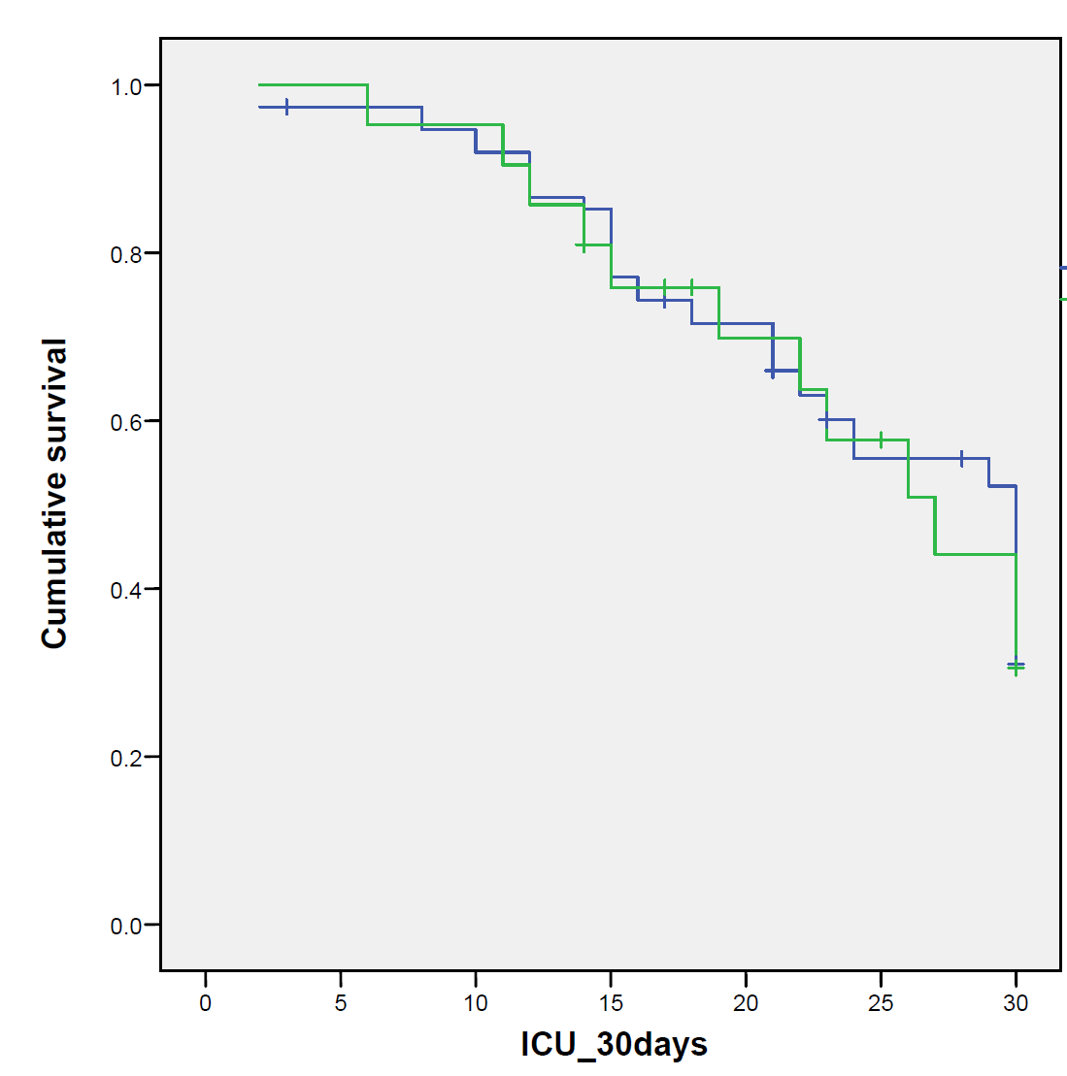
Colistin monotherapy
(n = 76)
Colistin + tigecycline
(n = 42)
Clin Microbiol Infect 2018; 24; 630

Slide 33
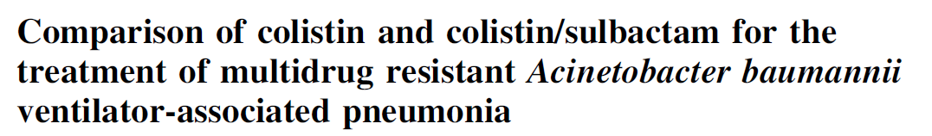
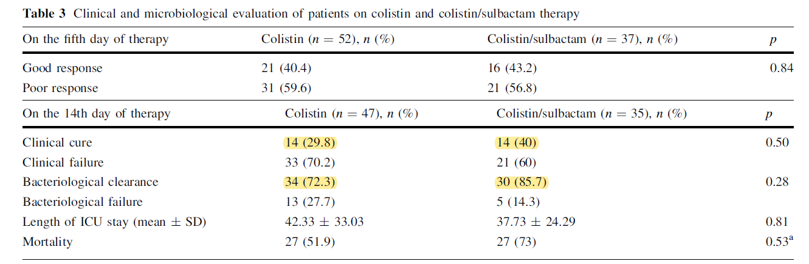
Infection 2014;42:37-42
Notes:
Retrospective
mortality

Slide 34
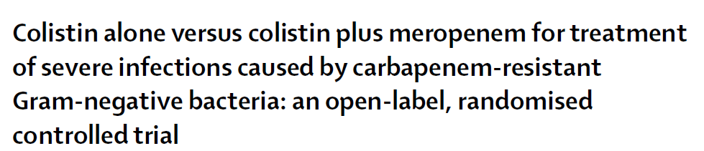

  Lancet Infect Dis 2018; 18: 391

Slide 35

Carbapenem resistant pathogens
(P. aeruginosa, A. baumanni, enterobacteriaceae)
Therapeutic options
- colistin
Other options
- ampicillin/sulbactam
- tigecycline
- colistin +α
- double carbapenem (in vitro)

Slide 36


Slide 37



Slide 38


Slide 39



Slide 40
3. Inhaled colistin

Slide 41



Clinical response rate
Microbiological eradication
  Int J Antimicrob Agents 2015;46:603-9

Slide 42


Mortality
Nephrotoxicity
  Int J Antimicrob Agents 2015;46:603-9

Slide 43


Mortality
  J Infect 2018;76:321-327

Slide 44


Slide 45



Mortality 33.8% (23-55%)
Clinical success 70.4% (18-75%)
Microbiological success 71.3% (18-75%)
Notes:
Mortality 33.8% (control 과 차이없음) – IV colistin study 결과: 23-55%
Clinical success 70.4% - 75%
Microbiological success 71.3% -75%

Slide 46



Slide 47
4. Infection control

Slide 48

  Analysis of KARMS data from 2013 to 2015
Notes:
CTX: cefotaxime
CAZ: ceftazidime
FEP: cefepime
FOX: cefoxitin

Slide 49

  Analysis of KARMS data from 2013 to 2015

Slide 50

  Analysis of KARMS data from 2013 to 2015

Slide 51


Slide 52
의료관련 감염병 – 다재내성균 6 종
MRSA (Methicillin-resistant S.aureus)
VRSA (Vancomycin-resistant S.aureus)
VRE (Vancomycin-resistant enterococcus)
MRPA (Multidrug-resistant P.aeruginosa)
MRAB (Multidrug-resistant A.baumanni)
CRE (Carbapenem-resistant enterobacteriaceae)
Notes:
장내세균과: E.coli, K.pneumoniae, citrobacter, shigella, salmonella, enterobacter

Slide 53


Slide 54


Slide 55

  Antimicrob Agents Chemo 2013;57:1488-1495
Notes:
Carrier/control/odds ratio

Slide 56




Slide 57


항생제 추가 없이 volume control, sputum expectoration
CRP 3.37->14.75 -> 4.76
Notes:
2주 meropenem -> 중단 중

Slide 58
경청해 주셔서 감사합니다.

