Slide 1
Advanced Treatment Strategies for Anemia
-Chemotherapy induced Anemia-
계명대학교 동산병원 호흡기내과
박 순 효

Slide 2
Classification of Anemia
Iron Deficiency Anemia: Due to insufficient iron, often from chronic blood loss or inadequate dietary intake.
Megaloblastic Anemia: Due to impaired DNA synthesis, often from vitamin B12 or folate deficiency.
Hemolytic Anemia: Due to increased destruction of red blood cells, from causes like autoimmune disorders, hereditary conditions (e.g., sickle cell anemia), or infections.
Aplastic Anemia: Due to bone marrow failure, which can be idiopathic or caused by factors like radiation, toxins, or infections.
Concept -> RBC size, RBC production (reticulocyte count)
Notes:
Etiologic
생산이 안되거나 destruction이 많거나 blood loss 가 많거나...

Slide 3
Classification
Uptodate
Notes:
Hemolysis typically is associated with a normal or high. Hemolysis is typically associated with some degree of macrocytosis because reticulocytes are larg

Slide 4
빈혈의 종류에 따른 말초혈액 현미경 소견
Normal
IDA
Vit B12 or folate deficiency
Notes:
철은 Hb의 주요 구성성분 -> 없으면 정상적인 크기와 색을 못 갖춤
DNA합성이 지연되어 핵분열이 원활하게 이루어지지 않음. -> 세포는 계속 성장하지만 분열이 되지 못해서 크기가 커짐
핵의 성숙이 지연되면서 세포질은 상대적으로 정상적인 성장을 계속하게 되어 적혈구의 전구세포가 비정상적으로 커짐 -> megaloblast가 됨. (핵의 성숙 지연과 세포질의 성장 불균형)

Slide 5
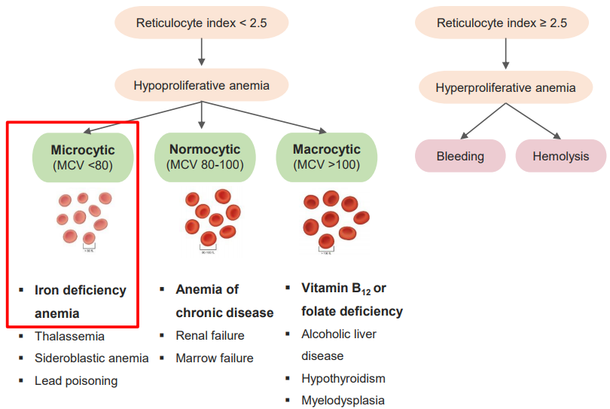

Slide 6
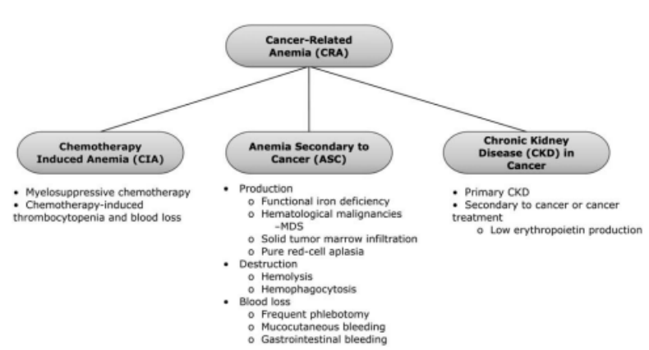
Then? Anemia in Lung Cancer ??
Multifactorial
Chemotherapy
Chronic disease – erythropoietin deficiency
Iron deficiency
Cancer bleeding
Tumor invasion of BM or kidney
Notes:
만성염증으로 인한 IL-1, 6, TNF-a등의 cytokine 이 신장에서 EPO 생산을 억제,
종양이나 항암자체로 인해 신장 기능이 저하.
만성질환에 의한 inf cytokine이 간에서 hepcidin 분비를 증가시킴, 이는 철의 흡수와 재활용을 억제 -> 그 결과 철 이용 가능성을 감소시키고, 적혈구 생성에 필요한 철을 제한하게 되며, 신장은 이를 적혈구 생성 감소로 인식하여 EPO 분비를 감소 시킴

Slide 7
What is ‘CIA’?
Chronic
disease
Nutritional deficiency
 | At diagnosis | During Tx | Total
Gastric Cancer | 14 (20.3%) | 40 (39.6%) | 101
Colorectal Cancer | 14 (13.9%) | 15 (21.7%) | 69
HCC | 2 (8.7%) | 6 (26.1%) | 23
Lung cancer | 19 (12.5%) | 68 (44.7%) | 152
Oncotarget. 2015; 6:42803-42812
Cytokines
Hemolysis
Anemia
in cancer
patients
Chronic bleeding at tumor site
Chemotherapy
Radiotherapy
Notes:
암환자는 다양한 원인으로 인해 빈혈을 경험합니다. 그 중 특히 chemotherapy에 의해 발생하는 빈혈을 Chemotherapy-Induced Anemia, 줄여서 CIA 라고 합니다.

Slide 8
Severity of Chemotherapy induced Anemia
High % of CIA in Gynecologic Cancers due to accumulation effect of repeated chemotherapy cycle, nephrotoxic platinum agents induced erythropoietin decrease and Pelvic Irradiation ²
ECAS: The European Cancer Anemia Survey. Ref. 1. Stasi R, et al., The Oncologist 2005;10:539-554 , 2. Ludwig H. et al.,. Eur J Ca. 2004:40(15):2293-2306.
Notes:
암종과 치료에 따른 CIA의 빈도를 비교해 본 자료입니다(NCCN 가이드라인에서 인용).
H&N, NSCLC, Ovarian, Breast, NHL은 가장 흔히 발생하는 암종으로 나타났습니다.
일반적으로, 부인암에서 빈혈이 더 심각하다는 보고가 있습니다.
유럽에서 진행된 multinational prospective survey 결과입니다.
약 15,000의 암환자를 대상으로 어떤 암종에서 빈혈이 가장 심한지 조사했습니다.
부인암 환자 중 49%에서 빈혈이 발생했습니다.
이는 조사 대상이던 다른 고형암에 비해 부인암 환자에서 빈혈 발생률이 가장 높았습니다.
왜 부인암에서 빈혈이 가장 심했을까요? 그 이유는
- 많은 종류의 항암제를 투여 받게 되기 때문입니다.
또한 platinum제제가 투여되는데, 이는 신장독성이 있기 때문에 신장에서 생산되는 내인성 erythropoietin이 저하될 수 있습니다.
자궁경부암 환자의 경우 항암화학요법에 들어가기 전에 pelvic irradiation을 이미 받아서 골수 기능이 저하될 가능성이 있습니다.
이러한 상황 때문에 부인암에서는 CIA의 관리가 더욱 필요하다고 강조하고 싶습니다.
ECAS was conducted to prospectively evaluate the prevalence, incidence and treatment of anaemia (haemoglobin <12.0 g/dL) in European cancer patients, including the relationship of mild, moderate and severe anaemia to performance status.
Patients were evaluated for up to 6 months.
Data (N=15367) included demographics, tumour type, performance status, haemoglobin levels, cancer treatments and anaemia treatments.
Prevalence of anaemia at enrollment was 39.3% (haemoglobin<10.0 g/dL, 10%), and 67.0% during the survey (haemoglobin <10.0 g/dL, 39.3%). Low haemoglobin levels correlated significantly with poor performance status.
Incidence of anaemia was 53.7% (haemoglobin <10.0 g/dL, 15.2%).
Anaemia was treated in 38.9% of patients (epoetin, 17.4%; transfusion, 14.9%; and iron, 6.5%).
Mean haemoglobin to initiate anaemia treatment was 9.7 g/dL.
Anaemia prevalence and incidence in cancer patients are high.
Anaemia significantly correlates with poor performance status and many anaemic patients are not treated. ( Ludwig H, Belle SV, et al. The European Cancer Anaemia Survey (ECAS): A large, multinational, prospective survey defining the prevalence, incidence, and treatment of anaemia in cancer patients, European Journal of Cancer 2004;40:2293–2306 )

Slide 9
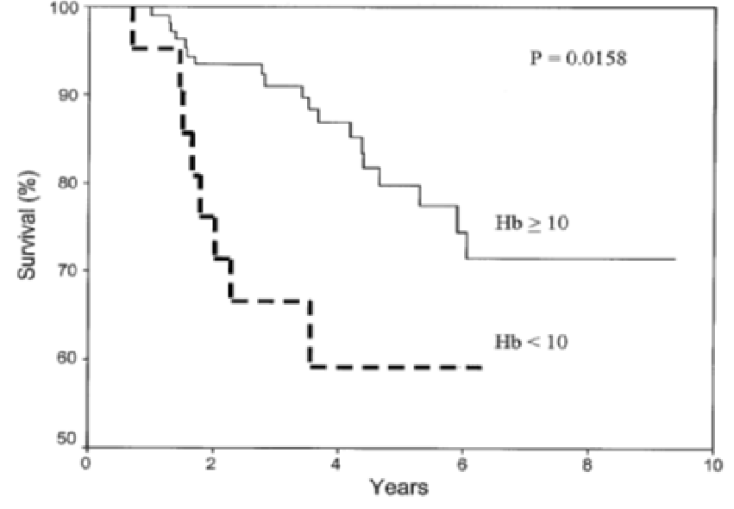
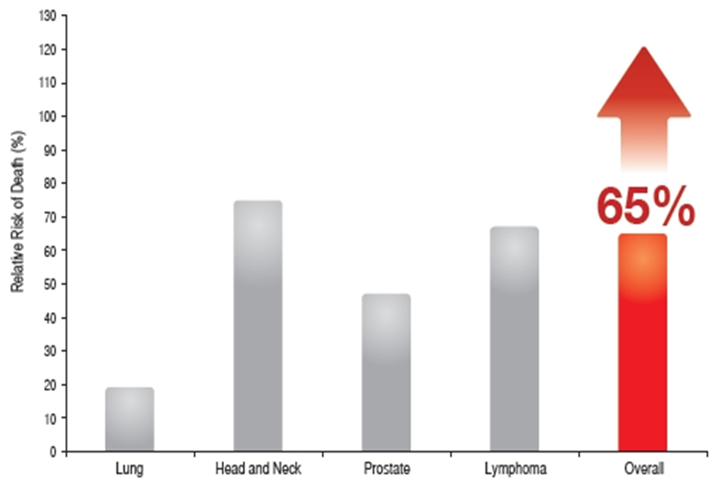
Negative impact of CAA
65% higher relative risk of death for anemic patients than for non-anemic patients. ¹
Anaemia during adjuvant chemotherapy is associated with poor survival in breast cancer patients.²
Impact of anemia on relative risk of death
(anemic patients vs. non-anemic patients)
.
Kalpan-Meier plot: survival according to Hb (thereshold 10g/dl)
Hb≥10
Hb<10
Oncologist 2005;10:539-554
Acta Oncologica 2005; 44: 129-133
[Method] A systematic review of 60 articles reporting the survival of cancer patients in relation to anemia and hemoglobin concentration
[Patients&Methods] Retrospective study, 129 Primary Breast Cancer patients with adjuvant cytotoxic chemotherapy
1. Stasi R, et al., The Oncologist 2005;10:539-554 2. Peters -Engl C, et al. Acta Oncologica, 2005; 44: 129-133
Notes:
CIA 는 왜 치료해야 할까요 ?
보시는 것처럼, 암 환자의 생존율을 분석한 결과 CIA가 있는 환자의 사망률이 65% 더 높았습니다(NCCN 가이드라인 참조).
아울러 유방암 수술 및 항암화학요법 후 빈혈, 즉 Hb<10g/dl의 경우 낮은 생존율과 관련이 있었습니다.
항암화학요법으로 인한 빈혈이 환자의 QOL뿐 아니라 생존율에도 영향을 미친다는 것을 알 수 있습니다.
따라서 항암치료 환자의 Hb level을 높이는 것이 매우 중요합니다.
The estimated median five-year overall survival rate: 76.6%.
Low nadir Hb, larger tumours, and hormone-receptor-negative tumours (p=0.008, p=0.042, p=0.022, resp.) to be significantly associated with poor patient survival.
Increased risk for death: Nadir Hb, 1.54-fold (95% CI 1.03-2.32), tumour size, 3.2-fold (95% CI 1.17-8.77)
참고)
Survival analyses did not show a correlation between preoperative Hb levels with DFS hazard ratio 0.98 (95% CI 0.71/1.33), DDFS 0.97 (95% CI0.70/1.37), and OS 1.03 (95% CI 0.73/1.45). → 수술 전 Hb level은 생존율과 관련이 없음
Prechemotherapy Hb levels also failed to correlate with DFS hazard ratio 1.09 (95% CI 0.83/1.43), DDFS 1.06 (95% CI 0.79/1.45), and OS 1.18 (95% CI 0.85/1.61) respectively. →Chemo 전 Hb level도 생존율과 관련이 없음

Slide 10
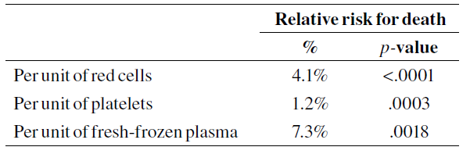
Risks of RBC transfusion (continued)
Increased risk of venous and arterial thrombotic events and mortality in hospitalized cancer patients: [OR 1.60, (95%CI 1.53–1.67); OR 1.53 (95%CI 1.46–1.61), P<0.0001 ]; OR 1.34 (95% CI 1.29–1.38 p<0.0001 ] ¹
Avoidance of unnecessary transfusion is essential for reduction of the mortality of CVP-BSI.²
A restrictive strategy of RBC transfusion
(Hb threshold, 7.0 g of Hb/dl, maintenance range 7.0 to 9.0) is at least as effective as and possibly superior to a liberal transfusion strategy (threshold, 10.0 g/dl; maintenance range, 10.0 to 12.0) in critically ill patients. ³
Table.
Higher relative risk for death within 10 years of transfusion, after adjustment for the effects on mortality of age, gender, and number of days of hospitalization (n = 802) ⁴
1. Khorana AA et al., Arch Intern Med. 2008 Nov 24; 168(21): 2377–2381. 2. Jin Hyoung Kang, et al., Cancer Res Treat. 2014;46(3):250-260 3. Paul C et al., N Engl J Med 1999;340:409-17 4. Vamvakas EC, Taswell HF. Transfusion 1994;34:471–477.
Notes:
ESA 제제의 효과로, 우선 빈혈교정과 이에 따른 수혈의 감소 효과를 들 수 있습니다.
이 자료는 darbepoetin을 투여할 때의 효과입니다.
- 수혈을 받는 환자 수 감소
Hb가 8 이하로 떨어지는 환자 수 감소
수혈을 받더라도 unit은 감소

Slide 11
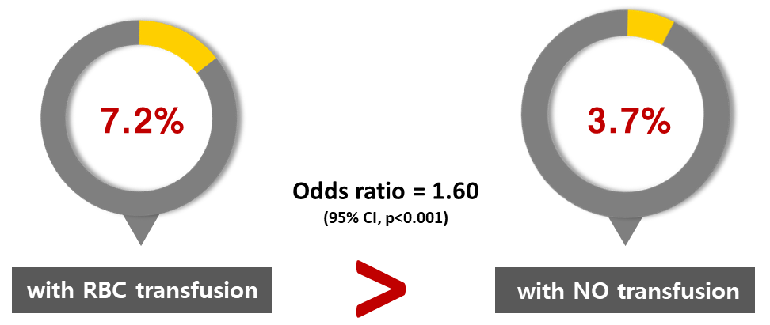
Association of Transfusion and Thrombosis
Thromboembolism risk of transfusion: Of patients receiving RBC transfusions, 7.2% developed ve-nous thromboembolism and 5.2% developed arterial thromboembolism, and this was significantly greater than the rates of 3.8% and 3.1%, respectively, for the remain-ing study population (P<.001).
RBC transfusions are associated with increased risks of venous and arterial thrombotic events and mortality in hospitalized patients withcancer.
Incidence of VTE in cancer pts. with or with out transfusion
JAMA Internal_2008;168(21);2377-2381
DA: darbepoetin alfa, TE: Thromboembolism, VTE: Venous Thromboembolism
Ref. 1. NCCN Guidelines ver. 2.2016 , 2. Ludwig H, J Clin Oncol 2009;27:2838-47 3. Bennett CL et al., JAMA 2008;299:914-924.
Notes:
하지만 ESA 투여에 따른 부작용도 있습니다.
Thromboembolism가 보고된 바 있는데요.
메타분석 결과,
암환자에서 ESA는 thromboembolism의 교차비(odds ratio)가 1.48~1.69로
통계적으로 유의하게 증가하였습니다.
TE 위험도가 높은 암환자에서 ESA 사용시 적절한 조치가 이뤄질 수 있게 준비할 필요가 있습니다.

Slide 12
Proven Methods for Anemia Correction
For patients receiving chemotherapy, the increasing hemoglobin level is of great impor­tance for improving survival and anti-tumor efficacy of chemotherapy.
If anemia is not due to absolute or functional iron deficiency, there are currently only two proven methods, ESA and RBC transfusion. ¹
Risk & goals of ESA vs. RBC transfusion
ESA in the cancer setting |  | RBC Transfusion
Transfusion avoidance Gradual improvement in anemia-related symptoms | Benefits | Rapid increase of Hb and hematocrit levels Rapid improvement in anemia-related symptoms
Increased thrombotic events Possible decreased survival Time to tumor progression shortened | Risks | Transfusion reactions(hemolytic, febrile, non-hemolytic, lung injury) TACO Virus transmission(hepatitis, HIV) Bacterial contamination Iron overload Increased thrombotic events Possible decreased survival
Ref 1) NCCN guidelines version 1.2018
Notes:
현재 절대적 또는 기능성 철결핍에 기인하지 않은 빈혈 치료법으로 조혈자극제(ESA, erythropoiesis stimulating agent)와 적혈구 수혈(RBC transfusion)이 있습니다.
Transfusion은, 빈혈을 짧은 시간 동안에 개선시키는 효과가 있는 반면 fever와 같은 경미한 부작용부터 큰 부작용도 있을 수 있습니다.
최근 발표된 논문에서는 암환자에서의 잦은 수혈이 암환자의 생존을 감소시킨다고 보고하여 2016년 업데이트된 NCCN guideline에서는 transfusion이 생존에 위험성이 있다고 기재되어 있습니다.
이에 반해 ESA는 수혈을 피할 수 있는 장점이 있지만 효과가 점진적이고, ESA 역시 암환자의 생존율을 감소시킬 위험이 있다고 알려져 있습니다.

Slide 13
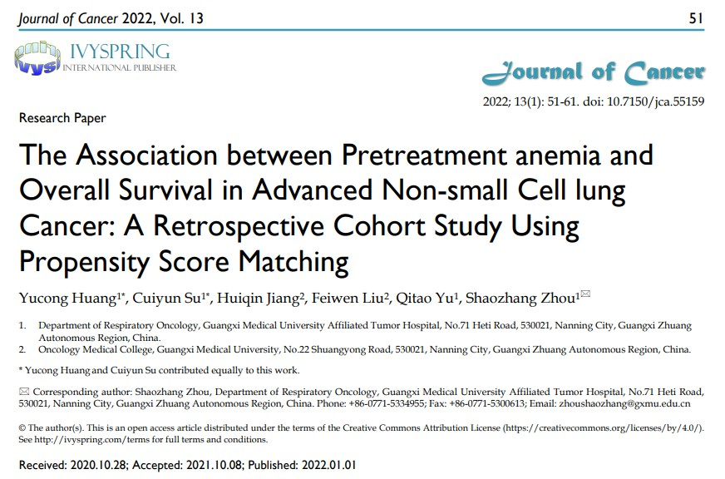
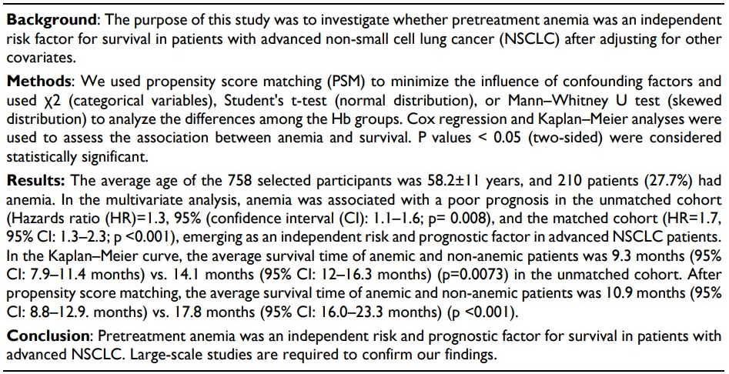

Slide 14
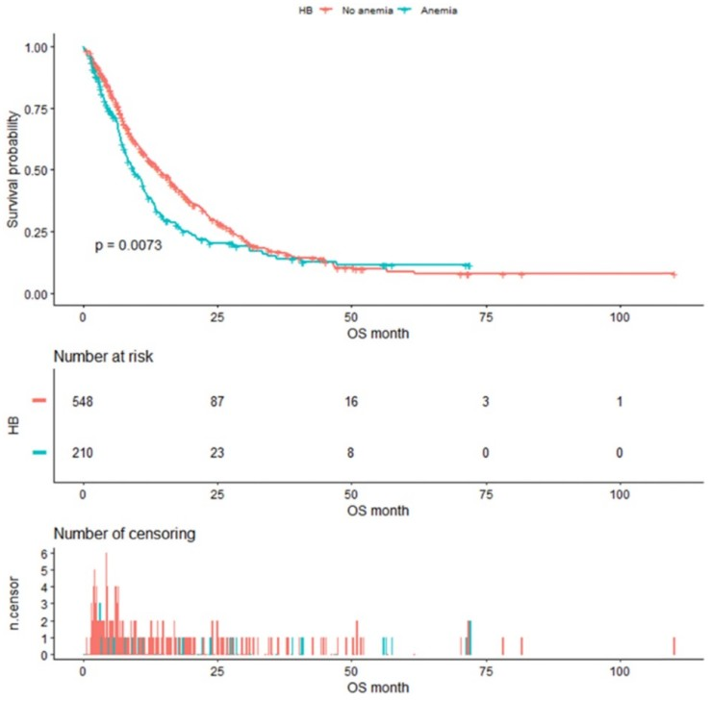
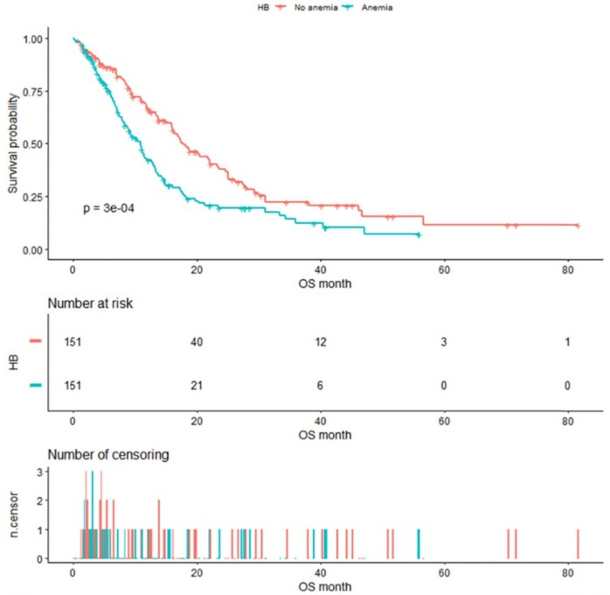
Kaplan–Meier analysis of Hb level before propensity score matching
Kaplan–Meier analysis of Hb level after propensity score matching
9.3 months (95% CI: 7.9–11.4 months) 14.1 months (95% CI: 12–16.3 months) (p=0.0073)
10.9 months (95% CI: 8.8–12.9. months)
17.8 months (95% CI: 16.0–23.3 months) (p <0.001)

Slide 15
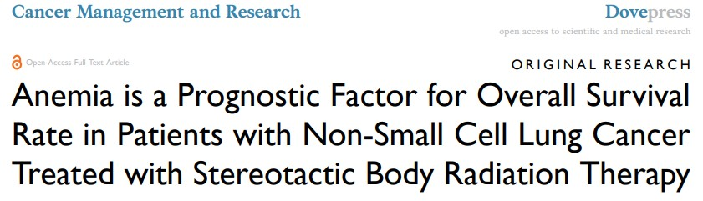
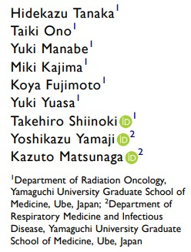
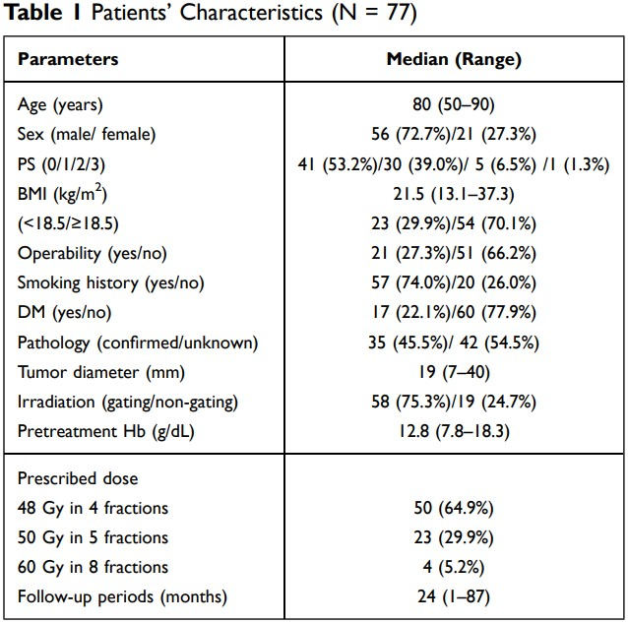
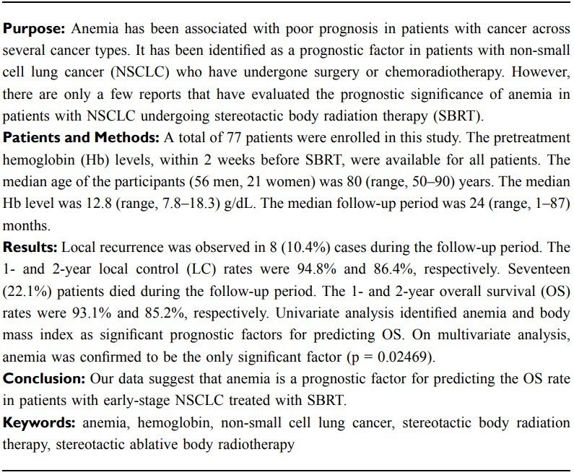

Slide 16
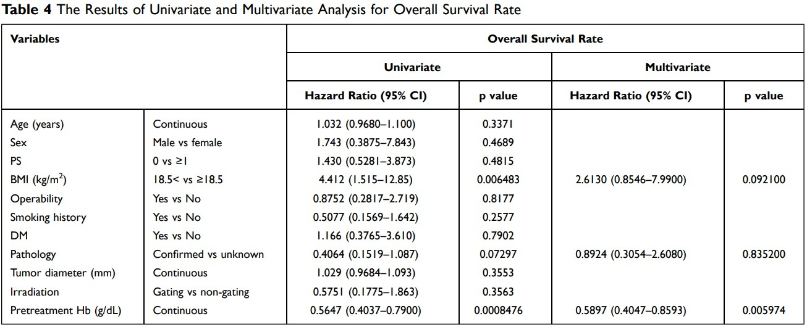

Slide 17
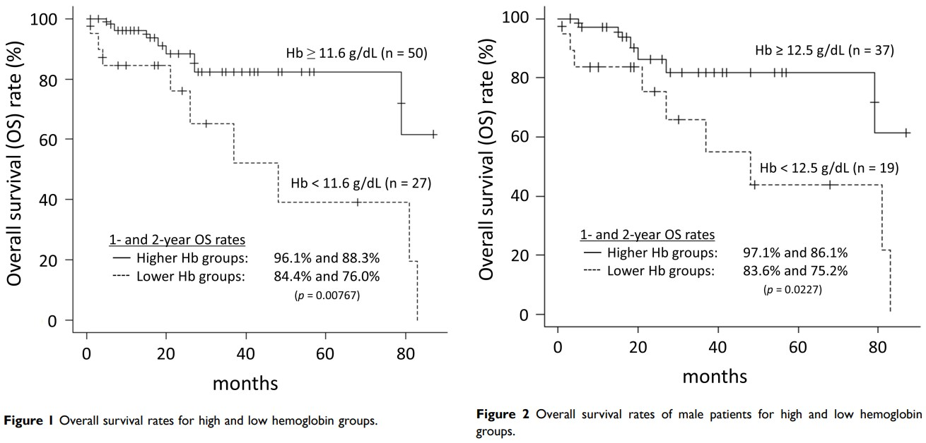

Slide 18
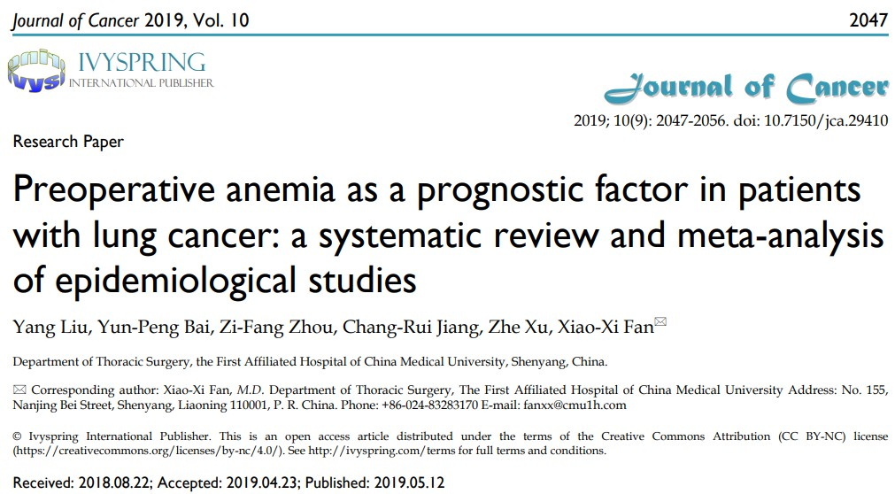

Slide 19
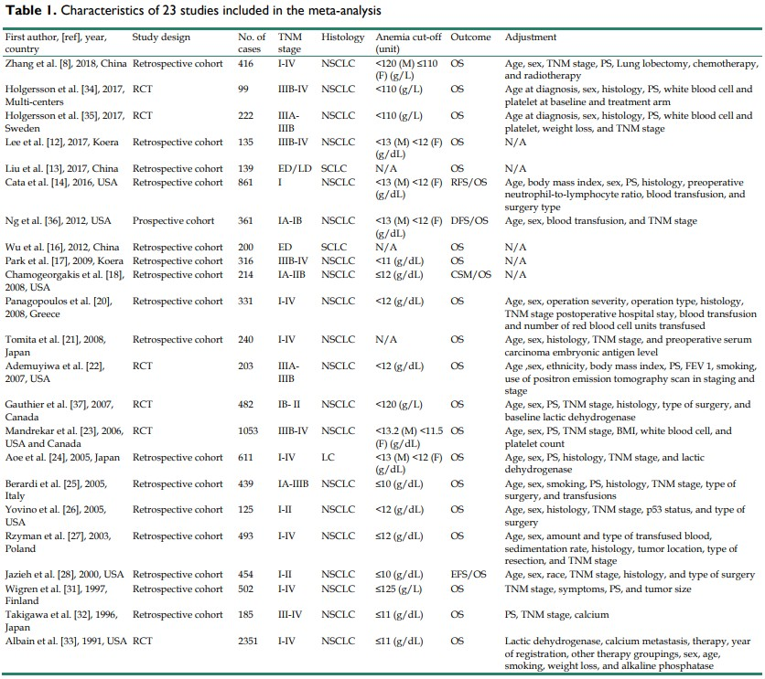
Notes:
CSM, cancer-specific mortality; DFS, disease-free survival; ED, extensive stage; EFS, event-free survival; F, female; LC, lung cancer; LD, limited stage; M, male; NSCLC, non-small cell lung cancer; N/A, not available; OS, overall survival; PFS, progression-free survival; PS, performance status; RCT, randomized controlled trial; RFS, recurrence-free survival; SCLC, small cell lung cancer

Slide 20
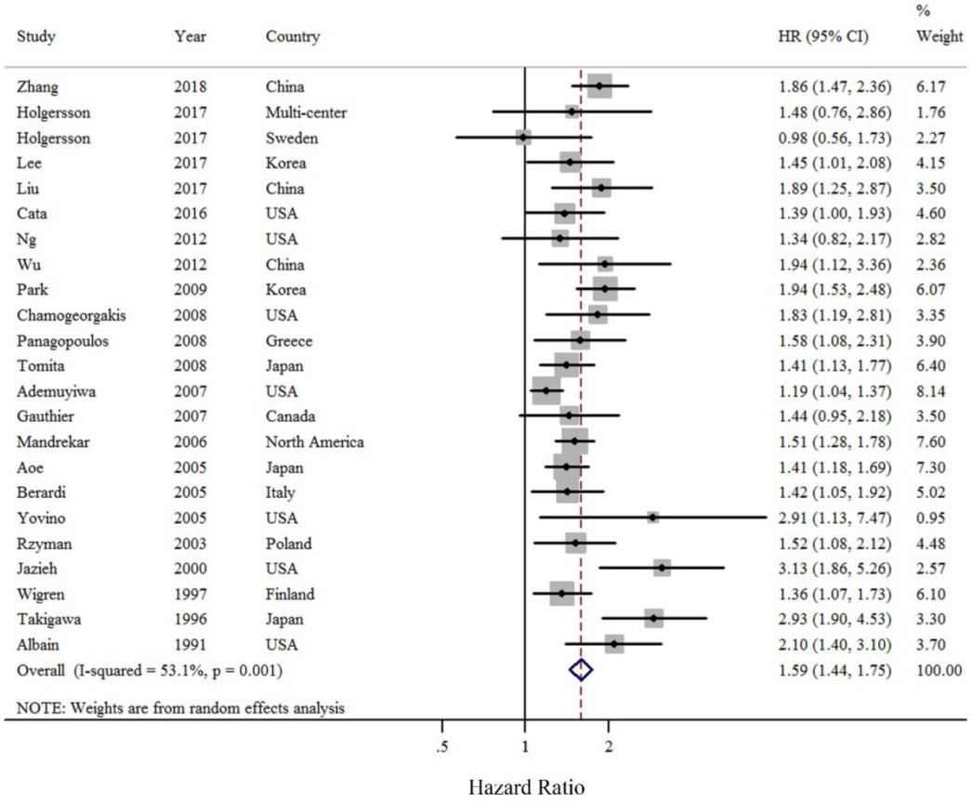
Notes:
Forest plot (random effects model) of pre-operative anemia and OS of LC patients. The squares indicate study-specific hazard ratios (size of the square reflects the study-specific statistical weight); the horizontal lines indicate 95% CIs; and the diamond indicates the summary hazard ratio estimate with its 95% CI.

Slide 21
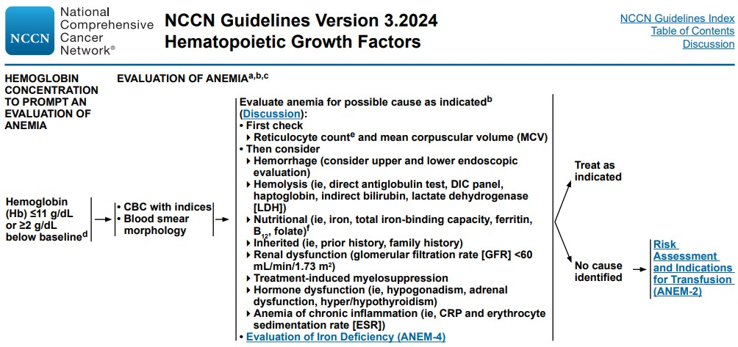
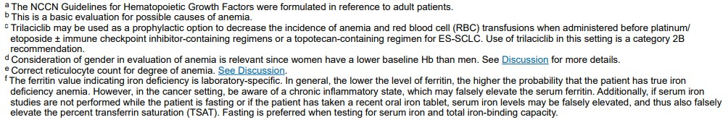

Slide 22
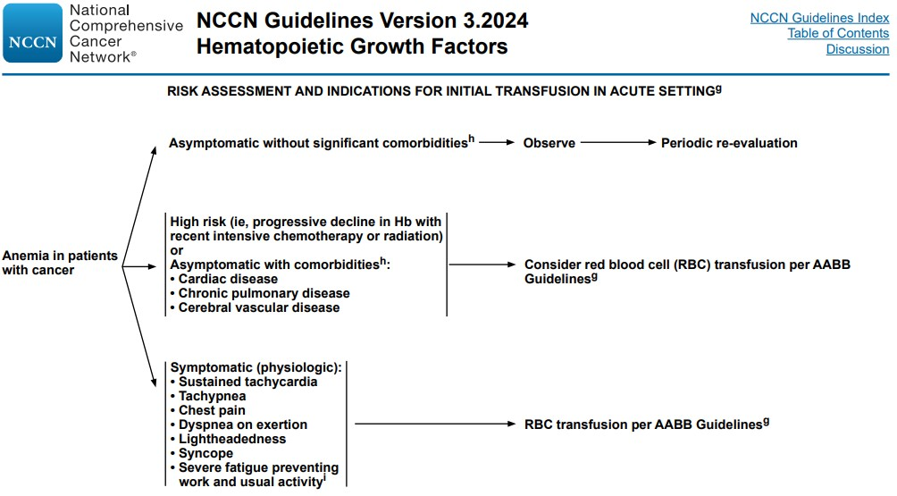
Degree of severity of comorbidities in combination with the degree of severity of anemia should be taken into consideration when initiating RBC transfusion.

Slide 23
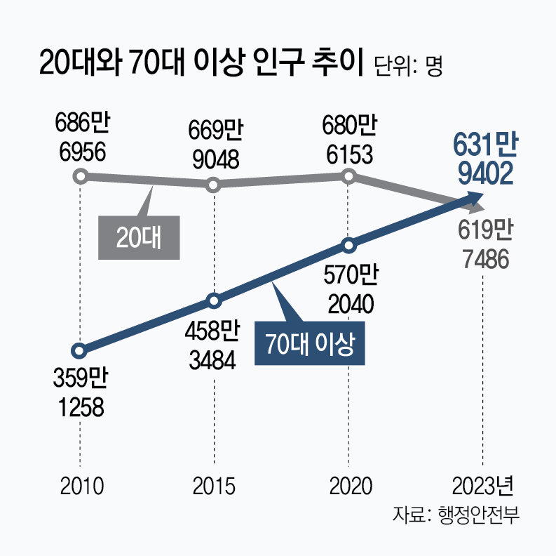
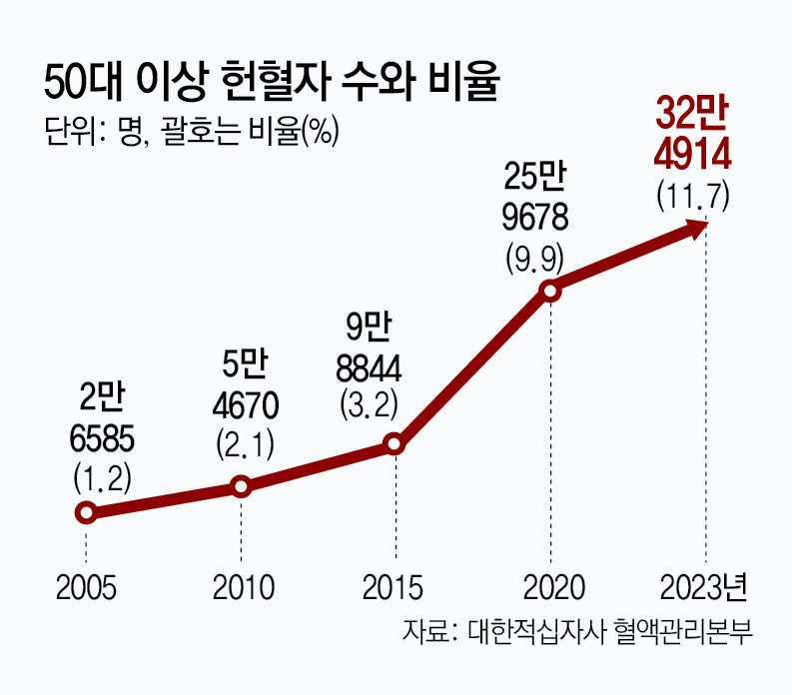

Slide 24
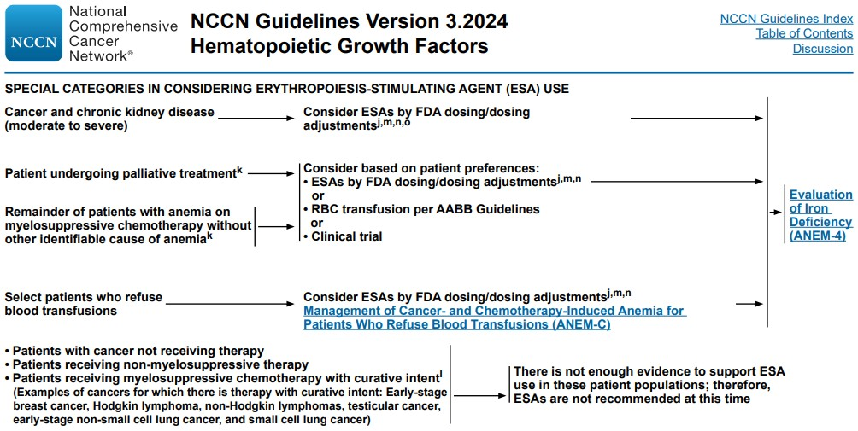
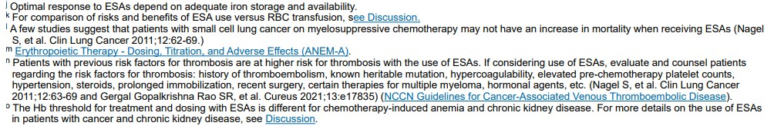

Slide 25
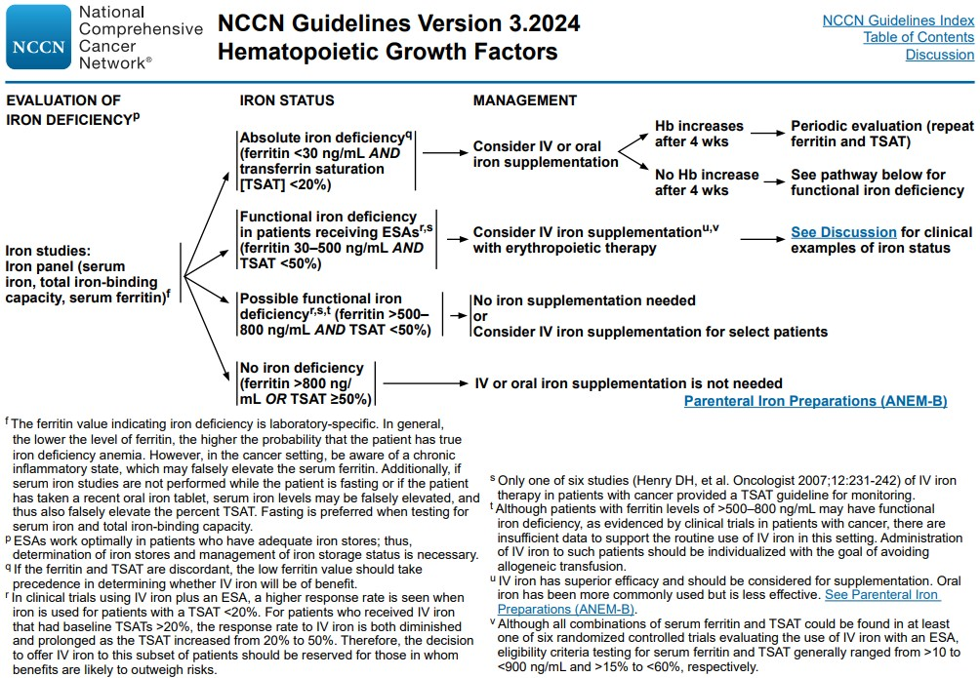
Ferritin:
30 ~ 400 ng/mL (male)
13 ~ 150 ng/mL (female)
TSAT:
20 ~ 50% (male)
15 ~ 50% (female)

Slide 26
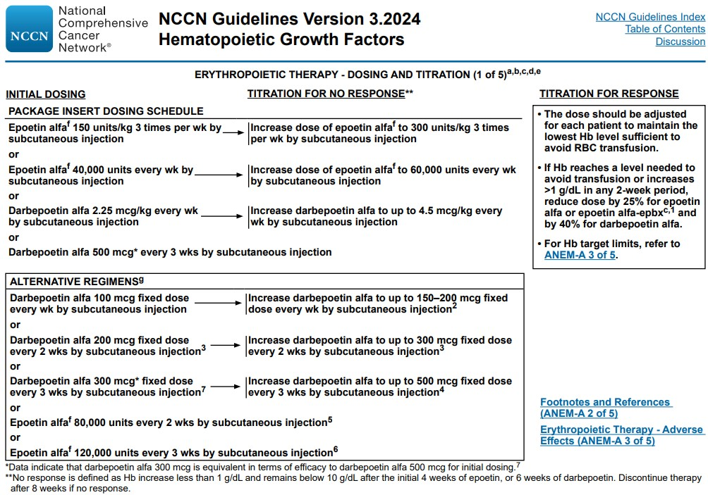

Slide 27
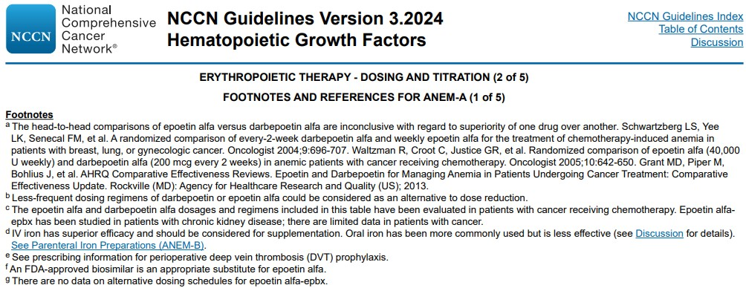

Slide 28
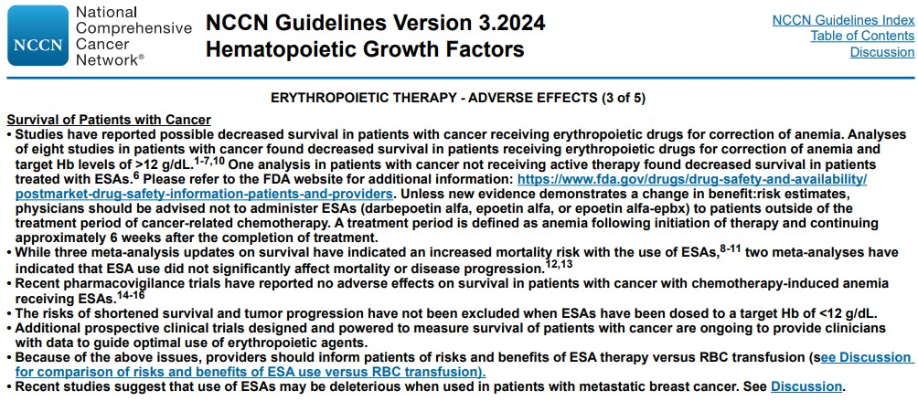

Slide 29
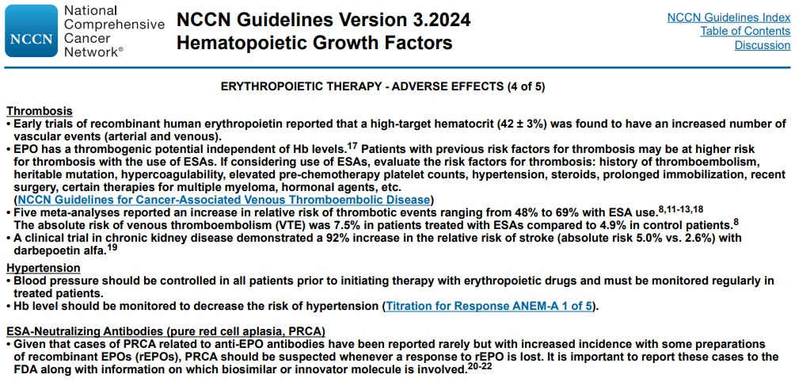

Slide 30
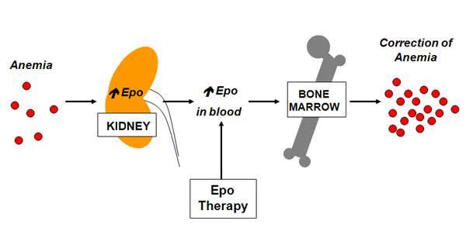
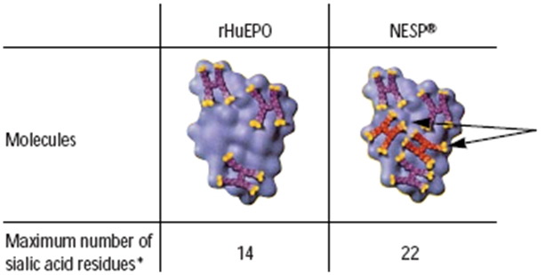
Pharmacology of Darbepoetin-alfa (NESP®)
Recombinant human erythropoietin (rHu-EPO), 165-amino-acid glycosylated protein hormone.
Darbepoetin alfa(DA) differs from rHu-EPO in that it contains additional 5 N-linked oligosaccharide chains. The additional carbohydrates result in longer half-life, increased biologic activity, and decreased receptor affinity. ¹
Both rHu-EPO and DA bind to the erythropoietin receptor on erythroid progenitor cells. Binding stimulates differentiation into mature red cells and inhibits apoptosis. ²
DA exhibits a half-life approximately 3 times longer than that of rHu-EPO. ³
Schematic model of NESP
Sialic
acid
Ref. 1. Egrie JC, Br J Cancer. 2001;84(Suppl 1):3–10. 2. Macdougall IC. Semin Nephrol. 2000;20:375–381. 3. Macdougall, J Am Soc Nephrol. 1999;10:2392–2395.
Notes:
말씀드린 것처럼 당 체인의 추가로 인해 시알산이 추가되었고
시알산을 제거하는 체내 대사 시간이 연장되어 결국 반감기가 길어진 지속형 제제가 되었습니다.
세포에 대한 작용은 기존 EPO와 동일하여 동일한 수용체에 작용해서 적혈구 전구세포의 분화와 증식을 촉진하여 RBC의 증가와 Hb의 증가 효과가 있습니다.
Recombinant human erythropoietin (rHu-EPO), 165-amino-acid glycosylated protein hormone. (the number of sialic acid residues is a significant determinant of the net negative charge of the molecule. Because of its structure, rHu-EPO can contain a maximum of 14 sialic acid residues )
Darbepoetin alfa(DA) differs from rHu-EPO in that it contains additional 5 N-linked oligosaccharide chains which are accommodated by substitutions at 5 positions along the 165-amino-acid backbone, which do not alter the tertiary structure or its biologic activity. The additional carbohydrates result in longer half-life, increased biologic activity, and decreased receptor affinity. ¹
Both rHu-EPO and DA bind to the erythropoietin receptor on erythroid progenitor cells. Binding stimulates differentiation into mature red cells and inhibits apoptosis. In vitro, the affinity of the EPO receptor for DA is less than that for rHu-EPO, but this does not translate into a loss of potency in vivo ²
DA exhibits a half-life approximately 3 times longer than that of rHu-EPO when given as a single dose by the intravenous route in humans. With similar volumes of distribution, the extended half-life results in a significantly increased area under the curve ³

Slide 31
The mechanism of action of EPO
Erythroid
burst-forming
unit (BFU-e)
Erythroid
colony-forming
unit (CFU-e)
Normoblasts
Red cell
Pluripotent
stem cell
Reticulocyte
Pro-erythroblast
Hemoglobin
accumulation
Neutrophils
Monocytes
Megakaryocytes
Lymphocytes
Erythropoietin
responsiveness
Globin mRNA
accumulation
Bunn HF. Harrison's principles of internal medicine. 13th ed. New York: McGraw-Hill; 1994

Slide 32
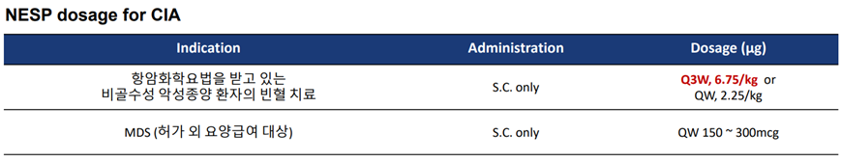
ESA Dosage & Insurance Guideline
항암화학요법(Chemotherpy)을 받고 있는 비골수성 악성종양 환자의 빈혈치료
Hb 10g/dL 이하 또는 Hct 30% 이하인 경우
Hb 12g/dL 또는 Hct 36%까지 요양급여를 인정하며, 진료비 청구 시 매월별 혈액검사 결과치를 첨부하여야 함
Hb 농도가 12.0g/dL를 넘지 않도록 하고, 12.0g/dL 초과시 11.0g/dL로 저하될 때까지 휴약. 전회 투여량의 절반으로 투여 재개. 암화학요법 종료 시 본제 투여 종료

Slide 33
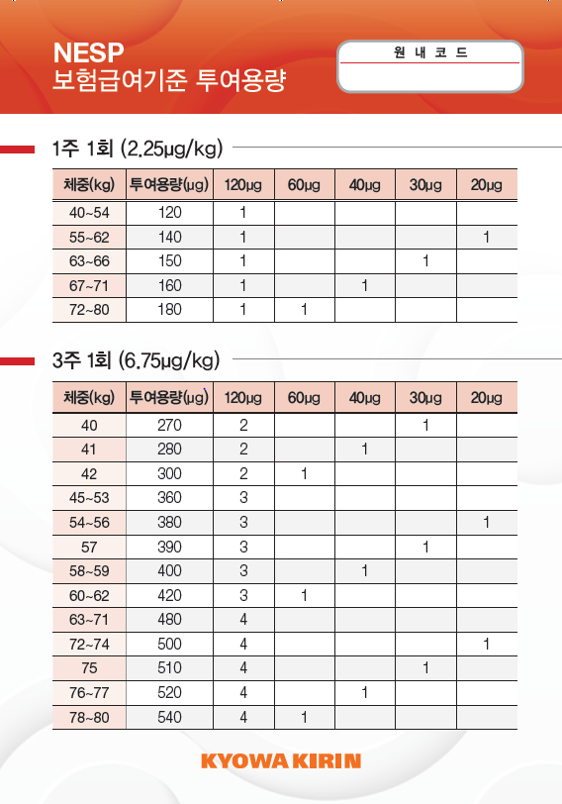
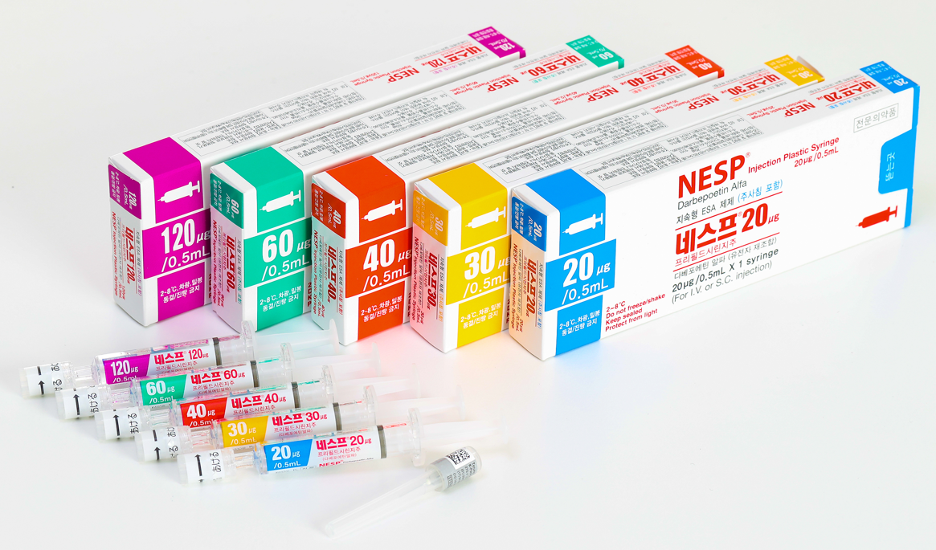


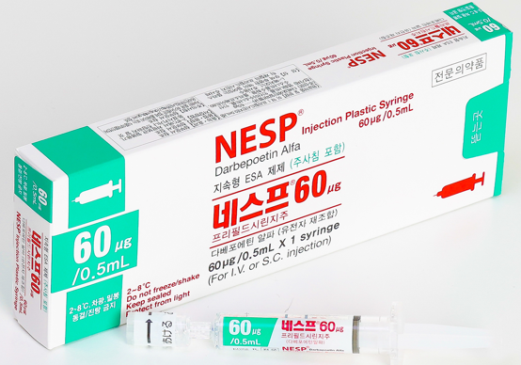

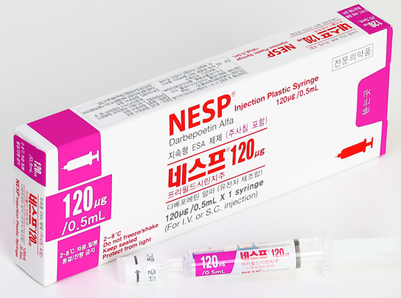
1주 요법
용량 60kg x 2.25㎍/kg = 135㎍
120㎍ x 1syr. + 20㎍ x 1syr.
약가 93,626원
➔ 환자 부담 5%= 3,709원
➔ x 3주 = 11,125원
3주 요법
용량 60kg x 6.75㎍/kg = 405㎍
120㎍ x 3syr. + 60㎍ x 1syr.
약가 199,113원
➔ 환자 부담 5%= 9,956원
(계산된 용량만 투여하시고, 남은 용량은 폐기하십시오.)

Slide 34

Thank You !

Slide 35
