Slide 1
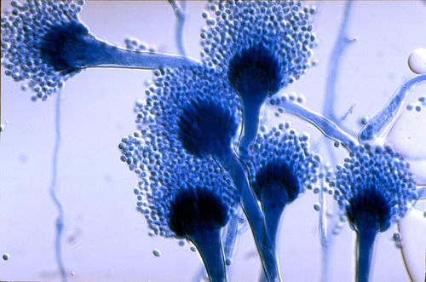
Chronic Pulmonary Aspergillosis
Diagnosis & management
2019.9.26
인제의대 부산백병원 호흡기,알레르기내과
이 현 경

Slide 2
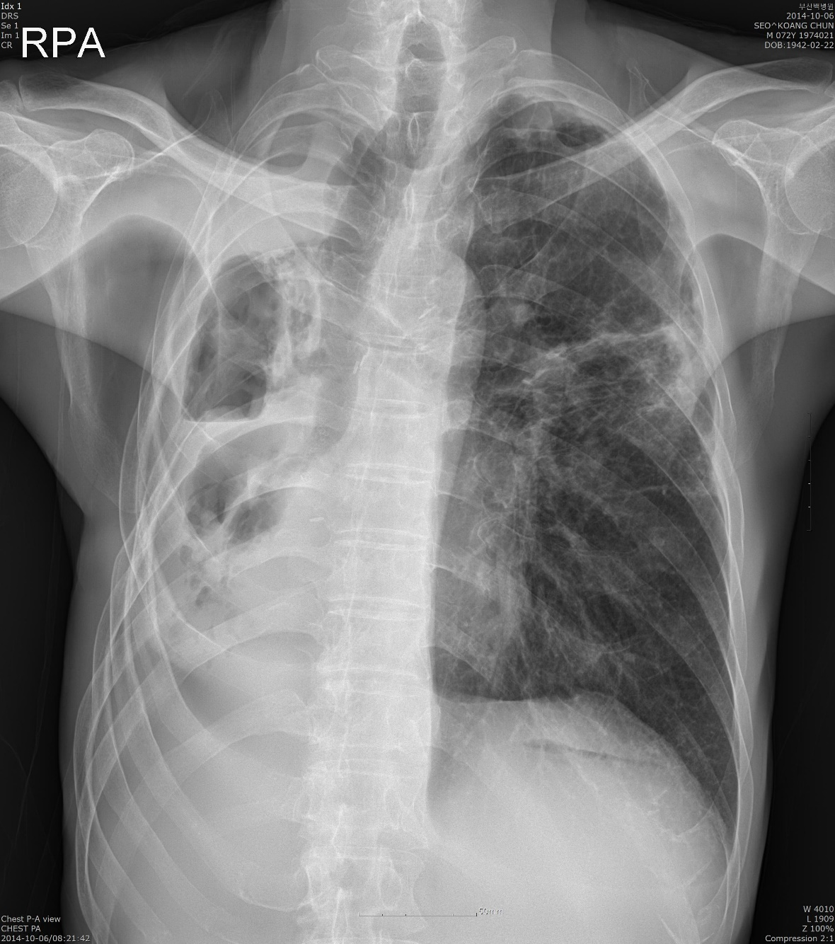
CASE (72/M)
s/p RLLectomy 7 YA due to lung cancer
H/O pul.TB in his thirties
non-smoker
presented with cough, sputum, BTS, fever 5MA

Slide 3
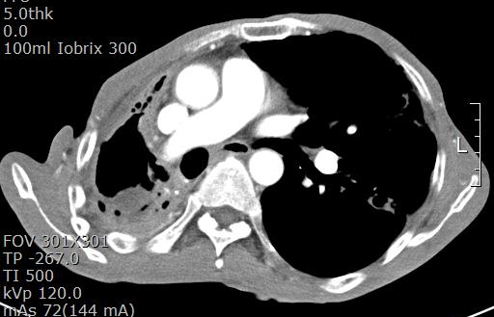
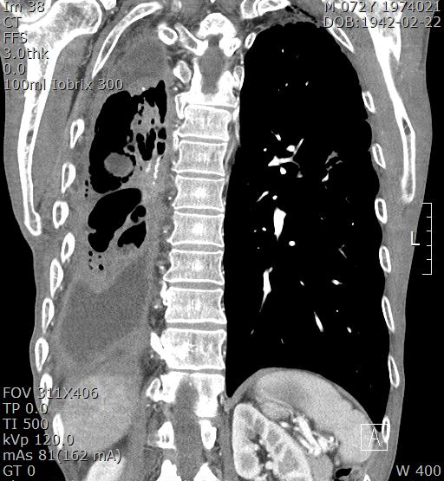
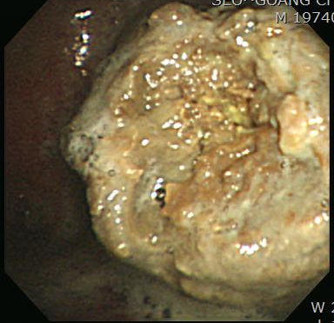
Notes:
Bronchopleural fistula and fungal ball inside the pleural cavity

Slide 4
Contents
Introduction : Aspergillus
Pulmonary aspergillosis : classification
Chronic pulmonary aspergillosis
  Diagnosis
  Treatment
Summary and Conclusion

Slide 5
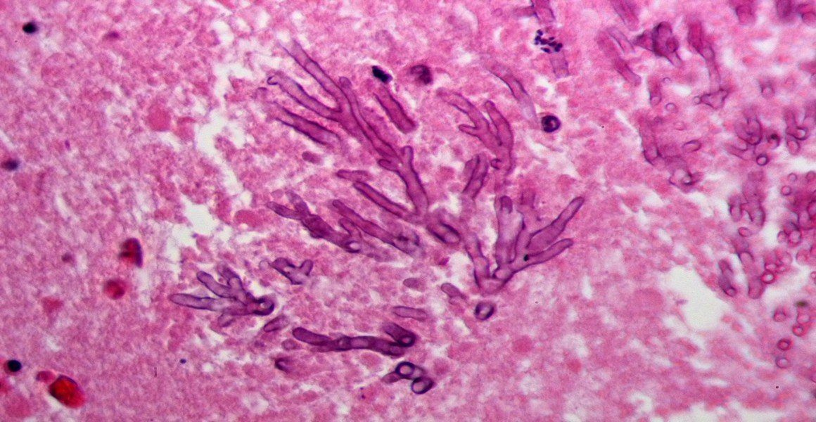
Introduction about CPA
- microbiology
- classification
- history
- epidemiology

Slide 6
Introduction about Aspergillus (1)
Where? anywhere
  ubiquitous in the environment; it can be found in soil,
  decomposing plant matter, household dust, building
  materials, plants, food, and water.
Who?
  면역억제자나 기존 폐질환자(TBC, NTM, COPD, etc)
  에서 감염유발
What species?
  약 180종의 Aspergillus 중 40종 정도가 사람에게 감염유발
  Aspergillus fumigatus가 가장 흔하게 감염유발
  Aspergillus niger, terreus, flavus가 소수에서 감염 유발

Slide 7
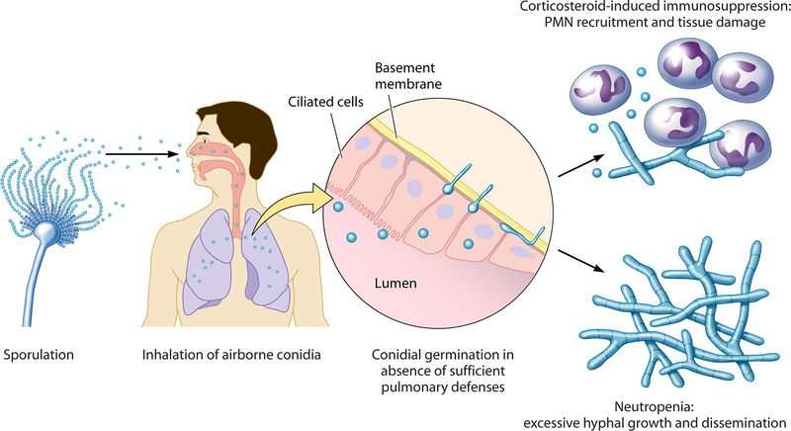
Introduction about Aspergillus (2)
- Life cycle-
Dagenais T, et al. Clin Microbial Rev 2009
Notes:
conidia germinate and form a network of hyphae on the interior surface of a cavity, damaging the surrounding parenchyma

Slide 8
Spectrum Pulmonary Aspergillosis
SAFS : severe asthma with fungal sensitization
CPA : chronic pulmonary aspergillosis
SAIA : subacute invasive aspergillosis
IA : invasive aspergillosis
Maghrabi F, et al. Curr Fungal Infect Rep (2017) 11:242–251
Notes:
SAFS L

Slide 9
Chronic pulmonary aspergillosis (CPA) history
1st recognized as a fatal condition in UK
1st radiological description of aspergilloma in France
1st classified (mycetoma)
Term SIPA, CNPA introduced
Criteria and classification proposed
1842 1938 1957 1959 early 1980s 2003 2010 -
1st recorded Ampho-B Tx (CPA complicating TBc)
Surgery for aspergilloma tried
Itraconazol, voriconazol, micafungin trials
SIPA : Semi-invasive aspergillosis
CNPA : chronic necrotizing pulmonary aspergillosis
Denning D, et al. ERJ 2016

Slide 10
Chronic pulmonary aspergillosis (CPA)
Epidemiology : global burden
Denning D, et al. ERJ 2016

Slide 11
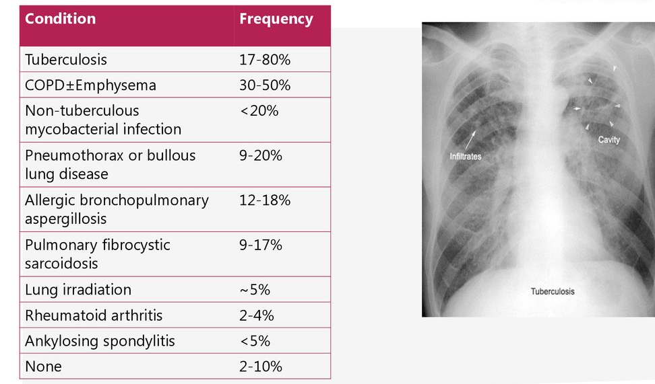
Risk factors for CPA

Slide 12
European Guideline for CPA
Eur Respir J 2016; 47: 45–68

Slide 13
Chronic pulmonary aspergillosis (CPA)
Simple aspergilloma
Aspergillus nodule
Chronic Pulmonary Aspergillosis (CPA)
Chronic cavitary pulmonary aspergillosis (CCPA)
Subacute invasive aspergillosis (chronic necrotizing pulmonary aspergillosis) (CNPA)
Chronic fibrosing pulmonary aspergillosis (CFPA)
Denning D, et al. ERJ 2016

Slide 14
Clinical characteristics of CPA

Slide 15
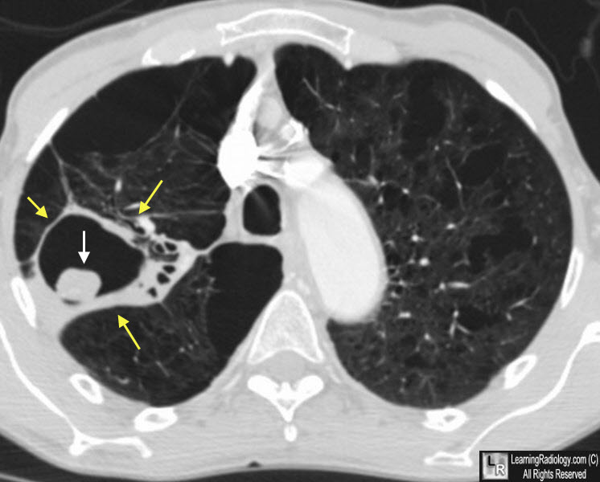
Aspergilloma
Morphological appearance of fungal ball (fungal hyphae & ECM)
Can be present in a pulmonary or pleural cavity or an ectatic bronchus
May be found in all forms of CPA (except Aspergillus nodule)
Learning radiology website

Slide 16
Single (simple) pulmonary Aspergilloma
Denning D, et al. ERJ 2016
Notes:
Simple aspergilloma that developed within a post-tuberculous cicatricial atelectasis of the left upper lobe with saccular bronchiectasis. Surgical resection by video-assisted thoracic surgery was performed because of recurrent haemoptysis and a requirement for anticoagulant therapy

Slide 17
Chronic cavitary pulmonary Aspergillosis (CCPA)
Denning D, et al. ERJ 2016
Notes:
a) lung and b) mediastinal windows at the level of the right upper lobe. Multiple cavities are visible with a fungus ball lying
within the largest one. The wall of the cavities cannot be distinguished from the thickened pleura or the
neighbouring alveolar consolidation. The extra pleural fat is hyperattenuated (white arrows). *: the dilated
oesophagus should not be confused with a cavity.

Slide 18
CCPA radiologic progression
2007
2012
Denning D, et al. ERJ 2016
Notes:
Untreated, over years, these cavities enlarge and coalesce, developing pericavitary infiltrates or perforating into the pleura, and an aspergilloma
may appear or disappear. Thus serological or microbiological evidence implicating Aspergillus spp. is required for diagnosis.
사진설명 : Chronic cavitary pulmonary aspergillosis showing marked progression between a) 2007 and b)
2012. Chest radiographs prior to 2007 (i.e. 1990s) showed “upper lobe fibrosis”, without a firm diagnosis. A
large cavity with pleural thickening is visible on the left in both images, with additional small cavities
inferiorly in 2012, and contraction of the left upper lobe. The right side shows interval development of a large
cavity, with some pleural thickening. Neither cavity contains a fungal ball.

Slide 19
Chronic fibrosing pulmonary Aspergillosis (CFPA)
Denning D, et al. ERJ 2016
Notes:
CFPA is often an end result from untreated CCPA. Extensive fibrosis with fibrotic destruction of at least
two lobes of lung complicating CCPA (figure 5), leading to a major loss of lung function. Usually the
fibrosis is solid in appearance, but large or small cavities with surrounding fibrosis may be seen.
Serological or microbiological evidence implicating Aspergillus spp. is required for diagnosis. One or more
aspergillomas may be present
그림설명
Imaging of chronic fibrosing pulmonary aspergillosis complicating chronic cavitary pulmonary
aspergillosis, which followed tuberculosis, with mild chronic obstructive pulmonary disease. Complete opacification
of the left hemi-thorax developed between February 1998, when a left upper lobe cavity with a fluid level was
present, and May 1999. Multiple left lung autopsy percutaneous biopsies showed evidence of chronic inflammation,
but no granulomas or fungal hyphae

Slide 20
Aspergillus nodule
Denning D, et al. ERJ 2016
Notes:
One or more nodules (<3 cm), which do not usually cavitate, are an unusual form of CPA (figure 6). They may
mimic carcinoma of the lung, metastases, cryptococcal nodule, coccidioidomycosis or other rare pathogens and
can only be definitively diagnosed on histology. Nodules in patients with rheumatoid arthritis may be pure
rheumatoid nodules or contain Aspergillus. Tissue invasion is not demonstrated, although necrosis is frequent.
Sometimes lesions larger than 3 cm in diameter are seen and may have a necrotic centre. These are not well
described in the literature and are best described as “mass lesions caused by Aspergillus spp
사진설명
Successive axial views within the lung window showing Aspergillus nodules, of variable size and
borders, and a fungus ball filling a cavity with a wall of variable thickness in a patient with pre-existing
bronchiectasis and cicatricial atelectasis of the middle lobe

Slide 21
Subacute invasive aspergillosis (SAIA/CNPA)
Susceptible conditions
DM, malnutrition, alcoholism, advanced age, prolonged corticosteroid administration or other modest immunocompromising agents, COPD, CTD, radiation therapy, NTM infection or HIV infection
Denning D, et al. ERJ 2016
Notes:
Subacute invasive aspergillosis (SAIA) was previously termed chronic necrotising or semi-invasive
pulmonary aspergillosis. SAIA occurs in mildly immunocompromised or very debilitated patients and has
similar clinical and radiological features to CCPA (figures 7 and 8) but is more rapid in progression [7].
SAIA typically occurs in patients with diabetes mellitus, malnutrition, alcoholism, advanced age, prolonged corticosteroid administration or other modest immunocompromising agents, chronic
obstructive lung disease, connective tissue disorders, radiation therapy, non-tuberculous mycobacterial
(NTM) infection or HIV infection [24–27]. Patients are more likely to have detectable Aspergillus antigen
in blood [28], and will show hyphae invading lung parenchyma, if a biopsy is done
그림설명
Subacute invasive aspergillosis in a patient with hepatocellular carcinoma being treated with the
sorafenib (a multityrosine and Raf kinase inhibitor with some immunosuppressive features against T-cells).
a) The chest radiograph shows a large irregular right upper-lobe cavitary lesion that developed with multiple
symptoms over 6 weeks during treatment with sorafenib. The patient presented with unresectable
hepatocellular carcinoma. b) The computed tomography scan shows a dual cavity with moderately thick walls,
an external irregular edge and some material within the cavity on an almost normal lung background. L: left
side; R: right side.

Slide 22
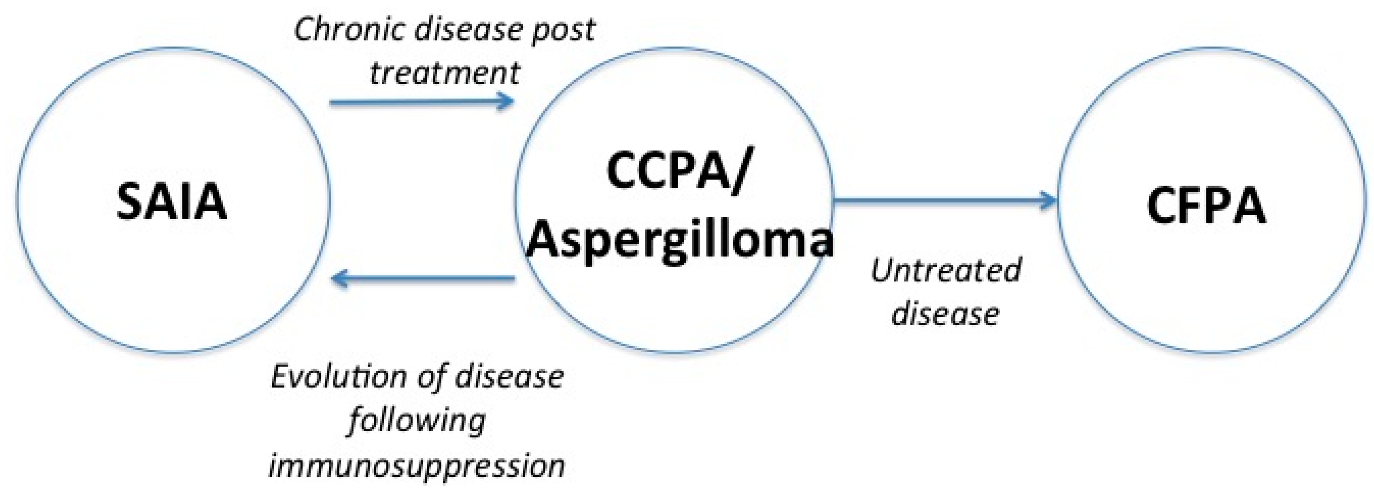
Evolution between CPA
G. Hayes et al. J. Fungi 2016, 2, 18

Slide 23
Diagnosis of CPA

Slide 24
Diagnostic criteria of CPA
Radiology (CT)
Direct evidence of Aspergillus infection
Exclusion of alternative dx
OR
Present at least 3 months
Immunological response to Aspergillus spp.
Not immunocompromised (HIV, ca, CS)
Denning D, et al. ERJ 2016
Notes:
Direct evidence : biopsy / culture

Slide 25
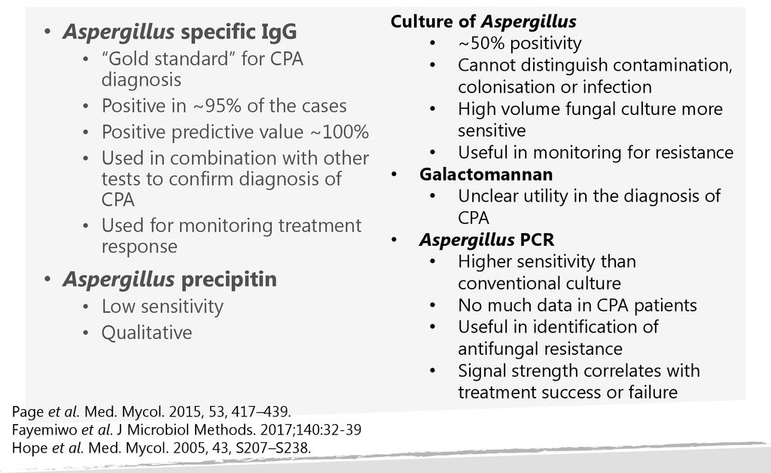
Laboratory tests for CPA (summary)
The antibody titer bears little relationship to the extent or severity of disease, although very high antibody titers are more common in those with aspergilloma.
Antibody titer generally slowly fall with successful therapy, but rarely become undetectable, unless continuous therapy has been given for years.
A sharply rising antibody titer is usually a sign of therapeutic failure or relapse, but should be repeated before initiating a change in therapy in case of laboratory error.
Notes:
Presence of Aspergillus in Sputum sample : not diagnostic << bronchoscopic sample

Slide 26
Galactomannan Ag test
specimens | Sensitivity (%) | Specificity (%)
BAL | 77.2 / 85.7 | 76.3 / 77.0
Serum | 23 / 66.7 | 63.5
BAL and not serum GM should be used in dx of CPA (SoR, QoE II)
Denning D, et al. ERJ 2016

Slide 27
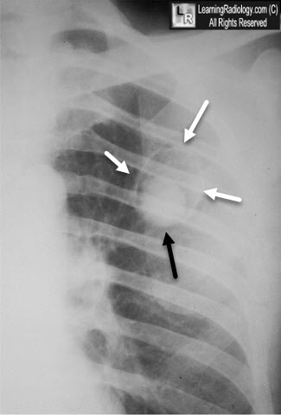
Clinical scenario for dx of CPA (1)
If pos result : confirm dx
Aspergillus IgG or precipitins test
If neg result : need other evidence of Aspergillus
A fungal ball is present
Denning D, et al. ERJ 2016
Learning radiology website

Slide 28
Clinical scenario for dx of CPA (2)
Required tests
Aspergillus IgG or precipitins test pos
Strongly positive Aspergillus Ab
DNA in resp. fluids
Biopsy showing fungal hyphae
Growing fungal hyphae on microscopy
Growing Aspergillus spp. from a cavity
One or more cavities c/w CPA
Denning D, et al. ERJ 2016

Slide 29
Clinical scenario for dx of CPA (3)
Respiratory sample showing hyphae c/w Aspergillus
NOT enough alone for a confirmed dx of CPA
and/or
2. Growing Aspergillus spp.
and/or
3. Positive Aspergillus PCR assay
Denning D, et al. ERJ 2016
Notes:
but are not enough alone for a confirmed
diagnosis of CPA as numerous other conditions can yield Aspergillus in the airways.

Slide 30
Mycobacterial infection and CPA
TB or NTM
CPA
CPA
TB or NTM
CPA
TB or NTM
AFB s/c, PCR are required work up of possible CPA
Denning D, et al. ERJ 2016

Slide 31
Radiological Diagnosis (1)
Chest x-ray, chest CT (contrast at least for baseline CT)
Underlying lung disorders (TB, NTM, etc)
Changes secondary to Aspergillus infection
Denning D, et al. ERJ 2016

Slide 32
Radiological Diagnosis (2)
The distinctive hallmarks of CPA :
new and/or expanding cavities of variable wall thickness in the setting of chronic lung disease with or without intracavitary fungal ball formation, often with pleural thickening and marked parenchymal destruction and/or fibrosis.
Denning D, et al. ERJ 2016

Slide 33
Radiological Diagnosis (3)
Aspergilloma formation
Denning D, et al. ERJ 2016
Notes:
FIGURE 9 Cavity with irregular edge and aspergilloma presenting as a coarse and irregular network in a patient with a previous left upper-lobe resection. Note the apical pleural thickening bordering the cavity well seen on the topogram of the a) computed tomography scan. b) Axial view with lung window at the level of the left upper lobe
FIGURE 10 Aspergilloma in chronic, cavitary pulmonary aspergillosis. Axial view with a) lung and b) mediastinal windows. The fungus ball appears as a left upper lobe solid oval mass partially surrounded by a crescent of air, the “air-crescent” sign (a), within a thick-walled and slightly irregular cavity. Note in this case the nondependent location of the aspergilloma and the typical absence of enhancement after contrast media
administration in (b).

Slide 34
Radiological Diagnosis (4)
CCPA
Denning D, et al. ERJ 2016
Notes:
FIGURE 8 Chronic, cavitary pulmonary aspergillosis in a smoker with previous infection caused by
Mycobacterium kansasii, poor nutrition and cirrhosis. The patient had had several episodes of severe haemoptysis
treated by arterial embolisation with long-term treatment by voriconazole. a, b) Axial and c, d) coronal sections
in mediastinal (b and d) and lung windows (a and c). Typical bilateral fungus balls (*) are seen almost filling the
cavities on the left side. Of note are small air pockets within the fungus ball (c and d) on the left side and the
irregular walls of the cavity on the right side (a) representing surface growth of Aspergillus on the interior cavity
surface. The fungus balls appear hypoattenuated compared to enhanced thickened pleura (thick white arrows)
and alveolar consolidation (arrow heads). Note the hypertrophic systemic arteries (thin white arrow). Figure
reproduced courtesy of A. Khalil (Tenon Hospital, Paris, France; personal communication).
FIGURE 11 Chronic cavitary pulmonary aspergillosis of the right upper lobe. a) Axial view and b) sagittal
reformat in mediastinal window show cavitary alveolar consolidation delimited inferiorly by fissures. Note the
dense extrapleural fat.

Slide 35
Radiological Diagnosis (5)
CFPA
Denning D, et al. ERJ 2016
Notes:
Chronic fibrosing pulmonary aspergillosis (CFPA) is the terminal fibrosing evolution of CCPA [26]. This
situation may occur when CCPA remains untreated resulting in extensive pulmonary fibrosis (figures 4
and 12). The fibrosis may be limited to one or both upper lobes but also commonly involves the whole
hemithorax [10]. There is no distinctive feature of fibrosis related to CPA, other than the cavitation and
fungal balls seen in close proximity
FIGURE 12 Chronic fibrosing aspergillosis with atelectasis and fibrosis of the whole left lung, secondary to
untreated chronic cavitary pulmonary aspergillosis. The cavity contains strands of Aspergillus

Slide 36
Radiological Diagnosis (6)
Aspergillus nodule
Denning D, et al. ERJ 2016
Notes:
FIGURE 14 Chronic pulmonary aspergillosis presenting as bilateral upper lobes lung masses partly necrotic
and cavitary on the left. a) Topogram of the chest computed tomography. b) Axial view in mediastinal window
with contrast media administration.

Slide 37
Treatment of CPA

Slide 38
Oral triazole therapy for CPA
Decision to treat CPA
  depend on patient’s type of disease, clinical phenotype, eligibility for surgery
General recommendation
  progressive and/or symptomatic CPA
  SGRQ or respiratory symptom score may guide
  SAIA : treat as acute IA
Benefit of oral triazole therapy
  prevent or treat life-threatening hemoptysis
  clinical and radiological stabilization

Slide 39
Duration of antifungal therapy for CPA
Time to response
  usually respond by 6 months
Minimum duration of Tx
  4-6 months
Response to treatment
  treatment failure : if deteriorate after tx of 6 months
  minimal response : extend tx upto 9months
  in responder : consider long term suppressive tx
  only stable disease : consider multiple factors (cost, comcomitant med, tolerability etc)
Relapse is common, but not universal after D/C
Notes:
Tx failure : consider alternative regimen

Slide 40
IV alternatives for the Tx of CPA
in Whom to use
  triazole failure
  intolerant to triazole
  triazole resistance
  progressive disease
  IV induction followed by an oral maintenance therapy
Which agents
  Ampho-B, echinocandin (micafungin, caspofungin)
Notes:
Tx failure : consider alternative regimen

Slide 41
Local cavity therapy for CPA
When ?
  when surgical resection is not an option to control recurrent hemoptysis
Which methods to instillate of antifungals
  by BFS guidance
  by percutaneous TT needle
  catheter placed into the aspergilloma cavity
Which agents? Amp-B
response rate : 70-100%
Notes:
Tx failure : consider alternative regimen

Slide 42
Follow-up imaging
Which imaging ?
  usually LDCT
How frequently ?
  after beginging tx : every 3-6months, and then less often
Signs of improvement
  reduced pl thickening
  less material or fluid in a cavity
  a smoother interior cavity wall
  a smaller nodule or area of pericavitary consolidation

Slide 43
Indication for surgery in CPA
Indication : should be considered in all patients with severe hemoptysis
adequate lung function is required
careful patient selection is very important
  performance, nutritional status, cardiopulmonary function
surgical technique : full resection of aspergilloma without spillage of fungal elements into the pleural space
Surgical outcome : favorable outcome in aspergilloma, but CCPA higher morbidity and mortality

Slide 44
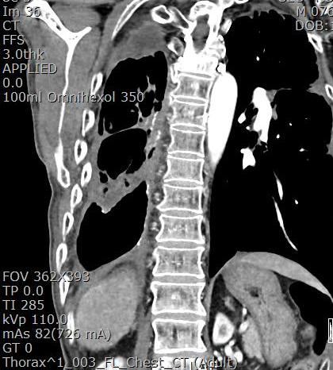
After about 4 year of itraconazol Tx
4YA at the beginning of Tx
after 4 yrs of itraconazol Tx
Notes:
Disappeared fungal ball inside the pleural cavity
Minimally decreased walls of cavity

Slide 45
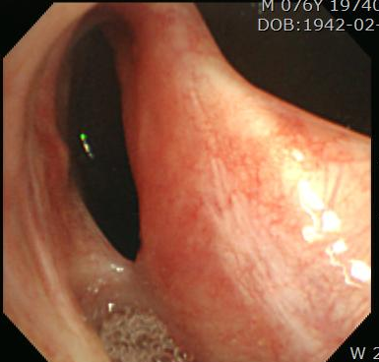
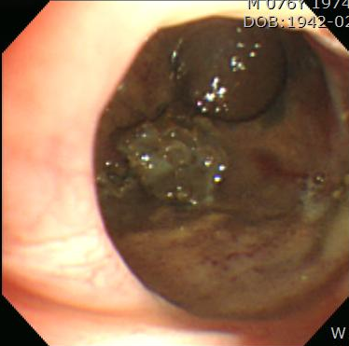
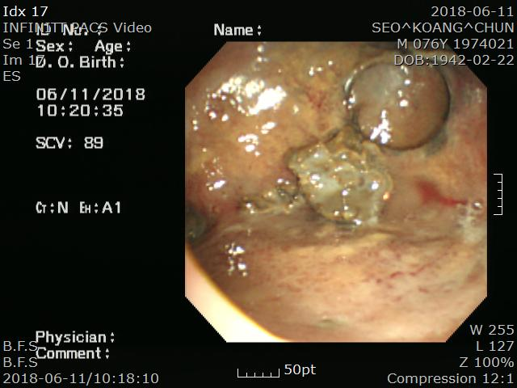
Follow up BFS after itraconazol Tx

Slide 46
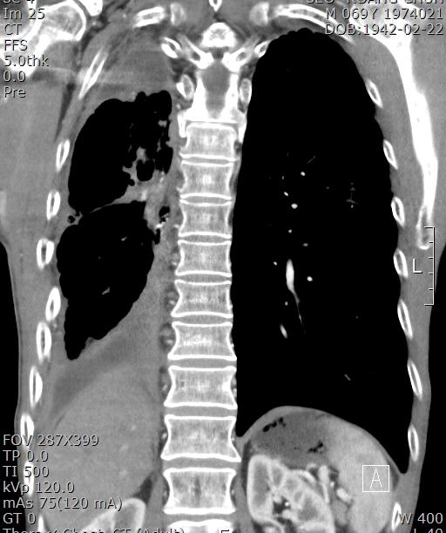
3 years before itraconazol Tx

Slide 47
Summary & conclusion (1)
The prevalence of CPA is very high and high 5 year mortality (75-80%) without intervention
The respiratory physician and radiologist should make an effort to diagnose CPA ASAP
Majority of patients with CPA require chronic antifungal therapy
Earlier and precise diagnosis are needed.
  patient might be benefit from long term antifungal tx

Slide 48
Summary & conclusion (2)
Aims of Tx
  reduction of symptoms and prevention of progression
Key Goals of therapy
  arresting progression
  minimizing loss of lung function
Team approach is important
  Pulmonologist, radiologist, lab physician, infectious disease physician, thoracic surgeon etc.

Slide 49


Thank you.

