Slide 1
TNM 9th stage of lung cancer
부산대학교병원 호흡기내과
김수한

Slide 2
Contents
TNM history
TNM definition in 9th edition
New changes in TNM 9th edition
Other considerations
Summary
Limitations and future perspectives

Slide 3
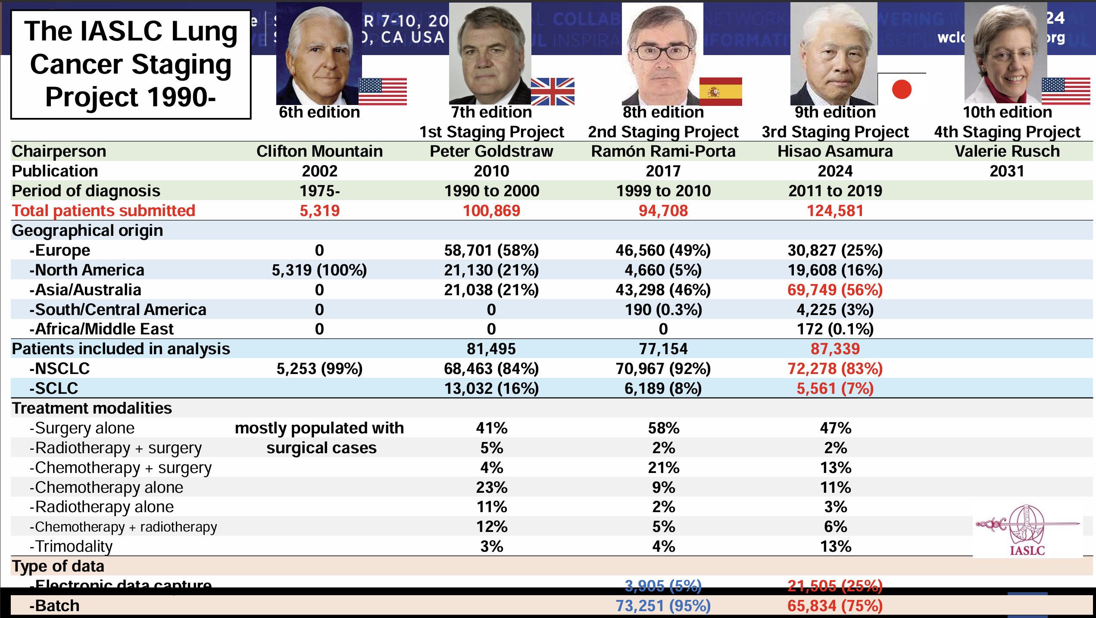

Slide 4

Staging Manual in Thoracic Oncology (3rd edition). IASCLC, 2024.

Slide 5
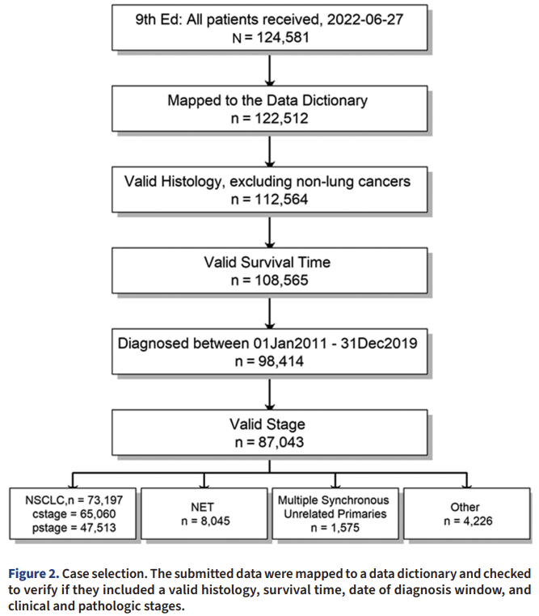
Staging Manual in Thoracic Oncology (3rd edition). IASCLC, 2024.

Slide 6
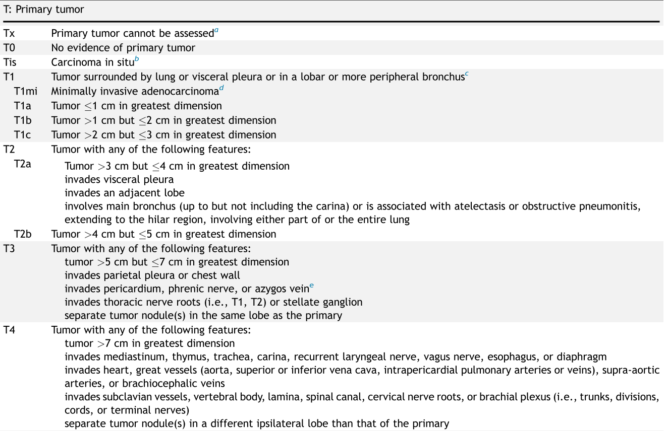
TNM 9th edition definition (T)

Slide 7
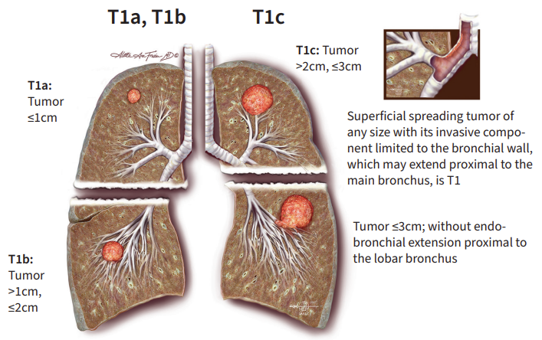
Staging Manual in Thoracic Oncology (3rd edition). IASCLC, 2024.

Slide 8
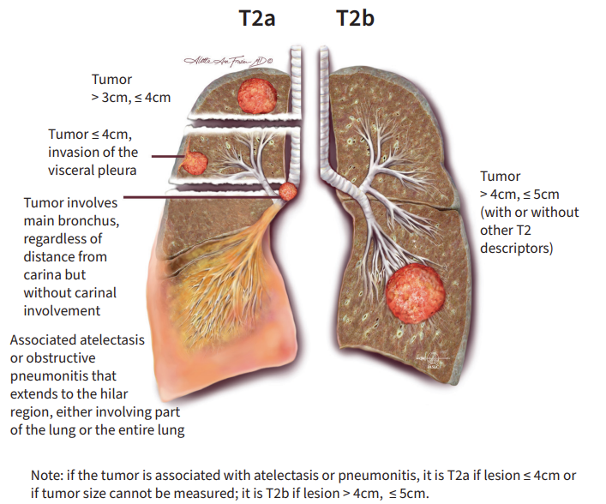
Staging Manual in Thoracic Oncology (3rd edition). IASCLC, 2024.

Slide 9
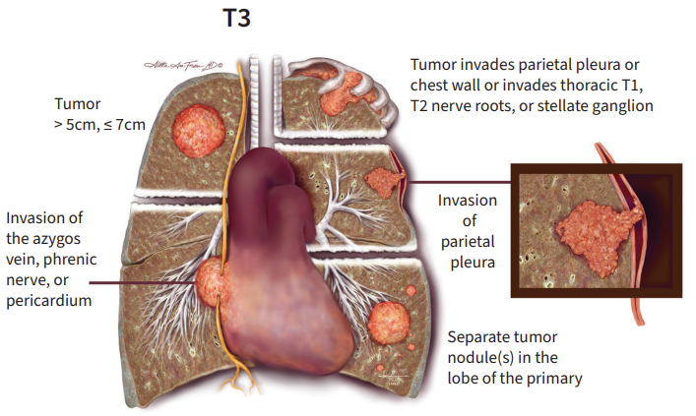
Staging Manual in Thoracic Oncology (3rd edition). IASCLC, 2024.

Slide 10
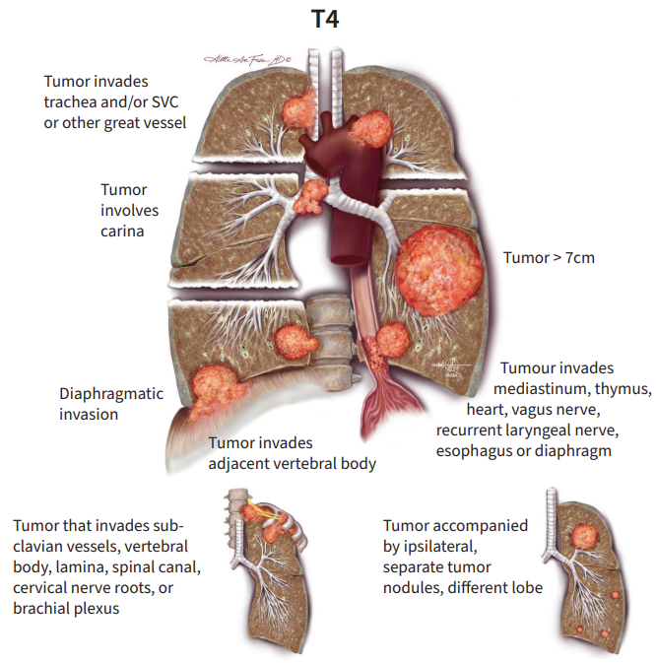
Staging Manual in Thoracic Oncology (3rd edition). IASCLC, 2024.

Slide 11
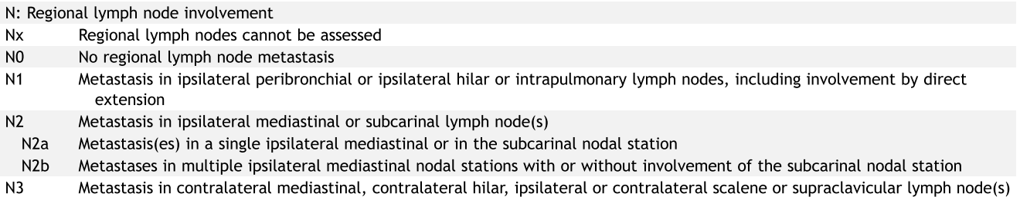
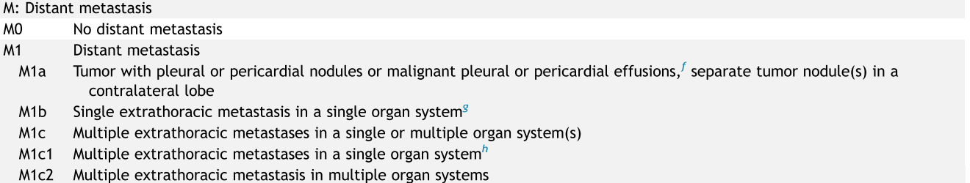
TNM 9th edition definition (N, M)

Slide 12
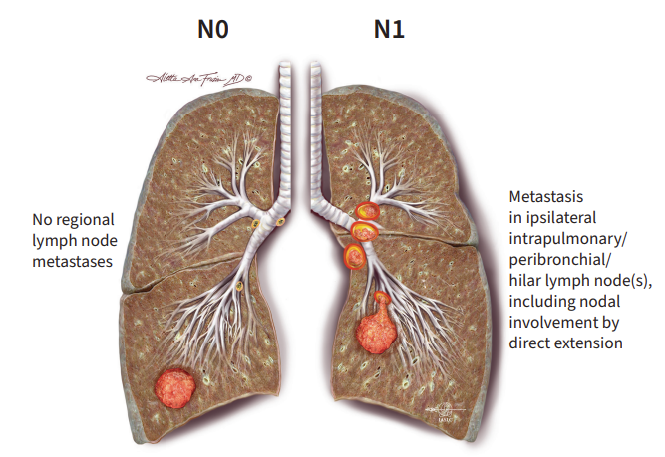
Staging Manual in Thoracic Oncology (3rd edition). IASCLC, 2024.

Slide 13
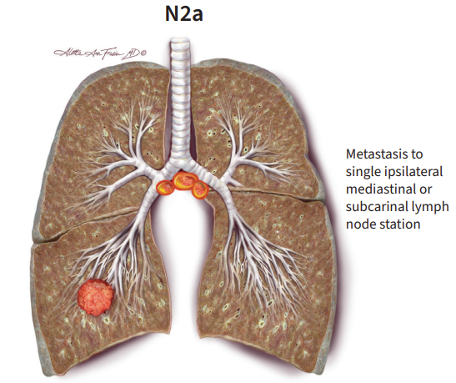
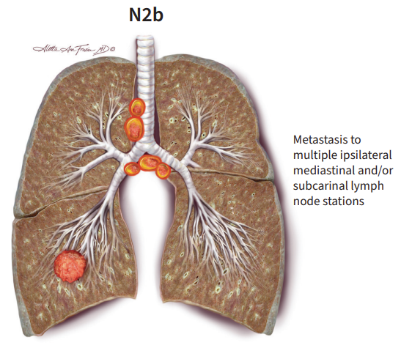
Staging Manual in Thoracic Oncology (3rd edition). IASCLC, 2024.

Slide 14
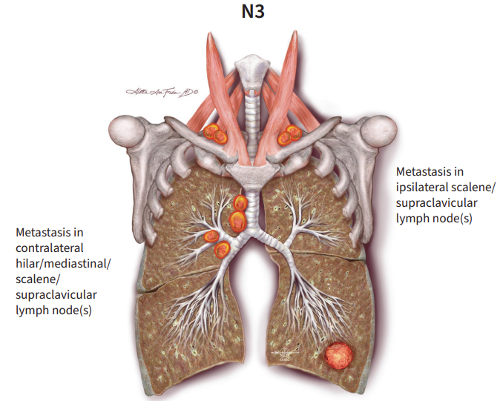
Staging Manual in Thoracic Oncology (3rd edition). IASCLC, 2024.

Slide 15
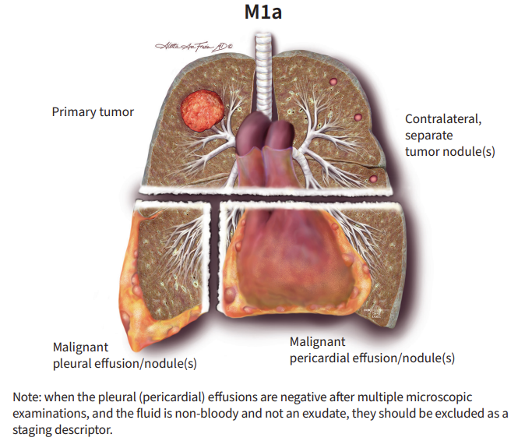
Staging Manual in Thoracic Oncology (3rd edition). IASCLC, 2024.

Slide 16
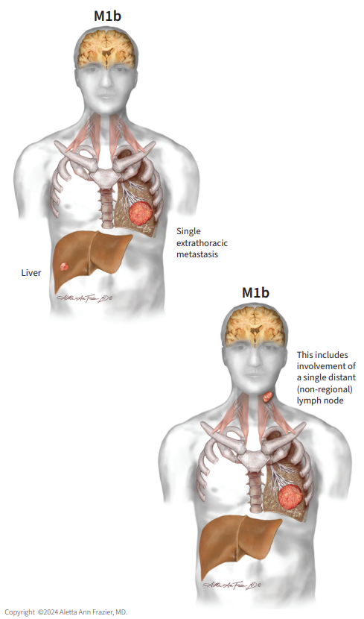
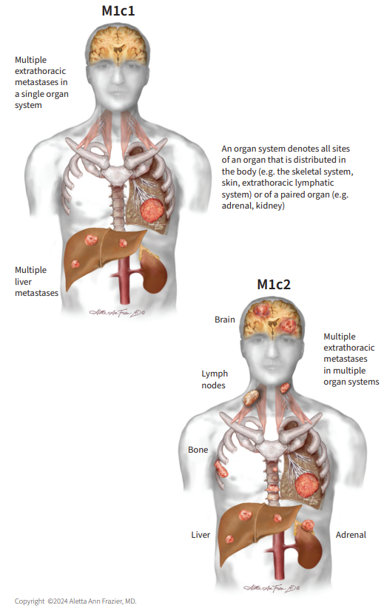
Staging Manual in Thoracic Oncology (3rd edition). IASCLC, 2024.

Slide 17
What’s New in the 9th Edition TNM?
Lung Cancer
T (Tumor) | No changes
N (Node) | The N2 category is subdivided into the N2a category, which denotes metastasis limited to a single ipsilateral mediastinal or subcarinal station, and the N2b category, metastases in multiple mediastinal or subcarinal stations.
M (Metastasis) | The M1c category is now divided into M1c1 (multiple extrathoracic metastases in a single organ system) and M1c2 (multiple extrathoracic metastases in several organ systems).
Stage Groups | T1N2a is assigned to stage IIB. T1N1 is downstaged from stage IIB to stage IIA. T2N2b is assigned to stage IIIB. T3N2a is assigned to stage IIIA.

Slide 18
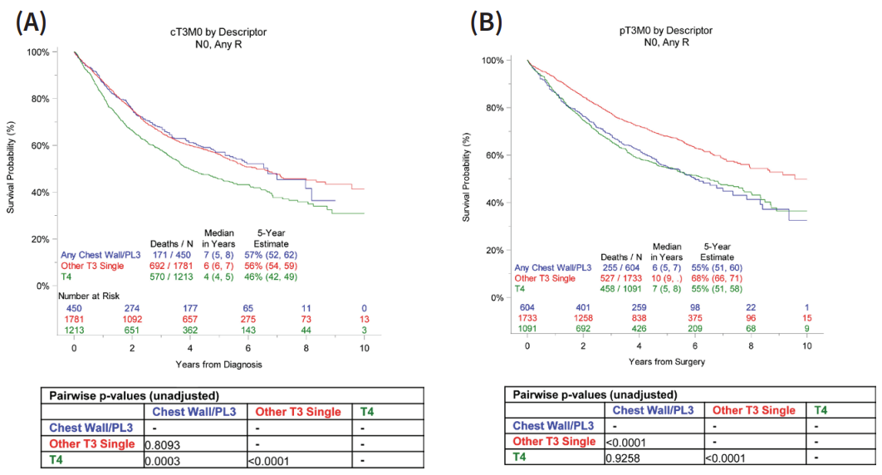
T3 analysis
Chest Wall/PL3 (parietal pleura inv) was hypothesized to have worse survival than the other T3 descriptors.
Given inconsistent findings in clinical vs path, the consensus was that there was insufficient evidence to change the Chest Wall/PL3 classification as a T3 descriptor.
9thEd publication will not recommend any changes to the current 8thEd T criteria.
Staging Manual in Thoracic Oncology (3rd edition). IASCLC, 2024.
Notes:
PL1: visceral pleura/ PL2: deeper visceral pleura

Slide 19
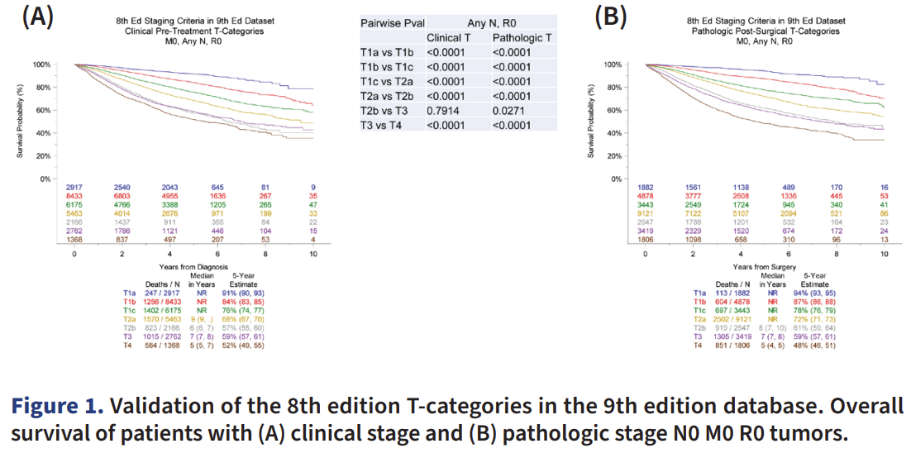
IASLC 8th/9th Edition T-category
Staging Manual in Thoracic Oncology (3rd edition). IASCLC, 2024.

Slide 20
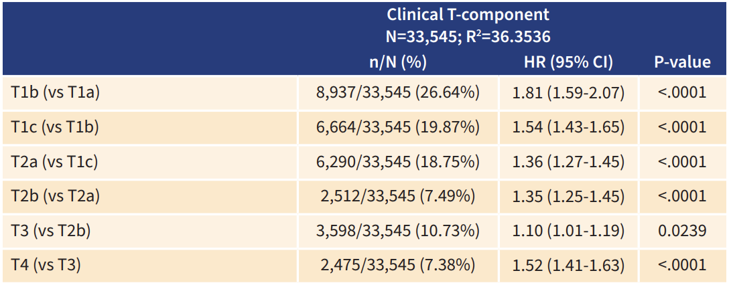
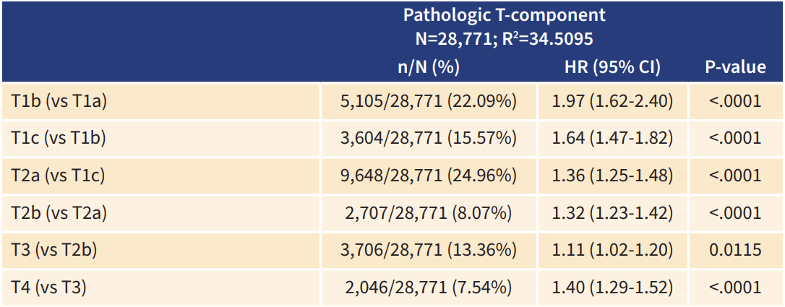
Staging Manual in Thoracic Oncology (3rd edition). IASCLC, 2024.

Slide 21
IASLC 9thEdition, N-category:
Split N2 into N2a and N2b
Proposed 9thEdition N-categories |  |  | 9th edition
NX |  | Regional lymph nodes cannot be assessed | No changes
N0 |  | No regional lymph node metastasis | No changes
N1 |  | Metastasis in ipsilateral peribronchialand/or ipsilateral hilar lymph nodes and intrapulmonary nodes, including involvement by direct extension | No changes
N2 |  | Metastasis in ipsilateral mediastinal and/or subcarinal lymph node(s)
 | N2a | Single N2 station involvement | Subdivided
 | N2b | Multiple N2 station involvement | Subdivided
N3 |  | Metastasis in contralateral mediastinal, contralateral hilar, ipsilateral or contralateral scalene, or supraclavicular lymph node(s) | No changes

Slide 22
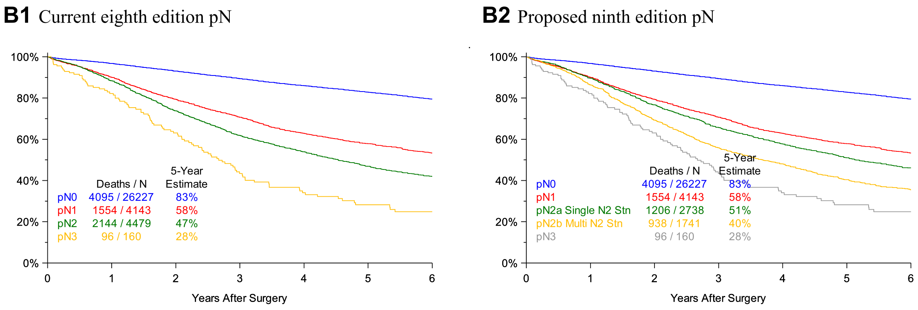
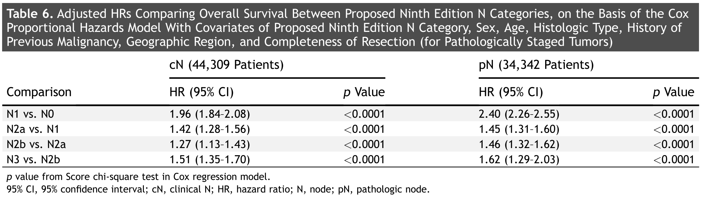
IASLC 8th vs 9th Edition N-category -Pathologic
J Thorac Oncol. 2024; 19(5):766-785.
Notes:
IIIB까지 포함하여 구분

Slide 23
IASLC 9thEdition, M-category:
Split M1c into M1c1 and M1c2
Proposed 9thEdition M-categories |  |  | 9thEdition
m0 |  | No distant metastasis | No changes
m1 |  | Distant metastasis | No changes
 | m1a | Separate tumor nodule(s) in a contralateral lobe; tumor with pleural nodules or malignant pleural or pericardial effusion. Most pleural (pericardial) effusions with lung cancer are due to tumor. In a few patients, however, multiple microscopic examinations of pleural (pericardial) fluid are negative for tumor, and the fluid is non-bloody and is not an exudate. Where these elements and clinical judgment dictate that the effusion is not related to the tumor, the effusion should be excluded as a staging descriptor. | No changes
 | m1b | Single extrathoracic metastasis in a single organ and involvement of a single distant (non-regional) node | No changes
 | m1c1 | Multiple extrathoracic metastases in a single organ system | Subdivided
 | m1c2 | Multiple extrathoracic metastases in multiple organ systems | Subdivided

Slide 24
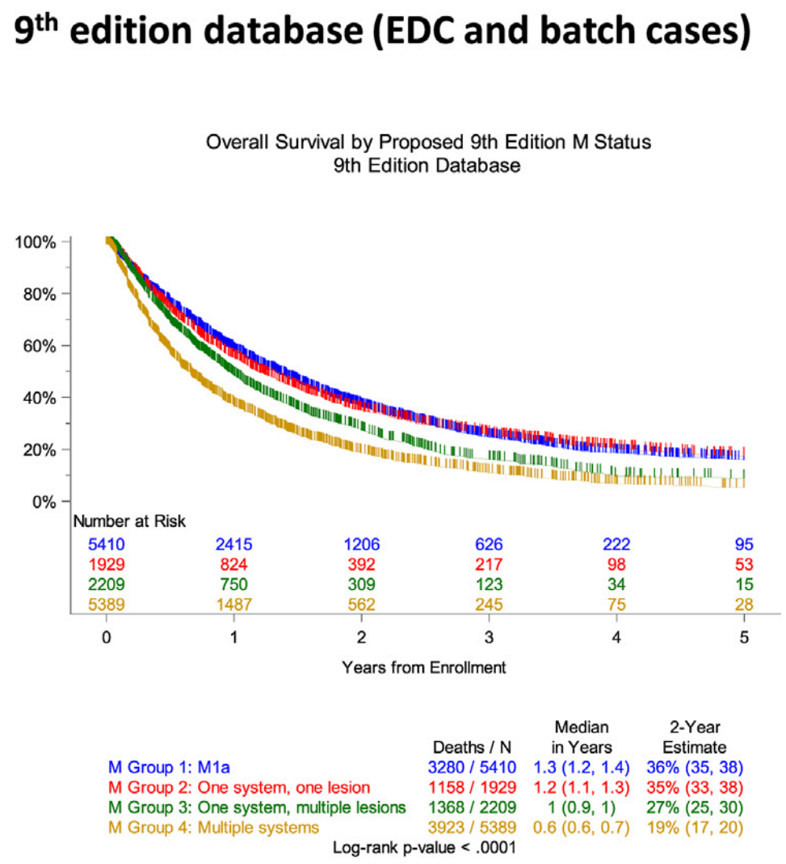
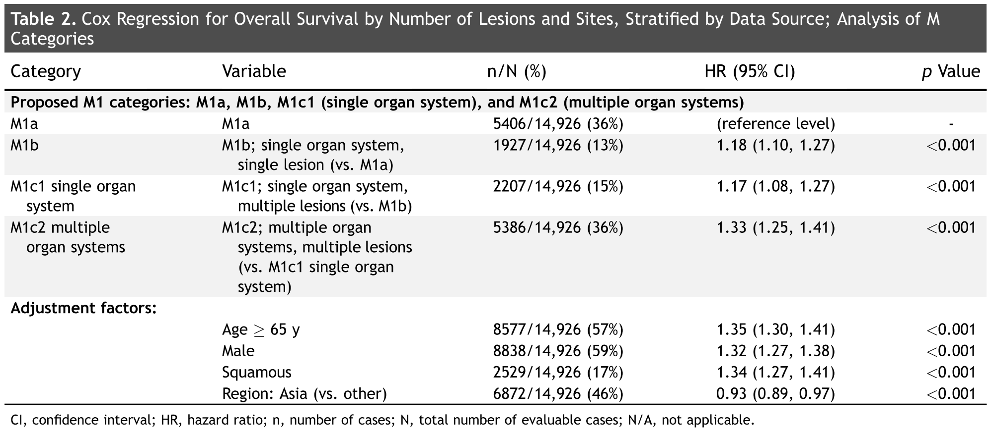
IASLC 8th vs 9th Edition M-category – Clinical: Divide M1c into two Subcategories
J Thorac Oncol. 2024; 19(5):786-802.

Slide 25
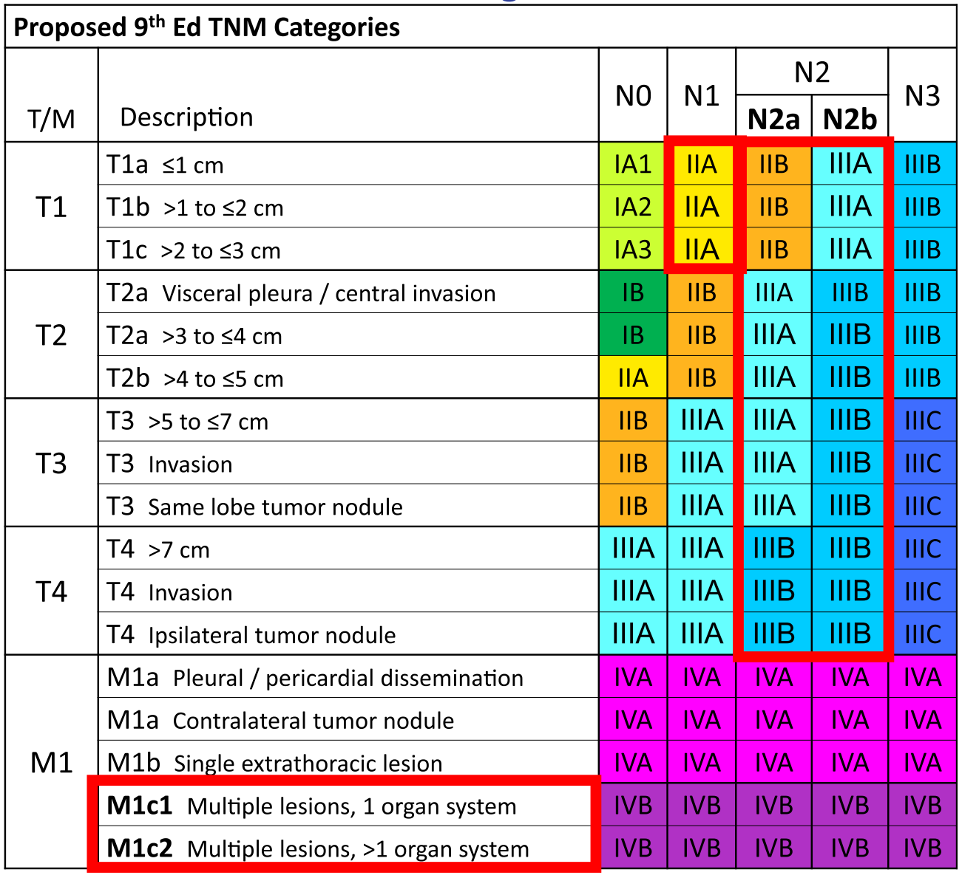
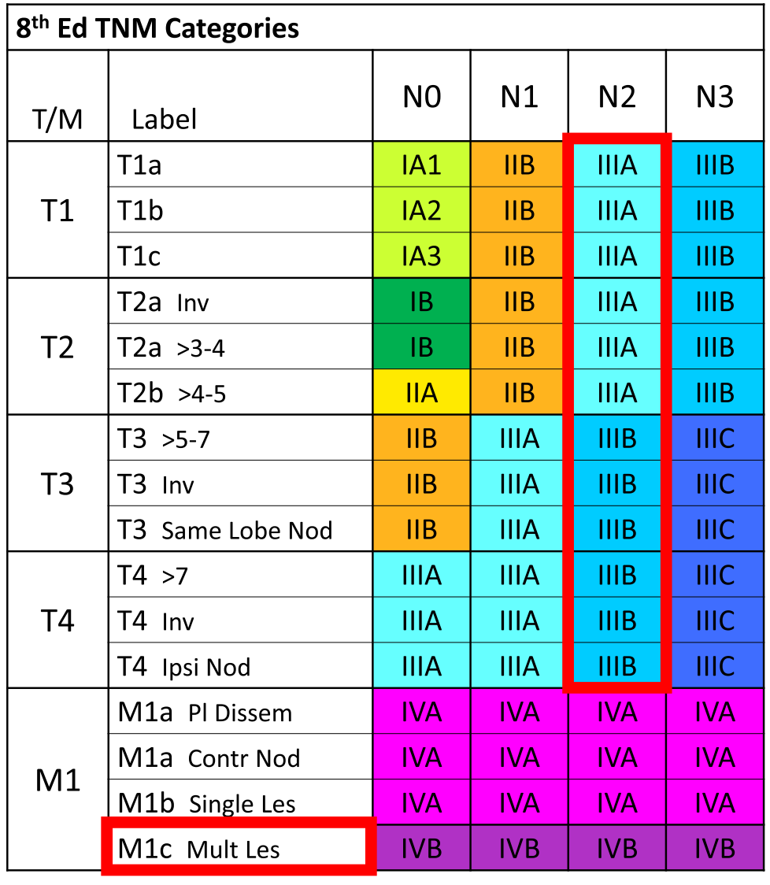
J Thorac Oncol. 2024; 19(7):1007-1027.

Slide 26
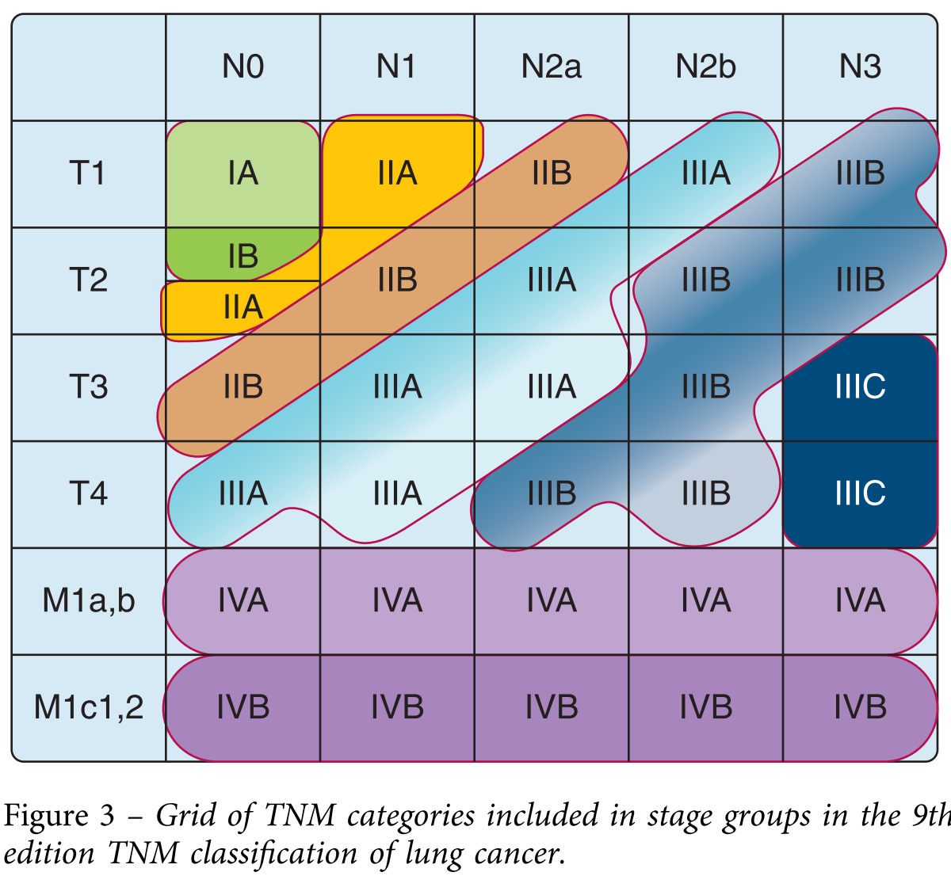
M0 tumors are coalesced into groups that largely lie along diagonals.
Higher stage groups consist of tumors with progressively higher T or higher N categories.
Chest. 2024; S0012-3692(24)00706-2.

Slide 27
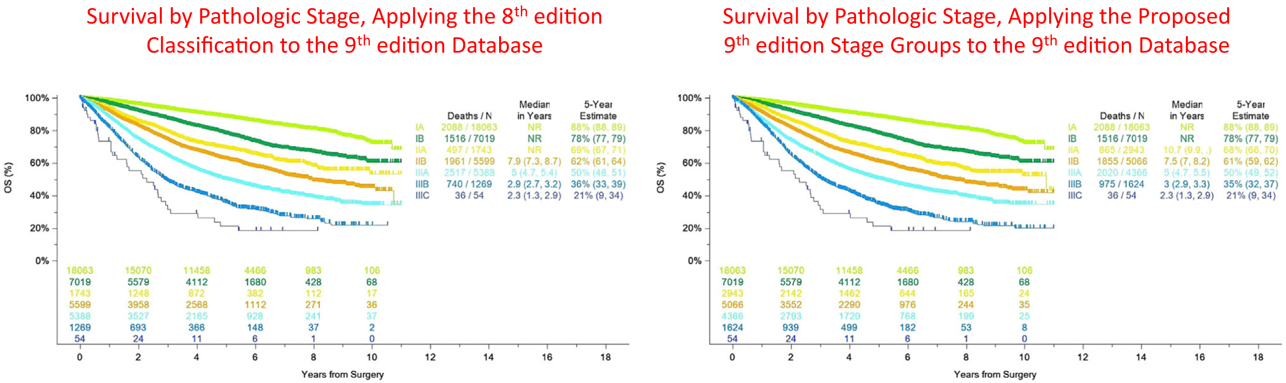
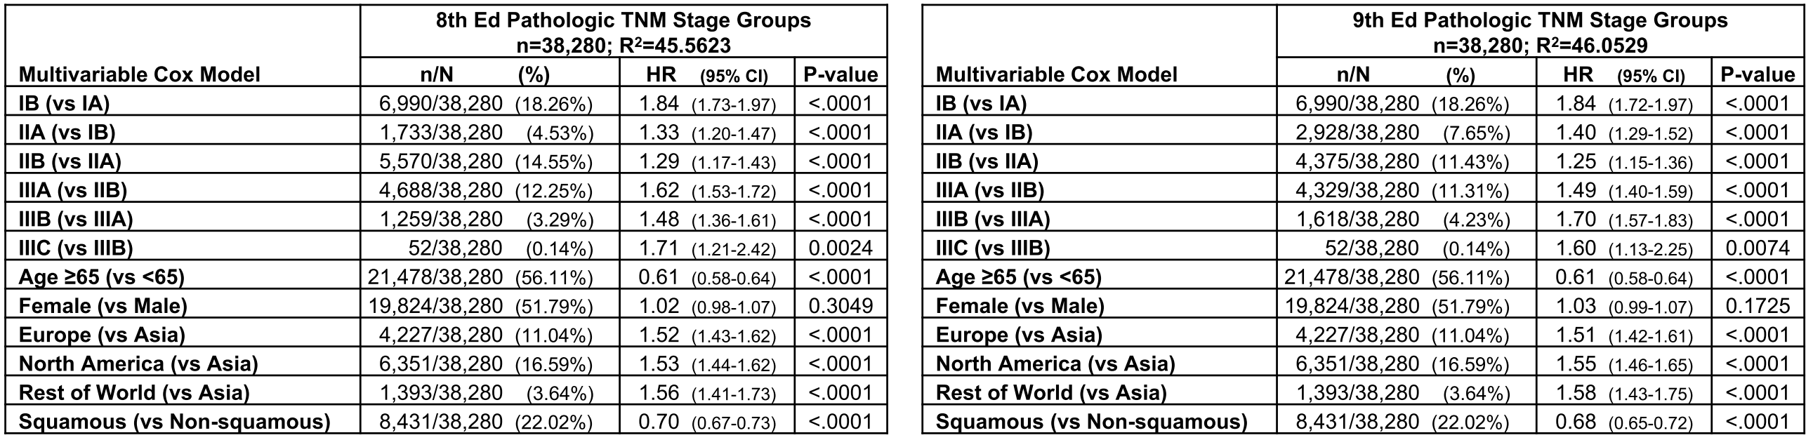
J Thorac Oncol. 2024; 19(7):1007-1027.

Slide 28
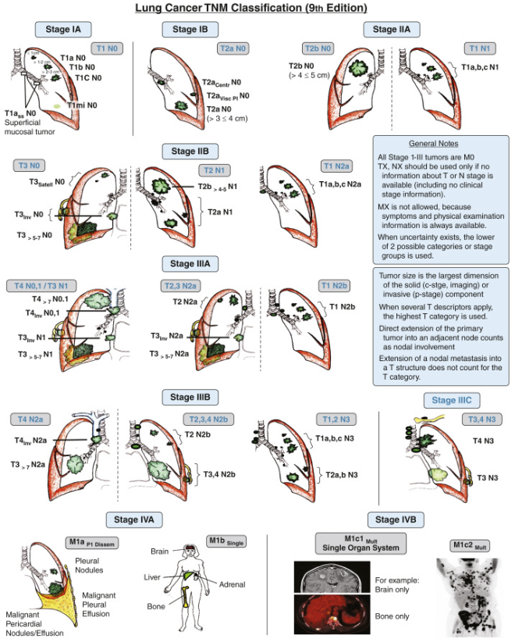
Chest. 2024; S0012-3692(24)00706-2.

Slide 29
Other considerations for prognosis
STAS (spread through air spaces)
Visceral pleural invasion, lymphatic invasion, vascular invasion
Lymphangitic carcinomatosis
Micro-metastasis
Circulating tumor cell

Slide 30
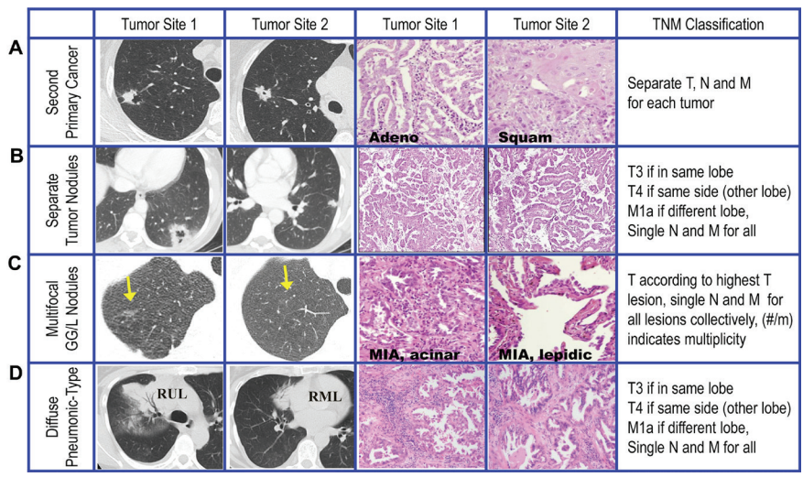
TNM stage in multiple pulmonary sites involvement
Staging Manual in Thoracic Oncology (3rd edition). IASCLC, 2024.

Slide 31
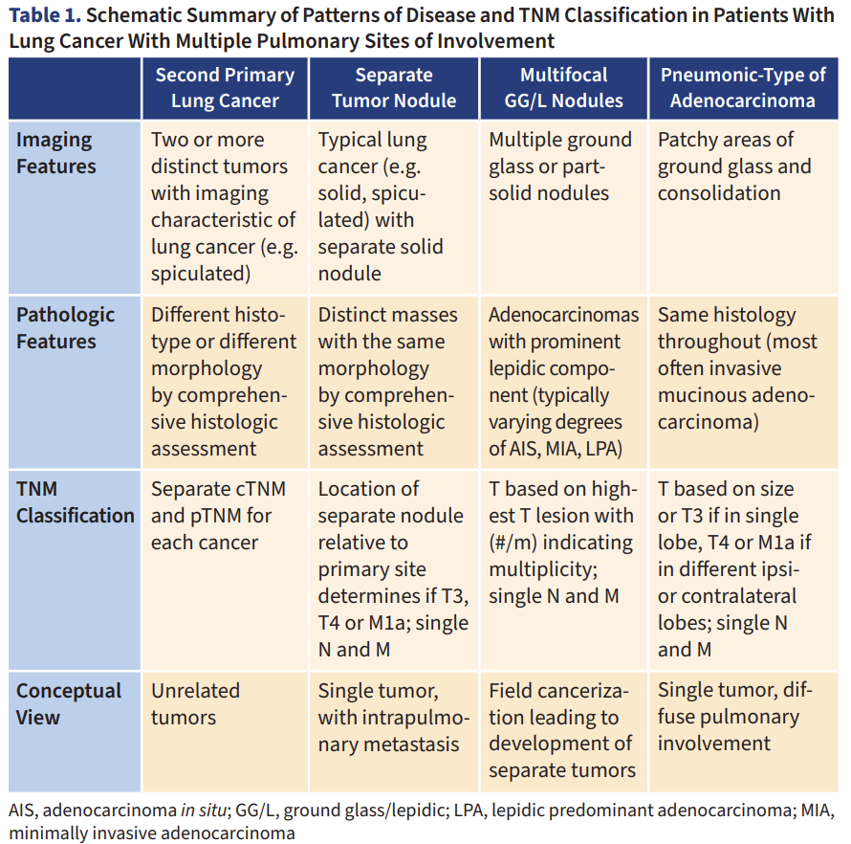
Staging Manual in Thoracic Oncology (3rd edition). IASCLC, 2024.

Slide 32
Summary
No change in T stagings
N2 divided into N2a, N2b
M1c divided into M1c1, M1c2
Staging
  T1N1 is down-staged from IIB (8th) to IIA (9th)
  T1N2a is assigned to IIB (9th), and T1N2b to IIIA (9th)
  T2N2b is assigned to IIIB (9th), and T2N2a to IIIA (9th)
  T3N2a is assigned to IIIA (9th), and T2N2b to IIIB (9th)

Slide 33
Limitation of current TNM
Based on only anatomic extent of disease
Population based
World wide used
-> Individual, molecular based biomarker incorporated to staging to guide precision therapy
Chest. 2024; S0012-3692(24)00706-2.

