Slide 1


Update of HAP & VAP
management
2024.06.22 영남호흡기 심포지엄
부산백병원 호흡기 내과
이 호 영

Slide 2

CONTENTS
Introduction
Pathogenesis
Epidemiology
Diagnosis
Treatment
Prevention

Slide 3
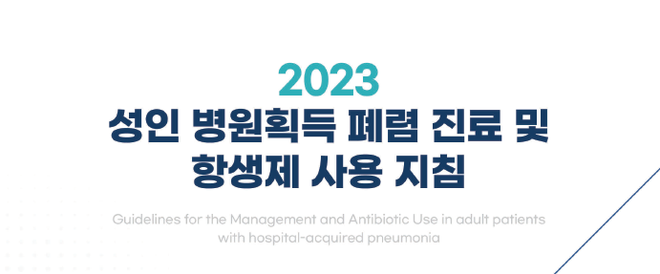
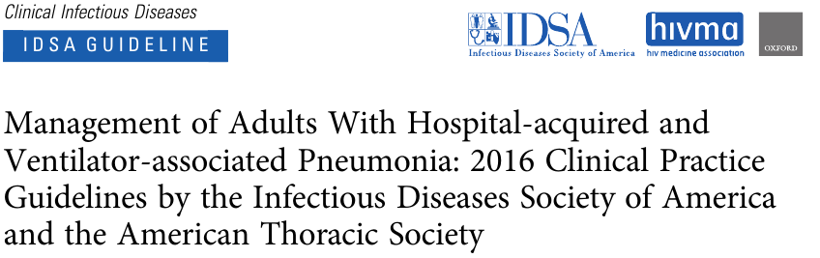

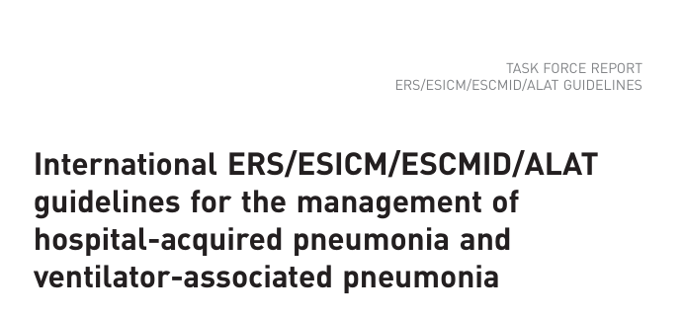

GUIDELINES

Slide 4
INTRODUCTION
Nosocomial Pneumonia
HAP
Hospital Acquired Pneumonia
VAP
Ventilator Associated Pneumonia
Pneumonia in a nonventilated patient becoming
apparent more than 48 hours after admission to
hospital.
Pneumonia in a patient receiving mechanical
ventilation for more than 48hours.

Slide 5
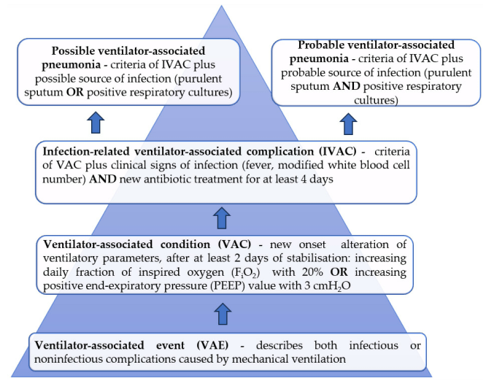
INTRODUCTION
Microorganisms 12.1 (2024): 213.

Slide 6
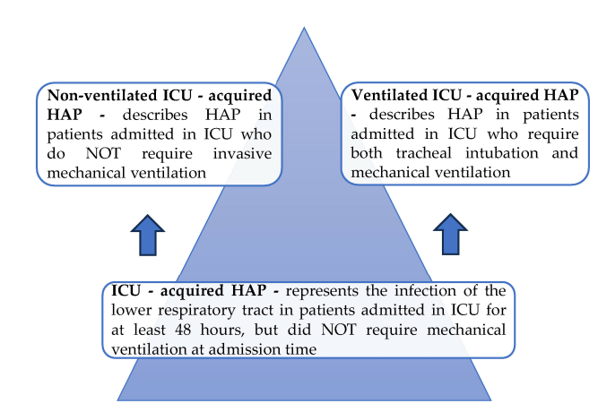
INTRODUCTION
Microorganisms 12.1 (2024): 213.

Slide 7
PATHOGENESIS
Development of HAP or VAP
  The number and virulence of the microorganisms entering the lower respiratory tract
  Patient’s response; cellular, humoral and mechanical defense mechanisms
  Endotracheal tube itself

Slide 8
PATHOGENESIS
Aspiration of oropharyngeal secretions
Large volume gastric aspiration
Hematogenous spread of infection
Inhalation of contaminated aerosols (e.g. Legionella)

Slide 9
PATHOGENESIS
Mechanisms to protect the Lungs from infection
  Glottis and Larynx
  Coughing
  Mucociliary clearance, epithelial lining fluid
  Immune system

Slide 10
PATHOGENESIS
Hospitalized patients
  Oropharyngeal colonization with pathogenic bacteria (gram-negative bacilli)
  Increased risk of aspiration
  - impairment of consciousness (anesthesia, opioids, sedative)
  - impair swallowing function (neurologic comorbities)
  Impairment of cough (pain, sedation,weakness)
  Immune defects (malnutrition…)

Slide 11
PATHOGENESIS
  Aspiration of potential pathogens
  Endotracheal intubation compromises the natural barrier
  Facilitates the entry of bacteria into the lung by pooling and leakage of contaminated secretions around the endotracheal tube cuff
  Biofilm formation on the inner and outer surfaces of tube
  Cross infection from the hands of health care personnel and contaminated respiratory therapy equipment

Slide 12
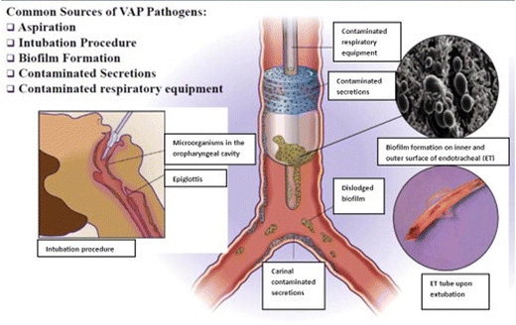
PATHOGENESIS

Slide 13
EPIDEMIOLOGY_INCIDENCE
  2ND most common in-hospital infection
  (1st UTIs )
  0.5-2% of hospitalized nonventilated patients have HAP at any time
  13% of non-ICU stroke patients develop HAP
  6-20-fold higher in ventilated patients than non-ventilated patients.
  9-27% of all intubated patients
  Increases with duration of intubation
  50%of VAP develop within the first 4 days of mechanical ventilation
  Depending on region
  - North America 1-2.5cases/1000
  - Europe 18 cases/1000

Slide 14

EPIDEMIOLOGY_INCIDENCE
INCIDENCE
  Cardiothoracic and abdominal surgeries increased the risk
  5.8% lobar pulmonary resection → $\frac{1}{3}$ ↓ Video-assisted thoracic resection
  3% major abdominal surgery develop postoperative pneumonia
  Risk factors
    Age, COPD, DM, CVA, Dysphagia, malnutrition
    Preoperative oropharyngeal colonization, PPI use

Slide 15
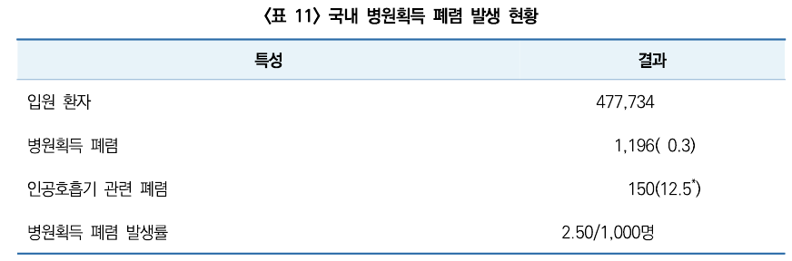
EPIDEMIOLOGY_KOREA(2019)
  2019년 1월~2019년 12월
  국내 16개 종합병원 및 상급종합병원
  성인환자 477,734 명
  병원 사망 343 (28.7%)

Slide 16
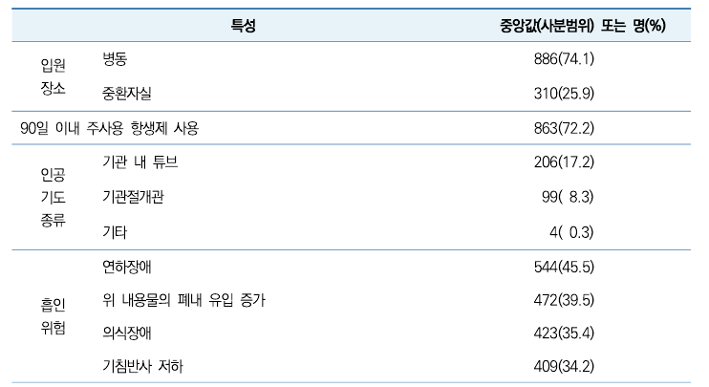
EPIDEMIOLOGY_KOREA(2019)

Slide 17
EPIDEMIOLOGY
IMPACT ON OUTCOMES
  Mortality (2-14%)
  ICU admission
  Subsequent need for mechanical ventilation
  Prolonged hospital length of stay

Slide 18
EPIDEMIOLOGY_Etiologic agents
  Difficult to obtain adequate samples of respiratory secretions
  50-90% of patients with HAP → No pathogens are isolated
  Gram-negative bacilli 35%
    Nonfermenting organism (20%)-P.aeruginosa, S.maltophilia, Acinetobacter sp.
    Enteric gram-negative bacilli(15%)-E.coli, Klebsiella sp., Proteus sp.,Enterobacter sp.
  S. aureus (15%)
  Respiratory virus(20%, Influenza, RSV)-bacterial coinfection
  Fungi (Aspergillus sp.)
  Local ICU ecology is the most important risk factor for acquiring MDR pathogens
  MDR pathogens → more frequently in late-onset VAP cases (5 days of MV)
  GNB: P.aeruginosa and Enterobacteriaceae
  Extended-spectrum B-lactamase-producing Enterobacteriaceae (ESBL-PE): 19-61%
  Acinetobacter baumannii
  - US and Europe: 8-14%
  - Asia, Latin: 19% - >50%
  Carbapenem resistant Enterobacteriaceae (CRE)

Slide 19
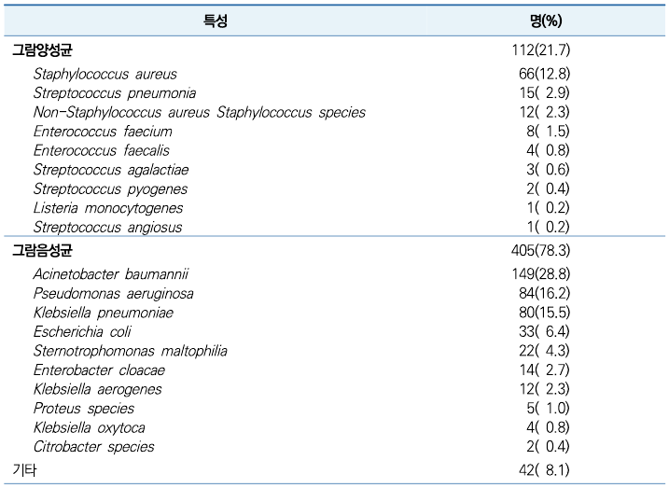
EPIDEMIOLOGY_Etiologic agents
  Korea (2019)
    G(-): 78.3%, G(+): 21.7%
    Staphylococcus aureus(12.8%)
    Acinetobacter baumannii(28.8%)
    P.aeruginosa(16.2%)
    Klebsiella pneumoniae(15.5%)

Slide 20
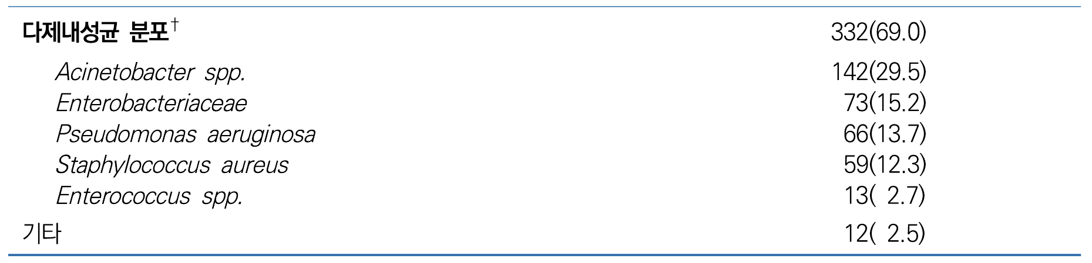
EPIDEMIOLOGY_Etiologic agents
  Korea (2019)

Slide 21
DIAGNOSIS
  Clinical observations suggesting infection
    New onset fever, purulent sputum, leukocytosis
    Increased minute ventilation, decline oxygenation, increased vasopressor
  New or progressive persistent radiographic opacities
  “Positive” microbiologic culture
    Tracheal aspirates, BAL, pleural fluid, blood

Slide 22
DIAGNOSIS
ESTABLISHING A CLINICAL DIAGNOSIS
  The clinical diagnosis of HAP may be inaccurate
  35% of HAP patients did not have radiographic findings of pneumonia
  Chest radiography showed poor sensitivity and specificity compared to CT.

Slide 23
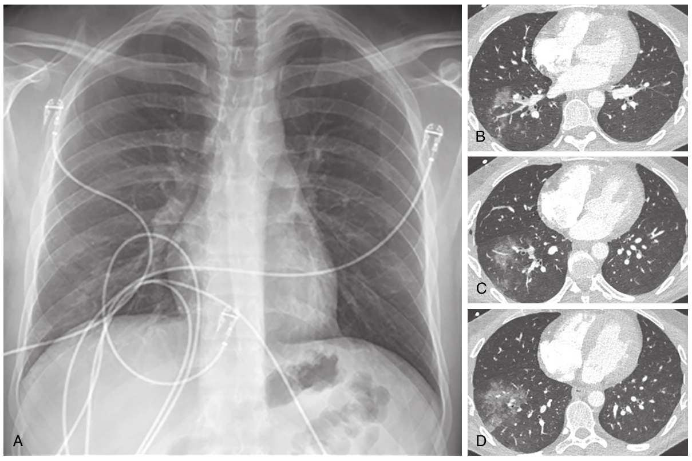

Slide 25
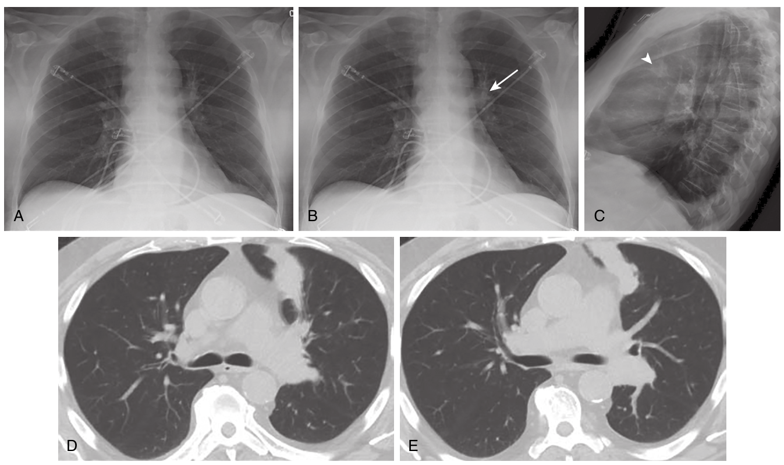

Slide 27
DIAGNOSIS
ESTABLISHING A CLINICAL DIAGNOSIS
  Biomarkers
  Procalcitonin
  C-reactive protein(CRP)
  Neither of these is currently recommended for identifying HAP

Slide 28
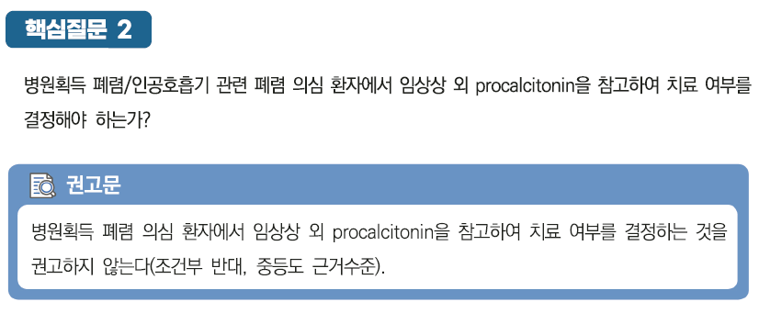
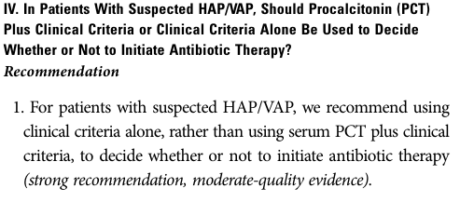
DIAGNOSIS

Slide 29
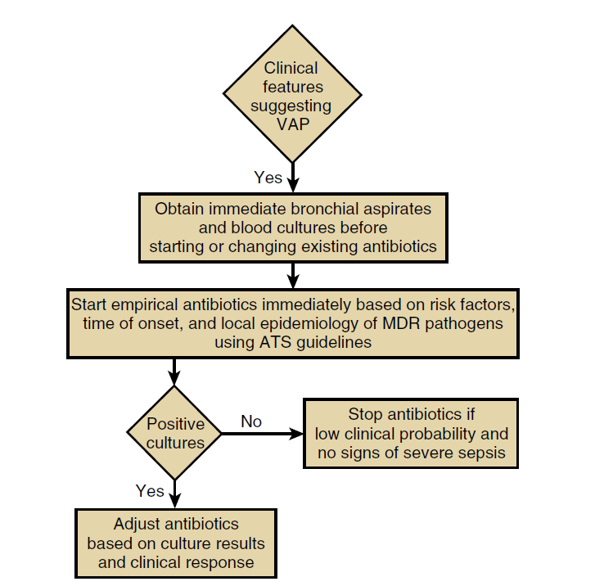
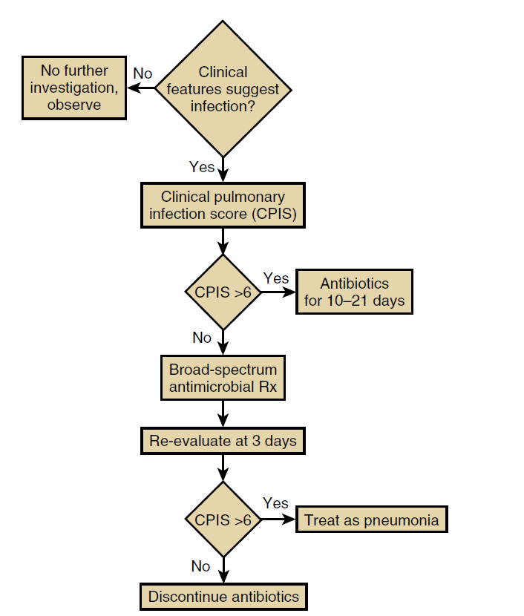
DIAGNOSIS
THE CLINICAL DIAGNOSTIC STRATEGY

Slide 30
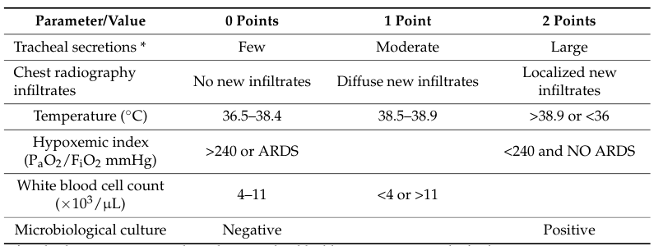
DIAGNOSIS
Clinical Pulmonary Infection Score (CPIS)

Slide 31
DIAGNOSIS
THE CLINICAL DIAGNOSTIC STRATEGY
  No invasive diagnostic procedures
  Risk of missing a patient who needs antibiotic treatment is minimal
  Potential sampling errors from the proximal airways

Slide 32
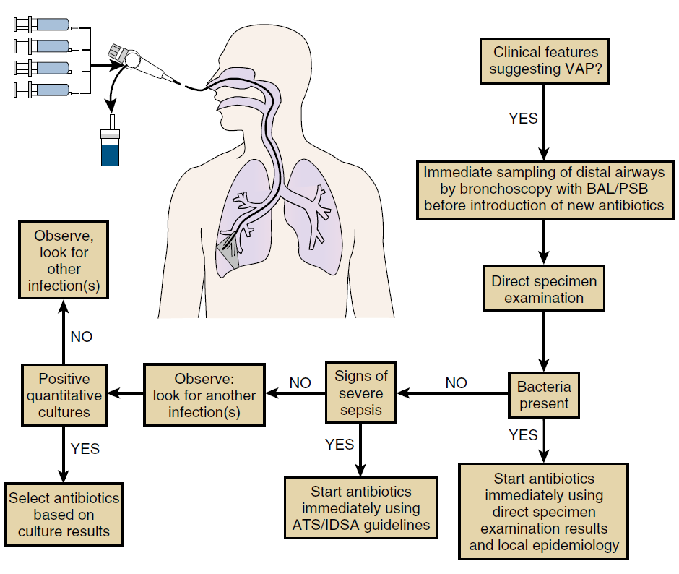
DIAGNOSIS
THE INVASIVE DIAGNOSTIC STRATEGY

Slide 33
DIAGNOSIS
DETERMINING THE ETIOLOGIC AGENT
  Accurate targeting of empirical antibiotics therapy
  Narrower-spectrum antibiotics therapy
  Discontinuation of broad-spectrum antibiotics targeting MDR pathogens
  Identify the pathogen by culturing respiratory secretions.
  Sputum culture, Blood culture

Slide 34
DIAGNOSIS
DETERMINING THE ETIOLOGIC AGENT
  Non-invasive
  Invasive
Spontaneous sputum
Nasotracheal suction
Endotracheal aspirates
Bronchoscopy
Washing, PSB, BAL
  Advantage
Who cannot produce an adequate sample
Less likely to be contaminated with oropharyngeal flora

Slide 35
DIAGNOSIS
DETERMINING THE ETIOLOGIC AGENT
  Non-invasive
  Invasive
Spontaneous sputum
Nasotracheal suction
Endotracheal aspirates
Bronchoscopy
Washing, PSB, BAL
  Disadvantage
Adverse events related to sedation
Worsening gas exchange
Respiratory deterioration
Invasive sampling is NOT generally recommended

Slide 36
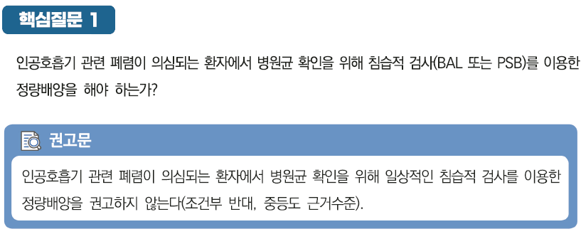
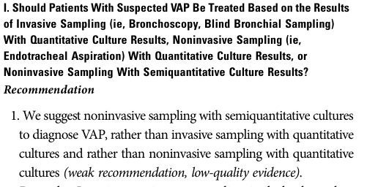
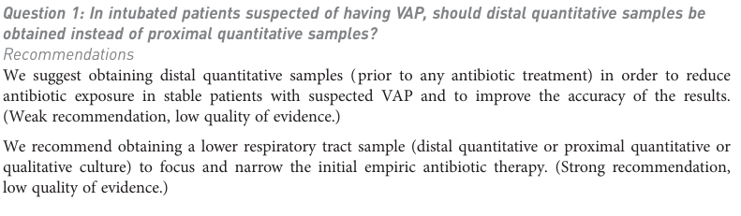
DIAGNOSIS

Slide 37
DIAGNOSIS
DETERMINING THE ETIOLOGIC AGENT
  Nasal MRSA screening → High negative predictive value (over 90%)
  Multiplex PCR platforms for rapid detection
  (viruses, bacteria, antimicrobial resistance genes)
  Mass spectrometry, exhaled breath biomarkers, fluorescence microscopy

Slide 38
TREATMENT
EMPIRICAL TREATMENT APPROACH
  Most effective coverage
  Avoiding the use of unnecessary antibiotics
  Administering broad-spectrum antibiotics to avoid inadequate treatment of patients with true bacterial pneumonia
TARGETED TREATMENT APPROACH
  Without overusing or abusing antibiotics

Slide 39
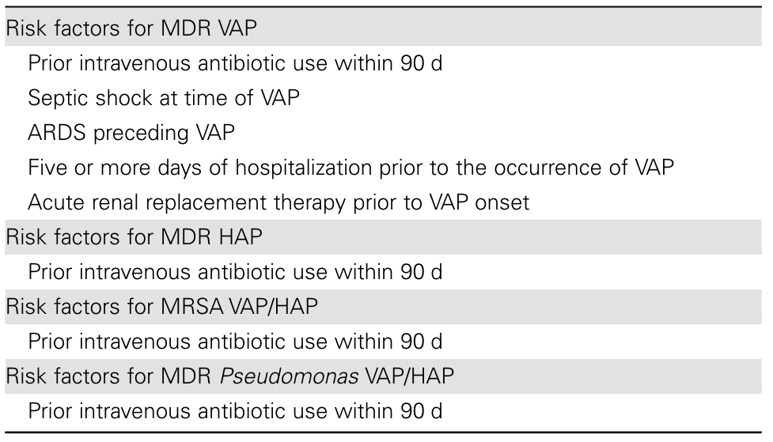
TREATMENT
Microorganisms 12.1 (2024): 213.

Slide 40
TREATMENT
EMPIRICAL TREATMENT APPROACH
  1. Low disease severity and No risk factors for MRSA
  - monotherapy with anti-pseudomonal activity
  2. Low disease severity and presence of risk factors for MRSA
  - one anti-pseudomonal plus one anti-MRSA
  3. High disease severity (Septic shock, need to intubation)
  - dual anti-pseudomonal plus anti-MRSA

Slide 41
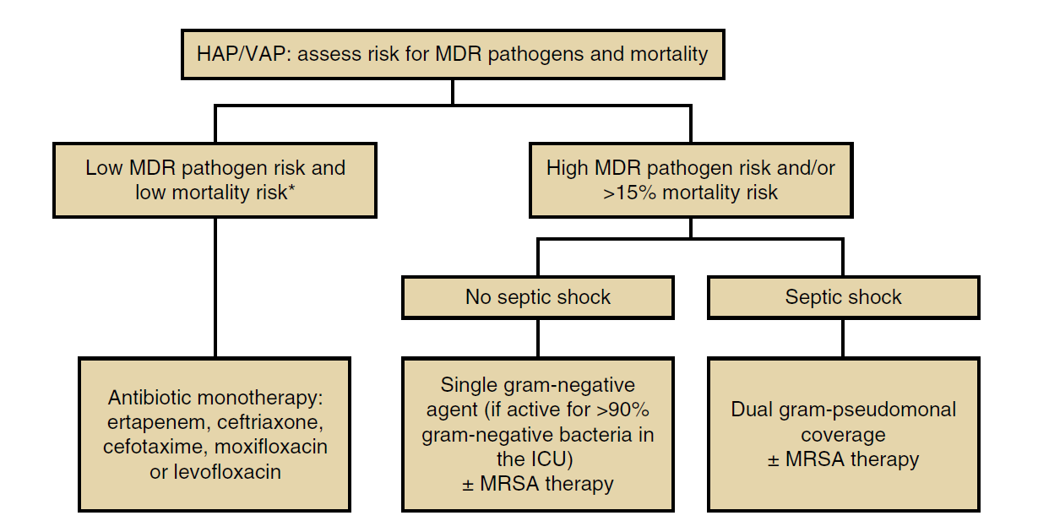
TREATMENT
INITIAL TREATMENT
#HIGH RISK of Mortality#
ICU admission
Need for ventilatory support
Septic shock
Elevated procalcitionin

Slide 42
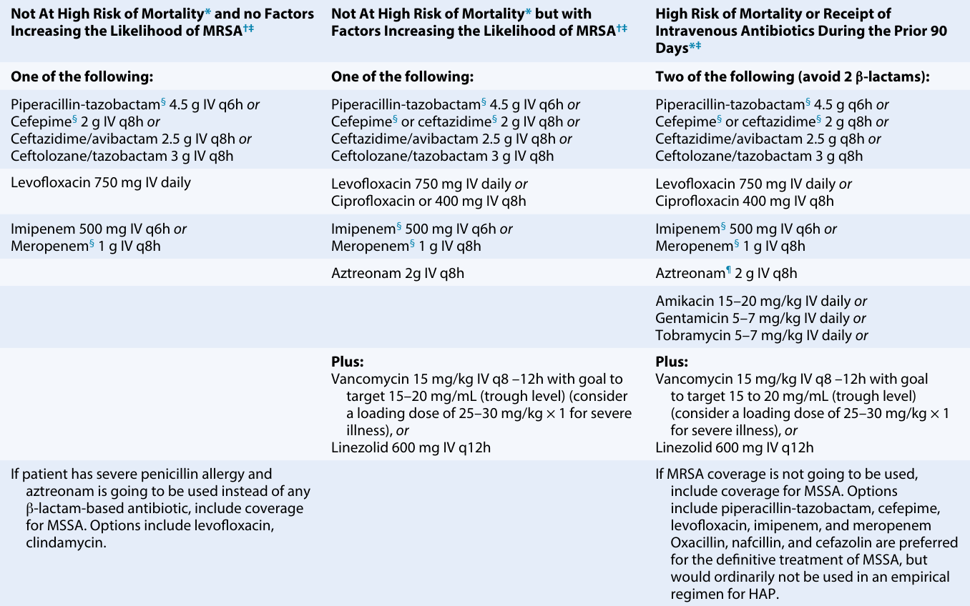

Slide 43
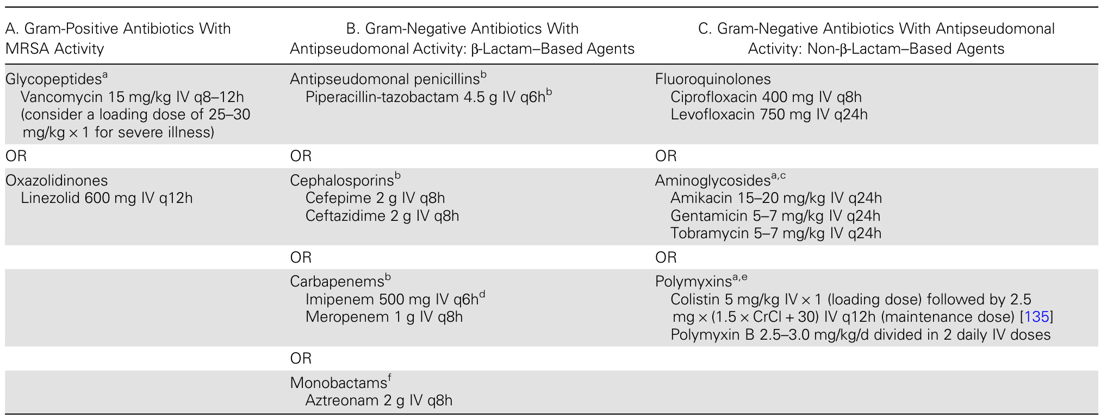

Slide 44
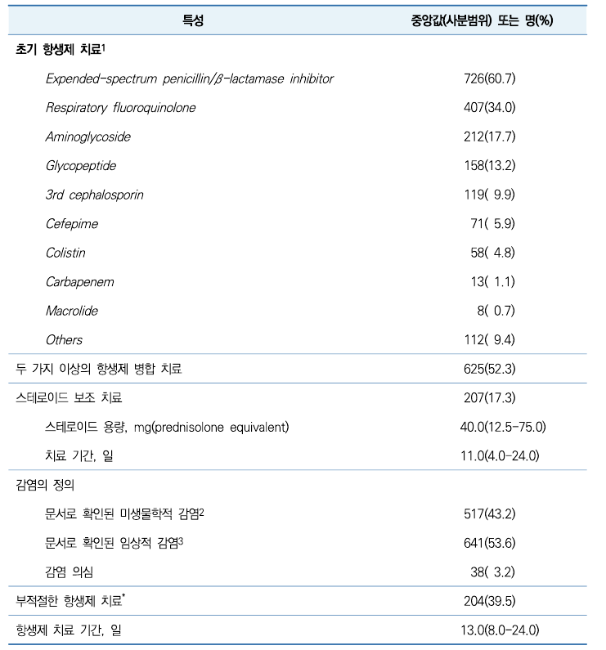
TREATMENT_성인 병원획득 폐렴의 국내역학

Slide 45
TREATMENT_성인 병원획득 폐렴의 국내역학

Slide 46
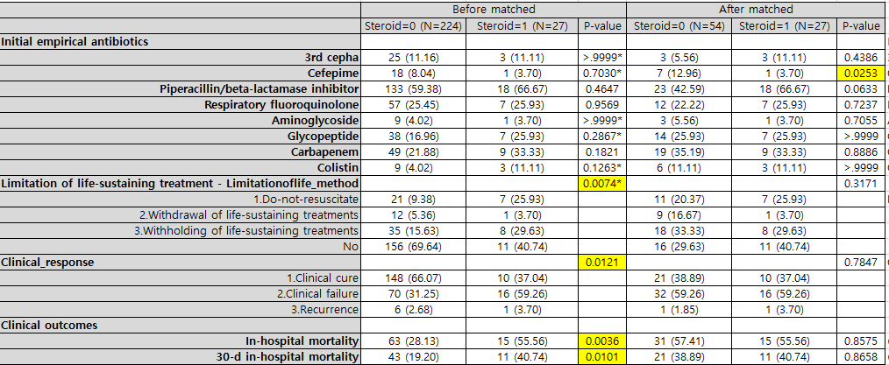
TREATMENT_성인 병원획득 폐렴의 국내역학
  Retrospective multi-center, 13 tertiary hospital in KOREA, 6months
  Appropriate antibiotics → corticosteroid usage
  Propensity score matching

Slide 47
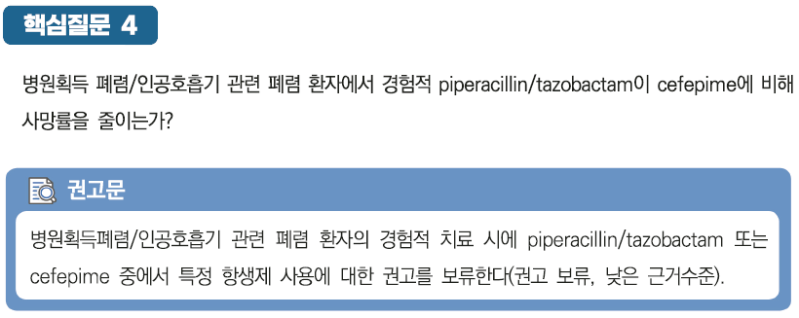
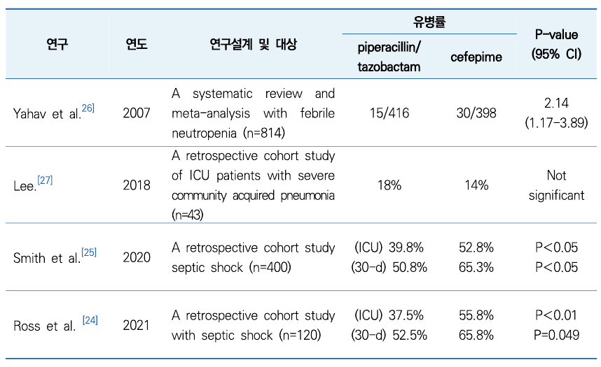
TREATMENT
  폐 상피내막액/혈장 투과율
  G(-) 정균/살균 약력학적 목표 달성 확률
  → Cefepime > Pip/tazo
  Combination with Vancomycin
  →Nephrotoxicity (pip/tazo > Cefepime)
  CNS toxicity → (Cefepime > pip/tazo)

Slide 48
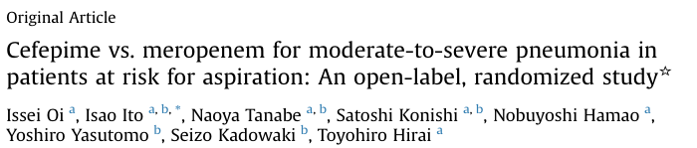
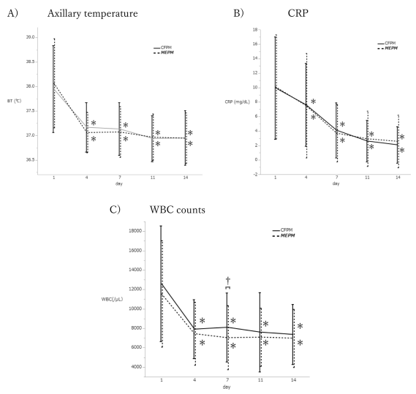
TREATMENT
  Cefepime vs meropenem
  Open-label, randomized study
  End of treatment
  Clinical response, End of study, Survival at day 30

Slide 49
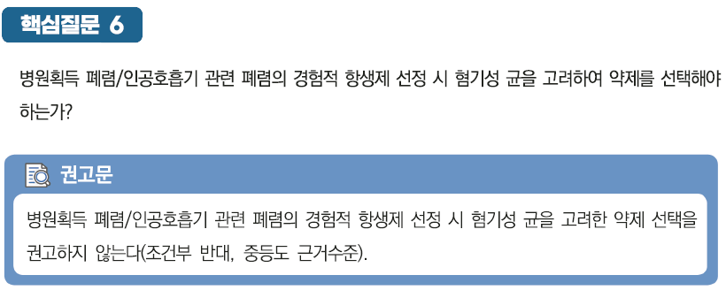
TREATMENT
  Change in the epidemiology of Aspiration pneumonia
  (60-90 % of Anaerobes in 1990s, 1-2% in 2000s)
  Anaerobic antibiotics → Gut dysbiosis
  High incidence of C.difficile infection
  Necrotizing pneumonia, empyema, lung abscess, severe peri-odontal disease

Slide 50
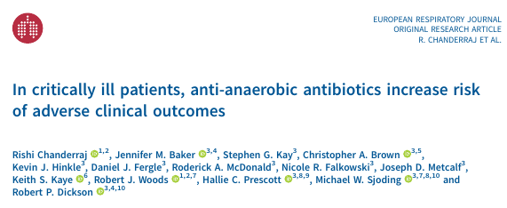
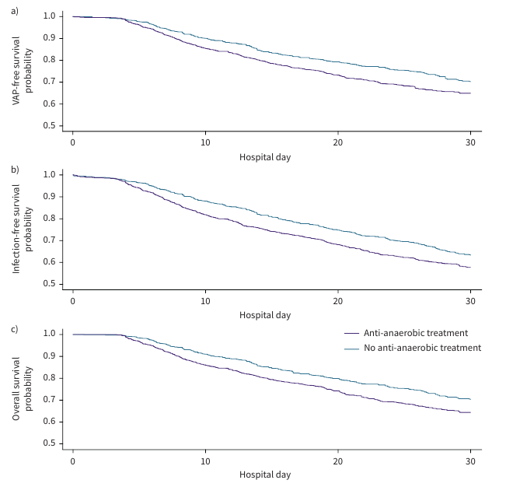
TREATMENT
  VAP-free survival
  Infection-free survival
  Overall survival

Slide 51
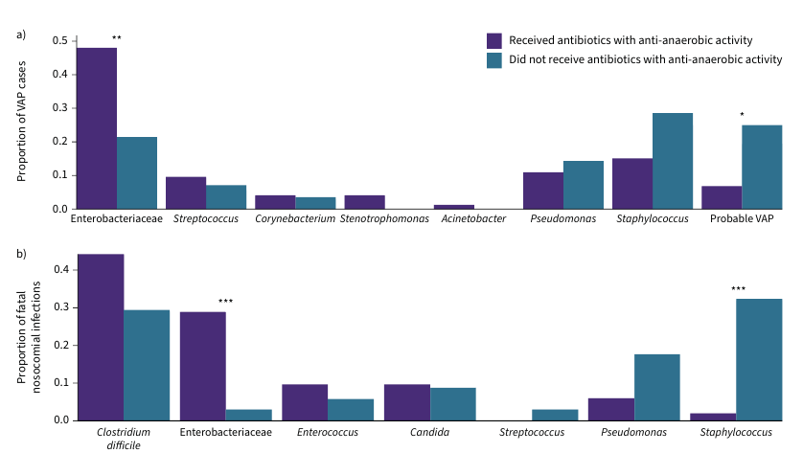
TREATMENT

Slide 52
TREATMENT
TARGETED TREATMENT APPROACH
  Pharmacokinetic/Pharmacodynamic (PK/PD) Antibiotics dosing
    Measurement and targeting of serum antibiotics concentrations
    Extended and continuous infusion
    Weight-based dosing of specific antibiotics
  Inhaled antibiotics
    High peak concentration and low systemic exposure
    No strong evidence
    MDR G(-) pathogen sensitive only to aminoglycosides or polymyxins.

Slide 53
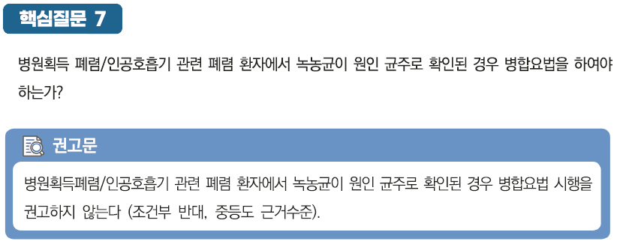
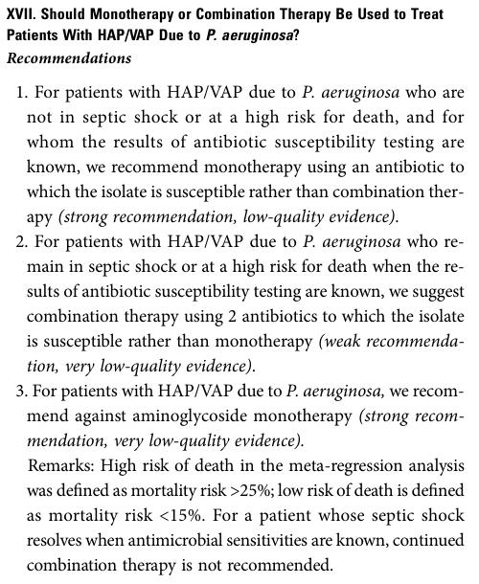
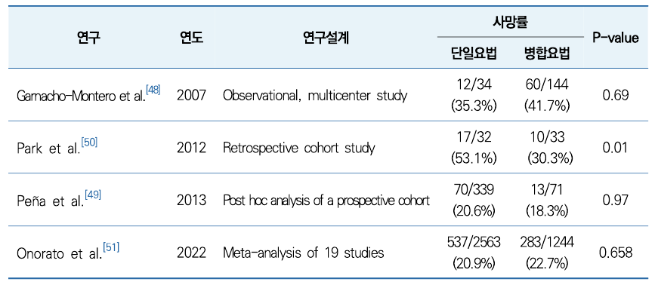
GUIDELINES

Slide 54
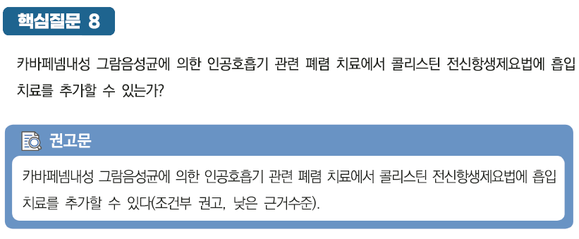
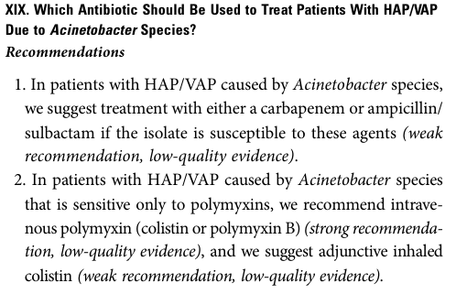
GUIDELINES

Slide 55
TREATMENT
ANTIBIOTIC DE-ESCALATION AND DURATION OF TREATMENT
  Clinical, laboratory, radiologic evaluation
  Procalcitonin
  De-escalation of Antibiotics

Slide 56
TREATMENT
ANTIBIOTIC DE-ESCALATION AND DURATION OF TREATMENT
  Depending on the individual patient progression
  Short courses (7days) ⟩ Longer courses (8-15 days)

Slide 57
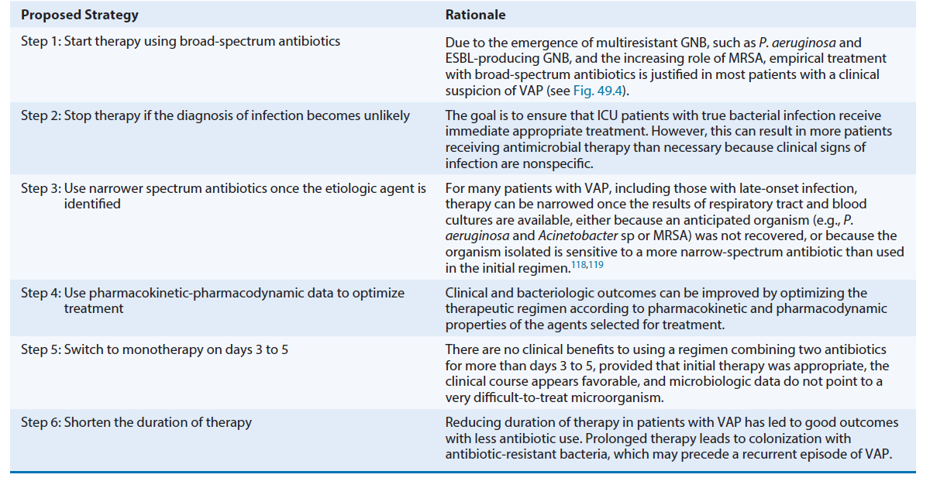
TREATMENT
AVOIDING OVERUSE OF ANTIBIOTICS

Slide 58
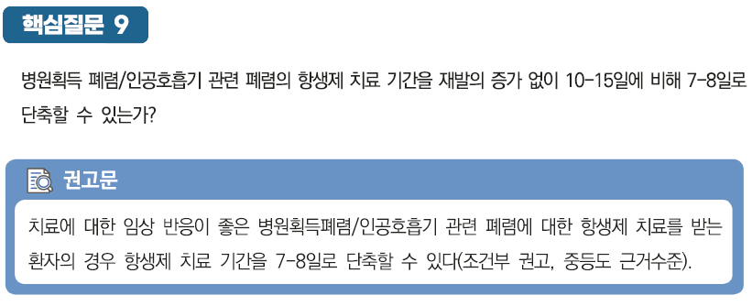
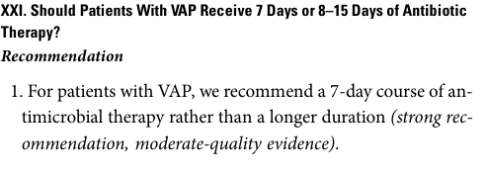
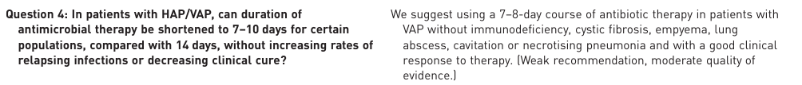
GUIDELINES

Slide 59
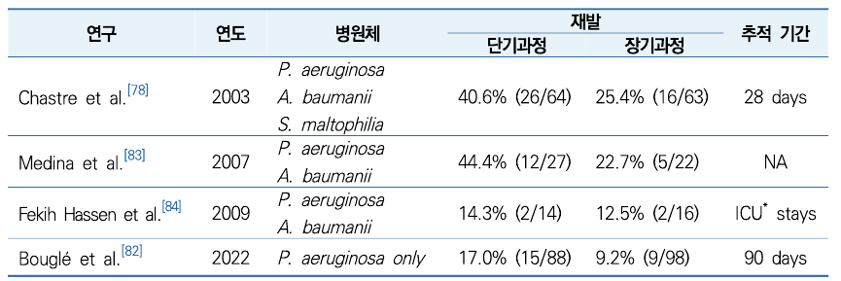
GUIDELINES
Non-glucose fermenting GNB VAP → 단기치료 → 재발 증가

Slide 60
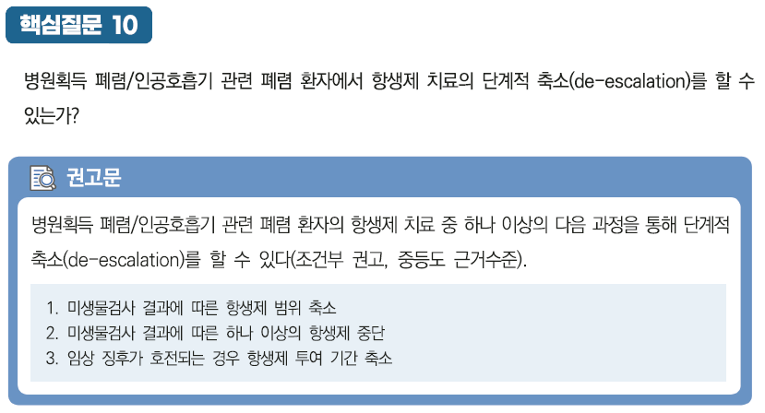
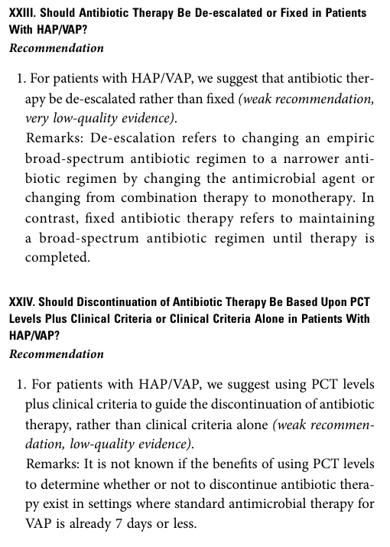
GUIDELINES

Slide 61
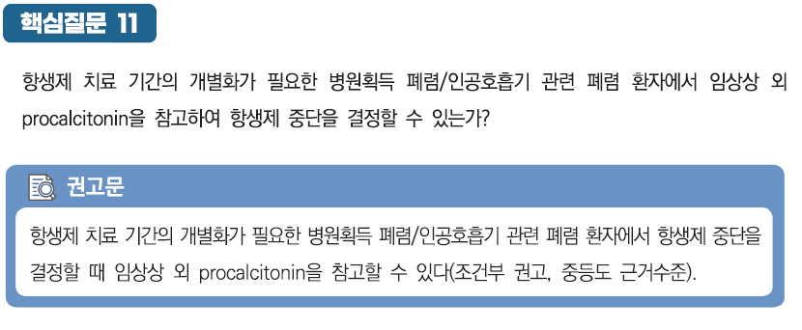
GUIDELINES

Slide 62
TREATMENT_New Antibiotics
Ceftobiprole : 5th cephalosporin for HAP
Ceftolozane-tazobactam: 5th cephalosporin + β-lactamase inhibitor (BLI)
Meropenem-vaborbactam: Carbapenem + non- β-lactam BLI
Ceftazidime-avibactam: 3rd cephalosporin + non- β-lactam BLI
Imipenem-relebactam: carbapenem + non- β-lactam BLI
Cefiderocol: siderophore cephalosporin

Slide 63
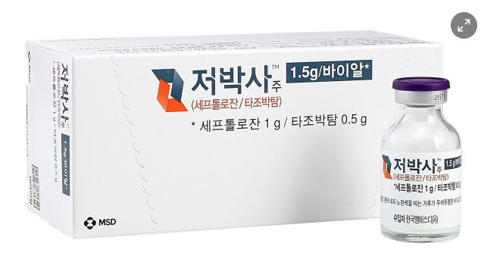

TREATMENT_New Antibiotics
Ceftolozane-tazobactam: 5th cephalosporin + β-lactamase inhibitor (BLI)
  MDR or XDR of P.aeruginosa, ESBL-Enterobacterales
  Limited against anaerobic, G(+) cocci, A.baumannii
Ceftazidime-avibactam: 3rd cephalosporin + non- β-lactam BLI
  MDR of P.aeruginosa, ESBL-Enterobacterales
  No activity against Ambler class B β-lactamases

Slide 64
TREATMENT_New Antibiotics
○ 복잡성 복강 내 감염(Complicated intra-abdominal infections), 복잡성 요로감염(Complicated urinary tract infections)과 원내 감염 폐렴(Hospital-acquired and ventilator-acquired pneumonia)에 Carbapenem계 항생제에 실패한 경우 또는 다제내성 녹농균이나 카바페넴 내성 장내세균이 증명된 경우 요양급여를 인정하며, 투여소견서를 첨부하여야 함.

Slide 65
PREVENTION
MINIMIZING OROPHARYNGEAL COLONIZATION
  Oral care interventions (dental care, toothbrushing, chlorhexidine)
  Avoiding gastric acid-suppressing medication
PREVENTING ASPIRATION
  Dysphagia
  Diet modification, swallowing training, non-oral feeding
  Minimizing sedative medications, Multimodality postoperative pain control
AIRWAY CLEARANCE, EARLY MOBILIZATION, PAIN CONTROL
PROPHYLACTIC ANTIBIOTICS

Slide 66
PREVENTION
CONVENTIONAL INFECTION CONTROL APPROACHES
  Adequate space, ventilation systems, handwashing facilities
  Attitudes and practices of health care personnel
  Health care staff, number, quality, motivation
  Antibiotic policy

Slide 67
PREVENTION
SPECIFIC PROPHYLAXIS AGAINST VAP
  Cuff pressure above 20cm H2O
  Semi-recumbent position
  Oral hygiene with sterile water

Slide 68
PREVENTION
SPECIFIC PROPHYLAXIS AGAINST VAP
  Continuous or intermittent suctioning of oropharyngeal secretions
  (sub-glottic secretion drainage)
  Antacids, histamine 2 blockers, PPI
  Oral care with chlorhexidine
  Selective decontamination of the digestive tract (SDD)

Slide 69

PREVENTION

Slide 70


PREVENTION
  Toothbrushing (VAP)
  Twice daily (no additional benefit of 3 or more)
  Lower rates of pneumonia
  Shorter duration of MV
  Shorter ICU length of stay
  Lower ICU mortality
  No differences of Hospital LOS, use of Antibiotics

Slide 71
SUMMARY_HAP
HAP is associated with excess mortality, hospital length of stay, and cost.
HAP is most commonly causes by aspiration of oro-pharyngeal secretions
contaminated with pathogenic bacteria.
P.aeruginosa, S.aureus, enteric gram(-) bacilli, Streptococcus sp..
Empirical treatment should target potentially resistant organisms.
Definitive culture returns, antibiotics should be de-escalated to
a narrow-spectrum agents.
For most patients, a 7-day course of antibiotics is recommended.

Slide 72
SUMMARY_VAP
VAP is associated with mortality, particularly in case of infection due to high-risk pathogens.
P.aeruginosa, S.aureus, and Enterobacteriaceae.
Pulmonary secretions should always be obtained before new antibiotics.
The initial approach involves broad-spectrum antibiotics to avoid inadequate treatment in patients with true bacterial pneumonia.
Switching to monotherapy after day 3-5, duration of therapy to 7-8 days.

Slide 73

Thank You

