Slide 1



Recent Advances in
Malignant Pleural Effusion
Seong Hoon Yoon
Pusan National University Yangsan Hospital

Slide 2
Contents
1. Background
2. Diagnosis of Maligant Pleural Effusion
Pleural cytology
Pleural biopsy
3. Treatment of Malignant Pleural Effusion
Pleurodesis
Indwelling pleural catheter

Slide 3
Malignant Pleural Effusion (MPE)
The presence of malignant cells in pleural fluid or biopsy
Thoracentesis
Pleural biopsy (surgery)
J Clin Oncol 2014;32:960-967
Notes:
Thoracentesis or drain => cytology
VATS => surgical biopsy

Slide 4
Leading Causes of Pleural Effusion in the US
Cause | Annual Incidence | Transudate | Exudate
Congestive heart failure | 500,000 | Yes | No
Pneumonia | 300,000 | No | Yes
Cancer | 200,000 | No | Yes
Pulmonary embolus | 150,000 | Sometimes | Sometimes
Viral disease | 100,000 | No | Yes
Coronary artery bypass surgery | 60,000 | No | Yes
Cirrhosis with ascites | 50,000 | Yes | No
Total | 1,500,000
N Engl J Med 2002;346(25):1971-7
Notes:
1년에 미국에서 150만건의 new pleural effusion 환자가 발생하고 이중 20만건은 malignant effusion

Slide 5

Characteristics of the Patients Hospitalized with Malignant Pleural Effusion
Variables | Total (n = 126,835)
Female sex, No. (%) | 70,750 (55.8%)
Age at admission , Median, y | 68.0 (58.4-77.2)
Length of Stay, Median, d | 5.5 (2.7-10.1)
In-Hospital Mortality, No. (%) | 14,660 (11.6)
Total Charge, Median | 42,375 (21,618-84,679)
Charges > $5 billion/yr
CHEST 2017; 151(4):845-854
Notes:
Retrospective 하게 NIS date를 분석하였다…MPE 의 prevalence
년간 127000 명이 입원을 한다…MPE로…
년간 50억 달러 이상의 비용이 들어감…
1년에 발생하는 new pleural effusion 수가 150만 명임….

Slide 6
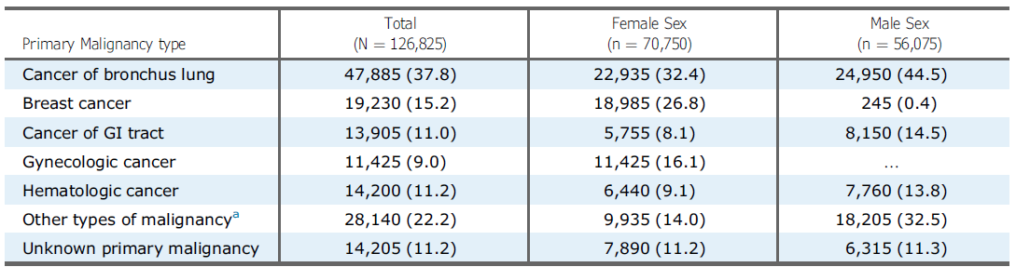
Primary Malignancy Types Among Patients with Malignant Pleural Diseases
CHEST 2017; 151(4):845-854

Slide 7
Effusions due to Lung cancer
15% of patients have effusion on presentation
50% of patients with lung cancer will develop effusion during their illness
Light, Pleural Disease, 4th ed

Slide 8
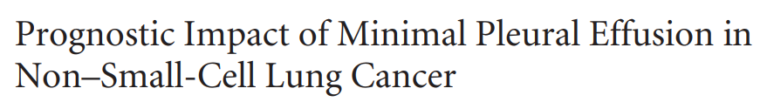


Minimal pleural effusion (PE)
minimal thickness (<10mm) on lateral decutbitus radiography or chest computed tomography
Thoracentesis are not recommended
8th edition (AJCC)-2016
Ambiguous
*
Most pleural (pericardial) effusions with lung cancer are due to tumor. In a few patients, however, multiple microscopic examinations of pleural (pericardial) fluid are negative for tumor and the fluid is nonbloody and not an exudate. When these elements and clinical judgment dictate that the effusion is not related to the tumor, the effusion should be excluded as a staging descriptor.
*
J Clin Oncol 2014;32:960-967
Notes:
Minimal PE => <10mm thickness (max)

Slide 9
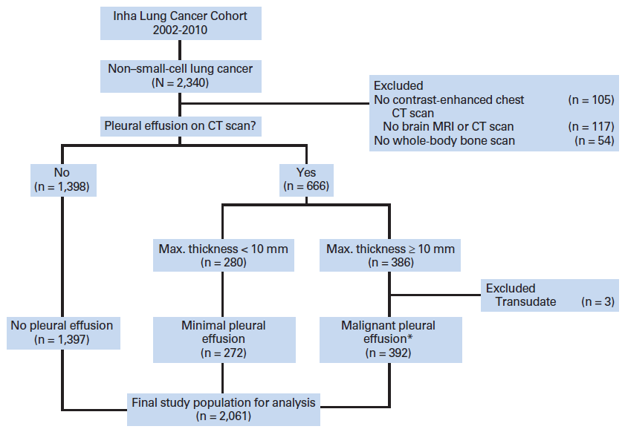
Flow chart for enrollment and classification of patients
1
2
3
13.2%
(*) Nine patients were reclassified into malignant pleural effusion from minimal pleural effusion
J Clin Oncol 2014;32:960-967
Notes:
Three group (13.2%에서 minimal PE 이 존재한다…)

Slide 10
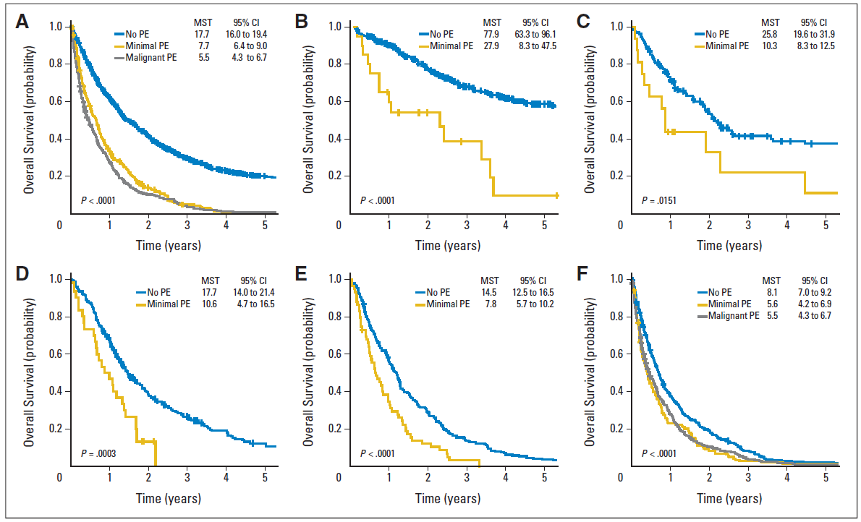
Overall survival
Stage I
Stage II
total study population
Stage IIIA
Stage IIIB
Stage IV
MST, median survival time
J Clin Oncol 2014;32:960-967
Notes:
Minimal PE의 존재는 예후에 좋지않은 영향을 준다…

Slide 11
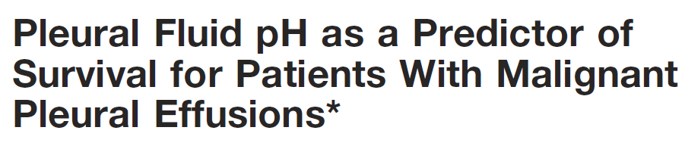
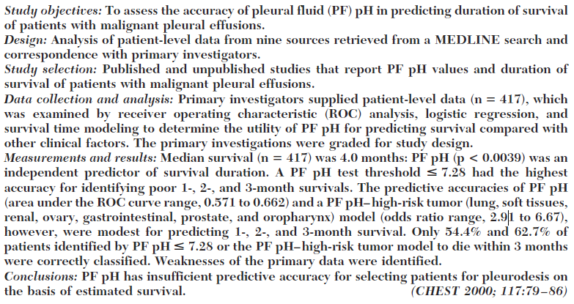
Median Surival (n=417) : 4.0 months
CHEST 2000; 117:79–86
Notes:
PF pH and survival may result from the accumulation of end products of glycolysis
in the pleural space caused by extensive tumor
deposits, which signify a late stage or aggressive
malignancy with a poor survival.5

Slide 12
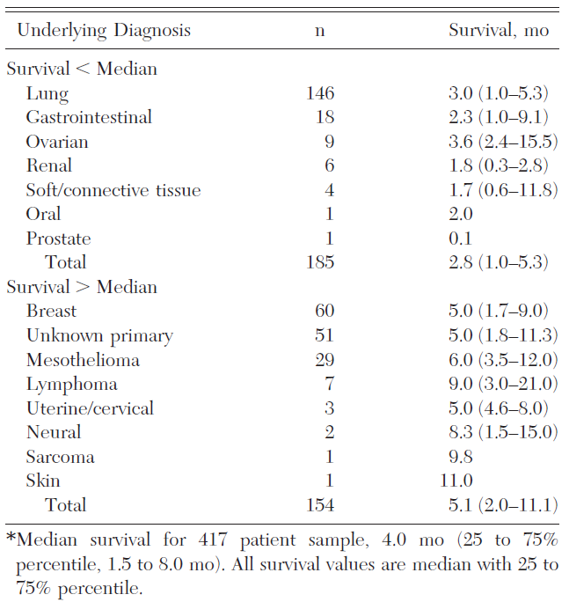
Survival of 339 Patients With Known Underlying Cancer
(high risk)
CHEST 2000; 117:79–86

Slide 13
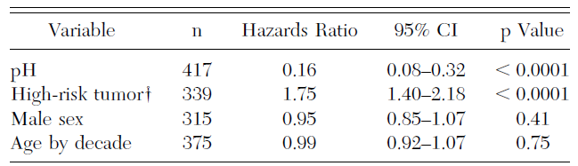
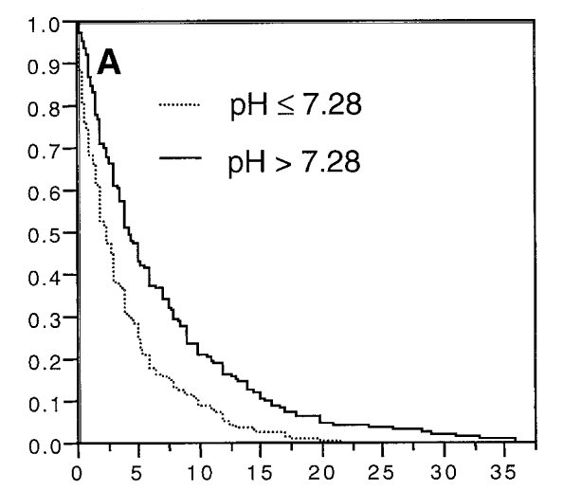
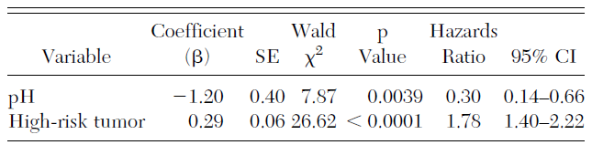
Univariate Analyses of Potential Predictors of Time to Death
Multivariate Analyses of Potential Predictors of Time to Death
CHEST 2000; 117:79–86
Notes:
7.28 이 ROC curve가 가장 이상적으로 보임…

Slide 14
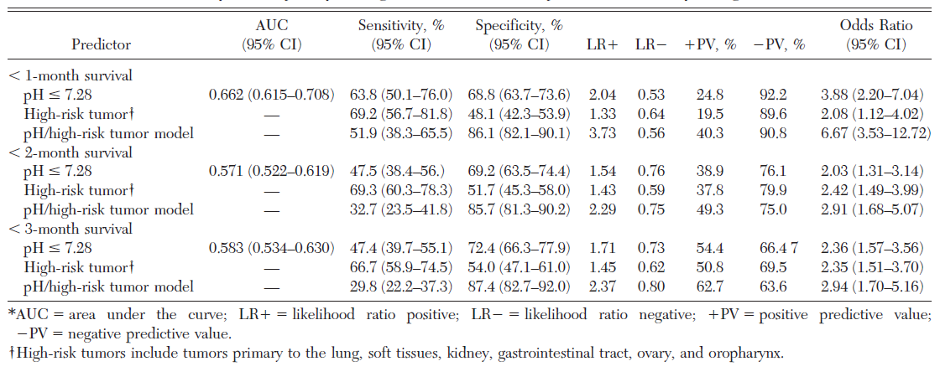
Predictive Properties of PF pH, High-Risk Tumor Classification
CHEST 2000; 117:79–86
Notes:
연관성은 되나 predictive accuracy가 떨어진다….

Slide 15
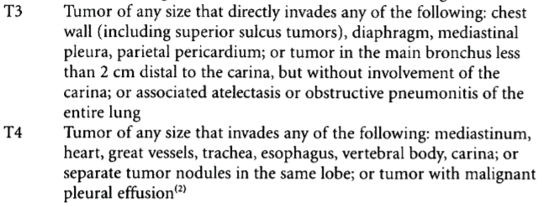
TNM staging
6th edition (AJCC)-2002
Notes:
2002-AJCC 6th edition

Slide 16
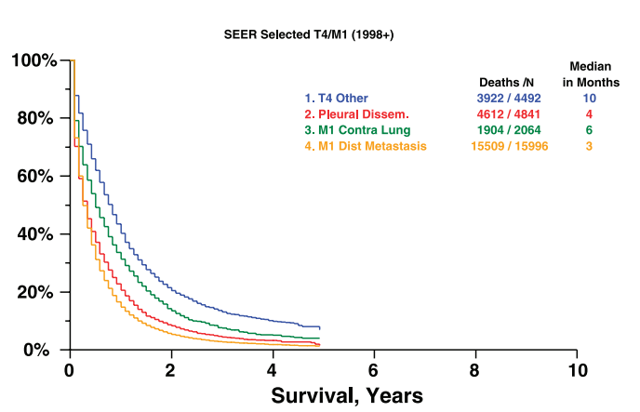
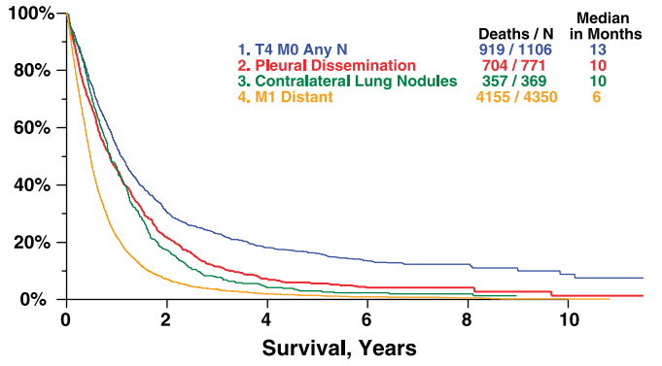
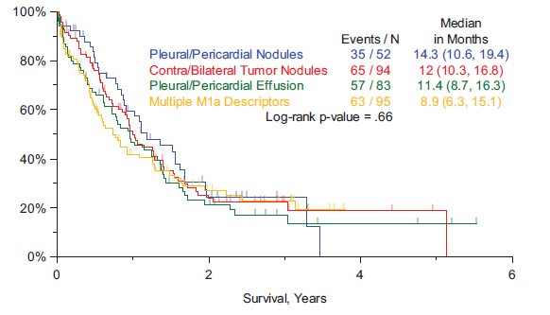
Effusions due to Lung cancer
7th edition of TNM
8th edition of TNM
J Thorac Oncol 2007;2:686-693
J Thorac Oncol 2015;10:1515-1522

Slide 17
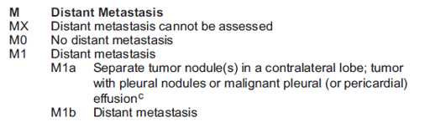
TNM staging
6th edition (AJCC)-2002
7th edition (AJCC)-2009
Notes:
2002-AJCC 6th edition

Slide 18
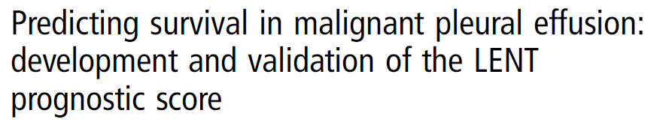
(L) Pleural fluid Lactate dehydrogenase
(E) Eastern Cooperative Oncology Group performance score
(N) Serum Neutrophil to Lymphocyte ratio
(T) Tumor type
Clive AO, et al Thorax 2014;69:1098–1104
Notes:
3개의 cohort를 가지고 연구함….

Slide 19
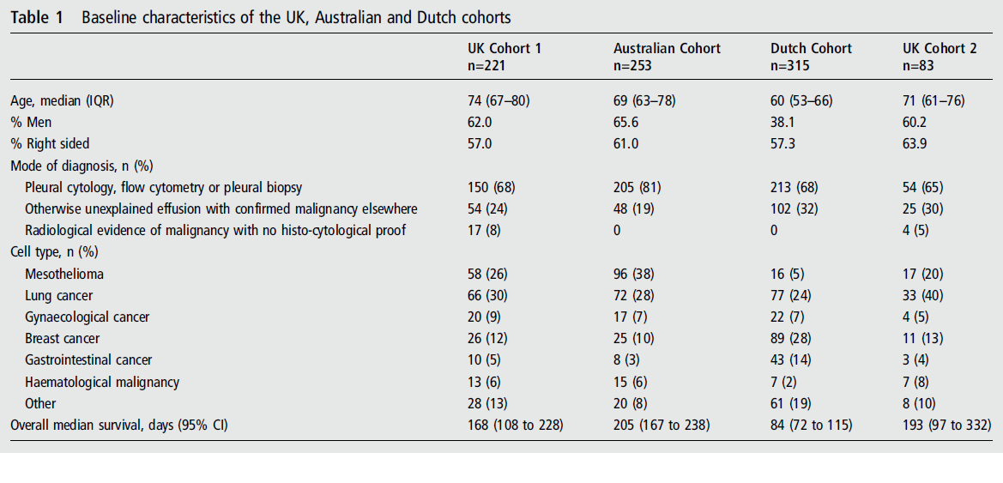
Baseline characteristics
Clive AO, et al Thorax 2014;69:1098–1104

Slide 20
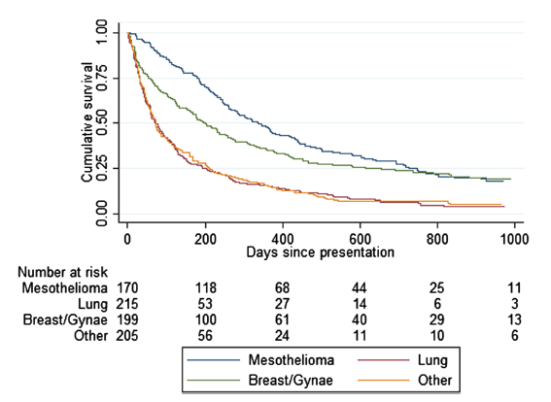
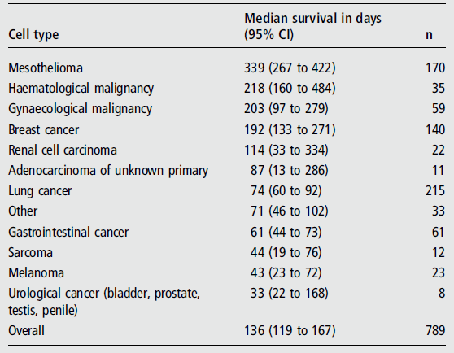
Median survival according to tumor types
Clive AO, et al Thorax 2014;69:1098–1104

Slide 21
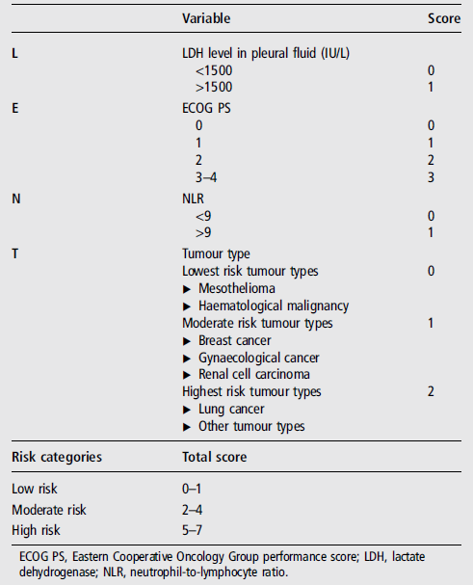
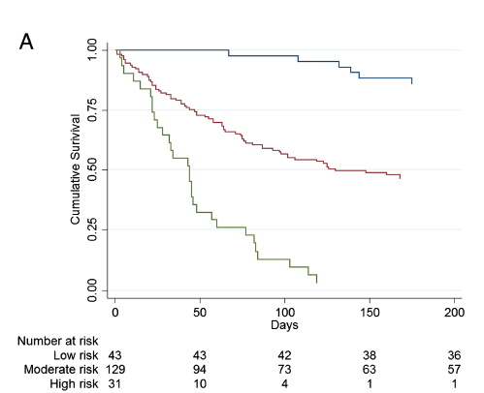

The LENT score calculation
Survival curves according to the LENT score
MS (IQR) days
HR (95% CI)
319 (228-549)
319 (228-549)
130 (47-467)
1.49 (1.03-2.15)
44 (22-77)
5.97 (3.58-9.97)
Clive AO, et al Thorax 2014;69:1098–1104

Slide 22
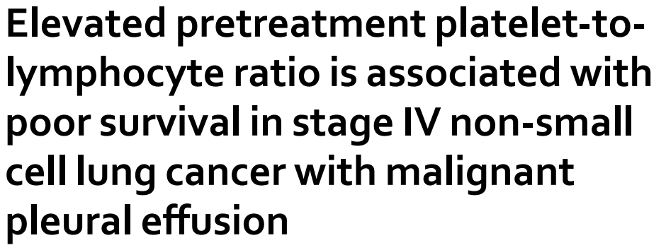
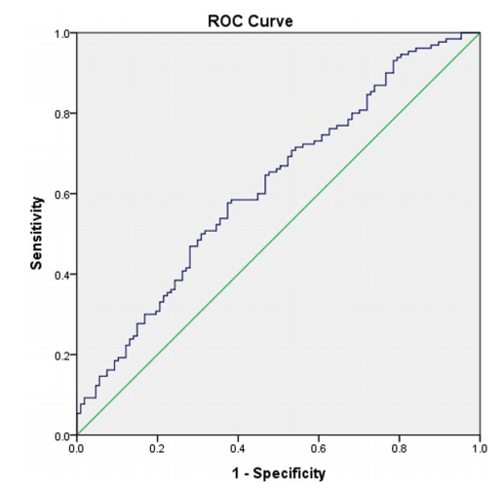
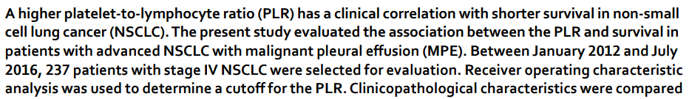
Cutoff => 181.2
Sci Rep 2019 Mar 18;9(1):4721

Slide 23
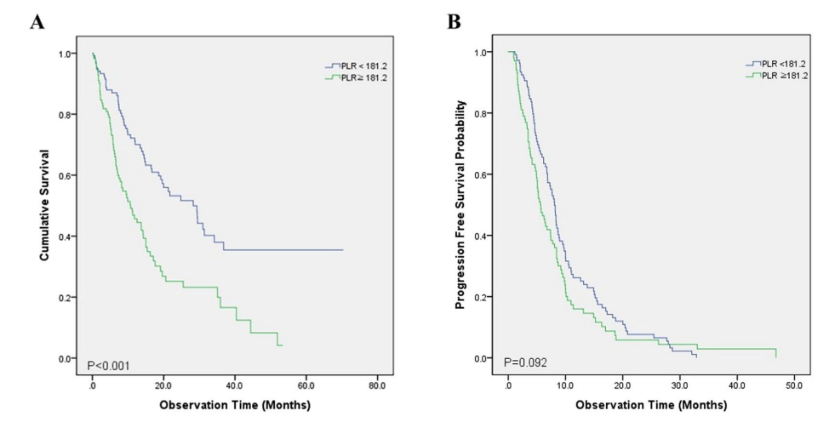
Survival
 | Median OS (95% CI) | P-value
Low PLR | 28.3 ms (19.7-36.9) | < 0.001
High PLR | 10.7 ms (7.0-14.4)
 | Median PFS (95% CI) | P-value
Low PLR | 8.1 ms (7.9-9.0) | 0.092
High PLR | 5.6 ms (4.5-6.8)
Sci Rep 2019 Mar 18;9(1):4721

Slide 24
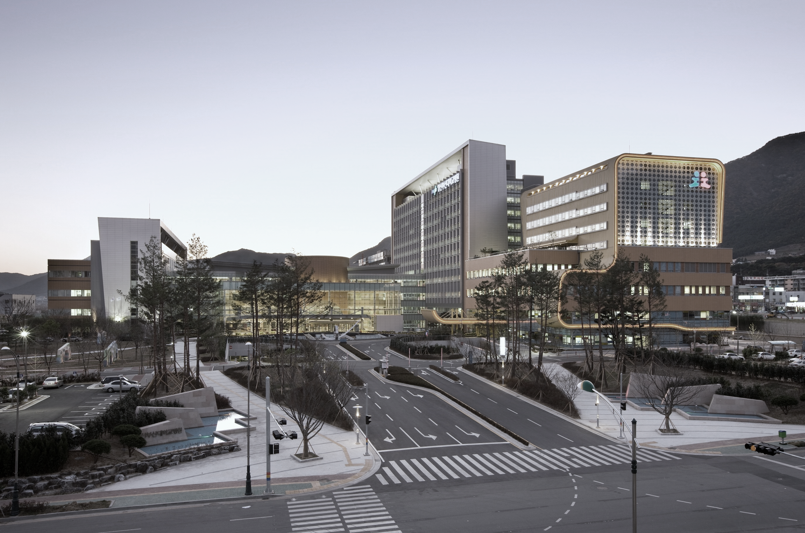

Diganosis
Chest images
Pleural fluid cytology
Tumor marker
Pleura biopsy
Molecular biotechnology

Slide 25
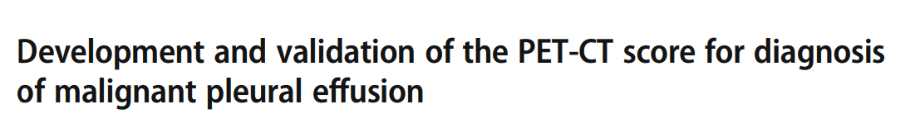
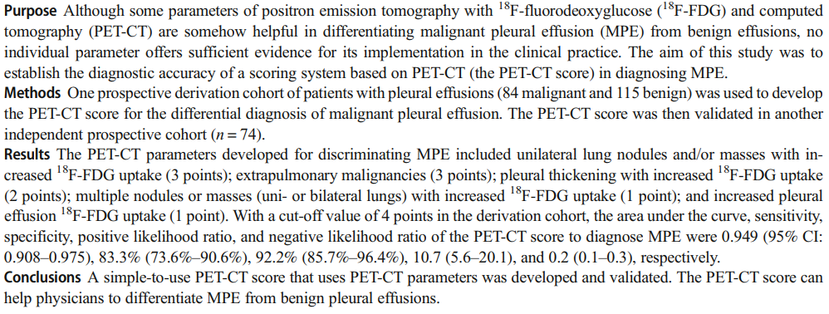
Yang MF, et al. Eur J Nucl Med Mol Imaging 2019
Notes:
Deviation cohort (n 199)/validation cohort (n 74)

Slide 26
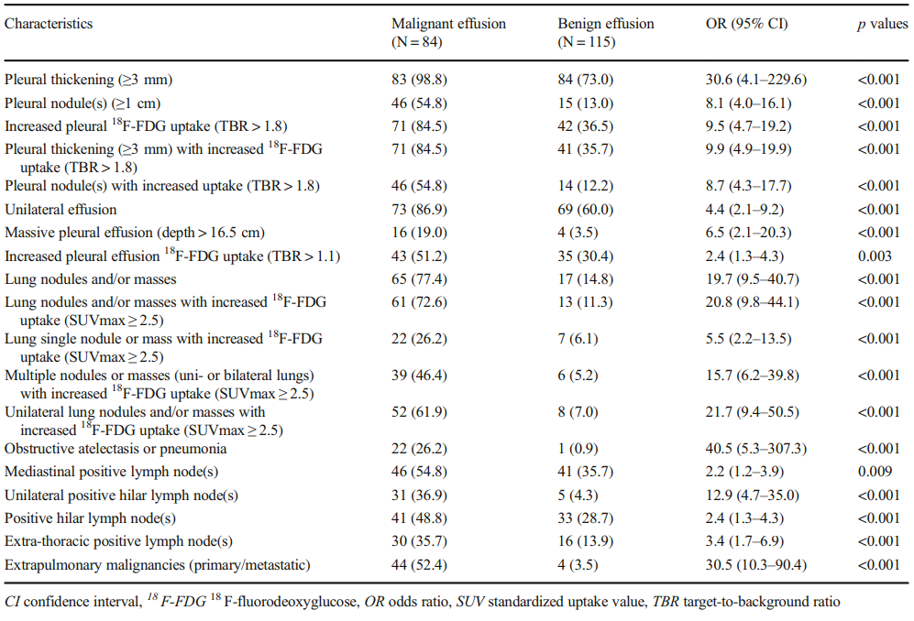
Univariate analysis of PET/CT scan findings in the derivation cohort (n, %)
Yang MF, et al. Eur J Nucl Med Mol Imaging 2019
Notes:
Malignancy 와 연관된 19개의 항목에

Slide 27
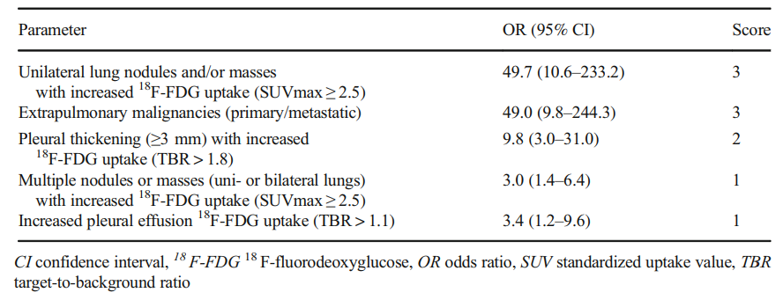
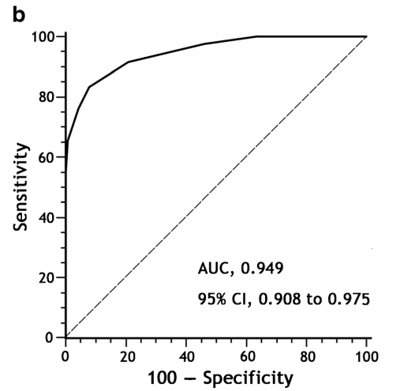
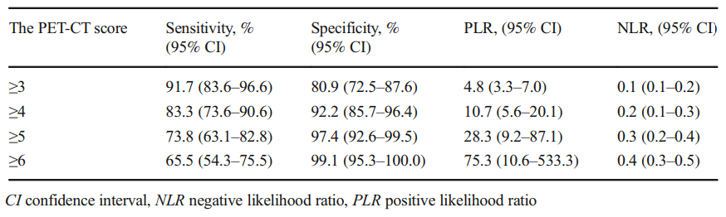
Development of the PET-CT score for diagnosing malignant pleural effusion
Diagnostic value of the PET-CT score for malignant pleural effusion
Yang MF, et al. Eur J Nucl Med Mol Imaging 2019

Slide 28
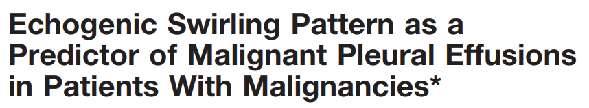
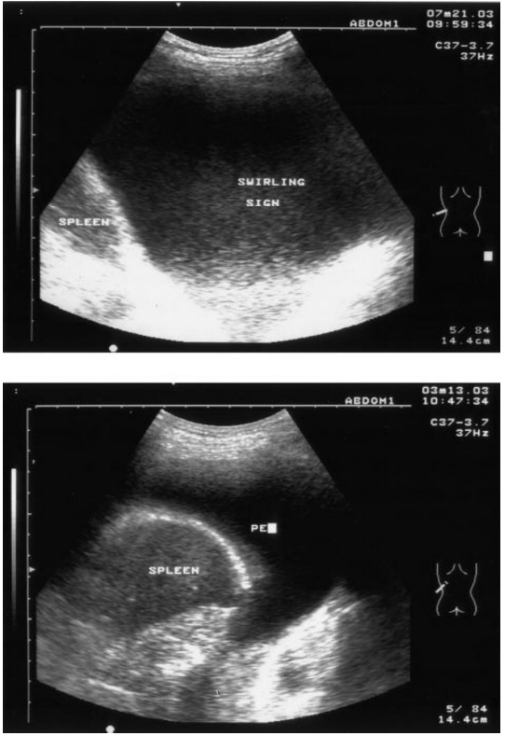
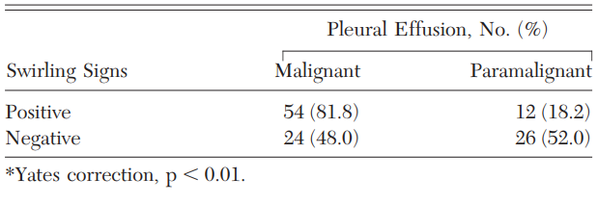
Correlation Between Echogenic Swirling Pattern and Malignant Pleural Effusions in Patients With Underlying Malignancies
The echogenic swirling pattern is a useful predictor of possible malignant pleural effusions, and may be a good marker for malignant pleural effusions in patients with underlying malignancies
CHEST 2004; 126:129–134
Notes:
US는 5cc detection 을 할 수가 있다…
Swriling 의 mechanism은 fibrotic/fibrinolytic complex로 설명된다…
Us => numerous floating hyperechoic particles within the PE

Slide 29
CT in differential diagnosis of benign and malignant pleural effusion
Parameter | Sensitivity | Specificity
Circumferential pleural thickening | 41% | 100%
Nodular pleural thickening | 51% | 94%
Parietal pleural thickening greater than 1 cm | 36% | 94%
Mediastinal pleural involvement | 56% | 88%
Am J Roentgenol 1990;154: 487–92

Slide 30
Diagnostic accuracy of effusion cytology
Report on the diagnostic accuracy of conventional effusion cytology (n =600)
Variables | Pleural effusions (n =300) | Ascites (n=300)
Sensitivity | 50.0% | 62.4%
Specificity | 97.0% | 98.0%
PPV | 95.7% | 100.0%
NPV | 86.4% | 88.3%
PPV, positive predictive value; NPV, negative predictive value
Diagnostic accuracy of effusion cytology is still unsatisfactory and should be improved. Therefore, the use of different adjuvant methods is recommended
Diagn Cytopathol 1999;20(6):350-7
Notes:
Cytospin을 돌려서 alcohol로 고정시키는 과정 => liquid (다시 사용할수도…) => cell 일 잘 보임…(cell의 loss가 거의 없다…)
Cell block은 cell이 loss되나 forlmalin으로 고정시키고 조직처럼할수 있다…IHC에는 더 좋음.
IHC의 도입으로 mesothelial cell과 cancer cell을 구분하는 것이 용이하게 되었다…

Slide 31
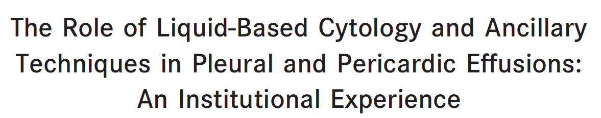
Cytology methods
Conventional smears
Cytospins
Cell blocks
Liquid based cytology
Ancillary techniques
Molecular testing/
Immunocytochemistry
3171 liquid-based cytology pleural and pericardial effusions were appraised between January 2000 and December 2013 (fine needle aspiration)
Cancer Cytopathol 2015;123:258-66.
Notes:
21 게이지 needle을 이용함. 2번 시행함.

Slide 32
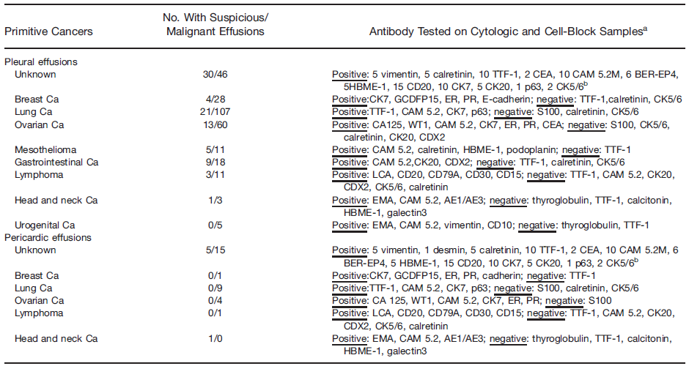
Correlation Between Primary Tumors and Pleural Effusions: Morphologic and Immunocytochemical Profiles
ªValues for positive results are reported, so that the remaining values reflect the corresponding negative values.
^{b}Immunocytochemistry was performed both on stored liquid-based cytology slides and on cell blocks derived from stored liquid-based cytology material, and there was no significant difference in expression.
Cancer Cytopathol 2015;123:258-66.

Slide 33
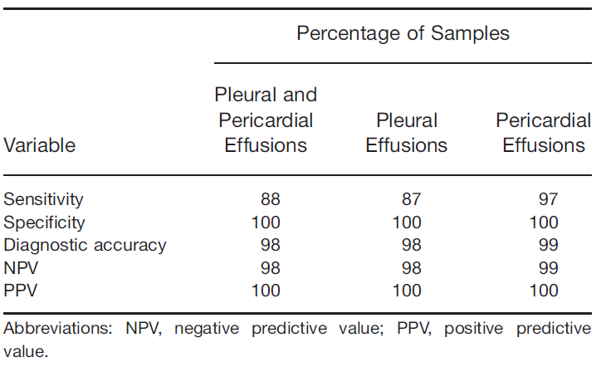
Descriptive Statistics for Morphologic Yield in the Pleural and Pericardial Groups
Cancer Cytopathol 2015;123:258-66.

Slide 34
The value of multiple fluid specimens in the cytological diagnosis of malignancy
Increasing the number of thoracocentesis can increase the diagnostic yield rate
Frequency | Diagnostic yield rate (n=55)
First thoracentesis | 65%
Second thoracentesis | additional 27% (92%)
Third thoracentesis | additional 5% (97%)
Mod Pathol 1994;7(6):665-8.

Slide 35
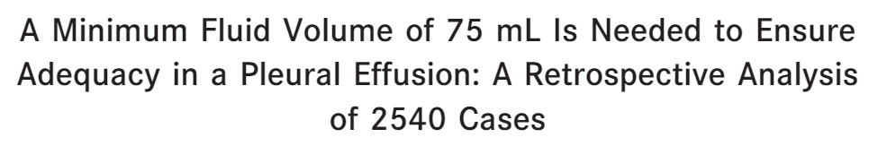
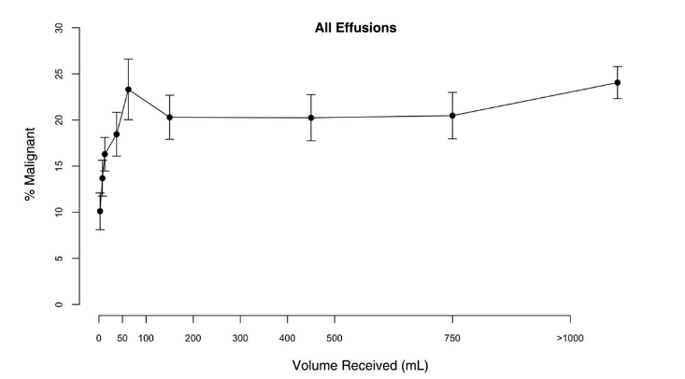
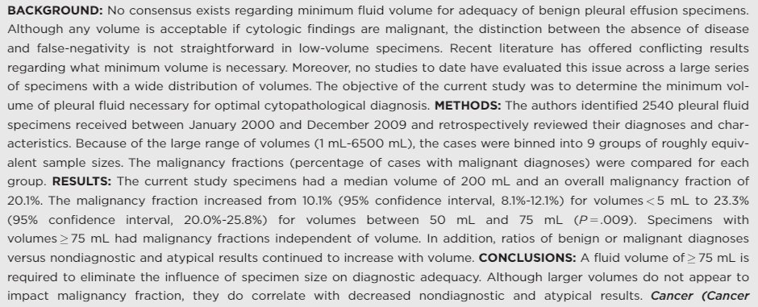
Volume of Pleural fluid
Increasing the volume of pleural fluid collected for cytology does not increase sensitivity
75 mL is the optimal minimal cutoff volume for diagnosis of MPE
Cancer Cytopathol 2014;122(9):657-65
Notes:
이전 연구에서는 60cc가 적절하다…(prospective study)

Slide 36
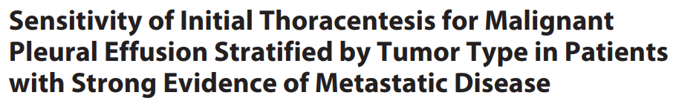
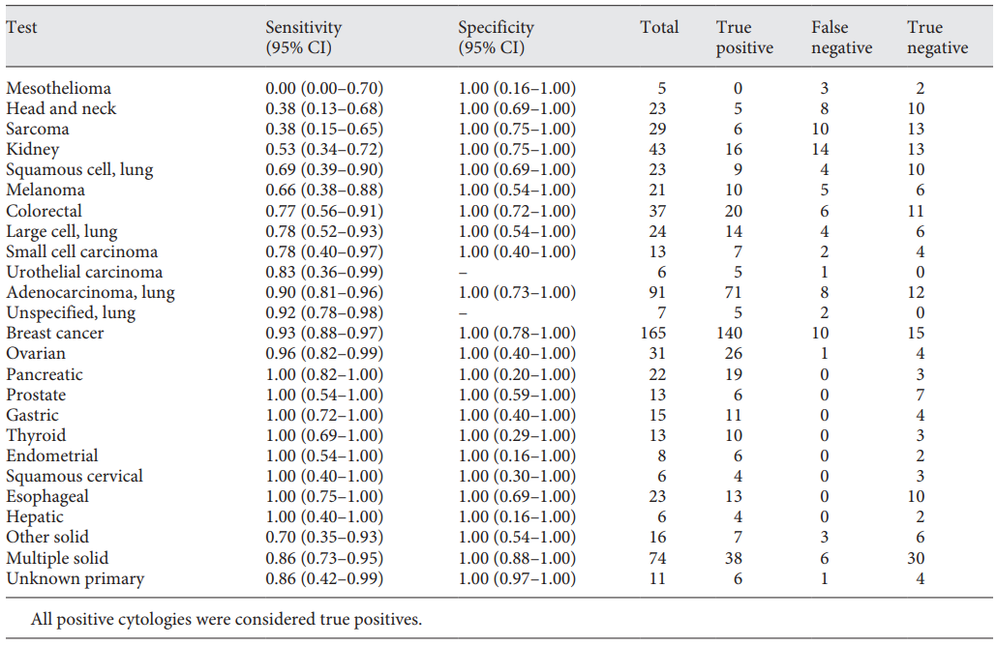
Sensitivity and specificity by tumor type in patients with solid tumor malignancy
Respiration 2018;96:363–369
Notes:
Initial thora …
Malignant 의 위험인자…large volume/protein
Negative risk factor ….contralateral fluid

Slide 37
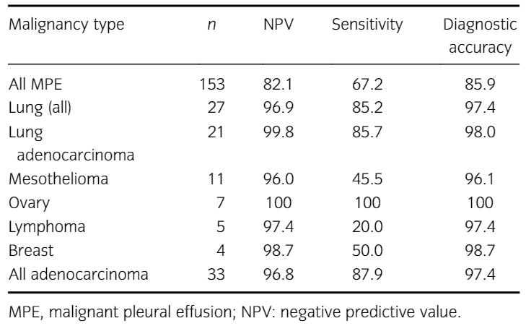
Yield of pleural fluid cytology for the diagnosis of malignant pleural effusion
Tumor type is an important determinant of pleural fluid cytology diagnostic yield
Intern Med J 2018;48(11):1318-1324
Notes:
ADC에서 MPE가 잘 나온다…

Slide 38
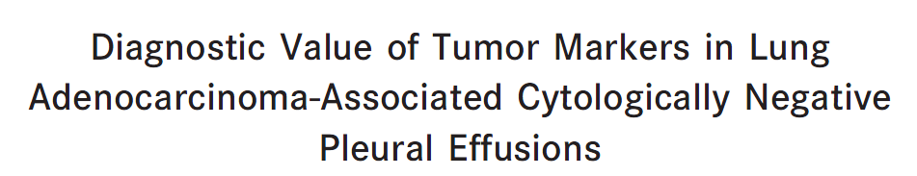
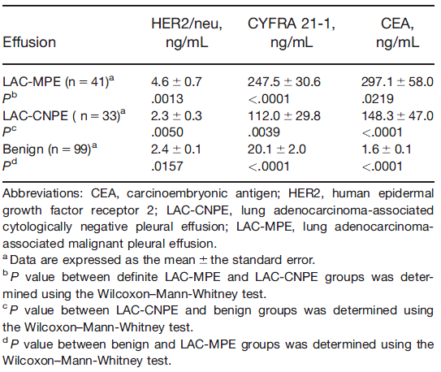
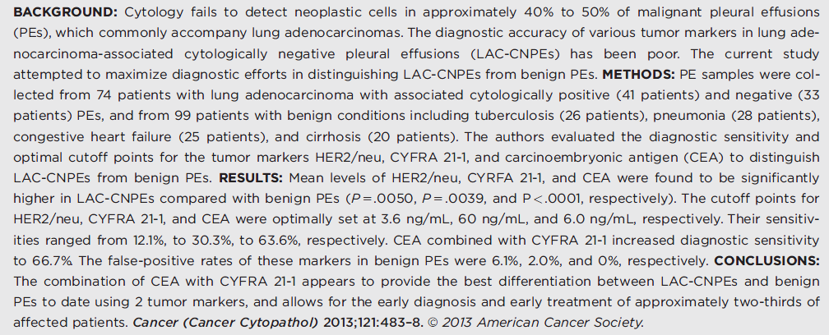
Level of tumor markers in various groups of pleural effusion
Cancer Cytopathol 2013;121:483–8.
Notes:
Level of tumor markers in various groups of pleural effusion

Slide 39
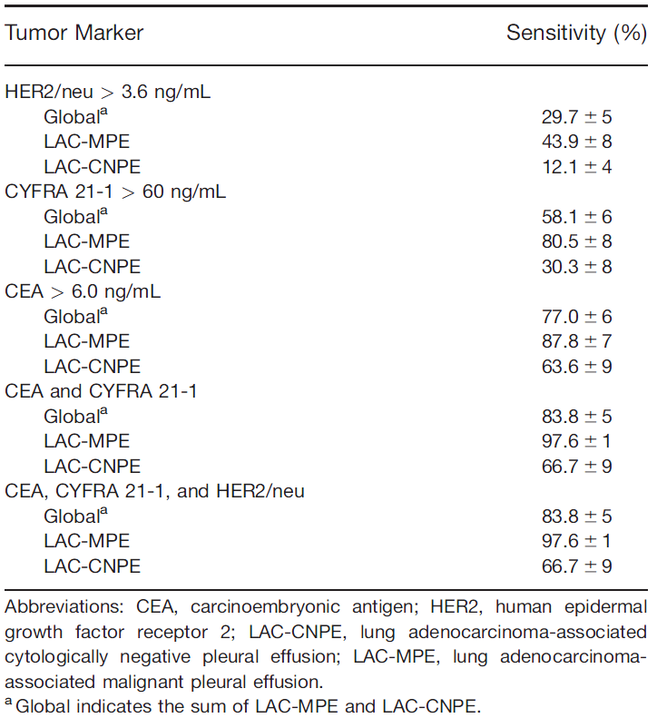
Measures of Diagnostic Sensitivity for Tumor Marker
Cancer Cytopathol 2013;121:483–8.
Notes:
HRE2를 추가하는 것은 LAC-CNPE의 진단적 sensitivit에는 도움이 되지 않는다…
Combined tumor marke는 cytology가 negative 인 환자 (early stage)에서 2/3에서 진단이 가능하다…

Slide 40
Pleural biopsy
Non-surgical methods of pleural biopsy
Methods | Sensitivity | Specificity
Closed needle biopsy | 7-72% | 100%
Ultrasound-guided Percutaneous pleural biopsy | 86% | 100%
CT-guided percutaneous pleural biopsy | 87% | 100%
Diagnostic sensitivities of thoracoscopy greater than 90% with specificities of 100%
In some instances, however, visualization of the pleura with white light may fail to detect pleural metastases or misdirect biopsy towards non-malignant lesions
Respirology 2008;13:5–20

Slide 41
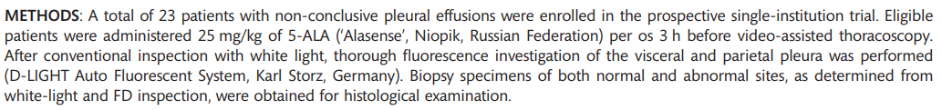
White-light mode
Results of histological examination in relation to the macroscopic findings
Histologic examination | Type of the specimen
 | V(+)/F(+) | V(-)/F(+) | V(-)/F(-)
T(+) | 60 (50.9%) (TP) | 22 (18.6%) (TP) | 10 (8.5%) (FN)
T(-) |  | 3 (2.5%) (FP) | 23 (19.5%) (TN)
TP, true positive; TN, true negative; FP, false positive, FN, false negative V(+)/F(+), visible at white-light and fluorescence; V(-)/F(+), visible only by fluorescence
Fluorescence mode
European Journal of Cardio-Thoracic Surgery 2012;41:649–652
Notes:
5-ALA 는 photo sensitizer

Slide 42



Complications of medical thoracoscopy
Respiration 2015;90:251–255
Wu YB et al. BMC Pulmonary Medicine 2017;17:109
Notes:
전신마취에 대한 부담감으로…medical thoaracoscopy

Slide 43


Cancer Res Treat 2018;50(3):908-916
Notes:
Mutation 의 빈도과 EGFR-TKIs 를 사용하였을때 반응을 비교하고자 함….

Slide 44

Comparison of EGFR mutation status
Discrepancy : 6/23 (26.1%)
Cancer Res Treat 2018;50(3):908-916
Notes:
Paired smaple (tissue/MPE)
Effusion 을 centrifugation 시켜서 cell free supernatant vs cell pellet 의 EGFR mutation rate에서 차이가 난다….어떤 연구는 supernatant 가 더 좋다고 하나 (centrifugation을 하면
Damaged cell에서 DNA 가 supernatant로 유리된다…)
이번 연구는 cell pelle을 추천함…

Slide 45



Cell pellet
(tissue)
Cell-free Supernatant
(Liquid)
Cancer Res Treat 2018;50(3):908-916
Notes:
조직이 더 잘나온다?? Damaged cell에서 DNA가 더 잘 유리된다….

Slide 46


Progression-free survival according to EGFR mutation status in cell blocks of malignant pleural effusion
. Comparison of the response to EGFR tyrosine kinase inhibitors between target lesions and pleural effusions in patients with EGFR MT-MPE
Comparison of the response to EGFR tyrosine kinase inhibitors between target lesions and pleural effusions in patients with EGFR MT-MPE
Cancer Res Treat 2018;50(3):908-916
Notes:
EGFR-TKI를 사용하였을때의 PFS가 차이가나므로 좋은 biomarker 가 될수 있다…
가설…1) pleural space로의 흡수력이 떨어진다….2) cancer에 의해 손상된 lymphatic drain 이 TKIs를 사용해도 회복되지 않아서 effusion 이 줄이 않는다…3) effusion 에 있는 stem cell이 EMT를 말들어서 저항을 자체적으로 가니다…

Slide 47


The role of VEGF in MPE
<Data from the studies that compared pleural fluid VEGF levels>
<Data from the studies that compared serum VEGF levels>
Physiol Rep 2016;4 (24):e12978
Notes:
This study showed that malignant PEs were associated with higher levels of both pleural fluid and serum VEGF
VEGF appears to represent a promising biomarker for the differential diagnosis between benign and malignant PEs.

Slide 48


Mol Med Rep 2018;17(6):8019-8030

Slide 49



The control rate of MPE without pleurodesis (A) and the response (B)
Lung Cancer 2016;99:131–136
Notes:
Beva/carbo/pem => 35%-50% (RR)

Slide 50


Hiranuma O, et al. Clin Lung Cancer 2019 Feb

Slide 51

Primary end point: 1-year PFS rate
Secondary end points: ORR, PFS, OS, safety
Hiranuma O, et al. Clin Lung Cancer 2019 Feb

Slide 52
Treatment
Guidelines
Therapeutic thoracentesis
Pleurodesis
Indwelling pleural catheter (IPC)
Clinical trials

Slide 53



Guidelines for management of MPE
American Thoracic Society
British Thoracic Society

Slide 54

Management of patients with known or suspected malignant pleural effusion
Known or suspected MPE
Asymptomatic
Pleural intervention not needed
(unless for diagnostic purposes)
Symptomatic
Ultrasound-guided therapeutic thoracentesis (i.e., large-volume tap*)
Causes of dyspnea in patients with malignant pleural effusions
Improvement in dyspnea
No
Yes
Investigate for other causes of dyspnea
Lung re-expansion
* With goals of assessing lung expansion and relief of dyspnea
Am J Respir Crit Care Med 2018;198(7):839-849

Slide 55

IPC, indwelling pleural catheter
*** There is a low likelihood (2–4%) of indwelling pleural catheter (IPC)–related infection. Escalation of care (intravenous antibiotics, hospital admission, removal of catheter) should be made on a case-by-case basis and is recommended if there are any signs/symptoms of worsening infection.
Am J Respir Crit Care Med 2018;198(7):839-849
Notes:
IPC => indwelling pleural catheter
Poudrage 살포/slurry 물에 녹여서 진흙처럼…

Slide 56

* There is no evidence as to what proportion of unopposed pleura prevents pleurodesis. We suggest that <50% pleural apposition is unlikely to lead to successful pleurodesis
Thorax 2010;65(Suppl 2):ii32-ii40
Notes:
Pleural apposition
구체적이고 현실적임…

Slide 57

<Algorithm for the management of malignant pleural effusion>
Annals of Thoracic Medicine 2017;12(1):3-10
Notes:
Saudi thoracic society
40Disabled; requires special care and assistance.

Slide 58

<Algorithm for the management of malignant pleural effusion>
√
√
√
Tuberc Respir Dis 2014;76(5):211-7

Slide 59
Therapeutic thoracentesis
Re-expansion pulmonary edema (less than 1%)
Recurrence
Risk factors
Pulmonary collapse for longer than 1 week
Younger age
Rapid removal of a large amount of pleural fluid over a short time period (Removal rate of 1-2L every 2hr should not be exceeded)
Lancet 2018; 392: 507
Pleural fluid and related symptoms recur in 98–100% of patients within 30 days
Notes:
기전은 잘 모르나…alterations of vascular permeability and hydrostatic mechanism
Risk factors for the complication include pulmonary collapse for longer than 1 week, younger age, and the rapid removal of a large amount of pleural fluid over a short time period which is why the recommended rate of removal of 1–2 L every 2 h should not be exceeded.

Slide 60


Pleural manometry during large-volume thoracentesis can prevent the development of excessively negative pleural pressures, which have been associated with re-expansion pulmonary edema
The recommendation is not to exceed - 20 cm H2O
CHEST 2004; 126:1764 –1769
Notes:
Water manometer

Slide 61




Symptoms and Pleural Pressures*
The development of chest discomfort is associated with a potentially unsafe drop in pleural pressure values and should be a sign to terminate thoracentesis. It is not necessary to terminate thoracentesis solely because of the development of cough.
CHEST 2006; 129:1556 –1560

Slide 62

Pleurodesis
Questions to assist patient selection for pleurodesis
Chest tube pleurodesis
Thoracoscopic pleurodesis
Notes:
Lymphoma/SCLC 는 가능함….

Slide 63


Chest tube pleurodesis
Implications
Chest tubes are left in place until pleural fluid drainage remains <150 mL/day
Small bore catheter (9-14Fr) vs Large-bore catheter (20-32Fr)
≤ 150 mL/day of fluid drainage
Radiographical evidence of lung re-expansion

Slide 64

Chest tube pleurodesis
Sclerosing agents for pleurodesis
Respirology 2008;13:5–20
Notes:
Staphylococcus aureus 는 보고된 case 가 많지 않아 100%로 나옴…

Slide 65

Chest tube pleurodesis
Complications Among Treated Patients*
TS, talc slurry; TTI, talc insufflation
CHEST 2005; 127:909 –915
Notes:
The mechanism by which talc induces pleurodesis remains unclear. Experimental data demonstrate that talc stimulates mesothelial cells to release proinflammatory
mediators, such as basic fibroblast growth factor, IL-8, VEGF and transforming growth factor (TGF), that have the capacity to promote intrapleural
fibrosis.

Slide 66

Thoracoscopic pleurodesis
Talc poudrage vs Talc slurry
Efficacy of Talc Slurry and Talc Insufflation*
CHEST 2005; 127:909 –915

Slide 67


Slide 68

Thoracoscopic pleurodesis
Cochrane review of two studies of 112 patients treated with talc by chest tube or thoracoscopy found a relative likelihood of MPE non-recurrence of 1.19 (95% CI: 1.04–1.36) slightly in favour of thoracoscopy
Cochrane Database Syst Rev 2004; 1:CD002916
benefit of thoracoscopy for breaking down adhesions and loculations that result from greater degrees of intrapleural inflammation and tumour burden as reflected by low pleural pH
European Journal of Cardio-thoracic Surgery 2004;26:432–436

Slide 69

Other treatments
Chronic drainage with indwelling catheters
Pleuroperitoneal shunting

Slide 70

Complications of IPC
0.4–4% (thoracoscopic pleurodesis)
CHEST 2006; 129:362–368
Notes:
Single center

Slide 71


IPC–Plus trial
N Engl J Med 2018;378:1313-22

Slide 72

43%
23%
N Engl J Med 2018;378:1313-22

Slide 73

Adverse Events
N Engl J Med 2018;378:1313-22
Notes:
No significant between-group differences in effusion size and complexity, number of inpatient days, mortality, or number of adverse events were identified. No significant excess of blockages of the indwelling pleural catheter was noted in the talc group.

Slide 74


* The primary endpoint: improvement from baseline in Modified Borg Score (MBS) 6 weeks after randomized treatment * Secondary endpoints: hospitalization days, re-interventions, and adverse events.
Lung Cancer 2017;108:9–14

Slide 75


Black is TP, dotted lines is IPC
Conclusions: IPC was not superior in the primary endpoint, improvement of the modified Borg scale (MBS). However, IPC patients had lower hospital stay, fewer admissions and fewer re-interventions. The IPC is an effective treatment modality in patients with symptomatic malignant pleural effusion.
Lung Cancer 2017;108:9–14

Slide 76



JAMA 2017;318(19):1903-1912

Slide 77


Lancet Respir Med 2018;6: 671–80

Slide 78

Average VAS breathlessness scores of each patient over the first 60 days, by treatment group
Lancet Respir Med 2018;6: 671–80

Slide 79


Cumulative incidence curve of pleurodesis success rate based on 6 months’ data estimated from Fine and Gray competing risks model
Patient-reported quality-of-life measures, assessed with EuroQoL-5 Dimensions-5 Levels (EQ-5D-5L), were better in the aggressive group than in the symptom-guided group (estimated means 0·713 [95% CI 0·647–0·779] vs 0·601 [0·536–0·667]). The estimated difference in means was 0·112 (95% CI 0·0198–0·204; p=0·0174).
Interpretation We found no differences between the aggressive (daily) and the symptom-guided drainage regimens for indwelling pleural catheters in providing breathlessness control. These data indicate that daily indwelling pleural catheter drainage is more effective in promoting spontaneous pleurodesis and might improve quality of life.
Lancet Respir Med 2018;6: 671–80
Notes:
여기서도 mortality는 증명하지 못함

Slide 80

Thank you for your attention!!
Notes:
경청해 주셔서 감사합니다.

