Slide 1
irAE management of immune checkpoint inhibitors in NSCLC
Mi-Hyun Kim
School of Medicine, Pusan National University
Pusan National University Hospital

Slide 2
Contents
Background
Overview of immune related adverse events (irAEs)
Organ specific toxicity
Summary

Slide 3
01. Background

Slide 4
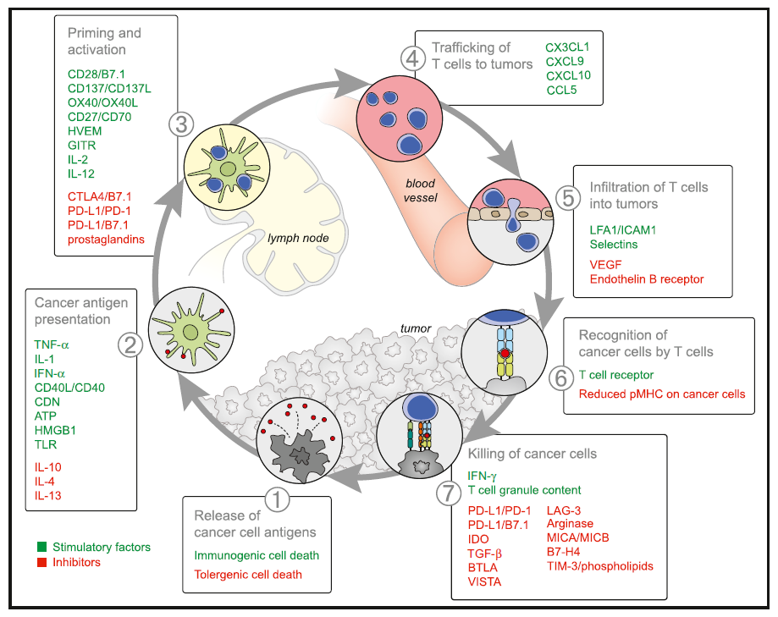
Checkpoint inhibitors and Cancer immunity cycle
Immunity 2013
Notes:
The generation of immunity to cancer is a cyclic process that can be self propagating, leading to an accumulation of immune-stimulatory factors that in principle
should amplify and broaden T cell responses. The cycle is also characterized by inhibitory factors that lead to immune regulatory feedback mechanisms, which
can halt the development or limit the immunity. This cycle can be divided into seven major steps, starting with the release of antigens from the cancer cell and
ending with the killing of cancer cells. Each step is described above, with the primary cell types involved and the anatomic location of the activity listed

Slide 5
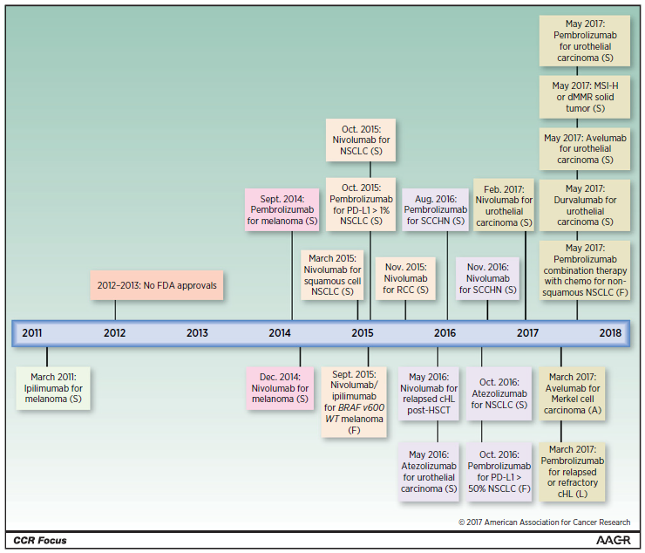
Immune checkpoint inhibitors
Clin Cancer Res 2017

Slide 6
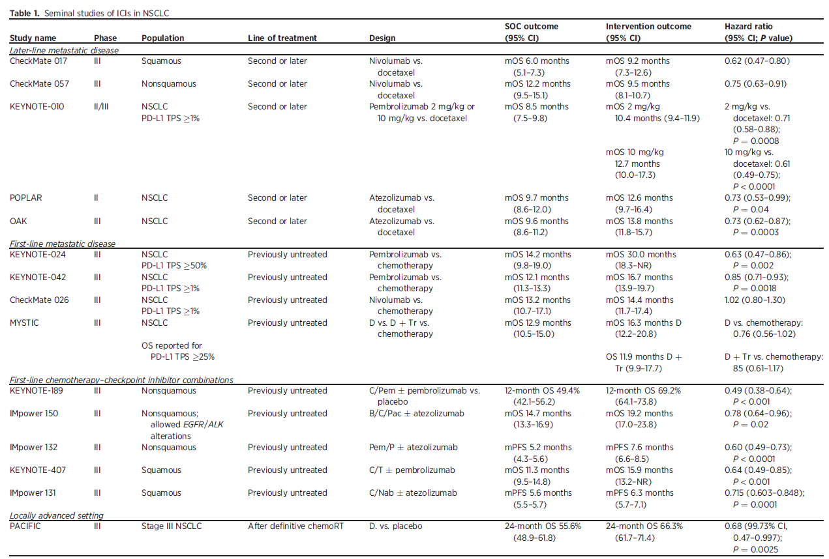
Seminal studies of ICIs in NSCLC
Clin Cancer Res 2019

Slide 7
ESMO patients’ guideline says
“As with chemotherapy and tumor-targeted drugs, treatment with checkpoint inhibitors may also cause
side effects but they are very different and require different management strategies”
ESMO patients’ guideline 2018

Slide 8
02. Overview of irAEs

Slide 9
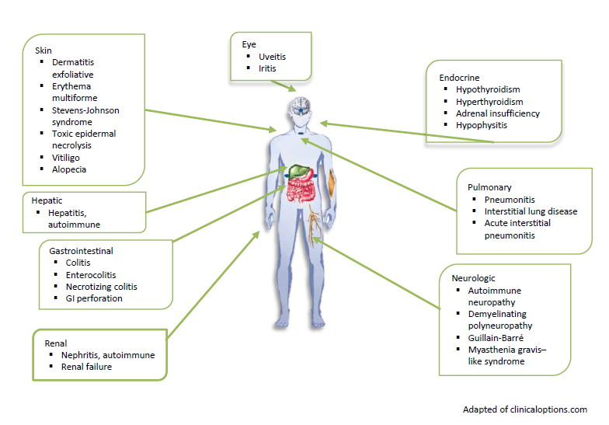
Spectrum of irAEs

Slide 10
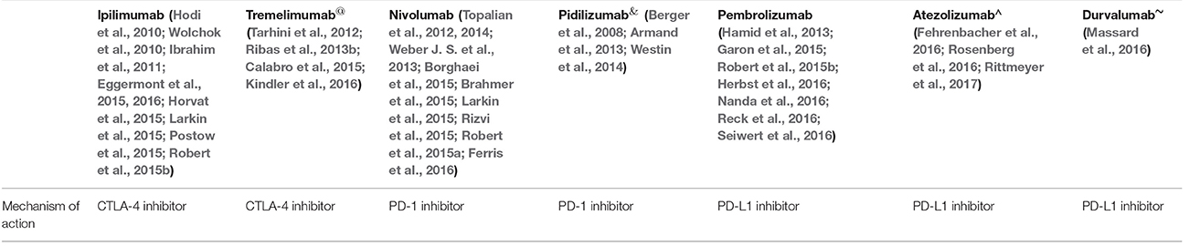
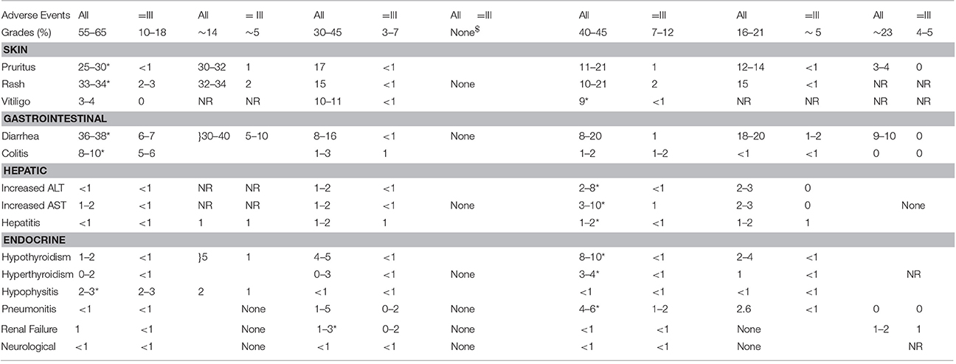
Incidence
Front Pharmacol. 2017

Slide 11
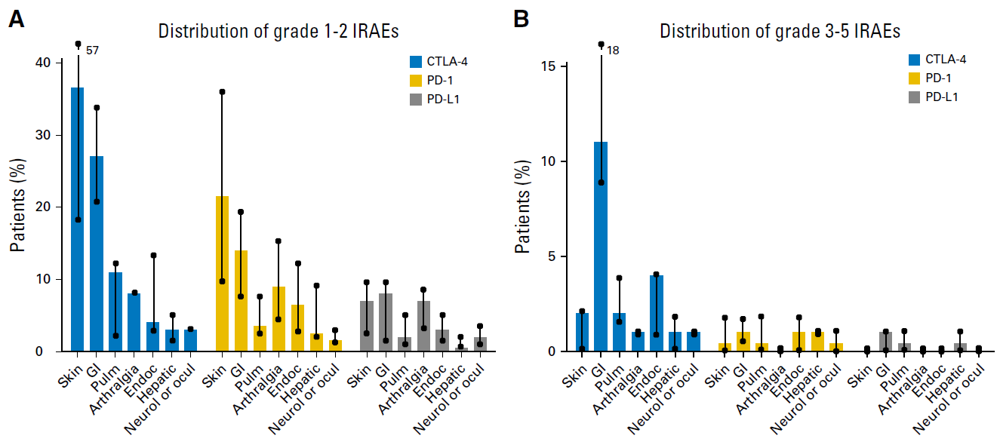
Incidence
J Clin Oncol 2018

Slide 12
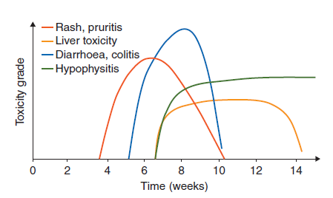
Timing
Annals of Oncol 2017

Slide 13
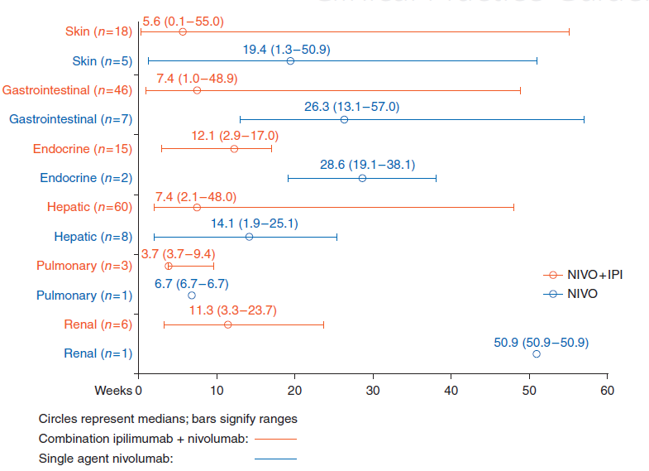
Timing
Annals of Oncol 2017

Slide 14
General principles of management
Grade 2 (moderate)
  ICIs are interrupted
  Resumed when symptoms and/or lab values decrease below grade 1
  Glucocorticoids should be started if symptoms persist beyond 1 week (prednisone 0.5–1 mg/kg/day or equivalent)
Front Pharmacol. 2017

Slide 15
General principles of management
Grade 3,4 (severe and very severe)
  High doses of glucocorticoids should be given
  (prednisone 1–2 mg/kg/day or equivalent)
  Tapered gradually when symptoms subside to grade 1 or less
  ★ The eligible patients (those on prednisone 20mg or equivalent doses for at least 4 weeks) should also receive appropriate prophylaxis against Pneumocystis jirovecii as per the established guidelines
Front Pharmacol. 2017

Slide 16
General principles of management
Alternative immunosuppressive agents should be considered if symptoms continue beyond 3 days on intravenous glucocorticoids
  Infliximab 5 mg/kg; mycophenolate mofetil in hepatitis
  Infliximab 5 mg/kg should be repeated after 2 weeks for persistent symptoms
For grade 4 toxicities, ICIs should be stopped permanently except in endocrinopathies controlled on hormone replacement
Front Pharmacol. 2017

Slide 17
03. Organ specific toxicity

Slide 18
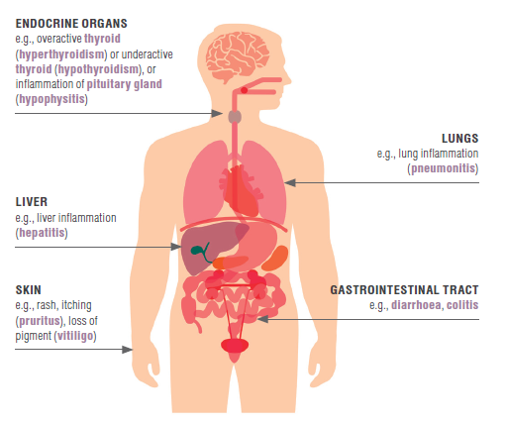
Common irAEs
ESMO guideline 2018

Slide 19
CASE 1
Male / 65 years old
HCC with bone metastasis, LC, CHB, DM
  2018. 7. 2. ~ 2018. 7. 13. RTx. For L1-4 spines (30Gy/#10)
  2018. 7. 25. Durvalumab 1500mg + Tremelimumab 75mg iv
  2018. 9. 12. Durvalumab 1500mg + Tremelimumab 75mg iv

Slide 20
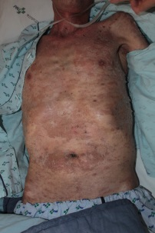
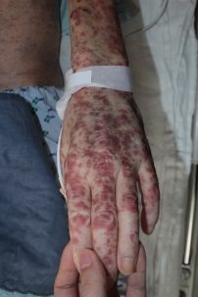
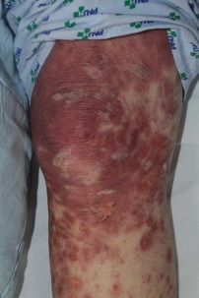
CASE 1
2018/7/25
Durvalumab 1500mg
+ Tremelimumab 75mg iv
2018/9/12
Durvalumab 1500mg
+ Tremelimumab 75mg iv
8/18
G2 Skin rash
9/13
G2 Skin rash
9/26
G4 Skin rash
Notes:
첫번째 dose 2주 후

Slide 21
01. Skin toxicity
Most common manifestation and earliest to occur
  All grade S/E : 30% (G3/4: ~ 3%)
  Commonly seen after the first dose
Rash/inflammatory dermatitis
Bullous dermatitis
Severe cutaneous adverse reactions (SJS, TEN, DRESS…)
Front Pharmacol. 2017 ESMO guideline 2018

Slide 22
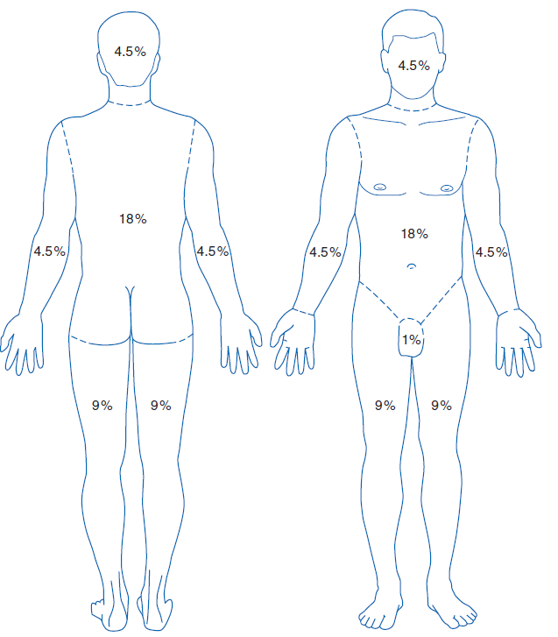
Skin toxicity
Grade 1: Rash affecting <10% BSA. Mostly asymptomatic
Grade 2: Rash affecting 10–30% BSA.
Grade 3/4: Rash covering >30% BSA. Severe life threatening symptoms. Generalized exfoliative/ulcerated rash
Front Pharmacol. 2017 ESMO guideline 2018

Slide 23
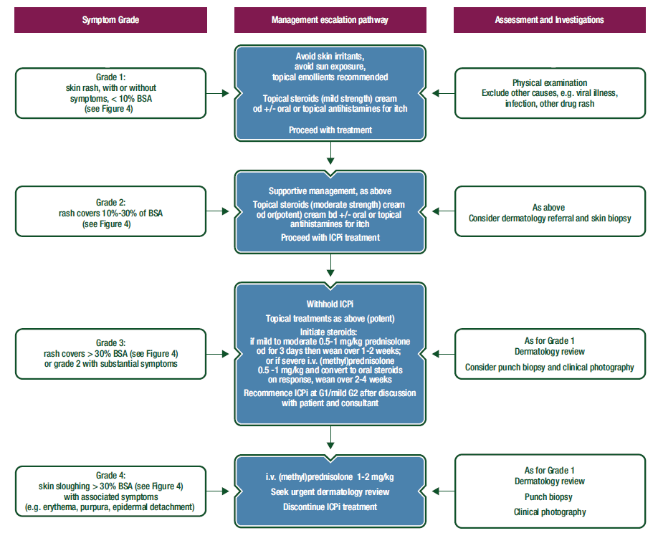
Skin toxicity

Slide 24
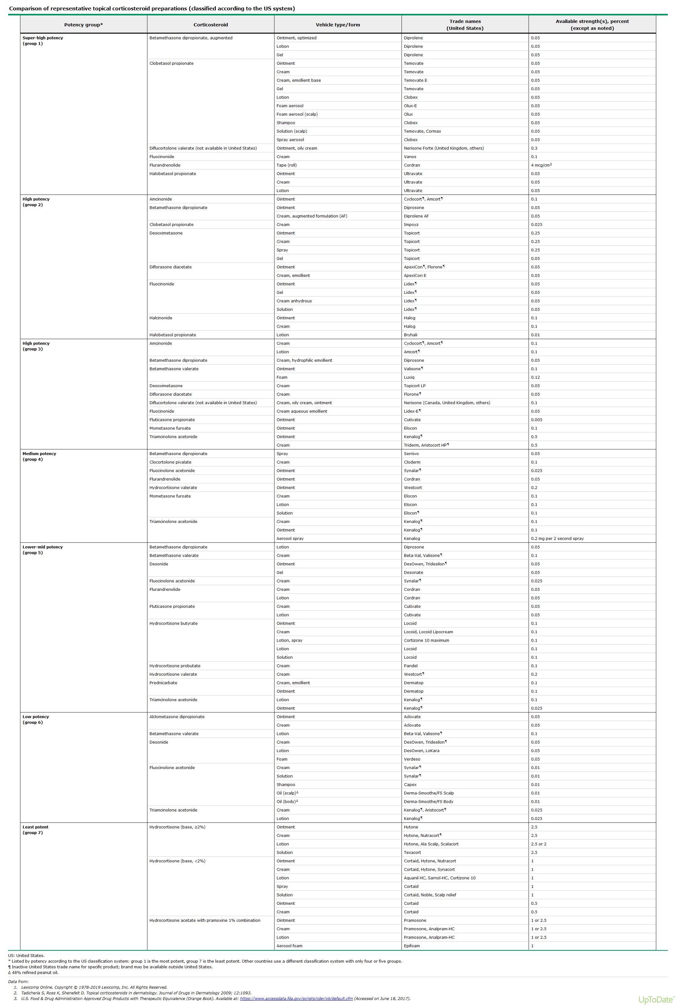
Skin toxicity

Slide 25
CASE 1
2018/7/25
Durvalumab 1500mg
+ Tremelimumab 75mg iv
2018/9/12
Durvalumab 1500mg
+ Tremelimumab 75mg iv
8/18
G2 Skin rash
9/13
G2 Skin rash
9/26
G4 Skin rash
→ 9/28~30 mPRS 225mg
10/1~7 mPRS 60mg
10/8~9 mPRS 125mg
10/10~16 mPRS 60mg
10/17~19 mPRS 40mg
10/20~11/5 mPRS 2일에 5mg씩 감량
11/6~14 mPRS 8mg
11/15 hydrocortisone 20mg bid
Notes:
Erythematous scaly macules and papules on whole body with mild itching
Imp) maculopapular eruptions, r/o drug eruption, r/o viral exanthem
Plan) 국소스테로이드도포제
2018-9-14 imp) immune-mediated adverse drug reactions, r/o viral exanthem
Plan) advantan cream + topisol lotion
2018-9-15 CT chest
1. Increased extent of bone metastasis in T7 and T11.
2. Peribronchial GGO at both lung and consolidation at right upper lobe.
-> Atypical pneumonia
3. New appearance of indeteminate nodule at right lower lobe(8mm sized).
4. Interlobular septal thickening.
5. Bronchiectasis at left lingular segment.
6. No significant interval change of
1) left supraclavicular LN (7mm).
2) 23mm sized anterior mediastinal nodule.
--> Thymic epithelial tumor or LN metastasis.
7.HCC lesion in liver.

Slide 26
CASE 2
Male / 70 years old
Lung ca (SCC, EGFR WT, SP263 10%, T3N2M0, IIIB)
  2018. 03.21 ~ 2018. 06.05 #4 TC
  2018.07.25 ~ 2018.09.03 sequential RTx (poor PS로 조기종료)
  2018.12.21 progression (liver, bone meta)
  2019.01.08 1st nivolumab
  2019.01.22 2nd nivolumab
  2019.02.08 3rd nivolumab

Slide 27
CASE 2
2019.01.22
2nd nivolumab
2019.02.08
3rd nivolumab
??
G1 diarrhea
2019.02.10
G2 diarrhea
→ loperamide,
metronidazole po
2019.02.12
G3 diarrhea

Slide 28
02. GI toxicity
More common with anti-CTLA-4 therapy (30–40%)
  Grade 3 and 4 toxicities in 10% patients against 1–2% on anti-PD-1/anti-PD-L1 therapy
  Seen 5–10 weeks later typically after 2nd dose of ipilimumab
Increase in stool frequency, diarrhea or constipation, blood or mucus in stool, abdominal pain/cramping, nausea and vomiting
Front Pharmacol. 2017 ESMO guideline 2018

Slide 29
02. GI toxicity
Grade 1: < 4 stools/day over baseline. Mild abdominal symptoms
Grade 2: Moderate new symptoms. 4–6 stools/day over baseline
Grade 3/4: Severe grade. =7 stools/day over baseline. Severe and persistent abdominal pain, fever, ileus. Life threatening complications like intestinal perforation and peritonitis
Front Pharmacol. 2017 ESMO guideline 2018

Slide 30
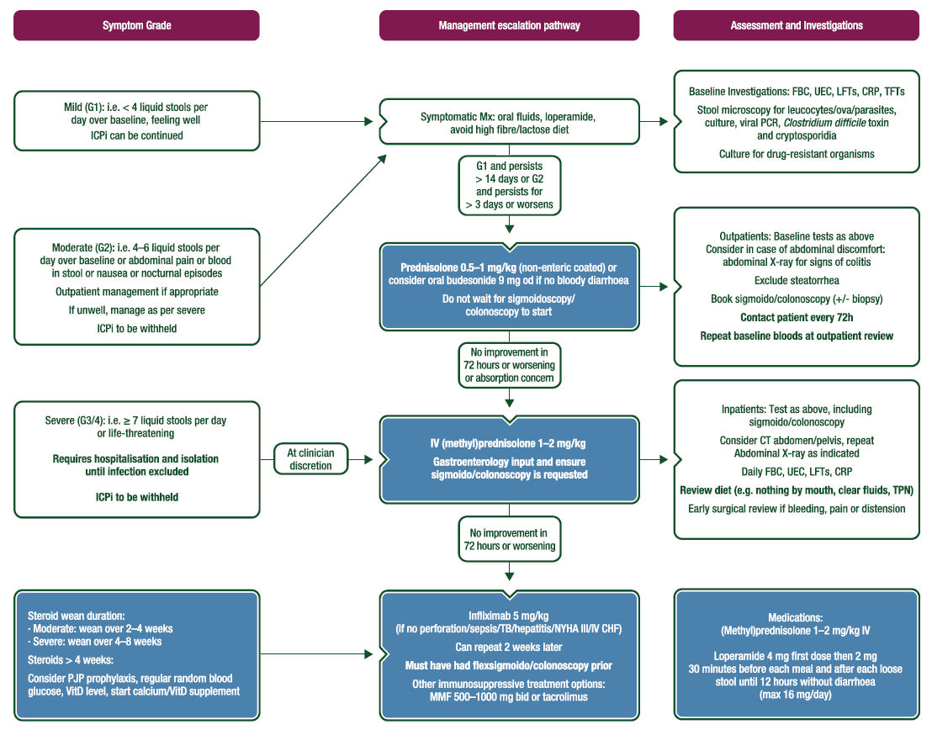

Slide 31
CASE 2
2019.01.22
2nd nivolumab
2019.02.08
3rd nivolumab
??
G1 diarrhea
2019.02.10
G2 diarrhea
→ loperamide,
metronidazole po
2019.02.12
G3 diarrhea
2019.02.15
G1 diarrhea으로 회복되어 퇴원
→ iv methylprs 0.5mg/kg

Slide 32
CASE 3
Male/49year old
Lung ca (ADC)
  2014 CCRT
  2019.3 MPE
  2019.03.22 1-1 pembrolizumab/pemetrexed/carboplatin
  2019.04.12 1-2 pembrolizumab/pemetrexed/carboplatin

Slide 33
CASE 3
1-2 pem/pem/carbo

Slide 34
03. Hepatotoxicity
Appears 8–12 weeks after initiation of treatment with ICIs
  Typically seen after the 3rd dose of checkpoint inhibitor treatment
5%–10% (grade 3/4: 1~2%)
Mostly asymptomatic elevation of liver enzyme
Fever, fatigue and jaundice may be seen in some patients
► Serum transaminases and bilirubin measured before every cycle of treatment
Front Pharmacol. 2017 ESMO guideline 2018

Slide 35
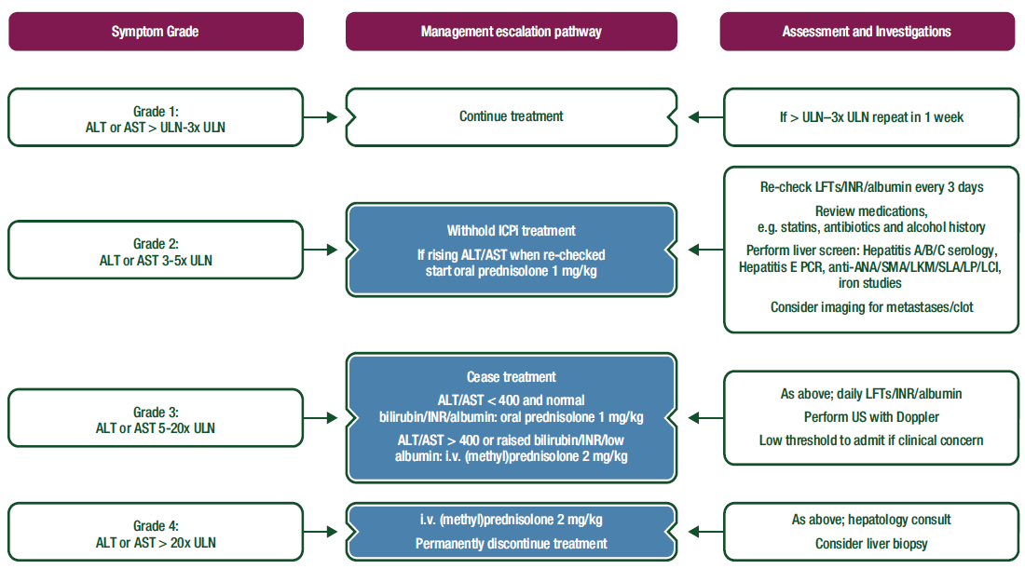
03. Hepatotoxicity
Annal of Oncol 2017

Slide 36
CASE 4
Male/77year old
HCC /c lung meta CHC, LC
2019.04.18~2019.05.10 RTx d/t PVT
2019.05.20 durvalumab+tremelimumab

Slide 37
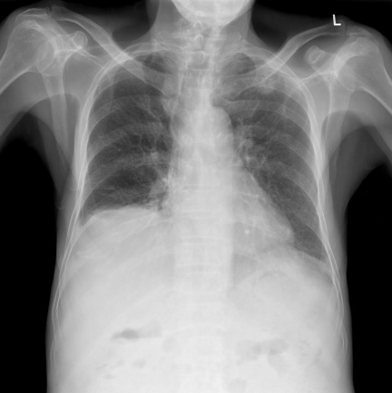
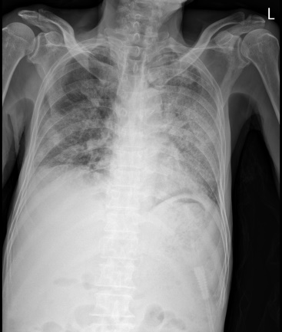
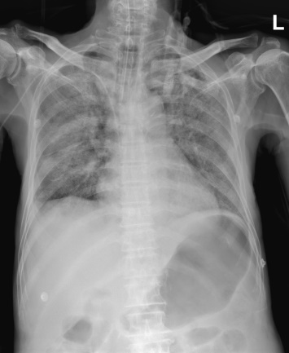
CASE 4
2019.05.20
Durvalumab + Tremelimumab
2019.06.14
Ascite 조절위해 입원
2019.06.17
Dyspnea
2019.06.19
Dyspnea악화, vent care 시작

Slide 38
04. Pneumonitis
Uncommon but potentially fatal toxicity
More common with anti-PD-1/anti-PD-L1 than anti-CTLA-4 therapy
Variable onset and clinical, radiological and pathological appearances
Front Pharmacol. 2017 Annals of Oncol 2017

Slide 39
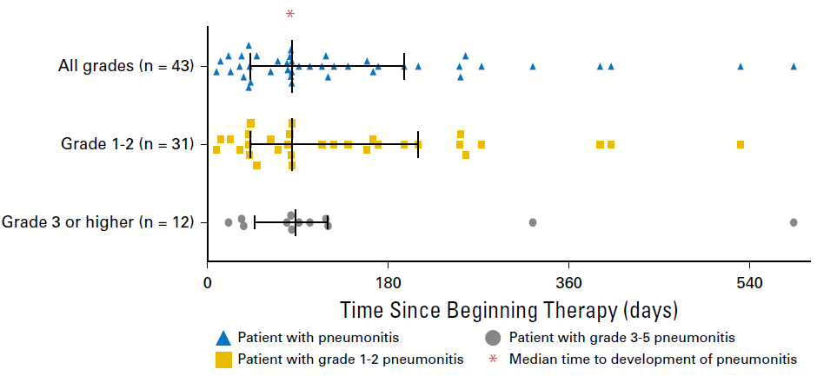
04. Pneumonitis
J Clin Oncol 2017

Slide 40
04. Pneumonitis
History
  Pulmonary hypertension/respiratory disease/connective tissue disease
  Influenza/Mycobacterium tuberculosis exposure
  Smoking history
  Travel history
  Allergy history including exposure to home/occupational aeroallergens
Differential Diagnosis
  Pneumonia (including atypical, pneumocystis, tuberculosis)
  Lymphangitis
  Usual interstitial pneumonias
  Pulmonary oedema
  Pulmonary emboli
  Sarcoidosis
Annals of Oncol 2017

Slide 41
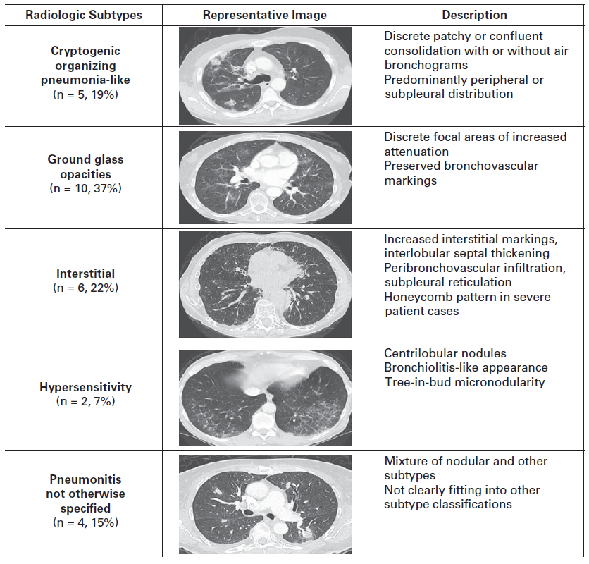

Slide 42
04. Pneumonitis
Grade 1: Asymptomatic, only radiological changes
Grade 2: Mild/Moderate new symptoms limiting instrumental activities of daily living
Grade 3/4: Severe symptoms limiting self-care activities of daily living. Hypoxia or Respiratory failure requiring urgent interventions like endotracheal intubation or tracheostomy.
Front Pharmacol. 2017 ESMO guideline 2018

Slide 43
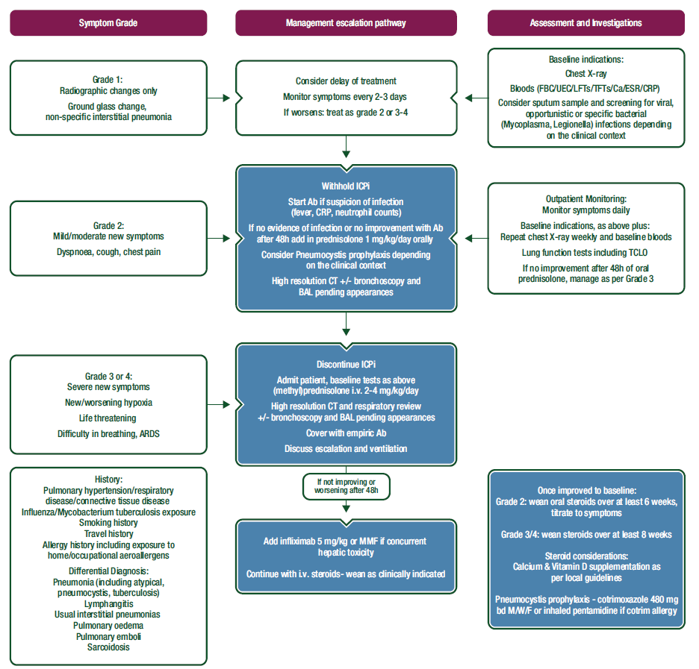

Slide 44
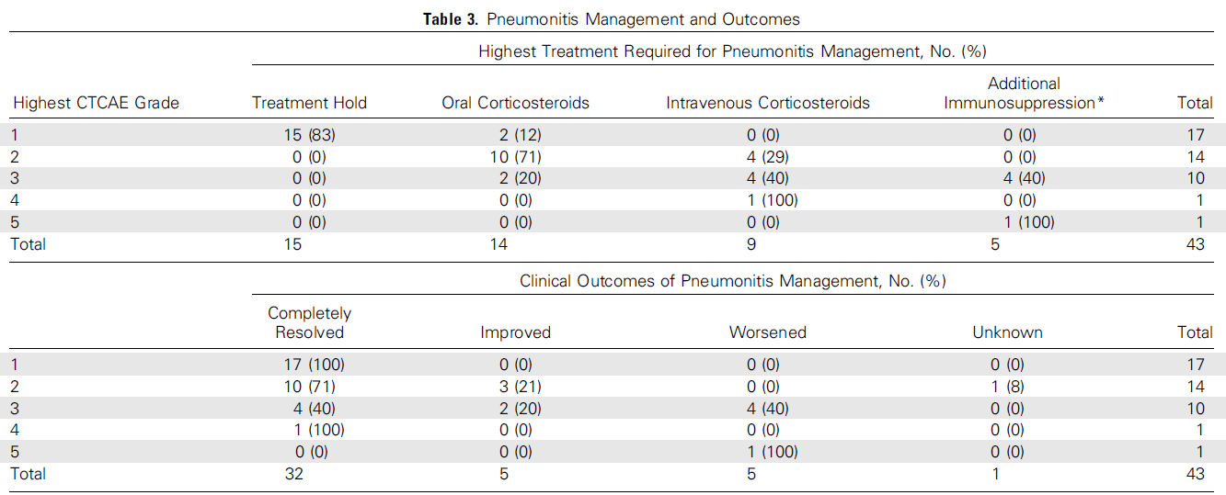
04. Pneumonitis
J Clin Oncol 2017

Slide 45
CASE 4
2019.05.20
Durvalumab
+ Tremelimumab
2019.06.17
Methylprednisolone 2mg/kg iv
Broad spectrum AB + bactrim + anti-viral agent
2019.06.19
Infliximab 5mg/kg iv
2019.06.22
발표
2019.06.14
Ascite 조절위해 입원
2019.06.17
dyspnea
2019.06.19
Dyspnea악화, vent care 시작

Slide 46
05. Endocrine toxicities
Thyroid
  Primary hypothyroidism
  Hyperthyroidism
Adrenal
  Primary adrenal insufficiency
Pituitary
  Hypophysitis
Diabetes

Slide 47
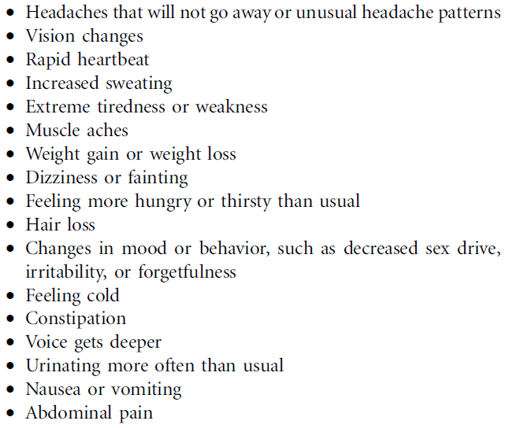
05. Endocrine toxicities
J Clin Oncol 2018

Slide 48
05. Endocrine toxicities
05-01. Thyroid gland disorders
  Hypothyroidism > Hyperthyroidism
  Fatigue, weakness, asthenia, new onset atrial fibrillation, constipation/diarrhea, cold/heat intolerance, dry skin/excessive diaphoresis, weight gain/weight loss
  More common with anti-PD-1/anti-PD-L1 than anti-CTLA-4 therapy (5~10%)
  Monitoring during treatment
Anti-CTLA4
(including combination with anti-PD-1)
・ TFTs every cycle
・ TFTs 4-6 weeks after cycle 4 (i.e. with restaging CT). Late endocrine dysfunction can occur
Anti-PD-1/Anti-PD-L1
・ TFTs every cycle for first 3 months, every second cycle thereafter (in case of 2-weekly schedule)
・ Cortisol as indicated by symptoms/falling TSH

Slide 49
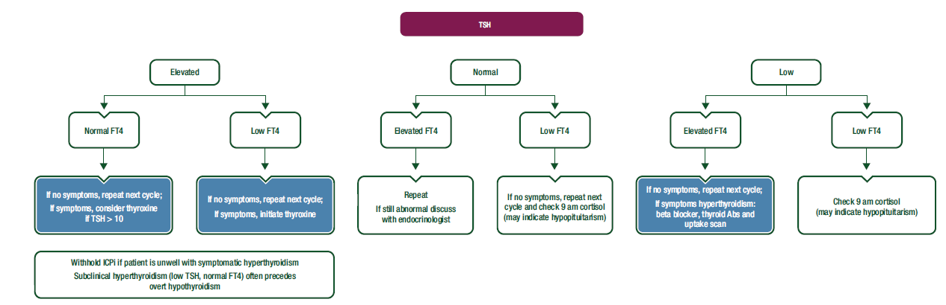
05-1. Thyroid gland disorders
[Hypothyroidism]
[Hyperthyroidism]
Annals of Oncol 2017

Slide 50
05. Endocrine toxicities
05-02. Hypophysitis
  Very rare in patients treated with anti-PD-1 and anti-PD-L1
  Headache, visual field defects, blurring of vision, impotence, amenorrhea
  Diagnosis
    Brain MRI - swollen or enlarged pituitary gland may be visible
    Simultaneous low blood levels of TSH, adrenocorticotropic hormone and/or FSH/LH

Slide 51
05. Endocrine toxicities
05-03. Diabetes mellitus (DM)
  More common with PD-1 and PD-L1 blockade (or combination immunotherapy) than with ipilimumab
  Type 1 or type 2 DM
  Patients with type 2 DM may develop ketoacidosis, an infrequent but life-threatening event
  ► Recommended that blood glucose levels are regularly monitored

Slide 52
06. Rare events
Neurological toxicity
Cardiac toxicity
Rheumatological toxicity
Renal toxicity
Ocular toxicity
Hematological toxicity
Allograft rejection

Slide 53
06. Rare events
Neurological toxicity
  1%
  Time to onset varied from 6 to 13 weeks
  Polyneuropathy, facial nerve palsy, demyelination, myasthenia gravis, Guillain Barre´ syndrome, posterior reversible leukoencephalopathy, transverse myelitis, enteric neuropathy, encephalitis and aseptic meningitis

Slide 54
06. Rare events
Cardiac toxicity
  <1%
  Myocarditis, pericarditis, arrhythmias, cardiomyopathy and impaired ventricular function

Slide 55
06. Rare events
Rheumatological toxicity
    Mild or moderate myalgias and arthralgias occur in 2%–12% of patients
    More common with anti-PD-1 agents
    Vasculitis, polymyositis, myositis, temporal arteritis
Renal toxicity
  <1%
  Nephritis, renal dysfuction
  Serum sodium, potassium, creatinine and urea should be measured before every infusion of checkpoint inhibitor

Slide 56
06. Rare events
Ocular toxicity
  <1%
  Uveitis/iritris, episcleritis, blepharitis
  G3/4: permenantly discontinue ICPi

Slide 57
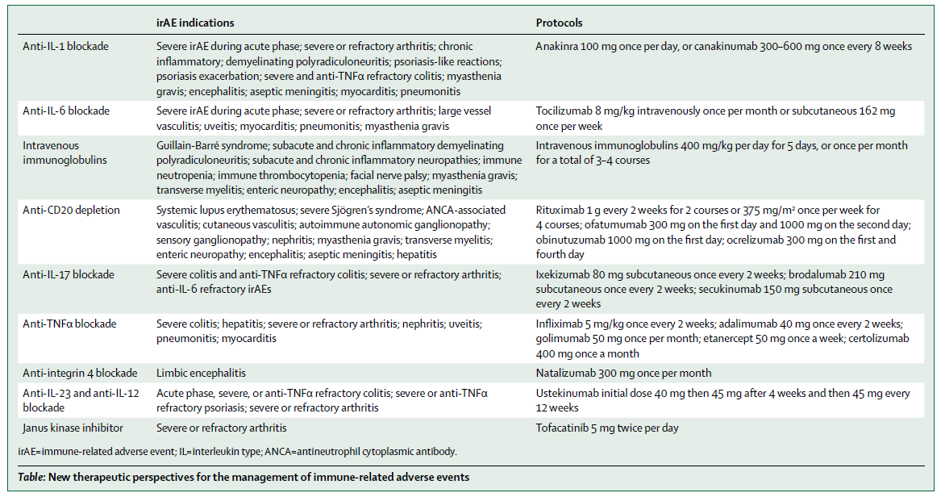
New therapeutic perspectives for the management of irAEs
Lancet Oncol. 2019

Slide 58
ICIs should be stopped permanently
Grade 4 toxicities
Grade 2 reactions lasting for 6 weeks or longer
# anti- PD-1/anti-PD-L1 antibodies can be continued in endocrinopathies controlled with hormone replacement
Inability to reduce glucocorticoids dose to 7.5mg prednisone or equivalent per day for patients treated with anti-CTLA-4 antibodies and less than 10mg /day within 12 weeks for anti-PD-1 antibodies
Grade 3,4 or 2 ocular reactions not improving to grade 1 within 2 weeks after treatment with topical immunosuppression or requiring systemic treatment
Front Pharmacol. 2017

Slide 59
04. Summary

Slide 60
Summary
In general, irAEs occur quite early, mostly within weeks to 3 months after initiation of immune checkpoint blockers
Before starting treatment, patients should be assessed in terms of susceptibility to develop irAEs
  Patient history (and family history), general physical condition, autoimmune diseases, baseline laboratory tests and radiological exams
Patients should be informed of the potential AEs of immunotherapy before treatment initiation
Once irAEs have developed, prompt work-up is required and action should be taken to prevent further aggravation of AEs

Slide 61
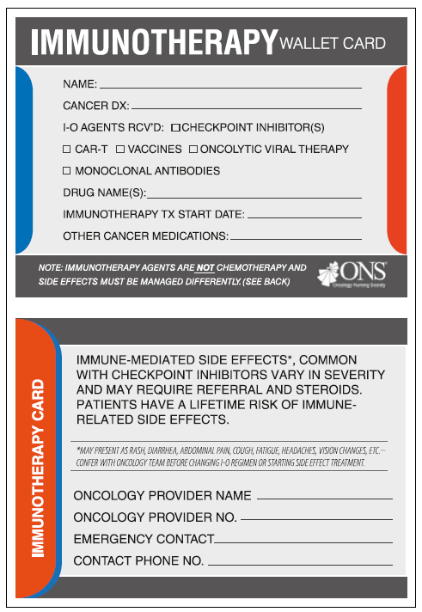
J Clin Oncol 2017

Slide 62
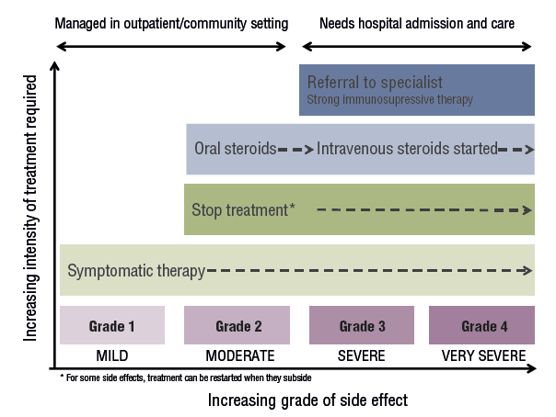
Summary
ESMO patients’ guideline 2018

Slide 63
THANK YOU

