Slide 1
Mucolytic Treatment in Respiratory Disease
- COPD / Bronchiectasis -
경북대병원 호흡기내과
박 지 은

Slide 2
Contents
Background
Mucolytics in COPD
Mucolytics in Bronchiectasis

Slide 3
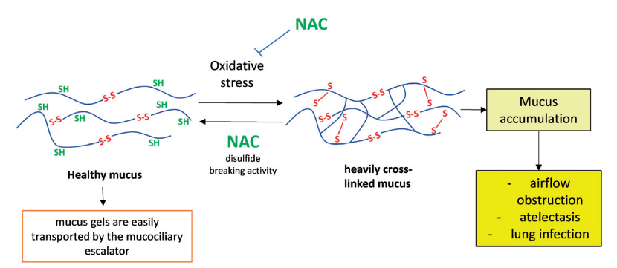
Mucus
  95% 수분, 나머지 5% 당단백질, 지질 및 무기질 등
  점액-섬모 escalator 작용으로 인두로 운반
  습도 유지
  외부자극에서 보호
  병원균의 기도 점막 부착방지
  독성물질 희석

Slide 4
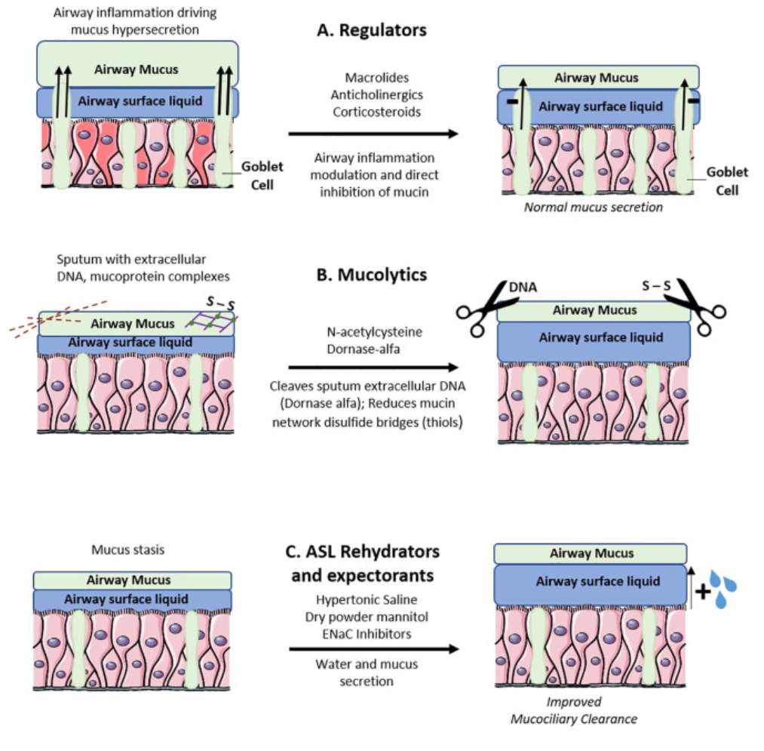






Mucoactive agents
Erdosteine

Slide 5
1. COPD

Slide 6
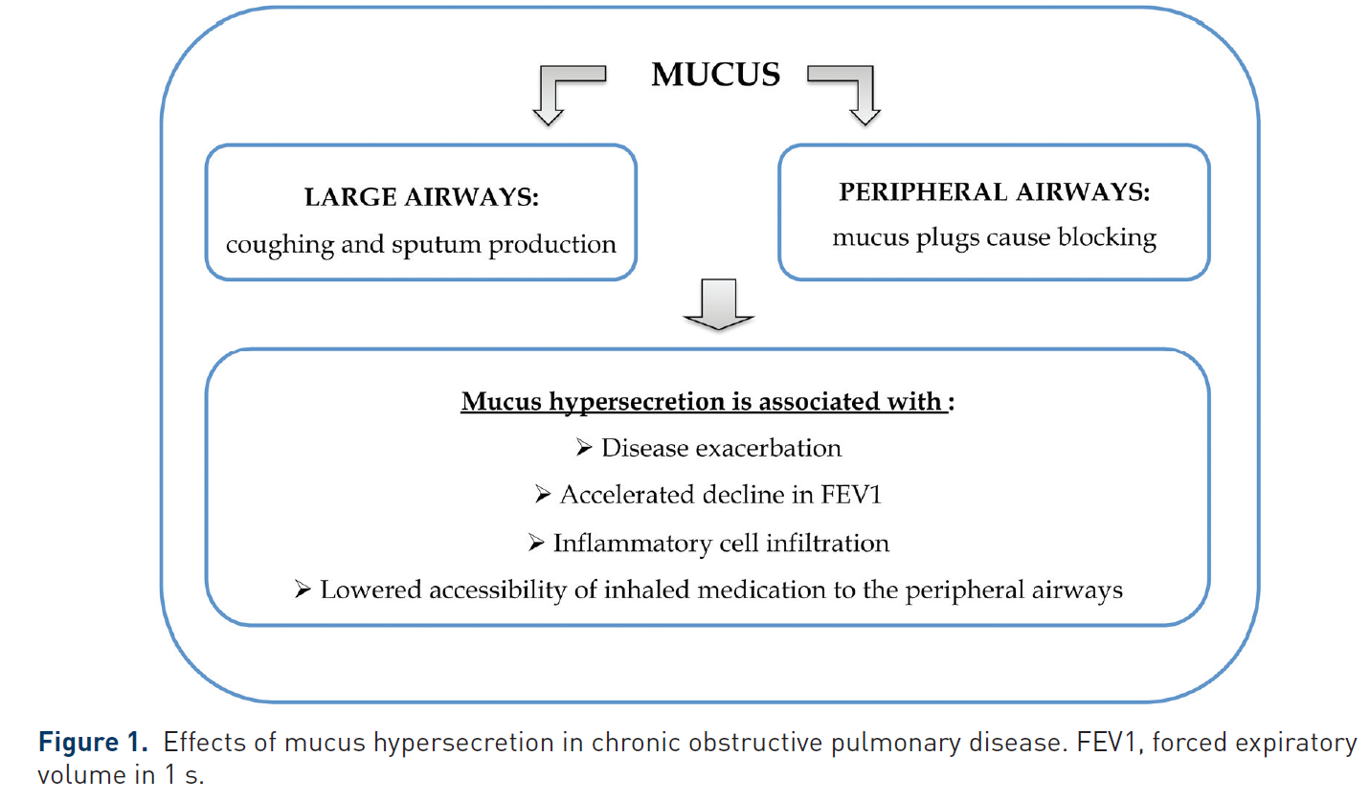
Mucus hypersecretion in COPD
Sadowska et al. Ther Adv Respir Dis 2012;6(3):127-135

Slide 7
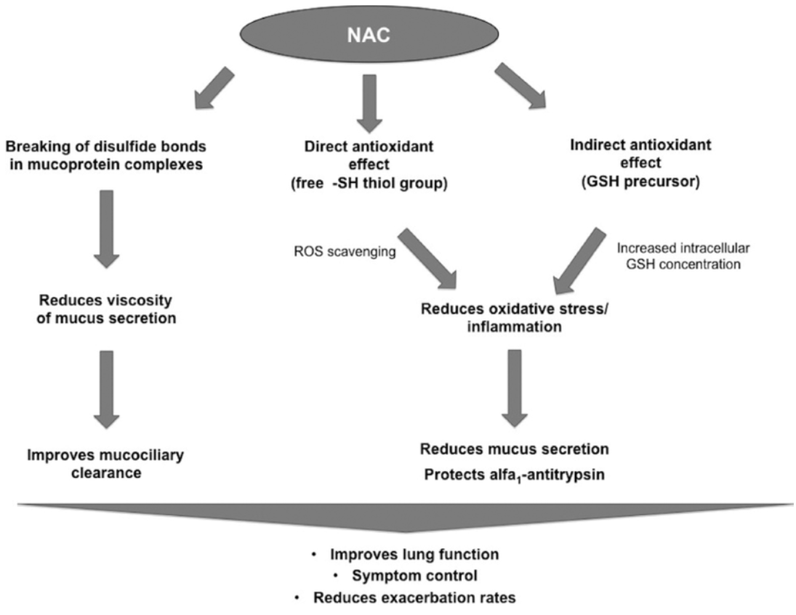
Mechanisms of NAC
Santus et al. COPD 2014;11(6):705-17

Slide 8
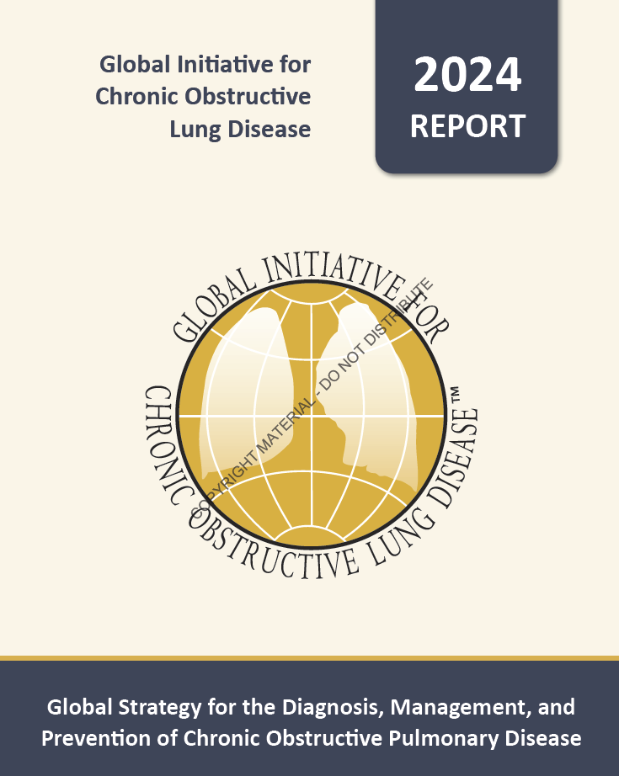

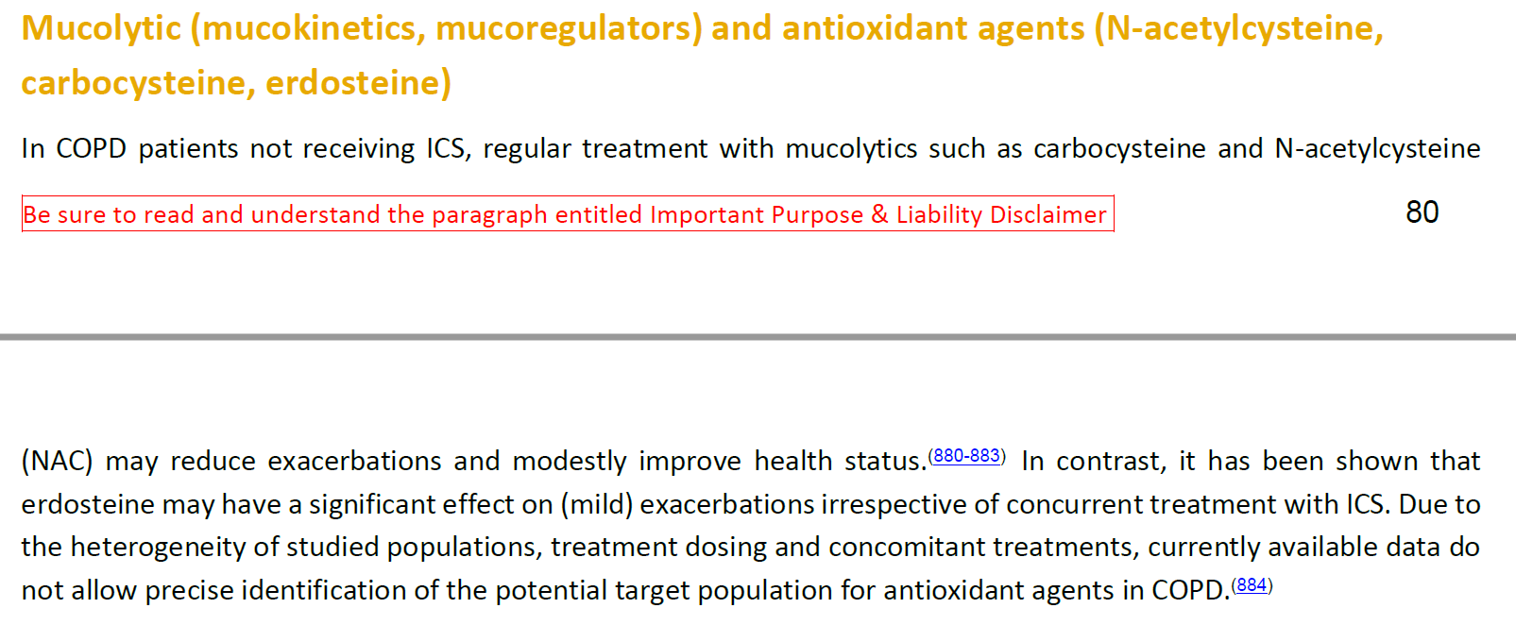
2024 GOLD guideline

Slide 9
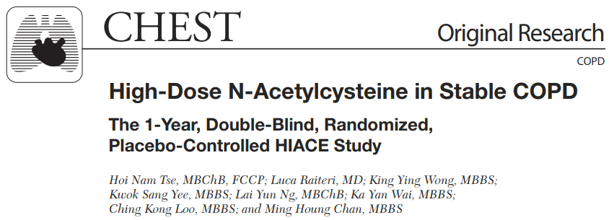
A Double-blinded, Randomized, Placebo-controlled Trial
March 1, 2010 - February 28, 2011: at Hong Kong
Aged 50 to 80 years with stable COPD
120 patients (NAC 58 / placebo 62)
: NAC 600 mg bid or placebo bid for 1 year
The primary endpoint
: small airways function parameters (FEF25%-75%)
Tse et al. Chest 2013; 144(1):106–118

Slide 10
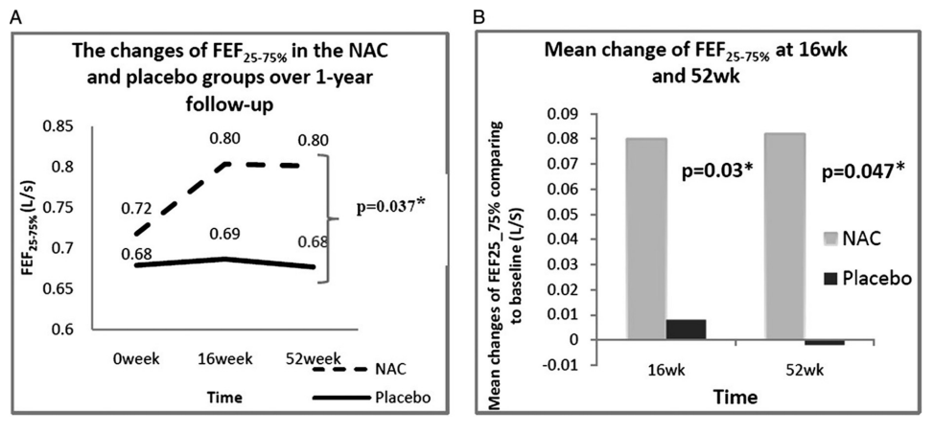
“Significant improvement in FEF25%-75% with NAC (after 52wk)”
Tse et al. Chest 2013; 144(1):106–118

Slide 11
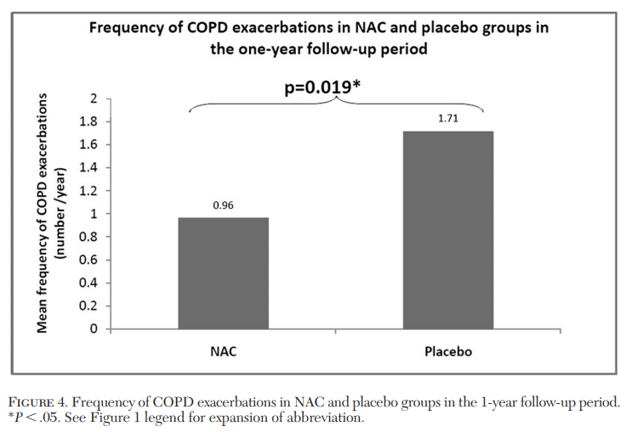
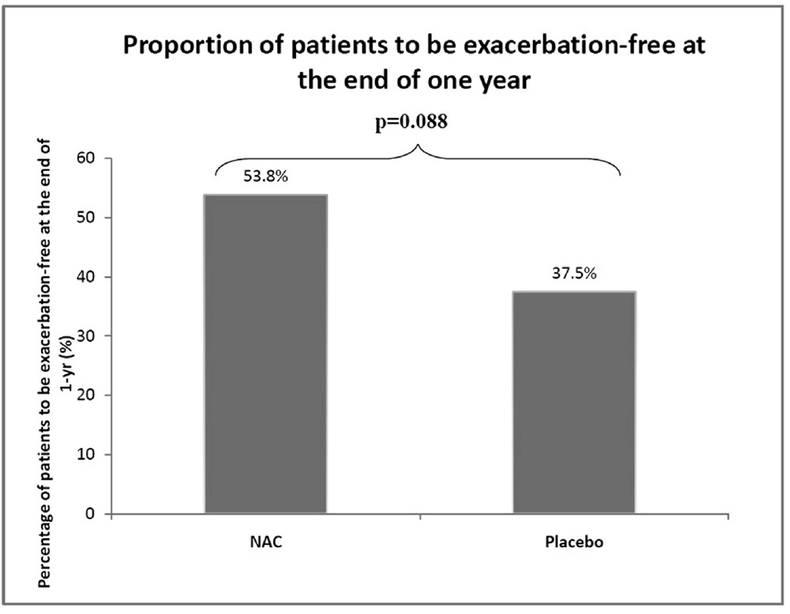
Mean frequency of COPD exacerbations
: NAC 0.96/y vs placebo 1.71/y; p=0.019
Exacerbation-free at the end of the study
: NAC 53.8% vs. placebo 37.5%; p=0.088
Conclusion : 1-yr treatment with high-dose NAC resulted in significant improved small airway function and decreased exacerbation frequency in patients with stable COPD
Tse et al. Chest 2013; 144(1):106–118

Slide 12
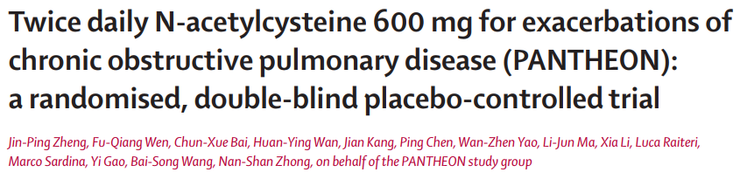
A prospective, randomised, double-blind, placebo-controlled study
June 25, 2009 - Dec 29, 2010 : at 34 hospitals in China
Aged 40–80 years with moderate-to-severe COPD
- post-bronchodilator FEV1/FVC <0.7
- FEV1 : 30–70% of predicted
1006 patients (NAC 504 / placebo 502)
: receive N-acetylcysteine (600 mg tablet BID) or matched placebo twice daily for 1 year.
The primary endpoint : exacerbation rate in 1 year
Zheng et al. Lancet Respir Med. 2014; 2: 187–94

Slide 13
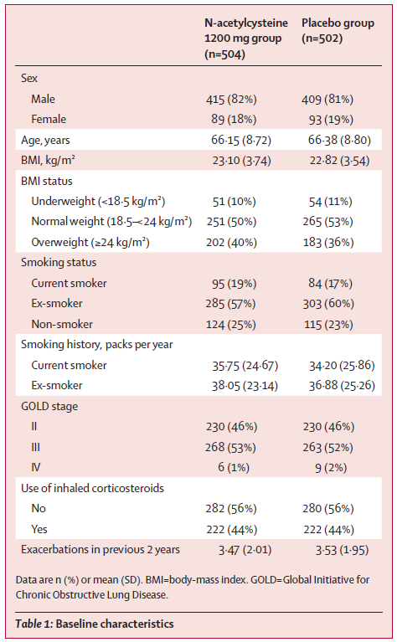
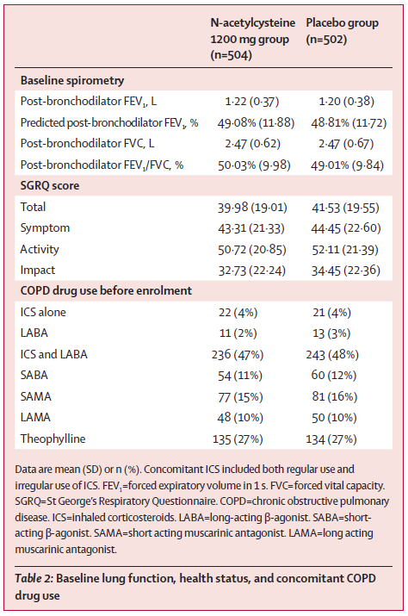
Baseline characteristics did not differ in the two treatment groups.
Zheng et al. Lancet Respir Med. 2014; 2: 187–94

Slide 14
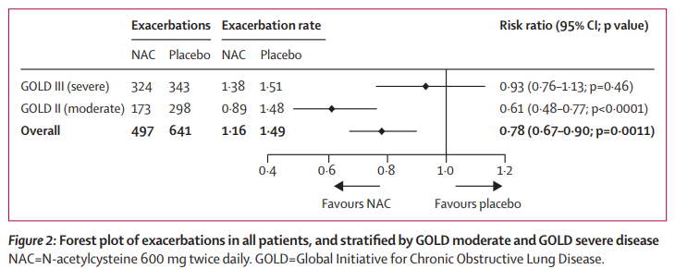
Zheng et al. Lancet Respir Med. 2014; 2: 187–94

Slide 15
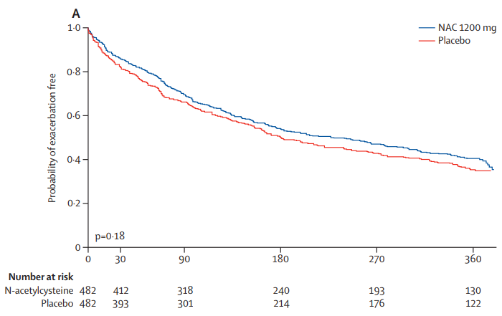
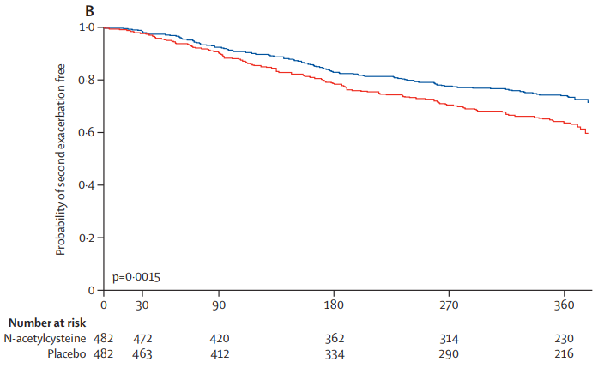
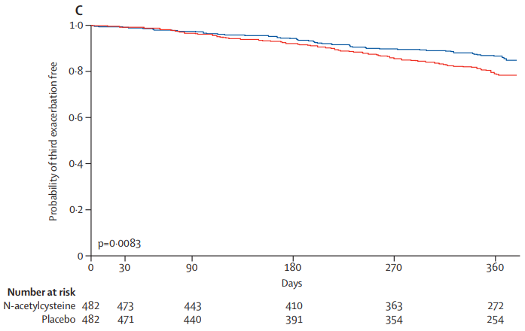
Time to 1st AE
Time to 2nd AE
Time to 3rdAE
Time to recurrent exacerbations was longer with NAC than placebo.
Zheng et al. Lancet Respir Med. 2014; 2: 187–94

Slide 16
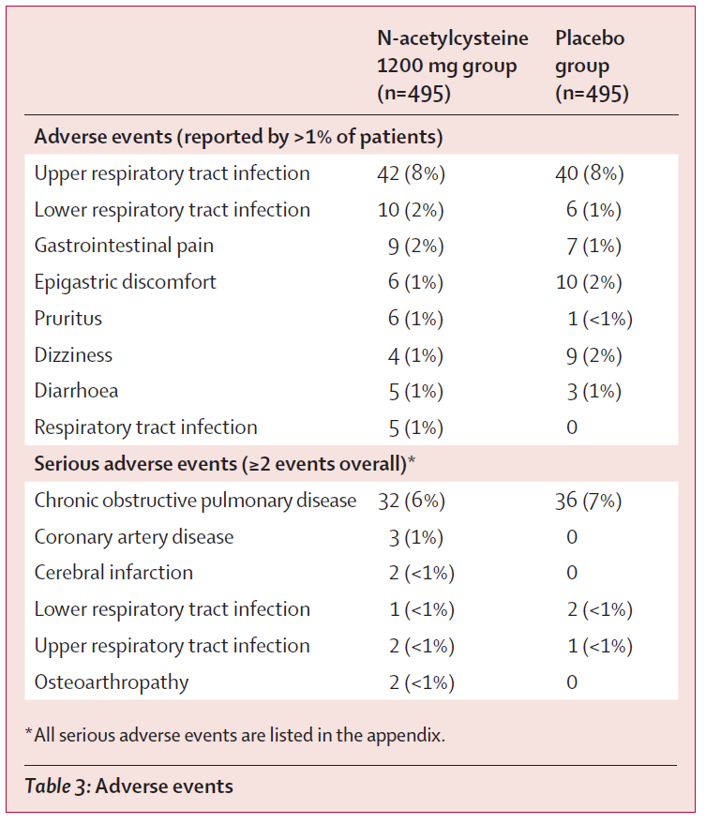
Treatment related AE
: NAC, 44/495 (9%) vs. placebo, 34/495 (7%); p=0.29
Conclusion : 1-yr treatment with NAC 600mg bid can prevent exacerbations, especially in disease of moderate severity.
Zheng et al. Lancet Respir Med. 2014; 2: 187–94

Slide 17
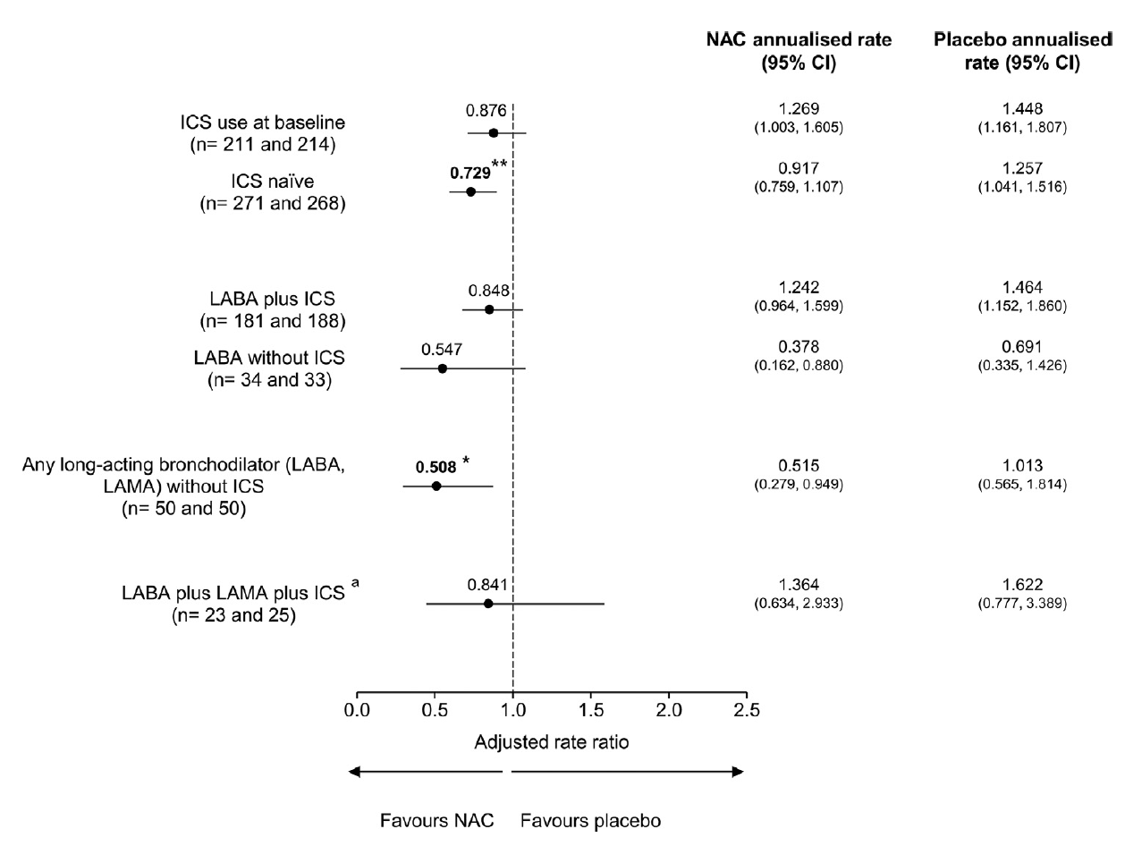
Post-hoc analysis of PANTHEON study
Overall exacerbation
27% reduction in the rate of
all exacerbations in ICS naïve group
Conclusion : NAC reduces the rate of exacerbations, particularly in those not treated with ICS.
A.Papi et al. Repiratory Medicine. 147 (2019) 37-43

Slide 18
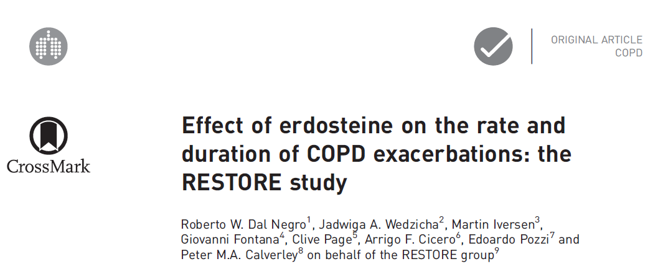
A prospective, randomised, double-blind, placebo-controlled study
November 2, 2010 ~ February 3, 2014, 10 European countries
Aged 40–80 years with moderate-to-severe COPD
2 or more acute COPD exacerbations in the previous 12 months
467 patients (erdosteine 228 / placebo 239)
: receive erdosteine 300mg twice daily or placebo for 12 months
The primary endpoint : number of acute exacerbations in 12-month study period
R.W. DAL NEGRO ET AL. Eur Respir J 2017; 50: 1700711

Slide 19
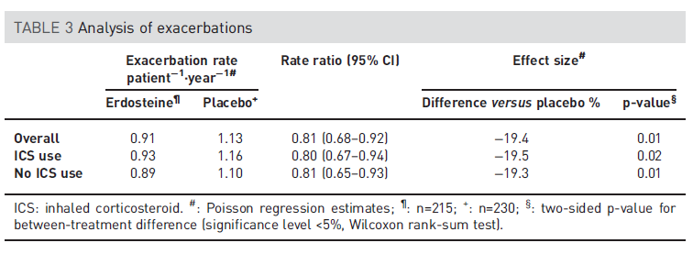
R.W. DAL NEGRO ET AL. Eur Respir J 2017; 50: 1700711

Slide 20
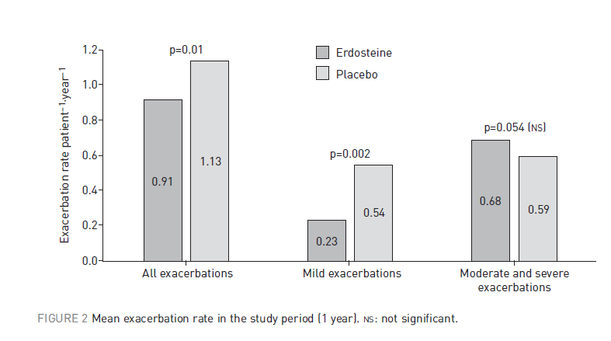
R.W. DAL NEGRO ET AL. Eur Respir J 2017; 50: 1700711

Slide 21
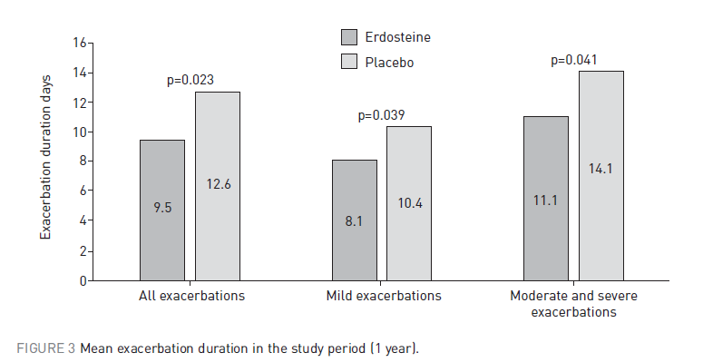
Conclusion : Erdosteine can reduce both the rate and duration of exacerbations.
R.W. DAL NEGRO ET AL. Eur Respir J 2017; 50: 1700711

Slide 22
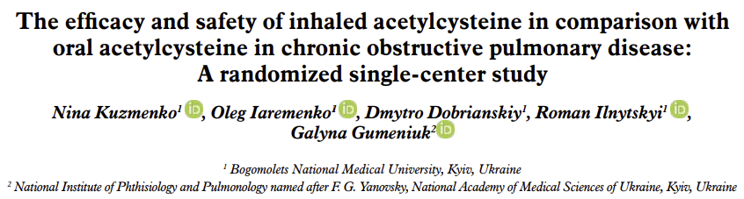
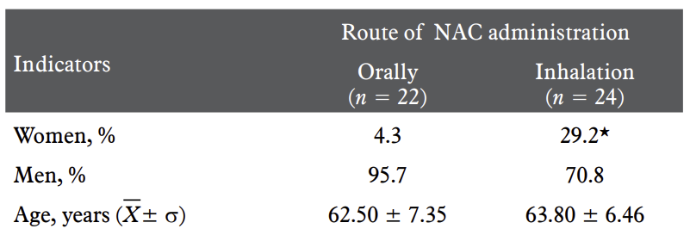
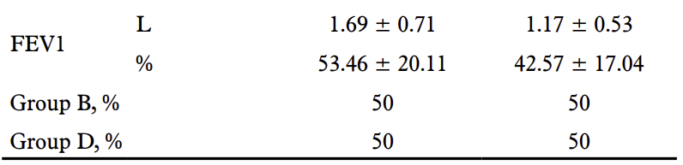
Randomized, prospective, interventional, single-center study
COPD patient who complained of difficulties with expectoration
Oral group: NAC 600 mg solution orally
Inhalation group: 3 mL of 10% solution * 2 times a day by a nebulizer, 10 minutes
Treatment period: 10 days
Kuzmenko et al. Pol Ann Med. 2020;27(2):108–114

Slide 23
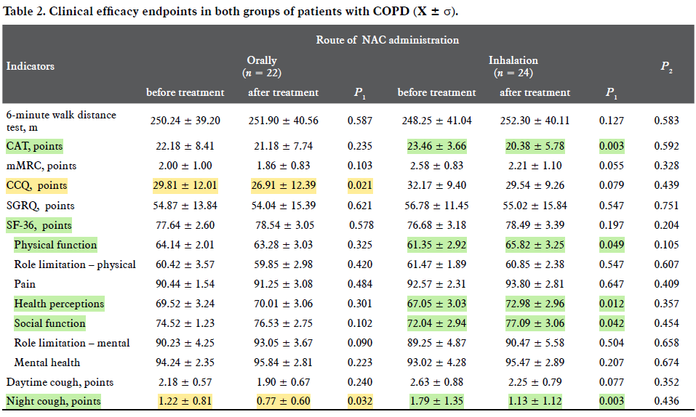
Kuzmenko et al. Pol Ann Med. 2020;27(2):108–114

Slide 24
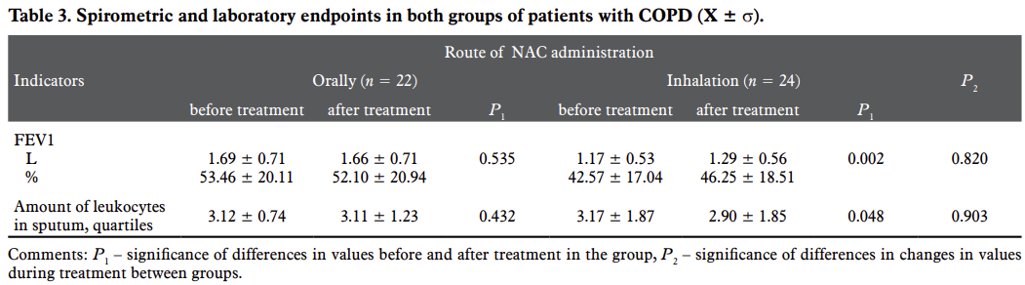
Conclusion :
Both oral and inhalation of NAC for 10 days has a similar positive
effect on the manifestations of COPD.
Inhalation is also accompanied by improved quality of life and lung function test (FEV1) as well.
Kuzmenko et al. Pol Ann Med. 2020;27(2):108–114

Slide 25
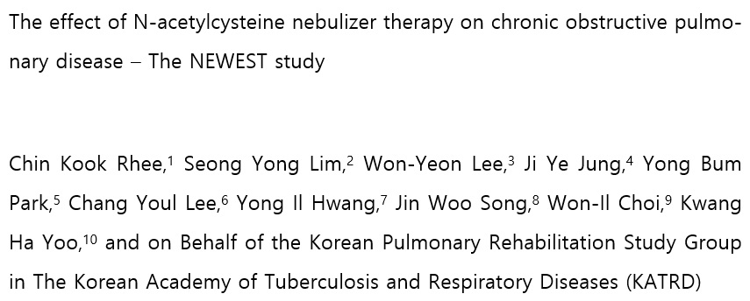
Methods :
Prospective, Multi-center trial
Enrolled Patients :
100 COPD Patients from 10 hospitals,
≥10 pack years, CAT phlegm score≥2
Inhalation group :
MUCOMYST(4mL 20%) diluted with
NS 1:1 ratio, 3 time/day , 12 weeks
Outcome : CAT and SGRQ-C score at baseline, 4, 8, and 12 weeks.
Ref) Rhee CK et al. 26th Congress of the ASeoul, Korea. Respirology. 2023 Feb;28 sian Pacific Society of Respirology Above and Beyond, 17-20 November 2022, Suppl 1:46

Slide 26
Baseline characteristics | N = 91
Age | 71.4 ± 8.2
<65 yrs old | 19 (20.88)
≥65 yrs old | 72 (79.12)
Male | 89 (97.80)
BMI | 23.1 ± 3.1
Smoking
Former | 72 (80.2)
Current | 18 (19.8)
Pack-years | 40.3 ± 35.2
Duration since COPD dx, yrs | 5.7 ± 5.3
PFT
FEV₁, L | 2.22 ± 5.6
FEV₁, % | 58.5 ± 19.4
FVC, L | 3.94 ± 8.2
FVC, % | 75.4 ± 18.0
FEV₁/FVC, % | 53.0 ± 13.0
Ref) Rhee CK et al. 26th Congress of the ASeoul, Korea. Respirology. 2023 Feb;28 sian Pacific Society of Respirology Above and Beyond, 17-20 November 2022, Suppl 1:46

Slide 27
Baseline CAT_Categories | Scores
Phlegm | 3.47 ± 1.06
Cough | 2.37 ± 1.41
Tightness | 1.93 ± 1.50
DOE | 3.70 ± 1.24
Activity limit | 1.24 ± 1.44
Confidence | 1.60 ± 1.62
Sleep | 1.78 ± 1.59
Energy | 2.64 ± 1.43
Total | 18.7 ± 7.6
Ref) Rhee CK et al. 26th Congress of the ASeoul, Korea. Respirology. 2023 Feb;28 sian Pacific Society of Respirology Above and Beyond, 17-20 November 2022, Suppl 1:46

Slide 28


뮤코미스트 12주 치료_Changes in CAT Score
Baseline 대비
24% 개선
Baseline 대비
P<0.01
21% 개선
P<0.01
Ref) Rhee CK et al. 26th Congress of the ASeoul, Korea. Respirology. 2023 Feb;28 sian Pacific Society of Respirology Above and Beyond, 17-20 November 2022, Suppl 1:46

Slide 29
뮤코미스트 12주 치료_Changes in Total CAT Score
Baseline 대비
11% 개선
Ref) Rhee CK et al. 26th Congress of the ASeoul, Korea. Respirology. 2023 Feb;28 sian Pacific Society of Respirology Above and Beyond, 17-20 November 2022, Suppl 1:46

Slide 30
Type of adverse events | Number of case (%) | Total count
General disorders and administration site conditions | 6 (6.06) | 7
Chest discomfort | 4 (4.04) | 4
Chest pain | 1 (1.01) | 1
Pyrexia | 1 (1.01) | 1
Swelling face | 1 (1.01) | 1
Gastrointestinal disorders | 1 (1.01) | 1
Nausea | 1 (1.01) | 1
Metabolism and nutrition disorders | 1 (1.01) | 1
Decreased appetite | 1 (1.01) | 1
Nervous system disorders | 1 (1.01) | 1
Dizziness | 1 (1.01) | 1
Respiratory, thoracic and mediastinal disorders | 1 (1.01) | 1
Dyspnea | 1 (1.01) | 1
Conclusion : NAC nebulizer significant improved phlegm symptom in patients with COPD. NAC nebulizer treatment is effective and safe.
Ref) Rhee CK et al. 26th Congress of the ASeoul, Korea. Respirology. 2023 Feb;28 sian Pacific Society of Respirology Above and Beyond, 17-20 November 2022, Suppl 1:46

Slide 31
NAC Route 비교 (투여 경로에 따른 차이)
Inhalation | Injection | Oral
• 기도를 통해 직접 분무 : 신속한 on set (분무 후 5-10분) • Target organ에 직접 작용 전신성 부작용 적음 • 안전성으로 유소아, 노인, 중환자에도 사용 가능 • Disagreeable odor • Relatively high cost • Time required for administration • 약물 상호 작용 거의 없음 | • 전신 부작용 가능성 : 소화기계, 빈맥, 고혈압, 알러지 (발진, 혈관부종) 등 • 약물 상호작용 : 리도카인, 이소프로테레놀, 에피네프린, 살부타몰, 페노테롤, 암피실린, 세팔로틴, 네오마이신, 덱사메타손 등 • Acetaminophen poisoning 치료로 주로 사용 (US FDA) • 앰플 용기 절단시 유리 파편 혼입 가능성으로 어린이, 노약자 사용 주의 | • 식전 경구투여 • 소화기계 부작용 : 오심, 구토 : 궤양 환자 금기 • 전신 부작용 가능성 : 빈맥, 고혈압, 알러지 (발진, 혈관부종) • 경구용 항생제 약효에 영향을 줄 수 있으므로 2시간 간격을 두고 투여 : 아목시실린, 세푸록심, 독시사이클린, 치암페니콜 ,에리트로마이신

Slide 32
2. Bronchiectasis

Slide 33
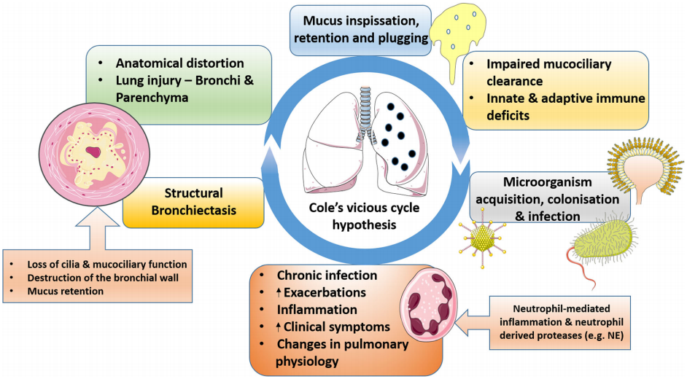
Vicious cycle of bronchiectasis
Chandrasekaran et al. BMC Pulmonary Medicine 2018; 18: 83

Slide 34
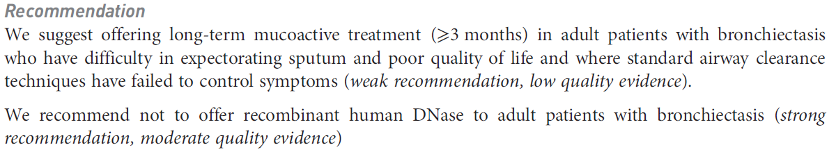
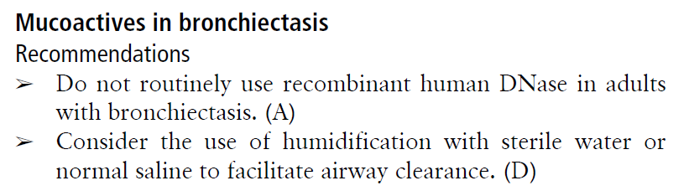
2017 ERS recommendation
2019 BTS guideline
Hill et al.Thorax 2019;74:1-69

Slide 35
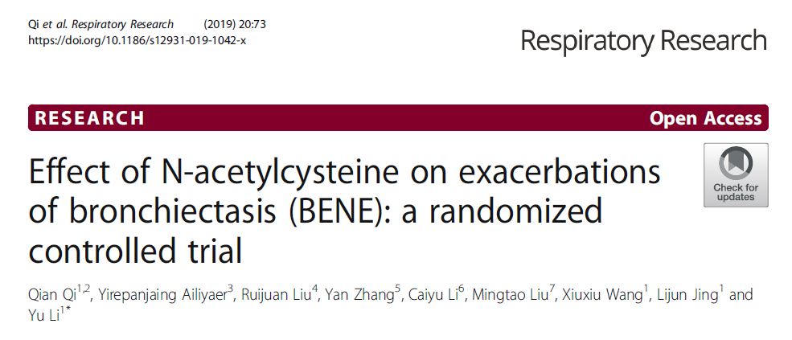
A randomized, placebo-controlled
Adult bronchiectasis patients with at least 2 exacerbations
in the past year
NAC 600 mg twice (n=81) vs placebo (n=80) for 12 months
Qian et al. Respir Res 2019;20:73

Slide 36
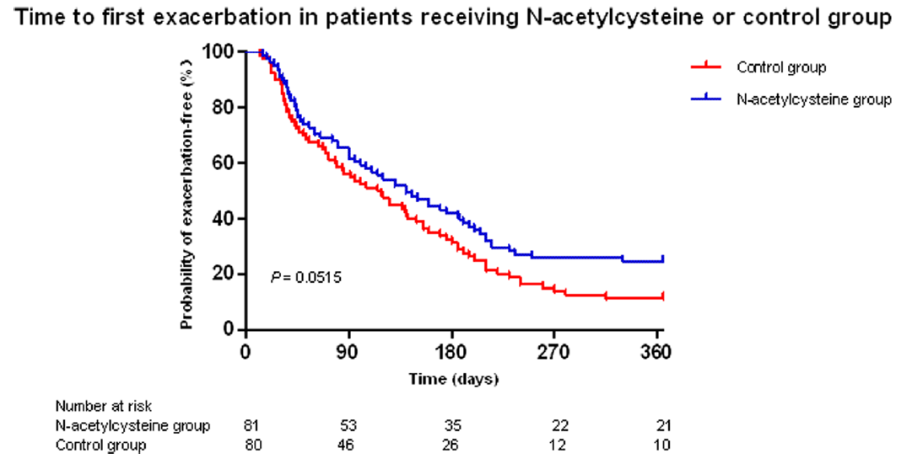
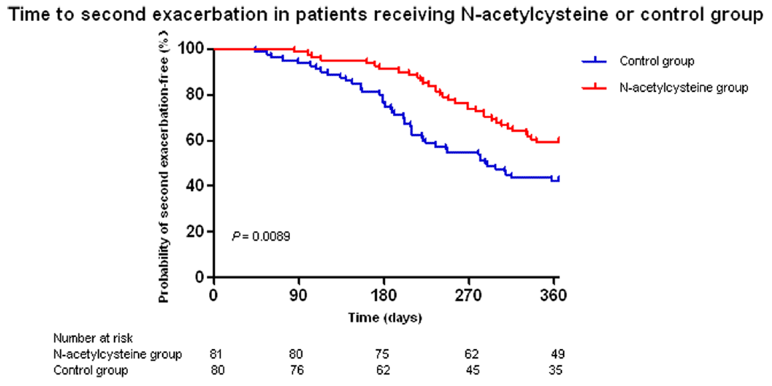
Incidence of AE : NAC, 1.31 vs. placebo, 1.98 exacerbations per patient-year;
risk ratio, 0.41; 95%CI, 0.17–0.66; P = 0.0011
Time to 1st, 2nd exacerbation
Qian et al. Respir Res 2019;20:73

Slide 37
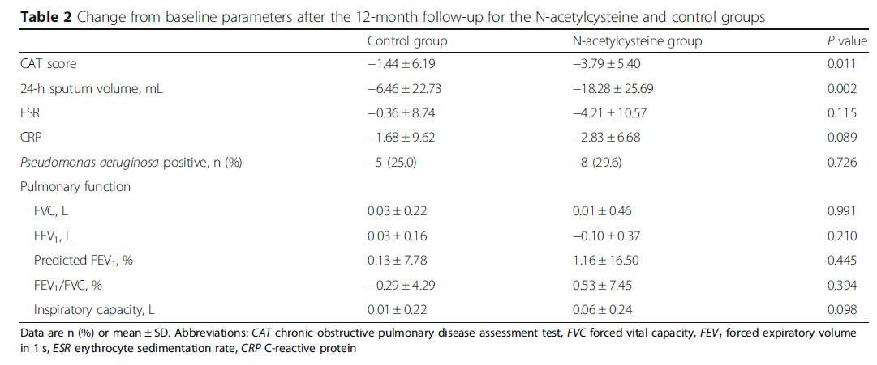
Conclusion : Long term use of NAC is able to reduce the risk of exacerbations for bronchiectasis patients.
Qian et al. Respir Res 2019;20:73

Slide 38
Take home message
COPD
N-acetylcysteine : 점액의 viscosity 감소 + antioxidant, anti-inflammatory 효과
High-dose NAC (600mg bid, 1년) : 급성 악화를 예방, 특히 ICS 를 사용하지 않는 환자에서
Erdosteine : 급성 악화의 빈도와 기간을 줄여 줌
The NEWEST study (뮤코미스트 inhalation, 하루 3번, 12주) : phlegm 증상 호전, 적은 부작용
Bronchiectasis
High-dose NAC (600mg bid, 1년) : 급성 악화 예방의 가능성

