Slide 1

Respiratory Disease in Elderly Patients
영남호흡기학회
계명의대 동산병원 김현정

Slide 2
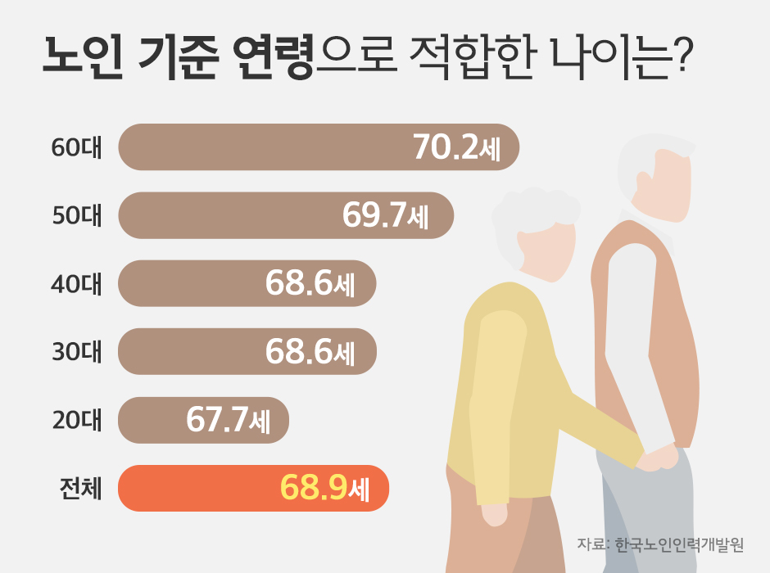
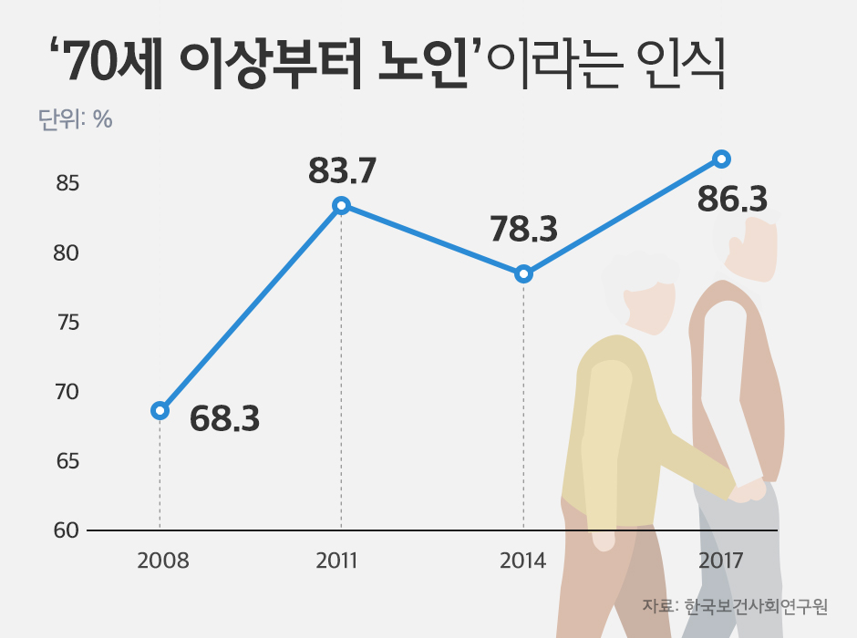
노인 기준 연령으로 적합한 나이?

Slide 3
UN이 정한 연령분류표
0 ~ 17세: 미성년자(Minor)
18~65세: 청년(Youth)
66~79세: 중년 (Middle)
80~ : 노인 (Old)
100~ : 장수 노인 (Longlived elderly)
2015 UN Statistics

Slide 4
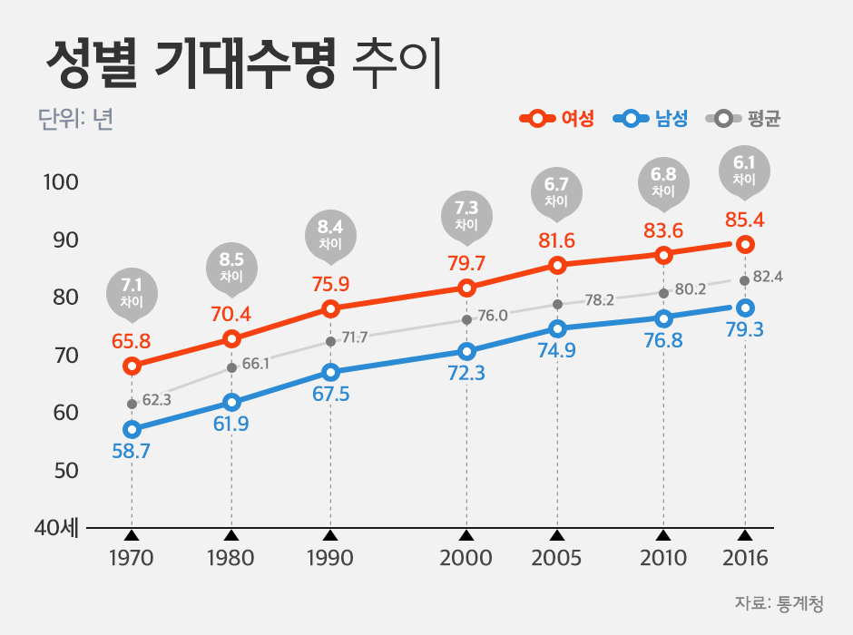
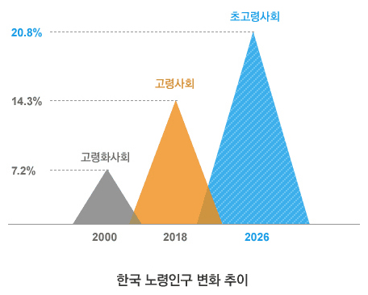
기대 수명
PSI, CURB-65

Slide 5
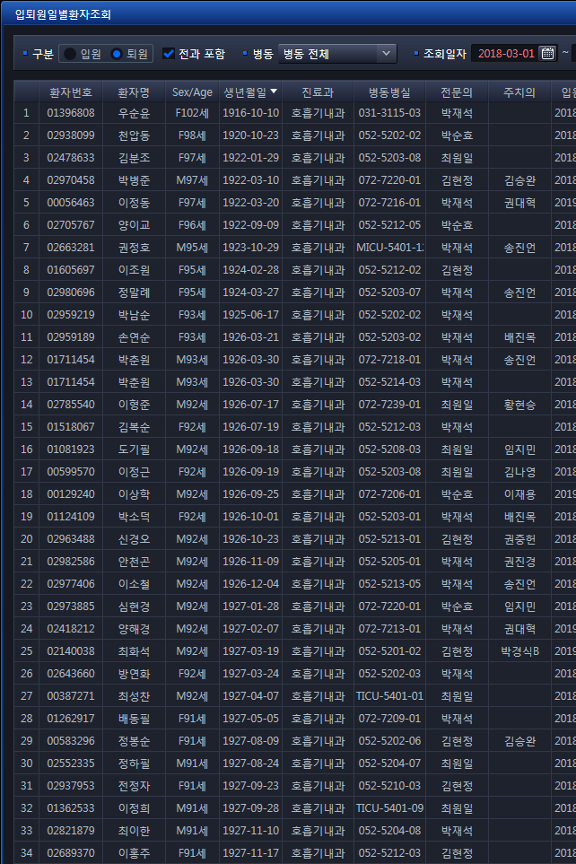
2019.6.19
≥ 80세; 16/58 = 27.5%
≥ 70세; 40/58 = 68.9%
2018.5.1-2019.5.31
≥ 80세
334/1126 = 29.6 = 30%
평균 연령 72세(20대 11명 포함)
CURB-65
65세는 cut-off value로 적절한가?
65세 이상의 폐렴 환자는
CURB로 예후 판별이 가능한가?

Slide 6
Contents
Pneumonia
Critical Care
COPD
Interstitial Lung Disease
Tuberculosis

Slide 7
Contents
Pneumonia
Critical Care
COPD
Interstitial Lung Disease
Tuberculosis
- Clinical presentation
- Causative agents
- Prognosis

Slide 8
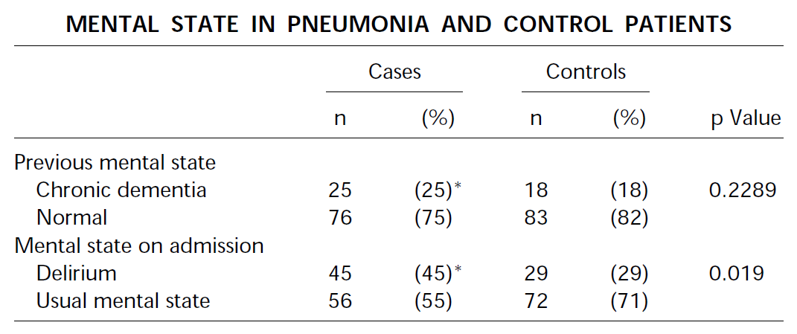
CAP in the Elderly
AM J RESPIR CRIT CARE MED 1997;156:1908–1914

Slide 9
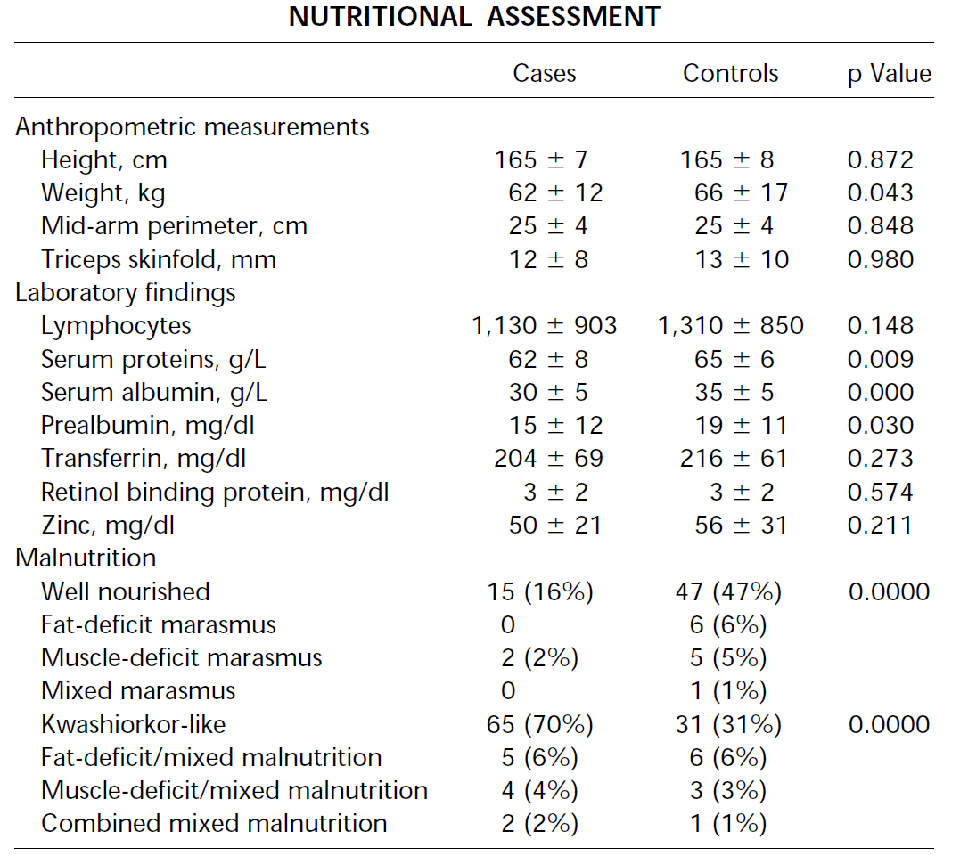
CAP in the Elderly
AM J RESPIR CRIT CARE MED 1997;156:1908–1914

Slide 10
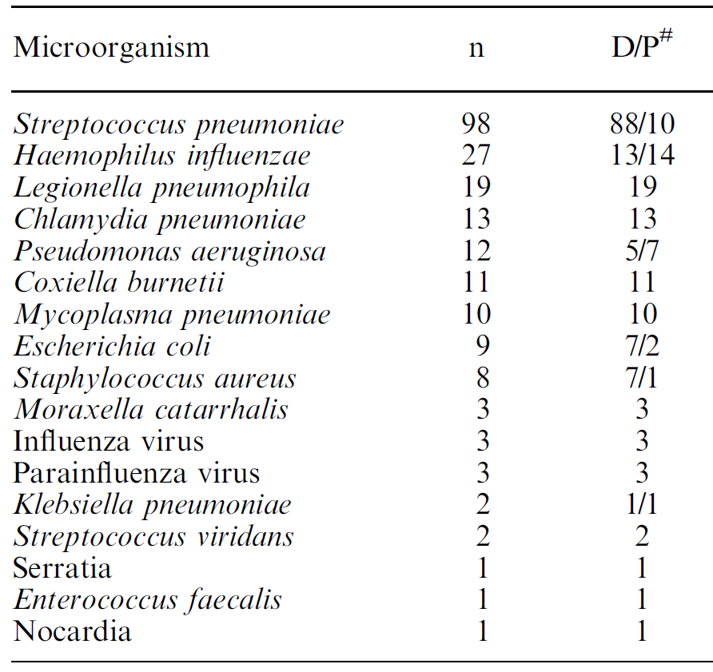
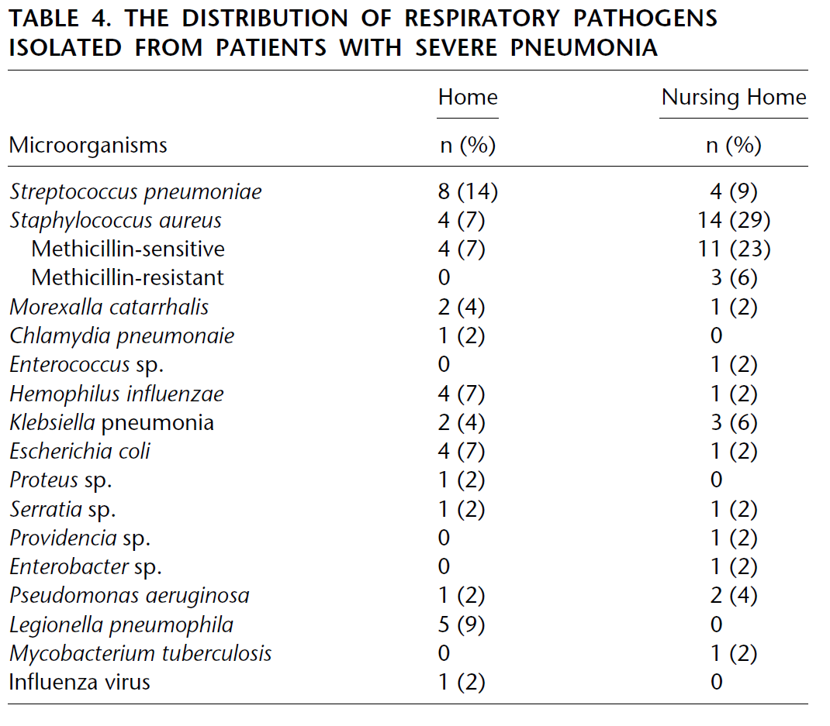
CAP in Elderly
Eur Respir J 2003;21:294-302
AJRCCM 2001;163:317-23

Slide 11
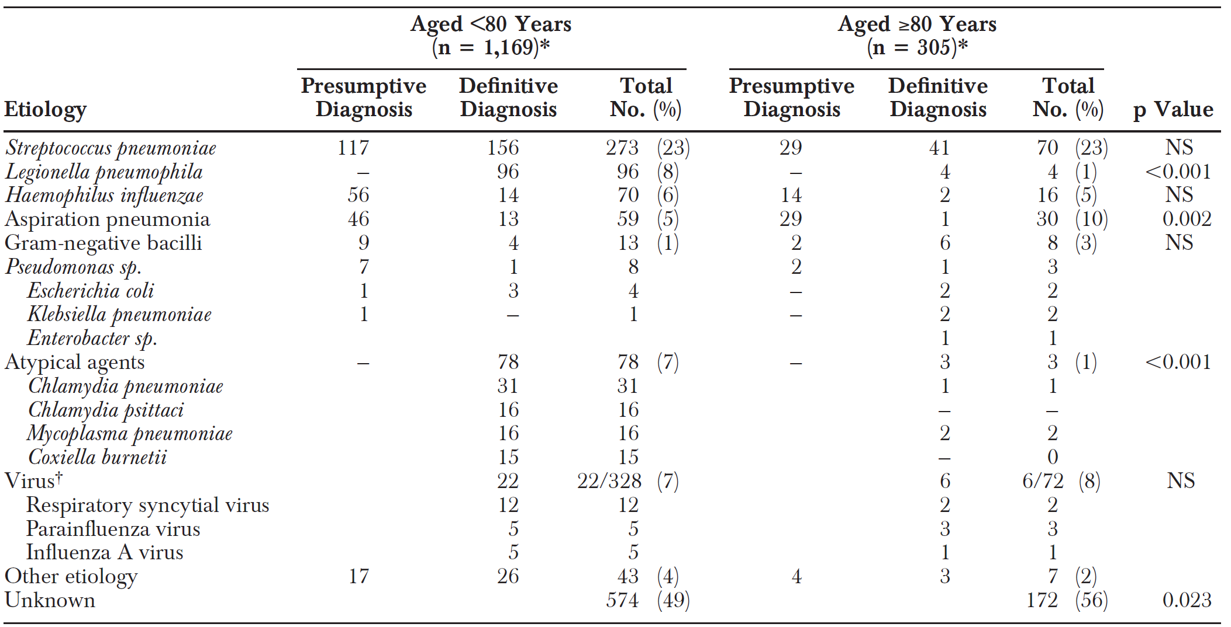
Etiology of CAP by age-group
Medicine 2003;82: 159–69

Slide 12
Pneumonia in Elderly
Wide variety of signs and symptoms → delayed diagnosis
More subtle clinical presentation
Different spectrum of causative agents
Different response to therapy than do younger patients
Delirium at admission, malnutrition – more common
Medicine 2003;82: 159–69
Eur Respir J 1999; 14: 370±375
Notes:
1) The clinical picture
of CAP in the elderly is usually incomplete; in addition,
there is a wide variety of signs and symptoms, with no association
among them. (2) A primary diagnosis of pneumonia was
not considered as such in 40 cases during the first medical visit,
and the definite diagnosis of pneumonia was delayed for more
than 72 h in 62 patients. (3) Delirium at admission was very
common (45%) in patients with pneumonia, and significantly
more frequent than in controls. (4) We did not find an association
between the clinical presentation (typical versus atypical)
and etiology. However, pleuritic chest pain was found to be an
independent risk factor for pneumonia caused by “classical”
microorganisms. (5) Malnutrition was more common in elderly
patients with pneumonia than in controls.

Slide 13
CASE 91/F
C/C Dyspnea for 1 week
P/I 평소 혼자서 생활하는 환자로 보름 전부터 기운이 없고 입맛이 떨어졌다고 하며, 일주일 전부터 일상 생활에서도 숨이 차다고 하여 타병원 들러 시행한 검사에서 r/o lung cancer 소견으로 큰병원 권유 받고 ER.
Cough (-) sputum (+) scanty, fever/chills (-/-) anorexia (+)
DM (-) HTN (+) TB (-) hepatitis (-) CKD (+)
Alcohol (+) social
Smoking (-) ex-smoker. 20년전 금연. 0.5 PPD X 40yrs
124/73, HR 68, 36.8’C, 20/min, 97%

Slide 14
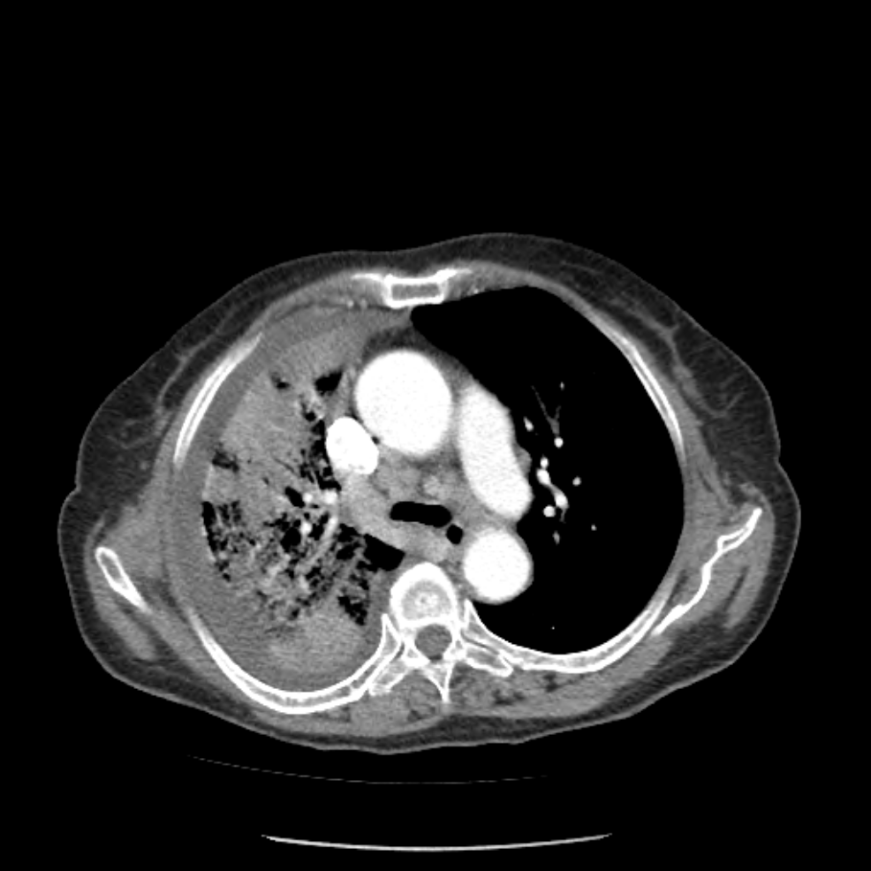
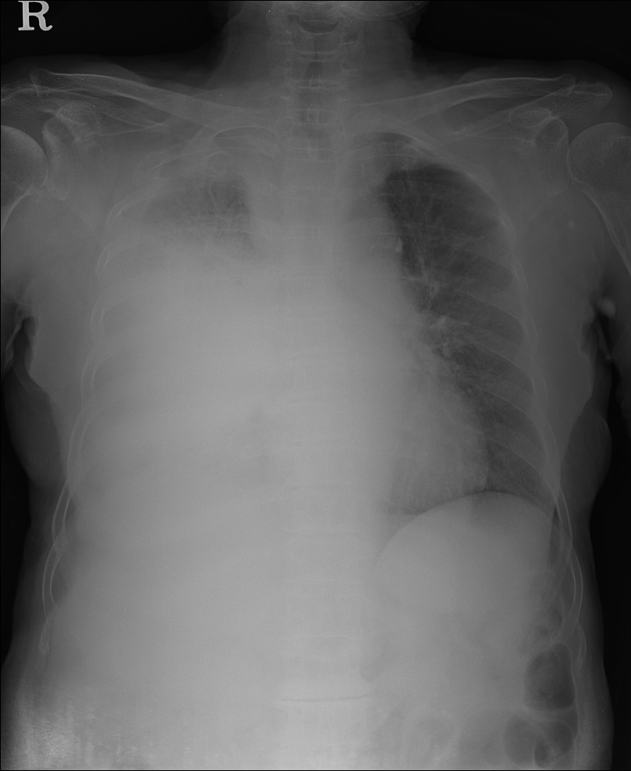
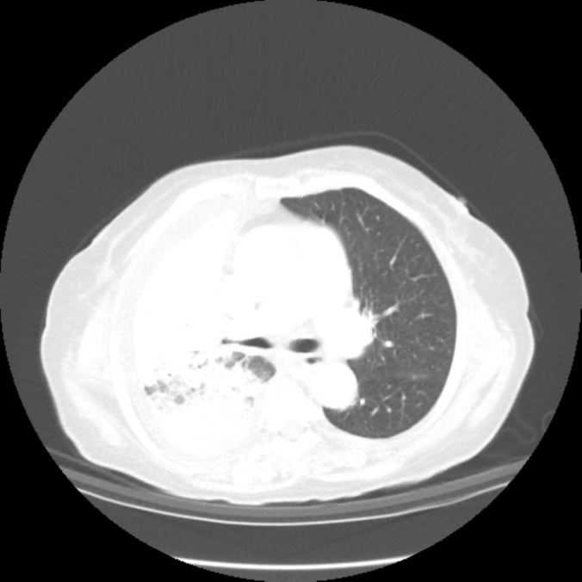
2019-01-23

Slide 15
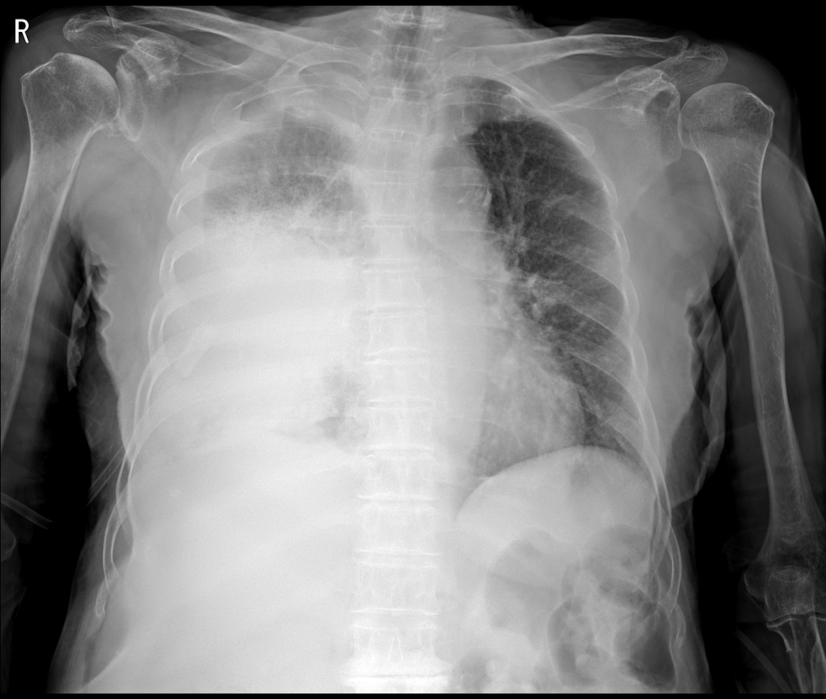
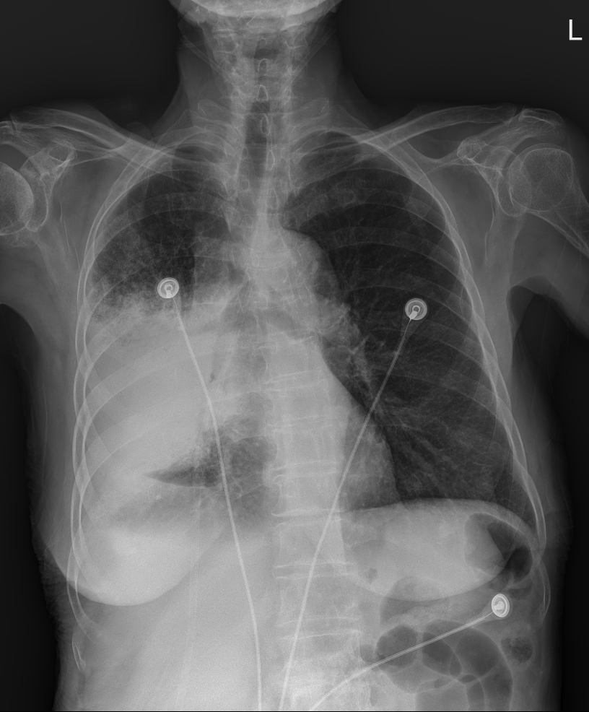
2019-01-23
2019-02-13

Slide 16
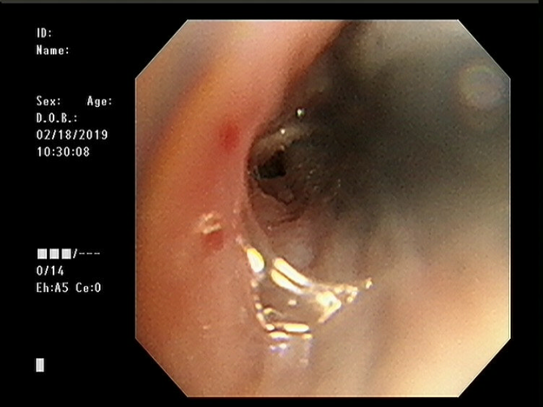
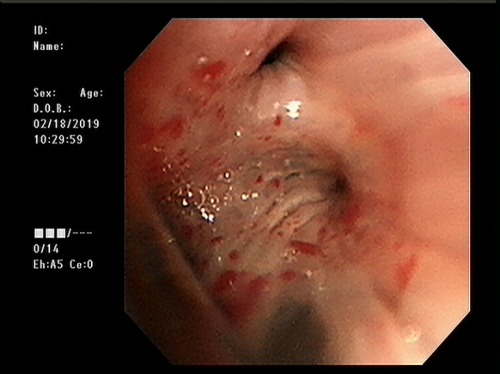
No evidence of endobronchial lesion
AFB stain (-) MTB/NTM PCR (-/-)
Cytology (-)
Culture (-)
2019-02-18

Slide 17
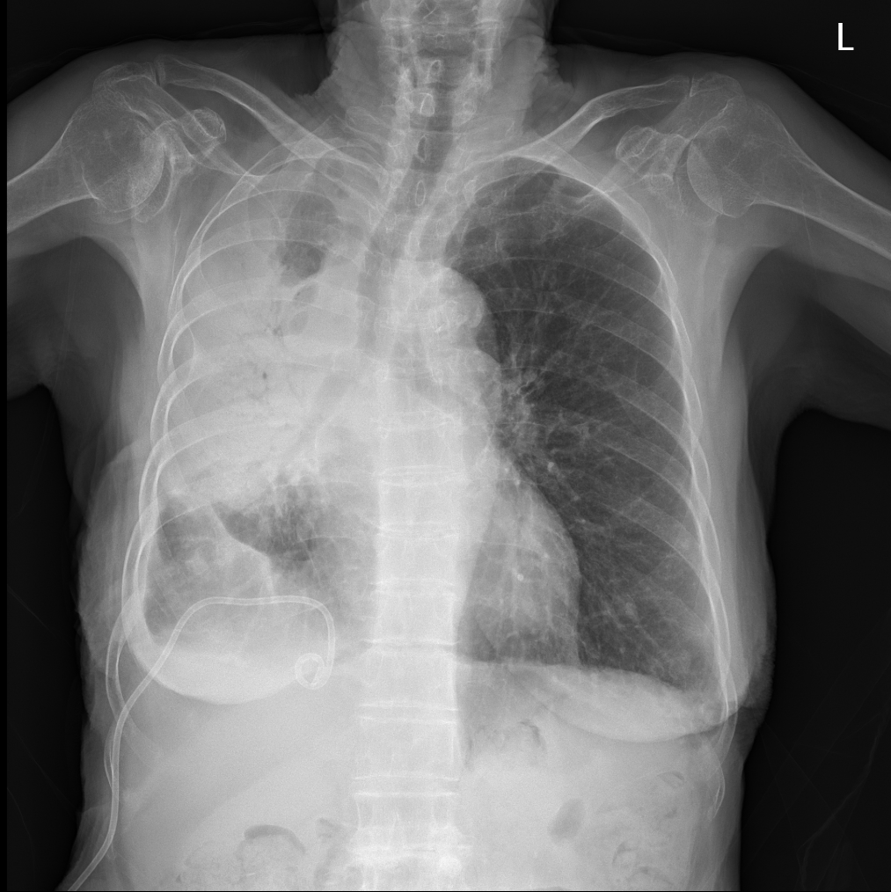
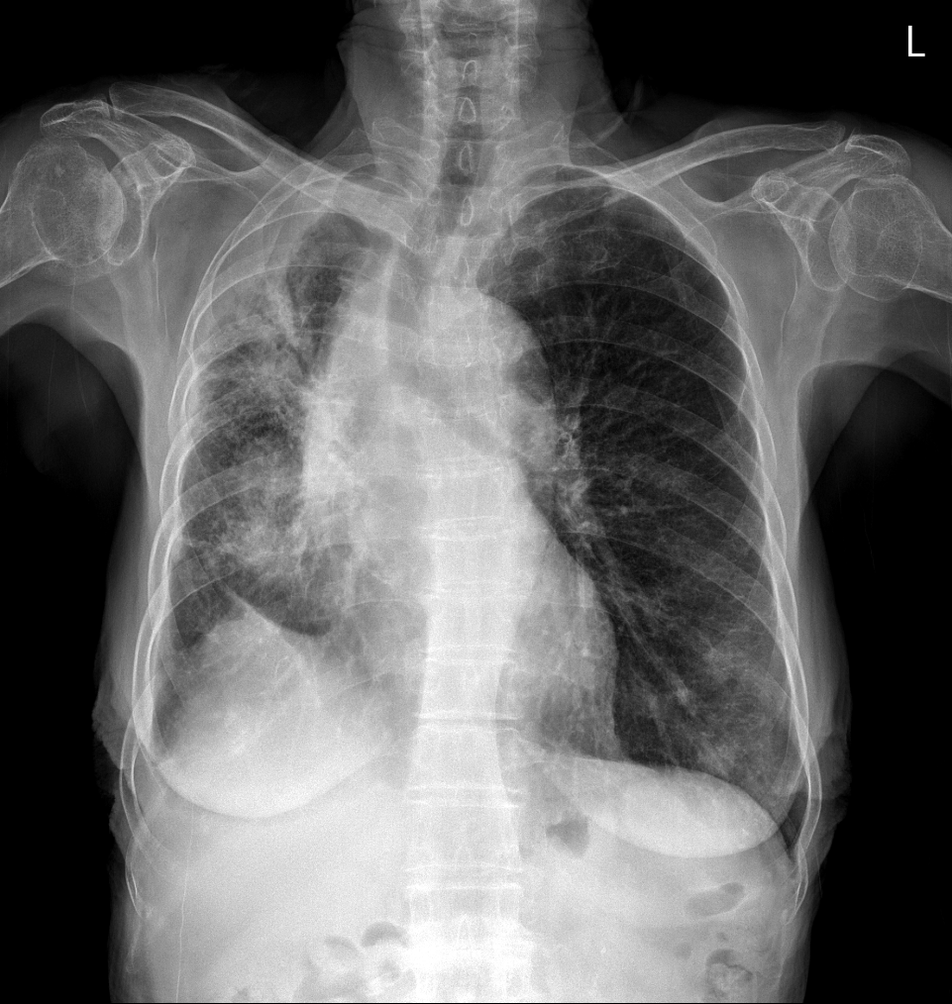
2019-04-23
2019-02-21

Slide 18
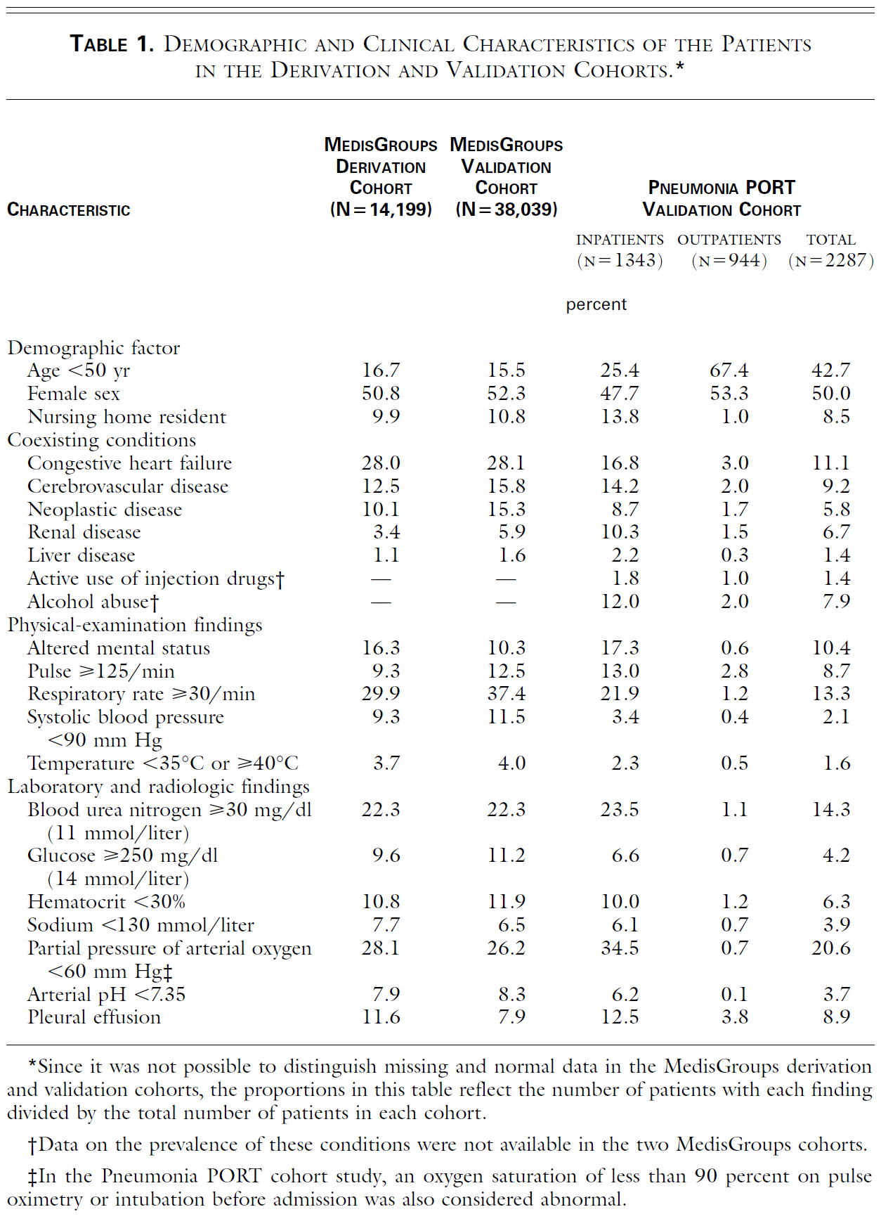
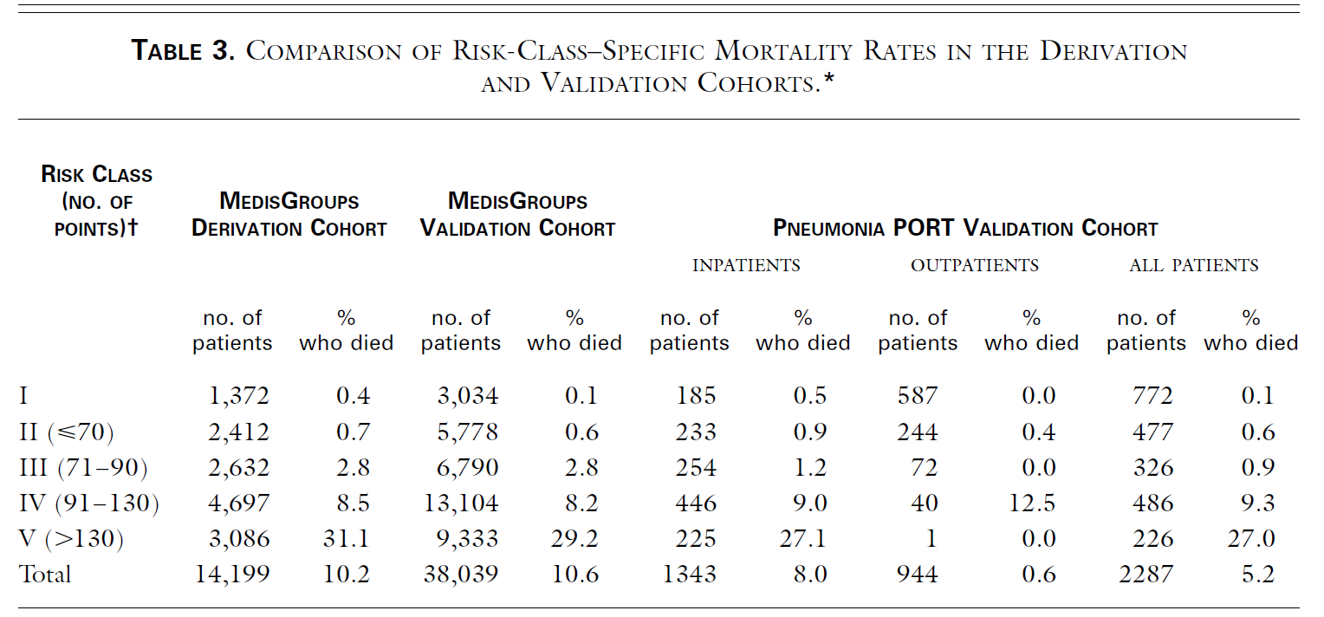
A PREDICTION RULE TO IDENTIFY LOW-RISK PATIENTS WITH CAP
N Eng J Med 1997;336:243-50

Slide 19
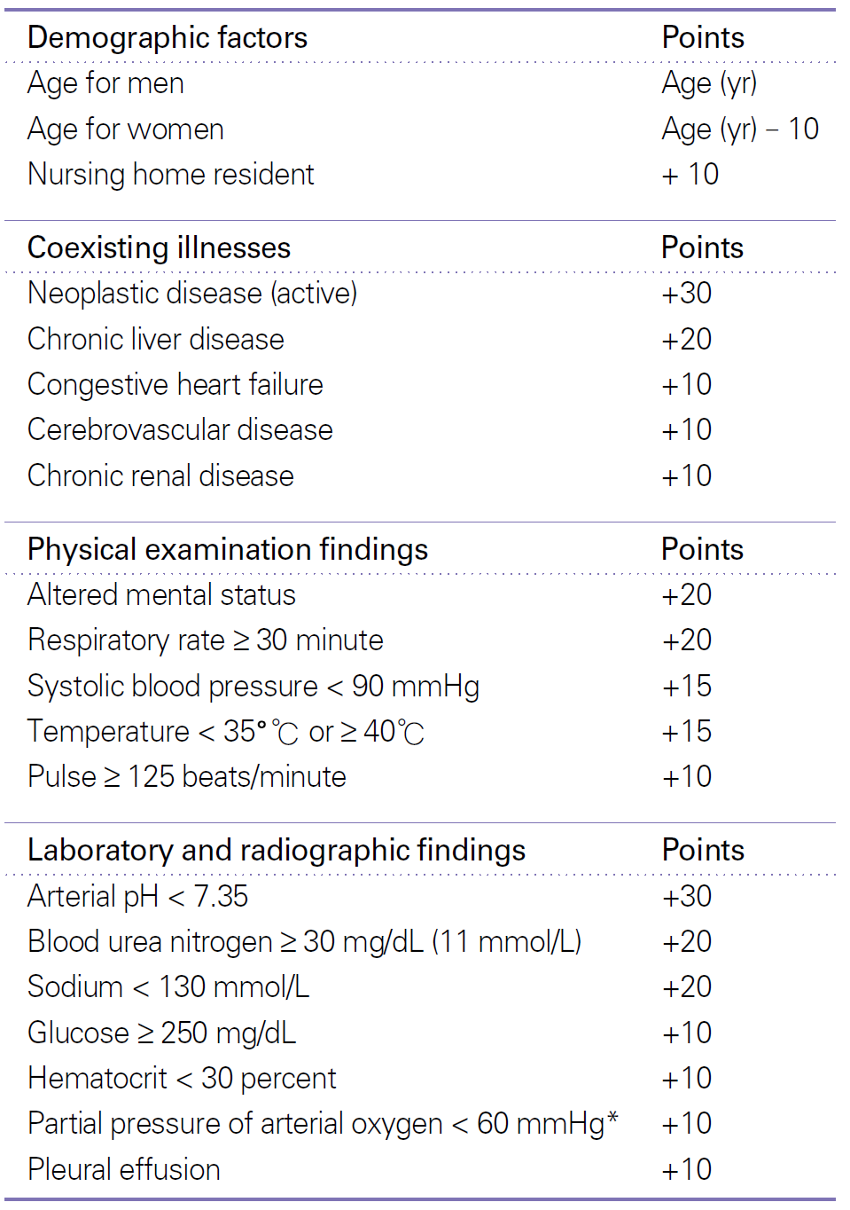
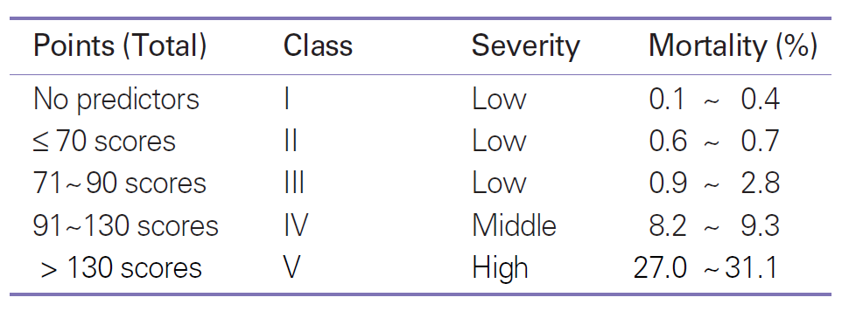
PSI score
N Eng J Med 1997;336:243-50

Slide 20
PSI score
+91
-10
0
20
0
0
10
0
10
0
0
0
0
+10
0
0
0
0
0
N Eng J Med 1997;336:243-50

Slide 21
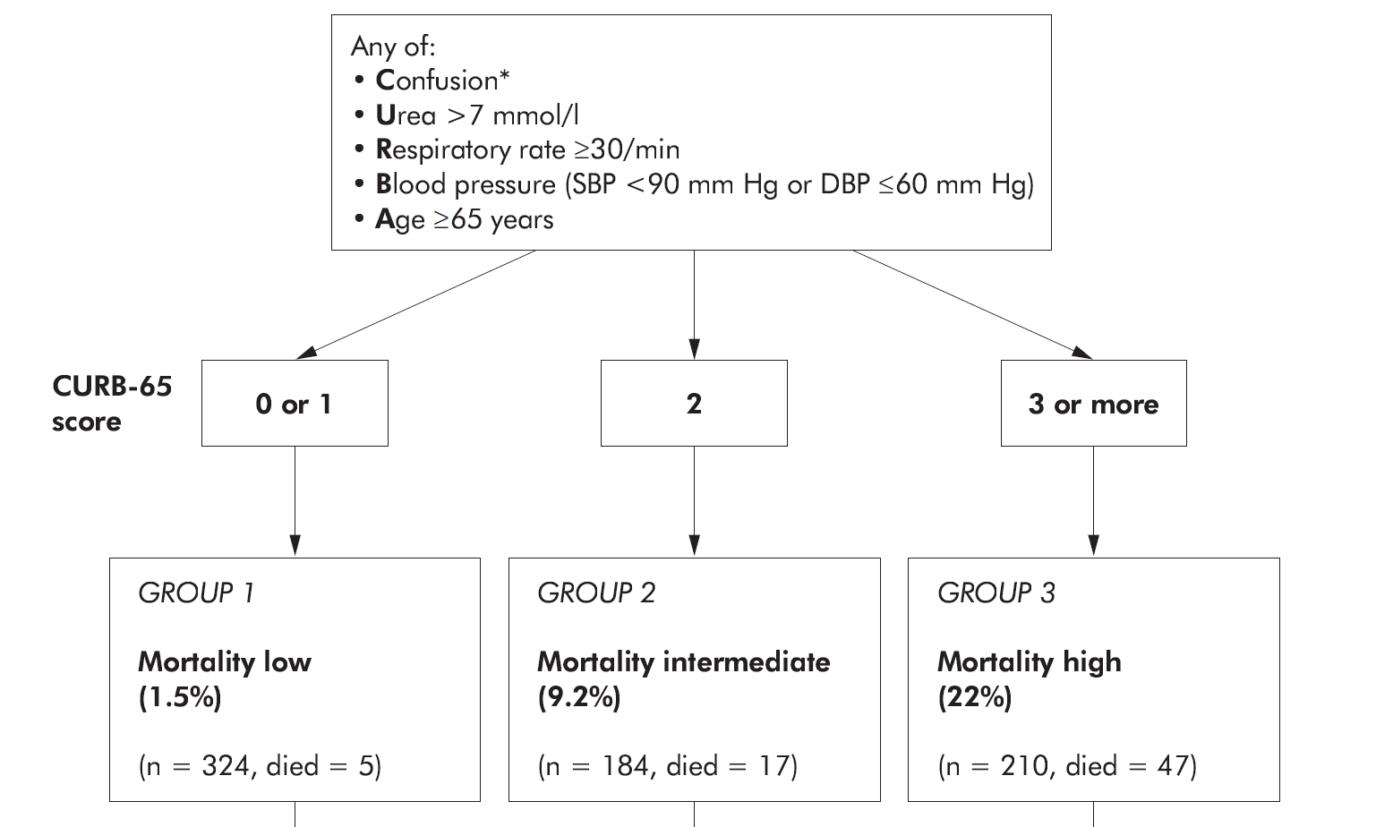
Defining community acquired pneumonia severity on presentation to hospital: an international derivation and validation study
Thorax 2003;58:377–382

Slide 22
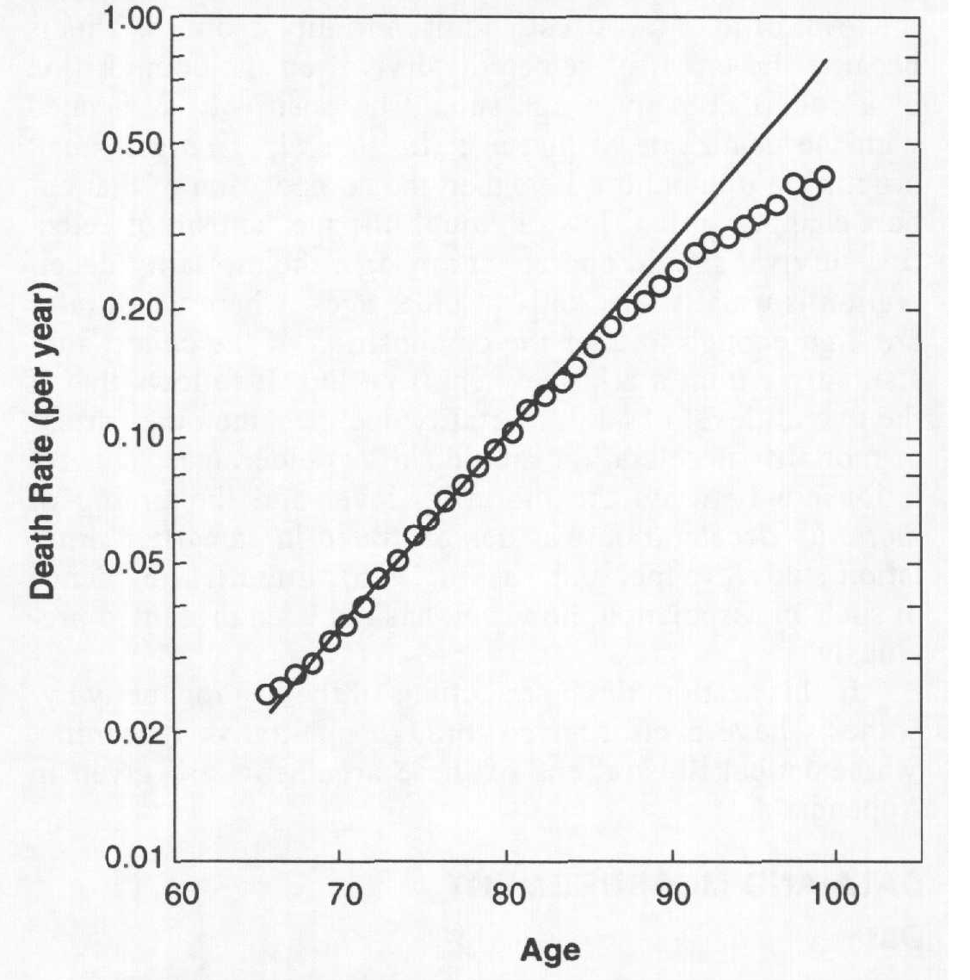
Prognostic factors in the elderly with CAP
Age per se may not be of prognostic significance in older patients.
No association between age & mortality. Within the elderly population, the more frail tend to die at younger ages, hence the older survivors tend to be healthier.
Demography, 1998 Nov;35(4):391-412.
Eur Respir J 2001;17:200-205

Slide 23
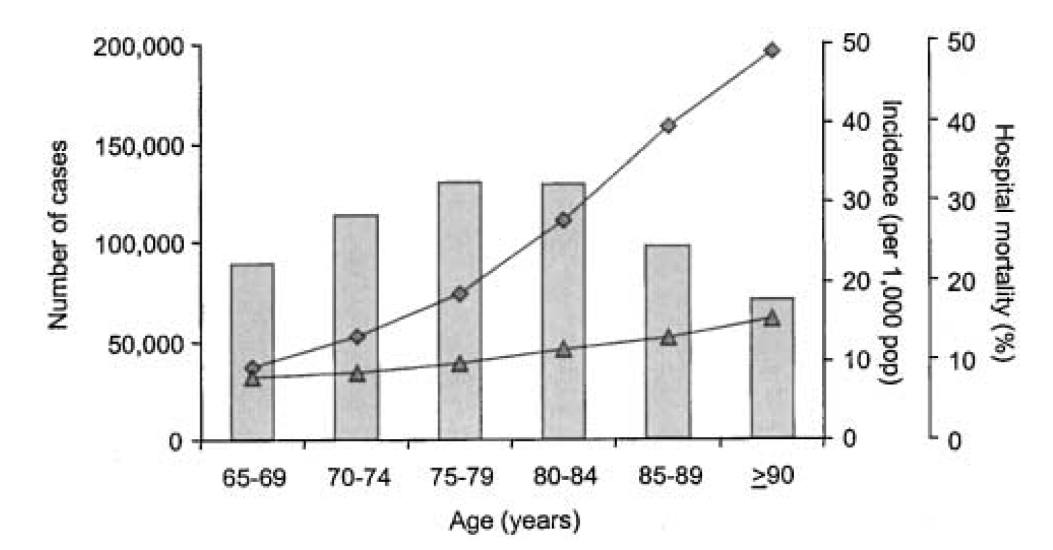
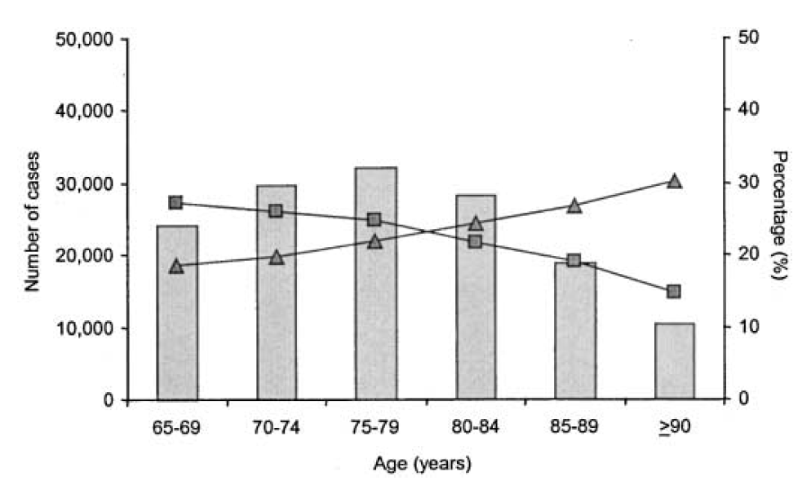
Hospitalized CAP in the Elderly
Pneumonia
Complex case
Am J Respir Crit Care Med 2002;165:766-772
Notes:
Am J Respir Crit Care Med Vol 165. pp 766–772, 2002
Age-specific number of cases, incidence, and hospital mortality
for hospitalized community-acquired pneumonia. Patient data
are generated from the HCFA 1997 Medicare discharge database and
represent only cases 65 years of age or older. Incidence (diamonds)
and hospital mortality (triangles) both rose with age across all age
groups (p 0.001). The number of cases fell beyond 80 years because
of the age distribution of the underlying population
Age-specific number, occurrence rate, and hospital mortality
for complex cases in hospitalized community-acquired pneumonia.
Complex pneumonia was defined as one involving ICU care or mechanical
ventilation. Occurrence rate of complex cases decreased and
hospital mortality increased for each age group (p 0.001). Number
of complex cases;

Slide 24
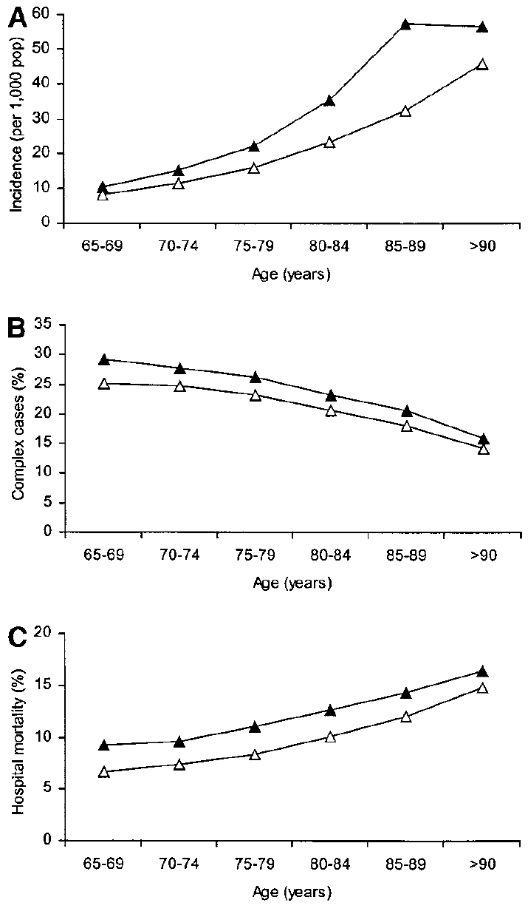
Hospitalized CAP in the Elderly
▲ men
△ women
> 65 years, Medicare data
Am J Respir Crit Care Med 2002;165:766-772
Notes:
Am J Respir Crit Care Med Vol 165. pp 766–772, 2002
Age-specific number of cases, incidence, and hospital mortality
for hospitalized community-acquired pneumonia. Patient data
are generated from the HCFA 1997 Medicare discharge database and
represent only cases 65 years of age or older. Incidence (diamonds)
and hospital mortality (triangles) both rose with age across all age
groups (p 0.001). The number of cases fell beyond 80 years because
of the age distribution of the underlying population
Age-specific number, occurrence rate, and hospital mortality
for complex cases in hospitalized community-acquired pneumonia.
Complex pneumonia was defined as one involving ICU care or mechanical
ventilation. Occurrence rate of complex cases decreased and
hospital mortality increased for each age group (p 0.001). Number
of complex cases;

Slide 25
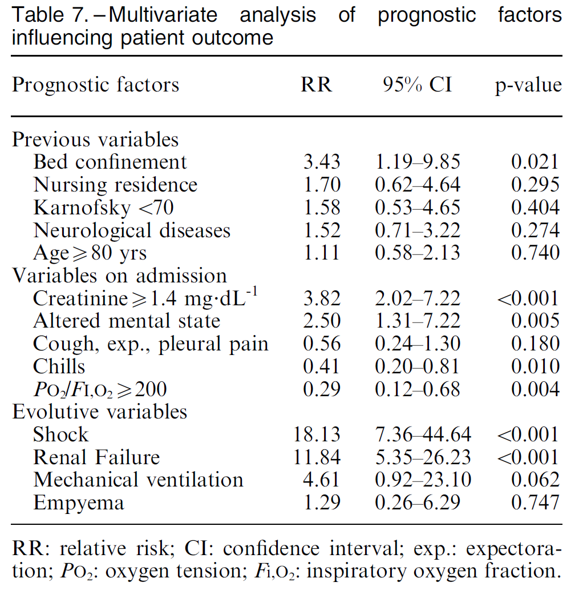
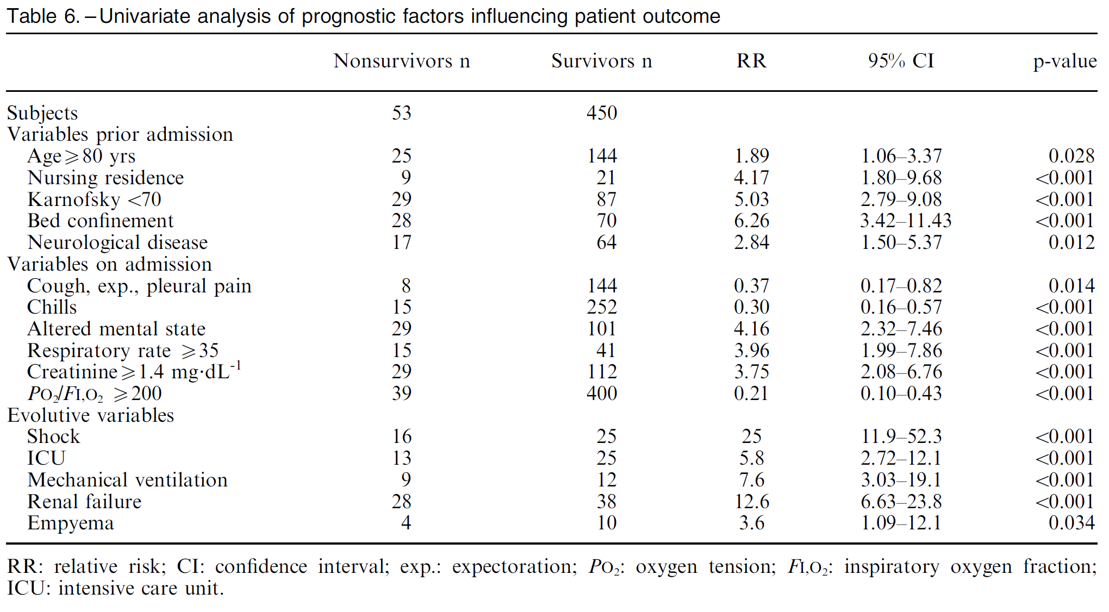
CAP in Elderly in Spain
Multivariate analysis of prognostic factors
Eur Respir J 2003;21:294-302

Slide 26
Prognostic factors in the elderly with CAP
In-hospital mortality, Case-control study, ≥ 75 years
Clinical feature | OR | 95% CI | P-value
Temperature < 37℃ | 3.7 | 1.6-8.7 | <0.01
Pulse ≥95/min | 3.1 | 1.3-7.2 | <0.01
RR > 24/min | 1.8 | 0.8-4.2 | 0.18
Confusion | 1.8 | 0.8-4.1 | 0.16
Urea ≥20 | 1.8 | 0.7-4.8 | 0.26
Bilateral or effusion | 4.1 | 1.3-13.2 | 0.02
Mortality related factor ; absence of fever, tachycardia,
bilateral involvement or effusion.
Eur Respir J 2001;17:200-205

Slide 27
A prognostic rule for Elderly Patients admitted with CAP
Independent predictors of hospital mortality in the derivation set of patients 65 years of age and older hospitalized with CAP
Predictor | Adjusted Odds Ratio (95% CI) | P-value
Age≥ 85 years | 1.8 (1.1-3.1) | 0.02
Presence of comorbid condition | 4.1 (2.1-8.1) | 0.0001
Impaired motor response | 2.3(1.4-3.7) | 0.0009
Abnormal vital sign | 3.4(2.1-5.4) | 0.0001
Serum Cre ≥1.5mg/dL | 2.5(1.5-4.2) | 0.0003
1
2
1
2
1
Abnormal V/S; BT< 36.1℃, SBP<90mmHg, HR>110/min
AmJ Med. 1999;106:20–28.
Notes:
Abnormal vital sign --- BT 36.1도 미만, SBP < 90mmHg, HR > 110 beats/min

Slide 28
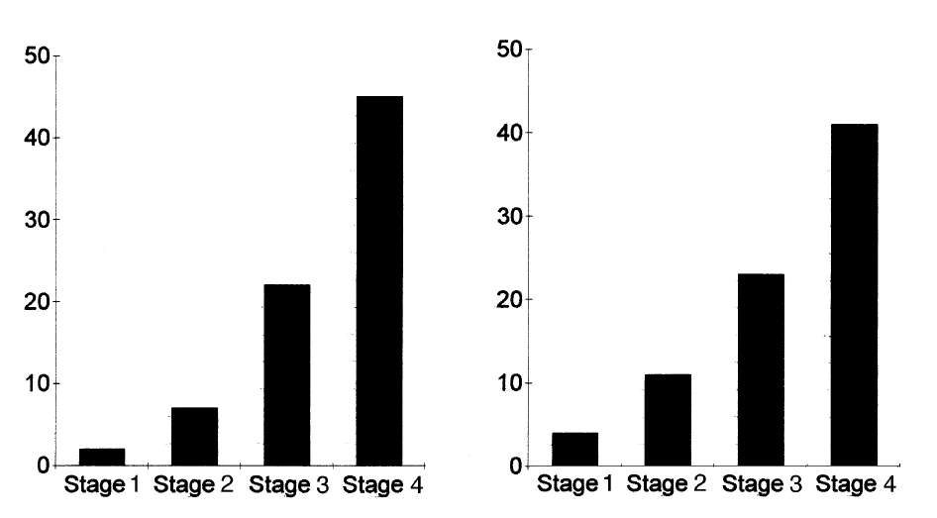
A prognostic rule for Elderly Patients admitted with CAP
Prognostic staging system in the derivation set and validation set
Stage | Score | Mortality
1 | 0 | 4%
2 | 1-2 | 11%
3 | 3-4 | 23%
4 | ≥5 | 41%
AmJ Med. 1999;106:20–28.
Notes:
Prognostic staging system in the derivation set (left) and validation set (right) of patients 65 years of age and older
hospitalized with community-acquired pneumonia. X-axis indicates risk Stage for hospital mortality. Y-axis indicates hospital
mortality (percent).

Slide 29
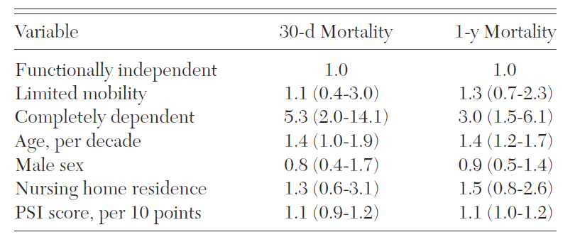
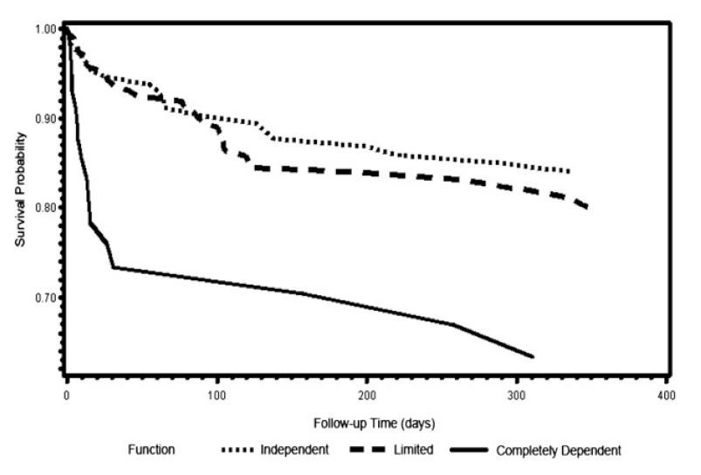
Only Severely Limited, Premorbid Functional
Status Is Associated With Short- and Longterm
Mortality in Patients With Pneumonia
Who Are Critically Ill
Multivariable Regression Examining Functional Status
as a Correlate of 30-d and 1-y Mortality in Patients With Pneumonia in ICUs
CHEST 2011; 139(1):88–94

Slide 30
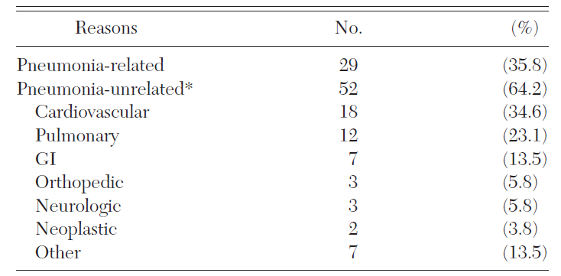
Age, still matters
Reasons for hospital readmission within 30-days after discharge (n=81)
Chest 2009;136;1079-1085

Slide 31
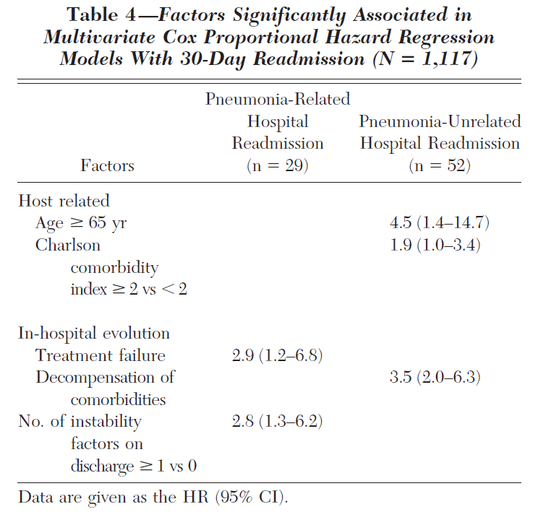
Re-admission after hospitalized CAP
Factors significantly associated in multivariate Cox Proportional Hazard Regression Models with 30-day Readmission (N=1,117)
Chest 2009;136;1079-1085

Slide 32
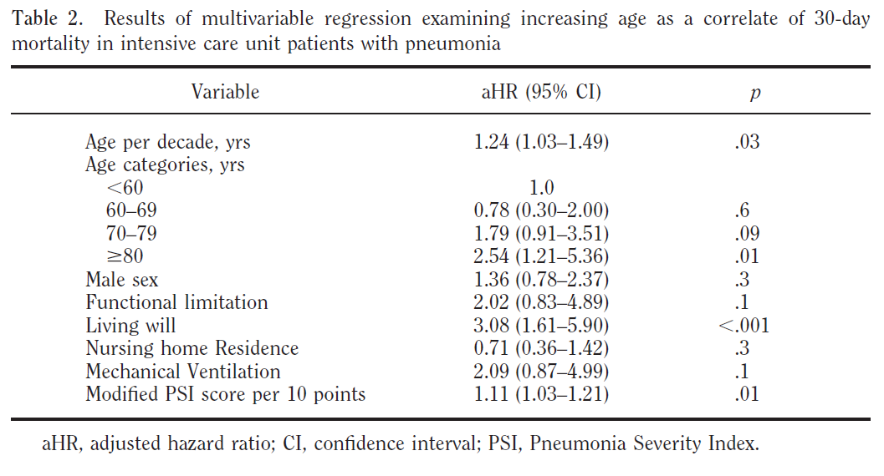
But, ≥ 70 years
Age, still matters
Crit Care Med 2010;38:2126-2132

Slide 33
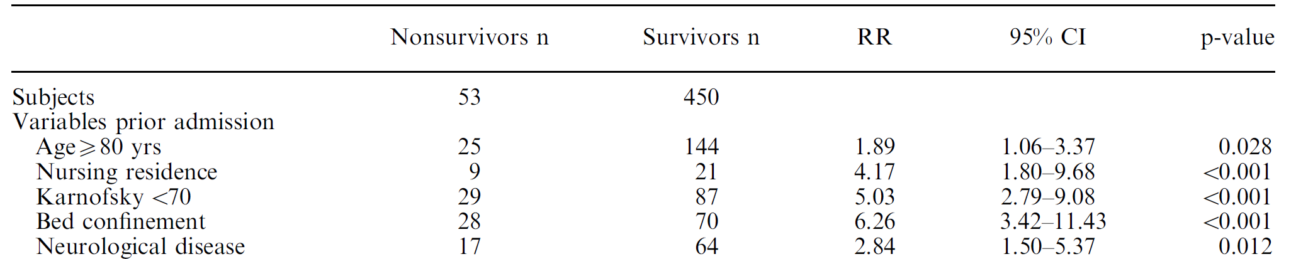
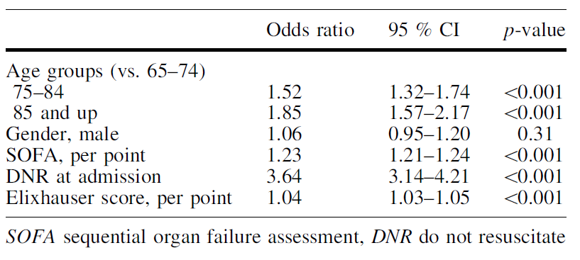
Cut-off value

Slide 34
Management of elderly patients with CAP
More extensive diagnostic work-up
Expansion of antimicrobial coverage
Evaluation of other infectious sources or nosocomial superinfections
Rule out non-infectious process
Optimization of adjuvant tx. (nutrition, hydration, oxygen)
Stabilization and treatment of medical comorbidities
Eur J Int Med 2013

Slide 35
Contents
Pneumonia
Critical Care
COPD
Interstitial Lung Disease
Tuberculosis

Slide 36
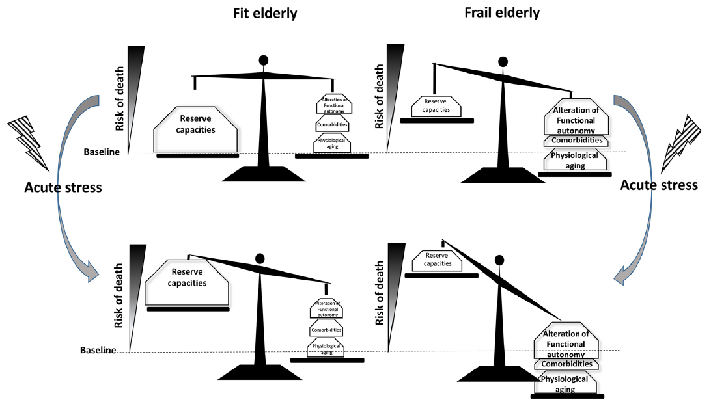
Impact of acute stress on fit or frail elderly
Ann. Intensive Care (2018) 8:114

Slide 37
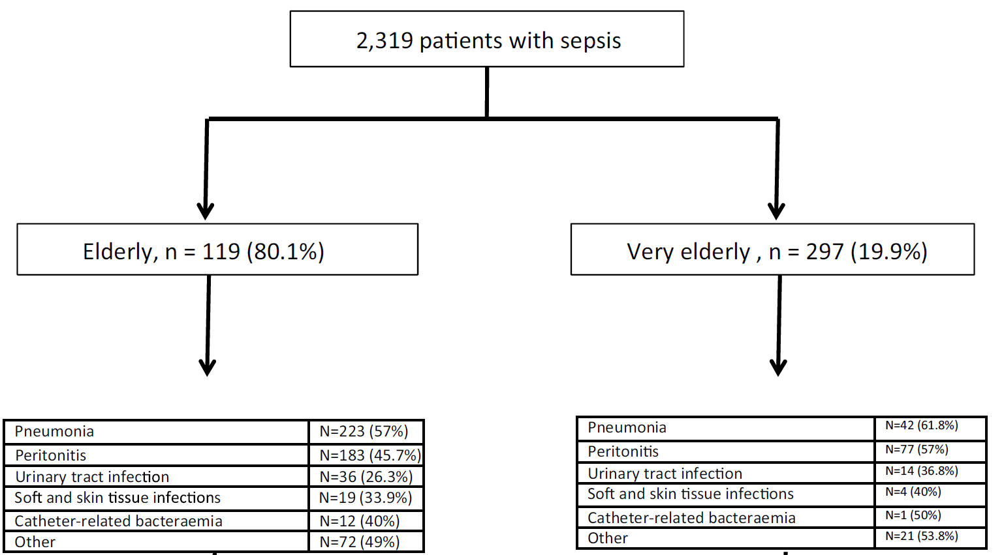
Risk factors for mortality in elderly and very elderly critically ill patients with sepsis
Ann. Intensive Care (2019) 9:26

Slide 38
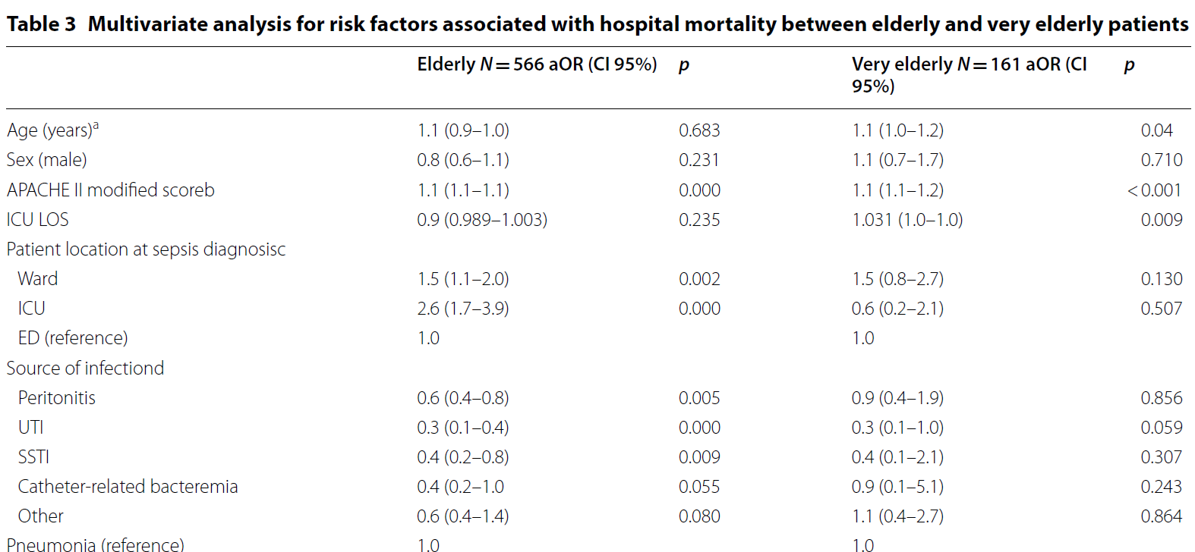
Risk factors for mortality in elderly and very elderly critically ill patients with sepsis
Ann. Intensive Care (2019) 9:26

Slide 39

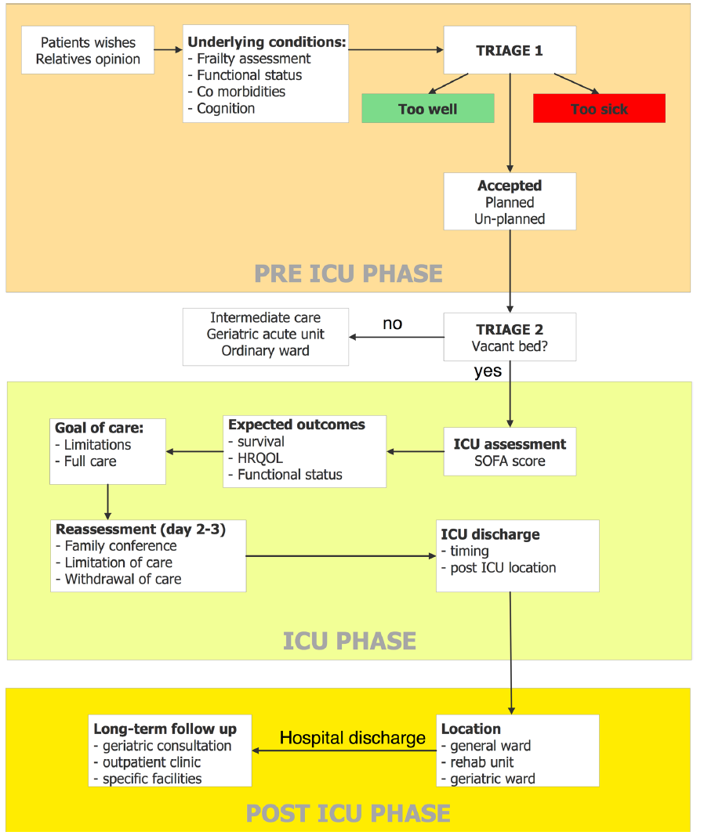
Notes:
claim their rights to receive high-quality health care
including intensive care. The outcome of the very old
has improved over the past decades but remains poorer
than for younger patients. Several factors account for this
high mortality and more related to underlying disease
than age by itself. Advanced care planning will become
more and more important in the future because of the
increasing number of admission in combination with
technological innovation. We summarized in a table, the
keys elements that should be considered when deciding
to admit a patient older than 80 in ICU (Table 4). There
are still many unresolved questions [3] (Table 4), and it
is important to get answers to these unresolved issues
before the huge ≪ age-tsunami ≫ reaches the hospitals
within 10–15 years.

Slide 40
Caring for the critically ill elderly patients
rights to receive high-quality health care including intensive care
high mortality and more related to underlying disease than age by itself
Advanced care plan; more and more important
- increasing number of admission
- technological innovation

Slide 41
Contents
Pneumonia
Critical Care
COPD
Interstitial Lung Disease
Tuberculosis

Slide 42
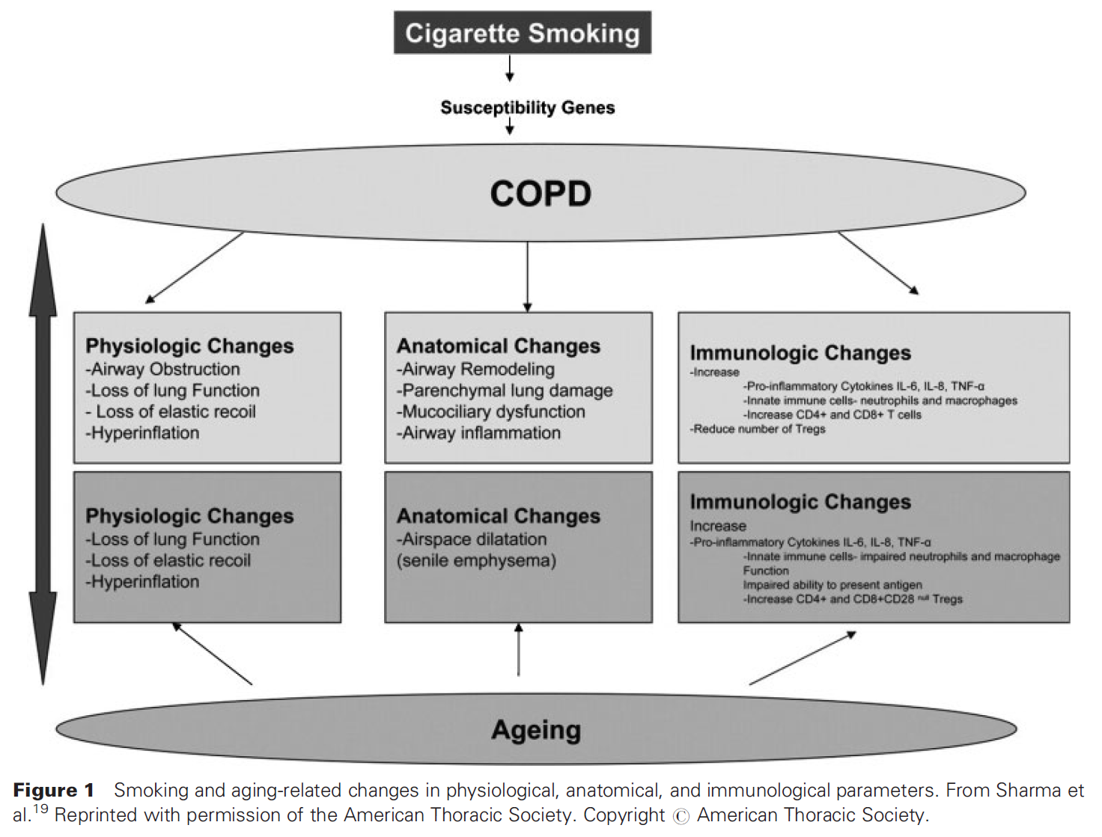
Smoking and Aging-related changes
Semin Respir Crit Care Med 2010;31:596-606

Slide 43
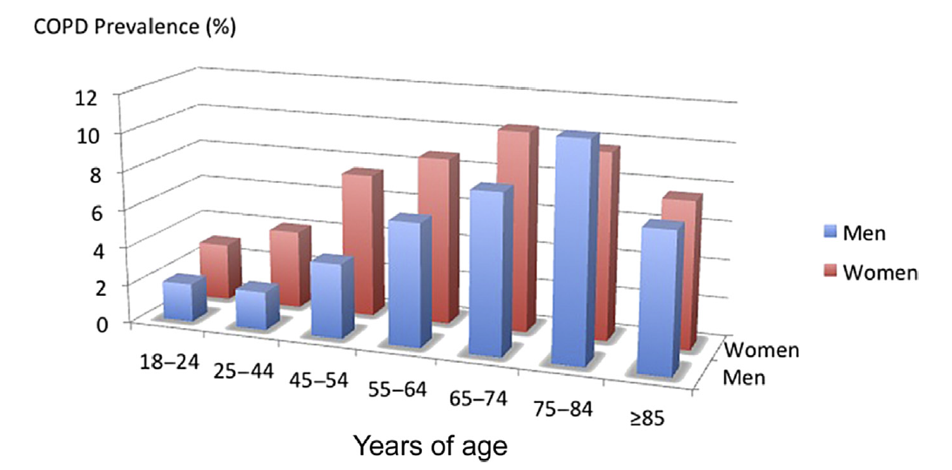
Prevalence of COPD by age
Clin Geriatr Med 33 (2017) 539–552

Slide 44
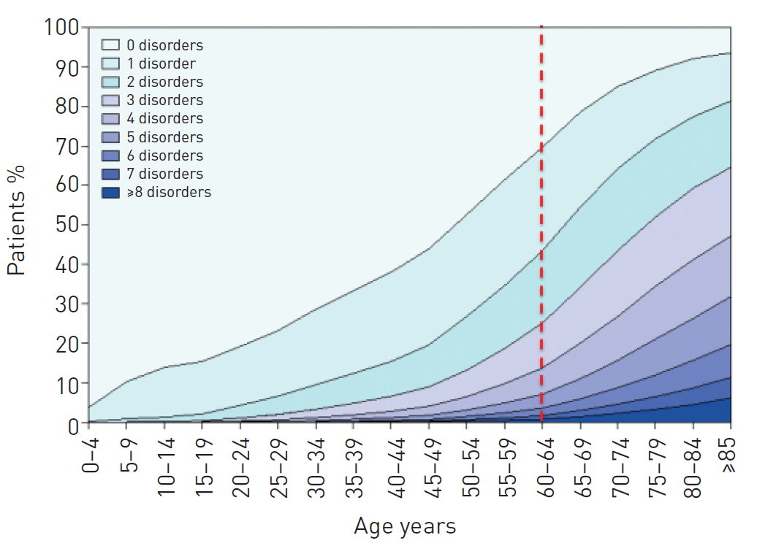
Ageing and multimoribidity
Eur Respir J 2014;44:1055-1068
Notes:
Number of chronic comorbidities by age sratum. The number of comorbidities increases with age and is larger in individuals 65 years and older.

Slide 45
COPD in Elderly
Under-diagnosis & under-treatment
- nonspecific symptoms
- physical, cognitive and educational
- polypharmacy
- adverse effect

Slide 46
Contents
Pneumonia
Critical Care
COPD
Interstitial Lung Disease
Tuberculosis

Slide 47
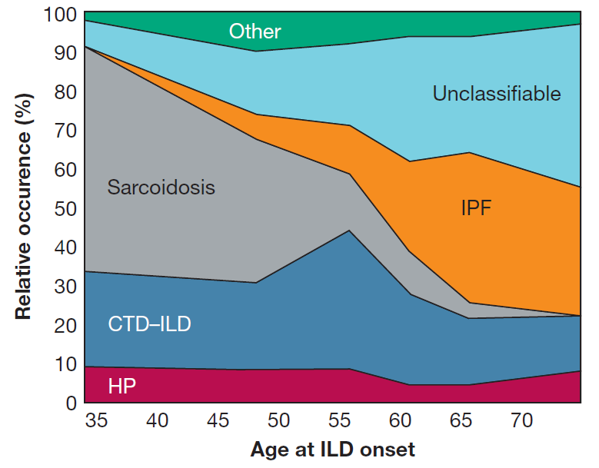
ILD in the Elderly
Elderly; ≥ 70 years
Prospective cohort study
327 subjects enrolled,
80 (24%) were elderly.
The need for every patients with new-onset ILD, regardless of age, to be surveyed for exposures and findings of CTD.
No differences in pulmonary function or 3-year mortality between nonelderly and elderly subjects.
45%
34%
11%
8%
Chest 2017;151(4):838-844

Slide 48
Contents
Pneumonia
Critical Care
COPD
Interstitial Lung Disease
Tuberculosis

Slide 49
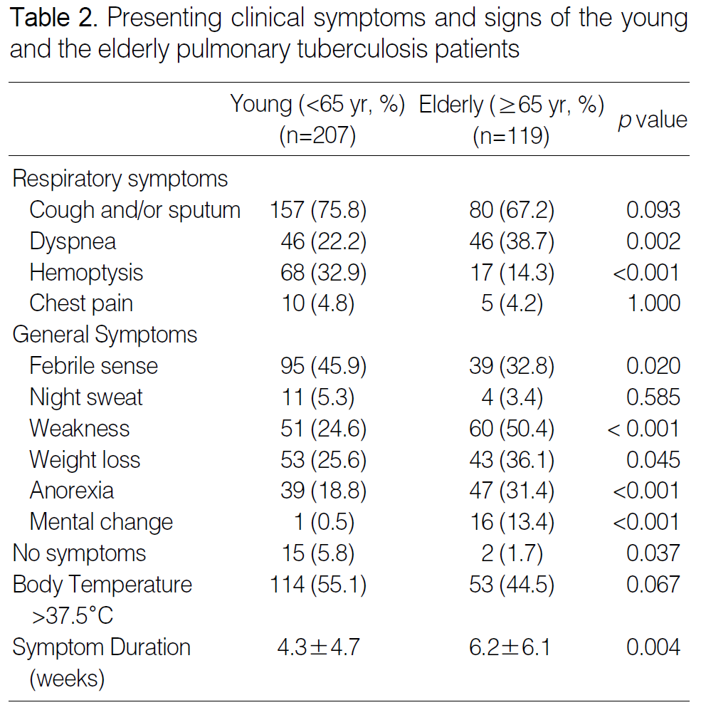
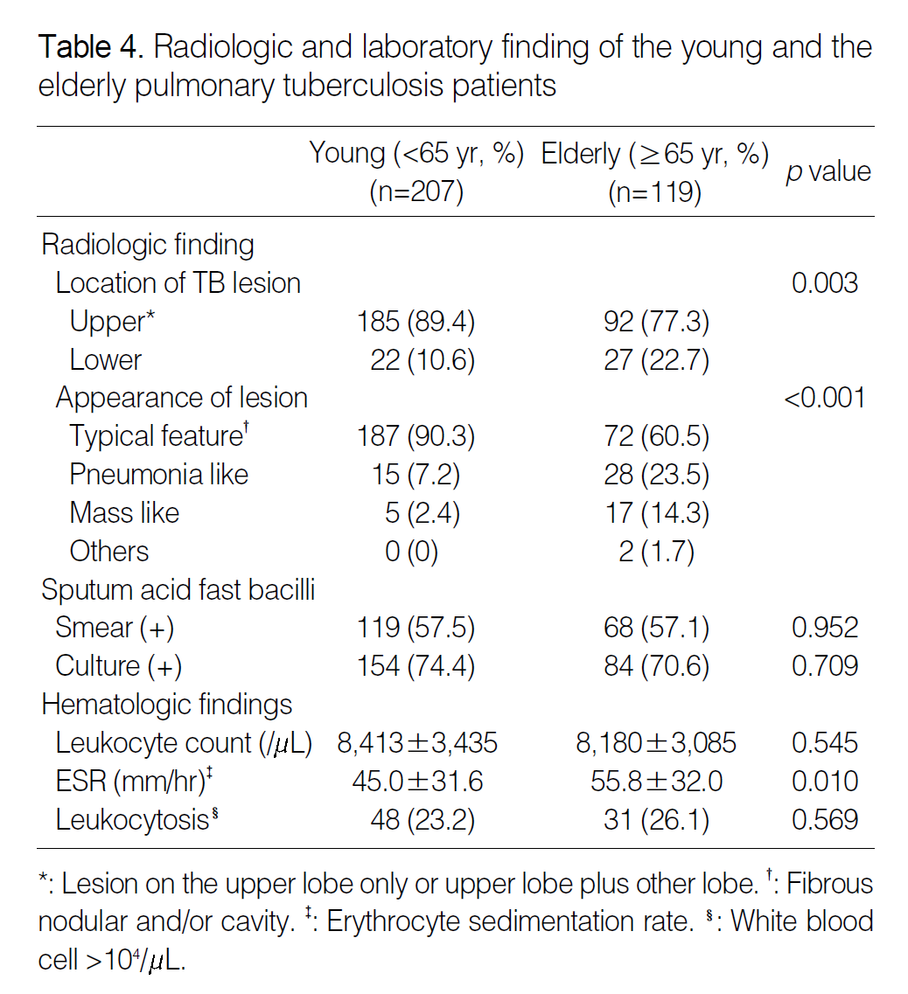
Diagnostic problems of Pulmonary tuberculosis in Elderly Patients
J Korean Med Sci 2005;20:784-9

Slide 50
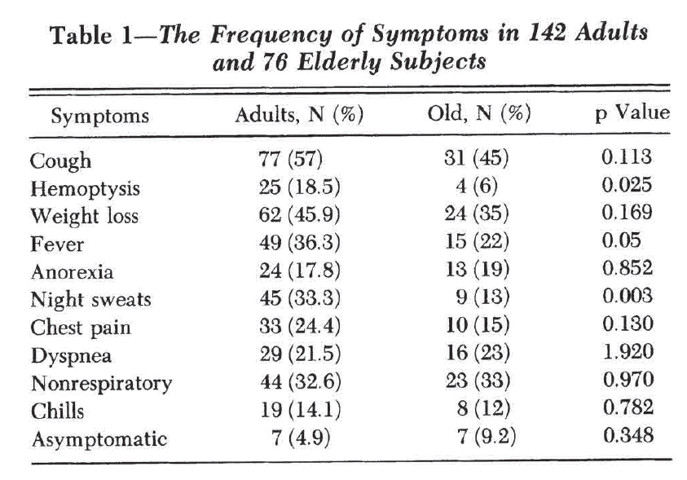
Tuberculosis in Young Adults and the Elderly
A Prospective Comparison Study
JChest 1994; 106:28-32

Slide 51
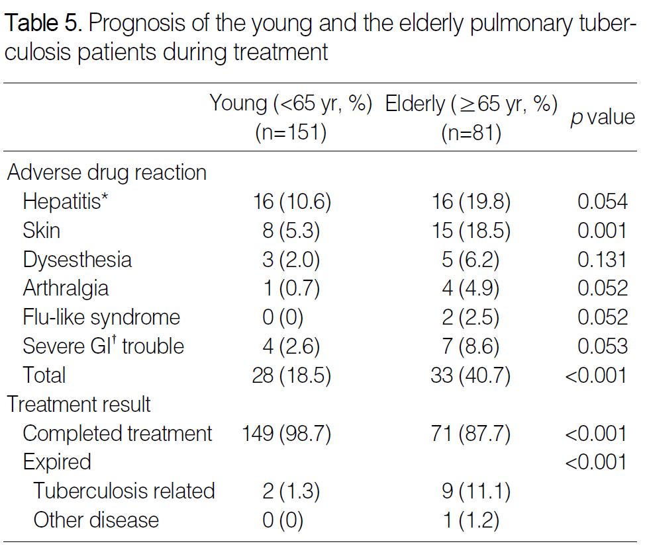
Therapeutic problems of Pulmonary tuberculosis in Elderly Patients
J Korean Med Sci 2005;20:784-9

Slide 52
Conclusions
Pneumonia
-Difficult to diagnosis
-Complications related to treatment
-Poor prognosis according to increasing age, but need to set new point
Critical Care
- a lot of unsolved problems
- Advanced care plan

Slide 53
Conclusions
COPD
- multi-morbidities & polypharmacy
- underdiagnosis
ILD
- Other than IPF
- No differences of prognosis bwt elderly and non-elderly
Tuberculosis
- atypical clinical and radiological presentation
- Adverse effect of medication

Slide 54

Thank you for your attention

Slide 55


Defining community acquired pneumonia severity on presentation to hospital
Thorax 2003;58:377–382

Slide 56

Interrelationship of risk factors, acute illness, and outcomes in CAP
Current Opinion in Infectious Diseases 2011,24:142–147

Slide 57



Clinical manifestations

Slide 58
Algorithm for critically ill patients over 80y
Ann. Intensive Care (2018) 8:114

Slide 59


ICU admission characteristics and mortality rates among elderly and very elderly patients
Intensive Care Med (2012) 38:1654–1661

Slide 60


ICU admission characteristics and mortality
rates among elderly and very elderly patients
Intensive Care Med (2012) 38:1654–1661

