Slide 1
결핵 저널 리뷰
인제의대 해운대백병원 김현국

Slide 2
Contents
역학, close contact
진단, Xpert ultra
잠복결핵, 9H vs 4R
당뇨병과 결핵, metformin
치료, high dose rifampin
다제내성결핵, new regimen

Slide 3
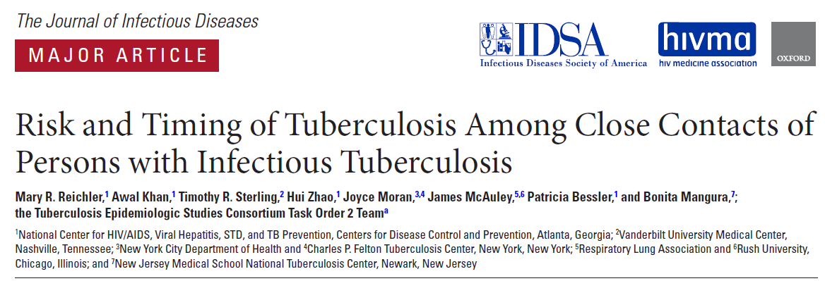
Reichler MR et al. J Infect Dis 2018 Aug 14

Slide 4
Background

Slide 5
Close contacts
  increased risk of developing M.Tbc infection and disease
Risk of Tbc with latent M.Tbc infection (LTBI)
  5%–10% over the course of a lifetime
  half of cases occurring within the first 2 years after exposure

Slide 6
The risk and timing of tuberculosis among recently exposed close contacts of patients with infectious Tbc are not well established
  important implications for the expected yield and optimal timing of contact investigations

Slide 7
Methods

Slide 8
Close contacts of all adults aged ≥15 years with culture-positive pulmonary Tbc
prospectively enrolled
9 health departments (7 in the US and 2 in Canada)
from 2002.1 to 2006.12

Slide 9
Close contacts
  persons who had shared air space with an individual with pulmonary tuberculosis in the household or other indoor setting
    >15 hours / week or >180 hours total during an infectious period
    Infectious period : the interval from 3 months before collection of the first culture-positive sputum specimen or the date of onset of cough (whichever was longer) through 2 weeks after the initiation of appropriate antituberculosis treatment

Slide 10
Contacts were screened as soon as possible after they were identified through interview of patients with tuberculosis and again 10–12 weeks after last exposure to the patient
Screening
  standardized interview
  tuberculin skin test (TST), with a + result defined as a ≥5mm induration.
  chest X-ray was performed for contacts with positive results of TST

Slide 11
Contacts were cross-matched with state and provincial tuberculosis registries at the end of the enrollment period and annually for 4 years thereafter (the final match was in February 2011)
  with the exception of one study site, which cross-matched contacts annually for 2 years

Slide 12
The timing of tuberculosis among contacts was calculated by
  Tbc diagnosis date(s) for their contact( s) (-) Tbc diagnosis date for each index patient
Tuberculosis rates per interval
  the number of contacts with tuberculosis diagnosed in a given interval (/) the number of observed contacts who were disease free at the start of that interval

Slide 13
Tuberculosis events among contacts
  incident cases - diagnosed >30 days after the index cases’ diagnosis
  coprevalent cases - diagnosed before or ≤30 days after the index cases’ diagnosis

Slide 14
culture-positive sputum collection date
cough
cross-matched annually
Dx & Tx
Close contacts
Timing
Coprevalent case
Incident case
30일

Slide 15
Results

Slide 16
718 patients with active pulmonary tuberculosis (index)
Tbc was diagnosed in 158 of 4490 close contacts (4%)
  77 (49%) was confirmed by culture
    67% of adults and 16% of children
  81 (51%) was diagnosed on the basis of clinical criteria

Slide 17
Characteristics of Contacts with Tuberculosis
Notes:
Contacts were categorized as having coprevalent tuberculosis if disease was diagnosed before, at the same time as, or ≤1 month after the index cases’ tuberculosis diagnosis and as having incident tuberculosis if disease was diagnosed >30 days after the index cases’ diagnosis.
Abbreviations: HIV, human immunodeficiency virus; TST, tuberculin skin test.
aNot screened, partially screened, not eligible for screening, or unknown screening

Slide 18
158 contacts - Tbc
27 (17%) before
4 (3%) same day
124 (80%) after
131 contacts
Contacts with Tbc cumulatively
81 (51%) – 1month
119 (75%) - 3 months
128 (81%) - 6 months
145 (92%) - 12 months
Notes:
Figure 1. Timing of tuberculosis (defined as the interval from index case treatment initiation to contact treatment initiation) among 131 contacts, by interval from index case treatment initiation; the 27 contacts in whom tuberculosis was diagnosed before the index cases received a diagnosis are excluded. Of note, tuberculosis registry matches were used to identify the diagnosis of tuberculosis among enrolled contacts after contact investigations were completed; tuberculosis registry matches were performed annually for 4 years after last site enrollment at 8 sites and annually for 2 years at one site. Since enrollment occurred over a 4-year period, contacts enrolled earlier in the study had a longer tuberculosis registry match observation period, with 100%, 94%, 76%, 55%, and 34% observed for 4, 5, 6, 7, and 8 years, respectively, after enrollment.

Slide 19
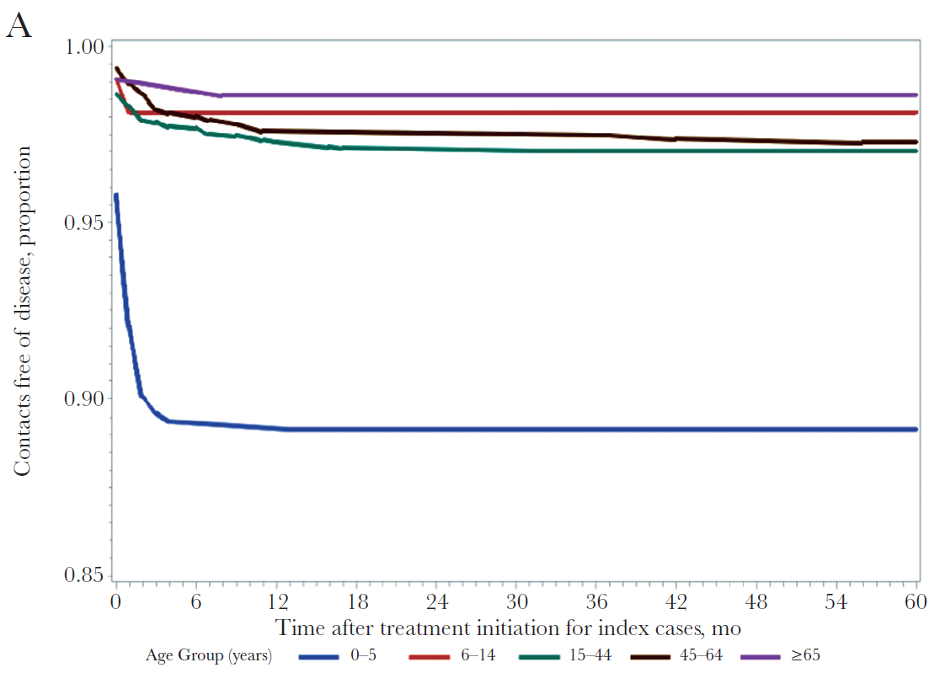
Disease-free survival for 4490 contacts
Age group
Screening TST result
0.6%, 2.8%, 6.1%, 8.2%, 8.9%
Notes:
Figure 2. Disease-free survival for 4490 contacts (158 with and 4332 without tuberculosis), by age group (A), screening tuberculin skin test (TST) result (B), and receipt of treatment for latent Mycobacterium tuberculosis infection (C). Tuberculosis registry matches were performed annually for 4 years after last site enrollment at 8 sites and annually for 2 years at 1 site. Since enrollment occurred over a 4-year period, contacts enrolled earlier in the study had a longer tuberculosis registry match observation period, with 100% and 94% observed for 4 and 5 years, respectively.
Neg, negative; pos, positive; PT, preventive therapy.

Slide 20
Disease-free survival for 4490 contacts,
Receipt of treatment for latent M.Tb infection

Slide 21
Table 2. Rates and Timing of Tuberculosis Among 4490 Contacts of Index Patients With Culture-Positive Tuberculosis, by Time Since Treatment Initiation for Index Cases
Notes:
Tuberculosis registry matches were performed annually for 4 years after last site enrollment at 8 sites and annually for 2 years at 1 site. Since enrollment occurred over a 4-year period, contacts enrolled earlier in the study had a longer tuberculosis registry match observation period, with 100%, 94%, 76%, 55%, and 34% observed for 4, 5, 6, 7, and 8 years, respectively, after enrollment.
aZero, 1–30, 31–60, 61–90, 91–120, etc. days were considered equivalent to months 0, 1, 2, 3, 4, etc.
bCalculated as the proportion of all contacts with tuberculosis (denominator, 158).
cCalculated as the proportion of all contacts observed who received a diagnosis of tuberculosis (denominator, 4490).
dOf 27 contacts with an interval of <0 months from index case treatment initiation to contact treatment initiation, 22, 2, 1, 1, and 1 initiated treatment 1–12, 13–24, 25–36, 61–72, and 85–96 months, respectively, before the index case.

Slide 22
Table 3. Rates and Timing of Tuberculosis Among 499 Contacts With Positive Results of Tuberculin Skin Tests (TSTs) and No Treatment for Latent M.Tbc Infection
Notes:
Tuberculosis registry matches were performed annually for 4 years after last site enrollment at 8 sites and annually for 2 years at 1 site. Since enrollment occurred over a 4-year period, contacts enrolled earlier in the study had a longer tuberculosis registry match observation period, with 100%, 96%, 85%, 64%, and 47% of contacts with positive results of TSTs observed for 4, 5, 6, 7, and 8 years, respectively, after enrollment.
a Zero, 1–30, 31–60, 61–90, 91–120, etc. days were considered equivalent to months 0, 1, 2, 3, 4, etc.
b Calculated as the proportion of all contacts with tuberculosis (denominator, 102).
c Calculated as the proportion of all contacts observed who received a diagnosis of tuberculosis (denominator, 499).
d Of the 13 contacts with an interval of <0 months from index case treatment initiation to contact treatment initiation, 12 and 1 initiated treatment 1–12 and 84–96 months, respectively, before the index case.

Slide 23
Discussion
4% of all close contacts had tuberculosis diagnosed
75% had tuberculosis diagnosed before or ≤3 months after the index cases had tuberculosis diagnosed
1950s studies
  1.5% over a 7-year observation period
  identified the risk of tuberculosis to be highest in the first 2 years after exposure, with 48% of all cases occurring in that period

Slide 24
Discussion
Tuberculosis among exposed contacts is not evenly distributed over the first 2 years after exposure
most cases occur soon after exposure and are already evident at the time of contact investigation
the importance of performing contact investigations immediately after identifying index cases

Slide 25
Discussion
Contact investigations took anywhere from a few weeks to many months to complete
  difficult to be certain which tuberculosis cases identified at the time of contact investigation represent secondary transmission from the index case
≥1 month after diagnosis of tuberculosis in the index case to distinguish incident from coprevalent tuberculosis diagnoses in contacts

Slide 26
Discussion
2 previous reports presented results separately for prevalent and incident tuberculosis
  270 and 180 days
Tbc risks in this study were higher
  overall (3.5% vs 1.2% and 1.5%)
  coprevalent tuberculosis (1.8% vs 1.0% and 1.2%)
  incident tuberculosis (1.7% vs 0.3% and 0.3%)

Slide 27
Discussion
The higher tuberculosis rates among contacts
  prospective, enabling us to use a standard structured interview to elicit contacts and track outcomes
  standard definition for contact closeness, based on a high minimum number of hours of exposure (>15 hours per week) to a patient with infectious tuberculosis

Slide 28
Discussion
Considerably higher LTBI rate in our study (48%)
  33% in New York City, 16% in Amsterdam
  our study methods resulted in the evaluation of contacts with a greater likelihood of exposure, compared with those in previous studies
  Conducting registry matches to identify contacts who received a tuberculosis diagnosis for 4 years (and for some contacts, up to 8 years)
  in the context of tuberculosis control programs

Slide 29
Discussion
High rates and rapid progression to tuberculosis were particularly notable among young children
  among contacts 0–5 years of age, 10% developed tuberculosis
  59% of all cases were diagnosed by 1 month
  93% by 3 months after index case diagnosis
  important implications for the optimal timing, expected yield, and prevention goals of contact investigations.

Slide 30
Discussion
Based on our data, strategies that improve the timeliness of identifying and treating recently exposed persons would likely have the greatest effectiveness in preventing tuberculosis
However, they do not preclude the importance of screening and treatment at later time points, particularly in groups at increased tuberculosis risk, such as persons born outside the United States

Slide 31
Conclusions
Close contacts to infectious patients with tuberculosis
  high rates of tuberculosis, 4%
  most disease diagnosed before or within 3m after the index patient’ Dx
Contact investigations need to
  be prompt to detect tuberculosis
  maximize the opportunity to identify and treat LTBI, to prevent disease

Slide 32
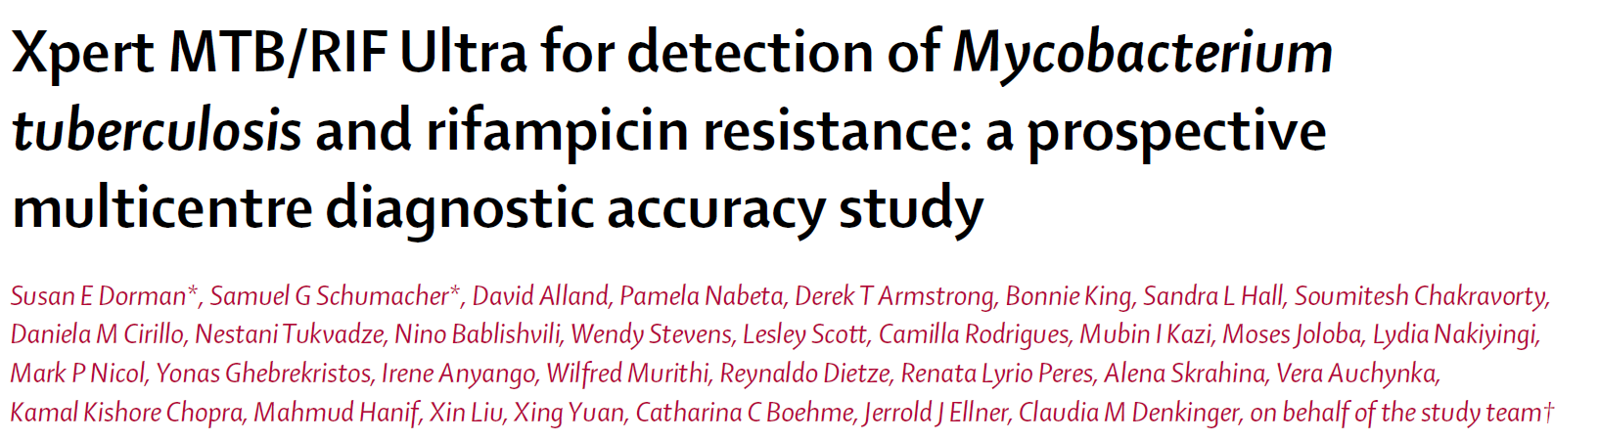
Lancet Infect Dis 2018;18: 68–75

Slide 33
Background
The Xpert MTB/RIF assay
  has improved the detection of Tbc & RIF resistance
  sensitivity is inadequate in pts with paucibacillary disease or HIV
> Xpert MTB/RIF Ultra (Xpert Ultra)
diagnostic performance for detection of Tbc & RIF resistance
  Xpert Ultra vs Xpert

Slide 34
Sputum AFB smear - 10,000 cfu/ml
  Sensitivity: 50%
TB-PCR, Xpert – 110 ~ 130 cfu/ml
  Sensitivity: 67% in smear negative
Sputum AFB culture – 10 ~ 50 cfu/ml

Slide 35
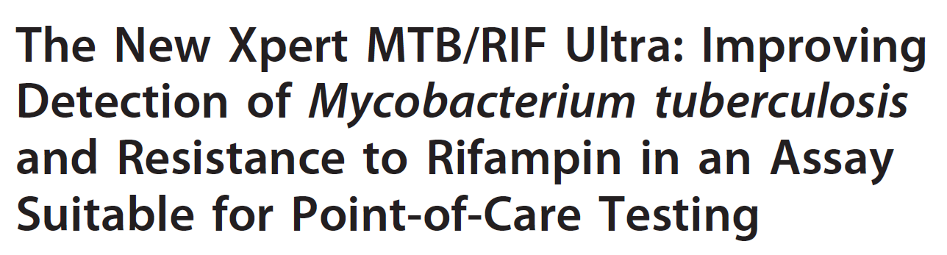
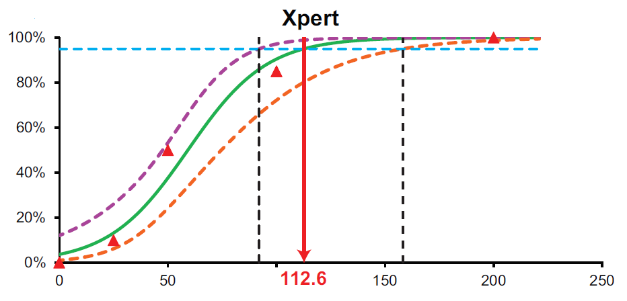
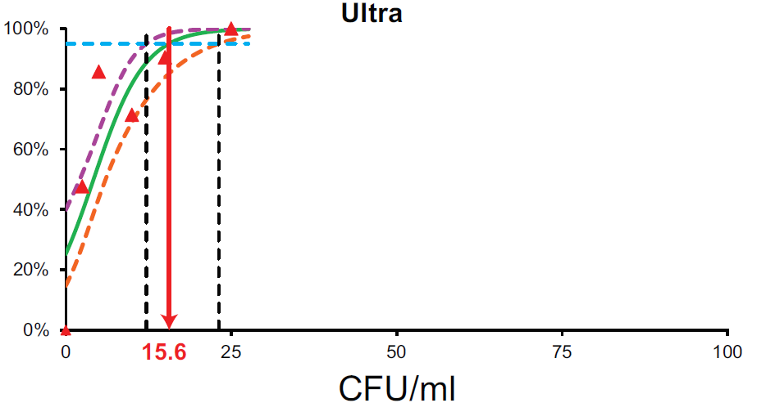

Mbio 2017;8 pii: e00812-17

Slide 36
Methods
Setting : prospective, multicentre, diagnostic accuracy study
Primary health-care centers and hospitals
Eight countries (South Africa, Uganda, Kenya, China..)
Between December 2016 and February 2018

Slide 37
patients
Pulmonary Tbc Sx & Four sputum specimen at study enrollment
The case detection group
  Four sputum specimen – Xpert, Xpert ultra, AFB s/c, DST
MDR risk group
  History of Tx failure, history of drug-resistance TB
  Four sputum specimen – Xpert, Xpert ultra, AFB s/c, DST

Slide 38
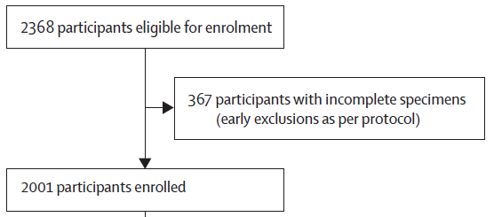
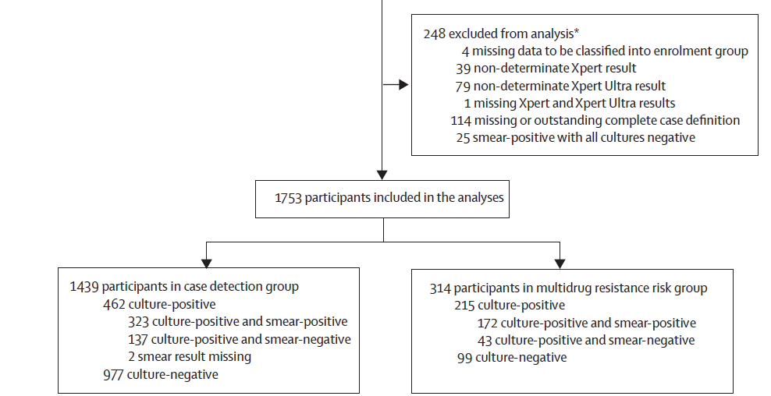
Results

Slide 39
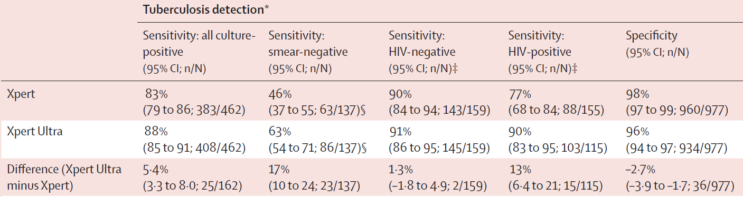
TBc detection

Slide 40
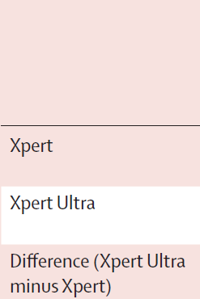
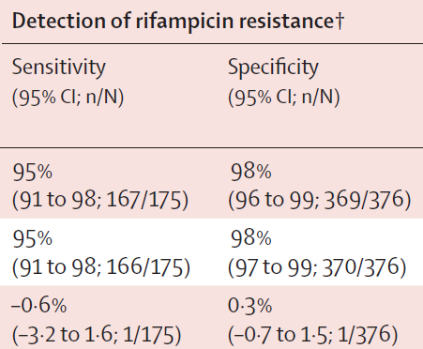
RIF resistance detection

Slide 41
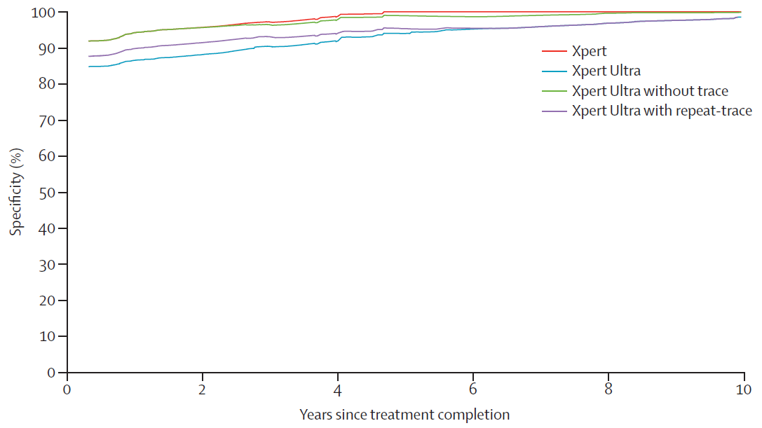
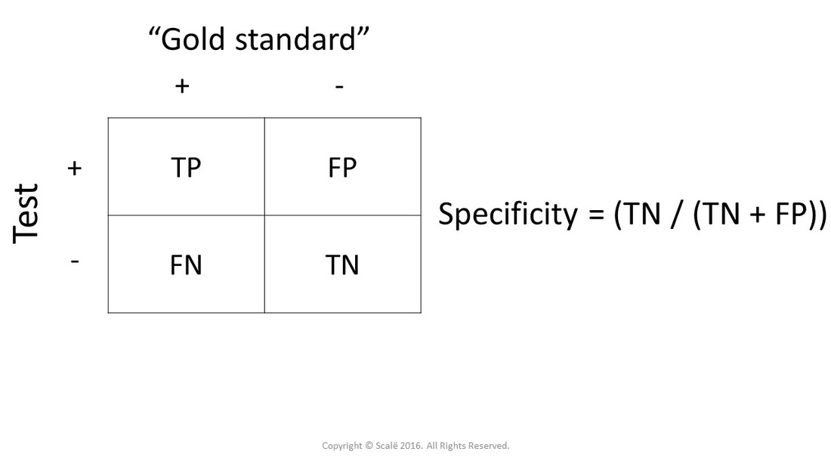

Slide 42
Conclusion
Sensitivity of Tbc detection
  Xpert Ultra > Xpert
  Smear negative tuberculosis
  → diagnosis of Tbc at earlier stage
Decreased specificity
  History of previous tuberculosis history

Slide 43
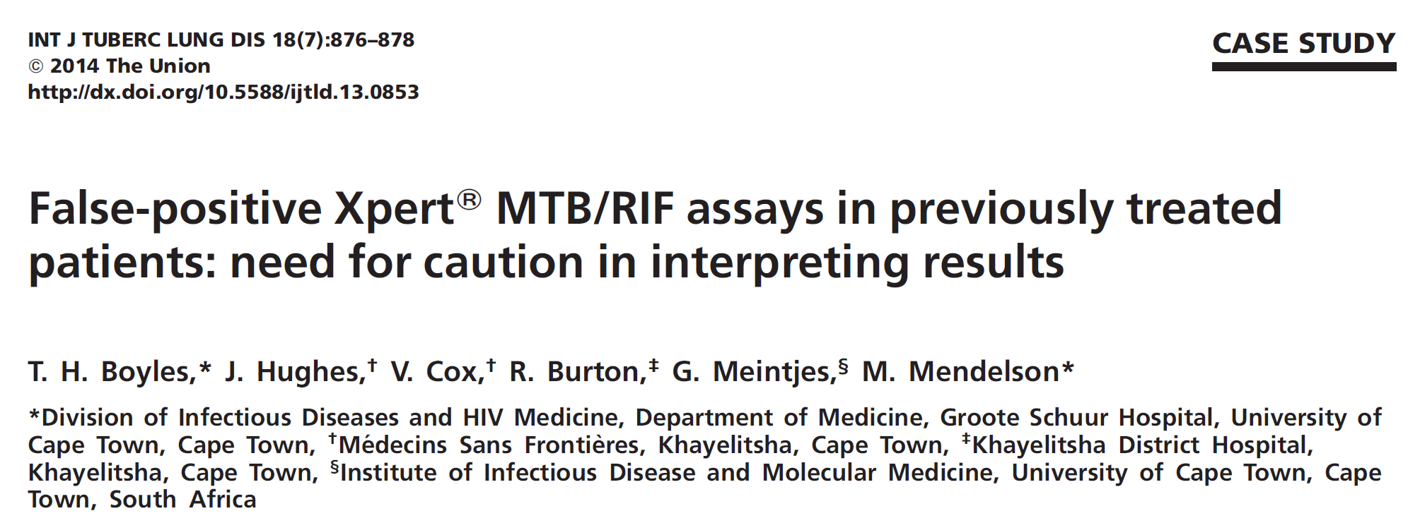
DNA fragment from non-viable bacilli

Slide 44
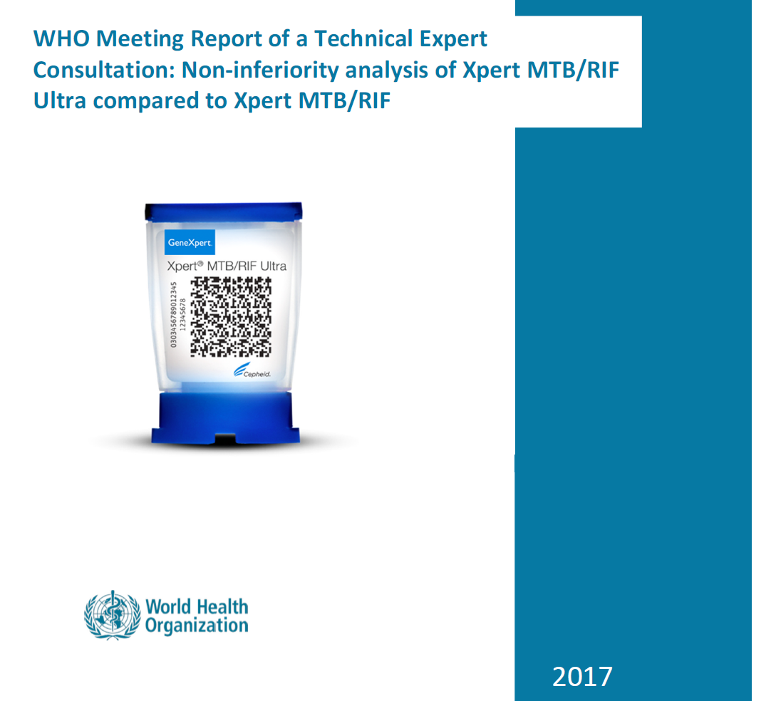
“Xpert ultra can replace Xpert in all settings”

Slide 45
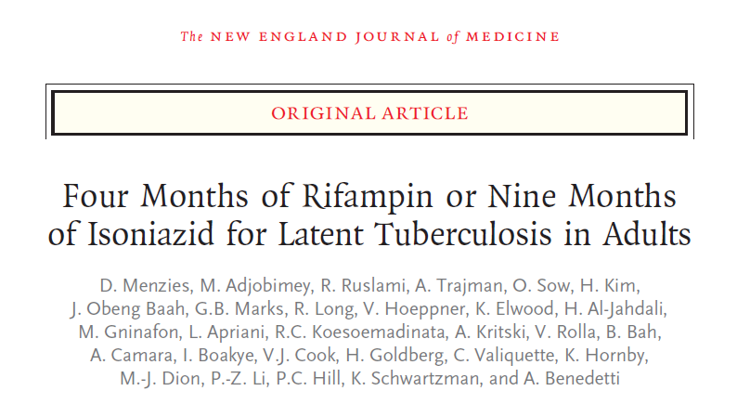
N Engl J Med 2018;379:440-53

Slide 46
Background
9H
  standard treatment for preventing active Tbc
  poor adherence rates
  toxic effects
4R (vs 9H)
  lower incidence of grade 3 or 4 drug-related adverse events
  lower costs
  higher rate of Tx completion
Effectiveness? 4R vs 9H

Slide 47
Methods
open-label trial conducted in nine countries
randomly assigned adults with LTBI to 4R or 9H
Primary outcome
  Prevention of confirmed active Tbc within 28 mo after randomization
Secondary outcomes
  clinically diagnosed active Tbc
  adverse events of grades 3 to 5
  completion of the treatment regimen

Slide 48
Results

Slide 49
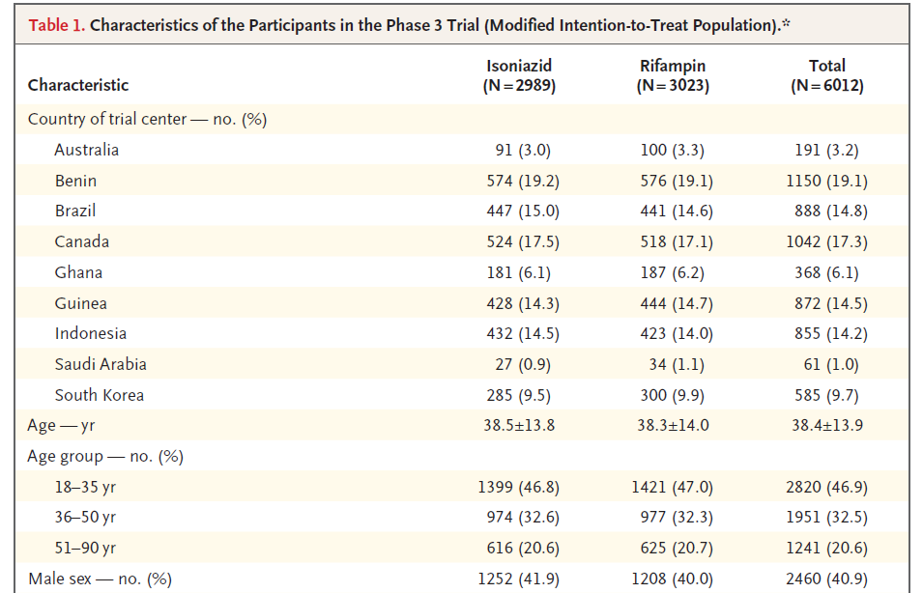

Slide 50
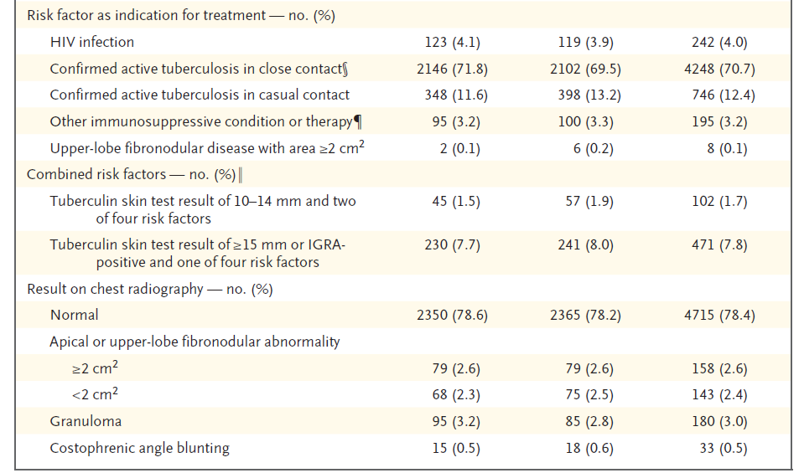
Notes:
Close contacts were defined as having at least 4 hours per week of contact with a patient with confirmed active pulmonary
tuberculosis.
Of the close contacts, 854 (14.2% of all the participants) lived in the same household as at least 1 other trial participant, of whom 436 had been randomly assigned to the 9-month isoniazid regimen and 418 had been randomly assigned to the 4-month rifampin regimen.

Slide 51
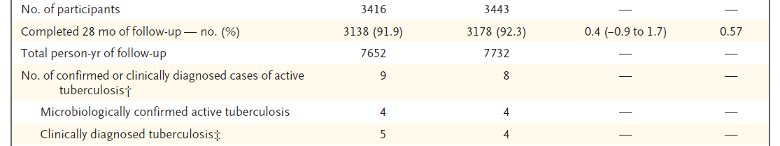
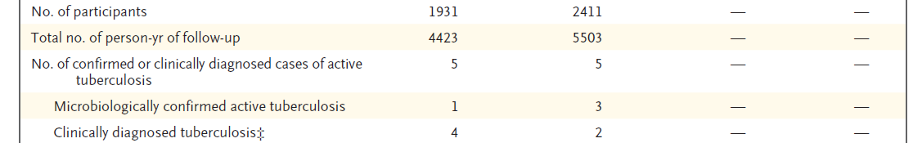

Slide 53
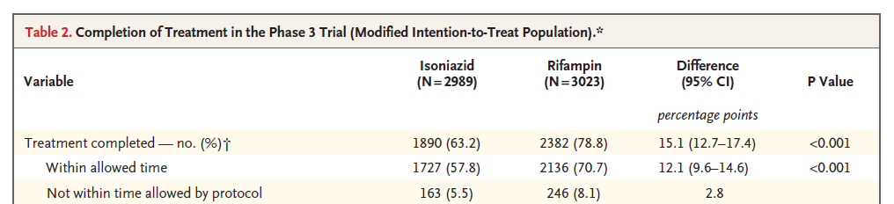

Slide 54
Conclusions
4R
  not inferior to the 9H for the prevention of active Tbc
  higher rate of Tx completion
  better safety

Slide 55
CID 2018;66(2):198–205

Slide 56
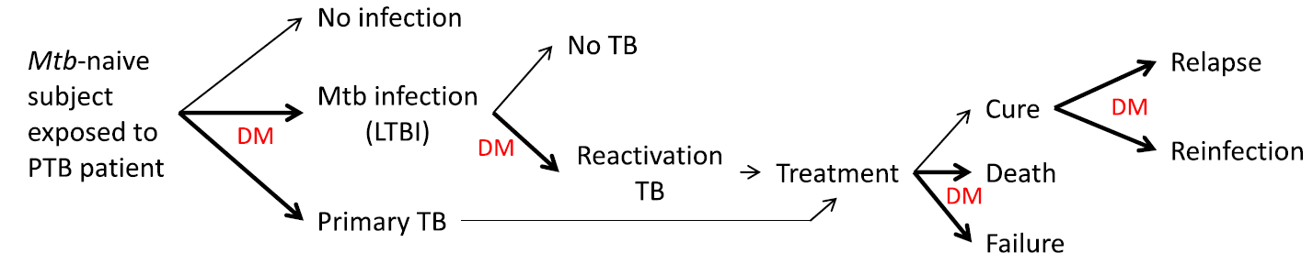
Background
Diabetes Res Clin Pract. 2014;106:191-9
Notes:
The global type 2 DM epidemic threatens progress made in reducing tuberculosis (TB)–related mortality worldwide.
Previous clinical studies have not fully evaluated potential confounding variables in addressing the impact of DM on TB treatment outcomes.
The antidiabetic agent metformin regulates autophagy and may play a role as a host-directed therapeutic adjuvant to antitubercular treatment.

Slide 57
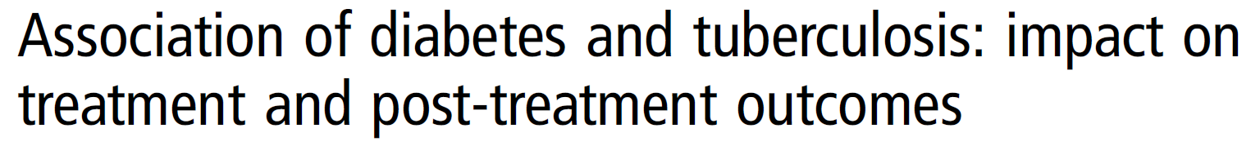
Mexico, prospective, 1262 pulmonary TB patients
DM, 29.6%
  Treatment failure, OR 2.9
  Recurrence, OR 1.8
Thorax 2013;68:214–220

Slide 58
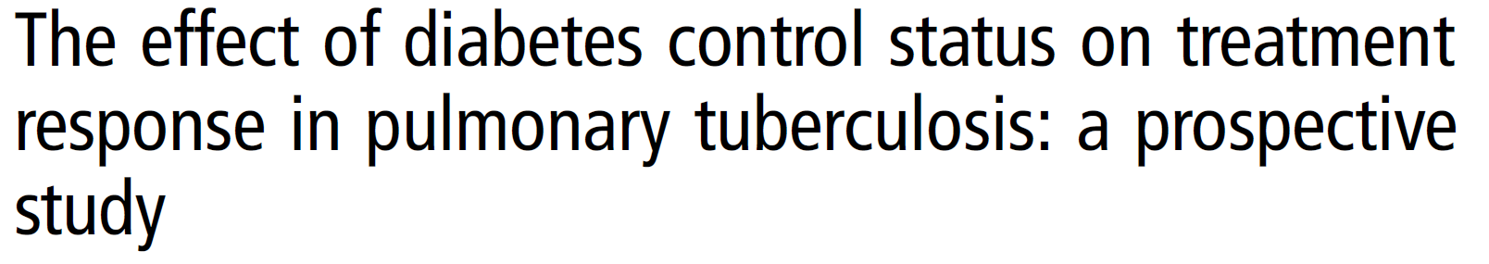
South Korea, prospective, 661 pulmonary TB patients
DM, 23.8%
DM → Controlled versus Uncontrolled – HbA1C 7.0%
Thorax 2017;72:263–270

Slide 59
 | Non-DM | Controlled-DM | Uncontrolled-DM | P-value
Treatment success | 89.2% | 87.5% | 79.6% | 0.057
Treatment failure | 0.7% | 2.5% | 5.4% | 0.003
Death | 0.4% | 0% | 4.3% | 0.003
Thorax 2017;72:263–270

Slide 60
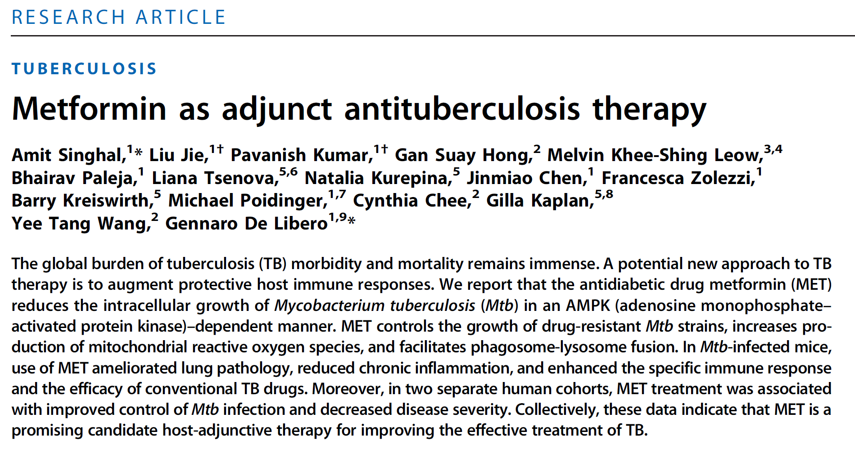
Sci Transl Med 2014;6:263ra159

Slide 61
Methods
Retrospective cohort study
patients
  aged ≥13 years
  undergoing treatment for culture-confirmed, drug-susceptible pul TB
  National Taiwan University Hospital, 2000 ~ 2013
the effect of DM on
  mortality during TB treatment
  2-months TB sputum-culture conversion
the effect of metformin use on survival during TB treatment

Slide 62
Results

Slide 63
Retrospective cohort study
2416
(+) 699 (634)
(+) 216
(-) 418
(-) 1717
Total No.
DM
Metformin
Mortality
2 mo culture +
Mortality

Slide 64
Adjusted Odds Ratios, Based on Logistic Regression Model, of Mortality During Tb Treatment (N = 2416)

Slide 65
Adjusted Odds Ratios, Based on a Logistic Regression Model, of 2-Mo Sputum Culture Positivity for M.Tbc (n = 1323)

Slide 66
Adjusted Hazard Ratios, Based on Cox Proportional Hazards Model, of Survival Among Diabetic Patients During Tbc Treatment (n = 634)

Slide 67
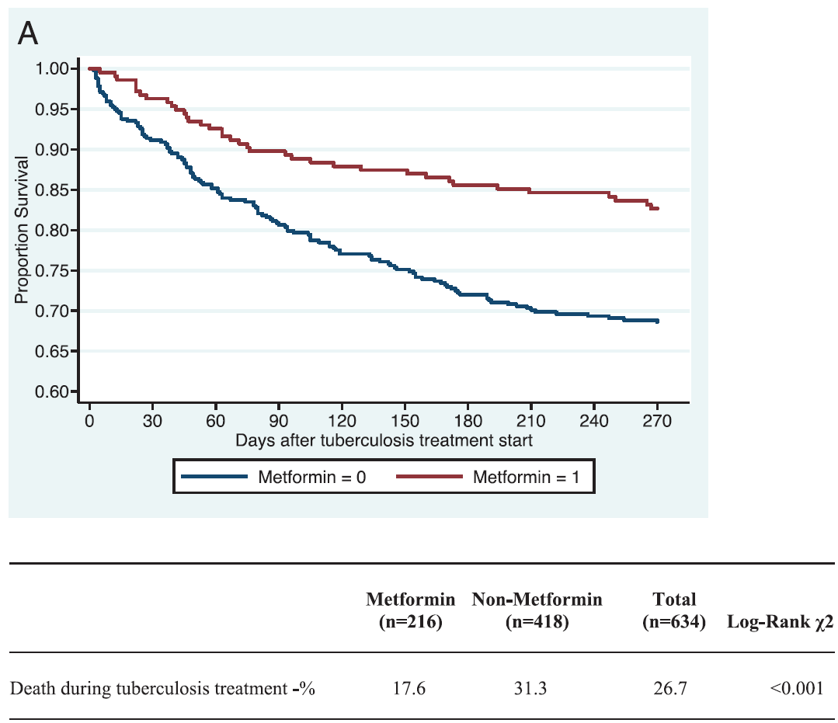
Notes:
Figure 1. Kaplan-Meier estimates of time to mortality among diabetic patients during tuberculosis treatment according to metformin use (n = 634). Patients with chronic kidney disease stage 3b or higher were excluded due to concerns for confounding.
A, Intention-to-treat analysis. If a person was on metformin within 30 days of starting tuberculosis treatment, they were classified as using metformin throughout tuberculosis treatment.
B, Documented metformin use for 80% of tuberculosis treatment. Only those patients with prescription data showing metformin use during equal to or more than 80% of tuberculosis treatment were classified as metformin users.

Slide 68
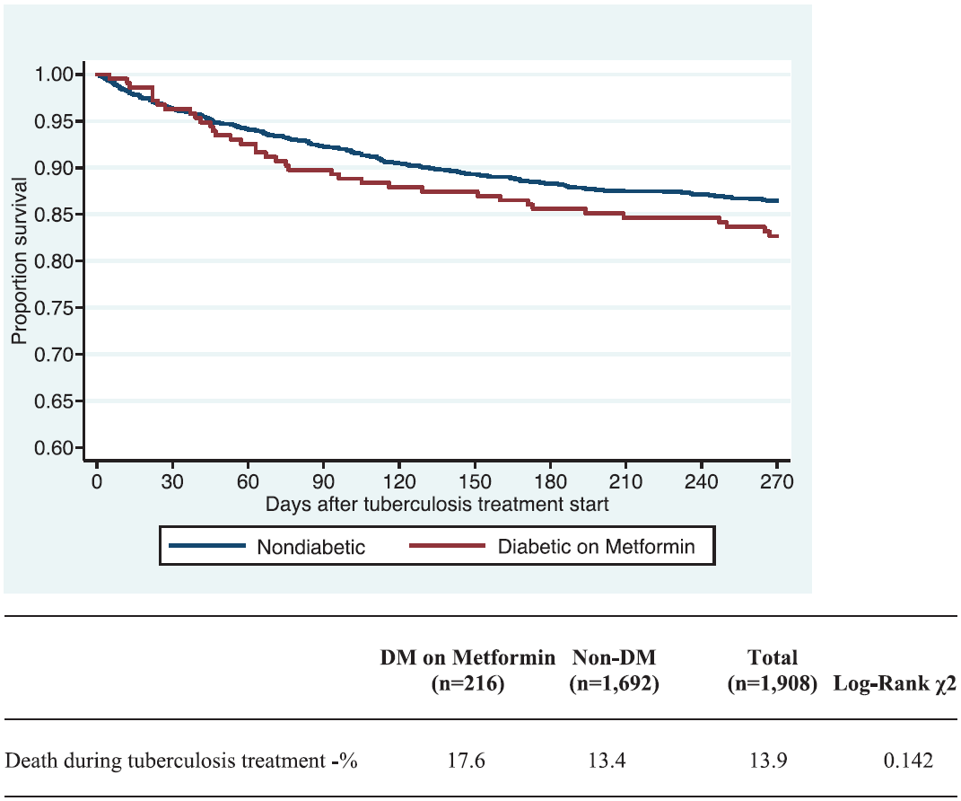

Slide 69
Conclusions
DM
  increased mortality during TB treatment
  delays sputum culture conversion (2 months)
Concurrent metformin use
  greatly decreased the odds of mortality during TB treatment
  potential role as an adjunctive, host-directed therapy (HDT) for TB
Notes:
This study suggests that despite multiple potential confounding variables, DM poses an increased risk of adverse TB treatment outcomes.
There was a significant association between metformin use and decreased mortality during TB treatment, suggesting a potential role for this agent as adjunctive, host-directed therapy

Slide 70
Host-directed therapy (adjunct therapy)
Three main approaches
  amplification of host immunity
  modulation of inflammation to reduce lung tissue destruction
  killing or containment of M.Tbc
Effects
  hasten elimination of M.Tb infection
  shorten the duration of treatment
  reduce excessive inflammation, minimise permanent lung damage
  prevent new drug resistance
Lancet Infect Dis 2018;18: e183–98

Slide 71
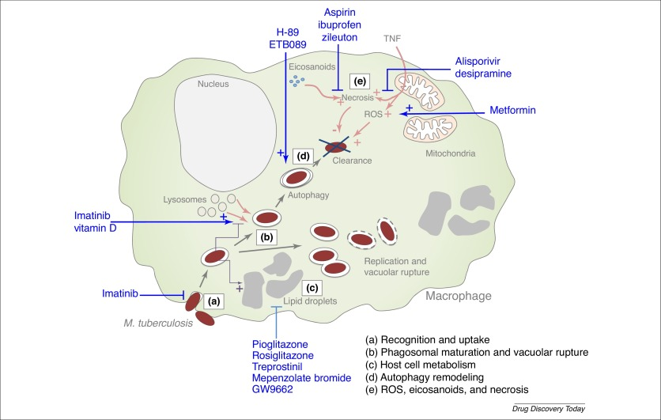
DDT 2017;22(8):1250-57
Notes:
Figure 2. Intracellular traffic of Mycobacterium tuberculosis and examples of drugs suggested as host-directed therapies (HDTs). A large panel of receptors is known to be implicated in the recognition and the uptake of the bacteria (a). Inside macrophages, M. tuberculosis resides in the phagosome and modulates mechanisms of the host cell to inhibit phagosome maturation (inhibition of lysosomal function and acidification of the vacuole) (b). Furthermore, this pathogen is able to polarize and modulate host cell metabolism (e.g., the production of lipid bodies) (c). The bacteria also induce phagosomal disruption to favor their replication. However, many effector mechanisms have been described to restrict mycobacteria multiplication, such as autophagy (d) or the production of reactive oxygen species (ROS) (e). The figure indicates several drugs (shown in blue) known to modulate host cell defense to result in M. tuberculosis elimination.

Slide 72
N Engl J Med 2018;379:823-33.

Slide 73
Background
Relapse of drug-susceptible Tbc after treatment
  6 months of first-line therapy : 5%
  4 months of short-course therapy : 20%
Analyzing pretreatment isolates of M.TB
could determine any correlations between
  the minimum inhibitory concentration (MIC) of a drug below the standard resistance breakpoint (INH 0.1μg/ml, RIF 1.0 0.1μg/ml)
  the relapse risk after treatment
Notes:
Approximately 5% of patients with drug-susceptible tuberculosis have a relapse after 6 months of first-line therapy, as do approximately 20% of patients after 4 months of short-course therapy. We postulated that by analyzing pretreatment isolates of Mycobacterium tuberculosis obtained from patients who subsequently had a relapse or were cured, we could determine any correlations between the minimum inhibitory concentration (MIC) of a drug below the standard resistance breakpoint and the relapse risk after treatment.

Slide 74
Methods
Using data from the Tuberculosis Trials Consortium Study 22 (development cohort), we assessed relapse and cure isolates to determine the MIC values of isoniazid and rifampin that were below the standard resistance breakpoint (0.1 μg per milliliter for isoniazid and 1.0 μg per milliliter for rifampin).
We combined this analysis with clinical, radiologic, and laboratory data to generate predictive relapse models, which we validated by analyzing data from the DMID 01-009 study (validation cohort)
Notes:
Using data from the Tuberculosis Trials Consortium Study 22 (development cohort),
we assessed relapse and cure isolates to determine the MIC values of isoniazid and
rifampin that were below the standard resistance breakpoint (0.1 μg per milliliter for
isoniazid and 1.0 μg per milliliter for rifampin). We combined this analysis with
clinical, radiologic, and laboratory data to generate predictive relapse models, which
we validated by analyzing data from the DMID 01-009 study (validation cohort).

Slide 75
Italian Journal of Medicine 2016; 10:794

Slide 76
RIF, standard resistant breakpoints : 1.0 μg/ml
Susceptible
SRB
0.016
0.003
0.063
0.125
0.25
0.5
1
MIC
MIC

Slide 77
Results

Slide 78
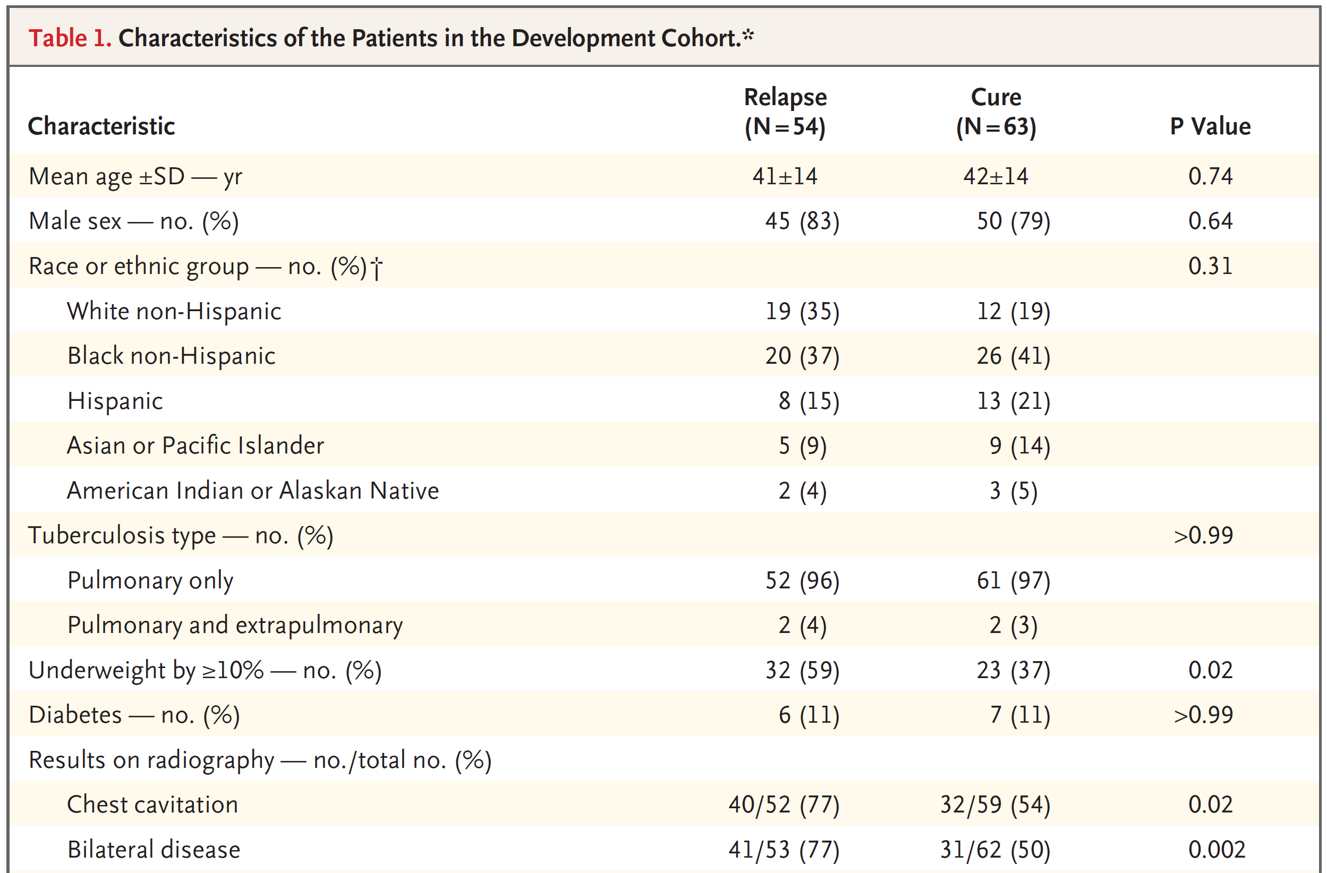

Slide 80
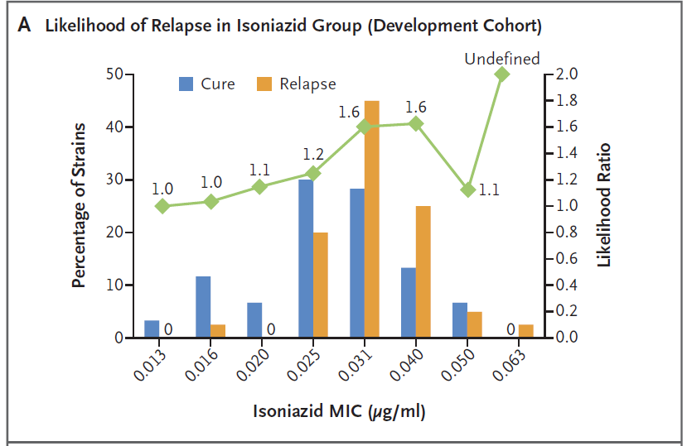
Notes:
In the development cohort, the mean (±SD) MIC of isoniazid below the breakpoint was
0.0334±0.0085 μg per milliliter in the relapse group and 0.0286±0.0092 μg per milliliter
in the cure group, which represented a higher value in the relapse group by a factor
of 1.17 (P = 0.02). The corresponding MIC values of rifampin were 0.0695±0.0276 and
0.0453±0.0223 μg per milliliter, respectively, which represented a higher value in the relapse
group by a factor of 1.53 (P<0.001). Higher MIC values remained associated with
relapse in a multivariable analysis that included other significant between-group differences.
In an analysis of receiver-operating-characteristic curves of relapse based on these
MIC values, the area under the curve (AUC) was 0.779. In the development cohort, the
AUC in a multivariable model that included MIC values was 0.875. In the validation cohort,
the MIC values either alone or combined with other patient characteristics were also
predictive of relapse, with AUC values of 0.964 and 0.929, respectively. The use of a
model score for the MIC values of isoniazid and rifampin to achieve 75.0% sensitivity in
cross-validation analysis predicted relapse with a specificity of 76.5% in the development
cohort and a sensitivity of 70.0% and a specificity of 100% in the validation cohort.

Slide 81
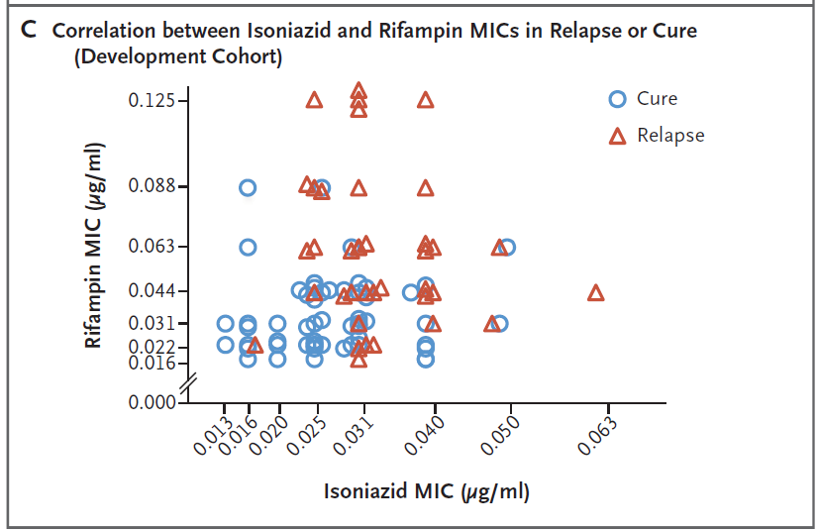

Slide 82
mean (±SD) MIC of I below the breakpoint
  0.0334±0.0085 μg/ml in the relapse group
  0.0286±0.0092 μg/ml in the cure group
  -> higher value in the relapse group by a factor of 1.17 (P = 0.02)
mean (±SD) MIC values of R
  0.0695±0.0276 μg/ml in the relapse group
  0.0453±0.0223 μg/ml in the cure group
  -> higher value in the relapse group by a factor of 1.53 (P<0.001).

Slide 83
MIC Only Model:
  ScoreMIC = -4.5713 + 32.0908 × MIC_{RIF} + 75.8572 × MIC_{INH}
Full Model:
  ScoreFull = -7.5237 + 35.8719 × MIC_{RIF} + 97.3619 × MIC_{INH} +1.3826 × I_{≥10% Underweight} + 0.9962 × I_{CXR Cavitations} + 0.0878 × I_{Rifapentine} + 1.9246 × I_{Positive 8-week Mtb Culture}

Slide 84
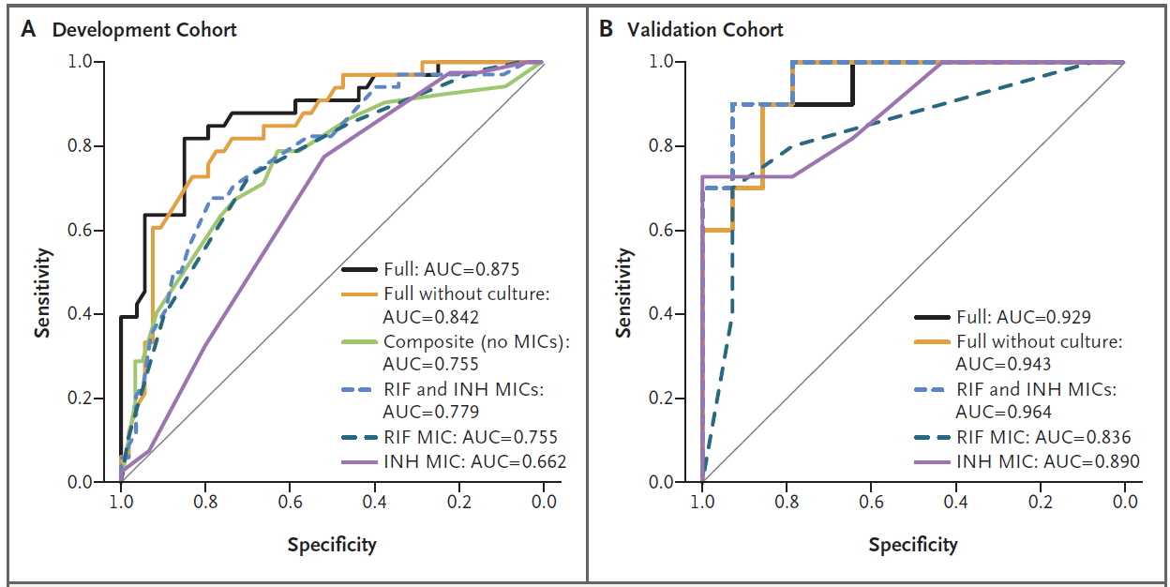

Slide 85
Conclusion
In pretreatment isolates of M.Tb with decrements of MIC values of I or R below breakpoints (SRB)
  higher MIC values were associated with a greater risk of relapse than lower MIC values
These findings were confirmed in a validation cohort

Slide 86
Lancet 2018; 392: 821–34

Slide 87
Background
Treatment outcomes for MDR-Tbc remain poor
  55% treatment success, 2015
To estimate
  association of treatment success and death with the use of individual drugs
  optimal number and duration of treatment with those drugs

Slide 88
Methods
individual patient data meta-analysis
MEDLINE, Embase, and the Cochrane Library, eligible observational and experimental studies published between Jan 1, 2009, and April 30, 2016
Eligible studies
  report original results, with end of treatment outcomes (treatment completion [success], failure, or relapse) in cohorts
  at least 25 adults (aged >18 years)
  bacteriologically confirmed pulmonary MDR tuberculosis

Slide 89
Anonymised individual patient data
  clinical characteristics, Treatment, outcomes
propensity score-matched generalised mixed effects logistic, or linear regression
adjusted odds ratios & adjusted risk differences for success or death during treatment
  specific drugs currently used to treat MDR Tb
  the number of drugs used
  treatment duration

Slide 90
Results

Slide 94
Treatment success (vs failure or relapse)
Drug | Adjusted risk difference, 95% CI
levofloxacin | 0·15, 0·13 to 0·18
moxifloxacin | 0·11, 0·08 to 0·14
bedaquiline | 0·10, 0·05 to 0·14
linezolid | 0·15, 0·11 to 0·18
clofazimine | 0·06, 0·01 to 0·10
carbapenems | 0·14, 0·06 to 0·21
Notes:
positively associated with the use of
linezolid (adjusted risk difference 0·15, 95% CI 0·11 to 0·18)
levofloxacin (0·15, 0·13 to 0·18)
carbapenems (0·14, 0·06 to 0·21)
moxifloxacin (0·11, 0·08 to 0·14)
bedaquiline (0·10, 0·05 to 0·14)
clofazimine (0·06, 0·01 to 0·10).

Slide 95
Mortality
Drug | Adjusted risk difference, 95% CI
levofloxacin | –0·06, –0·09 to –0·04
moxifloxacin | –0·07, –0·10 to –0·04
bedaquiline | –0·14, –0·19 to –0·10
linezolid | –0·20, –0·23 to –0·16
Notes:
significant association between reduced mortality and use of
linezolid (–0·20, –0·23 to –0·16)
Levofloxacin (–0·06, –0·09 to –0·04)
moxifloxacin (–0·07, –0·10 to –0·04)
bedaquiline (–0·14, –0·19 to –0·10)

Slide 96
Drug | Adjusted risk difference, 95% CI
Etambutol success death | -0.01, -0.03 to 0.01 0.00, -0.02 to 0.02
Pyrazinamide success death | -0.03, -0.04 to -0.01 -0.03, -0.05 to -0.01

Slide 97
Drug | Adjusted risk difference, 95% CI
Ethionamide or prothionamide success death | -0.02, -0.04 to -0.01 -0.00, -0.02 to 0.01
Cycloserine or terizidone success death | 0.05, 0.03 to 0.06 -0.09, -0.01 to -0.07
Para-aminosalicylic acid success death | -0.01, -0.03 to 0.01 0.02, 0.00 to 0.04

Slide 98
Drug | Adjusted risk difference, 95% CI
Amikacin success death | 0.06, 0.04 to 0.08 -0.00, -0.03 to 0.02
Steptomycin success death | 0.02, -0.00 to 0.04 -0.02, -0.04 to 0.01
Kanamycin success death | -0.07, -0.08 to -0.05 0.01, -0.01 to 0.02
Capreomycin success death | -0.03, -0.06 to 0.00 0.04, 0.01 to 0.07

Slide 102
Conclusion
Significantly better treatment outcomes for Tx of MDR-Tb
  Linezolid
  Later generation fluoroquinolones
  Bedaquiline
  Clofazimine
  Carbapenems

Slide 103
WHO/CDS/TB/2019.3

Slide 104
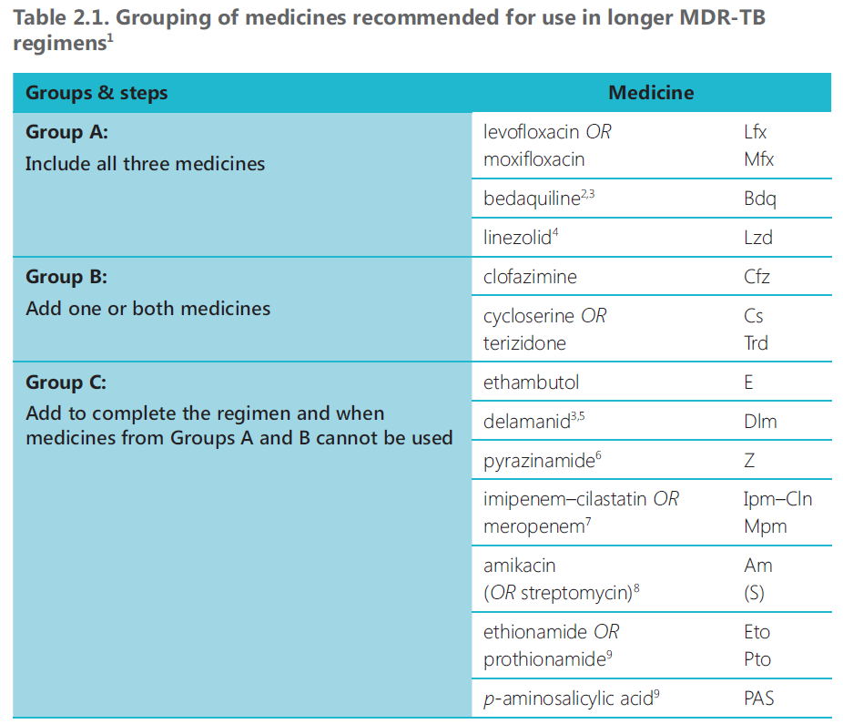

Slide 105
Longer MDR-TB regimen
All three Group A agents and at least one Group B agent should be included to ensure that treatment starts with at least four TB agents likely to be effective
at least three agents are included for the rest of the treatment after bedaquiline is stopped.
If only one or two Group A agents are used, both Group B agents are to be included.
If the regimen cannot be composed with agents from Groups A and B alone, Group C agents are added to complete it.
Total treatment duration of 18–20 months is suggested for most patients

Slide 106
감사합니다.

