Slide 1
New Trends and Practices in Early Stage Lung Cancer Treatment
An Overview of Advancements in Detection and Therapy - 2025
Dong-A university college of medicine
Insu Kim

Slide 2
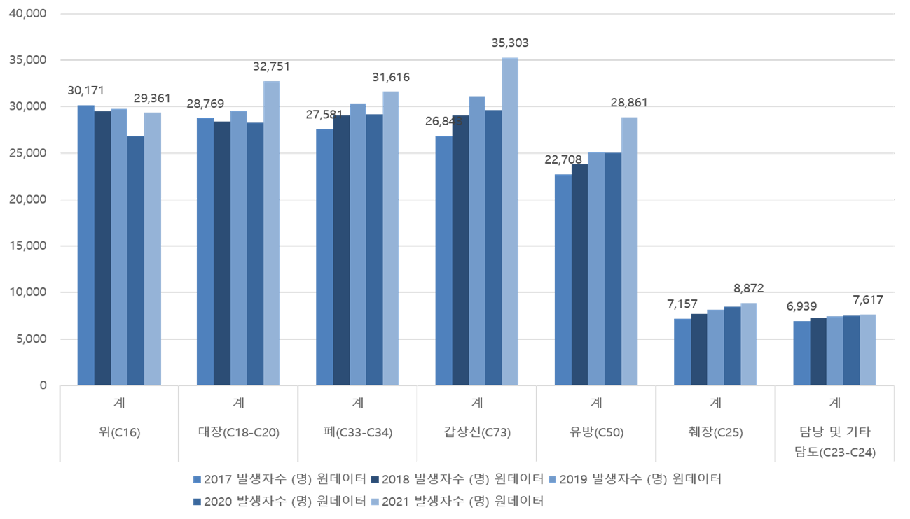
Introduction
Annual report of cancer statistics in Korea in 2021.; National cancer information center

Slide 3
Introduction
What is the definition of early lung cancer?
  Stages I to II, primarily based on the pathological TNM classification.
  The goal of treatment is curative.
Lung Cancer. 2004 Sep;45(3):267-77.
Notes:
Stage IA–IB는 수술 단독으로 완치가 가능한 가장 이상적인 조기암입니다.Stage II는 수술 후 **보조 항암치료(adjuvant chemotherapy)**가 필요한 경우가 많지만, 여전히 치료 가능성 높은 조기암으로 분류됩니다.최근에는 Stage I 중에서도 IA1–IA3로 세분화되어, 영상검사/광범위 폐절제/수술 방법 선택에 큰 영향을 줍니다.

Slide 4
Introduction
Early stage non-small cell lung cancer (NSCLC) accounts for approximately 40−60% of all NSCLC stages.^{1,2}
  Stage I: 25.6%
  Stage II: 9.5%
  Stage III: 22.9%
  Stage IV: 42.0%
Tuberc Respir Dis (Seoul) 2021;84:89-95.
Tuberc Respir Dis (Seoul) 2019; 82(2): 118–125.

Slide 5
Introduction
Earlier diagnosis leads to a survival gain of 33% and 60% for regional and local cancer stages.
  5-year relative survival rate (2013-2017)
    Localized cancer: 69.0%
    Regional cancer: 39.3%
    Distant cancer: 7.7%
Surgery is the primary treatment option for patients with early stage lung cancer.
Tuberc Respir Dis (Seoul) 2021;84:89-95.

Slide 6
Surgical treatment

Slide 7
Background
Purpose of surgery
  Surgery for lung cancer is performed with curative intent in patients with early-stage disease (NSCLC Stages I-II and some IIIA).
  Surgery is also performed to confirm the pathologic diagnosis and stage.
NCCN Guidelines Version 3.2025

Slide 8
Background
Indications
  The patient's general condition is adequate for surgery under general anesthesia.
  Lung resection is possible based on pulmonary function tests.
  The patient wants surgery.
BMC Cancer. 2020 Feb 10;20(1):109.

Slide 9
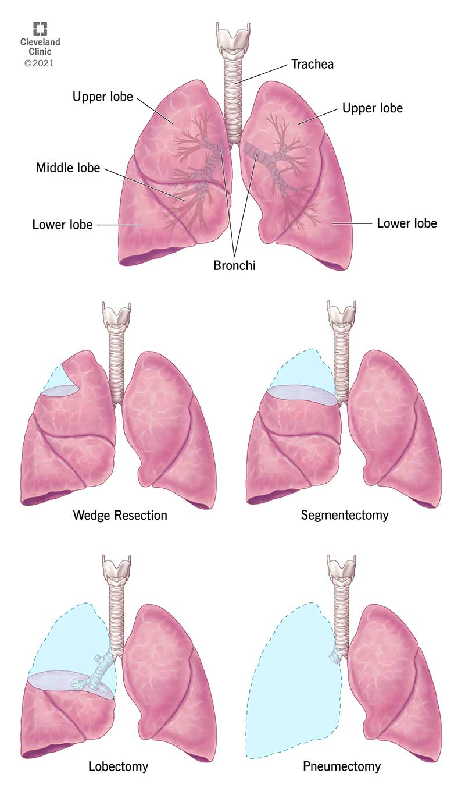
Anatomy
Rt.
Lt.
https://utpaqp.edu.pe/post/lung-resection-surgery-procedure-details-and-recovery-an-t-m/lung-removal-surgery

Slide 10
Methods
Pneumonectomy
https://utpaqp.edu.pe/post/lung-resection-surgery-procedure-details-and-recovery-an-t-m/lung-removal-surgery

Slide 11
Methods
Lobectomy
https://utpaqp.edu.pe/post/lung-resection-surgery-procedure-details-and-recovery-an-t-m/lung-removal-surgery

Slide 12
Methods
Segmentectomy
https://utpaqp.edu.pe/post/lung-resection-surgery-procedure-details-and-recovery-an-t-m/lung-removal-surgery

Slide 13
Methods
Wedge resection
https://utpaqp.edu.pe/post/lung-resection-surgery-procedure-details-and-recovery-an-t-m/lung-removal-surgery

Slide 14
Methods
Conversion OP
https://utpaqp.edu.pe/post/lung-resection-surgery-procedure-details-and-recovery-an-t-m/lung-removal-surgery

Slide 15
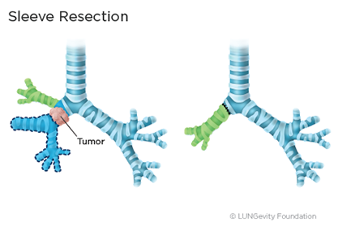
Methods
Sleeve resection
https://www.lungevity.org/for-patients-caregivers/navigating-your-diagnosis/treatment-options/surgery

Slide 16
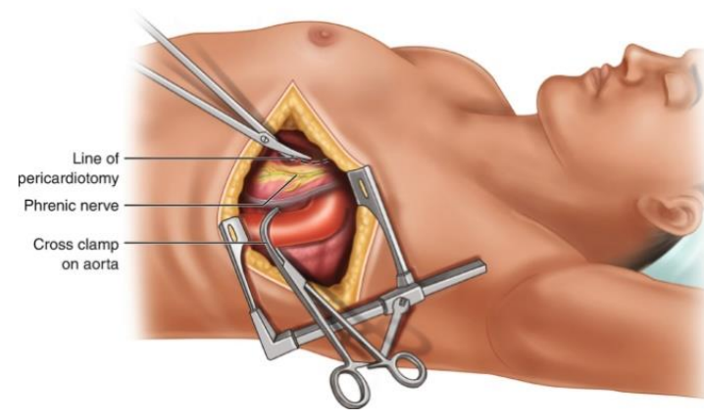
Surgical Approaches
Open Thoracotomy
Annals of Surgery 177(6):p 798-805

Slide 17
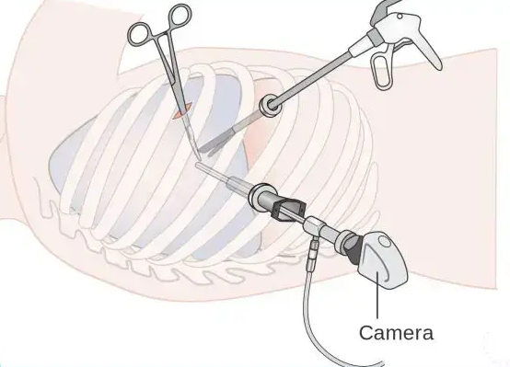
Surgical Approaches
VATS
https://bi-maristan.com/en/thoracic/lung-cancer/vats-lobectomy-3/

Slide 18
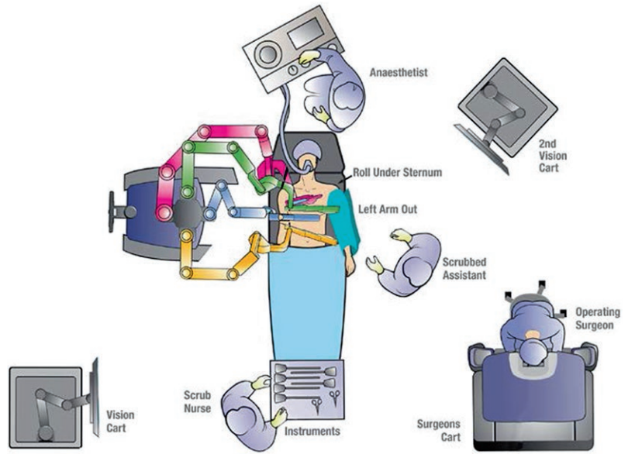
Surgical Approaches
RATS
Surgical I. About Intuitive USA 2019. https://www.intuitive.com/en/about-us/company

Slide 19
Surgical Approaches
Aspect | Open Thoracotomy | VATS | RATS
Incision | Large rib-spreading | Small ports | Small ports, robotic arms
Visualization | Direct | 2D/HD | 3D-HD with magnification
Dexterity | Limited | Moderate | High
Pain | High | Low | Minimal
Hospital Stay | 5–10 days | 3–5 days | 2–4 days
Recovery | Long | Faster | Fastest
Complications | Higher | Lower | Lowest
Lymph Node Dissection | High | Comparable | Superior (some studies)
Operative Time | Short | Moderate | Longer (setup time)
Learning Curve | Low | Moderate | High

Slide 20
Radiotherapy

Slide 21
Background
Radiotherapy is a key treatment option for early-stage NSCLC (Stage I–II).
Particularly useful in medically inoperable patients or those refusing surgery.
SBRT is now the standard of care for many early-stage cases.

Slide 22
Background
Indications
  Medically inoperable Stage I–II NSCLC.
  Patients refusing surgery.
  Small peripheral tumors.
  Oligometastatic lesions and recurrence.

Slide 23
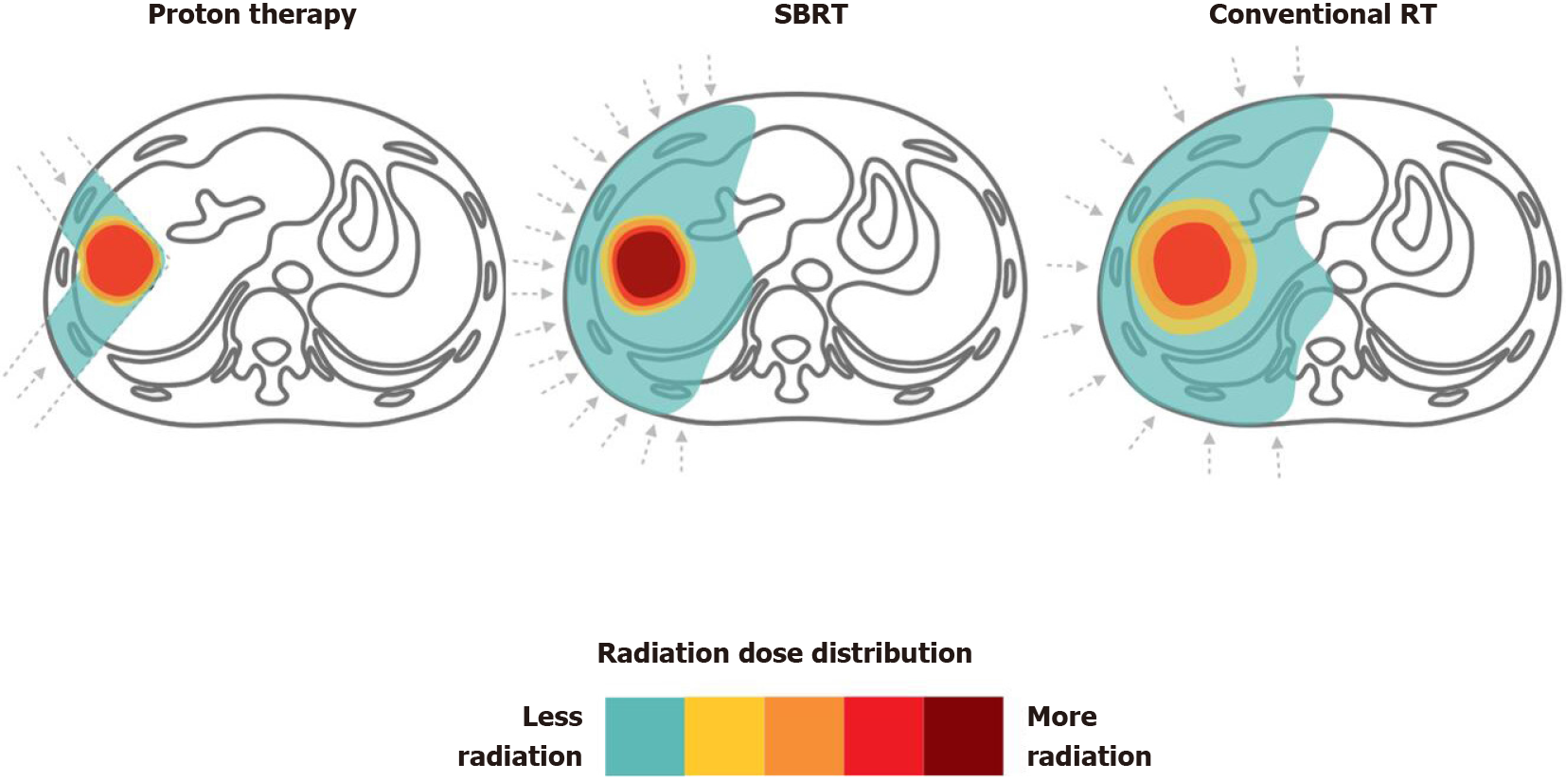
Types of Radiotherapy
World J Gastroenterol. May 28, 2021; 27(20): 2434-2457

Slide 24
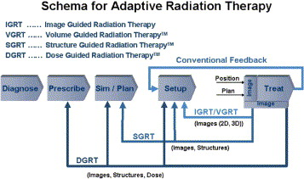
Types of Radiotherapy
Med Dosim. 2006 Spring;31(1):12-9.

Slide 25
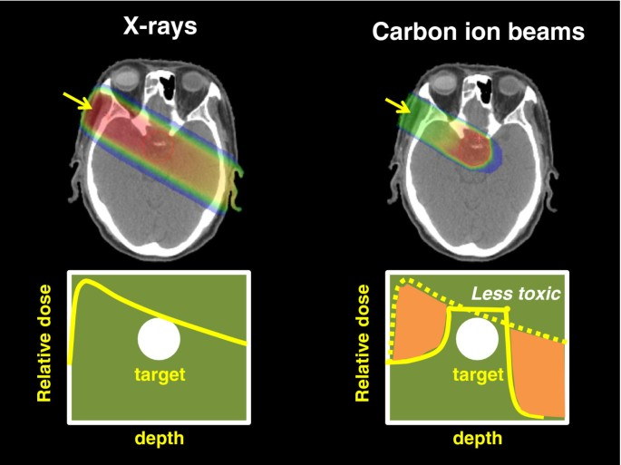
Types of Radiotherapy
EPMA J. 2013 Mar 4;4(1):9.

Slide 26
Types of Radiotherapy
Comparison Parameter | SBRT (X-ray) | Proton Therapy | Carbon Ion Therapy (CIRT)
Precision / Dose Distribution | Good; some dose spill to normal tissue | Very precise (Bragg peak) | Extremely precise (Bragg peak + heavier particles)
Biological Effectiveness (RBE) | Low (~1.1) | Low (~1.1) | High (2–3)
Local Control Rate (Stage I NSCLC) | 85–95% | 90–95% | >95%
Normal Tissue Sparing | Moderate | High | Excellent
Suitability for Re-irradiation | Limited | Better than SBRT | Highly suitable
Cost and Infrastructure | Relatively low cost; standard LINAC | High cost; proton center required | Very high cost; complex accelerator needed
Availability | Widely available | Limited (major cancer centers only) | Very limited (Japan, Germany, few centers)
Clinical Data and Evidence | Well established with large clinical evidence | Growing data; promising results in early NSCLC | Promising but limited long-term data
Lancet Oncol. 2015 Feb;16(2):e93-e100.

Slide 27
Clinical Outcomes
• Local Control:
  - SBRT: 85–95%
  - Surgery: >95%
• 5-Year Overall Survival:
  - SBRT: 40–60% (in inoperable patients)
  - Surgery: 60–80%
Lancet Oncol. 2015 Jun;16(6):630-7.

Slide 28
Complications
• RTx. is generally well tolerated.
• Common toxicities
  : Fatigue, chest wall pain, mild pneumonitis.
• Rare but serious complications
  : Rib fractures, bronchial stenosis (central tumors).
• Lower complication burden compared to thoracic surgery.
Lancet Oncol. 2015 Jun;16(6):630-7.

Slide 29
Medical therapy

Slide 30
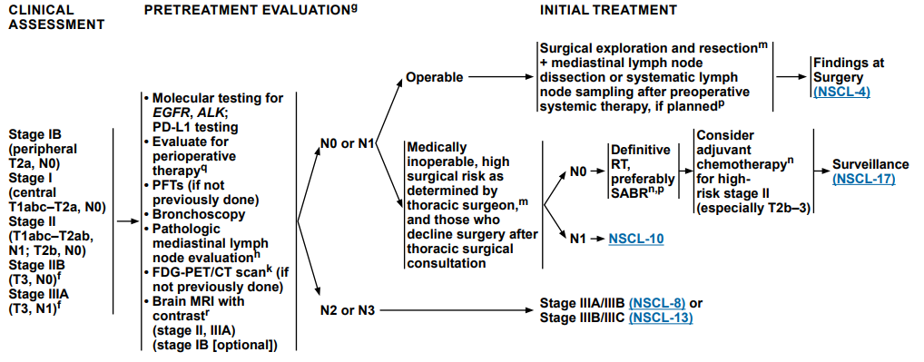
Targeted Therapy and Immunotherapy
NCCN Guidelines Version 3.2025

Slide 31
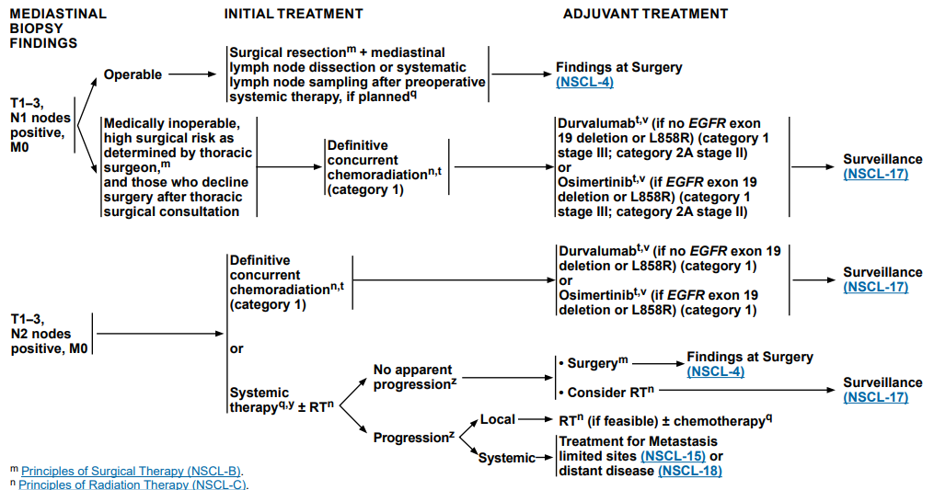
Targeted Therapy and Immunotherapy
NCCN Guidelines Version 3.2025

Slide 32
Immunotherapy
Perioperative setting
  Neo-adjuvant
    Nivolumab + chemotherapy vs. chemotherapy alone
    pCR: 24% vs. 2.2%
    MPR: 36.9% vs. 8.9%
    Median event-free survival: 31.6 vs. 20.8 months
  Adjuvant
    Atezolizumab vs. best supportive care
    Improved DFS, especially in PD-L1 ≥1% tumors
    Ongoing OS data

Slide 33
Immunotherapy
Immunotherapy is not currently a standalone definitive therapy in early-stage lung cancer.
Not replacing surgery or SBRT as the definitive treatment.

Slide 34
Targeted Therapy
Targeted therapy is not considered a standalone definitive therapy in early-stage lung cancer.
Typically after surgical resection, as adjuvant therapy (post-surgery) to reduce the risk of recurrence.
Not as a replacement for surgery or radiotherapy.

Slide 35
Conclusions

Slide 36
Surgery vs Definitive Radiotherapy (SBRT)
Aspect | Surgery | Definitive Radiotherapy (SBRT)
Indication | Medically operable patients | Medically inoperable or high-risk patients
Treatment Modality | Lobectomy or segmentectomy | High-dose stereotactic body radiotherapy
Survival Outcome | 5-yr OS ~60–80% | 5-yr OS ~50–70% (stage I)
Local Control | Excellent (~90%) | Excellent (~85–90%)
Recurrence Pattern | Mostly distant recurrence | Mostly local/distant
Adverse Effects | Surgical risks (bleeding, infection) | Radiation pneumonitis, rib fracture
Hospital Stay | Usually 3–7 days | Outpatient or 1–2 visits
Recovery Time | Weeks to months | Minimal downtime
Quality of Life | May be affected short-term | Generally well tolerated
Suitability for Elderly | Limited by comorbidities | Preferred option in frail/elderly
Lancet Oncol. 2015 Jun;16(6):630-7.

Slide 37
Conclusion
Early lung cancer treatment is evolving rapidly with technological and therapeutic advancements.
Emphasis on personalized and minimally invasive approaches.
Future directions include broader adoption of AI, molecular diagnostics, and precision medicine.

Slide 38
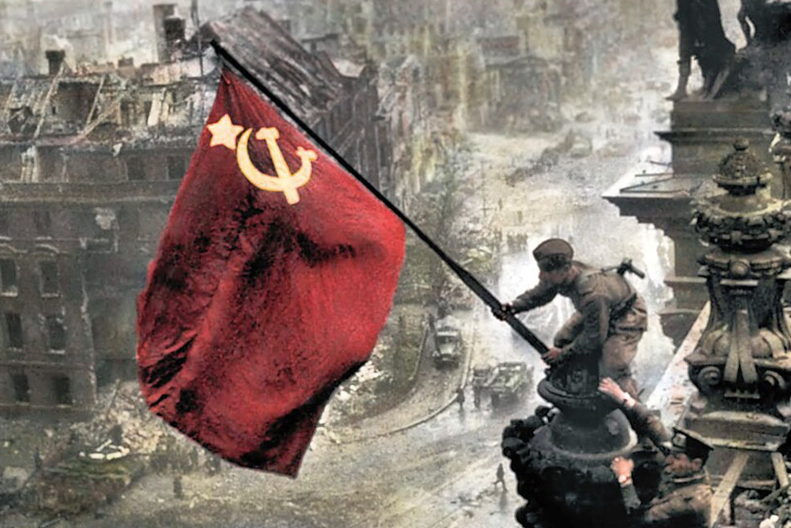
Conclusion

Slide 39
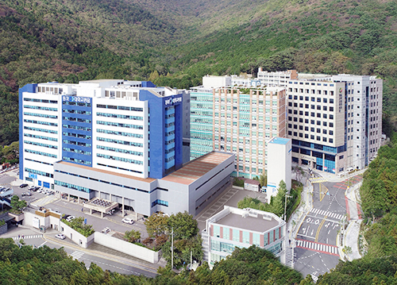
감사합니다.

