Slide 1
Latest update on early stage resectable NSCLC
영 남 의 대
안 준 홍

Slide 2
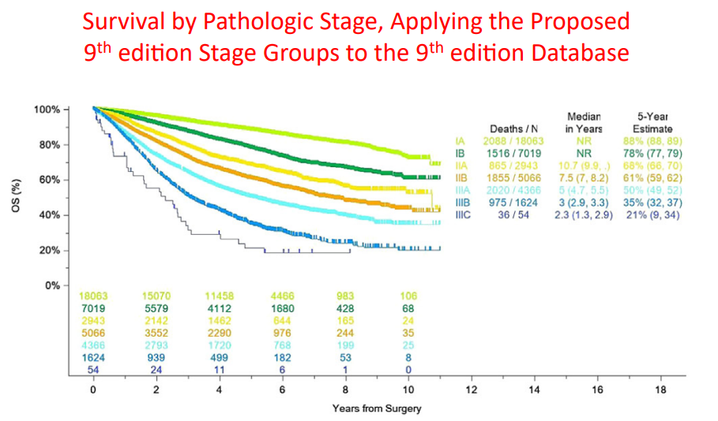
Unmet need in eNSCLC
J Thorac Oncol. 2024 Mar 4:S1556-0864(24)
Notes:
J Thorac Oncol. 2024 Mar 4:S1556-0864(24)

Slide 3
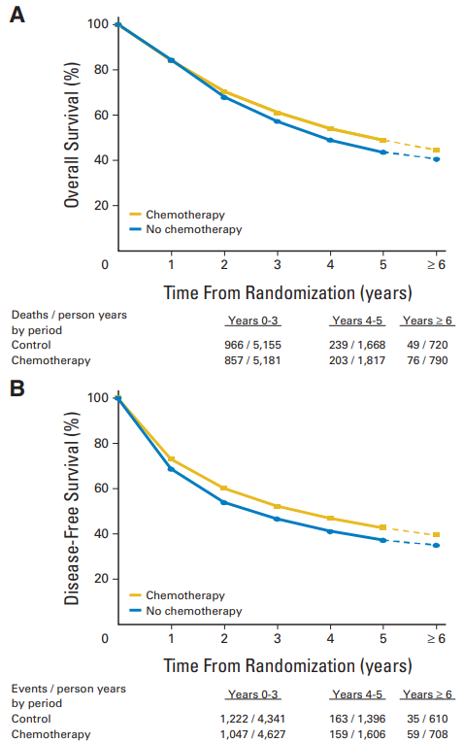
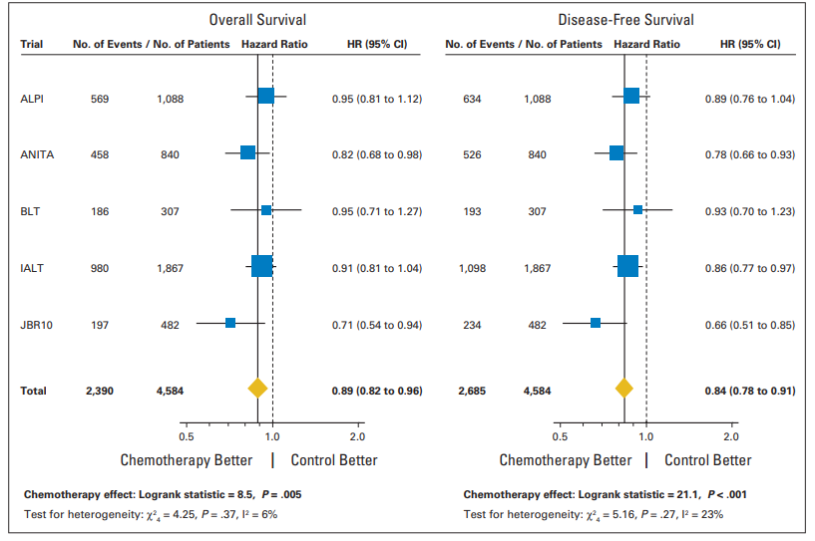
Adjuvant chemotherapy in NSCLC
OS
HR 0.89, p=0.005 5-year absolute benefit of 5.4% from chemotherapy
DFS
J Clin Oncol 26:3552-3559
Notes:
J Clin Oncol 26:3552-3559

Slide 4
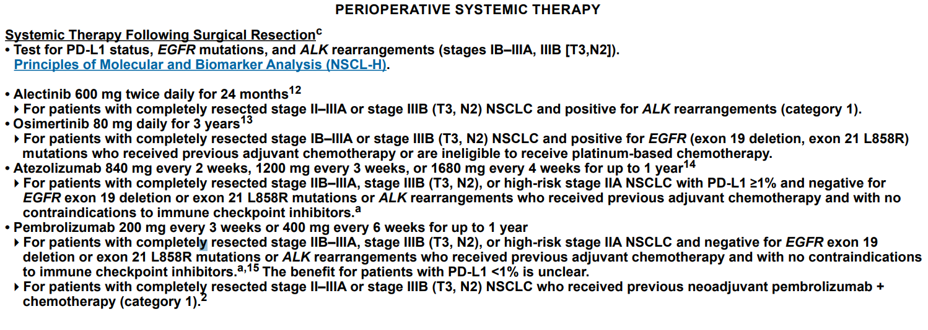
NCCN guideline (2024, v5)
Version 5.2024, 04/23/24 © 2024 National Comprehensive Cancer Network® (NCCN®)

Slide 5
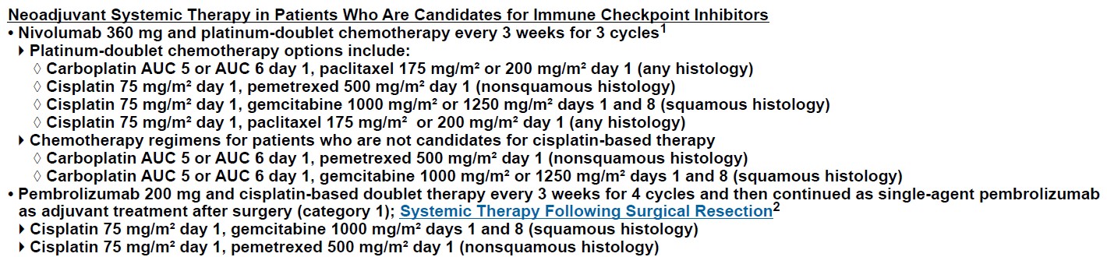
NCCN guideline (2024, v5)

Slide 6
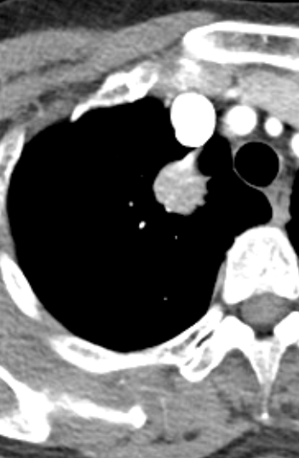
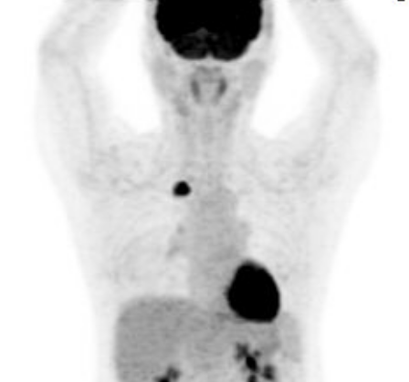
early of 60s/F, ADC, RUL, cT1bN0M0, 1A2, EGFR (WT)
Notes:
26066472 이옥자

Slide 7

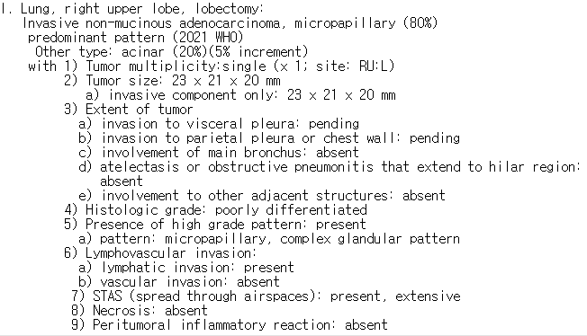
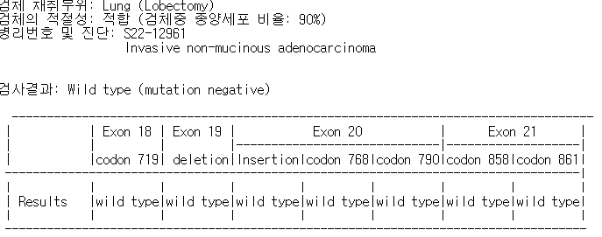

early of 60/F, ADC, RUL, pT1cN2a2M0, IIIA, EGFR (WT)

Slide 8
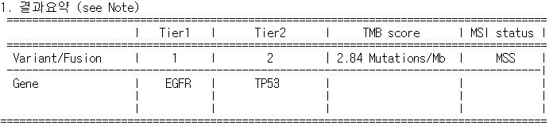
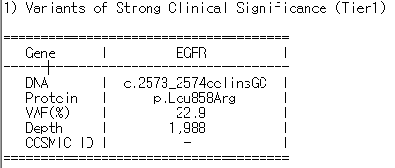
early of 60s/F, ADC, RUL, pT1cN2a2M0, IIIA, EGFR (21L858R)
-adj pem/cis #4 & NGS
early of 60s/F, ADC, RUL, cT1cN2a2M0, IIIA, EGFR (21L858R)
-adj pem/cis #4 & NGS & adj. osimertinib (202212)

Slide 9
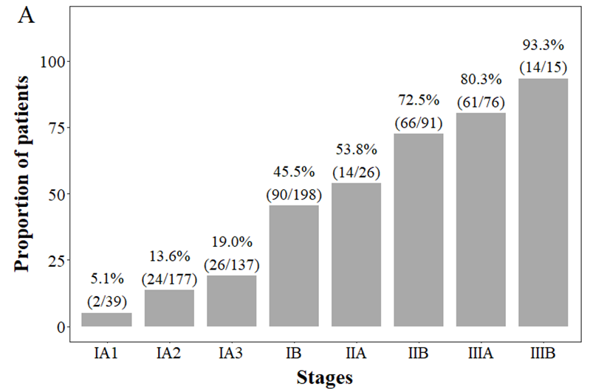
Recurrence rate in EGFRm NSCLC (n=759)
Unpublished data
Notes:
Unpublished data

Slide 10
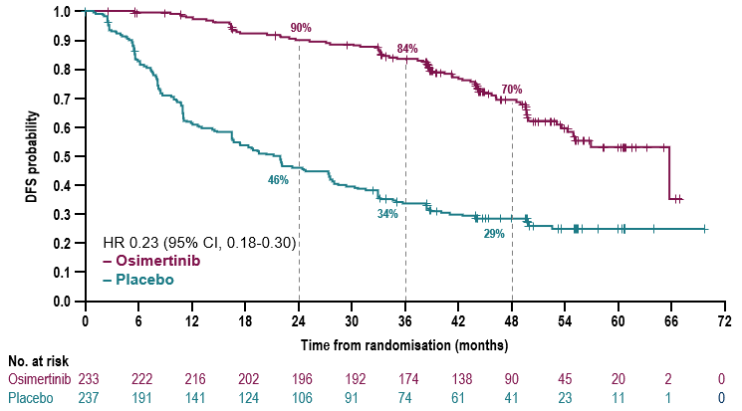
ADAURA: DFS in Patients With Stage II/IIIAª Disease (Primary Endpoint)
Median follow-up: osimertinib 44.2 months (0-67), placebo: 19.6 months (0-70)
Treatment arms | mDFS, months (95% CI)
Osimertinib (n=233) | 65.8 (54.4-NC)
Placebo (n=237) | 21.9 (16.6-27.5)
Maturity^{b} 51%:
Osimertinib 32%, Placebo 70%
Data cut-off: April 11, 2022.
Note: DFS by investigator assessment; Tick marks indicate censored data.
ªAJCC 7th edition staging. ^{b}Planned maturity for DFS analysis: 50%
Herbst RS, Tsuboi M, John J, et al. J Clin Oncol on January 31,2023: DOI https://doi. org/10.1200/JCO.22.02186
Notes:
AJCC = American Joint Committee on Cancer; CI = confidence interval; DFS = disease-free survival; HR = hazard ratio; mDFS = median disease-free survival; NC = not calculable.
Reference:
Tsuboi M, Wu YL, Grohe C, et al. Osimertinib as adjuvant therapy in patients with resected EGFRm stage IB-IIIA NSCLC: updated results from ADAURA [presentation]. Presented at: European Society for Medical Oncology (ESMO) congress; September 9-13, 2022; Paris.

Slide 11
Overall survival: patients with stage IB / II / IIIA disease
Adjuvant osimertinib demonstrated a statistically and clinically significant improvement in OS vs placebo in the overall population of stage IBꟷIIIA disease
95%
93%
5-year OS rate, % (95% CI)
 | Osimertinib (n=339) |  | 88 (83, 91)
 | Placebo (n=343) |  | 78 (73, 82)
Overall OS HR (95.03% CI) |  | 0.49 (0.34, 0.70); p<0.0001 | 0.49 (0.33, 0.73); p=0.0004
Maturity: 18% osimertinib 12%, placebo 24%
Median follow-up for OS* (censored patients): osimertinib 61.5 months, placebo 61.5 months
1.0
88%
0.9
89%
0.8
84%
0.7
78%
0.6
Overall survival probability
0.5
0.4
0.3
0.2
0.1
0.0
0
6
12
18
24
30
36
42
48
54
60
66
72
78
84
90
Time from randomization (months)
No. at risk
Osimertinib
339
332
325
324
319
311
304
301
294
252
176
108
50
15
0
-
Placebo
343
338
332
326
314
304
290
281
267
223
164
97
44
17
3
0
  Data cut-off: January 27, 2023.
  Tick marks indicate censored data. Alpha allocation of 0.0497. *Median follow-up for OS (all patients): osimertinib 60.4 months, placebo 59.4 months.
  1.Tsuboi M, Herbst RS et al. N Engl J Med. 2023 Jun 4. doi: 10.1056/NEJMoa2304594
  CI, confidence interval; HR, hazard ratio; OS, overall survival

Slide 12
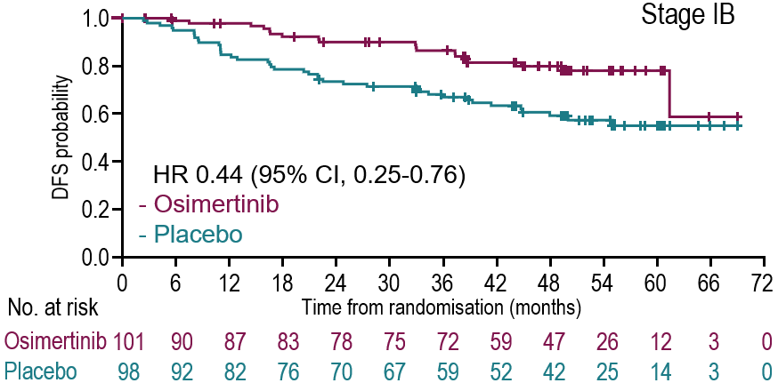
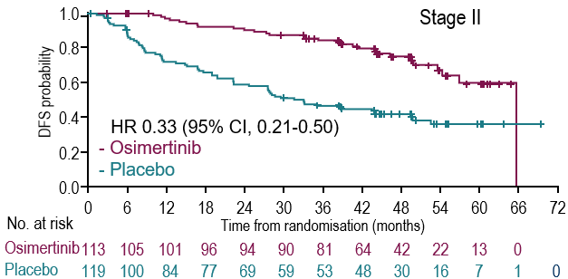
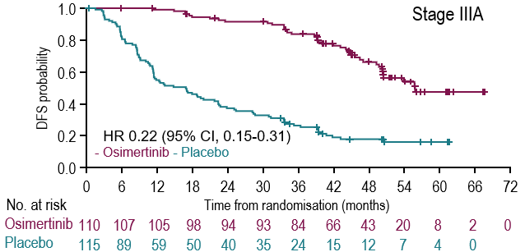

ADAURA: DFS by Stage (AJCC 8th Edition)
Treatment Arm | Stage IB | Stage II | Stage IIIA
4-year DFS rate, % (95% CI)
Osimertinib | 80 (69-87) | 75 (65-83) | 66 (55-75)
Placebo | 60 (49-69) | 43 (34-52) | 16 (10-24)
Overall HR (95% CI) | 0.44 (0.25-0.76) | 0.33 (0.21-0.50) | 0.22 (0.15-0.31)
Data cut-off: April 11, 2022.
ªRe-staging based on data captured in the Pathology at Dagnosis AJCC 8th edition manual, per investigator assessment conducted before the primary analysis.
Herbst RS, Tsuboi M, John J, et al. J Clin Oncol on January 31,2023: DOI https://doi. org/10.1200/JCO.22.02186
Notes:
AJCC = American Joint Committee on Cancer; CI = confidence interval; DFS = disease-free survival; HR = hazard ratio.
Reference:
Tsuboi M, Wu YL, Grohe C, et al. Osimertinib as adjuvant therapy in patients with resected EGFRm stage IB-IIIA NSCLC: updated results from ADAURA [presentation]. Presented at: European Society for Medical Oncology (ESMO) congress; September 9-13, 2022; Paris.
New slide
Wu 2020. Supp Figure S3

Slide 13
Overall survival by disease stage
1.0
Stage IB
94%
 |  | Stage IB | Stage II | Stage IIIA
5 year OS rate, % (95% CI)
 | Osimertinib | 94 (86, 97) | 85 (77, 91) | 85 (76, 91)
 | Placebo | 88 (80, 93) | 78 (69, 85) | 67 (57, 75)
Overall HR (95% CI) |  | 0.44 (0.17, 1.02) | 0.63 (0.34, 1.12) | 0.37 (0.20, 0.64)
0.8
88%
0.6
Overall survival probability
0.4
0.2
0.0
0
6
12
18
24
30
36
42
48
54
60
66
72
78
84
90
Time from randomization (months)
No. at risk
106
106
103
106
101
106
100
105
98
104
97
102
96
100
96
99
94
96
82
85
61
70
39
44
17
19
6
9
0
1
-
0
Osimertinib
Placebo
1.0
Stage II
1.0
Stage IIIA
85%
85%
0.8
0.8
0.6
78%
0.6
Overall survival probability
Overall survival probability
67%
0.4
0.4
0.2
0.2
0.0
0.0
0
6
12
18
24
30
36
42
48
54
60
66
72
78
84
90
0
6
12
18
24
30
36
42
48
54
60
66
72
78
84
Time from randomization (months)
Time from randomization (months)
No. at risk
112
114
112
110
109
107
104
104
104
103
100
94
83
79
61
56
36
32
19
16
4
7
0
2
-
0
No. at risk
115
119
113
114
112
109
112
107
109
100
105
95
104
86
101
79
100
77
87
59
54
38
33
21
14
9
5
1
0
0
Osimertinib
Placebo
118
118
116
118
112
117
Osimertinib
Placebo
  Data cut-off: January 27, 2023. Tick marks indicate censored data.
  1.Tsuboi M, Herbst RS et al. N Engl J Med. 2023 Jun 4. doi: 10.1056/NEJMoa2304594
  CI, confidence interval; HR, hazard ratio; OS, overall survival

Slide 14
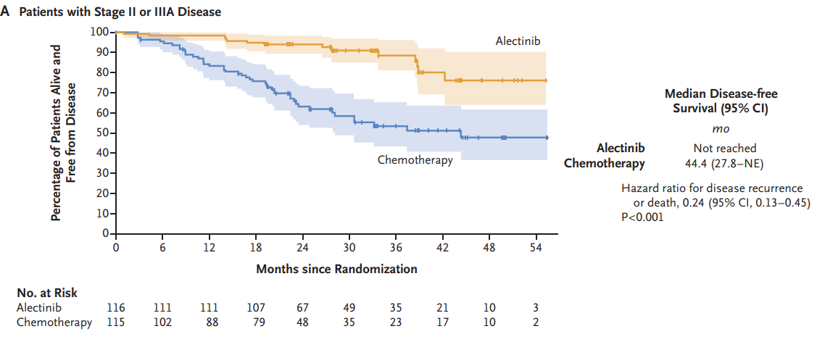
ALINA (II-IIIA), alectinib (2Y) vs. chemotherapy (4C)
2Y DFS: 93.8% vs. 63.0%
N Engl J Med 2024;390:1265-76
Notes:
We conducted a global, phase 3, open-label, randomized trial in which patients with completely resected, ALK-positive NSCLC of stage IB (tumors ≥4 cm), II, or IIIA (as classified according to the seventh edition of the Cancer Staging Manual of the American Joint Committee on Cancer and Union for International Cancer Control) were randomly assigned in a 1:1 ratio to receive oral alectinib (600 mg twice daily) for 24 months or intravenous platinum-based chemotherapy in four 21-day cycles. The primary end point was disease-free survival, tested hierarchically among patients with stage II or IIIA disease and then in the intention-to-treat population. Other end points included central nervous system (CNS) disease–free survival, overall survival, and safety
In total, 257 patients were randomly assigned to receive alectinib (130 patients) or chemotherapy (127 patients).
The percentage of patients alive and disease-free at 2 years was 93.8% in the alectinib group and 63.0% in the chemotherapy group among patients with stage II or IIIA disease (hazard ratio for disease recurrence or death, 0.24; 95% confidence interval [CI], 0.13 to 0.45; P

Slide 15
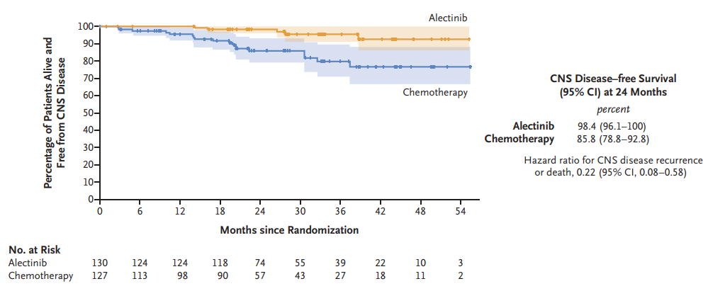
ALINA (II-IIIA), alectinib (2Y) vs. chemotherapy (4C)
2Y DFS: 98.4% vs. 85.8%
N Engl J Med 2024;390:1265-76
Notes:
Data for overall survival were immature.
No unexpected safety findings were observed.
2024.4 FDA approval

Slide 16
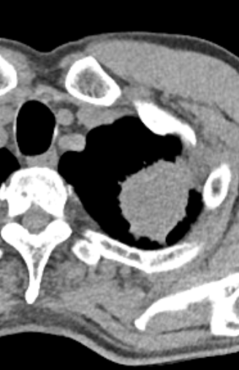
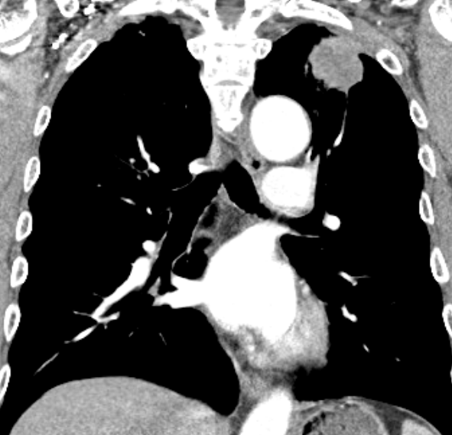
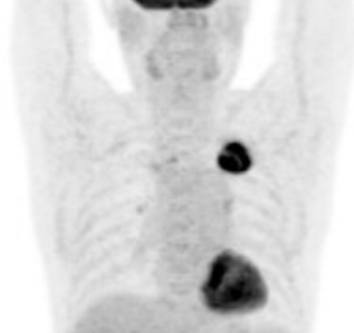
69/M, NSCLC, NOS, cT3N0M0, IIB, PD-L1: 70% (sp263)
Notes:
30013983 곽종환 4.8cm with chest wall invasion
Small bx: MEC or ADSQ

Slide 17
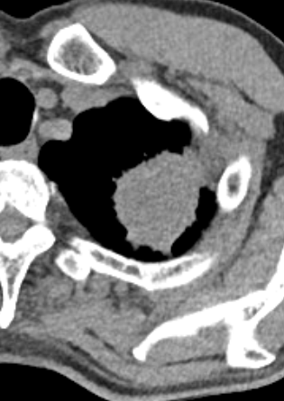
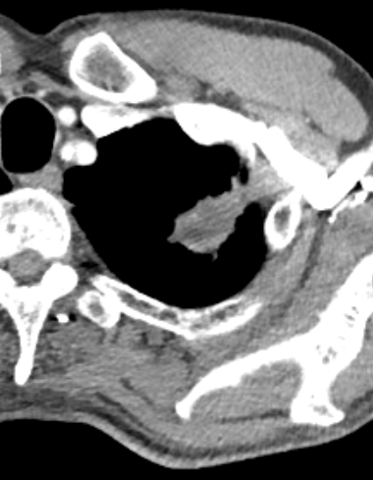
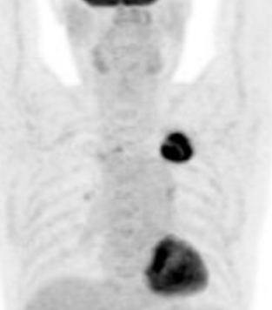
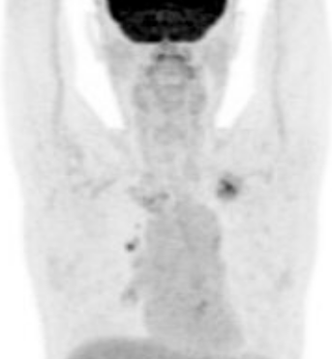
69/M, NSCLC, NOS, cT3N0M0, IIB, PD-L1: 70% (sp263)
-neoadj nivo/pem/cis #2

Slide 18
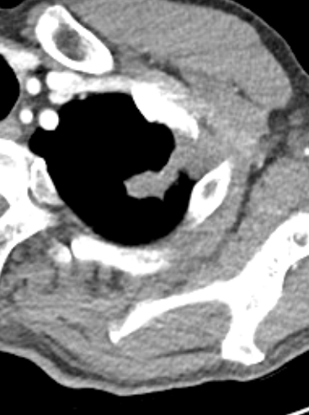
69/M, NSCLC, NOS, cT3N0M0, IIB, PD-L1: 70% (sp263)
-neoadj nivo/pem/cis #3 followed by surgery
Baseline
After 2C
After 3C

Slide 19
Op record (LULobectomy c MLND)
Parietal pleural, chest wall invasion Yes (V) / No ( )
Adhesiolysis Yes (V) / No ( ) : Tumor 의 chest wall invasion 보여 extrapleural dissection 시행함

Slide 20
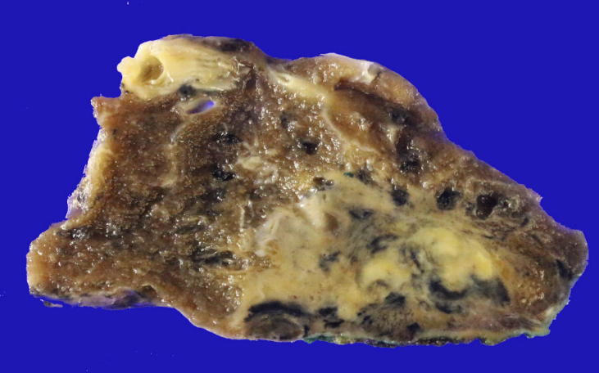
Pathologic stage: pCR
Treatment effect: pathologic complete remission
a) percentage of viable tumor: 0%
b) percentage of necrosis: 10%
c) percentage of stroma: 90%
Notes:
J Thorac Oncol. 2020 May;15(5):709-740.

Slide 21
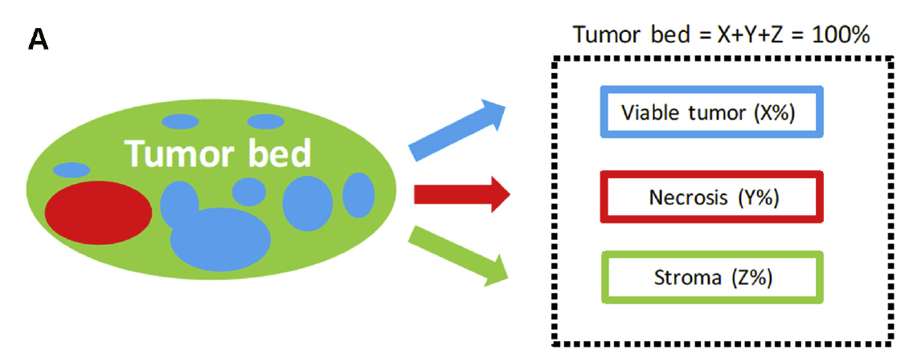
Pathologic assessment after resection
pCR: 0% residual viable tumor cells in both primary tumor (lung) and sampled lymph nodes
MPR: ≤ 10% residual viable tumor cells in both primary tumor (lung) and sampled lymph nodess
J Thorac Oncol. 2020 May;15(5):709-740
Notes:
Histologic components of the tumor bed. (A) Schematic image showing how percentage compositions are assigned.
The tumor bed is divided into viable tumor area, necrosis, and stroma. Stroma includes inflammation and fibrosis

Slide 22
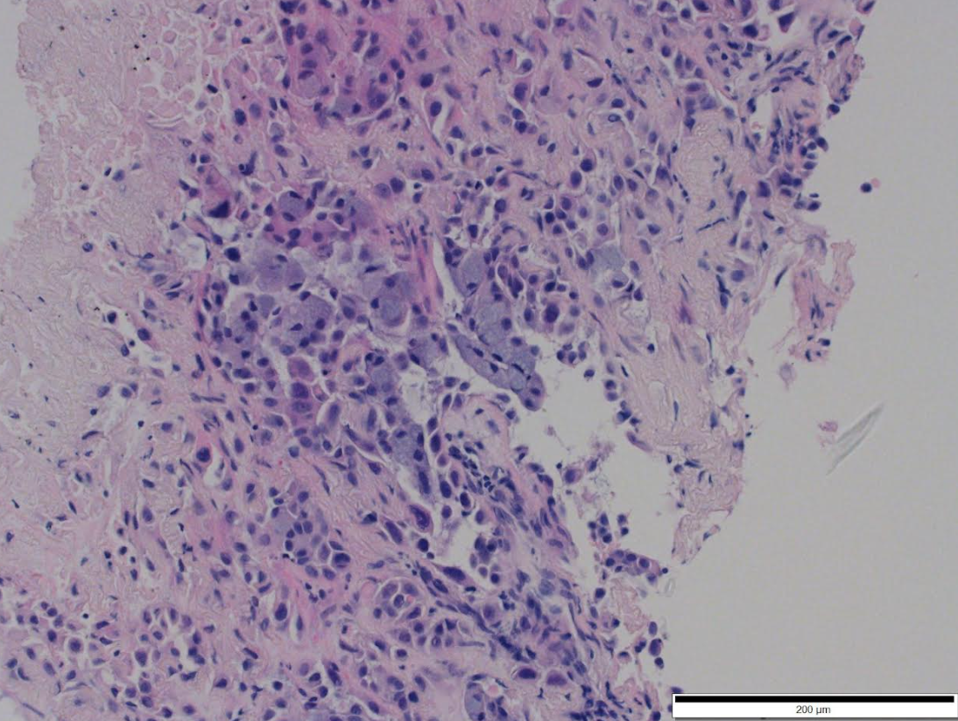
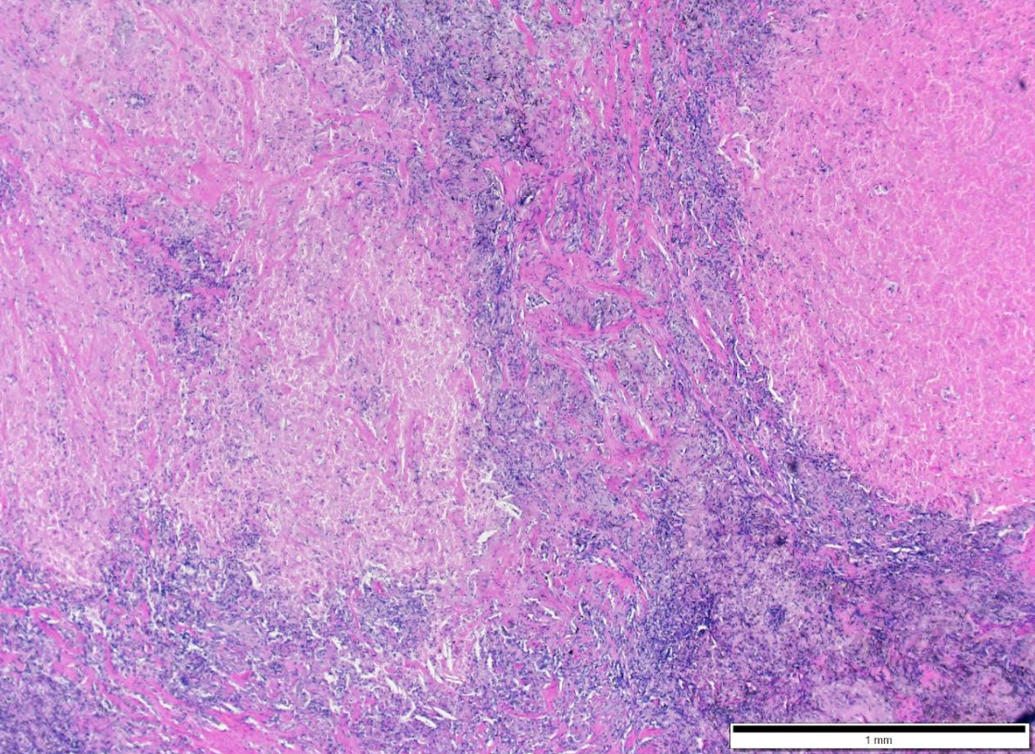
pCR after surgical resection
Small biopsy
Surgical specimen

Slide 23
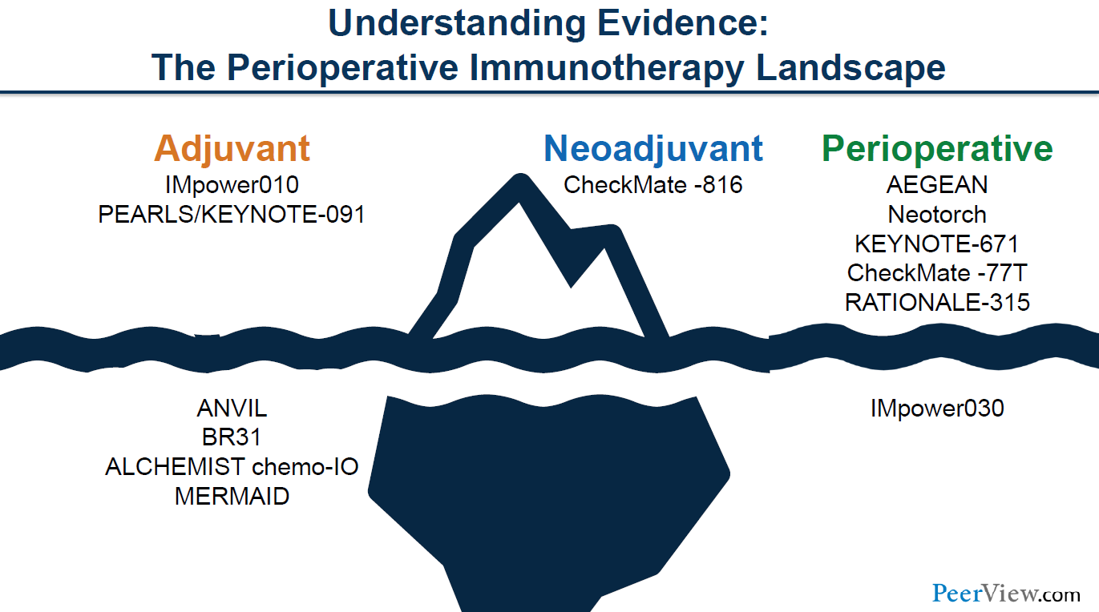

Slide 24

Adjuvant immunotherapy
Advantages
  No delay for curative surgery
  Eradicate MRD → Improved DFS
  Survival benefit in PD-L1 ≥50% NSCLC
Disadvantages
  Compliance of adjuvant IO: 50-65% (longer duration)
  Benefit depends on disease stage (II-III), PD-L1 expression
  Risk of chronic irAEs
Nature Reviews Clinical Oncology volume 20, pages664–677 (2023)
Clinical Lung Cancer, Vol. 25, No. 3, 197–214
Notes:
Nature Reviews Clinical Oncology volume 20, pages664–677 (2023)

Slide 25
Neoadjuvant chemoimmunotherapy
Advantages
  High compliance: 94%
  Eliminate micrometastatic disease, Immune priming, ↑resectability
  pCR correlates with DFS/EFS, potentially OS
Disadvantages
  Surgery can be delayed, difficult
  15% of patients: cancel surgery (progression, irAEs)
  No robust surrogate marker for survival
Nature Reviews Clinical Oncology volume 20, pages664–677 (2023)
Clinical Lung Cancer, Vol. 25, No. 3, 197–214
Notes:
↑resectability (fewer pneumonectomy)
Higher ag load and release from cancer cells in tumor cells-> immune priming

Slide 26
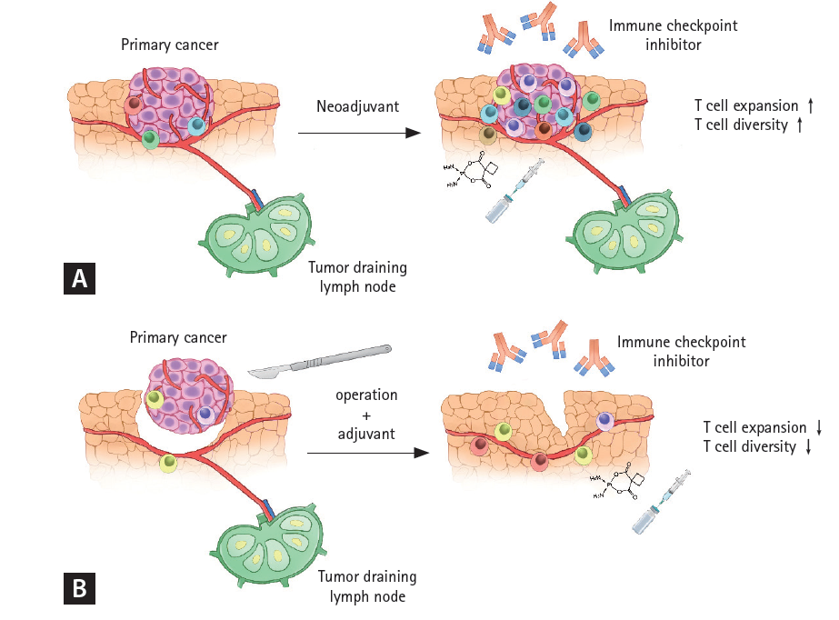
Advantages of the neoadjuvant immunotherapy
Korean J Intern Med 2023;38:787-796
Notes:
Korean J Intern Med 2023;38:787-796

Slide 27
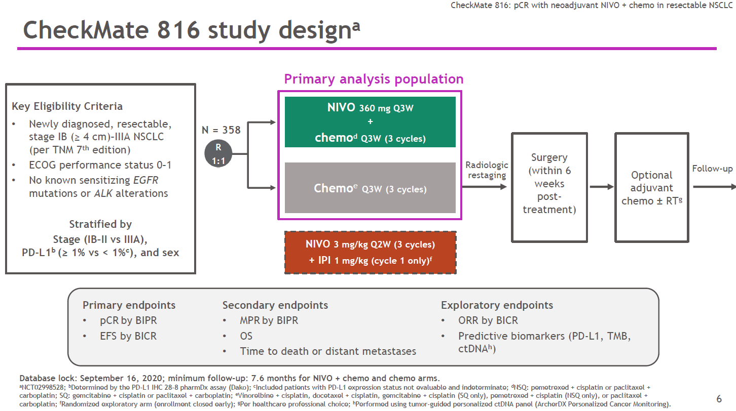

Slide 28
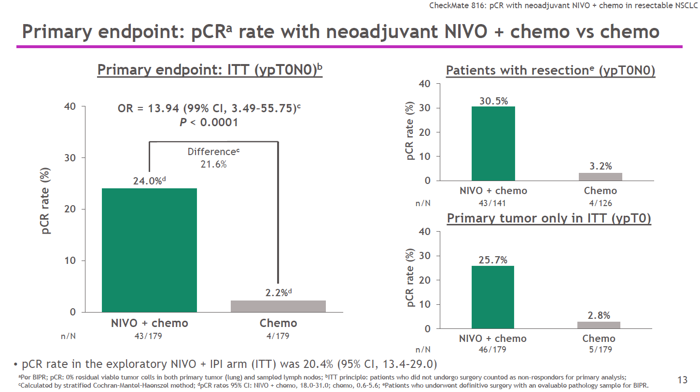

Slide 29
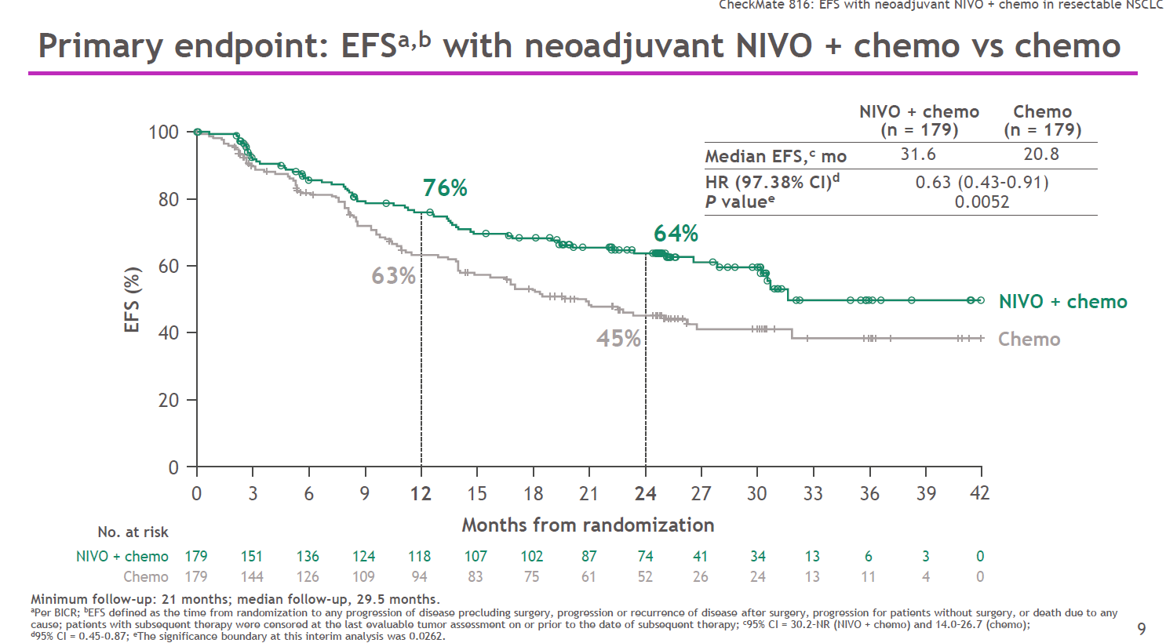

Slide 30
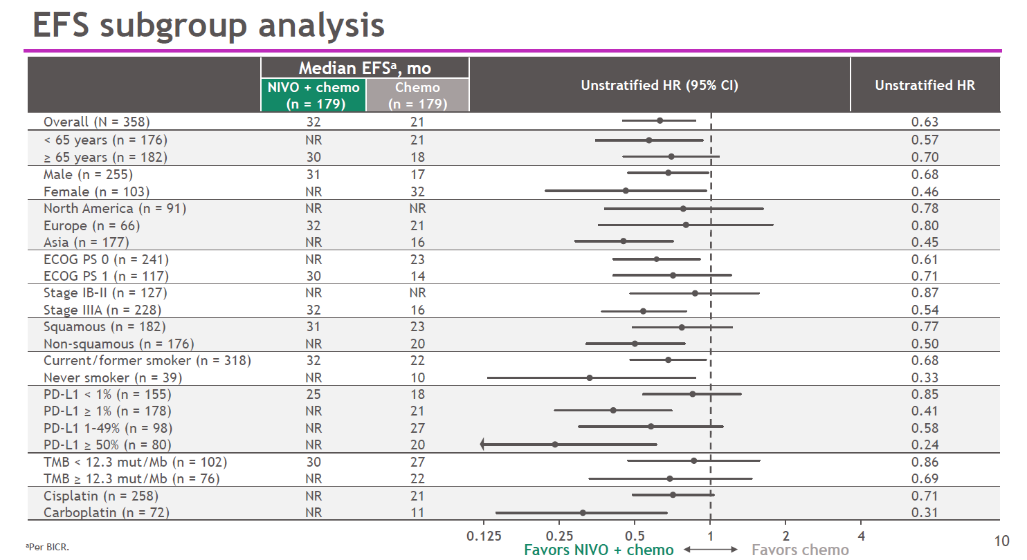

Slide 31
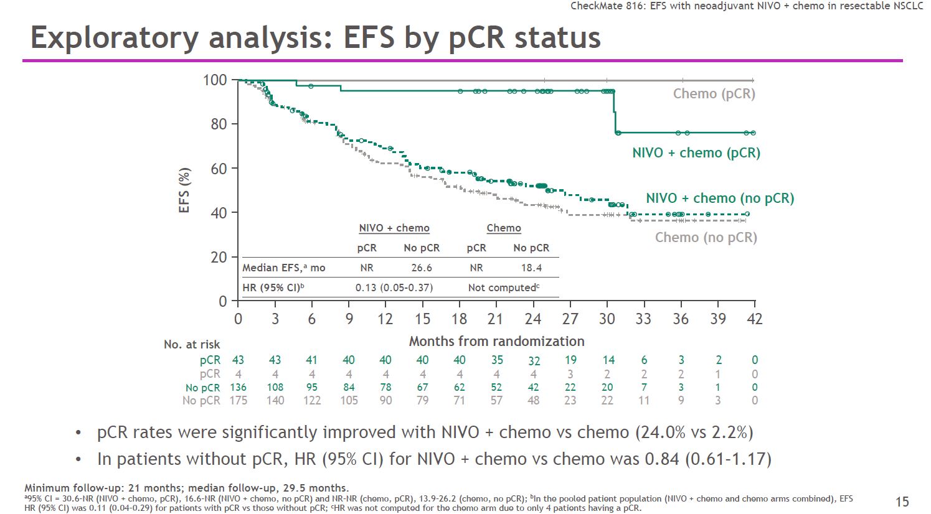

Slide 32
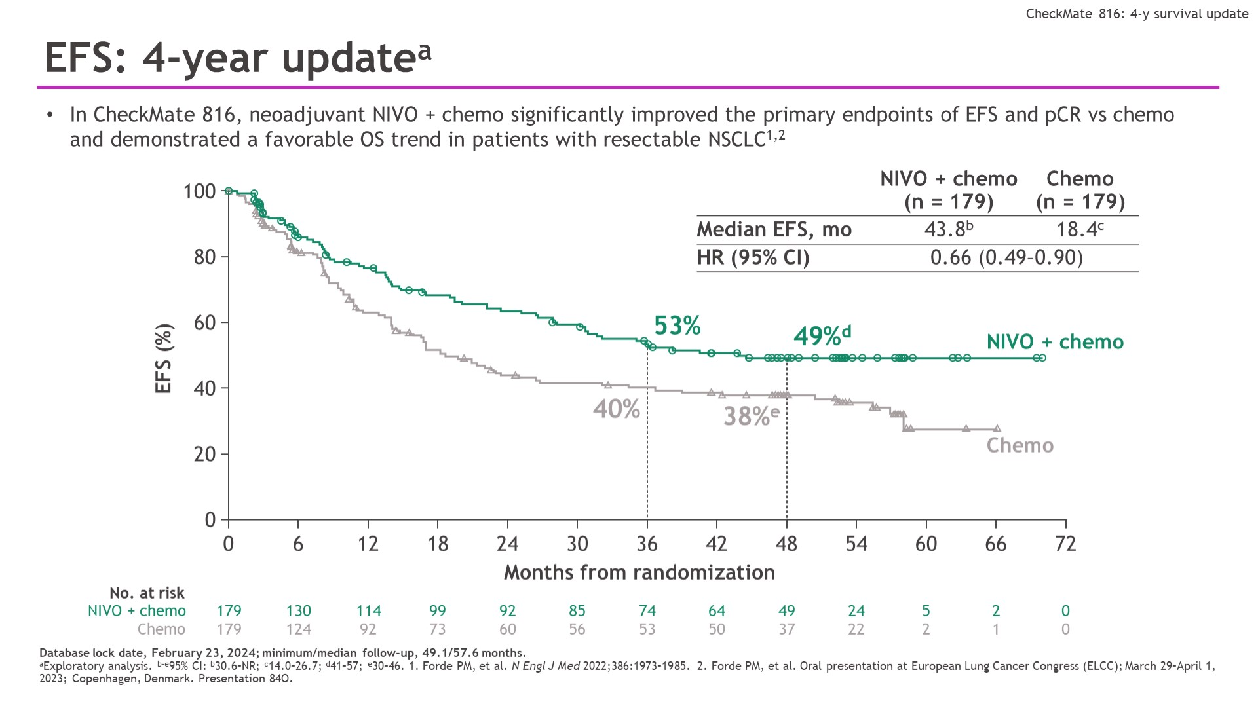
EFS: 4-year updatea
Content of this presentation is the property of the author, licensed by ASCO. Permission required for reuse.
Notes:
2024 ASCO

Slide 33
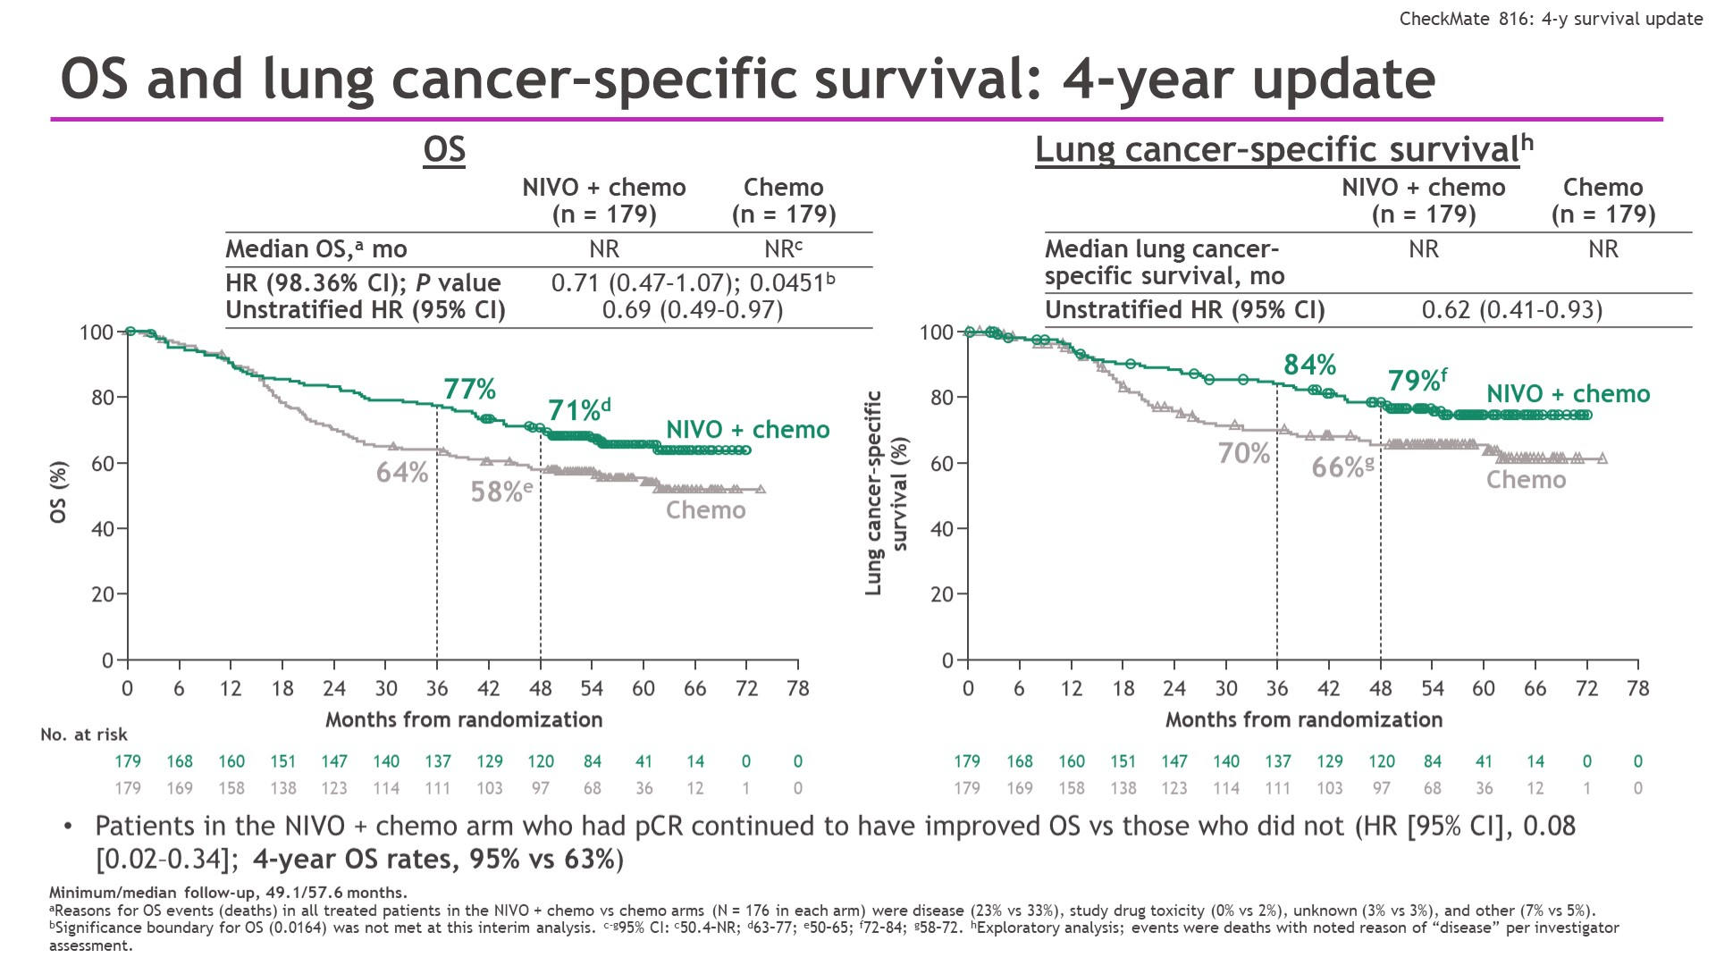
OS and lung cancer–specific survival: 4-year update
Content of this presentation is the property of the author, licensed by ASCO. Permission required for reuse.
Notes:
양해 부탁드리며, CM816 OS는 이번 4년 interim analysis 시점에 아쉽게도 사전에 설정된 significance boundary cut-off(0.0164)를 만족하지는 못했습니다.

Slide 34
Overview of Perioperative Immunotherapy trials
Adjuvant
Neoadjuvant
Perioperative
Trial | IMpower010 | KN 091 | CM 816 | AEGEAN | KN 671 | CM 77T
Timing | Adjuvant | Adjuvant | Neoadjuvant | Perioperative | Perioperative | Perioperative
Sample size | 1005 | 1177 | 358 | 802 | 786 | 461
I/O agent | Atezolizumab | Pembrolizumab | Nivolumab | Durvalumab | Pembrolizumab | Nivolumab
No. cycles | 16 | 18 | 3 | 4+12 (q 4wks) | 4+13 (q 3wks) | 4+12 (q 4wks)
Inclusion Criteria | Completely Resected IB (>4cm)-IIIA (7th) | Completely Resected IB (>4cm)-IIIA (7th) | Resectable IB (>4cm)-IIIA (7th) | Resectable II-IIIB (8th) by lobectomy | Resectable II-IIIB (8th) | Resectable II-IIIB (8th)
Stage II/III, % | 59/41 | 72/28 | 36/64 | 27/73 | 30/70 | 35/65
EGFR/ALK | Permitted | Permitted | Excluded | Excluded | Permitted | Excluded
Primary endpoint | DFS | DFS | pCR, EFS | MPR, EFS | EFS, OS | EFS
Chemotherapy | Cisplatin doublet Mandatory | Platinum doublet Encouraged, Not mandatory | Platinum doublet | Platinum doublet | Cisplatin doublet | Platinum doublet

Slide 35
Pathologic response

Slide 36
Pathologic response

Slide 37
Overview of Perioperative Immunotherapy trials
Neoadjuvant
Perioperative
 | CM 816 | AEGEAN | KN 671 | CM 77T
Completed neoTx | 94% | 87% | 87% | 85%
Surgery cancel | 16% | 19% | 18% | 22%
d/t PD | 7% | 6.8% | 4.1% | 6%
d/t AE | 1% | 1.8% | 6.3% | 3%
R0 resection | 83% | 95% | 92% | 89%
Pneumonectomy | 17% | 7.4% | 11.4% | 9%
Op related mortality | 2.8% | 2% | 2.8% | 0%
Postop. Morbidity (≥Gr 3) | 11% | 6% | 26% | 12%

Slide 38
2Y DFS/EFS
Adjuvant
Neoadjuvant
Perioperative
HR 0.81
HR 0.76
HR 0.68
HR 0.68
HR 0.59
HR 0.58

Slide 39
3Y OS
Adjuvant
Neoadjuvant
Perioperative
HR 0.42 (0.23-0.78)
PD-L1 ≥ TC 50%
HR 0.65 (0.36-1.05)
HR 0.72 (0.56-0.93)
12%
12%
24%
Notes:
The median OS in the ITT population was not estimable; the stratified hazard
ratio (HR) was 0.995 [95% confidence interval (CI) 0.78-1.28]. The stratified OS HRs (95% CI) were 0.95 (0.74-1.24) in the
stage II-IIIA (n¼882), 0.71 (0.49-1.03) in the stage II-IIIA PD-L1 tumour cell (TC)1% (n¼476), and 0.43 (95% CI 0.24-0.78)
in the stage II-IIIA PD-L1 TC 50% (n ¼ 229) populations
Although OS remains immature for the ITT population, these data indicate a positive trend favouring
atezolizumab in PD-L1 subgroup analyses, primarily driven by the PD-L1 TC 50% stage II-IIIA subgroup.

Slide 40
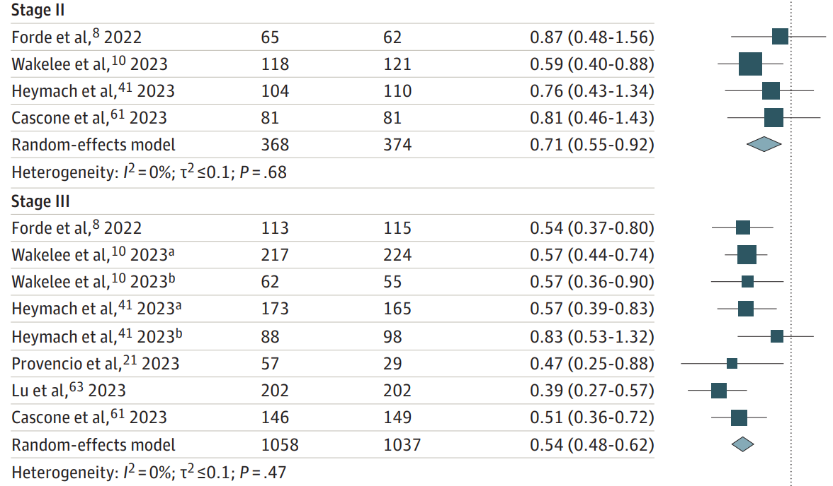
EFS benefit, not limited to stage III
JAMA Oncol. 2024;10(5):621-633
Notes:
JAMA Oncol. 2024;10(5):621-633

Slide 41
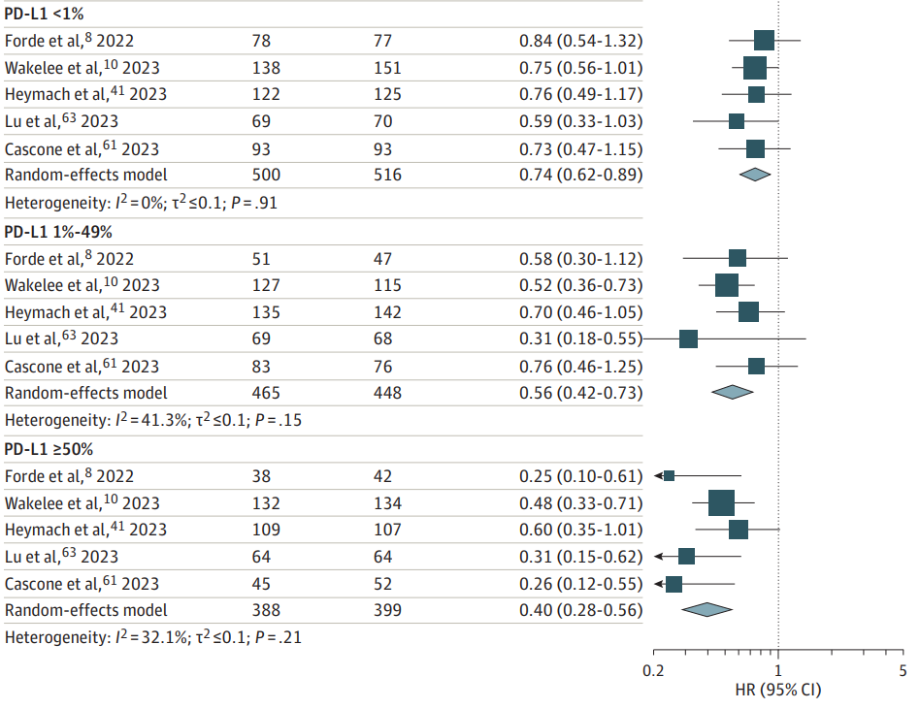
EFS benefit, across all PD-L1 strata
JAMA Oncol. 2024;10(5):621-633

Slide 42
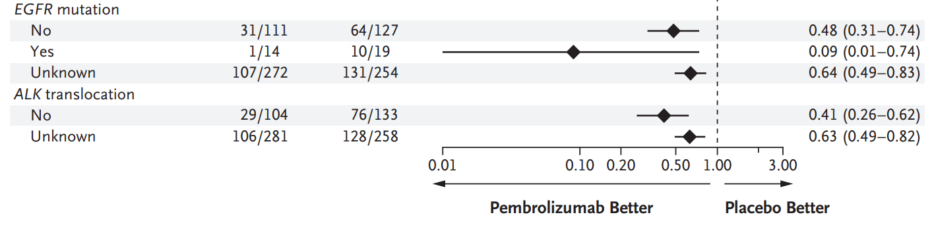
EGFR/ALK mutant patients
N Engl J Med 2023;389:491-503.
Notes:
N Engl J Med 2023;389:491-503.

Slide 43
국내 허가
Osimertinib
ADAURA
Pembrolizumab
KN 671/KN 091
Nivolumab
CM 816
Atezolizumab
IMpower 010
의약품 안전나라, 2024.6

Slide 44

ALIMTA
Alimta, for patients with eNSCLC

