Slide 1
Updated Guideline for Bronchiectasis in Adults
이 승 준
경상대학교병원 호흡기내과

Slide 2
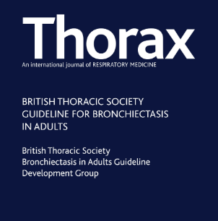
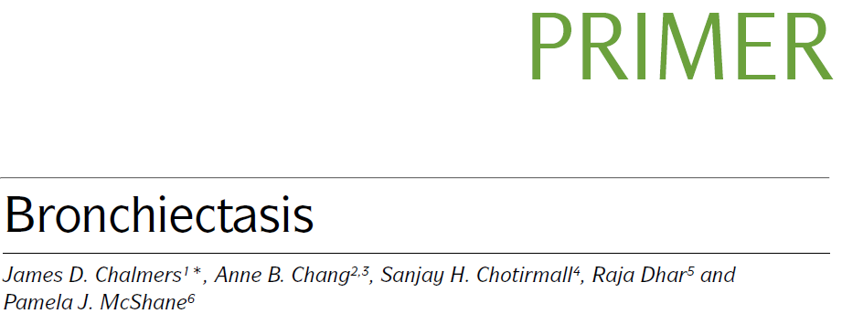
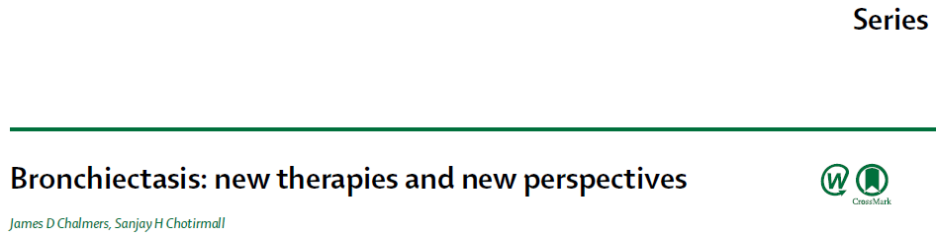

Slide 3
First scientific interest, personal
Airway disease (COPD, BA)
Bronchiectasis

Slide 4
ACO
BCO
CCO
DCO

Slide 5




Slide 6
목 차
Epidemiology
Pathophysiology
Diagnosis & Severity scoring
Causes & evaluation
Management

Slide 7
Prevalence , UK
Men(301.2->485.5)
Women (350.5->566.1))
Eur Respir J 2016; 47: 10–13
Notes:
ABSTRACT There is a paucity of data on incidence, prevalence and mortality associated with non-cystic
fibrosis bronchiectasis.
Using the Clinical Practice Research Datalink for participants registered between January 1, 2004 and
December 31, 2013, we determined incidence, prevalence and mortality associated with bronchiectasis in
the UK and investigated changes over time.
The incidence and point prevalence of bronchiectasis increased yearly during the study period. Across
all age groups, the incidence in women increased from 21.2 per 100000 person-years in 2004 to 35.2 per
100 000 person-years in 2013 and in men from 18.2 per 100000 person-years in 2004 to 26.9 per 100 000
person-years in 2013. The point prevalence in women increased from 350.5 per 100 000 in 2004 to 566.1
per 100 000 in 2013 and in men from 301.2 per 100 000 in 2004 to 485.5 per 100 000 in 2013. Comparing
morality rates in women and men with bronchiectasis in England and Wales (n=11 862) with mortality
rates in the general population from Office of National Statistics data showed that in women the ageadjusted
mortality rate for the bronchiectasis population was 1437.7 per 100 000 and for the general
population 635.9 per 100 000 (comparative mortality figure of 2.26). In men, the age-adjusted mortality
rate for the bronchiectasis population was 1914.6 per 100 000 and for the general population 895.2 per
100 000 (comparative mortality figure of 2.14).
Bronchiectasis is surprisingly common and is increasing in incidence and prevalence in the UK,
particularly in older age groups. Bronchiectasis is associated with a markedly increased mortality.

Slide 8
Incidence, UK
    21.2/100,000 PY (2004) → 35.2/100,000 PY (2013)
Eur Respir J 2016; 47: 10–13

Slide 9
Prevalence, USA
Claim data using ICD code from pulmonologist
-694 per 100,000 (2012)
-694 per 100,000 (2013)
-714 per 100,000 (2014)
-802 (Women) vs 617 (Men)
Chest 2018; 47: 10–13
Notes:
BACKGROUND: Bronchiectasis is an increasingly common chronic inflammatory airway disease.
There is an urgent need to understand the epidemiology of bronchiectasis in older
adults. We describe the prevalence and characteristics of patients with bronchiectasis within
the US Medicare population.
METHODS: Among the 40% of Medicare enrollees with prescription drug plans from 2006 to
2014, we identified patients $ 65 years of age with bronchiectasis by International Classification
of Diseases, Ninth Revision, Clinical Modification claims (494.0 or 494.1) from a pulmonologist
and no claim for cystic fibrosis. We calculated the prevalence from 2012 to 2014. Incident or
newly diagnosed patients were those enrolled in Medicare at least 12 months prior to the first
bronchiectasis diagnosis. We described clinical and health-care utilization characteristics for this
cohort during the prior 12-month (baseline) period, and explored differences between those
with and without a COPD diagnosis.
RESULTS: We identified 252,362 patients with bronchiectasis meeting all eligibility criteria. The
average annual prevalence from 2012 to 2014 was 701 per 100,000 persons. Newly diagnosed
patients were amean age of 76 years, predominatelywomen (65%), and predominately white, non-
Hispanic (84%). During the baseline period, 12% were hospitalized for respiratory infections. Fiftyone
percent had a dual diagnosis of COPD. Newly diagnosed patients with bronchiectasis and
COPD had significantly different characteristics and utilization, for example were more likely
hospitalized for respiratory infections during the baseline period (16%vs 7%) and to have a smoking
history (46% vs 17%) compared with those without a dual COPD diagnosis, respectively.
CONCLUSIONS: We confirmed a high prevalence of bronchiectasis in the United States and
significant heterogeneity in patients with bronchiectasis with and without COPD that should
be further explored.

Slide 10
Hospitalization a/w bronchiectasis, USA
-16.5 hospitalization per 100,000 population
-Median cost for admission 7,827 USD
Chest 2010; 138(4):944–949
Notes:
Background: Current data on bronchiectasis prevalence, trends, and risk factors are lacking; such
data are needed to estimate the burden of disease and for improved medical care and public
health resource allocation. The objective of the present study was to estimate the trends and burden
of bronchiectasis-associated hospitalizations in the United States.
Methods: We extracted hospital discharge records containing International Classification of
Diseases, 9th Revision, Clinical Modifi cation codes for bronchiectasis (494, 494.0, and 494.1) as
any discharge diagnosis from the State Inpatient Databases from the Agency for Healthcare
Research and Quality. Discharge records were extracted for 12 states with complete and continuous
reporting from 1993 to 2006.
Results: The average annual age-adjusted hospitalization rate from 1993 to 2006 was 16.5 hospitalizations
per 100,000 population. From 1993 to 2006, the age-adjusted rate increased signifi cantly,
with an average annual percentage increase of 2.4% among men and 3.0% among women. Women
and persons aged . 60 years had the highest rate of bronchiectasis-associated hospitalizations.
The median cost for inpatient care was 7,827 US dollars (USD) (range, 13-543,914 USD).
Conclusions: The average annual age-adjusted rate of bronchiectasis-associated hospitalizations
increased from 1993 to 2006. This study furthers the understanding of the impact of bronchiectasis
and demonstrates the need for further research to identify risk factors and reasons
for the increasing burden.

Slide 11
Mortality, UK
Eur Respir J 2016; 47: 10–13

Slide 12
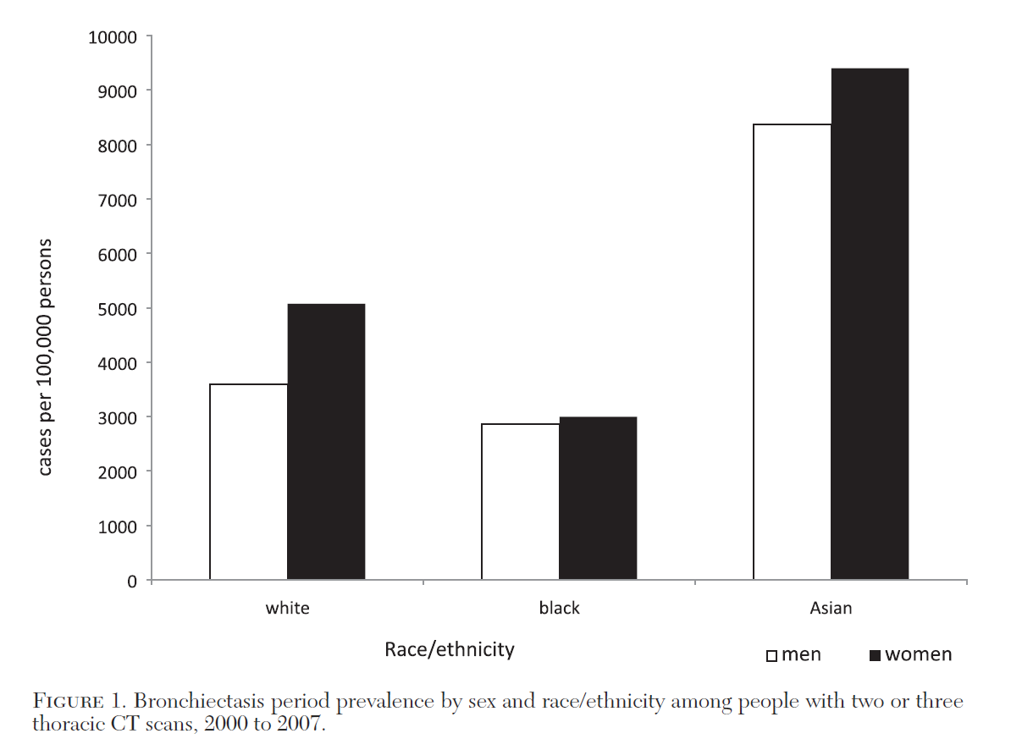
Prevalence by race/ethnicity
Chest 2012; 142(2):432–439

Slide 13
Bronchiectasis in China
-Urban population–based,
-Cross-sectional survey of bronchiectasis
-Between 2002 and 2004
=>1.2% (1,200/100,000)
Ann Am Thorac Soc 2016;13(5):609-16
Notes:
Abstract
Bronchiectasis is a common but long-neglected disease in China,
causing a substantial disease burden both to patients and to society.
The overall prevalence of physician-diagnosed bronchiectasis in
people aged 40 years or older is estimated at 1.2% and is trending
upward with aging of the population. The etiology of bronchiectasis
has not been identified heretofore in more than 70% of patients in
China, although pneumonia and tuberculosis still appear to be
the most common causes of acquired bronchiectasis. Etiologies,
comorbidities, and infecting organisms vary greatly across previously
published epidemiological studies, resulting in considerable
uncertainty. Little is known about the spectrum of severity of
bronchiectasis in China. Presently, engagement of pulmonologists
is largely limited to acute treatment of exacerbations of severe
bronchiectasis. Based on limited available data and expert
consensus, the first comprehensive guidelines for the diagnosis and
treatment of bronchiectasis in China were published in 2012.
Research to advance medical care for patients with this disease in
China should focus on several priorities, including: standardization
of diagnostic criteria with appropriate application of computed
tomographic imaging; use of validated multidimensional grading
systems to assess the severity of bronchiectasis; and epidemiological
studies that are designed to measure mild to moderate as well as
severe disease, and to represent the population beyond large urban
centers. Better estimates of the true burden of bronchiectasis are
needed to guide allocation of national medical resources and to
implement public health strategies for prevention of the disease.
Treatment should be expanded to include expert maintenance care
of ambulatory patients in addition to treatment of exacerbations.

Slide 14
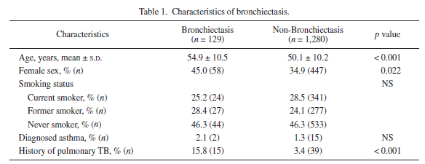
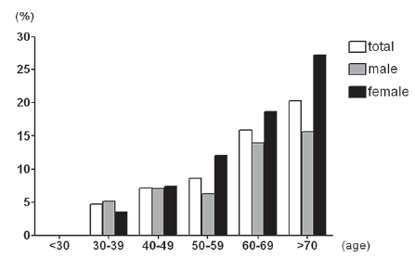

Health screening CT in Korea
9.1% had BE
Notes:
Bronchiectasis is one of the common chronic respiratory diseases and associated with respiratory morbidity and mortality. However, neither its prevalence nor its etiology is well-defined. We aimed to estimate the prevalence and risk factors of bronchiectasis in adults. In a retrospective study, we analyzed radiologic findings on chest computed tomography (CT) images performed as part of a health-screening program. From January to December 2008, 1,409 (24.6%) of 5,727 participants in the screening program of a health promotion center at a university hospital underwent chest CT scans based on the subject's decision. Bronchiectasis was diagnosed, if there was abnormal bronchial dilatation in any area of both lungs on chest CT. Respiratory symptoms, smoking status, and past medical history were also analyzed to define clinical characteristics and risk factors of bronchiectasis. Of 1,409 patients (aged 23-86 years), who were screened for respiratory diseases using chest CT for one year in a health promotion center, 129 patients (9.1%) were diagnosed with bronchiectasis. The prevalence of bronchiectasis was higher in females than in males (11.5% vs. 7.9%, p = 0.022) and increased with age. Respiratory symptoms were reported in 53.7% of subjects. Previous history of tuberculosis (TB) (OR 4.61, 95% CI 2.39-8.88, p = 0.001) and age (OR 2.49, 95% CI 1.56-3.98, p = 0.001) were significantly associated with bronchiectasis. This retrospective analysis of chest CT findings in health screening examinees revealed a very high prevalence of bronchiectasis in adults. Previous TB infection is one of the major causes of bronchiectasis.

Slide 15
Pathophysiology
Lancet 2018; 392: 880–90
Nature Reviews,(2018) 4:45
Notes:
Figure 1: Model describing the pathogenesis of bronchiectasis
A cycle of events that promote a persistent and progressive process over time. Impaired mucociliary clearance and
retention of airway phlegm disrupts normal host defences, rendering the airways susceptible to infection,
which can become persistent. This process, in turn, incites an inflammatory response causing injury and abnormal
remodelling of the airways, leading to bronchiectasis.

Slide 16
Aetiologies of non-CF Bronchiectasis
AnnThorac Med 2017;12:135-61
Nature Reviews,(2018) 4:45

Slide 17
Infection and Dysregulated immunity
Nature Reviews,(2018) 4:45
Notes:
Fig. 3 | Microbial infection and dysfunctional immunity contribute to the
pathophysiology of bronchiectasis. The respiratory epithelium recruits neutrophils by
releasing pro- inflammatory signals (IL-8, macrophage inflammatory protein 2 (MIP-2;
also known as CXC- chemokine ligand 2 (CXCL2)) and tumour necrosis factor (TNF))
and increasing cell surface expression of intercellular adhesion molecule 1 (ICAM1) and
vascular cell adhesion protein 1 (VCAM1). C5a (from circulating complement) stimulates
airway macrophages to release TNF, IL-8, IL-1β and leukotriene B4 (LTB4), which promote
neutrophil recruitment77. Expression of CD11a/CD18 integrins on neutrophils (not
shown) and increased expression of selectin on endothelial cells promote neutrophil
transmigration to the airway , where degranulation occurs. Key mediators of airway
inflammation and destruction in bronchiectasis include reactive oxygen species (ROS),
neutrophil elastase (NE), matrix metalloproteinases (MMPs), proteinase 3 and
cathepsin G, all of which are released by neutrophils56,76. Cleavage of neutrophil surface
complement (CD35 and CD11b/CD18) and Fcγ receptors (FcγR; CD16 and CD32) by
neutrophil elastase impairs opsonization and the phagocytic ability of neutrophils. The
recognition of opsonized immunoglobulin G (IgG) targets and C3b/C4b and iC3b (not
shown) complement components on microorganisms is also further compromised63.
Macrophages normally clear neutrophils by efferocytosis, a process impaired by
neutrophil elastase release from excessive neutrophil degranulation in bronchiectasis.
Other airway immune cells, including lymphocytes, specifically cytotoxic T cells and
T helper 17 (TH17) cells, have a role in the pathogenesis of bronchiectasis by, respectively,
downregulating major histocompatibility complex class I molecules (thereby enabling
microbial persistence) and releasing IL-17 , an additional neutrophil chemoattractant207.
Ineffective microbial killing, persistent infection and inflammation coupled to
mucus hypersecretion and airway epithelial damage all promote bronchiectasis.
NTM, non-tuberculous mycobacteria; PSGL-1, P- selectin glycoprotein ligand 1.

Slide 18
In whom should the diagnosis of bronchiectasis be suspected?

Slide 19
Prevalence of co-existing BE in COPD:
54.3% (25.6% - 69%)
International Journal of COPD 2015:10 1465–1475
Notes:
BACKGROUND:
In the 2014 Global initiative for chronic Obstructive Lung Disease guidelines, bronchiectasis was for the first time defined as a comorbidity of chronic obstructive pulmonary disease (COPD), and this change has been retained in the 2015 update, which emphasizes the influence of bronchiectasis in the natural history of COPD. The present meta-analysis was aimed at summarizing the impact of bronchiectasis on patients with COPD.
METHODS:
Databases including Embase, PubMed, and the Cochrane Central Register of Controlled Trials were searched comprehensively to identify all relevant human clinical studies published until August 2014. Bronchiectasis was confirmed either by computed tomography or high-resolution computed tomography. One or more clinicopathological or demographical characteristics, including age, sex, smoking history, daily sputum production, exacerbations, inflammatory biomarkers, lung function, and colonization by potentially pathogenic microorganisms (PPMs), were compared between COPD patients with and without bronchiectasis.
RESULTS:
Six observational studies with 881 patients were included in the meta-analysis. The mean prevalence of bronchiectasis in patients with COPD was 54.3%, ranging from 25.6% to 69%. Coexistence of bronchiectasis and COPD occurred more often in male patients with longer smoking history. Patients with COPD and comorbid bronchiectasis had greater daily sputum production, more frequent exacerbation, poorer lung function, higher level of inflammatory biomarkers, more chronic colonization by PPMs, and higher rate of Pseudomonas aeruginosa isolation.
CONCLUSION:
In spite of the heterogeneity between included studies and detectable publication bias, this meta-analysis demonstrated the impact of bronchiectasis in patients with COPD in all directions, indicating that coexistence of bronchiectasis should be considered a pathological phenotype of COPD, which may have a predictive value.

Slide 20
Diagnosis_Imaging
Notes:
Fig. 5 | Radiological features of bronchiectasis. High- resolution CT scan slice
(reconstructed from a multi- detector CT scan) shows bronchiectasis in a 7-year- old child
who first presented to the respiratory service with chronic cough. Dilatated bronchi and
the adjacent blood vessels are visible, with the typical signet ring shape: cylindrical
bronchiectasis is present in the right lower lobe (blue arrow), and varicose- to-cystic
bronchiectasis is present in the right middle lobe, left lingula (yellow arrow) and lower
lobe. Non- tapering of the bronchi is visible in the left lower lobe (black arrow), and visible
bronchi adjacent to the mediastinal pleura or within the outer 1–2 cm of the lung fields
are present in the left lingula and lower lobe (red arrow). The aetiology of bronchiectasis
in this child is primary aspiration.

Slide 22
Bronchogram
Normal
Cylindrical
Varicose
Cystic or saccular

Slide 23
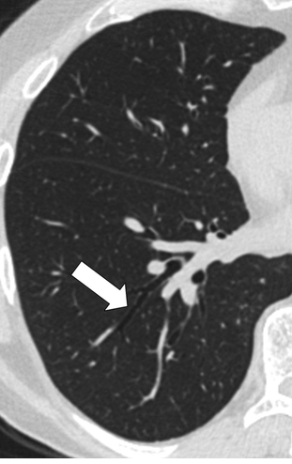
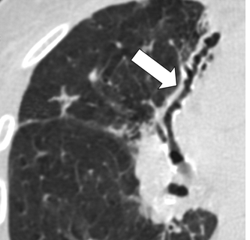
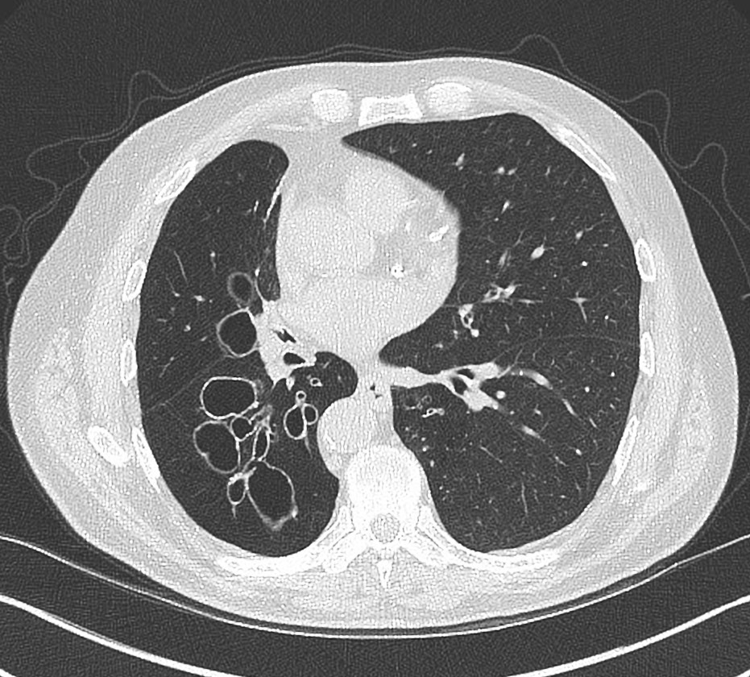
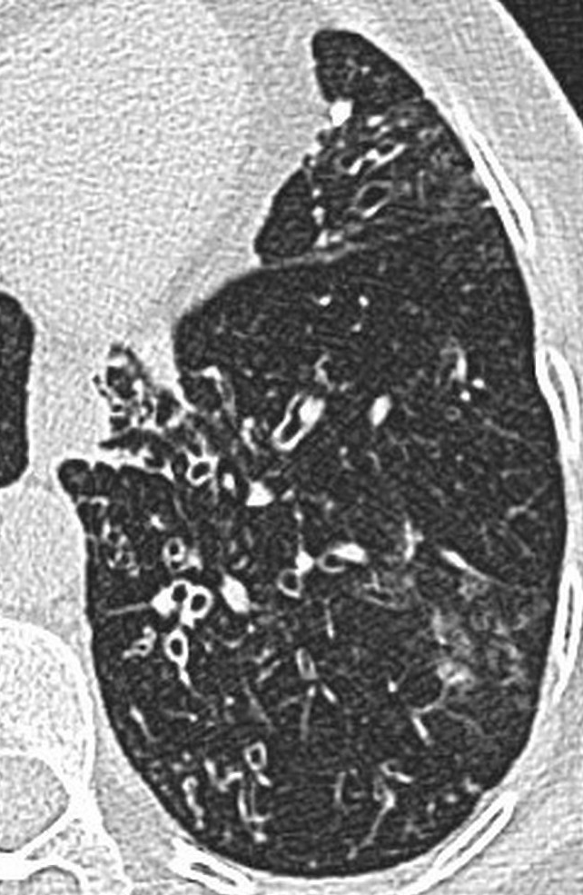
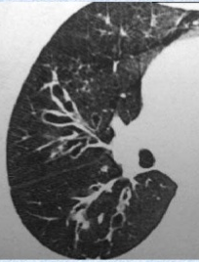
CT findings
Notes:
Varicose: string of pearls appearance

Slide 24
Notes:
30세 남자 , 만성기침, 객담, recurrent infection이 있었는데 소아때 과거력 조사해보니 measles을 앓았다.

Slide 25
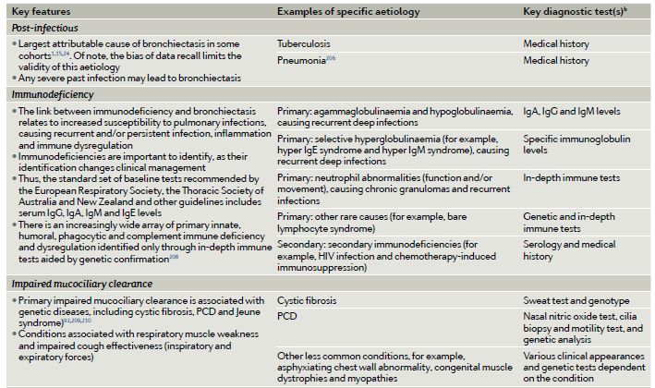
Aetiologies and Diagnostic tests
Nature Reviews,(2018) 4:45

Slide 26
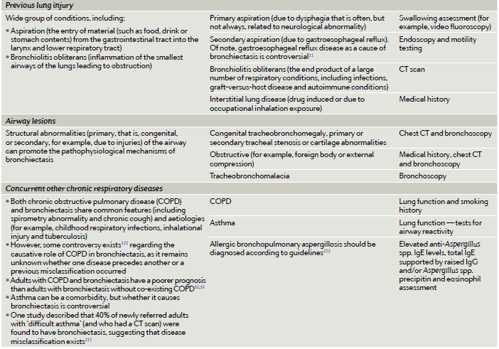
Aetiologies and Diagnostic tests
Nature Reviews,(2018) 4:45

Slide 27
Initial evaluation
-Spirometry is useful
-Bronchoscopy is not required routinely (except F.B.)

Slide 28
Severity scoring
Bronchiectasis Severity Index (BSI) and FACED are available
Consider using the bronchiectasis severity index which may help guide management

Slide 29
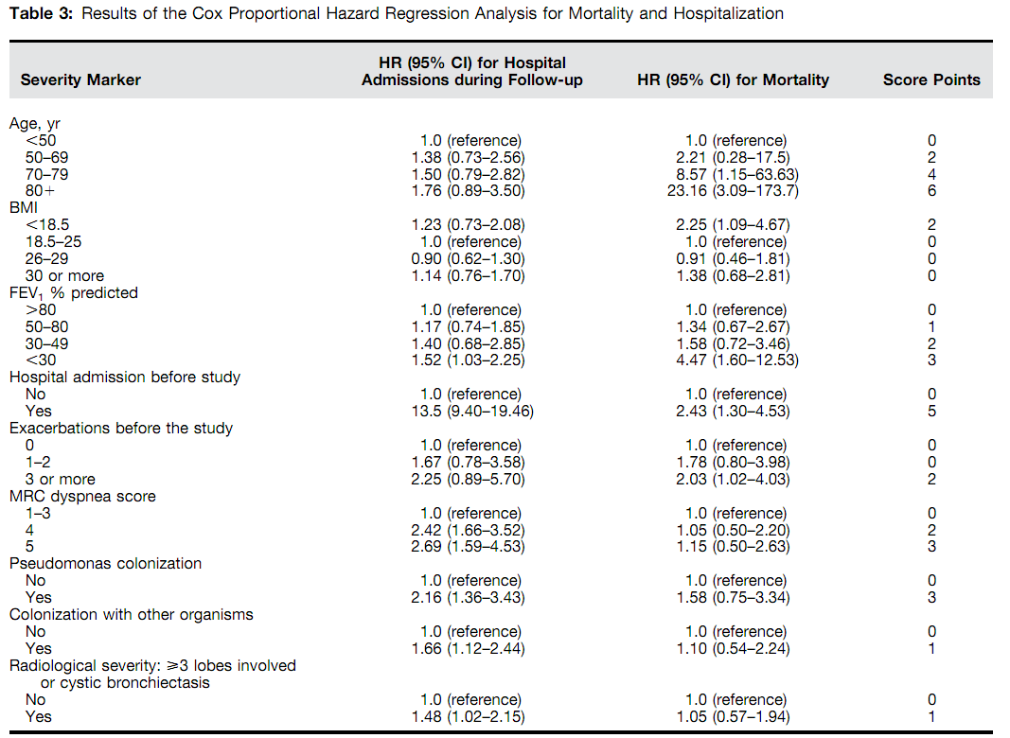
Bronchiectasis Severity Index (BSI)
Am J Respir Crit Care Med Vol 189, Iss 5, pp 576–585, Mar 1, 2014

Slide 30
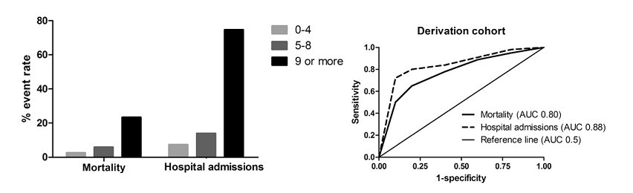
Bronchiectasis Severity Index (BSI)
Am J Respir Crit Care Med Vol 189, Iss 5, pp 576–585, Mar 1, 2014

Slide 31
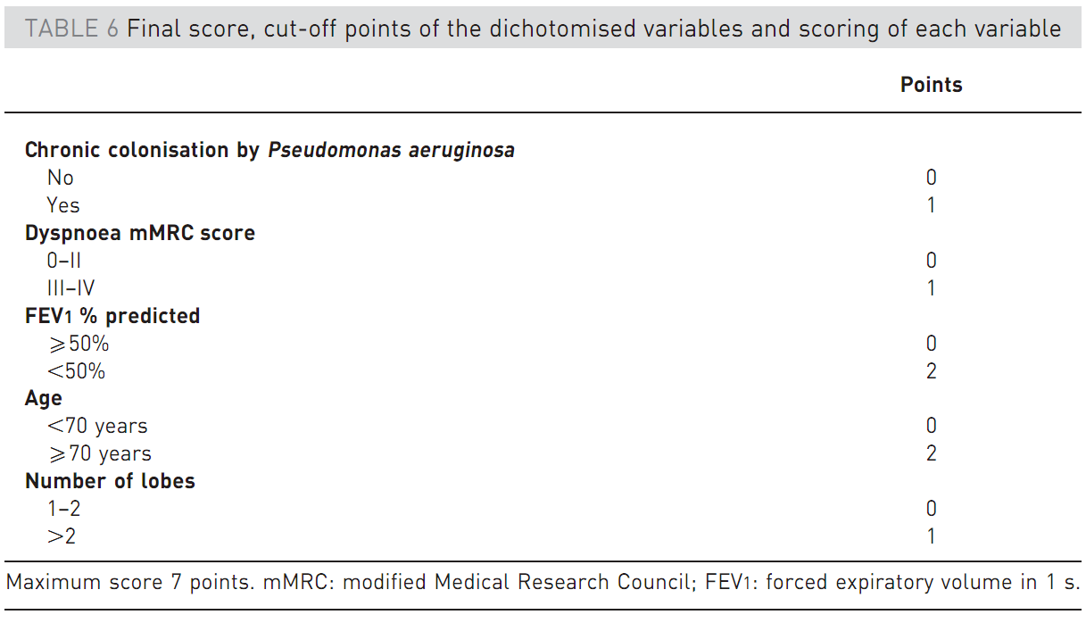
FACED score
Eur Respir J 2014; 43: 1357–1367

Slide 32
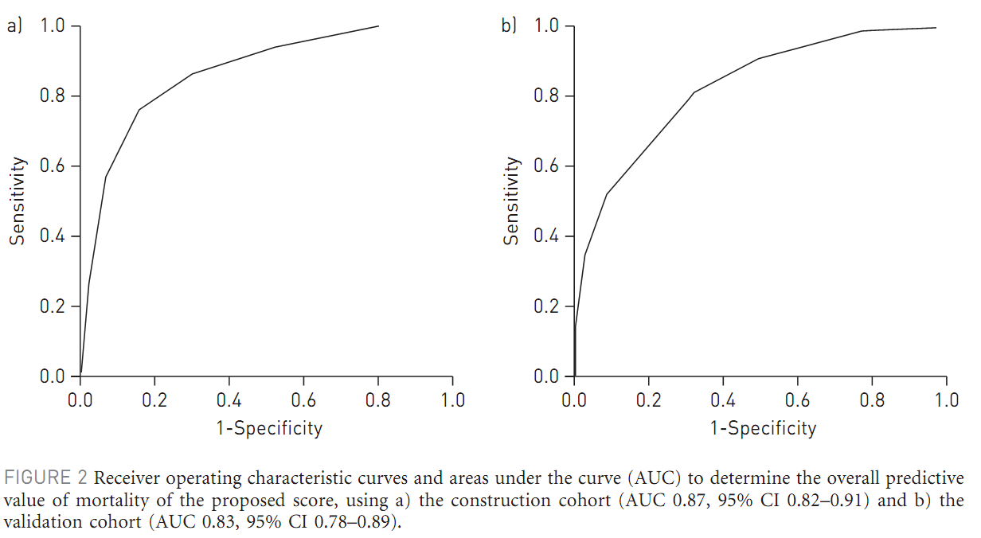
FACED score
Eur Respir J 2014; 43: 1357–1367

Slide 33
E-FACED score
AUC: 0.87 vs 0.72, p<0.005)
International Journal of COPD, 2017:12 275–284

Slide 34
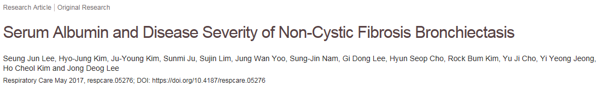
N=107
RESPIRATORY CARE • AUGUST 2017 VOL 62 NO 8

Slide 35
Albumin predicts respiratory hospitalization
N=177
Unpublished data

Slide 36
Factors for respiratory hospitalization
 | Univariate analysis |  |  | Multivariate analysis
 | OR | 95% CI | p-value | OR | 95% CI | p-value
Albumin ≥ 3.5 < 3.5 | 1 9.625 | 2.891-32.05 | <0.001 | 1 5.814 | 1.209-27.955 | 0.028
C-reactive protein | 1.061 | 1.026-1.097 | <0.001 | 1.053 | 1.010-1.099 | 0.016
Body mass index, kg/m² | 0.843 | 0.755-0.941 | 0.002 | 0.921 | 0.802-1.058 | 0.245
FEV₁, % | 0.963 | 0.946-0.980 | <0.001 | 0.992 | 0.967-1.017 | 0.522
mMRC dyspnea score | 2.549 | 1.513-4.292 | <0.001 | 2.583 | 1.208-5.527 | 0.014
Number of exacerbations in previous year | 2.082 | 1.392-3.113 | <0.001 | 1.474 | 0.898-2.420 | 0.125
Chronic colonization with pseudomonas No Yes | 1 5.476 | 2.563-11.696 | <0.001 | 1 3.466 | 1.334-9.006 | 0.011
Chronic colonization with other organism No Yes | 1 2.941 | 1.380-6.267 | 0.005 | 1 3.428 | 1.187-9.896 | 0.023
Number of affected lobes | 1.547 | 1.210-1.977 | 0.001 | 1.247 | 0.868-1.790 | 0.232
Cystic bronchiectasis pattern No Yes | 1 2.731 | 1.378-5.413 | 0.004 | 1 1.135 | 0.433-2.976 | 0.796
Unpublished data

Slide 37
Aim of management
Strengthening the mucociliary escalator
Reducing airway inflammation
Eradicating bacterial infections (if present)
Nature Reviews,(2018) 4:45

Slide 38
Airway clearance techniques

Slide 39

The active cycle of breathing

Slide 40
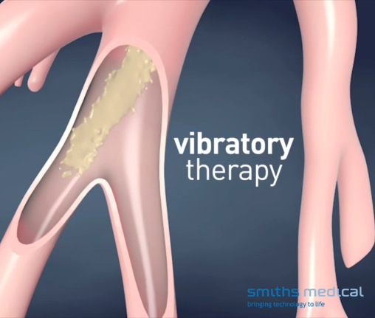
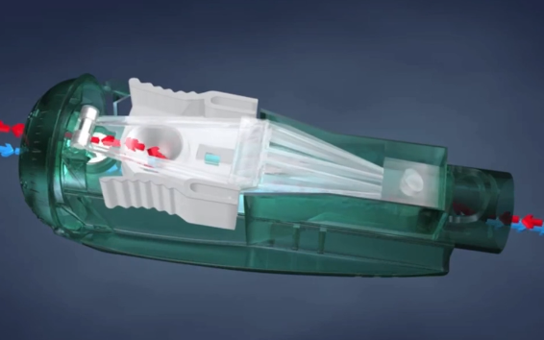
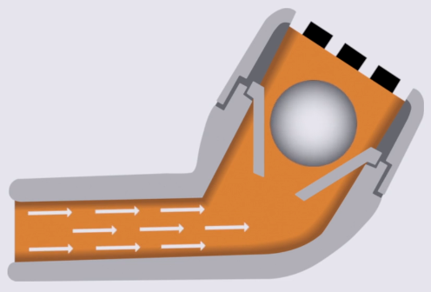
Oscillating positive expiratory pressure

Slide 41
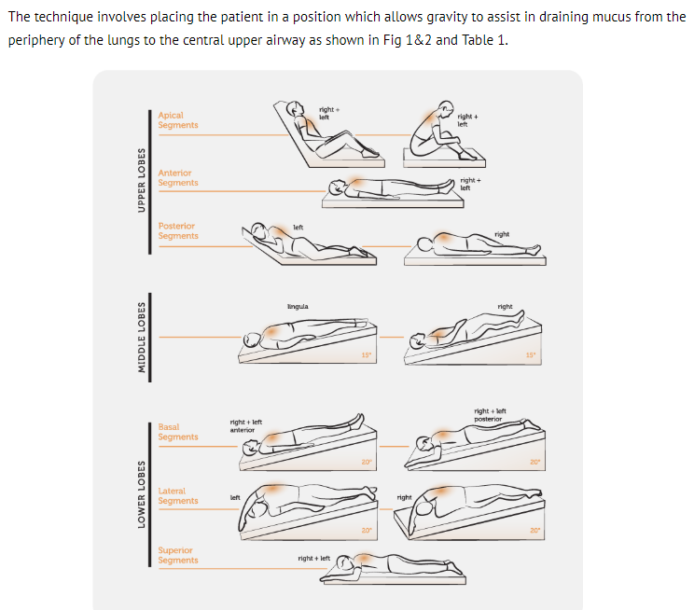

Gravity assisted positioning

Slide 42
Mucolytics

Slide 43
Macrolide
JAMA, March 27, 2013—Vol 309, No. 12

Slide 44

Chron Respir Dis. 2019 Jan-Dec;16:1479972318790269

Slide 45
Inhaled antibiotics
Eur Respir J 2014; 44: 382–393

Slide 46
Inhaled antibiotics

Slide 47
ICS and anti-inflammatory agents

Slide 48
Inhaled bronchodilators

Slide 49
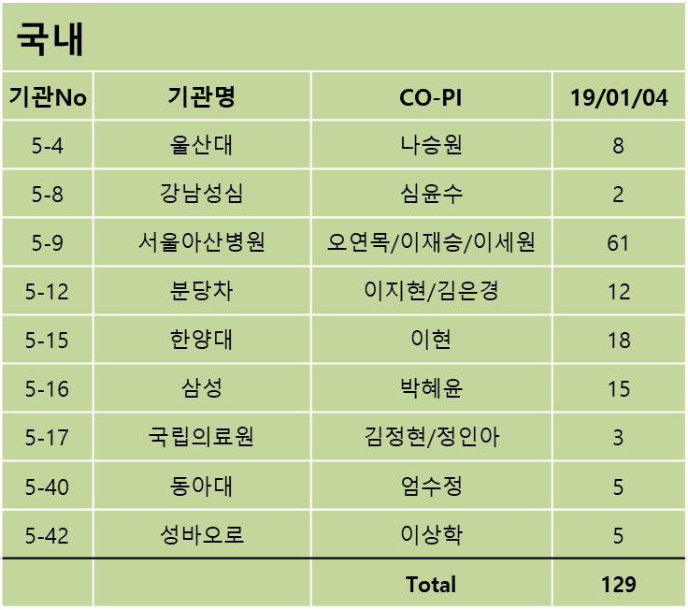
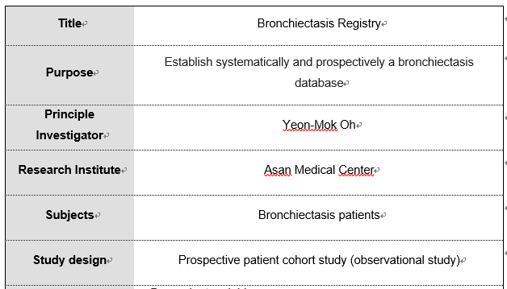
KMBARC (기관지확장증 레지스트리 등록현황)
(2019. 01. 04 기준)

Slide 50





Slide 51
감사합니다
Gyeongsang National University Hospital

