Slide 1

Neutrophilic pleural effusion
경북대학교 의과대학
김 창 호

Slide 2
Pleural fluid cell counts
Total nucleated cell = total leukocyte cell (WBC) – other cells
Total leukocyte cell
Never diagnostic
Most exudate: >1,000/μL
Differential (leukocyte) cell counts
Neutrophilic
Lymphocytic
Light RW and Lee YCG. Textbook of pleural diseases. 2003 Arnold,
Sahn SA & Heffner JE. Chapter 15. Pleural fluid analysis. P190
(2019-02-04)

Slide 3
Differential cell counts
Helpful in narrowing the differential diagnosis
But not disease-specific
Determined by the injury type and the thoracentesis timing
Acute response to any pleural injury attracts neutrophils to pleural space.
Whether infectious, immunologic, or malignant

Slide 4
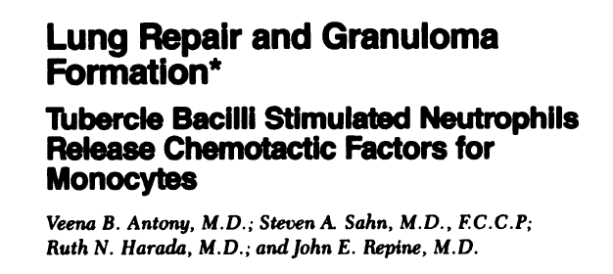
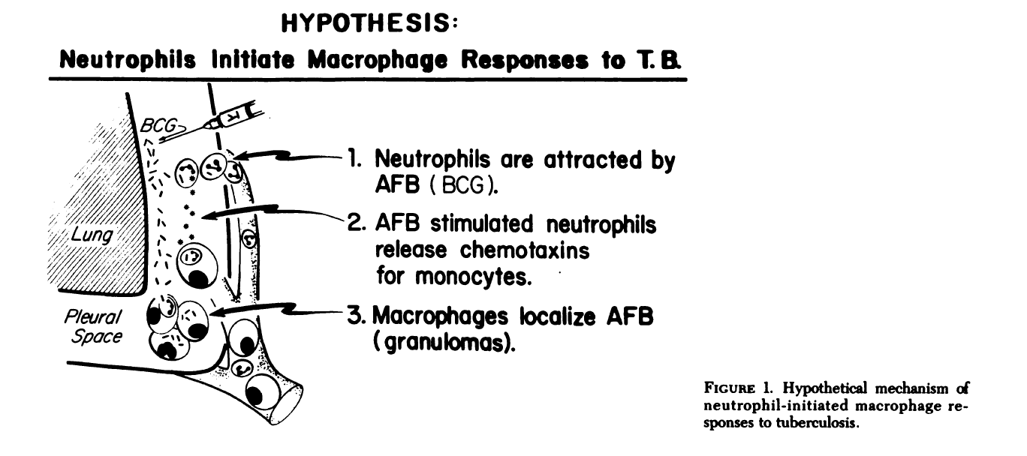
Chest 1983:83:95S

Slide 5
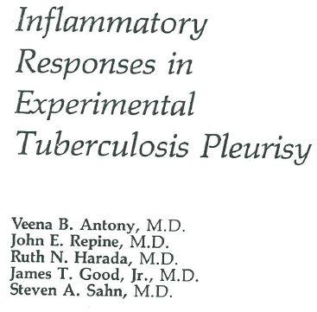
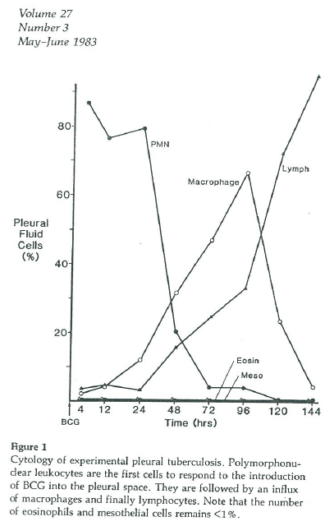
Antony VB et al. Acta Cytologica 1983;27:355

Slide 6

Neutrophilic pleural effusions
Usually exudative effusion
Reflect acute phase (or ongoing injury?)
Disease which presents shortly following the onset of symptoms
Differential diagnosis
Sahn SA
MD 1968
Sahn SA. State of the art: the pleura. ARRD 1988;138:p189
Notes:
Such as bacterial pneumonia, pulmonary infarction, acute pancreatitis

Slide 7
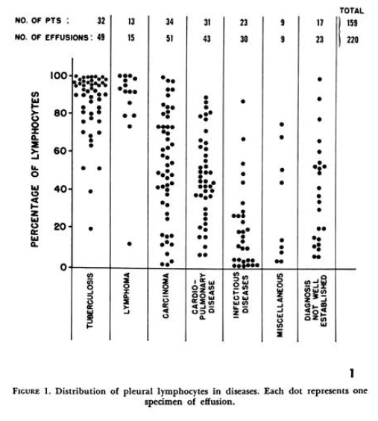
47 14 28 3
Lymphocytic
Neutrophilic
Yam LT, Ann Intern Med 1967;66:972

Slide 8
Differential diagnosis between neutrophilic effusions
Parapneumonic pleural effusion (PPE)
Tuberculous pleural effusion (TPE)
Malignant pleural effusion (MPE)

Slide 9
Neutrophilic TPE
Approximately 10%
Characteristics of neutrophilic TPE
Neutrophilic TPE vs PPE

Slide 10
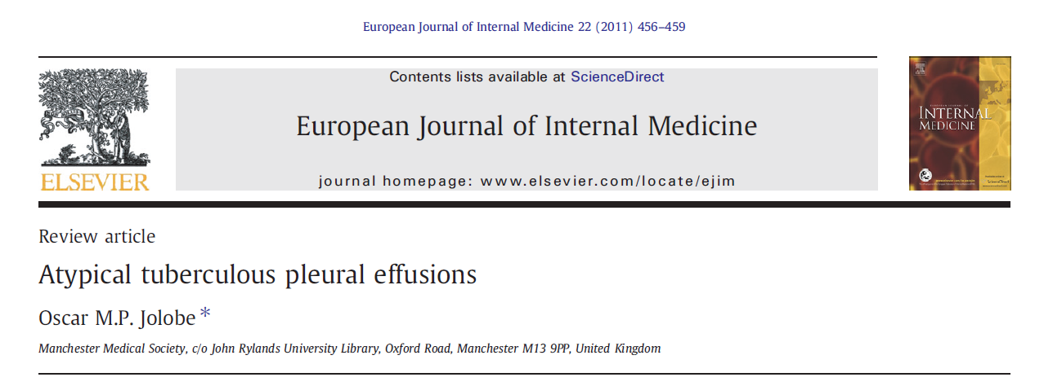
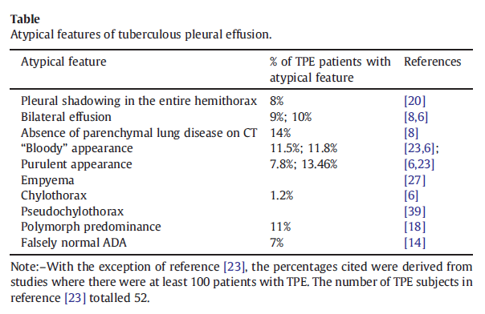

Slide 11

Porcel JM
MD 1986

Slide 12
Neutrophilic TPE => lymphocytic TPE
Table 2. Sequential pleural fluid change
Time interval, median: 7 days
Bielsa S, et al. IJTLD 2013;17:85
Kim CH, et al. Intern Med 2016;55;1713
79%, 58%, & 81% : shift toward lymphocytic predominance

Slide 13
Neutrophilic TPE vs PPE
TPE : 5.2% of patients presenting with PMN-predominant septic pleural effusions.
Weight loss, initial leukocyte ≤11,000/uL, & poor clinical response to antibiotics in the first 3 d.
ADA 측정하지 않음, Retrospective study
Lin MT et al. Respir Med 2009;103:820
Notes:
Taiwan study

Slide 14
Neutrophilic TPE and PPE with pleural fluid ADA levels ≥ 40 U/L
Comparison of clinical and laboratory findings between the two groups
ADA > 40 U/L: UPPE = 10%, CPPE = 30%, Empyema = 63%
(Porcel JM. Resp Med 2006;100:933)
Lee J et al. Infection 2017;45:59

Slide 15
Neutrophilic MPE
Approximately 20%
Characteristics of neutrophilic MPE
Neutrophilic MPE vs PPE
2019, KNUH

Slide 16
PMNL-predominant MPE
Poorer ECOG PS
Higher blood NLR
Higher serum CRP
Lower serum albumin
Lower pleural pH
Lower pleural LDH
Figure 1. Kaplan-Meier survival curves of patients with polymorphonuclear leukocyte
(PMNL)- and mononuclear leukocyte (MNL)-predominant malignant pleural effusion.
MS = median survival; IQR = interquartile range; d = days; HR = hazard ratio;
95% CI = 95% confidence interval.
KNUH, 193 MPE, under review

Slide 17
Neutrophilic MPE vs PPE
<6.0 mg/dL
<3.0
>8.0 ng
Diagnostic performance for identification of neutrophilic MPE
≥ any 2: sensitivity 88%, specificity 98%, AUC 0.928
Lee J et al. AJMS 2019 in press

Slide 18
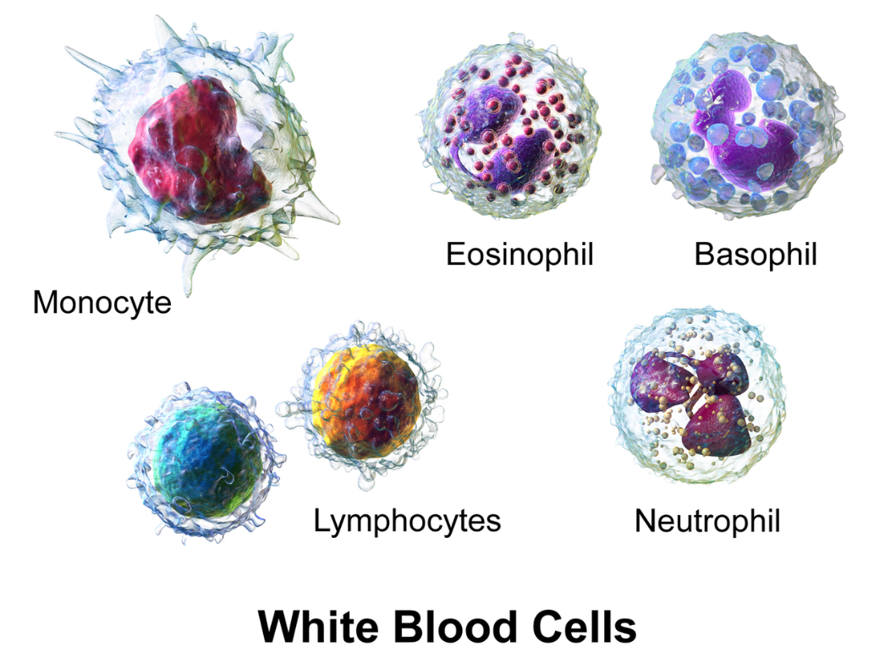
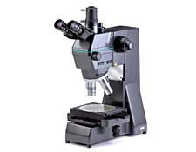
Laboratory measurement – clinical practice
- Total (WBC) cell counts
- Differential cell counts

Slide 19
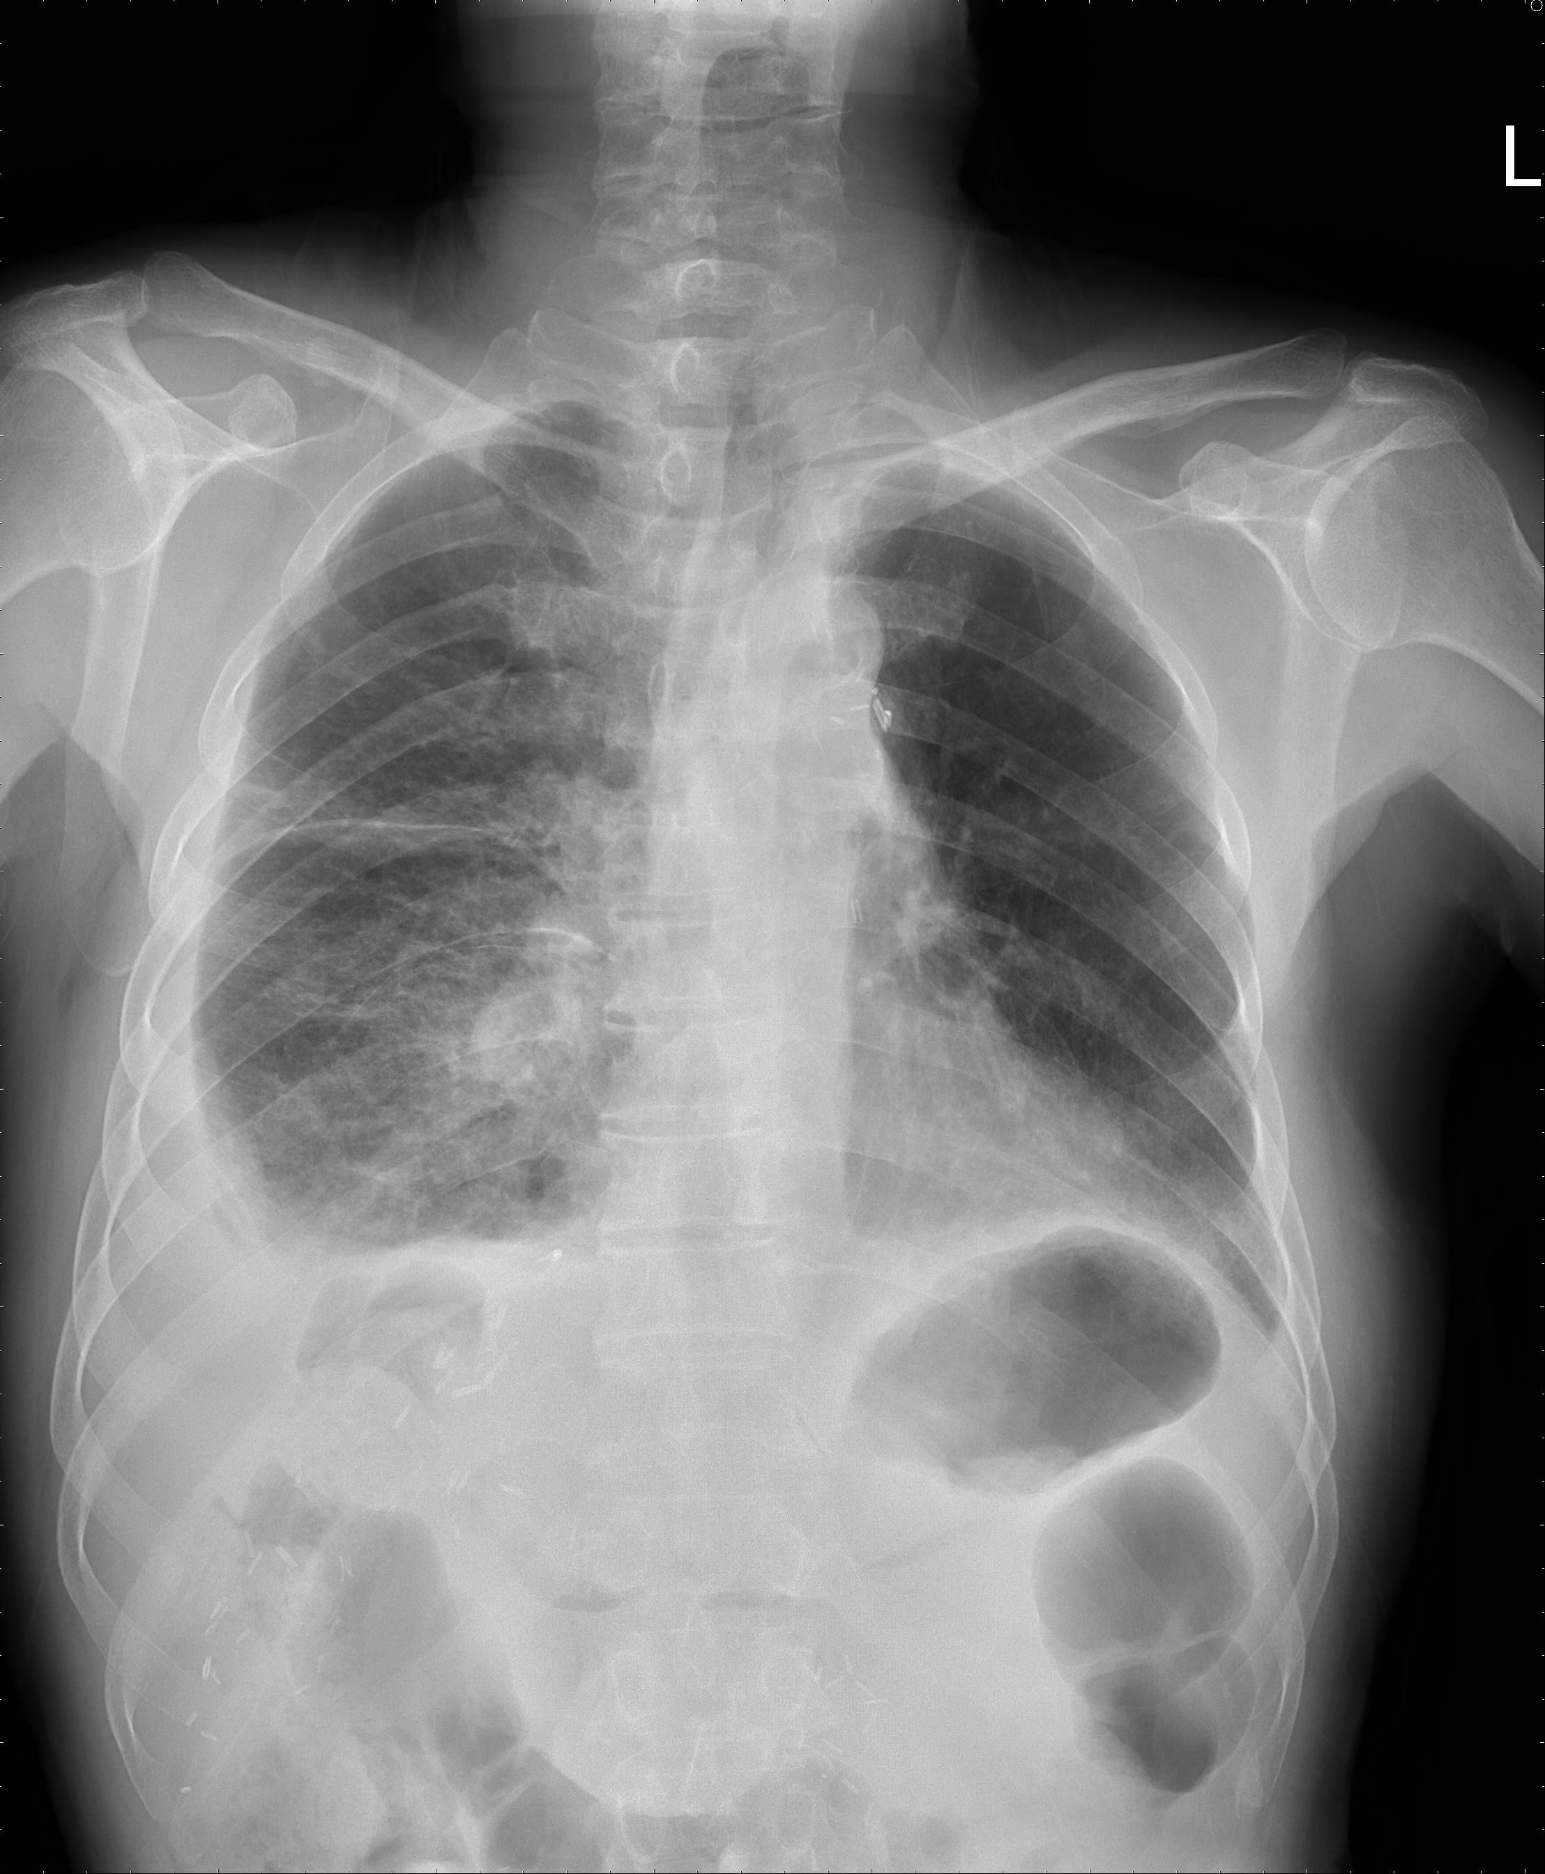
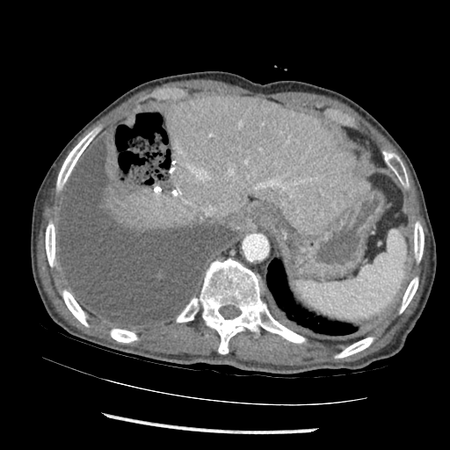
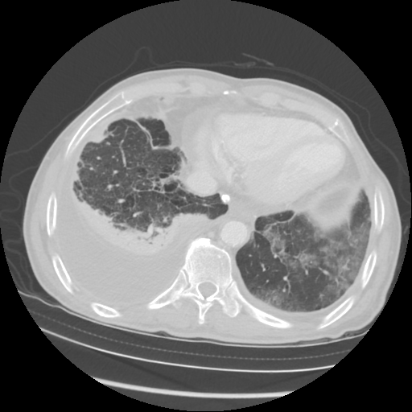
Case
M/80, 1740628, 신 O 훈, 2019-02-20
C/C : dyspnea for 4 days
P/I
2 yr ago, lung cancer LUL-op, Sq cell ca, T3N0M0
1 yr ago, hepatocellular ca, op
일주일 전부터 가래 량 증가, febrile sensation
4 일 전부터 dyspnea, purulent sputum, right pleuritic chest pain

Slide 20
검사분류: 일반혈액 (pleural fluid)
처방명: Fluid examination (cell count)
Cell count by XN-350
TNC 1368/uL
WBC 1327/uL
RBC 15500/uL
WBC differential by XN-350
PMN% 48%
MN% 52%
PMN# 637/uL
MN# 690/uL
검사분류: 일반혈액 (body fluid)
처방명: CBC 6 종 (CBC 5종+diff)
WBC Count 1.180/L
RBC Count 0.030/L
Hemoglobin 0
Hematocrit 0.2%
Differential count
Seg.-neutrophils 39.8%
Lymphocytes 19.2%
Monocytes 26.6%
Eosinophils 0.7%
Basophils 9.1%
LUC 13.7%
PMN = Neutro + (Eosino + Baso)
MN = Lympho + (mono + macroph)
By automated blood cell counts ADVIA 2120i
M/80, 1740628, 신 O 훈, 2019-02-20

Slide 21
검사분류: 일반체액 (Pleural fluid)
처방명: Body fluid cytology (cytospin)
검사실 소견
(cytospin – pleural fluid)
Serosanguineous on gross appearance
Differential: PMN/Lym dominant
Seg 45%, Lym 15%, macrophage 37%
A few RBCs are seen
결론:
monocytes 가 많은 경우 실제 neutrophilic effusion이 lymphocytic effusion 으로 오인될 수 있다.
M/80, 1740628, 신 O 훈, 2019-02-20

Slide 22
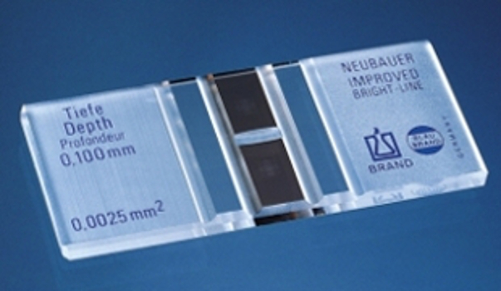
Total and differential cell counts
Gold standard: manual counting by Neubauer hemocytometer & cytocentrifuged Wright (or May-Grűnwald-Giemsa) staining (cytospin), respectively
Time-consuming & labor-intensive
Dependent on the skilled laboratory personnel
Intra- and inter-observer variation
In-nature imprecise and inaccurate
Neubauer hemocytometer

Slide 23
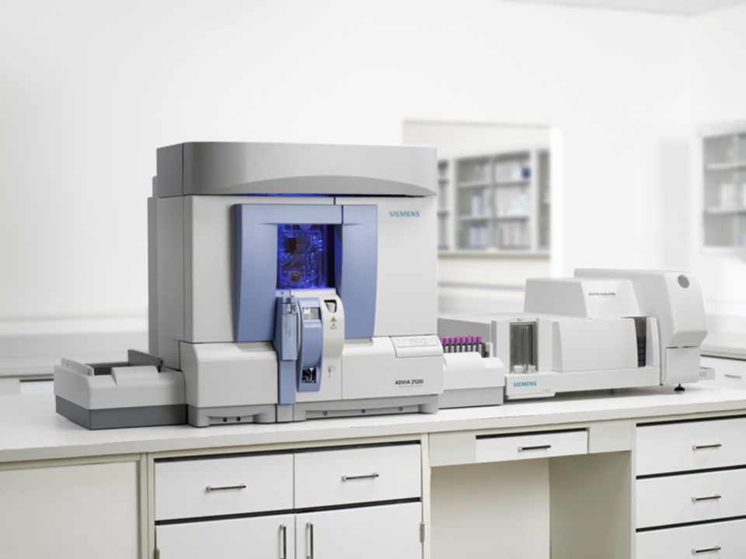
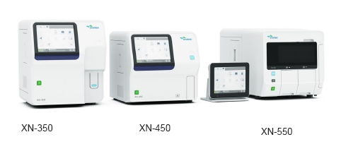
Evolution of cell counter
Automated cell counters 의 임상 적용
Blood analysis => urine analysis => body fluid & synovial fluid
Siemens ADVIA 2120i Hematology system

Slide 24
Automated analyzer
Flow cytometry 의 방법 이용
Total WBC counters- using two-angle laser light scatter signals
Differential counting: peroxidase staining (x axis) and size (y axis)
Monocyte and large undifferentiated cells => monocyte/mesothelial cell population으로 분류

Slide 25
목적: pleural fluid WBC count and differential count
Automated cell count are compared to manual count
다양한 tube : EDTA tube vs glass tube vs plastic tube
Within 4 h vs 24 h 후 시행한 것과 비교
방법
Automated cell counter, ADVIA-120 을 이용하여 WBC & diff count 시행
Manual count: Neubauer hemocytometer and Wright stained blood smear

Slide 26
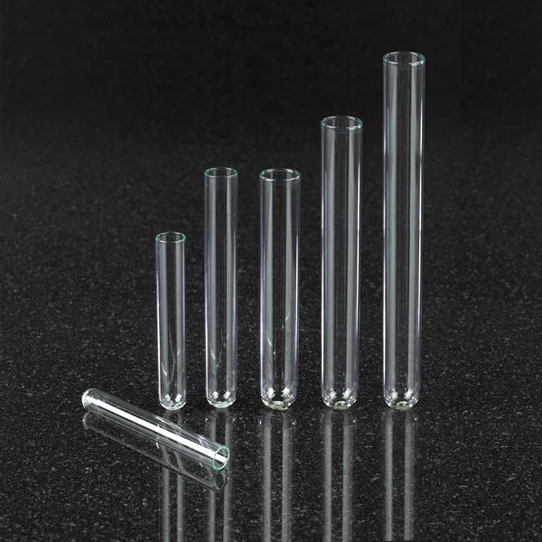
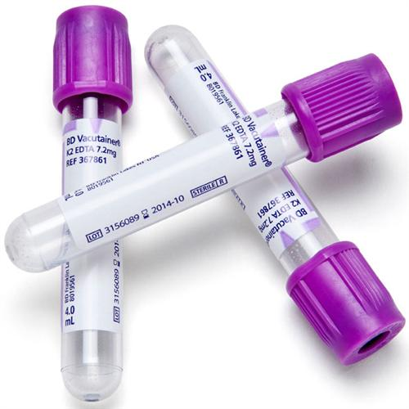
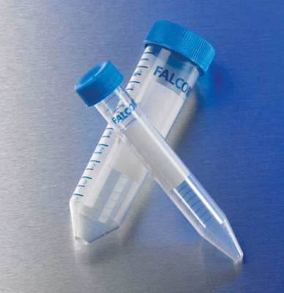
Glass tube vs EDTA tube vs plastic tube
Glass plain tube
EDTA plain plastic tube
Falcon plain plastic tube

Slide 27
Total WBC count
Manual and automated counting methods on EDTA-treated glass tube
= nearly identical (r = 0.92; p < 0.001)
Plastic and glass tube => cell clumping => lower counts
Conner BD et al, Chest 2003;123:1181
Notes:
Clumping 이 되면 lymphocyte 가 증가된다.

Slide 28
Differential WBC counts: manual vs automated
Neutrophil counts
Total WBC counts 와 달리 Diff WBC counts 는 not closely correlated
Neutrophils, R = 0.63
SEE = 12.8%

Slide 29
Effects of storage on pleural fluid WBC counts
Within 4 h vs 24 h, EDTA-tube : virtually no difference
Except for the counts with the glass tubes
Therefore, a 24-h delay in determining pleural fluid cell counts is acceptable
Glass tubes (x)

Slide 30
Results-summary
1. Total WBC counts (EDTA tube): manual vs automated
: virtually identical
2. Not affected if the fluid is stored for 24 h
3. Differential cell counts by automated cell counter
: Not sufficiently accurate for clinical use

Slide 31
when stored at 4 C in an anticoagulant-treated tube
Neoplastic cells : 24hr 후에는 clear degeneration
Notes:
Neoplastic cells 24hr 후에는 clear degeneration

Slide 32
Summary
1. Neutrophilic pleural effusion
Exudate of acute stage, whether infectious, immunologic, or malignant
MPE & TPE as well as PPE
2. Differential diagnosis between neutrophilic pleural effusions
Available biomarkers and cytospin
• CRP => PPE
• ADA => TPE
• CEA => MPE
• Cytospin => more accurate differential cell counts and early diagnosis of MPE
3. Variations of pleural fluid WBC counts due to different container and methods
EDTA-tube
Within 24 h
Limitations of current automated cell counter

Slide 33
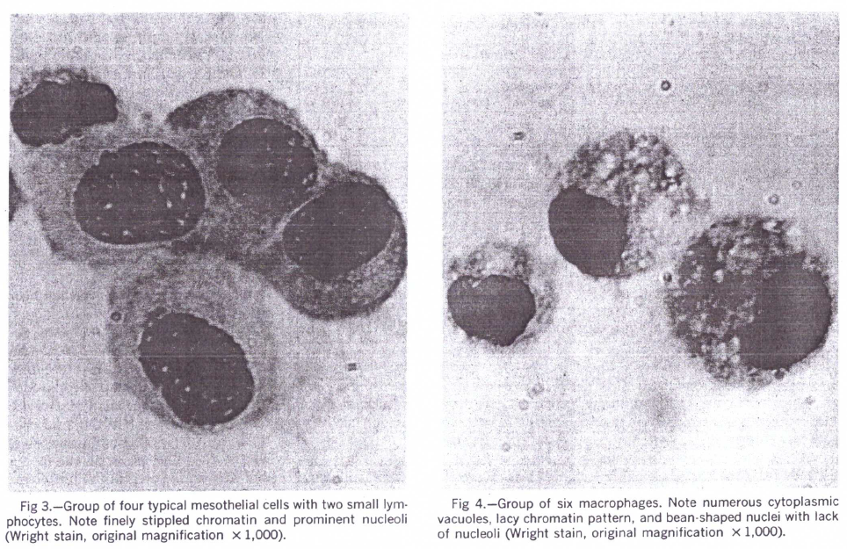
Macrophages should be differentiated from mesothelial cells.
They arise from either mesothelial cells or circulating mononuclear cells.

Slide 34
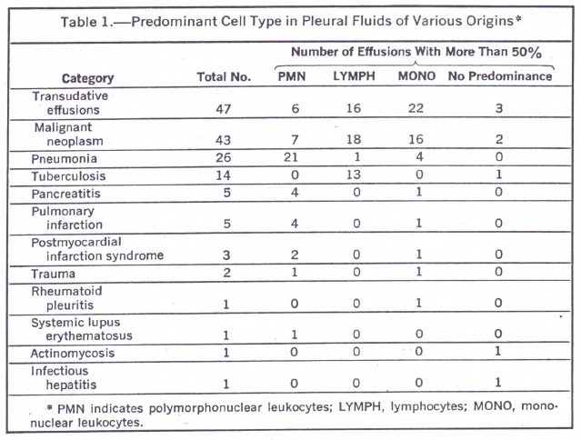
The pleural fluid WBCs were partitioned into three classifications
Polymorphonuclear leukocytes, including eosinophils
Small lymphocytes
Mononuclear cells other than small lymphocytes
Included mesothelial cells, macrophages, plasma cells, large lymphocytes, and malignant cells
PMN dominant
PPE: 81% (21/26)
MPE: 16% (7/43)
TPE: 0% (10% [1, 12])
A pattern of predominantly monocytic cells other than small lymphocytes was suggestive of neoplasm,
as 16 of 25 exudative effusions with this pattern were secondary to tumor.
Light RW. et al,
Notes:
Monocyte 가 많아 lymphocytic predominant로 읽인다 해도 별 문제 없는 것 아닌가?

Slide 35
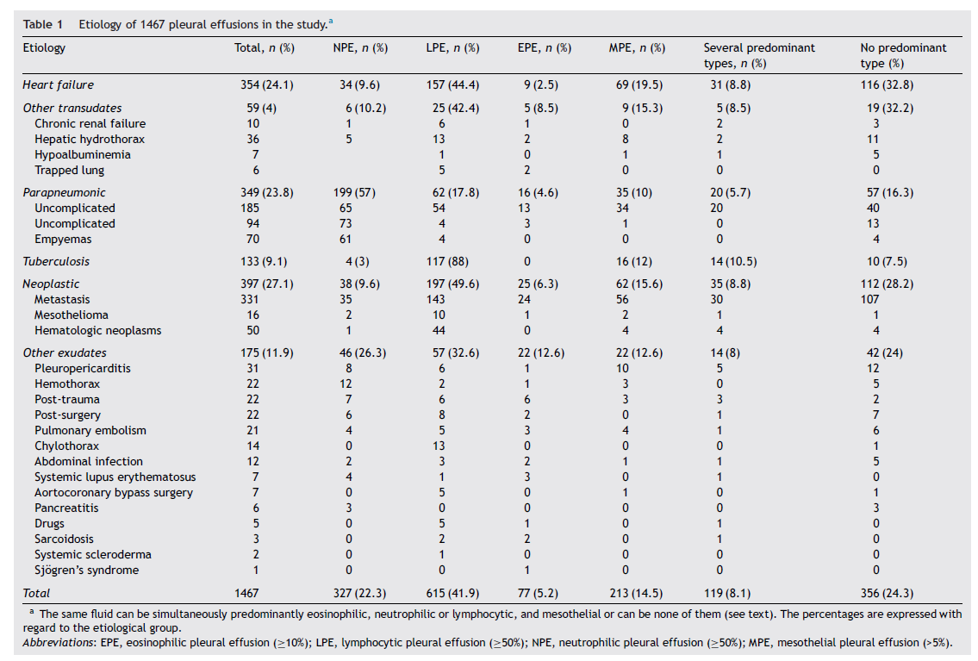
Ferreiro L, et al. Rev Clin Esp 2017;217:136

